Slide 1
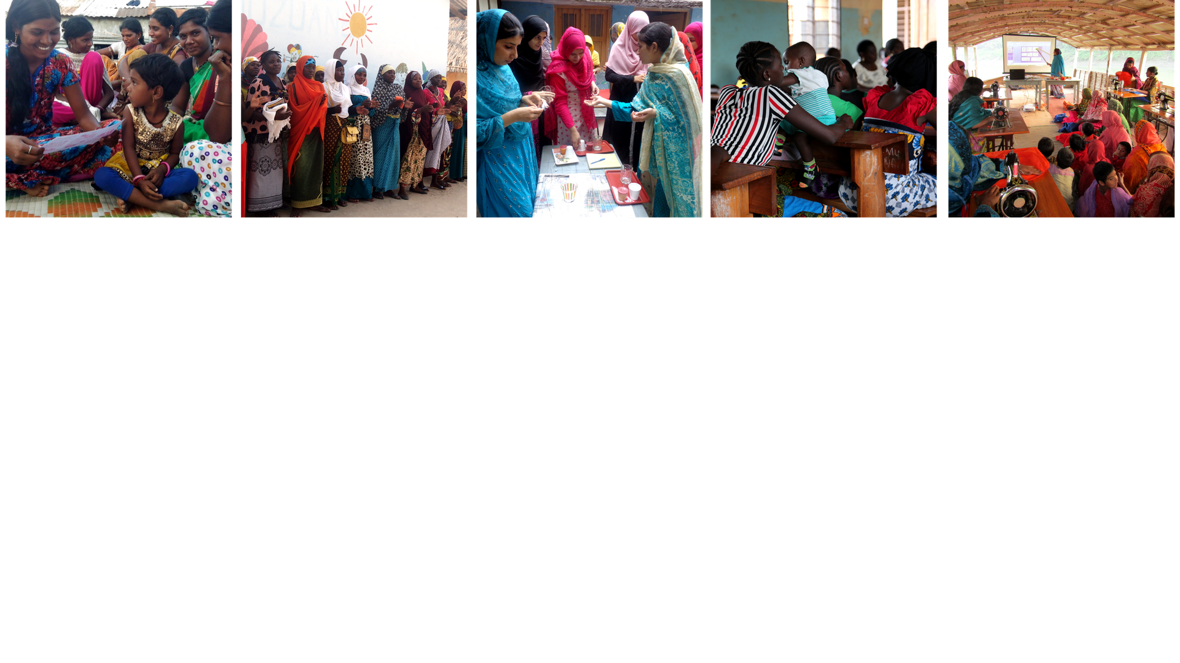

Ending Child, Early and
Forced Marriage: A Holistic Approach
Professor Asha Kanwar
President & CEO
Frances Ferreira, Senior Advisor
Women’s Forum, CHOGM
London, United Kingdom | April 18, 2018

Slide 2
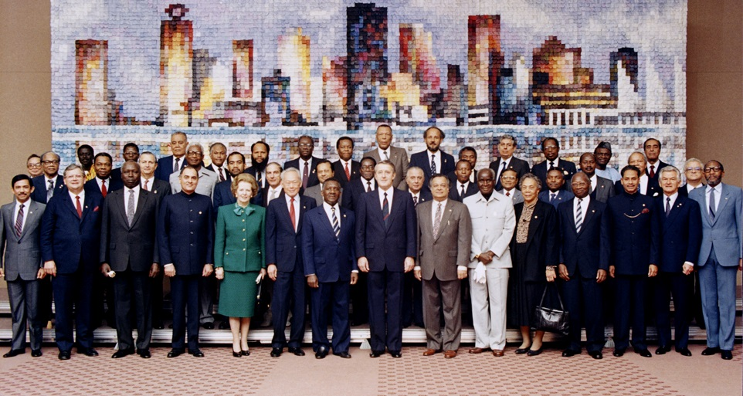
Commonwealth Heads of Government Meeting
Vancouver, 1987
Notes:
We invite you to engage us; tap into our thought leadership, expertise, networks and resources

Slide 3

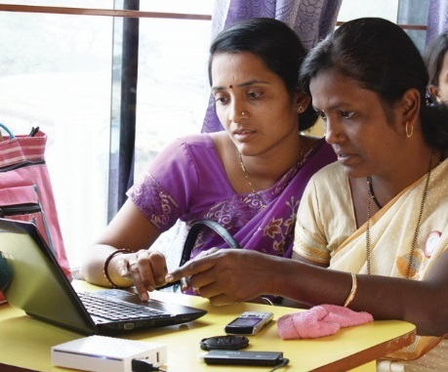
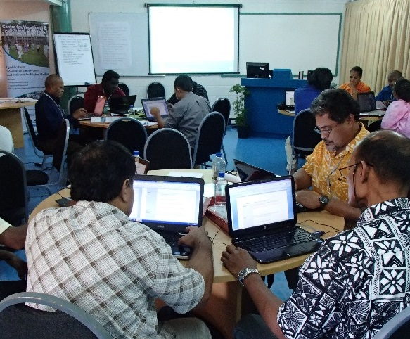
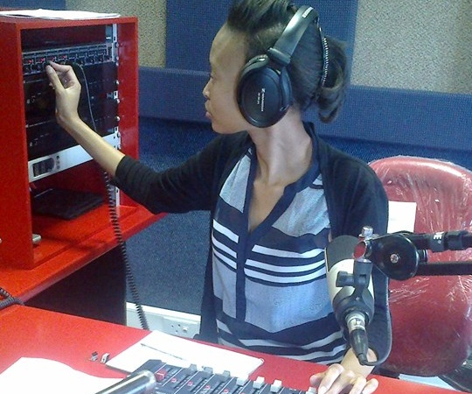
To help Commonwealth governments and institutions use technologies to improve and expand access to education and training

Slide 4

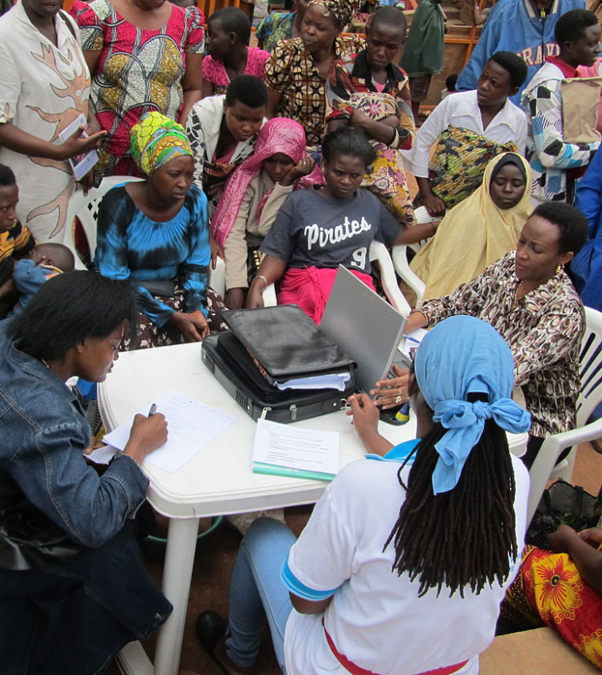
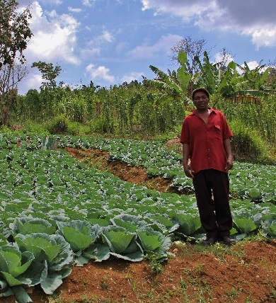



Learning for Sustainable Development
ECONOMIC
GROWTH
SOCIAL
INCLUSION
ENVIRONMENTAL CONSERVATION

Slide 5
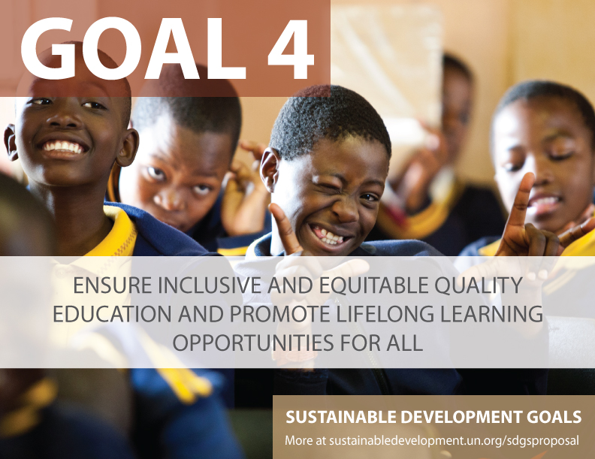

Slide 6
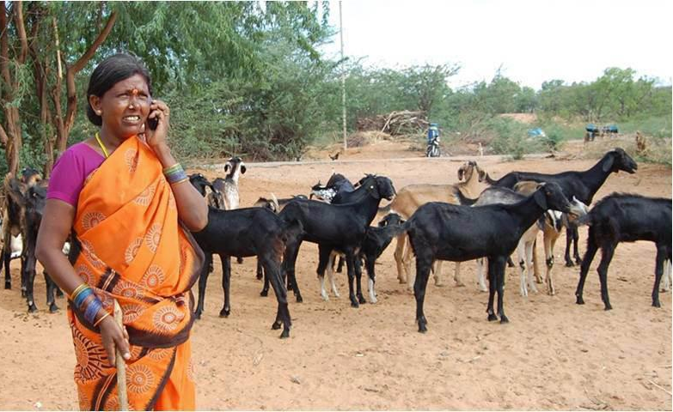
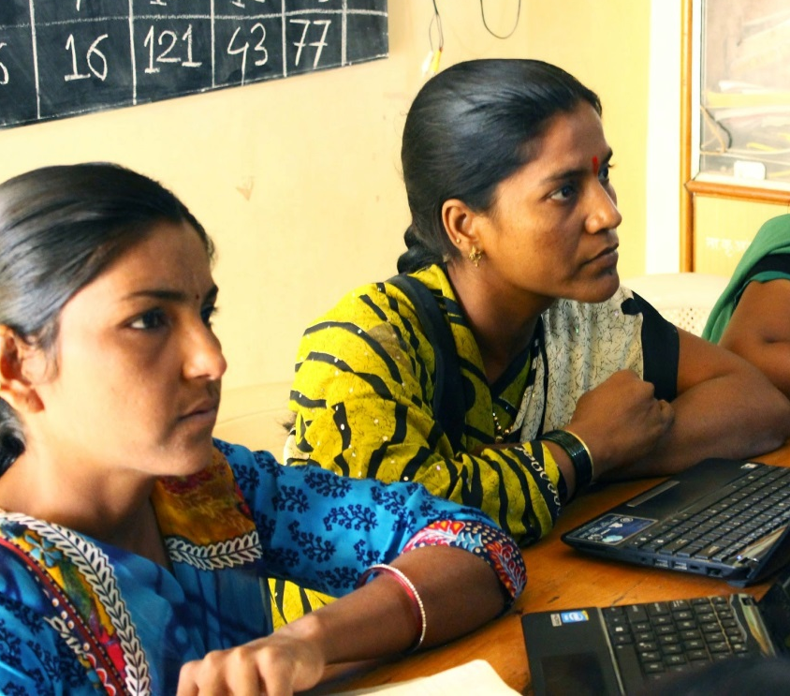
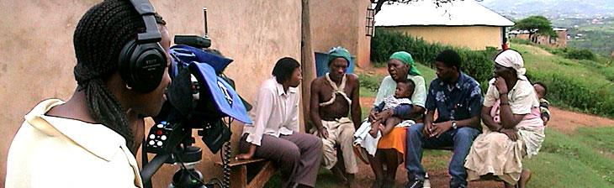

Leveraging
New & Existing Technologies

Slide 7
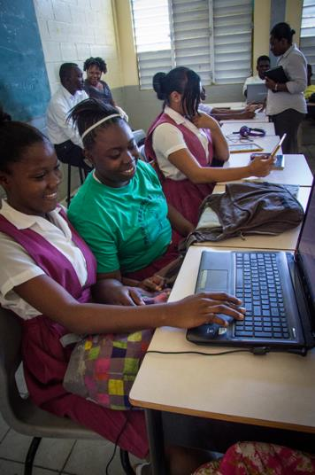
COL Strategic Plan 2015-2021
COL recognizes that advancing the goals of both women’s empowerment and gender equality are central to ‘Learning for Sustainable Development’

Slide 8
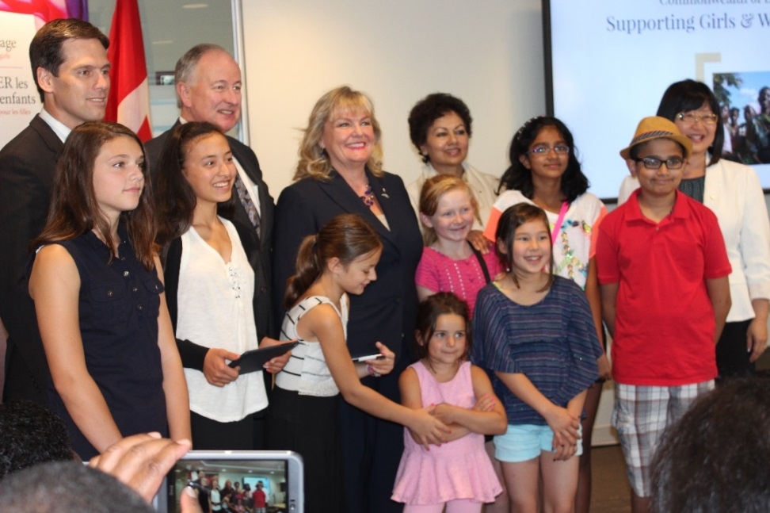

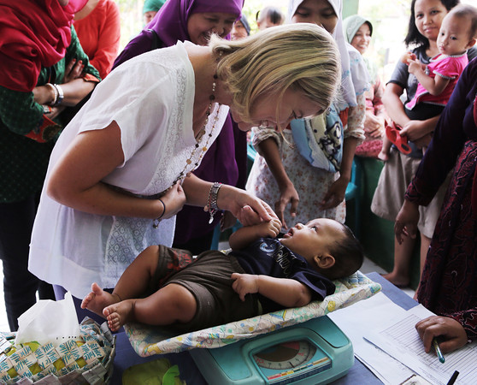

Empowering Women and Girls
Photo credit: Joshua Estey, DFAT Gallery

Slide 9


Pakistan
Bangladesh
India
Tanzania
Mozambique

Slide 10
High Rates of Child Marriage
Countries & Regions | Child marriage (%) 2010 - 2016*
 | Married by 15 | Married by 18
Bangladesh | 22 | 59
Pakistan | 3 | 21
India | 18 | 47
Mozambique | 14 | 48
Tanzania | 5 | 31
Source: The State of the World’s Children Report 2017 Statistical Tables: Child Marriages, UNICEF

Slide 11
The Price of Early Marriage
If girls are not educated, they are compelled to early marriages. Most of these girls, who enter into early marriage, cannot even take care of themselves, so how can they take care of their children?”
“
Religious leader in the Bihar, India

Slide 12
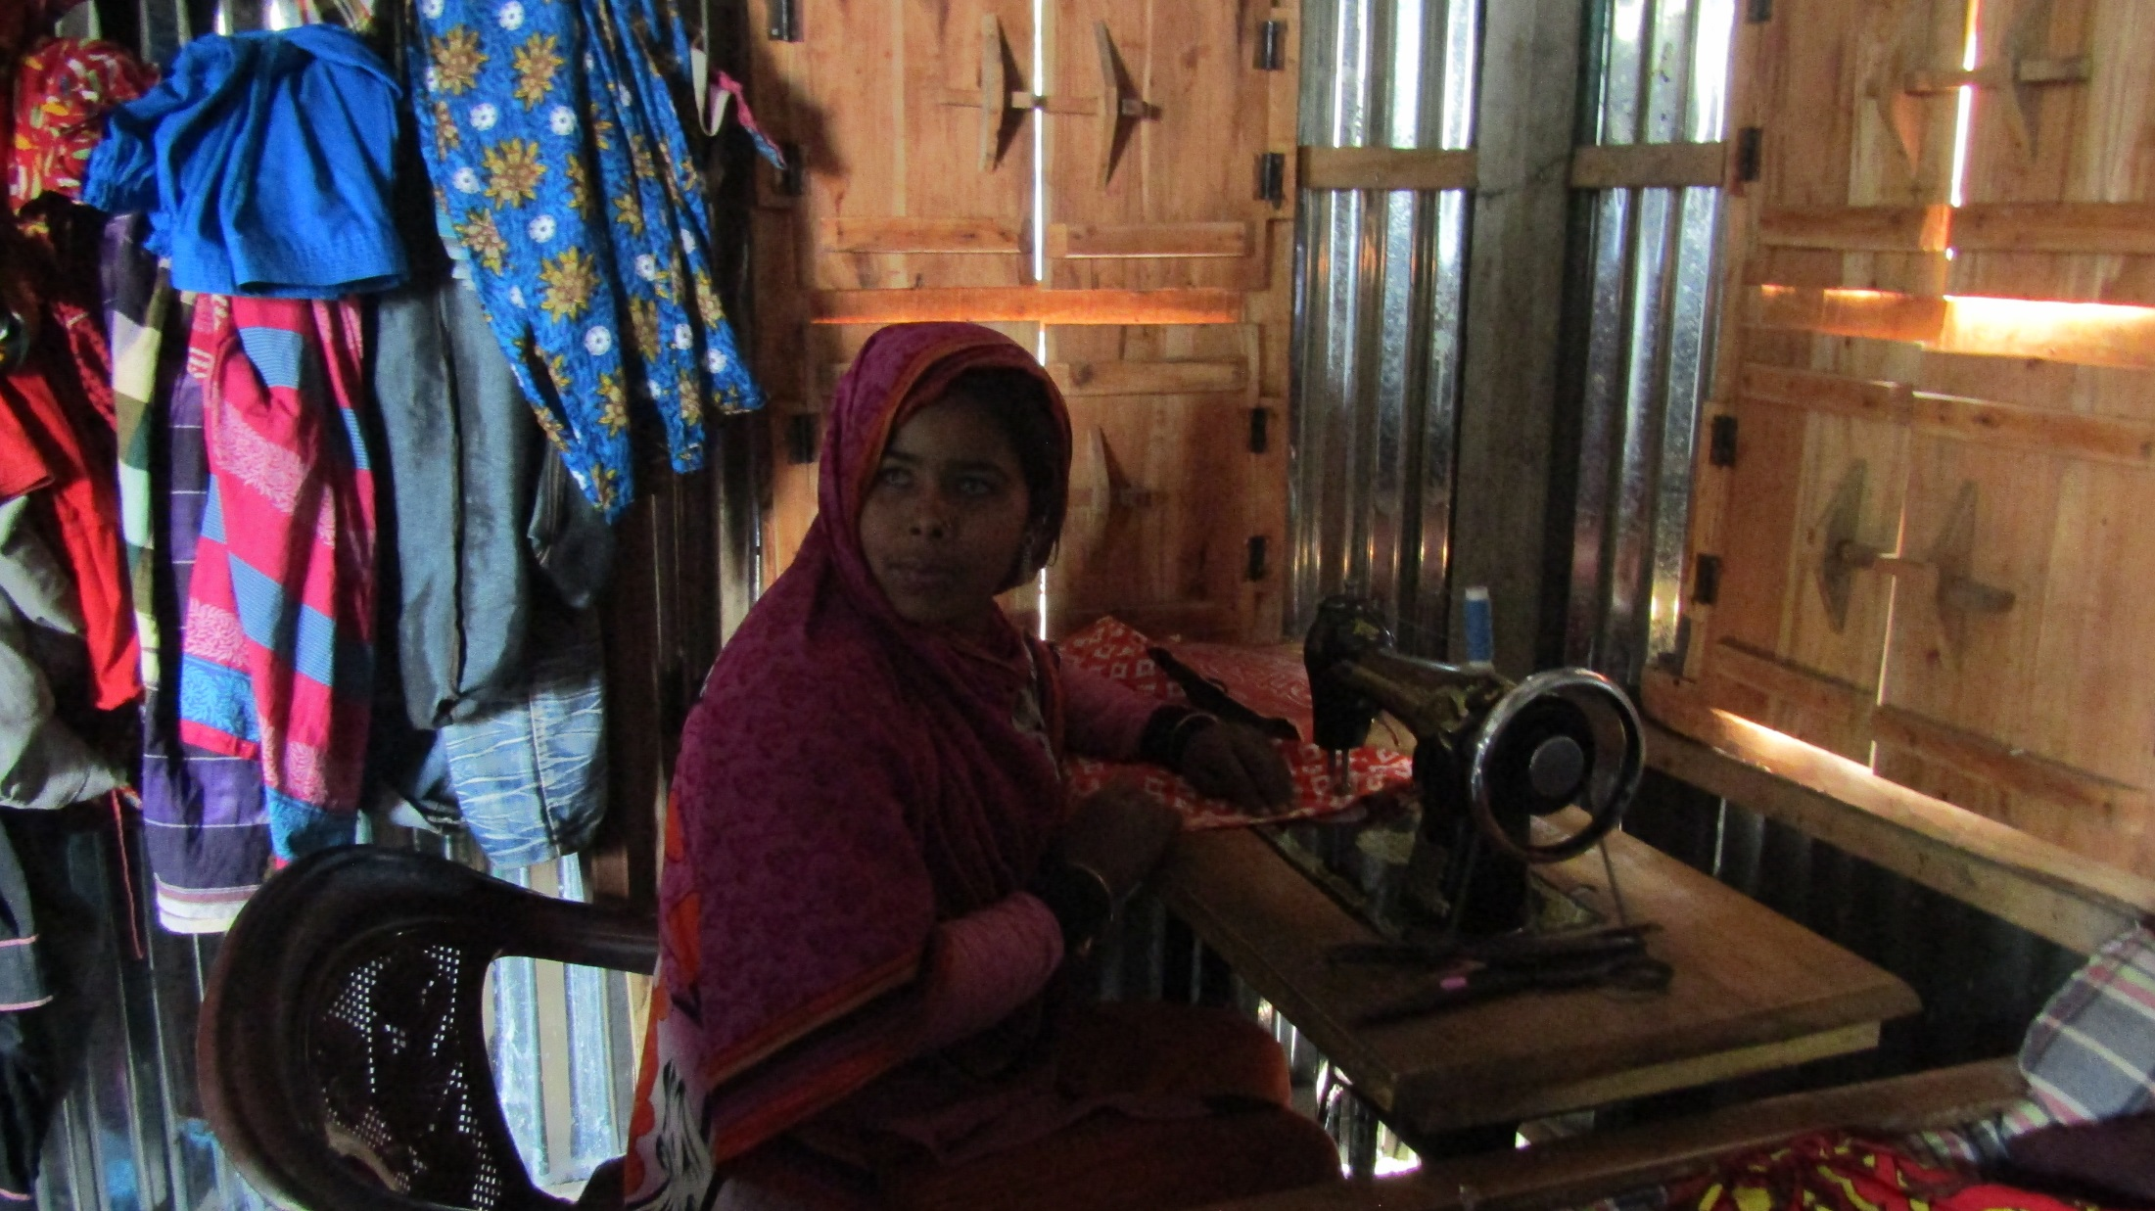
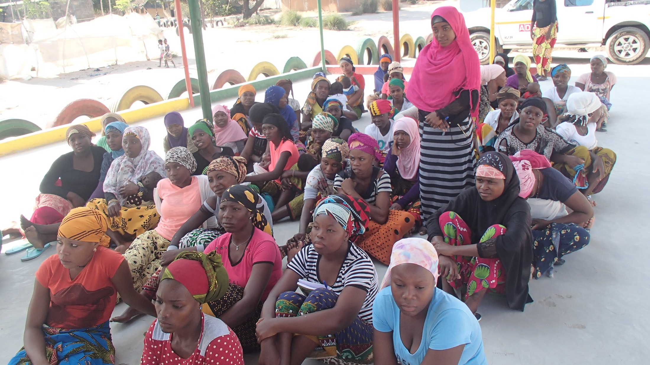
Community involvement prevented Fatima’s early marriage
in Mozambique

Slide 13
Giving girls and women agency: Atia’s Story

Slide 14
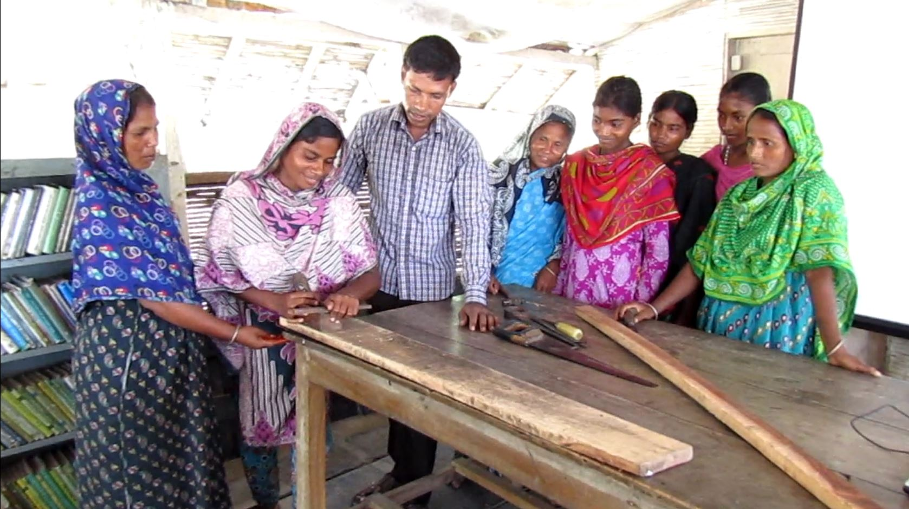
Carpentry training with Shidhulai Swanirvar Sangstha in Bangladesh

Slide 15
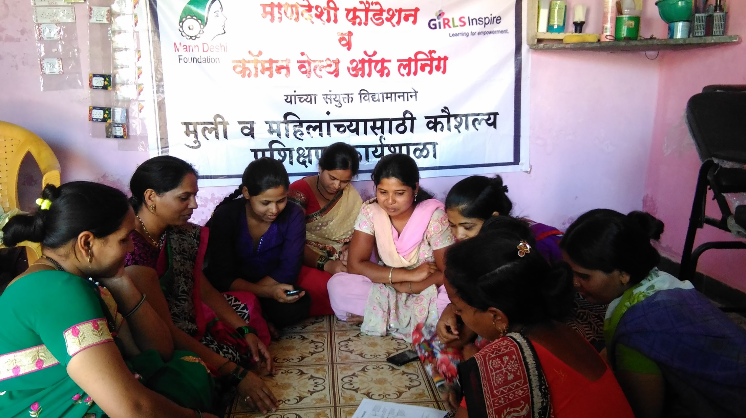
Mobile phone technology training with Mann Deshi in India

Slide 16
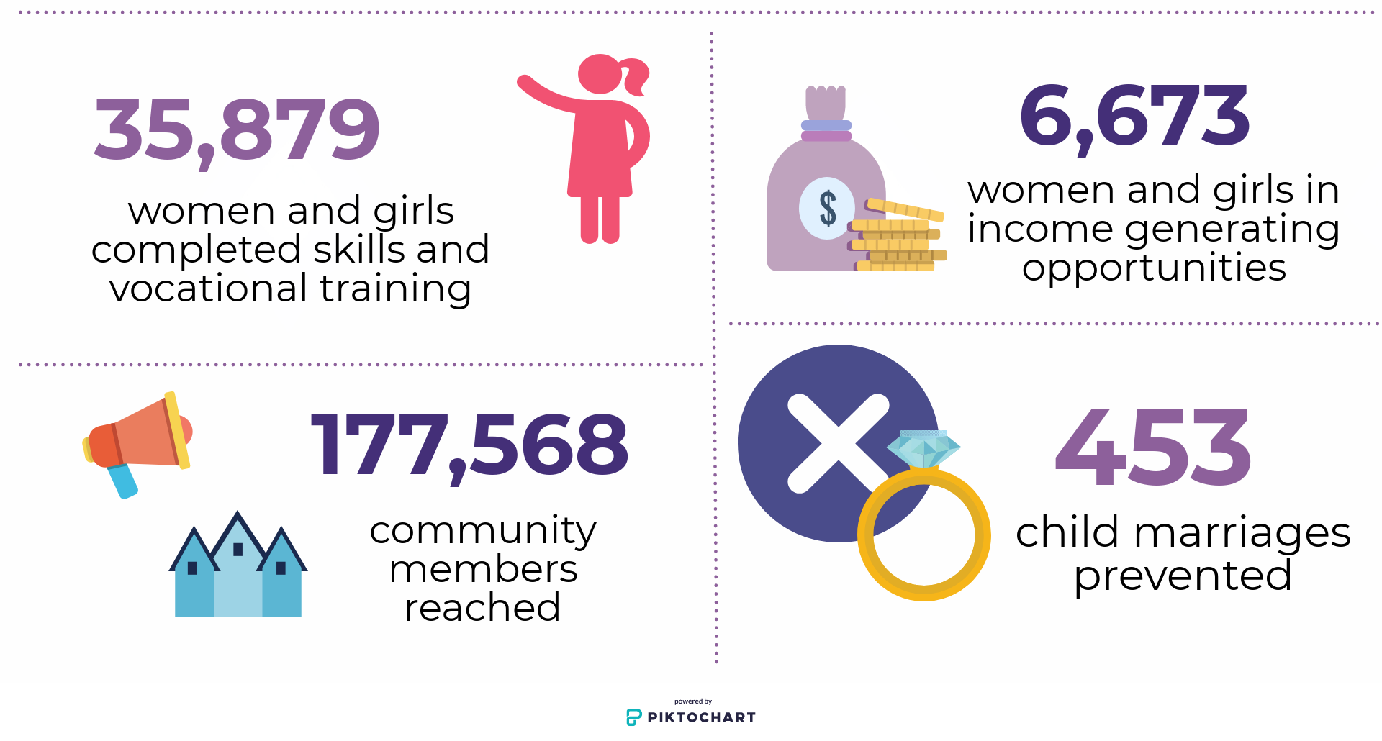
GIRLS Inspire: Results

Slide 17

Inform
Consult
Community Engagement
Collaborate
Empower

Slide 18

Education Strategy
Boat Schools in Bangladesh
Pop-Up Learning Centres in Pakistan
Mobile Learning Centres in India and Mozambique
Safe Learning Environments
Vocational Skills Training
Notes:
GIRLS Inspire worked with various stakeholders to improve girls’ and women’s access to quality education in supportive communities.

Slide 19

Capacity Building
Learning about legal and social rights
Acquiring life skills, including health care
Understanding their choices
Instil confidence for making decisions
Gaining the support of fathers, spouses and brothers

Slide 20


Health and Safety Strategy
Access to Health Resources
Accessible, safe, hygienic learning environments
Support Networks for family- and health-related issues

Slide 21

Strategy for Employment
Financial literacy
Career counselling
Job Fairs
Internships and Employment Placement
Microloans

Slide 22
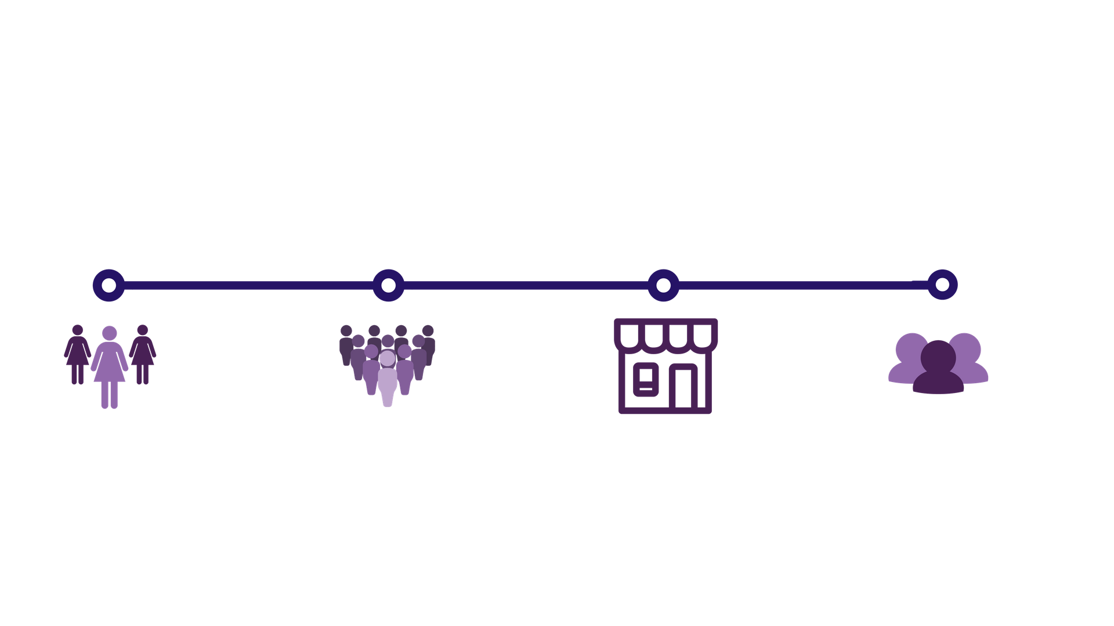
Model
Women & Girls
Communities
Local Employers
In-Country Partners

Slide 23
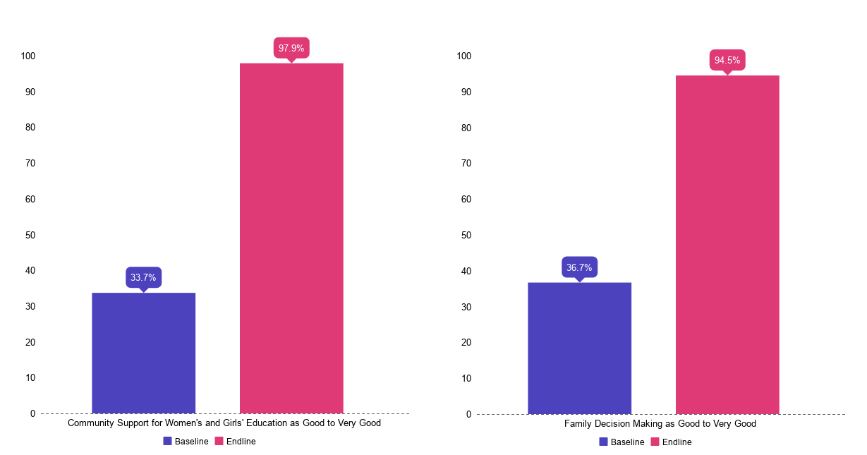
Changing Social Norms
Support for Women’s and Girl’s Education
Perceptions of Decision Making in the Family

Slide 24
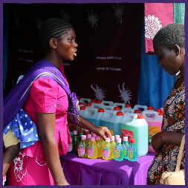
Social Return on Investment
Likelihood of being employed increased by 50 %
Average number of hours of paid work per week increased by 11 hours
Fivefold increase in income
10 % increase in the probability of females being decision makers

Slide 25

Lessons Learned
Building trust in the community
Establishing safe learning environments
Establishing multi-stakeholder partnerships
Creating linkages with the labor market and financial institutions

Slide 26

Integrate and Mainstream
Digitize training programs in local languages
Create skill-based value chains
Engage governments to effect policy change

Slide 27
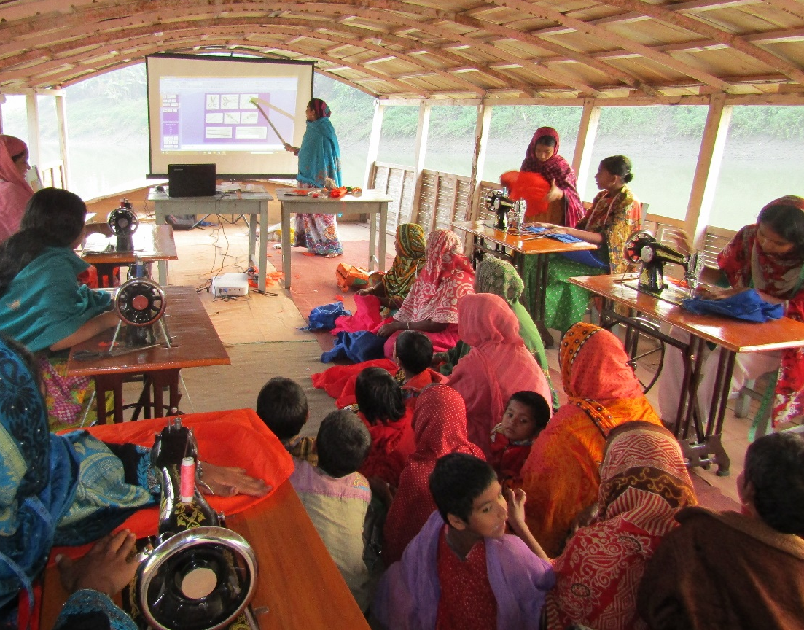
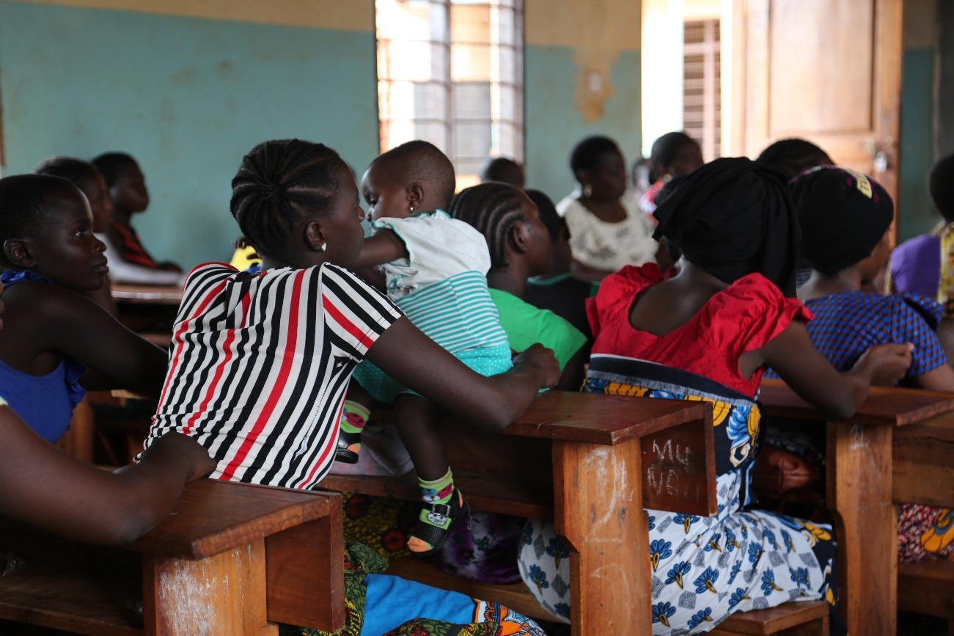
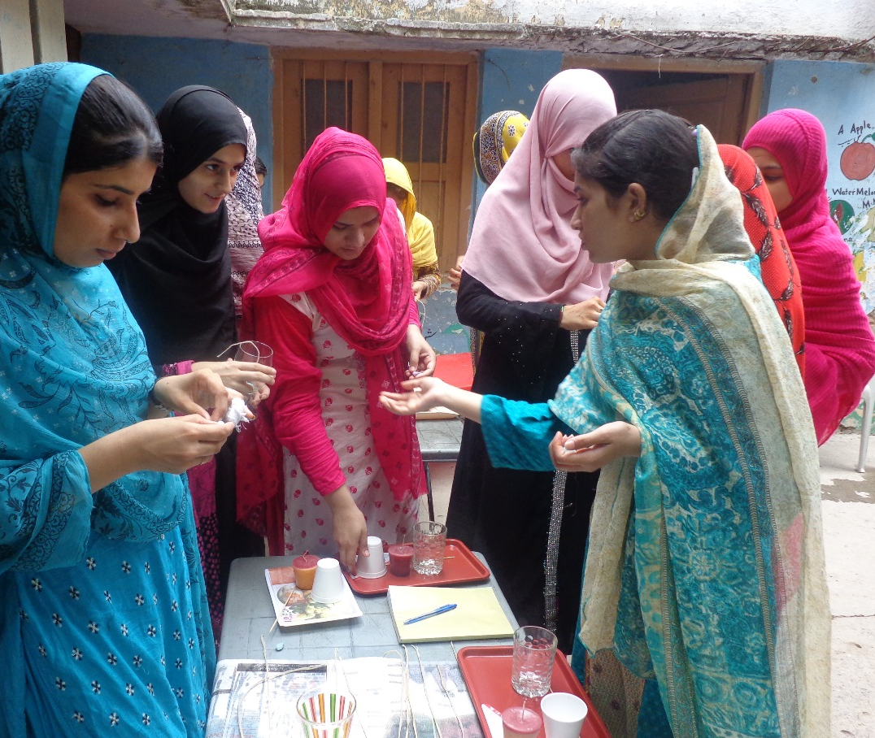
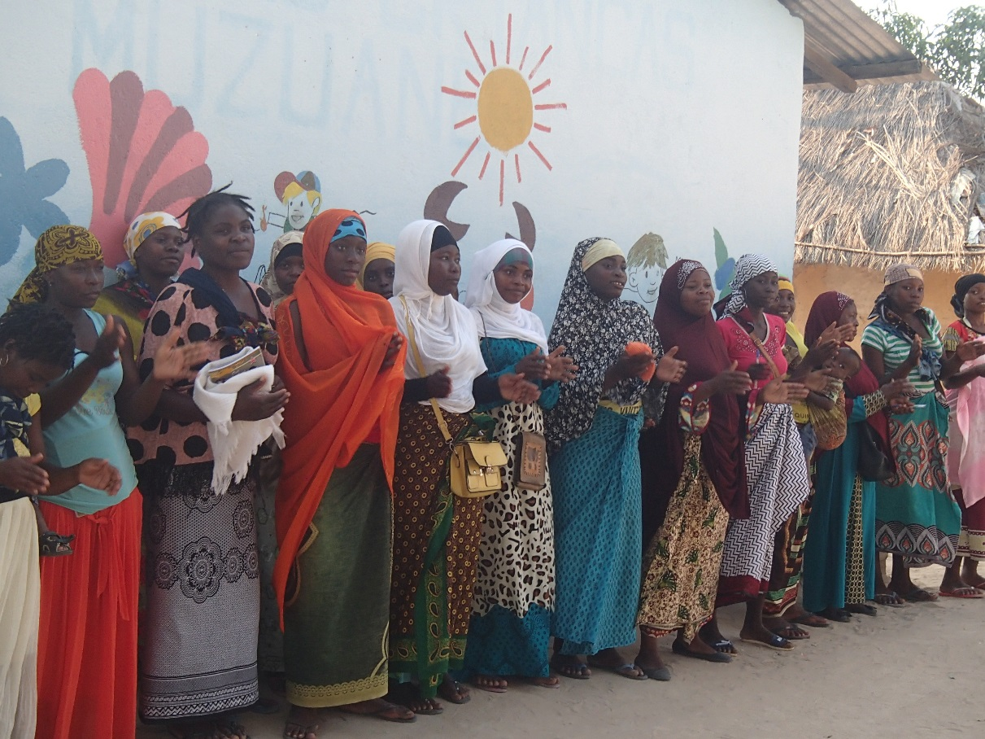
Thank You
www.col.org
Notes:
We invite you to engage us; tap into our thought leadership, expertise, networks and resources

