Slide 1
Digital transformation of learning due to COVID 19
Naveed Malik
August 10, 2020

Slide 2
Outline
The Pandemic – background
Effects on education – school to university
Approaches taken by various countries and institutions
The haves and the have nots – the digital divide
Schools and Universities
The opportunity – infrastructure and content
What does the future hold?

Slide 3
The Pandemic
Caught the world unawares
Speed of spread brought life to a standstill
  31st December 2019 – first case reported by China
  WHO declares pandemic in mid-March
Breadth of the spread is unprecedented
  No corner of the globe has been left unaffected
  Countries that had declared victory have gone back into lockdown

Slide 4
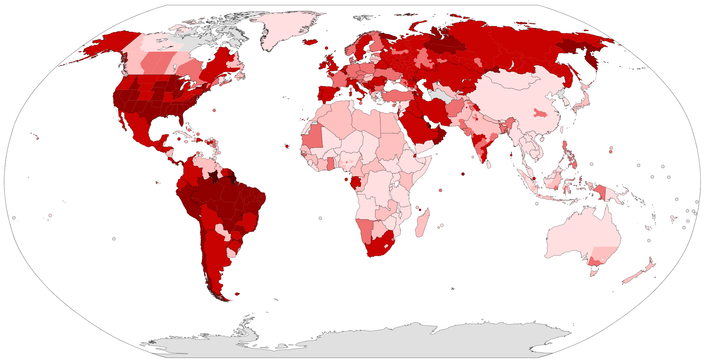
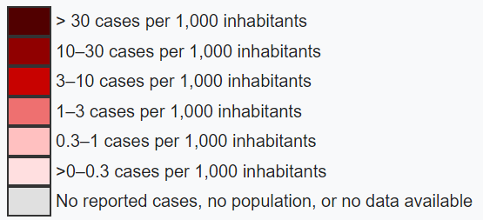
https://commons.wikimedia.org/wiki/File:COVID-19_Outbreak_World_Map_per_Capita.svg (August 8, 2020)

Slide 5
Effects on Education
All schools were closed
All universities ceased operations; hostels emptied
Even on-line universities stopped because of staff unavailability
Even Convocations went virtual!
Some pre-school and elementary schools remained open to provide services for children of essential service workers

Slide 6
Effects on Education
By mid-May:
  Worldwide: more than 1.5 billion students’ studies were interrupted
  Commonwealth (including Pakistan): more than 574 million learners had been impacted!
Interruption of studies affected all lives
  Parents found their resources strained
  Parents of younger children faced problems
    Especially front-line health workers
  School and university staff were laid off

Slide 7
As we move forward
As the world emerges from the pandemic
  “business as usual” will no longer be tenable
Many versions of the “new normal” are being tried
Education is leading in defining the new normal
There is no single solution applicable around the globe
Digital divide has become starkly visible
Most approaches center around the use of technology

Slide 8
Disparities in emergency preparedness
Logical choice – go online
Reality:
  Nearly half the world has no Internet access
  Majority of schools in the developing countries are technology constrained
  Schools do not have equipment to teach online
  Students do not have access to devices and the Internet
  Shortage/nonexistence of digital learning materials
  Teachers ill-equipped and untrained for online education

Slide 9
Resilience of mankind
However, people did not give up
Teachers learned quickly and acquired new skills
Developed content to the best of their abilities
Tried various techniques for engaging students

Slide 10
Digital Transformation
Schools (developed countries)
Teachers engaged with their students using videoconferencing
Gave students activities and projects to do
Came back online to discuss progress (typically the next day)
However
Assumption: adequate bandwidth at home
Enough devices to cover all siblings if more than one
- Not always true

Slide 11
Digital Transformation
Schools (developing countries)
Adopted many blended learning approaches
No interaction during lockdowns
Broadcast media used to deliver education
However, no possibility of interaction
Basically, operations halted till lockdowns eased

Slide 12
Digital Transformation
Higher education
Not much different
Clear divide between developed and developing countries
Similar challenges
Teachers had to learn to teach online
Every approach / technique was used
Different technologies were tried

Slide 13
Digital Transformation
Higher education approaches
From photographing and sharing course notes via social media
to
Developing and delivering lecture videos
Synchronous sessions
Similar challenges as school level education
Even print media used to deliver content

Slide 14
Digital Transformation
Learning Management Systems
Institutions showed varying levels of capability to induct LMSs
Infrastructure challenges
Trained manpower shortages
Steep learning curve
Availability of H/W platforms and familiarity with them
Still
Constrained by shortage of available content
Limited content development capability of face-face professors

Slide 15
Digital Transformation - Opportunity
Institutions using e-Learning have a distinct advantage
Already have platforms established
Develop custom content or use OER
Faculty already trained to mentor online
Can step up to lead from the front
Become thought leaders for the sector
E.g. Virtual University of Pakistan

Slide 16
Digital Transformation - MIT case study
Classic example of high intensity face-to-face environment
No stranger to e-content development – OCW, EdX etc.
Education shut down totally during the pandemic
However, thinking and planning continued

Slide 17
Digital Transformation - MIT case study
When studies resume in fall:
  Shorter terms (start early and conclude any f-f classes early)
  Semester to be finished remotely
  Only some undergraduates will be allowed back on campus
  Everything that can be taught online, will be taught online
  Small-group in-person experiences for courses requiring labs
  Hostels will be re-allocated to ensure one student per room!
Capacity will be constrained!!!

Slide 18
Digital Transformation - MIT case study
Mandatory Covid-19 testing before return and regularly thereafter
Mandatory public-health education
Mandatory wearing of masks
Physical distancing and Contact tracing
Staggered scheduling and reconfigured work spaces
Enhanced cleaning protocols
Access to buildings through a single point and only with an MIT ID
No large gatherings or lectures
Life will just not be the same!

Slide 19
Digital Transformation
Universities will learn to cope
What about schools?
The problem is much larger
However, there are opportunities!

Slide 20
Digital Transformation - Schools
Teachers will definitely need training
  For content development
  In the use of OER
  In the use of a digital environment
Administrations will need training
  How to cope with new environments
  Lower student counts
  Digital resilience and robust infrastructure

Slide 21
Digital Transformation - Schools
E-Learning enabled universities could take the lead
Help train teachers for the new environment
Develop/adapt content for use by schools
Act as the proverbial “big brothers”
Governments’ support will be needed in terms of infrastructure

Slide 22
Digital Transformation - Schools
Case study: Pakistan
Virtual University of Pakistan – on the spot at the right time
Has huge amount of expertise and experience
Knows how to establish and maintain infrastructure (H/w and S/w)
Has a network of digitally enabled campuses across the country
Campus network could assist school sector – minimize new expense
Can even assist with teacher training throughout the country

Slide 23
Digital Transformation - Schools
Commonwealth of Learning
  Has helped many countries with establishing LMSs or MOOC platforms
  Has the Open Schooling Model
  Focused on out-of-school children
  Could easily be adopted for mainstream schools
  Would help overcome the capacity shortage introduced by the pandemic
VUP could;
  Develop content for use by all schools – uniform high quality ensured!
  Especially important with the new curriculum being introduced
  Institute the Open School model through its virtual campuses
Major step forward for school education in Pakistan!

Slide 24
Digital Transformation of Learning due to the COVID-19 Pandemic
Where there are threats, there are also opportunities
Thank you

