Slide 1



Making ODL Inclusive: The Role of Technology
Professor Asha Kanwar President & CEO
Ricky Cheng Knowledge Services Manager
Muscat, Sultanate of Oman
December 19-21, 2017

Slide 2



Slide 3

Commonwealth Heads of Government Meeting Vancouver, 1987
Notes:
We invite you to engage us; tap into our thought leadership, expertise, networks and resources

Slide 4
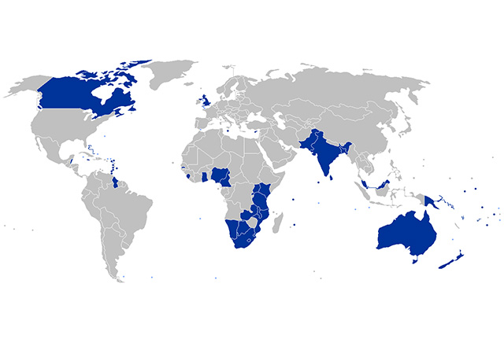
The Commonwealth
52 developed and developing nations around the world

Slide 5

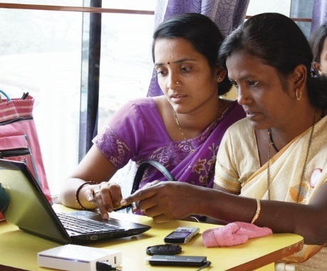
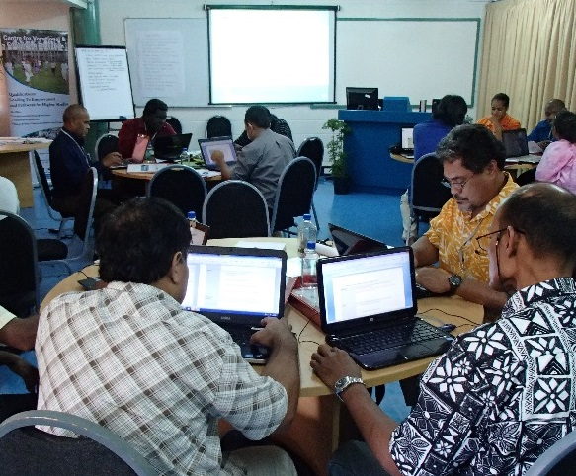
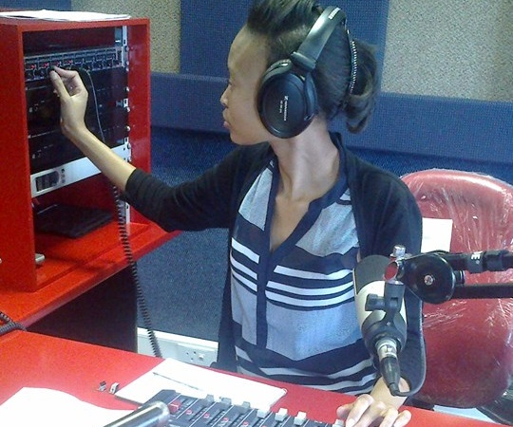
To help Commonwealth governments and institutions use technologies to improve and expand learning for sustainable development

Slide 6

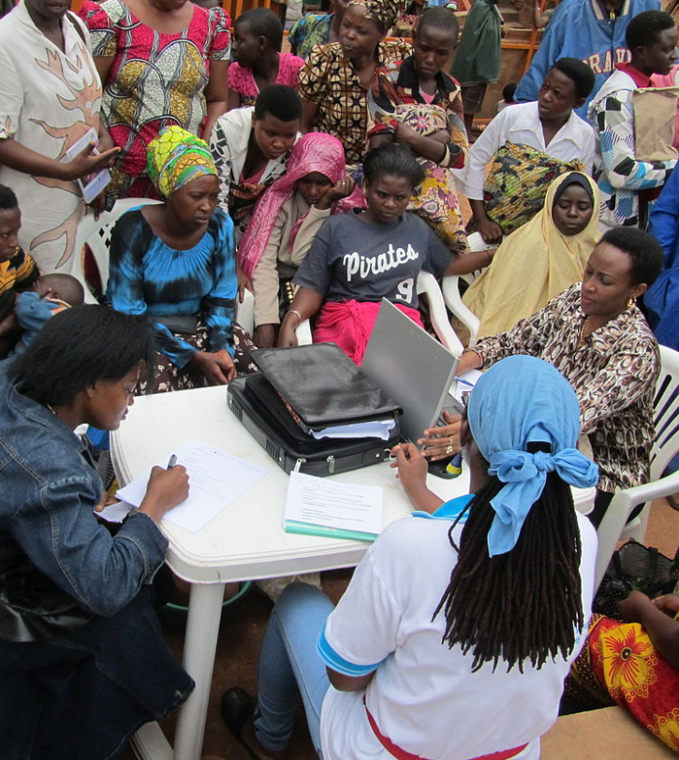
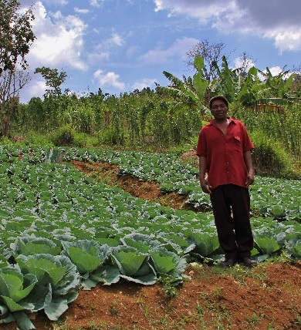



Learning for Sustainable Development
ECONOMIC
GROWTH
SOCIAL
INCLUSION
ENVIRONMENTAL CONSERVATION

Slide 7


Slide 8
Plan
The Context
What is ODL?
Is ODL Inclusive?
The Role of Technologies
Towards Inclusion

Slide 9
Context

Slide 10
Increase in # of people with disabilities
5%
1 billion
Source: WHO, World report on disability 2011
Notes:
1970’s—10%
2010’s—15% --1 billion people
(WHO estimates—reference?)

Slide 11
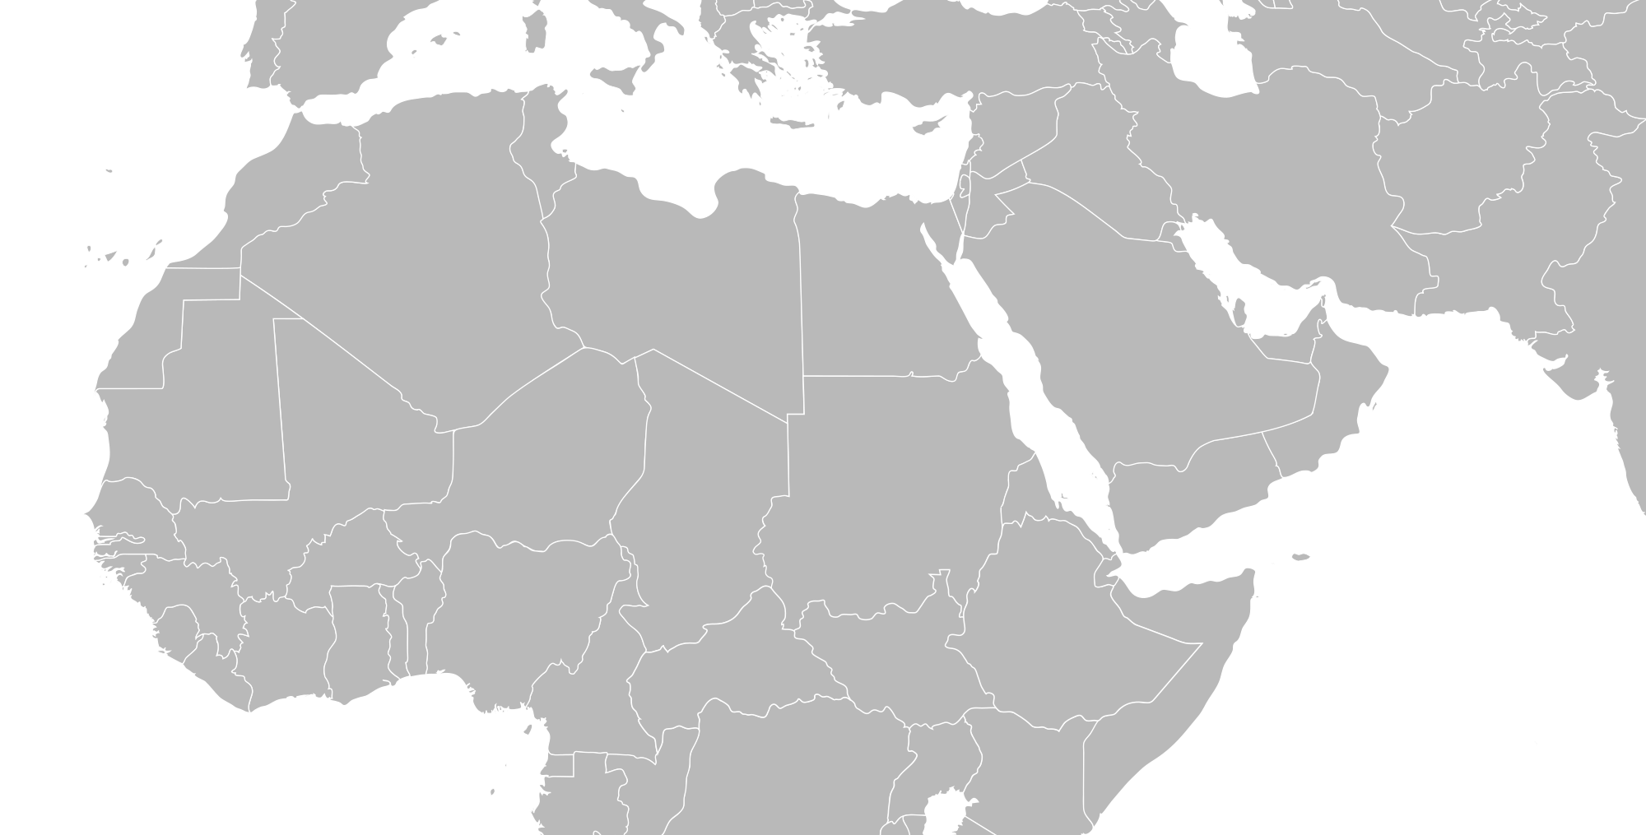
MENA Region
West Bank/Gaza: 4.6 %
Oman: 3.2 %
Bahrain: 2.9%
Tunisia: 1.3%
Egypt: 0.7%
Source: ESCWA & League of Arab States, Disability in the Arab Region - an Overview , published in April 2014
Notes:
Narrow definition of disability?
Societal stigma associated with disability?

Slide 12


Access to Education - Global
Children with disabilities…
186 million have not completed primary school
In developing countries, almost 90% are out of school
In Cambodia, primary attendance of children with disabilities 43% to 93% for those without
Sources:
Accessible ICTs & Personalised Learning for Students with Disabilities, 17-18 Nov 2011, UNESCO HQs, Paris, p. 13
2011 World Report on Disability, WHO
Model Policy for Inclusive ICTs in Education for persons with disabilities, UNESCO, Euro Agency, G3ict, 2014
2016 GEM Report
Notes:
186 million children with disabilities have not completed primary school (Accessible ICTs & Personalised Learning for Students with Disabilities, 17-18 Nov 2011, UNESCO HQs, Paris, p. 13)
93-150 million school-aged children with disabilities globally (2011 World Report on Disability, WHO)
In developing countries, almost 90% of the children with disabilities out of school. (Model Policy for Inclusive ICTs in Education for persons with disabilities, UNESCO, Euro Agency, G3ict, 2014)

Slide 13

Access to Education - MENA Region
95% of children with disabilities not in primary school (Peters, 2009)
Person with disabilities (Oman 2010)
56.4% illiterate
1.8% university
1.9% diploma
10.6% secondary

Slide 14







Access to Tertiary Education
USA
11.1%
Canada
10.7%
Australia
5.5%
India
.56%
South Africa
1%
In South Africa 80% of disabled people aged 20-24 are not in tertiary education.
Notes:
People with disabilities are often disadvantaged in terms of access to tertiary education. Of the 18 countries for which data is available, 15 report disability prevalence under 3 per cent and half report rates under 2 per cent.
No info on students with disabilities in tertiary education.
United states
Source: https://nces.ed.gov/fastfacts/display.asp?id=60
11.1% (students with disabilities enrolled in post-secondary institutions) in 2011-2012
Canada
Source: http://publications.gc.ca/collections/collection_2009/rhdcc-hrsdc/HS61-1-2009E.pdf
10.7%
Australia:
Source: https://www.cdu.edu.au/sites/default/files/the-northern-institute/10.18793-lcj215.17.02.pdf
5.5%
India
https://timesofindia.indiatimes.com/home/education/news/Disabled-get-only-0-56-of-seats-in-higher-education/articleshow/46810639.cms
0.56%
South Africa
https://www.dailymaverick.co.za/article/2017-08-15-students-with-disabilities-disadvantaged-at-higher-education-level/#.WhSt_lWnGUk
http://www.statssa.gov.za/publications/Report-03-01-59/Report-03-01-592011.pdf
According to Stats SA, 80% of disabled people aged 20-24 are not attending tertiary education. Put another way, around 7,5% of South Africans have a disability. Yet the number of disabled students at tertiary institutions is far from representative: just 1%.

Slide 15
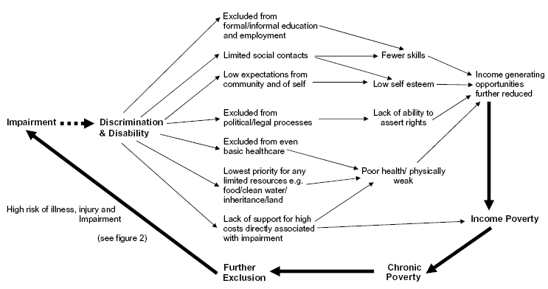
Disability - Poverty Cycle I How Persons with Disability are More Likely to Become Poor
Source: World Bank Report (2005)
Notes:
World Bank Report (2005)

Slide 16

UN Convention on the Rights of Persons with Disabilities (2006)
Education
Work and Employment
87 % countries ratified the Convention in 10 years
ALECSO countries have ratified the Convention
Source: UN Treaty Collection, Convention on the Rights of Persons with Disabilities. Last accessed on 24 November ,2017
Notes:
https://treaties.un.org/Pages/ViewDetails.aspx?src=TREATY&mtdsg_no=IV-15&chapter=4&clang=_en

Slide 17

Arab Decade for Persons with Disabilities 2004-13
Majority of MENA countries have included articles on disability in their constitutions
Most national governments have devised new laws, policies to align with the CRPD
Half the MENA countries had/were developing a national strategy/plan on disability
Legal provisions to provide employment for people with disabilities: quotas (1-5%) in Egypt Lebanon, Tunisia

Slide 18
Exclusion and Impact on Development
OECD: Employment rate for people with disabilities 47.3%
In 10 low/middle income countries, exclusion from the labour market of PWD is 3-7% GDP loss
Source: Learning for All: Guideline on the inclusion of Learners with Disabilities in ODL, Diane Chambers et al, UNESCO, 2016
Notes:
20% below those without disabilities

Slide 19

Disability and the MDGs
The Millennium Development Goals (MDGs) represent a concerted effort to address global poverty. Yet there is a striking gap in the current MDGs: persons with disabilities, that is, the estimated 1 billion people worldwide who live with one or more physical, sensory (blindness/deafness), intellectual or mental health impairments, are not mentioned in any of the 8 Goals or the attendant 21 Targets or 60 Indicators, nor in the Millennium Declaration.
Source: United Nations DESA, Disability and the Millennium Development Goals (2012)

Slide 21

SDG4 Targets
4.5: By 2030, eliminate gender disparities in education and ensure equal access to all levels of education and vocational training for the vulnerable, including people with disabilities….
4.a: Build and upgrade education facilities that are child, disability and gender sensitive and provide safe, non-violent, inclusive and effective learning environments for all (adapted infrastructure and materials for students with disabilities)
Notes:
Alternative approaches
ODL
ICTs

Slide 22
What is ODL?

Slide 23


DISTANCE EDUCATION = Separation of teacher and learner

Slide 24
OPEN LEARNING
= fewer barriers and is NOT the same as
DISTANCE EDUCATION
BUT, they are complementary
Therefore: ODL

Slide 25
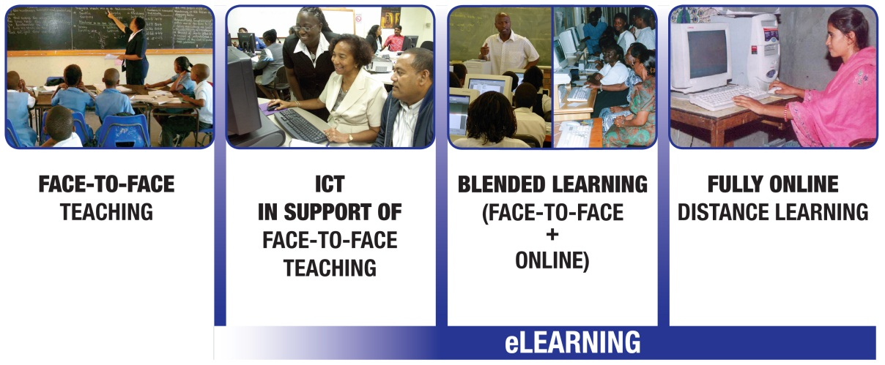
ODL and eLearning

Slide 26
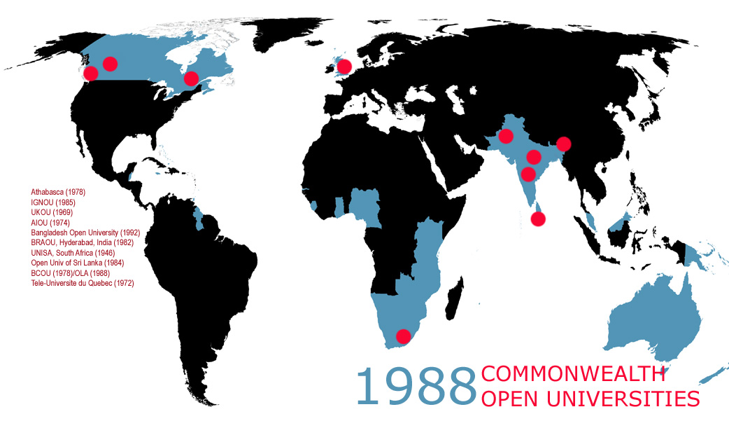
AIOU
ATHABASCA
BCOU
BRAOU
IGNOU
OLA
OUSL
TELUQ
UKOU
UNISA

Slide 27
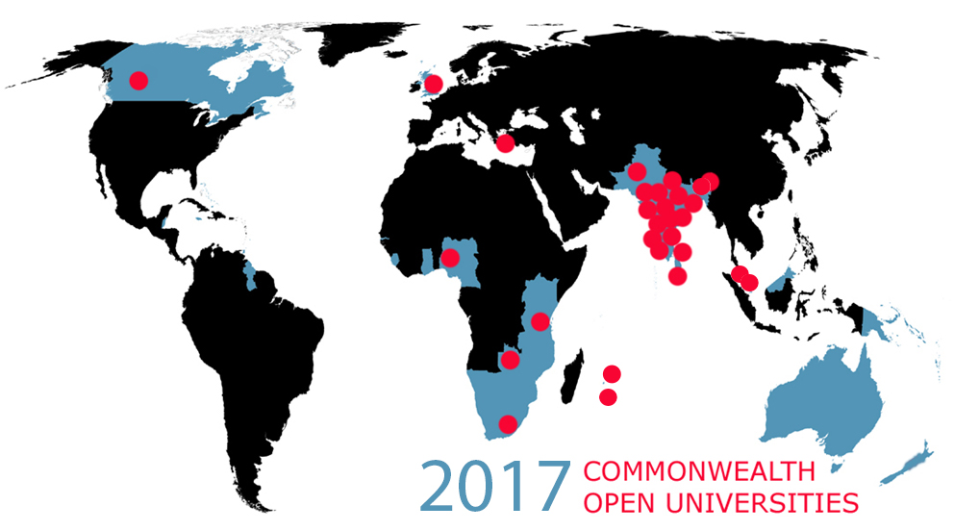
AIOU
ATHABASCA
BAOU
BOU
DrBRAOU
GOU
IGNOU
KKHSOU
KSOU
MPBOU
NOU
NOUN
NSOU
OSOU
OUC
OUM
OU Mauritius
OUSL
OUT
PSSOU
TNOU
UOU
UNISA
UKOU
UPRTOU
VOU
VMOU
SOU
YCMOU
ZAOU
Notes:
Remove one dot from Indian Ocean

Slide 28
Open and Distance Education in Mega Universities
Country | Institution | Enrolment | % of Campus Cost*
Pakistan | AIOU | 456.126 | 22
China | CCRTVU | 2,300,000 | 40
India | IGNOU | 1,187,100 | 35
UK | OU | 203,744 | 50
*Unit cost per student as a percentage of the average for other universities in the country, NKC, 2004.

Slide 29
Online Enrolment in the USA
11% Increase
Source: Digital Learning Compass: Distance Education Enrollment Report 2017, Retrieved from https://onlinelearningsurvey.com/reports/digtiallearningcompassenrollment2017.pdf
Notes:
Students who are taking at least one distance education course comprise 29.7% of all higher education enrollments as of fall 2015. In 2015, the number of students taking at least one distance education course increased 3.9% over the previous year, and grew by 11.0% in the three years since 2012.

Slide 30
Cost Per Unit Effectiveness
Training modes | Cost per completing participant | Total effectiveness points per completing participant (total 300 points) | Cost per unit Effectiveness
Face-to Face | US$1,614 | 244 | US$6.7
Online | US$901 | 242 | US$3.7
Source: Evers, A., Vermeulen, M., & van der Klink, M. (2007). The need to invest in teachers and teacher education.

Slide 31

Amongst top 10 universities for overall student satisfaction in the 2017 National Student Survey
86% student satisfaction
Source: https://www.timeshighereducation.com/student/news/national-student-survey-2017-overall-satisfaction-results
Notes:
Source: http://www.open.ac.uk/about/main/the-ou-explained/facts-and-figures

Slide 32
Openness: an evolving concept
ACCESS
CONTENT
TECHNOLOGY
Notes:
ACCESS: Open means open entry, easier access to study, increased enrollment since 1960s.
CONTENT: Open availability of content and resources since 2000s,
TECHNOLOGY: MOOCs in 2010s

Slide 33
New Dimensions of ‘openness’: OER
Free availability of quality content
Faculty time can now focus on learner support
course
development

Slide 34
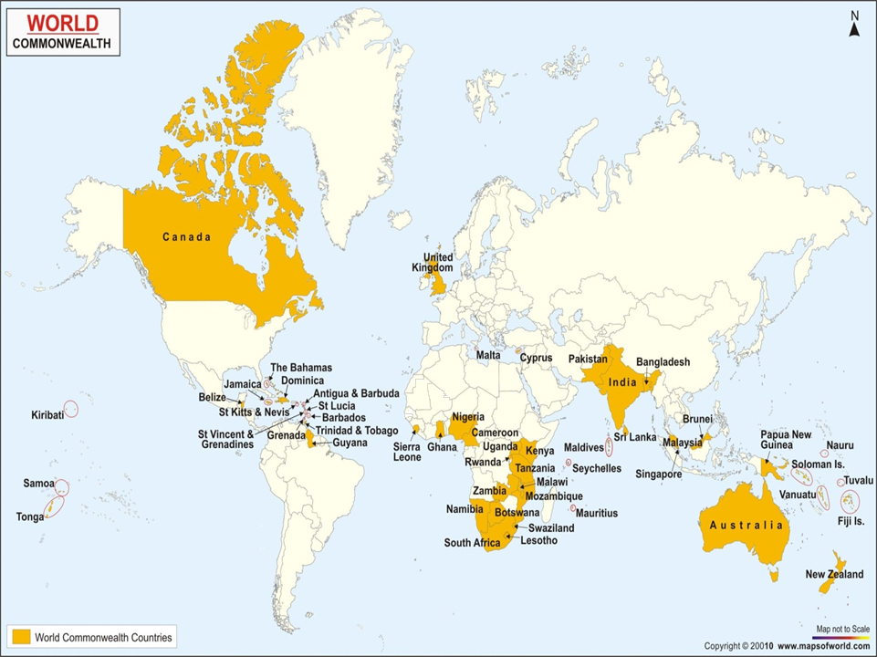
MOOCs: A Connected Classroom

Slide 35
More PWD joining ODL
CONVENIENT
Study at your own pace, place, time
FLEXIBLE
Option to listen, watch or read lecture in different formats
AFFORDABLE
ANONYMOUS
Don’t require to travel to campus or accommodation
Costs less than F2F
Engage with professors and classmates without feeling discriminated

Slide 36
Is ODL Inclusive?

Slide 37


Legal and Policy Framework on Disability – Australia
Disability Discrimination Act 1992: the act prohibits discrimination against persons with disabilities in employment, education, publicly available premises, provision of goods and services, accommodation, clubs and associations, and other contexts. Discrimination is defined to include failing to make reasonable adjustments for the person.
Notes:
Resources:
https://www.legislation.gov.au/Details/C2013C00022
https://en.wikipedia.org/wiki/Disability_Discrimination_Act_1992

Slide 38
Supporting students with disabilities
The OU strives to make all aspects of study accessible to everyone, which is why more disabled students choose the OU than any other UK University
In 2014, around 19,000 such students enrolled at the undergraduate level
Securing Greater Accessibility policy in place (2010)
Ensure that all learning objectives must be met regardless of access
Source: Open University – Supporting students with disabilities, last accessed on 14 November, 2017
Notes:
In 1976—750 students

Slide 39

Supporting students with disabilities
Produces study material in alternative formats, including Braille, large print, audio and electronic.
Provides sign language interpretation services in certain of its contact groups.
2,469 students (0.8% of total) enrolled in 2011 has a disability.
The enrolment of students with disabilities has grown by 59.3% since 2007
Sources:
UNISA: Students with disabilities, last accessed on 14 November 2017
An institutional profile: Unisa Facts & Figures HEMIS 2007 – 2011 (2012)

Slide 40

Supporting students with disabilities
Services provided by ASD (Access to Students with Disabilities):
Advocacy, Liaison and Referral
Alternative Format Course Materials
Assistive Technology
Course Management Services
Exam Accommodations
Learning Support Services
No statistics available on # of disabled students enrolled
Source: Athabasca University – Access to students with disabilities last accessed on 14 November 2017

Slide 41

AIOU offers free education for disabled persons up to PhD level
The Allama Iqbal Open University will offer free education to physically handicapped, visually and physically impaired students up to the PhD level
Students will get enhanced facilities including provision of study material through computerized accessibility network
The number of disabled persons enrolled with AIOU has recently reached 400
Source: Daily Times, AIOU offers free education for disabled persons up to PhD level, published on 13 February, 2017

Slide 42

OUT helps people with vision disabilities access ICT
People who are blind or low vision in Tanzania can now access Information and Communication Technology (ICT) studies following the introduction of a special program that offers computer courses to people with vision disabilities, an initiative launched recently by Open University of Tanzania (OUT)
Source: Global accessibility news - OUT helps people with vision disabilities access ICT, published on 8 January ,2014.

Slide 43

Krishna Kanta Handiqui State Open University (KKHSOU)
Policy for Persons with Disabilities
Content in accessible formats
Provision of various ICT s
Special Educators provided for support with sign language
Resource Centre for Persons with Disabilities
Rehabilitation Support
Appropriate funds and resources

Slide 44

Open Education and Disabilities
Inclusion fits with social mission of open universities
Varying levels of interventions
Emphasis on convergence of ODL and ICTs/Assistive Technologies
Services Provided
Course Accommodation
Examination Accommodation
External Support
Assistive Technology

Slide 45
The Role of Technology

Slide 46
Assistive Technology (AT) Definition
products, equipment, and systems that enhance learning, working, and daily living for persons with disabilities.
Source: Assistive Technology Industry Association(ATiA), What is AT?, last accessed on 23 November, 2017

Slide 47


Mobile Devices – Built-in AT features
Most mobile devices come with assistive technology (AT) that can help with reading, writing and organization.
Common built-in AT features include text-to-speech and dictation technology.
Some examples:
Made for iPhone hearing aids¹.
Use accessibility features with Siri (Voice access)¹.
Braille support for Android with BrailleBack².
Zoom & Magnification².
Sources:
Apple.com, iPhone & iPad Accessibility support, last accessed on 23 November, 2017
Google.com, Android Accessibility Help Center, last accessed on 23 November, 2017

Slide 48

Mobile Apps to Help People with Disability
Be My Eyes - a free mobile app designed to bring sight to the blind and visually impaired.
Avaz - an augmentative and alternative communication (AAC) tool, notable for being India's first successful AAC intervention.
Hear You Now - a free sound amplifier tool.
Roger Voice - an app allows deaf and hard of hearing persons to make phone calls by automatic captioning.
Wheel Mate - find wheelchair-accessible toilets and parking spaces.

Slide 49

Artificial Intelligence & Robotics
AI for the visually impaired such as vision-free communications
Robot caregivers
Exoskeletons for the Paralyzed
Smart cities for all
ICT accessibility
Digital inclusion
ICT accessibility procurement policy
Database solutions for digital inclusion in cities.
1
1 Progrss,. Four Tools to Design Smart Cities for Persons with Disabilities, published on 11 May, 2017

Slide 50

Virtual Reality & Augmented Reality
VR
Try out-of-reach experiences
Increase safety for persons with learning disabilities such as autism
Practice social skills
AR
Help visually-impaired persons to recognize their environments with ease
Learn essential life skills
Source: http://www.thegenius.ca/augmented-virtual-reality-benefit-disabled-people/

Slide 51
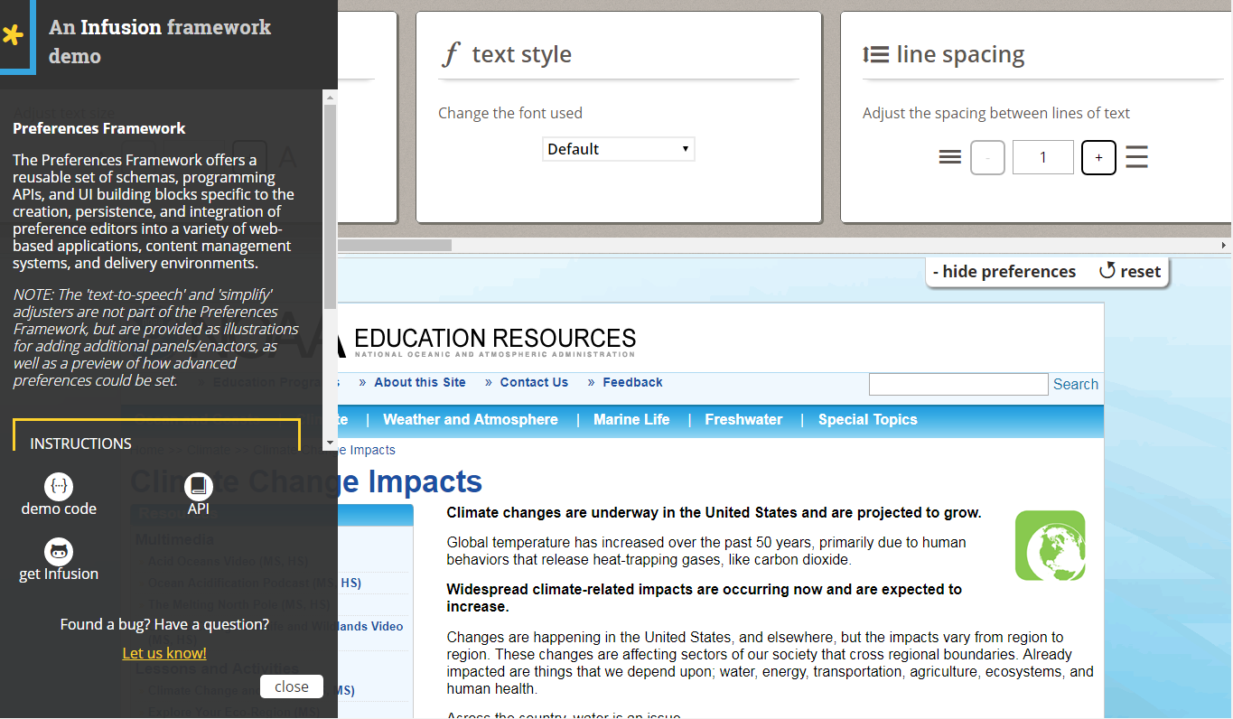
Inclusive Design Institute – Fluid project
Notes:
The Inclusive Design Institute (IDI) is a generative hub of applied research that addresses the challenge of designing our ICT systems so that they work for all potential users, including users with disabilities, varying language needs and diverse cultural preferences. The IDI is Canada’s first research hub focused on digital inclusion. Selected projects:
Fluid project: an open, collaborative project to improve the user experience and inclusiveness of open source software.
Floe project: supports learners, educators and curriculum producers in achieving one-size-fits-one learning design for the full diversity of learners, leveraging the variants made possible by Open Education Resources (OER).

Slide 52
Barriers to ICT in Education
Physical - access
Cognitive - specific learning problems
Content - language; software
Didactic - teachers lack skills; inflexible learning
Financial - cost of devices; hardware and software
Model Policy for Inclusive ICTs in Education for Persons with Disabilities, UNESCO, Euro Agency; G3ict, 2014, p.10

Slide 53
Using Technology
Assistive Technologies | ODL Technologies
Voice recognition of typing | Audio, video and interactive multimedia
Pointing devices (track ball, touch screen) | Online courses
Magnification of screen | Email, Forum and asynchronous tools
Planning and organisation software | Chatrooms, whiteboards and video conferencing
Refreshable braille display | Social media

Slide 54
ICT and Disabilities
Accessing and understanding content
Digital learning resources
Educational apps
Content creation and Classroom participation
Use of alternate means of content creation such as voice recognition
Using communication tools to interact with teachers
Organisation and memory
Calendars, memory aids, and organization apps can assist in improving focus
Assistive technologies
Online participation from home
Memory aids can support learning task
Source: Raja, Deepti Samant. 2015. “Bridging the Disability Divide through Digital Technologies.” Background paper for the World Development Report 2016, World Bank, Washington, DC.

Slide 55
Towards inclusion

Slide 56

Principles of Universal Design for Learning
Equitable use
Flexibility in use
Simple and intuitive use
Perceptible information
Tolerance for error
Low physical effort
Size and space for approach and use
Source: http://www.washington.edu/doit/universal-design-education-principles-and-applications

Slide 57
Benefits
‘There is little doubt that distance education can enhance access to students with disabilities and that disability specific support services can enhance success.’
- Susan D. Moisey, 2004
‘making courses accessible to students with disabilities promotes best practices for all students’
- Sheryl Burgstahler
‘learning activities…designed with accessibility in mind …facilitate learning in a variety of ways and usually exhibit well-considered pedagogy…accessibility is a driver for quality in general’
- Martyn Cooper, 2014

Slide 58
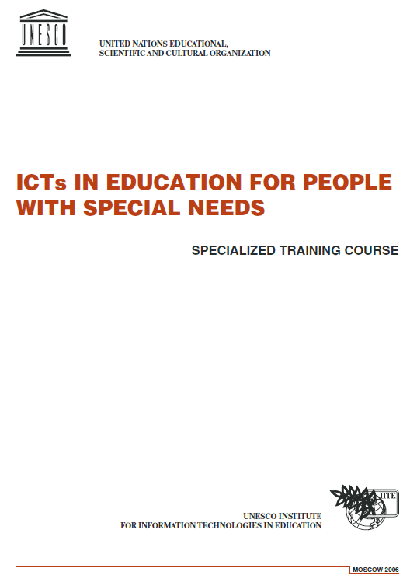
Capacity: Training Staff
Legal issues
Disabilities
Assistive technologies
ODL technologies

Slide 59

Special Needs Assessment Instruments
Diagnostic instruments for Reading and Mathematics which are culturally appropriate for students in the English-speaking Caribbean countries
Pilot tests to be administered in schools in Belize, Jamaica and Trinidad and Tobago

Slide 60
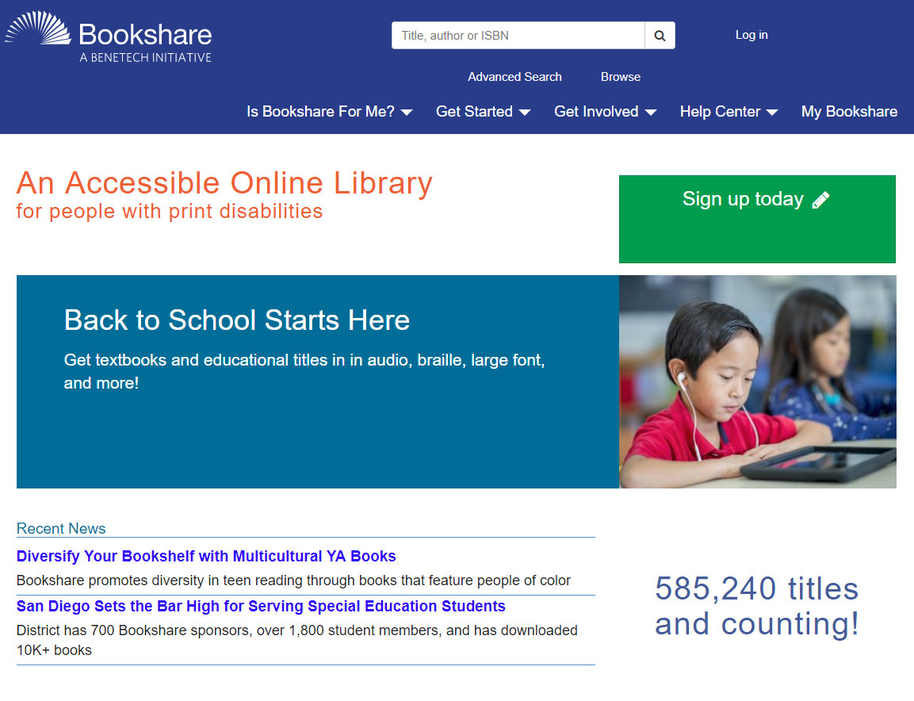
Promote Openness and Sharing
OER (including exceptions in copyright for people with disability)
Open Access
FOSS
Notes:
https://www.bookshare.org/cms/

Slide 61
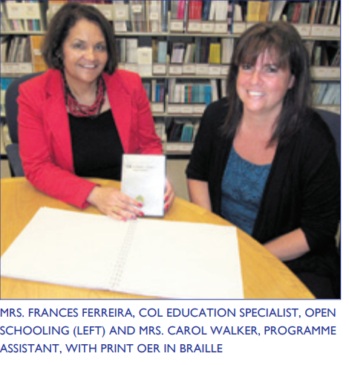
OER for Open Schools in Braille
Notes:
http://oasis.col.org/bitstream/handle/11599/795/Connections-2011-06.pdf?sequence=1&isAllowed=y
http://oasis.col.org/bitstream/handle/11599/202/ProgEvalReport_OER-OpenShools_2011.pdf?sequence=1&isAllowed=y
As OER for Open Schools is focused on expanding access to education, the OER have been designed to be easily accessed by learners of all abilities. The online OER will be accessible to people using assistive devices such as screen magnifiers and voice recognition programmes. This attention to accessibility was inspired by a presentation at a copyright and OER workshop held in conjunction with the launch of COMOSA in November 2009. Ms. Nirmita Narasimhan,Programme Manager at the Centre forInternet and Society and someone who liveswith a visual disability, urged participants to make OER truly “open” by ensuring they are accessible to learners of all abilities

Slide 62
Way Forward
ODL institutions need to be more proactive in catering to disabilities
ICT by themselves cannot serve the needs of PWD but need to be combined with content and pedagogy
Collect data and monitor the results
Develop open accessible content in Arabic
More Collaboration

Slide 63
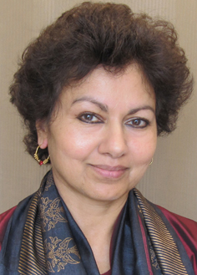


Thank You
Professor Asha S. Kanwar President & CEO
Mr Ricky Cheng
Knowledge Services Manager
www. col.org

