Slide 1


Structure, Function and Impact of Lifelong Learning Using ICT and ODL
K. Balasubramanian, Alexis Carr and James Onyango
Based on a study conducted by
Alexis Carr, Rosemary Atieno, Mamudu Akudugu, James Onyango and K Balasubramanian
Keynote Speech,
“Expanding Horizons in ODL”, ODLAA 2017, Conference
Melbourne
February, 6, 2017
1

Slide 2
Presentation Plan
About the Commonwealth of Learning
Education and Lifelong Learning
Lifelong Learning and ODL
Non-formal Learning and Social Learning
Lifelong Learning and Its Impact
Conclusion: Strengthening Lifelong Learning Through ODL

Slide 3
About the Commonwealth of Learning (COL)

Slide 4
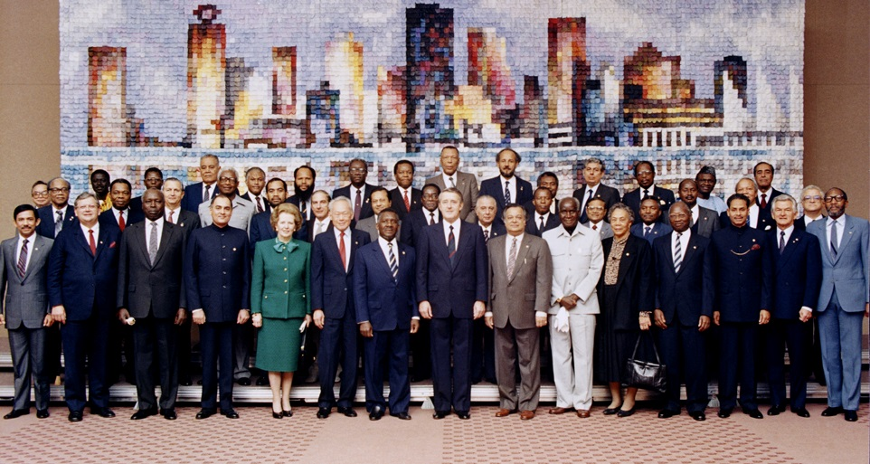
COL created by Commonwealth Heads of Government Meeting, 1987
Notes:
We invite you to engage us; tap into our thought leadership, expertise, networks and resources

Slide 5

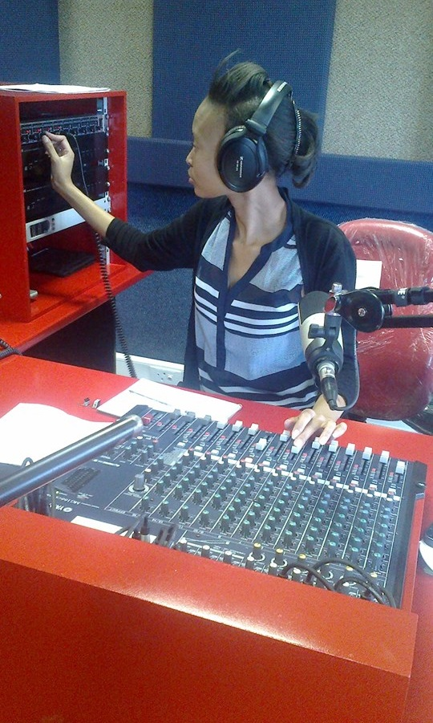
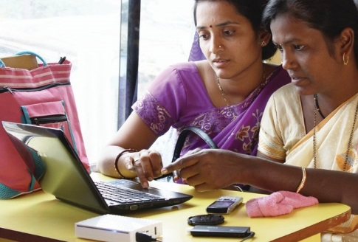
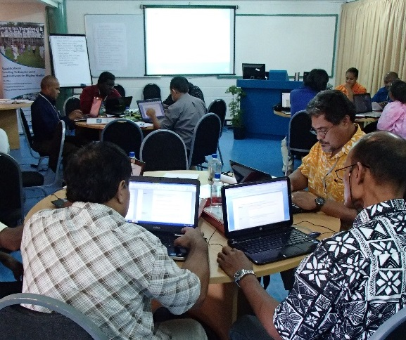

What is it for?
To help Commonwealth governments and institutions use technologies to improve and expand learning for sustainable development
6

Slide 6

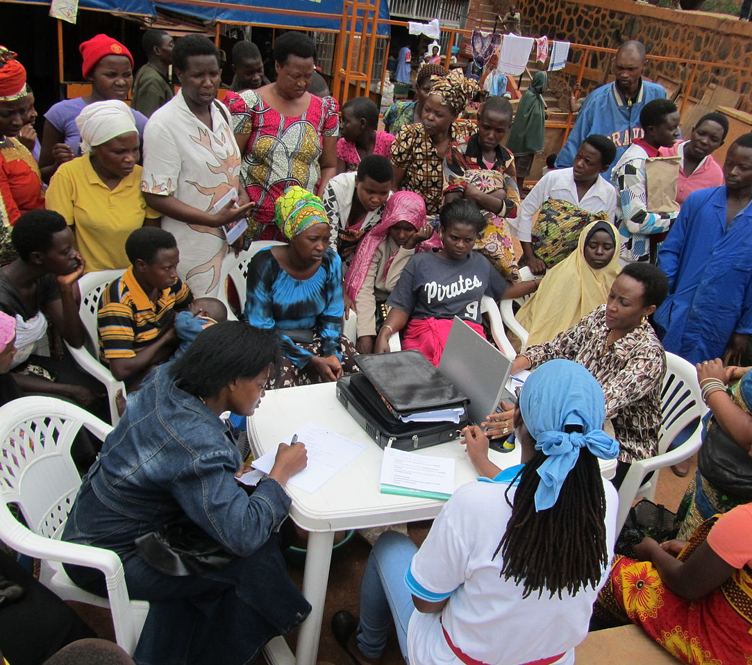
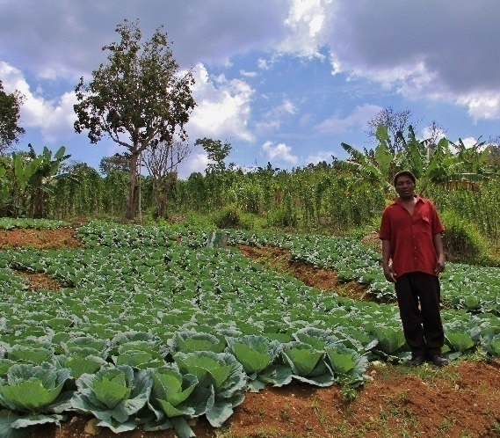
Learning for Sustainable Development
ECONOMIC
GROWTH
SOCIAL
INCLUSION
ENVIRONMENTAL CONSERVATION

Slide 7
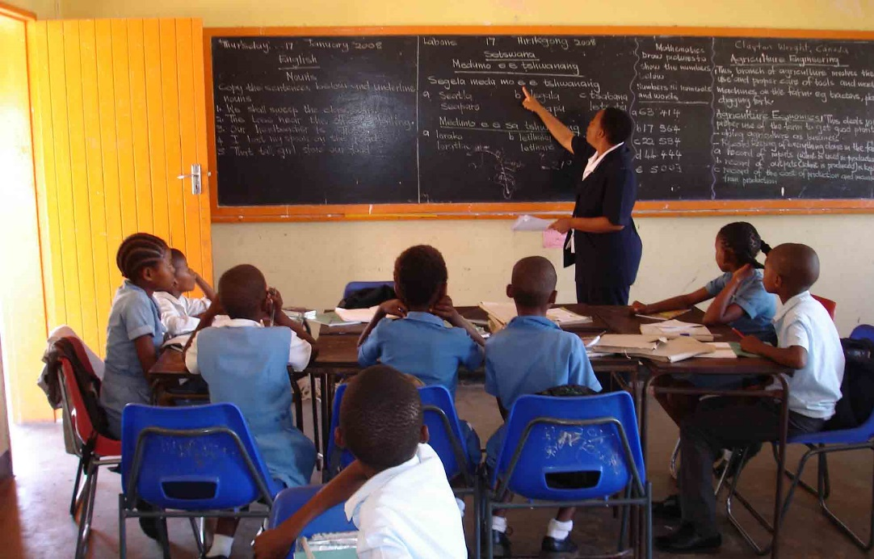
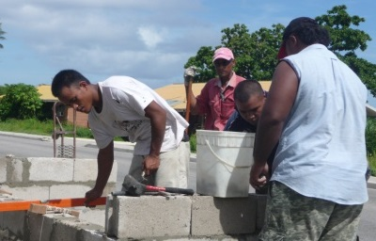
Two Sectors
Education
Skills
Gender

Slide 8
Works with more than 400 partners in 45 countries
Ministries: Education, Agriculture, Health, Finance, Labour, Industry, Commerce
Universities, Colleges, Polytechnics , Industrial Training Centres
Financial Institutions, Cooperatives including SACCOs, Microfinance Institutions
International Development agencies such as UNESCO, UNHCR, WHO, ILO, World Bank, DFID, GAC, Asian Development Bank
Civil Society: NGO, Community Based Organizations, Women Federation, Farmers’ organization
Provides Modest funds –
but not a funding agency but a technical and facilitating agency

Slide 9
Education
&
Lifelong Learning

Slide 10


7

Slide 11
SDG4
More on Formal education
Emphasis on Non-formal Learning Limited
Clarity on Lifelong Learning???

Slide 12
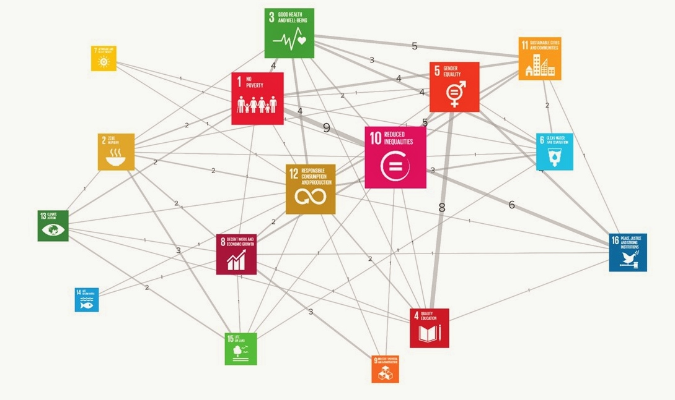
SDG4 to Other SDGs
SDG 4
Source: http://blog.kumu.io/a-toolkit-for-mapping-relationships-among-the-sustainable-development-goals-sdgs/#&gid=1&pid=1
http://www.un.org/esa/desa/papers/2015/wp141_2015.pdf
8

Slide 13
Literacy and Learning
Literacy and numeracy since worldwide 780 million
Agriculture and Informal sector-More than One Billion
Adult Learning is more than Literacy and Numeracy
Literacy is (always) not necessarily a precondition for Lifelong Learning.
Preliterate Societies were Learning Societies.

Slide 14
Three Premises
Lifelong learning approach is an integration of formal education, non-formal learning and informal learning.
The ability of education and learning to create economic, social and environmental externalities- Lifelong Learning approach add can add value?
ODL and ICT Based Learning - sine qua non for Lifelong Learning - Provided??

Slide 15
Education, Outcome and Impact
Being increasingly challenged
The optimism on the positive returns on investment in education is being questioned. “contributed much less to growth than expected” and called for reformation so that investments…in cognitive skills pay off”
Pritchett, L. (2000). “Where Has All the Education Gone?” World Bank and Kennedy School of Government. Retrieved from https://www.hks.harvard.edu/fs/lpritch/Education%20-%20docs/ED%20-%20Econ%20Growth,%20impact/where%20has%20all%20the%20education%20gone.pdf
Relationship between education and empowerment – yet to be fully established
Carr, Alexis et al (2015). From Learning to Empowerment: A study of smallholder farmers in South West Uganda. Journal of Learning for Development - JL4D, [S.l.], Vol. 2, N. 3, November ISSN 2311-1550. Retrieved from http://www.jl4d.org/index.php/ejl4d/article/view/124

Slide 16
Lifelong Learning
&
ODL

Slide 17
Lifelong Learning
…”is a more comprehensive and visionary concept which includes formal, non-formal and informal learning extended throughout the lifespan of an individual to attain the fullest possible development in personal, social and professional life”
The National Education Policy Investigation’s Adult Education report (1993) quoted in
Aitchison 2004. http://cae.ukzn.ac.za/Libraries/Publications/LLinSA.sflb.ashx

Slide 18
Lifelong Learning: Blending of Formal, Non-formal and Informal Learning
“Many are still unable to distinguish between lifelong learning as a common sense principle—of learning from the cradle to the grave — and lifelong learning as an educational principle that has to be realized in policies, programs and projects. One of the main challenges in this area then is to clarify the assumptions underlying the use of this concept”
Source: Medel-Añonuevo, Carolyn. (2002). Integrating Lifelong Learning Perspectives. Paris: UNESCO. Retrieved from http://unesdoc.unesco.org/images/0012/001264/126485e.pdf on February 3, 2017

Slide 19
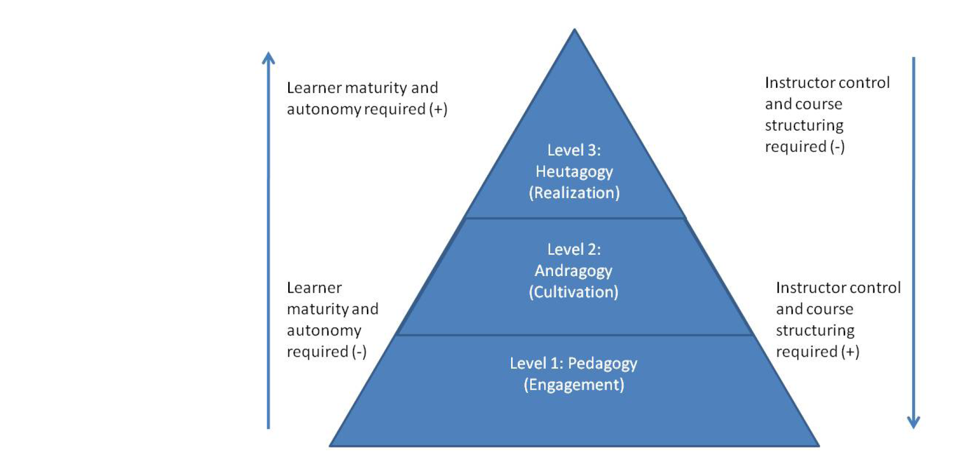
Lifelong Learning: An Integration of three approaches
Blaschke, Lisa Marie. (2012). Heutagogy and Lifelong Learning: A Review of Heutagogical Practice and Self-Determined Learning .International Review of Research in Open and Distance Learning. January. Retrieved from http://www.irrodl.org/index.php/irrodl/article/view/1076/2113

Slide 20
Lifelong Learning-The Challenge
the “removal of educator” which “makes the concept of heutagogy” and lifelong learning challenging
Source: McAuliffe, M.,et al (2008). Does pedagogy still rule? In Proceedings of the 2008 AAEE Conference, December 7-10, 2008. Yeppoon, Queensland. Retrieved from http://eprints.qut.edu.au/20502/1/c20502.pdf
It is not the removal of education, but change in the role of educator
heutagogical approach and lifelong learning in formal learning is possible through learner-defined learning contracts, flexible curriculum, learner-directed questions, flexible and negotiated assessments and collaborative learning
Source: Blaschke, Lisa Marie. (2012). Heutagogy and Lifelong Learning: A Review of Heutagogical Practice and Self-Determined Learning .International Review of Research in Open and Distance Learning. January. Retrieved from http://www.irrodl.org/index.php/irrodl/article/view/1076/2113

Slide 21
ICT enhances the scope of Lifelong Learning
ODL community yet to fully optimize the potentials of Lifelong Learning, since its focus is mostly in formal education with conventional pedagogy (???)

Slide 22
Non-Formal Learning
&
Social Learning

Slide 23
Learning in Agricultural Sector
Over one billion people to be reached in developing countries
During 60s-80s, agricultural extension in wheat and rice cultivation yielded high returns. Not any more
One trainer covers around 2900 farmers. Only 5% of women rural workers have access to extension services and in India, the present extension coverage reach only 6.8% of the farmers.
Replicating Classroom , didactic approach to reach millions of farm families
Roseboom, J. 2004. Agricultural research and extension funding levels required to meet the Anti-Hunger Programme objectives. Manuscript prepared for the Food and Agricultural Organization (FAO), Rijswijk, The Netherlands. Retrieved from http://www.eldis.org/vfile/upload/1/document/0708/DOC16282.pdf
GFRAS (2012). Fact Sheet on Extension Services: Position Paper, June 2012. Global forum for Rural Advisory Services, Switzerland. Retrieved from https://farmingfirst.org/wordpress/wp-content/uploads/2012/06/Global-Forum-for-Rural-Advisory-Services_Fact-Sheet-on-Extension-Services.pdf

Slide 24
Social Learning _ Farmers’ Learning Strategy
Farmer to Farmer Learning predominant form of learning
Rajasekaran, Bhakthavatsalam, "A framework for incorporating indigenous knowledge systems into agricultural research and extension organizations for sustainable agricultural development in India " (1993). Retrospective Theses and Dissertations. Paper 10180.
Conley, T., & Udry, C. (2010). Learning about a new technology: Pineapple in Ghana. American Economic Review, 100(1), 35-69.
Social Learning and Community Knowledge Management_ More than Peer learning _ leads to Lifelong Learning
Social Capital - A Precondition for lifelong Learning

Slide 25
Non-Formal, Informal Learning and
ODL
they “have a great potential for helping a wide range of learners achieve more desirable and rewarding circumstances for themselves and their communities”
“Developments and issues in these two important modes of provision are insufficiently represented in the literature of open and distance learning “
Latchem, Colin (2014). Informal Learning and Non-Formal Education for Development in Journal of Learning for Development. VOL. 1, No. 1. Retrieved from http://www.jl4d.info/index.php/ejl4d/article/view/6/6

Slide 26
Lifelong Learning
&
Its Impact

Slide 27
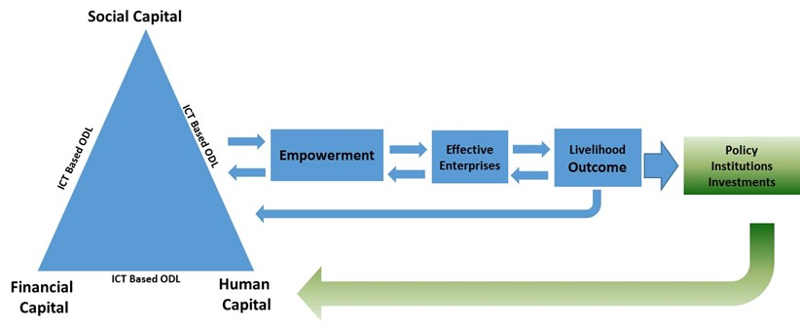
Lifelong Learning for Farmers (L3F) Project in Kenya and Ghana empowering farming communities

Slide 28
Components of Lifelong Learning in L3F Project
 | Theoretical Approach | Salient Features
1 | Pedagogy | Face to Face Training given by experts ICT based Learning from universities and research institutions Generic curriculums developed by universities Experts as trainers, trainings evaluated by experts
2 | Andragogy | Curriculum developed by experts ICT based learning from universities and research institutions- with community radio and mobile phones Context-specific, local problem-centred , task-centred learning materials prepared from the feedback from the participating communities. Guided by experts but learning takes place within the community based groups. Learning sequences, temporal aspects are defined by the learners Experts and NGOs as facilitators. Learning evaluated by experts
3 | Heutagogy | Learning design developed by “Table Banking” group Content developed by the members of the “Table Banking Group” Learning process defined by each learner Content vetted by the experts Content in audio format shared with other groups Experiences shared at intra-group and inter-group level. Learning through radios, Television, mobile phones and newspaper Community and the learners-self-evaluation

Slide 29
The Study
Survey among the Backyard Poultry householders participating in L3F in selected villages of western Kenya and among L3F participants in North, Volta and Upper regions of Ghana
Cross-sectional Study –Comparing L3F with Control Groups (Two in Kenya and One in Ghana)
15% of the respondents in Kenya and 90% of the respondents in Ghana did not go to school. Most of the Kenyan respondents had received below secondary education.
More than 60% of the participants _Women

Slide 30
Developed Lifelong Learning Index: using data about formal conventional training taught by experts, non-formal learning facilitated by experts and structured community based social learning.
Lifelong Learning Index: 0-1 Scale

Slide 31
Empowerment is “the expansion in people’s ability to make strategic life choices.”
-Naila Kabeer
Kabeer, N. (1999). Resources, agency, achievement: Reflections on the measurement of women's empowerment. Development and Change, 30(3), 435-464

Slide 32
COL’s Three Dimensional Empowerment Framework
Source: http://www.jl4d.org/index.php/ejl4d/article/view/124/112

Slide 33
Lifelong Learning Index
 | Kenya | Ghana
L3F Participants | .9478
Non-L3F but in SHGs (Control Group1) | .8444
Neither in L3F nor in SHG ( Control Group 2) | .7750
L3F ( Control Group A) |  | .2955
Non-L3F (control Group B) |  | .1971

Slide 34
Reasons for the Differences between Kenya and Ghana in L3 Index
The L3F project in Kenya started in 2009-10 while in Ghana, it started only during 2014.
The involvement of knowledge institutions in offering training programmes was high in Kenya compared to Ghana.
The credit flow from the financial institutions was substantial in Kenya with preconditions on learning. Ghana did not get such credit facilities.
Kenya used various types of technologies such as mobile phones, community radios and CDs . Due to infrastructural challenges CD based learning was the only major tool in Ghana.
The higher level of school education could also be a contributing factor.

Slide 35
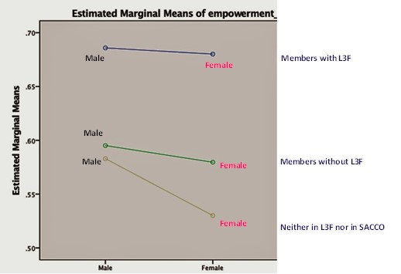
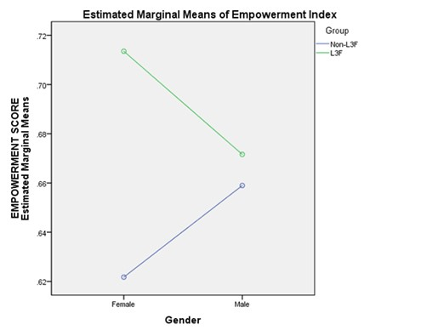
Empowerment Index
Ghana
Kenya

Slide 36
Determinants of Empowerment
Kenya
Regression Model
N=219 , adjusted R squared= .492, standard error of the estimate= .057344, significance= p<.05
 |  |  |  | t statistic | p value
 |  | Coefficient | Std. Error
 | (Constant) | .539 | .019 | 27.958 | .000
 | Sex | .020 | .009 | 2.276 | .024
 | Age | .000 | .000 | .417 | .677
 | Number of years spent in schooling | .002 | .001 | 1.961 | .051
 | L3F membership | .114 | .008 | 14.354 | .000

Slide 37
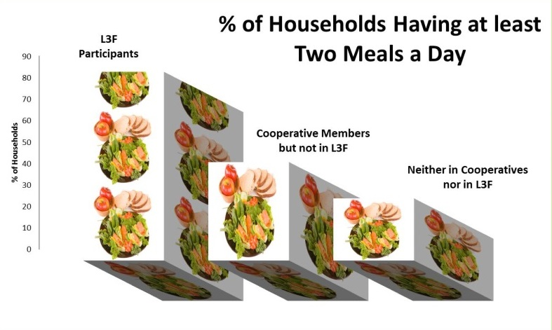
Outcomes & Impacts in Last Six Years
In India
Every $1 invested in learning, facilitation and networking resulted in $9 worth of income and assets
100% Prompt Repayments to Financial Institutions which earned 8 times more income from L3F farmers for the same product compared to non L3F farmers in the same region
Cost of Training and Capacity Building: Six time Lesser than that of the agricultural extension and bank trainings
Banks & Mobile companies beginning to invest in L3F
Improved Food Security in Kenya & Uganda

Slide 38
Conclusion: Strengthening Lifelong Learning Through ODL

Slide 39

Learning for Sustainable Development
Category
Description
Significance
Learning
in
development
Impact
Quality of Life, Food Security, Peace, Sustainable Development
What they achieve
Outcome
Competency, Employability, entrepreneurship, empowerment
What they do
Outputs
Credentials, performance, competency, capacity built
What we achieve
Activities
Mobilization, teaching learning materials, delivery, assessment
What we do
Inputs
Human and financial
resources, Learning Materials, technology
What we invest
Learning
in
education
Source: modified from Margarita F Guerrero (UNSIAP)Margarita F Guerrero (UNSIAP)

Slide 40
Conclusion: Strengthening Lifelong Learning Through ODL
Transition from “Learning in Education” to “Learning in Development”
Responsibility and Accountability do not stop with learners performance and credentials
Need to look at outcomes and impacts –Competencies, empowerment, employability, entrepreneurship, peace, quality of life etc in the value chain of education and learning

Slide 41
Submissions to ODLAA
Pacific- Environmental Sustainability, Domestic Violence, Skill Development, Employability are the major issues
Australia-a leading player in heutagogy, social learning capital
Strengthen the role of ODL and ICT based Learning in Non-formal Learning particularly in Pacific

Slide 42
Thank You

