Slide 1


Strengthening Institutional Effectiveness for Graduate Employability in India
Introduction to the Graduate Employability Project
Presentation by
Jane-Frances Agbu & Jako Olivier @
Stakeholders’ Consultative Meeting on Graduate Employability in Open Universities in India: 10-12 Dec. 2024
Hosted by Madhya Pradesh Bhoj (Open) University, Madhya Pradesh, India, in collaboration with Commonwealth Educational Media Centre for Asia (CEMCA), New Delhi, India & the Commonwealth of Learning, Vancouver, Canada

Slide 2


Outline
Introduction to the Commonwealth of Learning
More on the Higher Education Initiative
Reason why Graduate Employability is important
COL’s model on Graduate Employability
Project aim
Project schedule
Partner institutions
What next?

Slide 3
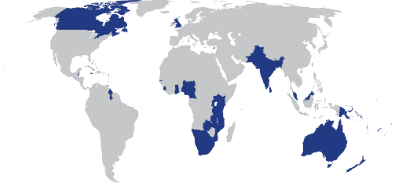
The Commonwealth of Learning (COL) was established in 1987 by Commonwealth Heads of Government “… to create and widen access to opportunities for learning, making use of the potential offered by distance education and by the application of communication technologies to education.”
HQ Vancouver
CEMCA New Delhi
Intergovernmental organisation supporting 56 countries

Slide 4
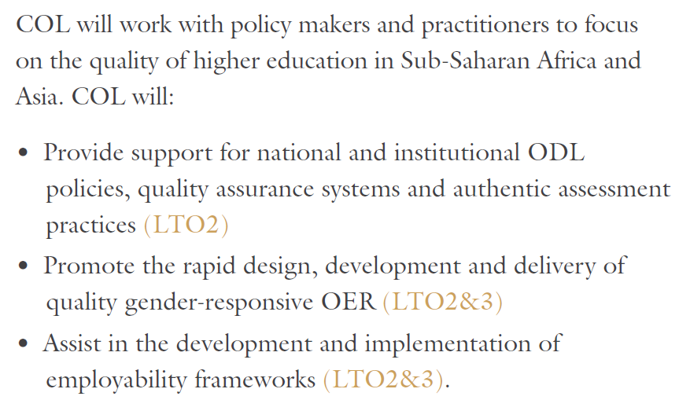
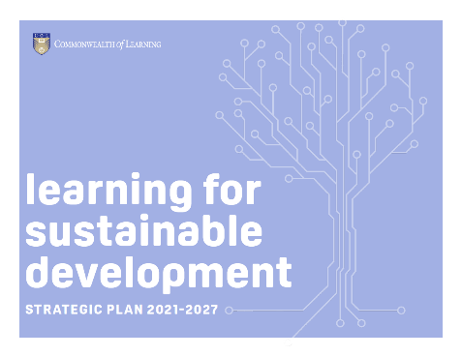
Higher Education at COL

Slide 5

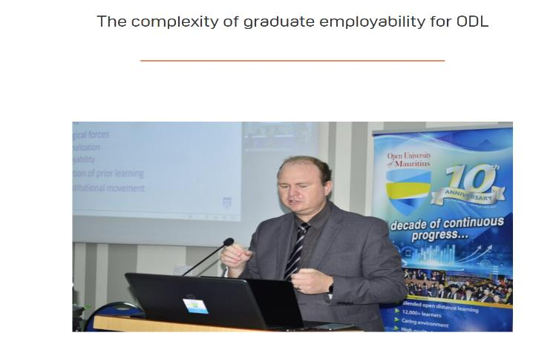
Why Graduate Employability
The complexity of graduate employability for ODL - Commonwealth of Learning
Connecting quality assurance and employability for a future-ready workforce - Commonwealth of Learning
The relevance of courses, the soaring cost of qualifications, and the pressing need to enhance employability have become important points of discussion. As universities grapple with their role in this changing environment, it’s crucial to reevaluate how they prepare students for the dynamic employment landscape (Olivier, 2023)
Companies are constantly rethinking what they do and how they work, that’s why they need employees who can flex, stretch and evolve to meet the challenges we can’t yet imagine (Agbu, 2022)

Slide 6
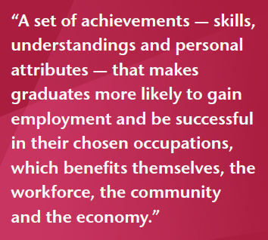
Why Graduate Employability
Employability defined
Why is this needed?
  Universities can show the value of higher education
  Be responsive to the needs of the job market
  Foster students who are adaptable and ready for a changing world of work
Mantz Yorke in Mohee (2019)

Slide 7

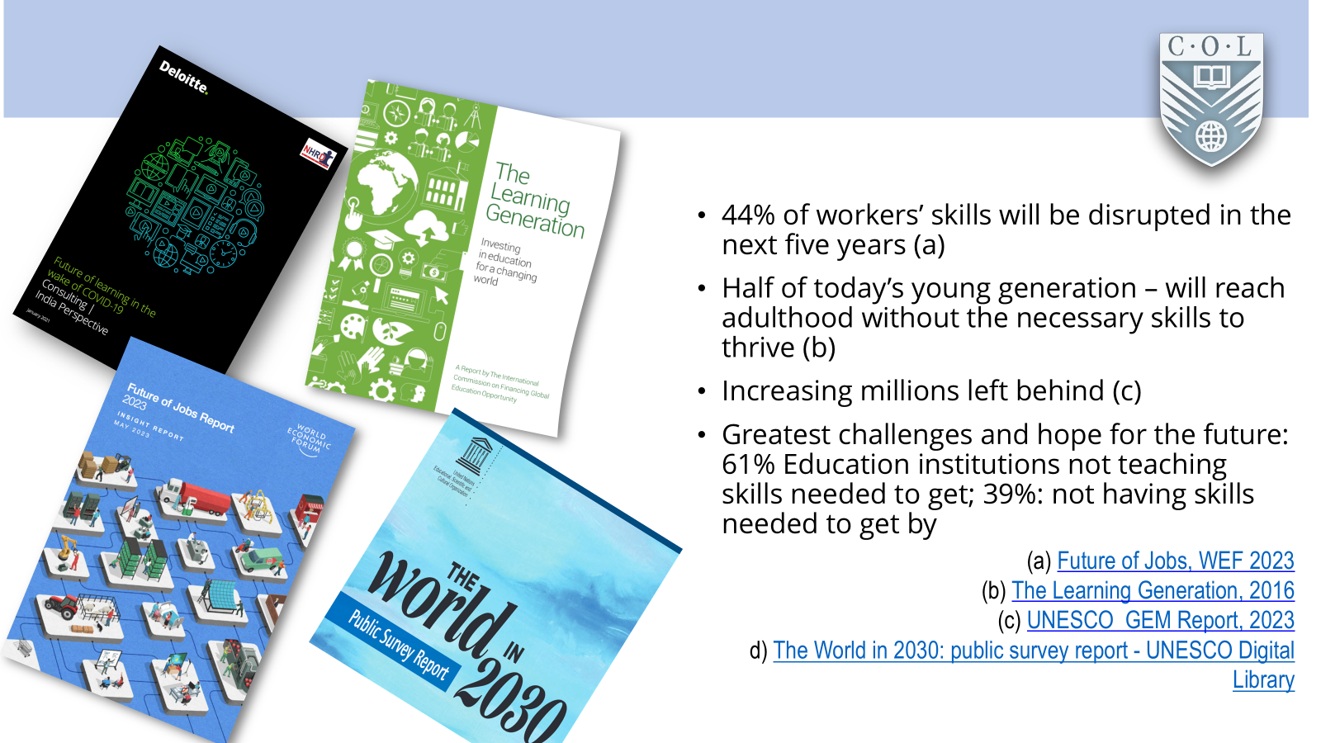
Why Graduate Employability

Slide 8
Why Graduate Employability
Points to note….
Skills - additional qualities that a graduate needs to have in order to gain and maintain employment
Competencies - the skills have to be demonstrable.
Social context - specific needs of different regions
Social change- influenced by emergence of new technologies and cultural advancement

Slide 9
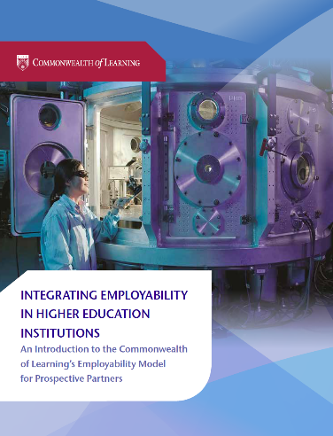
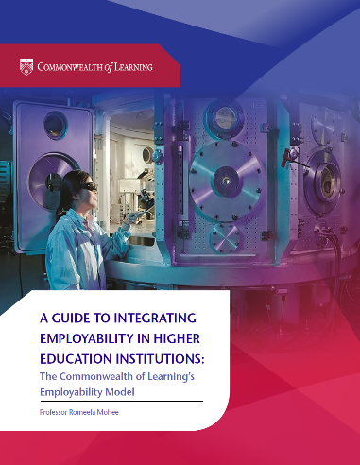

COL’s Model
http://hdl.handle.net/11599/3123
http://hdl.handle.net/11599/3251
http://hdl.handle.net/11599/3599

Slide 10
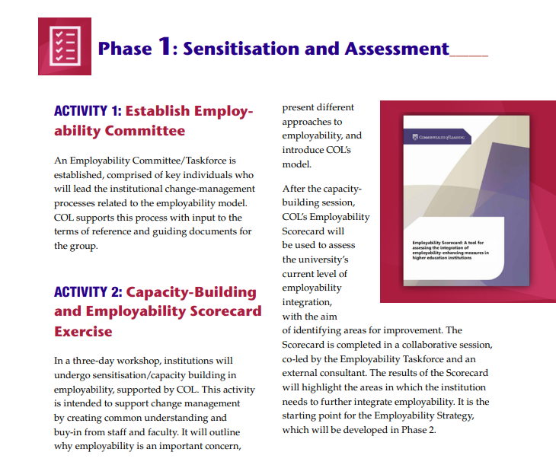
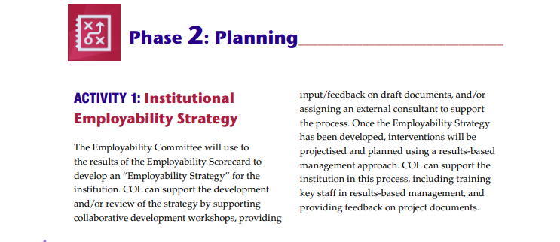
COL’s Model

Slide 11
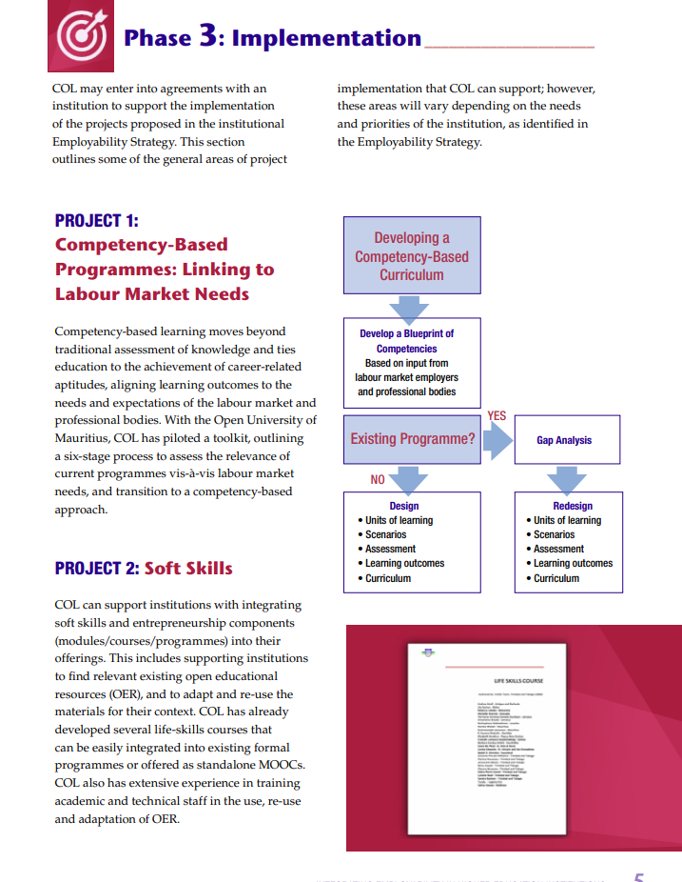
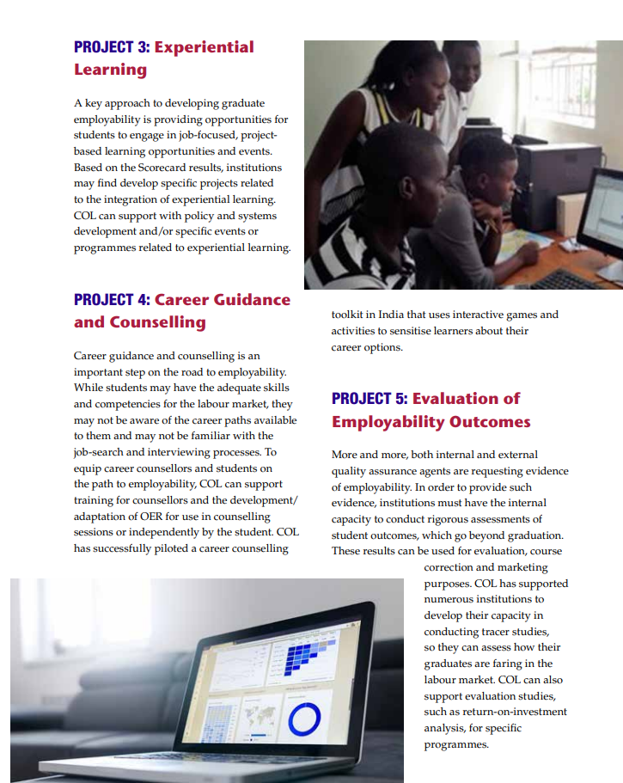
COL’s Model

Slide 12
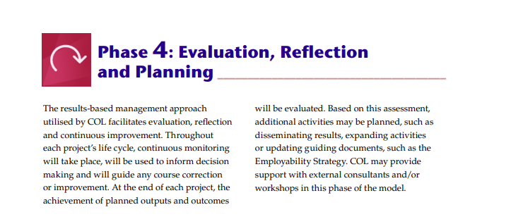
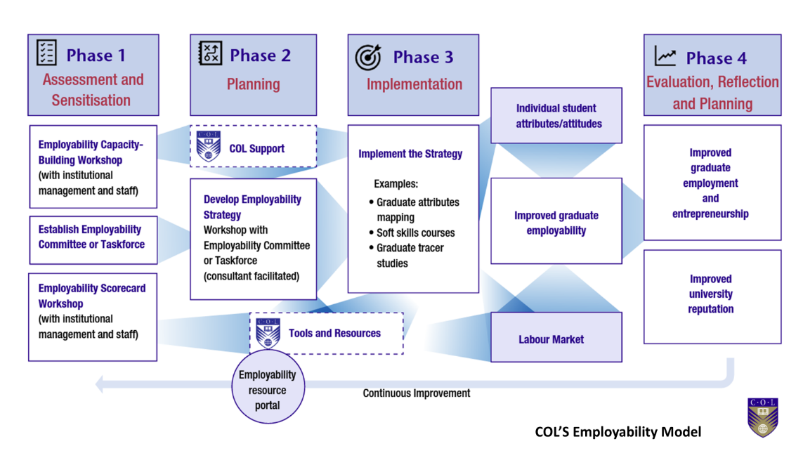
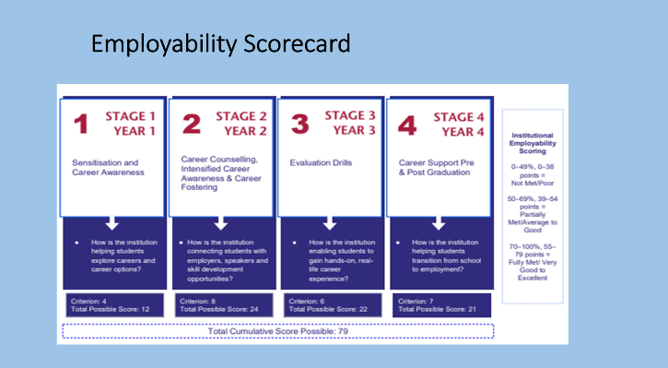
COL’s Model

Slide 13

COL’s Model
Key employability standards for QA
Institutional strategy
Admission
Programme design
Teaching and Learning
Student engagement
Digital learning environment
Assessment
Student support
Work integrated Learning
Internationalization
Research

Slide 14
Project aim
Collaboration and engagement
Status review of graduate employability and emerging skills in India
Evaluate institutional employability readiness
Identify emerging skills in India
Capacity-building for graduate employability
Development of skill-based courses/course enhancement
Strengthening institutional effectiveness for graduate employability
Courses shared as Open Educational Resources
Advocacy and Research
MEAL

Slide 15
Project schedule
Phase | Activities | Expected Outcome | Timeline
Phase 1: Status Review | Activity 1: Status review of employability processes and emerging employability skills in India, including enabling policy frameworks and published works. | Baseline data for informed implementation Enhanced awareness on employability issues and strategies Knowledge product developed and shared | Sept. – Dec. 2024
 | Activity 2: Employability readiness scorecard for pilot institutions | Baseline data for informed implementation (overall/specific) Enhanced awareness of employability status | Nov. – Dec. 2024
Phase 2: Stakeholders’ Consultative Meeting/Employability Framework | Activity 3: Stakeholders’ consultative meeting Activity 4: Capacity building for employability and framework | Stakeholders’ buy in Knowledge enhanced Pilot institutions trained Employability frameworks developed and validated Frameworks approved for implementation | 2025

Slide 16
Project schedule
Phase | Activities | Expected Outcome | Timeline
Phase 3:Framework Implementation | Activity 5: Capacity building Identification of emerging skills Course development/enhancement with employability attributes, using OER Course review Collaboration Advocacy Employability scorecard | Knowledge enhanced Emerging skill-based courses developed Courses enhanced with employability attributes OER awareness Curses review Interface between employers of labour Community sensitised Monitoring/Accountability/Learning | 2025-2026
Phase 4: Course Presentation/Dissemination and Feedback | Activity 6: Sharing of courses as OER Courses offered (where applicable) Advocacy/Dissemination Employability scorecard | OER-based shared and offered Community sensitised Monitoring/Accountability/Learning | 2026-2027
 | Project review/Evaluation | Impact Assessment | 2027

Slide 17
Partner institutions
No | Zone | Partner Institution
A | East India | Krishna Kanta Handiqui State Open University, Guwahati, Assam Nalanda Open University, Nalanda, Bihar Jharkhand State Open University, Ranchi, Jharkhand Odisha State Open University, Bhubaneswar, Odisha Netaji Subhas Open University, Kolkata, West Bengal
B | Central India | 6. M. P. Bhoj Open University, Bhopal, Madhya Pradesh 7. Pandit Sundarlal Sharma Open University, Bilaspur, Chhattisgarh 8. Babasaheb Ambedkar Open University, Ahmedabad, Gujarat 9. Yashwantrao Chavan Maharashtra Open University, Nasik, Maharashtra
C | South India | 10. Sreenarayanaguru Open University, Kollam, Kerala 11. Karnataka State Open University, Mysuru, Karnataka 12. Tamil Nadu Open University, Chennai, Tamil Nadu 13. Dr B. R. Ambedkar Open University, Hyderabad, Telangana
D | North India | 14. Jagat Guru Nanak Dev Punjab State Open University, Patiala, Punjab 15. Vardhman Mahaveer Open University, Kota, Rajasthan 16. Uttarakhand Open University, Haldwani, Uttarakhand 17. U. P. Rajarshi Tandon Open University, Prayagraj, Uttar Pradesh

Slide 18
Next Steps
Share institutional employability scorecard finding to support change-management
Facilitate formal agreement with partner institution
Capacity building for employability and framework, including,
  validation and formal approval (Jan-May 2025)

Slide 19
In conclusion
Impact statement: This project will contribute to strengthening institutional effectiveness for graduate employability in selected partner institutions.
Thank you to the participating institutions, institutional representatives and consultants.
Good luck with the workshop!

Slide 20






