Slide 1
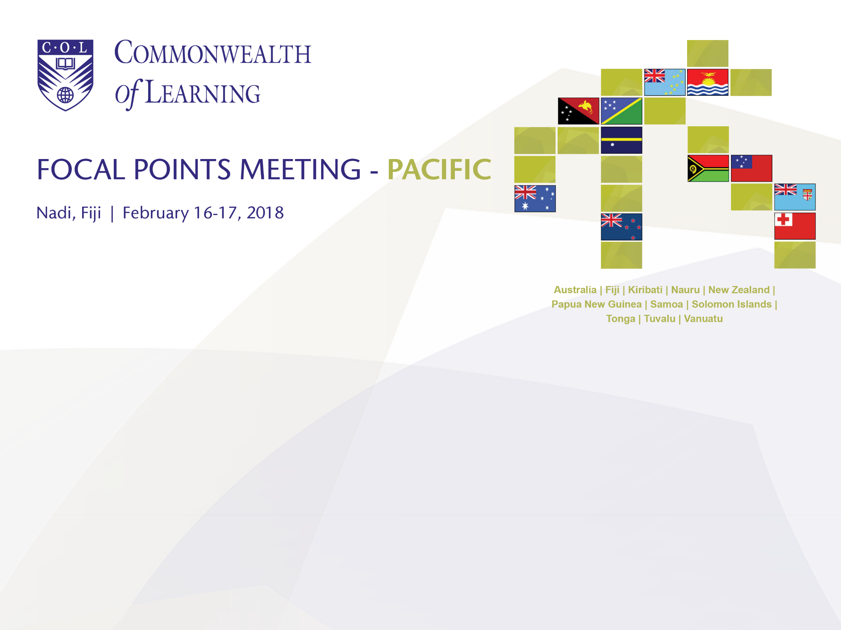
Promoting Learning for Sustainable Development
Professor Asha Kanwar
President & Chief Executive Officer

Slide 2
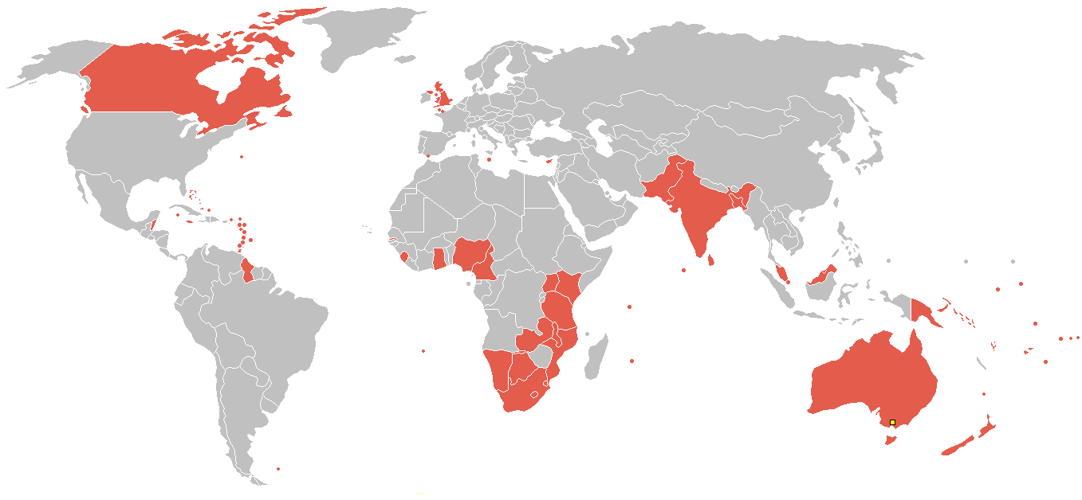
The Commonwealth
52 developed and developing nations around the world
Notes:
Maldives dropped out late 2016.

Slide 3
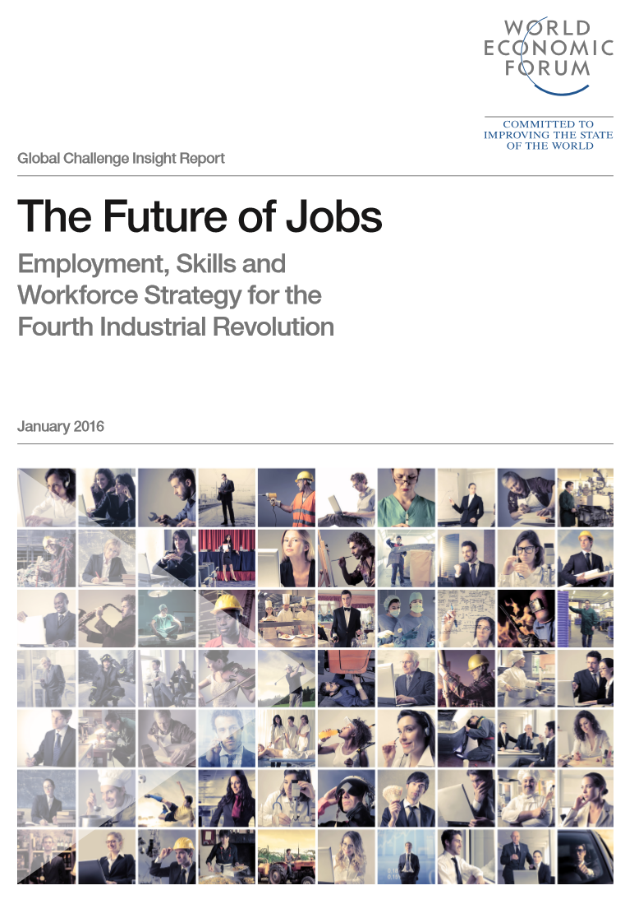

The Commonwealth
population 2.4 billion,
more than 60% under 30
65% of children entering primary school today will work in completely new job types that don’t yet exist.
Source: The Commonwealth Secretariat, Fast facts on the Commonwealth, retrieved on 7 November, 2017

Slide 4
Context
Sources (last accessed on 6 February 2018):
http://thecommonwealth.org/fastfacts
https://data.worldbank.org/indicator/SL.UEM.TOTL.ZS
https://data.worldbank.org/indicator/SP.POP.TOTL.FE.ZS
http://www.itu.int/en/ITU-D/Statistics/Pages/stat/default.aspx

Slide 5
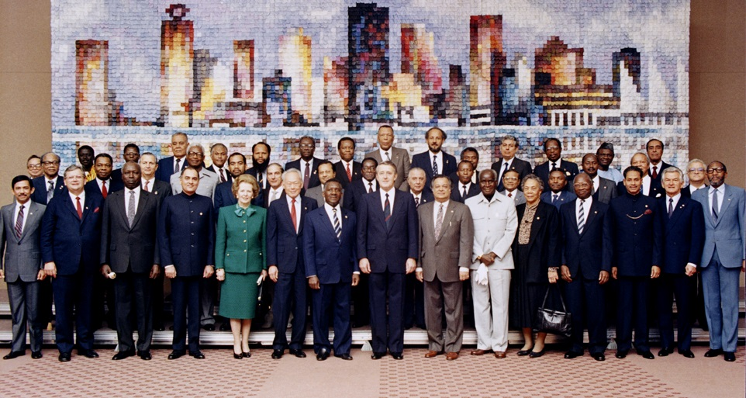
Commonwealth Heads of Government Meeting
Vancouver, 1987
Notes:
We invite you to engage us; tap into our thought leadership, expertise, networks and resources

Slide 6







Who supports COL?
Canada
UK
India
Australia
New Zealand
Nigeria
South Africa
The number of countries contributing
doubled from 23 in 2006 to 46 currently

Slide 7
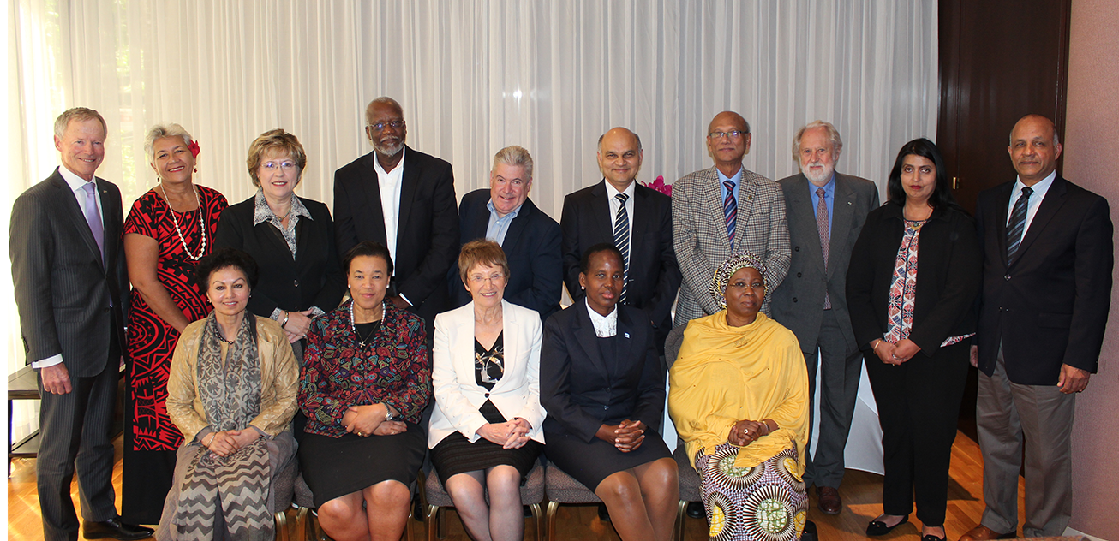
COL Board of Governors
June 2017

Slide 8
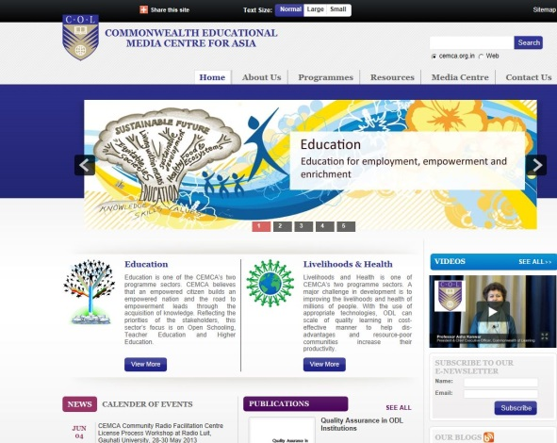
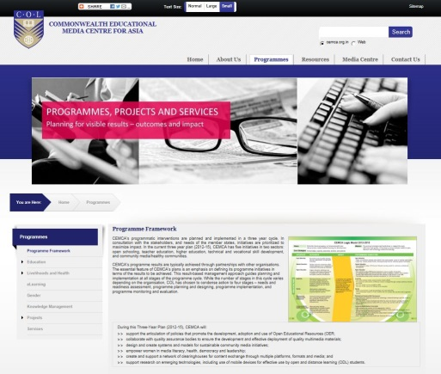
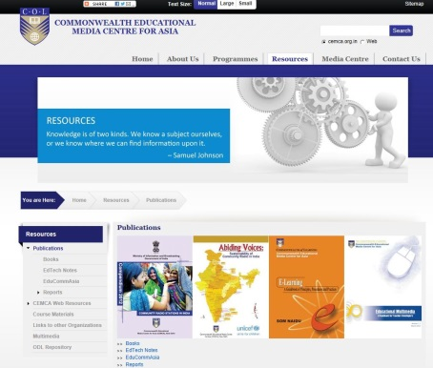







Regional Office
CEMCA
Bangladesh
Brunei Darussalam
India
Malaysia
Pakistan
Singapore
Sri Lanka

Slide 9



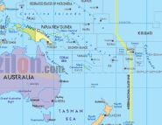
Regional Support
Southern African Development Community Centre for Distance Education (SADC-CDE)
Regional Training and Research Institute for Open and Distance Learning (RETRIDOL)
Commonwealth Centre for Connected Learning (CCCL)
Pacific Regional Centre (PACFOLD)

Slide 10


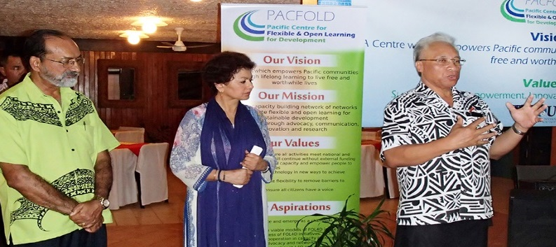
PACFOLD (Pacific)
COL Regional Centre
Notes:
We invite you to engage us; tap into our thought leadership, expertise, networks and resources

Slide 11
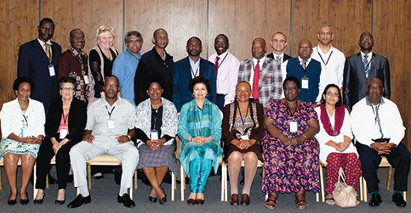
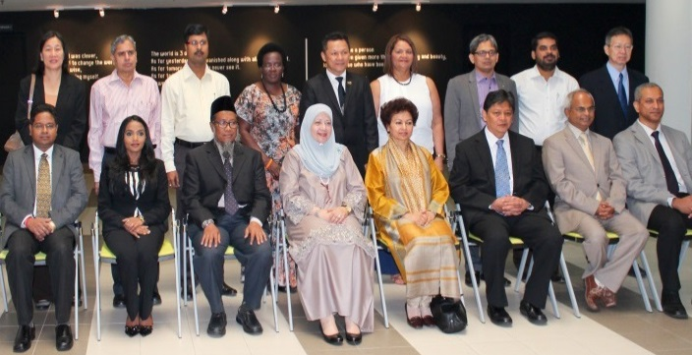
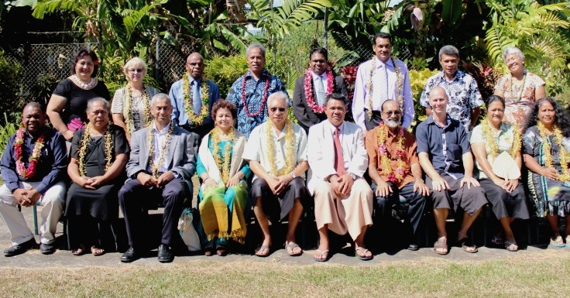
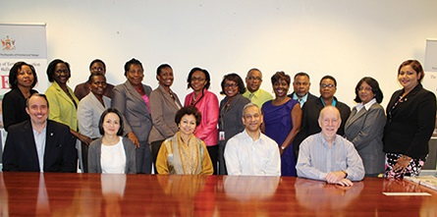
COL Focal Points
Our direct link to each country
Africa & the Mediterranean
Asia
Pacific
Caribbean
Notes:
We invite you to engage us; tap into our thought leadership, expertise, networks and resources

Slide 12
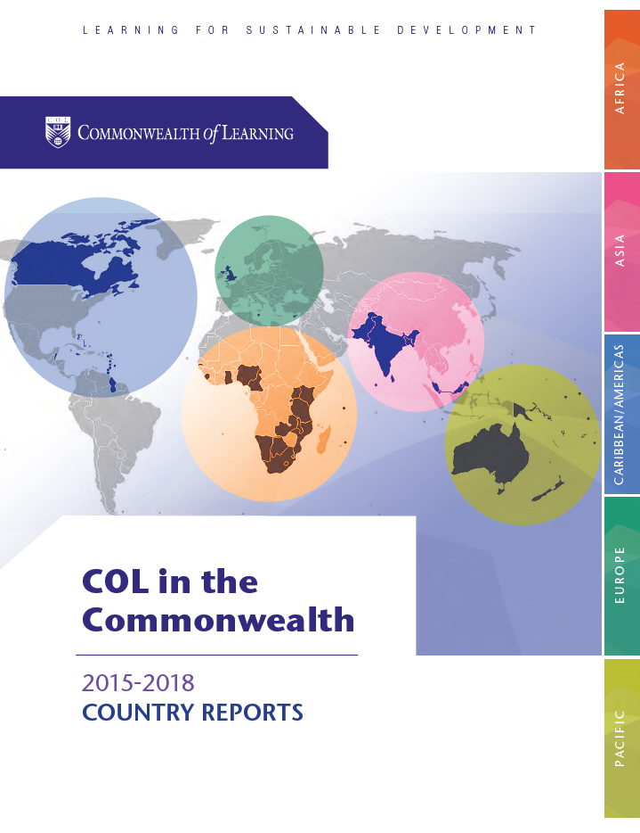

Slide 13

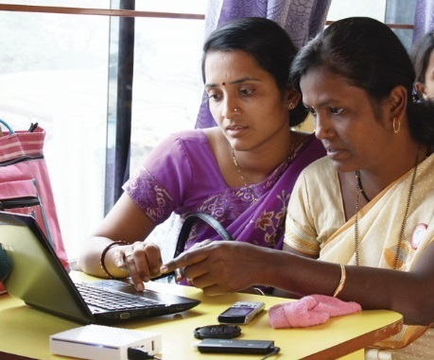
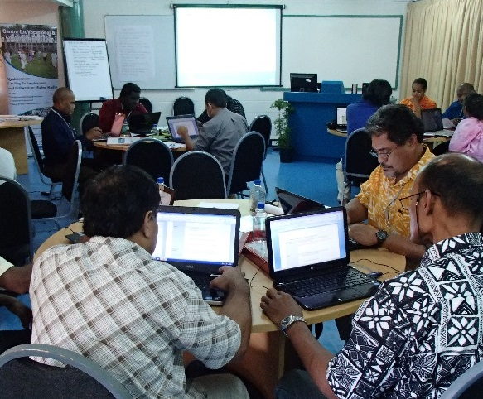
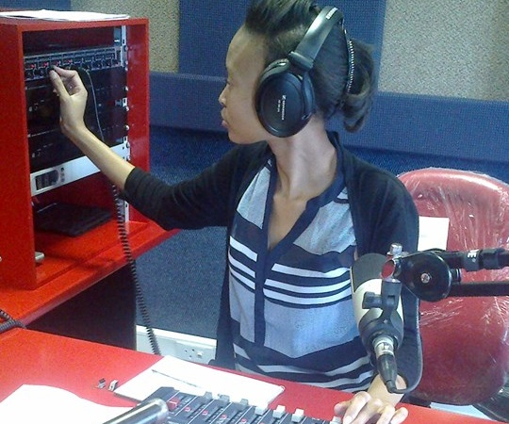
To help Commonwealth governments and institutions use technologies to improve and expand learning for sustainable development

Slide 14
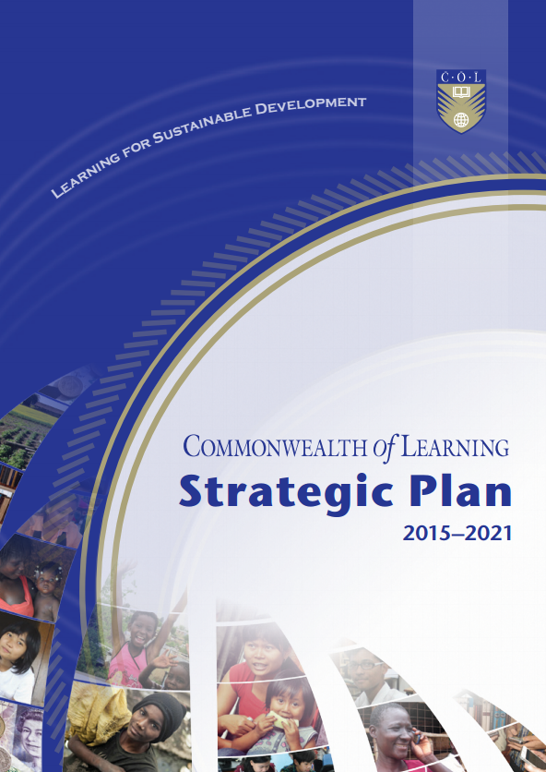

Slide 15
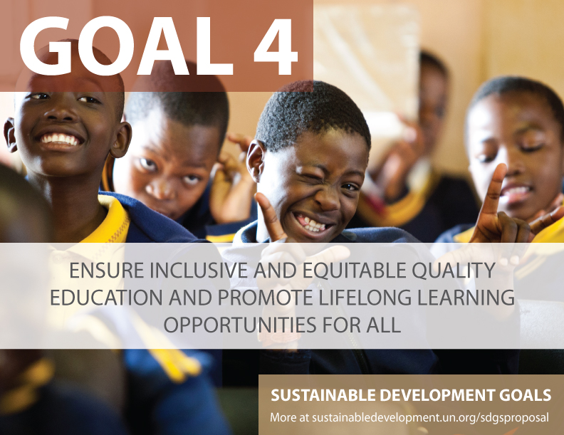

Slide 16

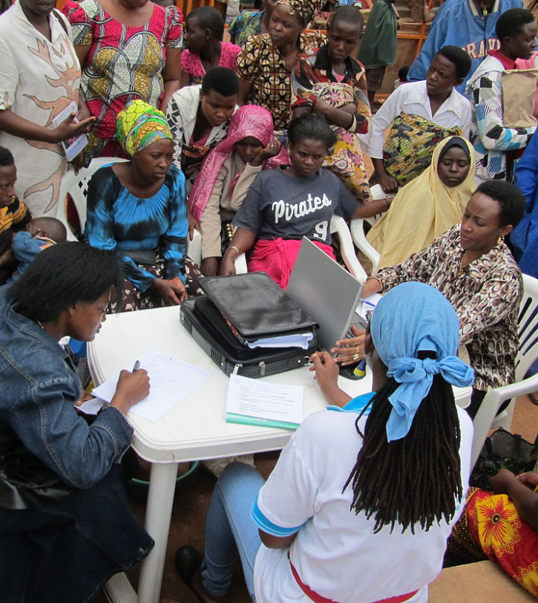
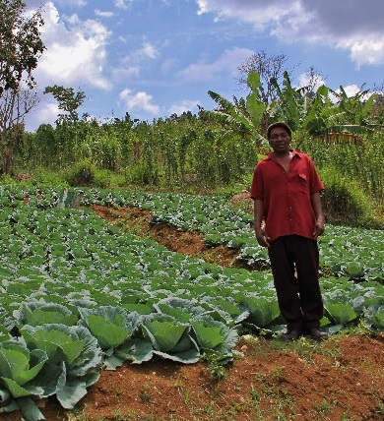



Learning for Sustainable Development
ECONOMIC
GROWTH
SOCIAL
INCLUSION
ENVIRONMENTAL CONSERVATION

Slide 17
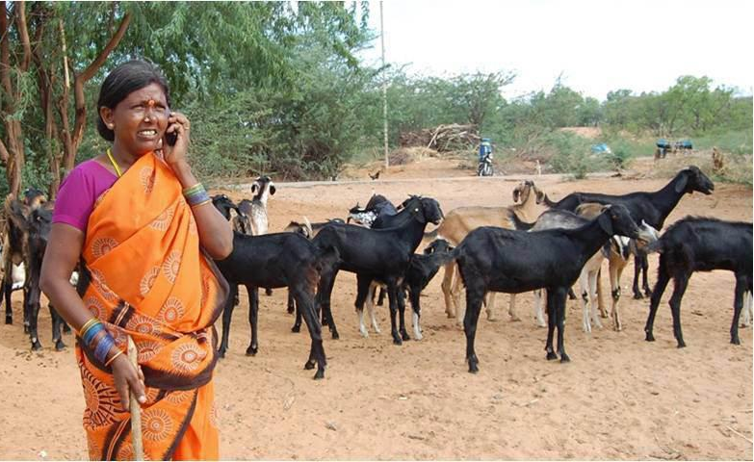
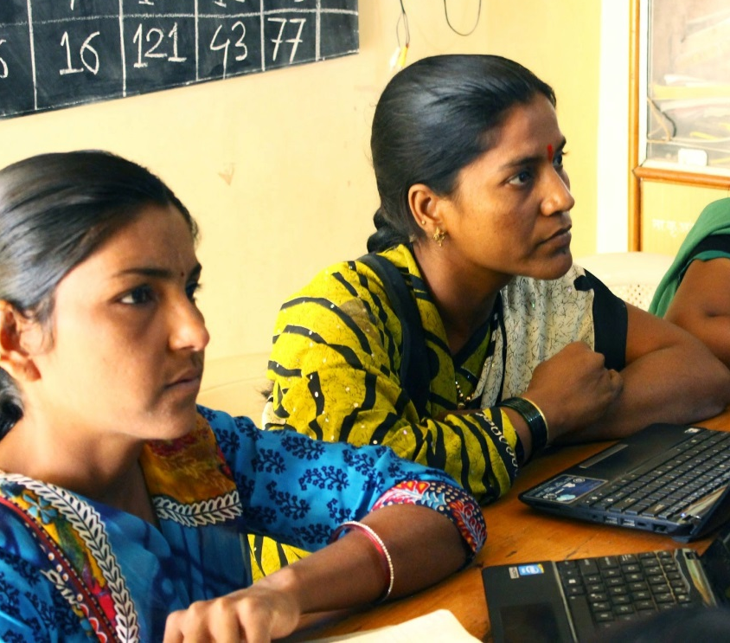
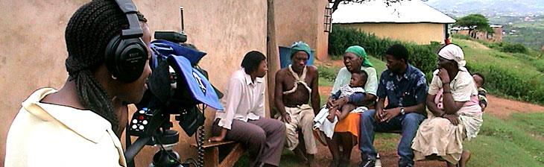

Leveraging
New & Existing Technologies

Slide 18

































Virtual University for Small States of the Commonwealth

Slide 19
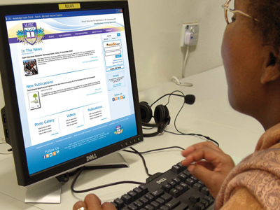
What has the VUSSC Achieved?
Professionals trained in ICT skills
Courses offered
Open Educational Resources (OER) developed
VUSSC Website and online Learning Management System in place

Slide 20




Courses offered: 23 institutions in 14 countries
Antigua State College
Barbados Community College
Belize Teachers’ College
Botswana College of Open and Distance Learning
RADA
National University of Lesotho
Villa College
Open University of Mauritius, Mauritius Institute of Training & Development, Sir Gaetan Duval Hotel School, University of Mauritius and Mauritius Qualifications Authority

Slide 21

Courses offered: 23 institutions in 14 countries
Namibian College of Open Learning
National University of Samoa
University of Seychelles, Seychelles Tourism Academy, Seychelles Institute of Management and Seychelles Institute of Teacher Education
Solomon Islands National University
University of Swaziland
University of The West Indies (Open Campus)
Policy Academy and Caribbean Public Health Agency

Slide 22

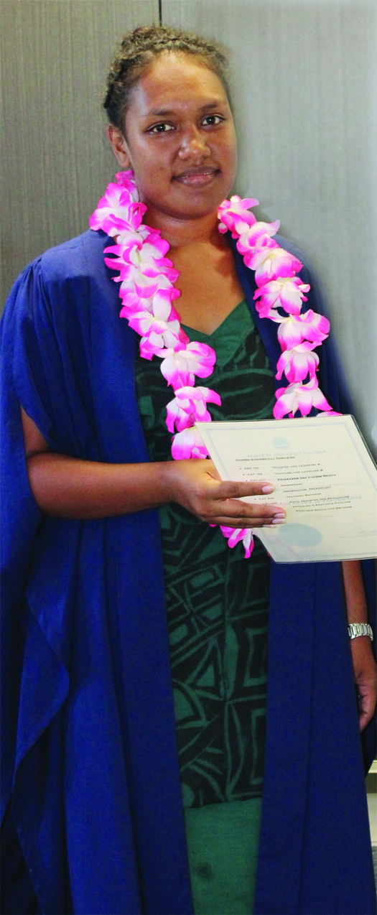
Graduation
First cohort graduate after following a full-time Diploma in Sustainable Agriculture for Small States, Samoa and are in full time employment

Slide 23
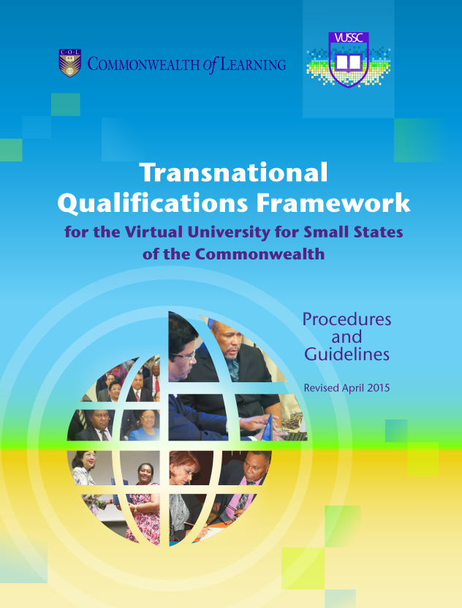
For QA and mobility

Slide 24

Commonwealth Executive MBA/MPA
National Open University of Nigeria
Kwame Nkrumah University of Science and Technology
University of the Commonwealth Caribbean
University of Guyana
University College of the Cayman Islands
Allama Iqbal Open University
Bangladesh Open University
Open University of Sri Lanka
Open University of Mauritius
Wawasan Open University
Botswana College of Distance and Open Learning
11
Partner
Institutions

Slide 25
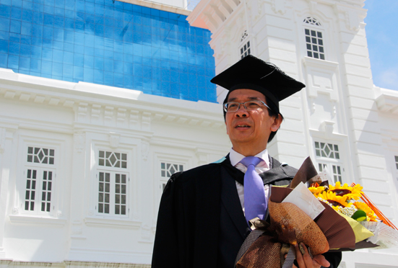


Raymond Loh: CEMBA Graduate - “…offering moving and relocation services to clients in over 40 countries.”

Slide 26
Lifelong Learning for Farmers
11
COUNTRIES
AFRICA
Kenya
Uganda
Tanzania
Ghana
Seychelles
Mauritius
Tonga
ASIA
India
Sri Lanka
CARIBBEAN
Antigua and Barbuda
Jamaica

Slide 27
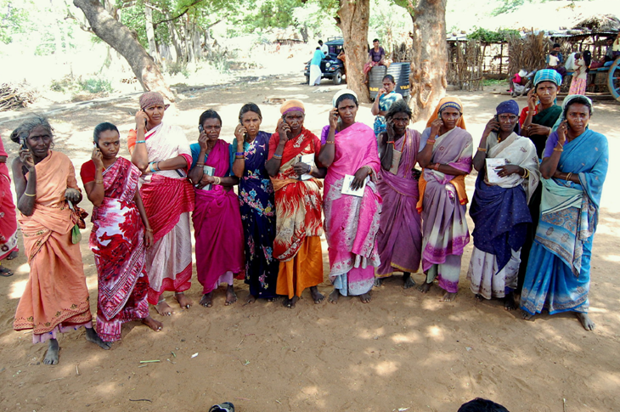

  INCREASING FOOD SECURITY - Every $1 invested in learning, facilitation and networking resulted in $9 worth of income and assets.

Slide 28
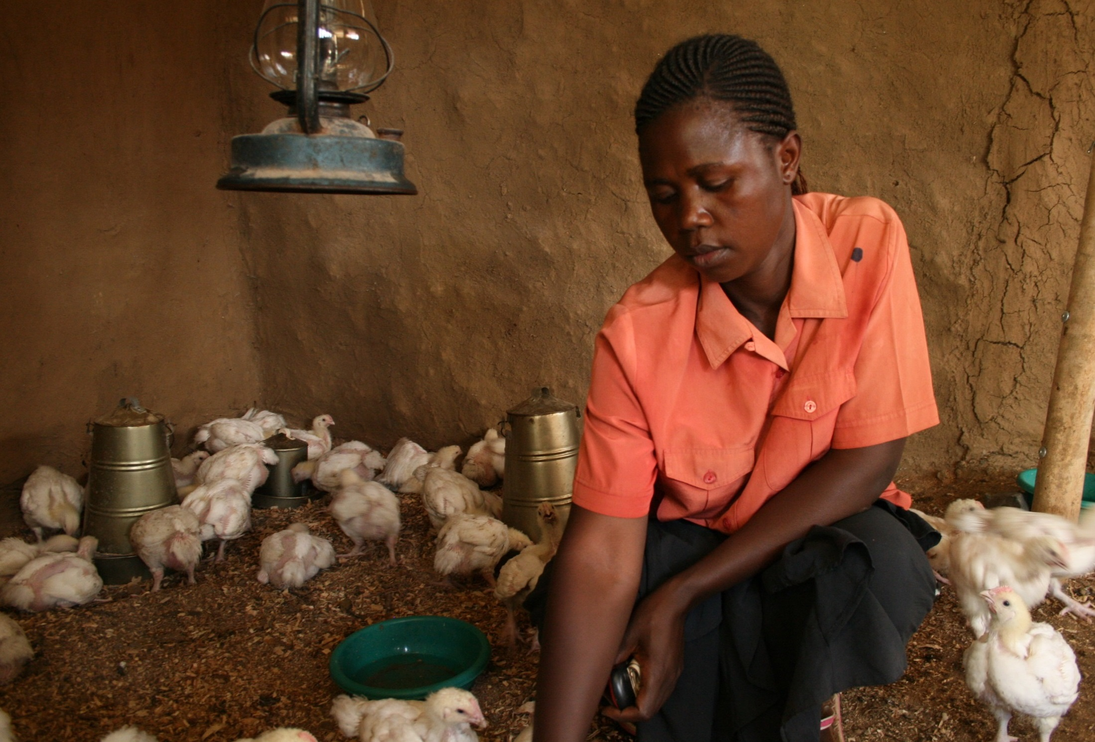


ECONOMIC GROWTH
1% increase in empowerment 2.3% increase in profit
Notes:
KENYA
This L3F project runs in 11 Commonwealth countries. Studies have found that learning leads to empowerment and that for 1% increase in women’s empowerment in Kenya, there was a 2.3% profit in agri-enterprises

Slide 29
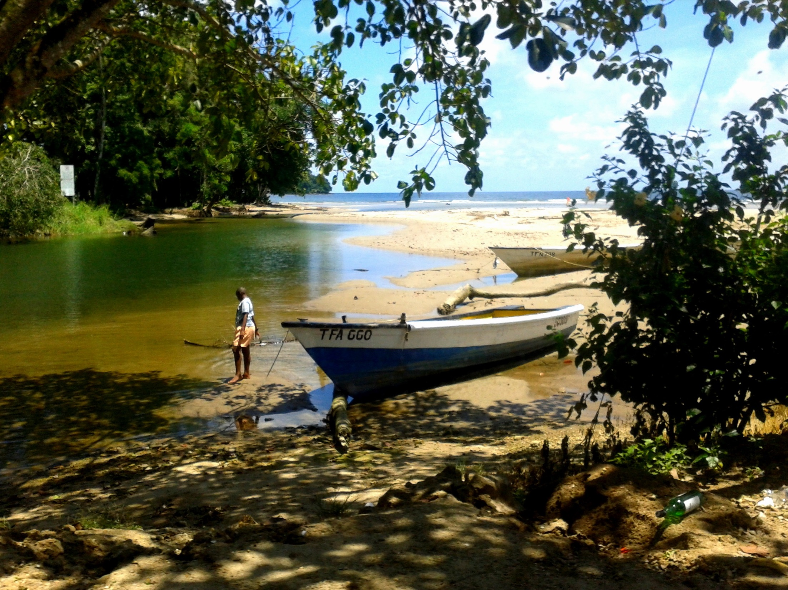

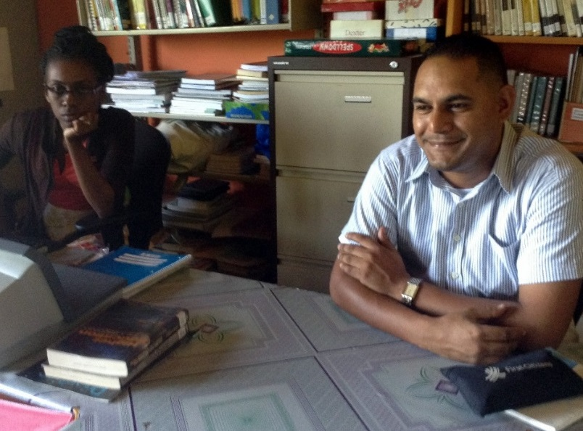
SOCIAL INCLUSION
Out-of-school youth in a remote fishing village graduate
Notes:
The first cohort of out of school youth in a remote fishing village in Trinidad & Tobago graduated through a COL-supported open school. The entire curriculum was structured around fisheries which was both interesting and relevant to the needs of the youth.
Photo: Staff Matelot

Slide 30

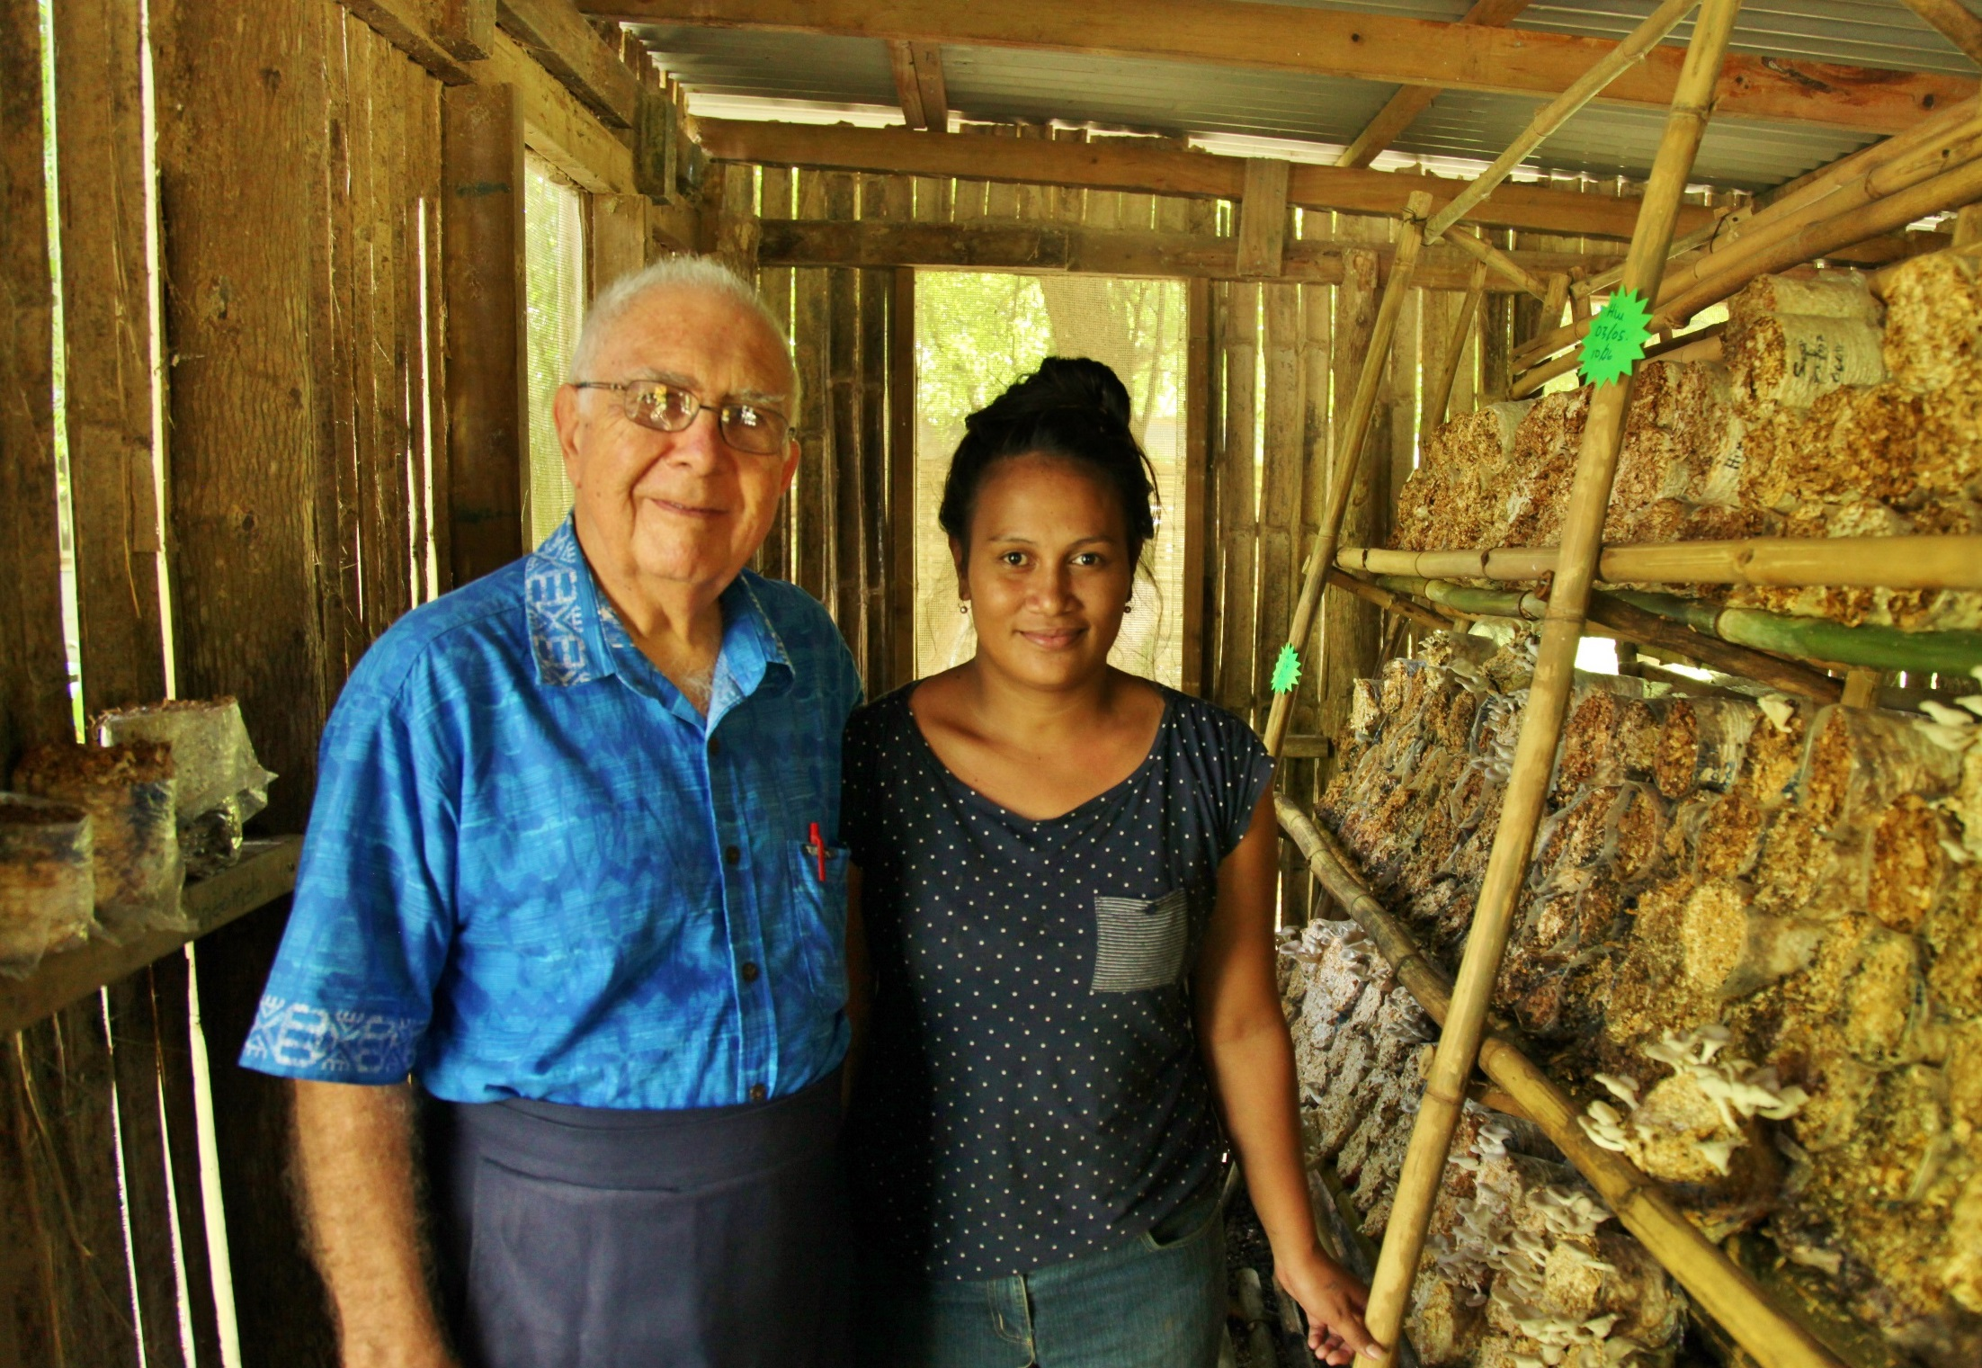
SOCIAL INCLUSION
Learners experienced increased knowledge in various skills, increased income and food security
Notes:
COL worked with a partner in a rural community in Samoa to train people in various skills and a study shows that this has enhanced their knowledge and skills leading to increased income and food security.

Slide 31
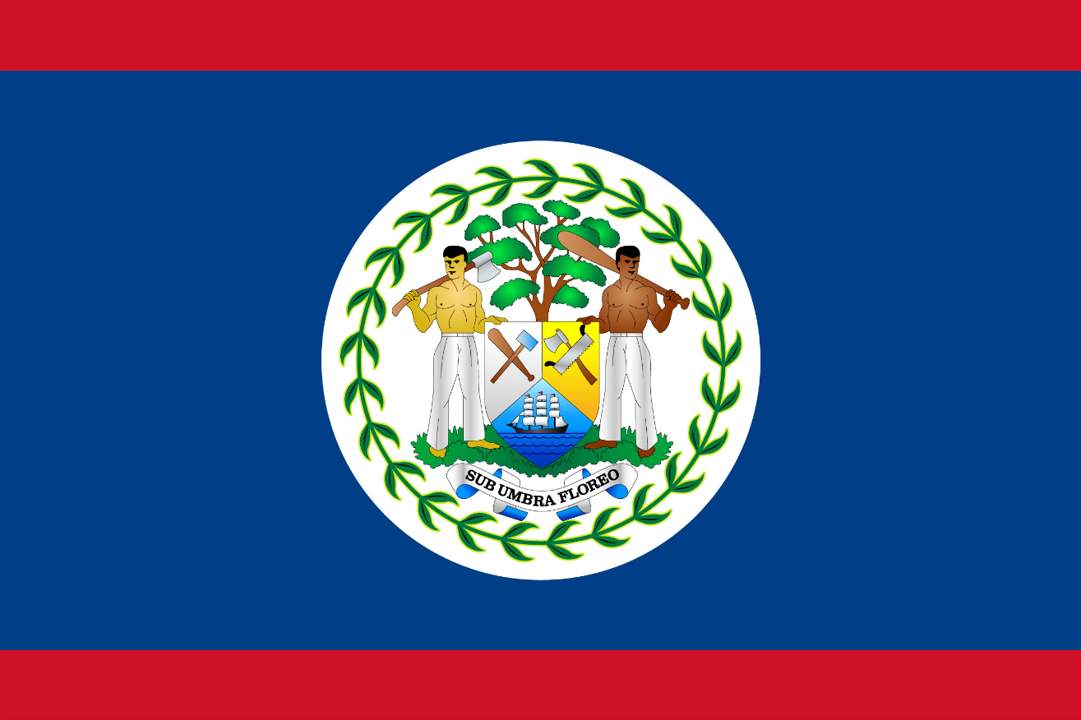
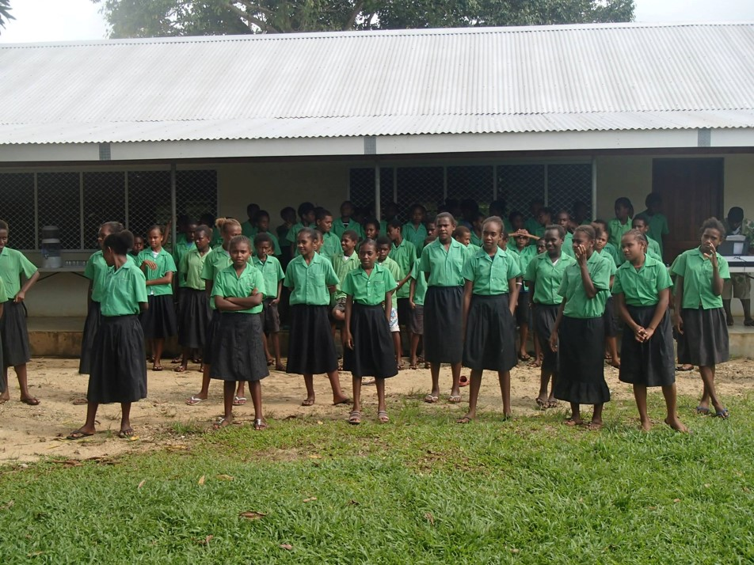
SOCIAL INCLUSION
Social Return on Investment of an Open School showed that every US$ invested resulted in US$8 worth of benefits to students.
Notes:
Belize
Benefits: skills, expected income

Slide 32




ENVIRONMENTAL CONSERVATION
ODL students have 1/3 carbon footprint compared to campus-based students
Notes:
A recent study conducted in Botswana showed that the carbon footprint of a distance learning student was only one tenth of that of a campus-based student, without a negative impact on learning outcomes.

Slide 33

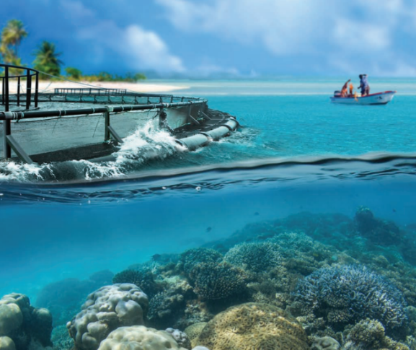

Blue Economy
Research Institute
ENVIRONMENTAL CONSERVATION
Understanding the Blue Economy:
Massive Open Online Course (MOOC)

Slide 34

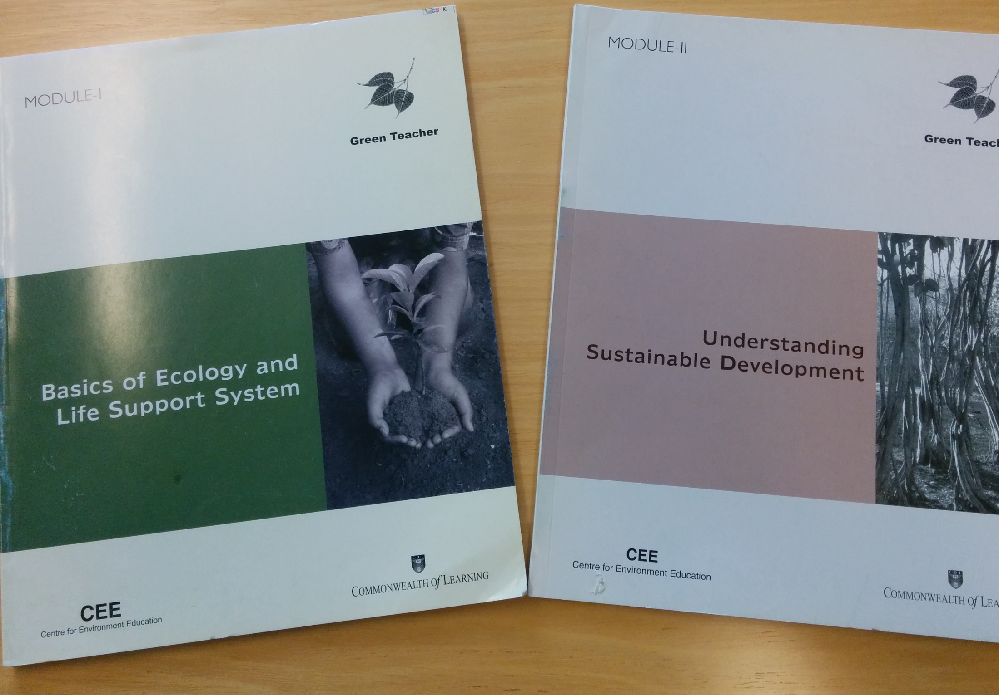

ENVIRONMENTAL CONSERVATION
Green Teacher
Notes:
COL is working with the National Teachers Institute, Nigeria, which has an annual enrolment of 50,000 trainee teachers, to develop a Green Teacher course which will help teachers to integrate environmental concerns into the classroom from a very early age.

Slide 35
COL Highlights
2015-2017
Notes:
Let me finally share three highlights of this year.

Slide 36
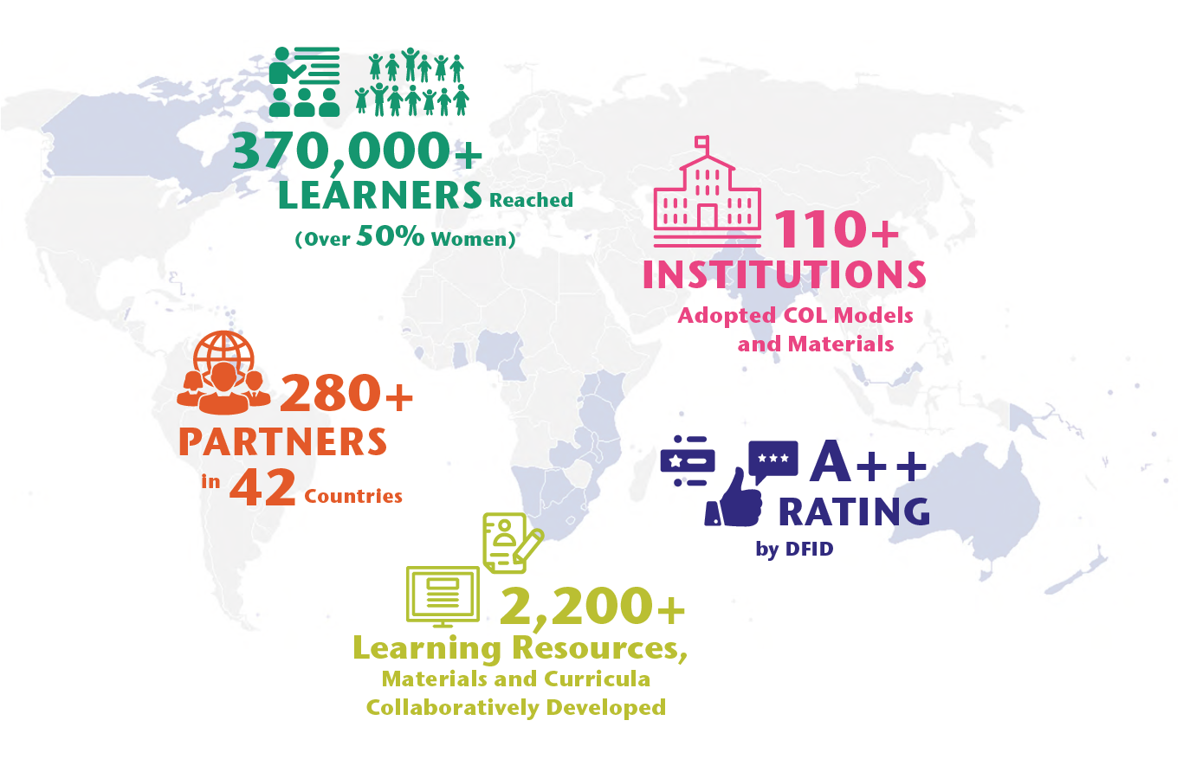
Results Achieved
Notes:
Results Achieved in 2016-17
Reached 372,600 learners, more than 50% women
Worked with 280 partners in 42 countries
102 institutions have adopted COL models and materials
Supported the development of 635 curricula and learning resources
DFID A++

Slide 37



Open Online and Flexible Learning:
the key to sustainable development
Notes:
COL organized its triennial Pan Commonwealth Forum in partnership with the Open University of Malaysia, which attracted over 500 participants from 60 countries, including ministers of education. This resulted in the 2016 KL Declaration which provides a roadmap forCommonwealth Member States to implement the SDG 4 on education.

Slide 38

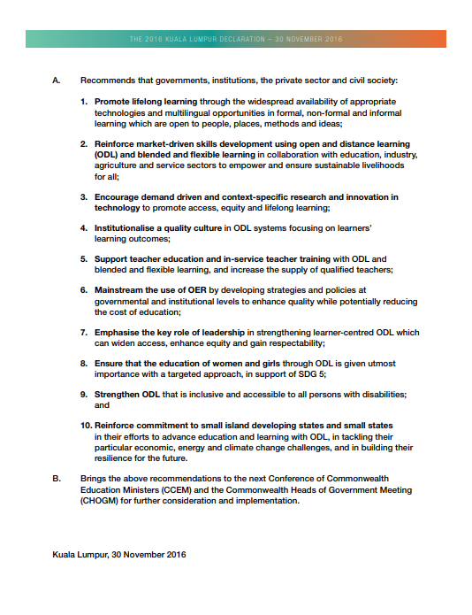
KL Declaration

Slide 39









Notes:
Thanks to grants from the governments of Australia and Canada, COL will train 45000 girls and women in five countries: Bangladesh, India Pakistan, Mozambique and Tanzania. You’ll be pleased to note that in the first eighteen months alone, over 29,000 girls have been trained in various skills and 5, 260 girls have found new sources of income generation.

Slide 40
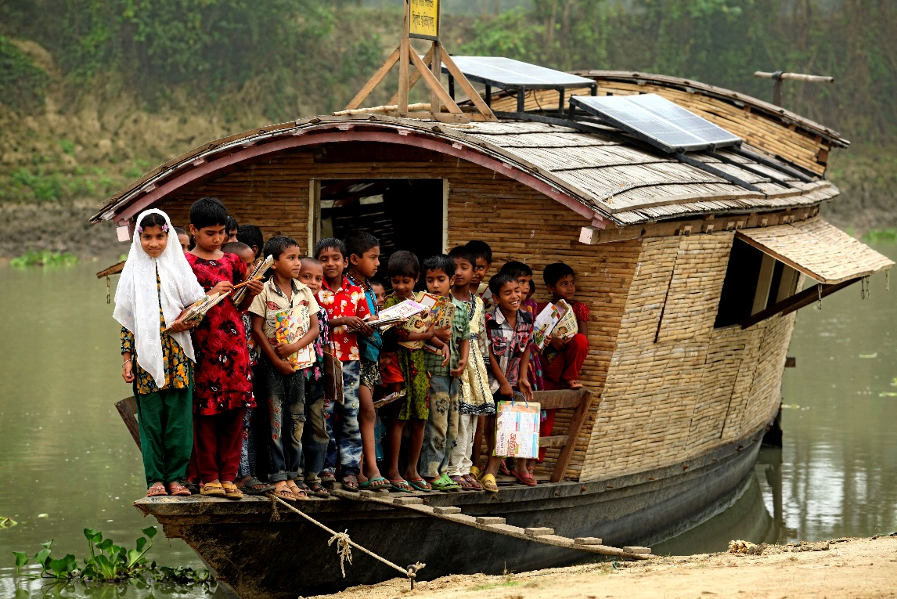

Schooling and Skilling
45,000 girls in 5 countries
Photo credit: Abir Abdullah / Shidhulai Swanirvar Sangstha. Bangladesh

Slide 41
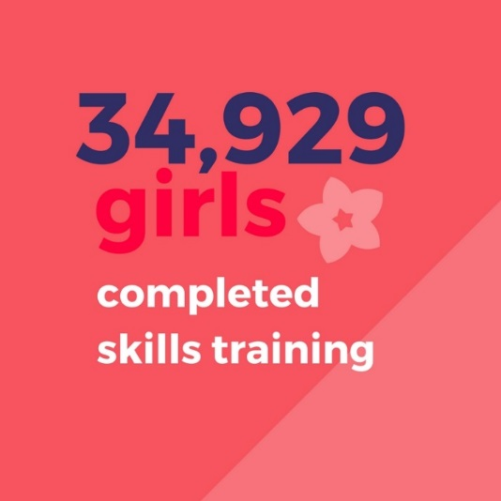
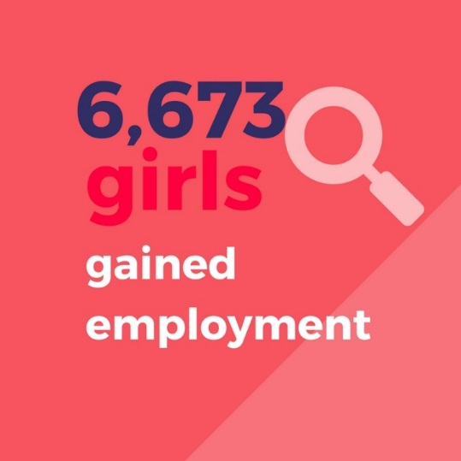
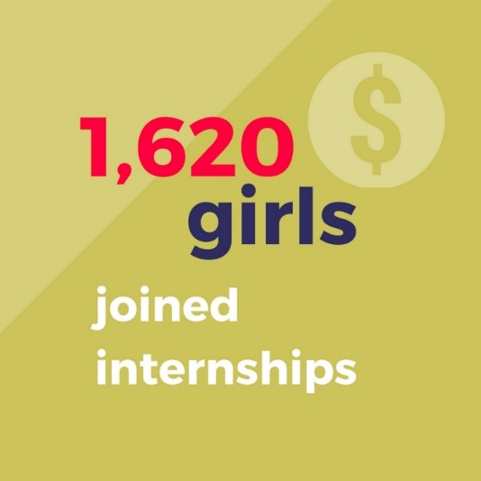
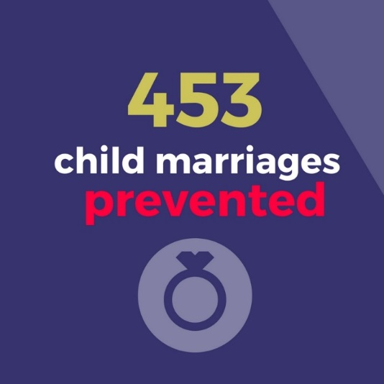

Slide 42
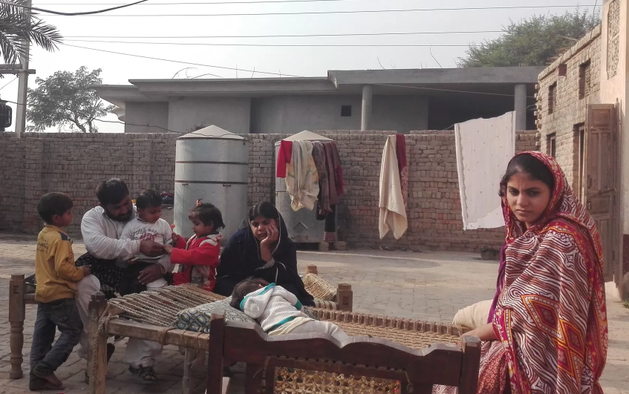

Faaria, on the right, is a 14-year old from Muzaffargarh in Pakistan, who was saved from child marriage through community advocacy.

Slide 43
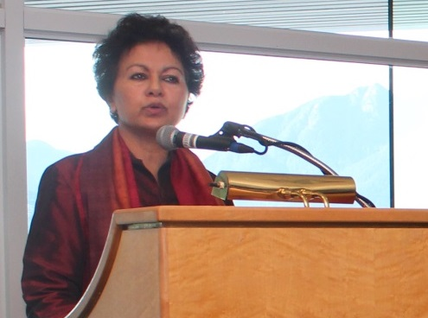
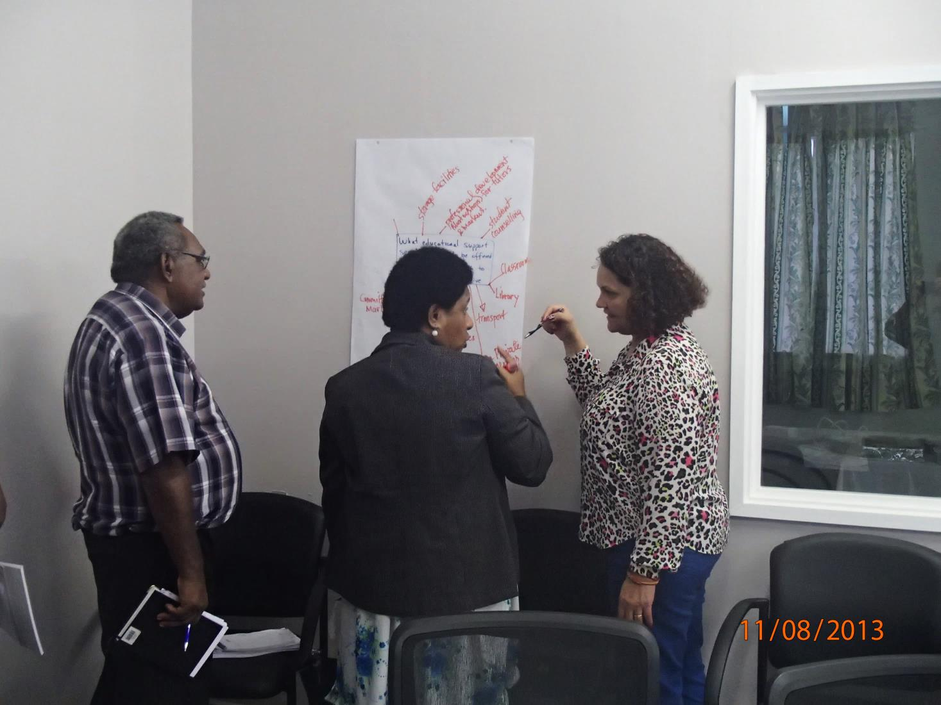
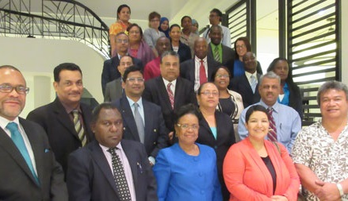
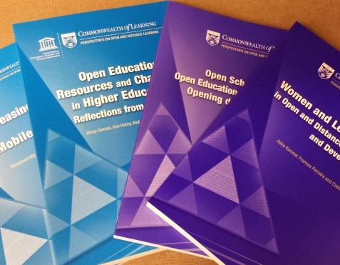




COL Offers…
World Class Expertise
Innovative Models
Capacity Building
Resources
Notes:
We invite you to engage us; tap into our thought leadership, expertise, networks and resources

Slide 44


What COL asks of you
Dialogue about your priorities
Identification of common regional issues
Your involvement

Slide 45




Thank You
for your contributions
col.org

