Slide 1







Making mobile learning highly viable in contexts with no connectivity or grid power
A Recent Implementation
Dr. Balaji Venkataraman, Commonwealth of Learning, Canada
Dr. Mohamed Ally, Athabasca University, Canada
Vanita Shinde, Mann Deshi Foundation, India
Mose Mose, National University of Samoa, Samoa
UNESCO MLW2017
March 22, 2017

Slide 2
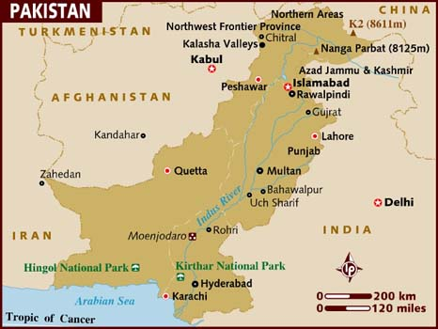

Slide 3
Project Funding and Support
Reach Out To Asia (ROTA) – Education Above All (EAA), Qatar Foundation
Commonwealth of Learning (COL)

Slide 4
Purpose of Project
To conduct research on the effectiveness of mobile learning to improve access to education and enhance the quality of teaching and learning for the purpose of recommending a sustainable and scalable model to improve access and quality of education in a dangerous area.

Slide 5
The Research Component
The following research questions were investigated:
How effective is mobile learning as a delivery
method for learning and student support as
measured by students’ performance?
How effective is mobile learning as a learning and support method as measured by students’ feedback?
How effective is mobile learning as a teaching and delivery method as measured by teachers’ feedback?
What is an effective pedagogical model for mobile learning to educate students located in dangerous and remote locations?

Slide 6
Implementation
This project ran for 6 weeks.
The project used a blended learning approach consisting of face-to-face instruction and mobile learning where students used the tablets to access learning materials from the Aptus system to learn independently.

Slide 7
Implementation
Teachers were trained on how to design
the courses and how to use the Aptus system
and the tablets
Teachers selected the course(s) they want
to use for the pilot
Teachers organized the course(s) into units (chapters) and modules
Teachers identified existing educational resources or used their own resources
The learning materials were loaded on the Aptus

Slide 8
Results
The first implementation gave very promising results. The project was implemented in Grades 8, 9 & 10. A total of 90 students participated in the project.
Grade 10 had 1-1 tablets (each student had a tablet
Grades 8 and 9 – two students shared 1 tablet

Slide 9
Result Highlights
Improved students’ technology skills: 79% of the students did not use a tablet or computer before this project. The students learned how to use the tablets in a matter of days and were then using them to access learning materials
In the 1-1 class, 100% of the students reported that they enjoyed learning on their own (independently)
The parents perception of mobiles and computers as tools of entertainment has changed after witnessing their children using technology for learning
Students who have eyesight problems were able to read better using the tablets than the blackboard

Slide 10
Use of Aptus for
Education in Emergencies and Crisis
Students do not need internet connectivity
Device is affordable and portable – can be located in refugee camps, disaster areas, remote areas, and used by people with nomadic lifestyles
Teachers control what students access
Students can access learning materials from the Aptus using any mobile device with wireless capability

Slide 11
