Slide 1


Quality Assurance in a
Digital Age
Professor Asha Kanwar
President & CEO
2nd Virtual Conference: Trends & Directions in Accreditation in Pre- and Post- Covid Stretch, hosted by the Accrediting Agency of Chartered Colleges and Universities in the Philippines
9-11 March 2022 (Virtual)

Slide 2

The Commonwealth
54 developed and developing nations around the world

Slide 3
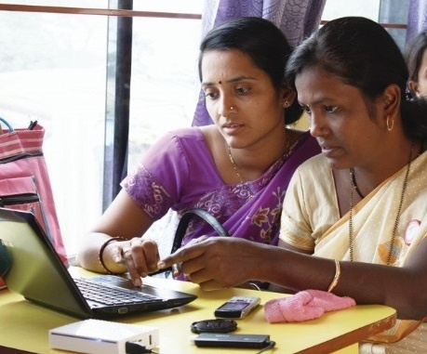
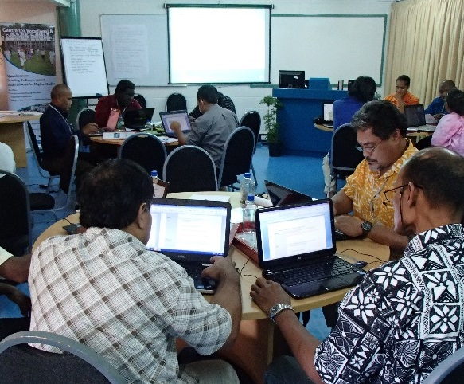
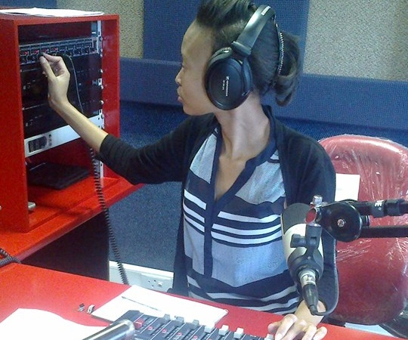
To help Commonwealth governments and institutions use technologies to improve and expand access to education and training

Slide 4

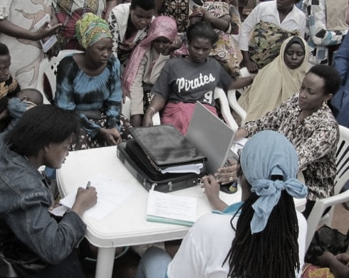
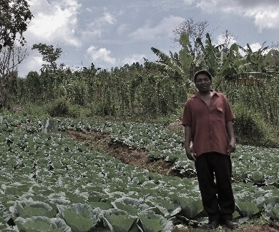

ECONOMIC GROWTH
SOCIAL
INCLUSION
ENVIRONMENTAL CONSERVATION
$
Notes:
COL continues to promote ‘learning for sustainable development’. Learning must lead to economic growth, social inclusion and environmental conservation.

Slide 5

Plan
Key Issues of our times
Emerging Landscape
Implications for Quality
Towards Quality

Slide 6
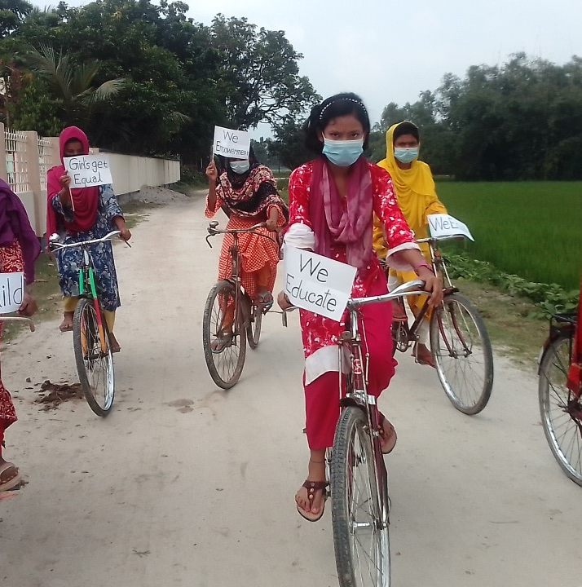

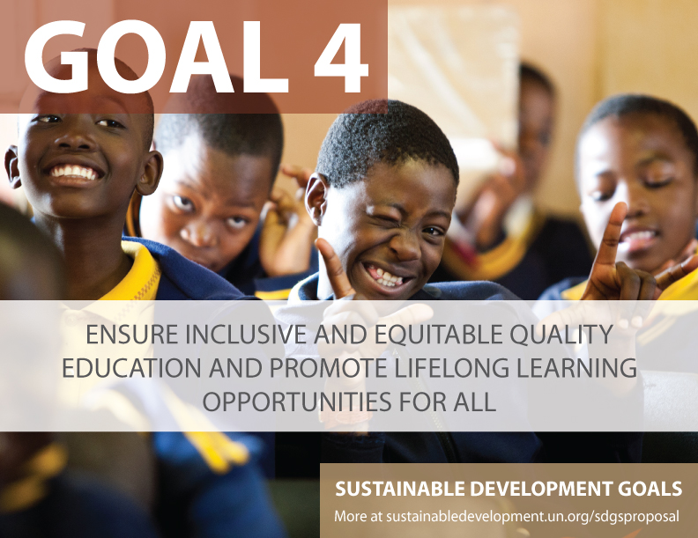
Key Issues of Our Times

Slide 8

4.3: ensure equal access to affordable and quality tertiary education
4.7:ensure that all learners acquire the knowledge and skills needed to promote sustainable development
Notes:
Mean year of schooling for persons with disabilities in select 49 countries in the UNESCO report is 4.8, whereas in general is 7 years. For female PWD, the mean years of schooling reduces to 4.3. ( see UIS, 2018: http://uis.unesco.org/sites/default/files/documents/ip49-education-disability-2018-en.pdf
People with disabilities are often disadvantaged in terms of access to tertiary education. Of the 18 countries for which data is available, 15 report disability prevalence under 3 per cent and half report rates under 2 per cent.
No info on students with disabilities in tertiary education.
United states
Source: https://nces.ed.gov/fastfacts/display.asp?id=60
11.1% (students with disabilities enrolled in post-secondary institutions) in 2011-2012
Canada
Source: http://publications.gc.ca/collections/collection_2009/rhdcc-hrsdc/HS61-1-2009E.pdf
10.7%
Australia:
Source: https://www.cdu.edu.au/sites/default/files/the-northern-institute/10.18793-lcj215.17.02.pdf
5.5%
India
https://timesofindia.indiatimes.com/home/education/news/Disabled-get-only-0-56-of-seats-in-higher-education/articleshow/46810639.cms
0.56%
South Africa
https://www.dailymaverick.co.za/article/2017-08-15-students-with-disabilities-disadvantaged-at-higher-education-level/#.WhSt_lWnGUk
http://www.statssa.gov.za/publications/Report-03-01-59/Report-03-01-592011.pdf
According to Stats SA, 80% of disabled people aged 20-24 are not attending tertiary education. Put another way, around 7,5% of South Africans have a disability. Yet the number of disabled students at tertiary institutions is far from representative: just 1%.

Slide 9
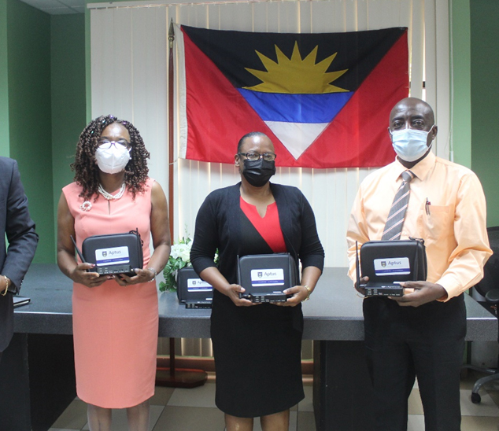

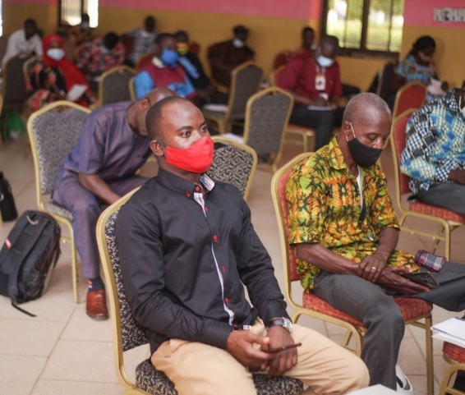
Covid-19 and Education
Technology
Teacher Capacities
Inequalities

Slide 10

Impact of COVID-19: Institutions
Transition to emergency remote teaching
Drop in international students
(20% in Germany; 16% in US—applications for student visas in Australia dropped by 80-90%)
Lack of technology infrastructure
Adverse impact on research—practical and collaborative
Drop in revenues from fees/budget cuts
Source: European Union (2021). The impact of COVID-19 on higher education: a review of emerging evidence.

Slide 11
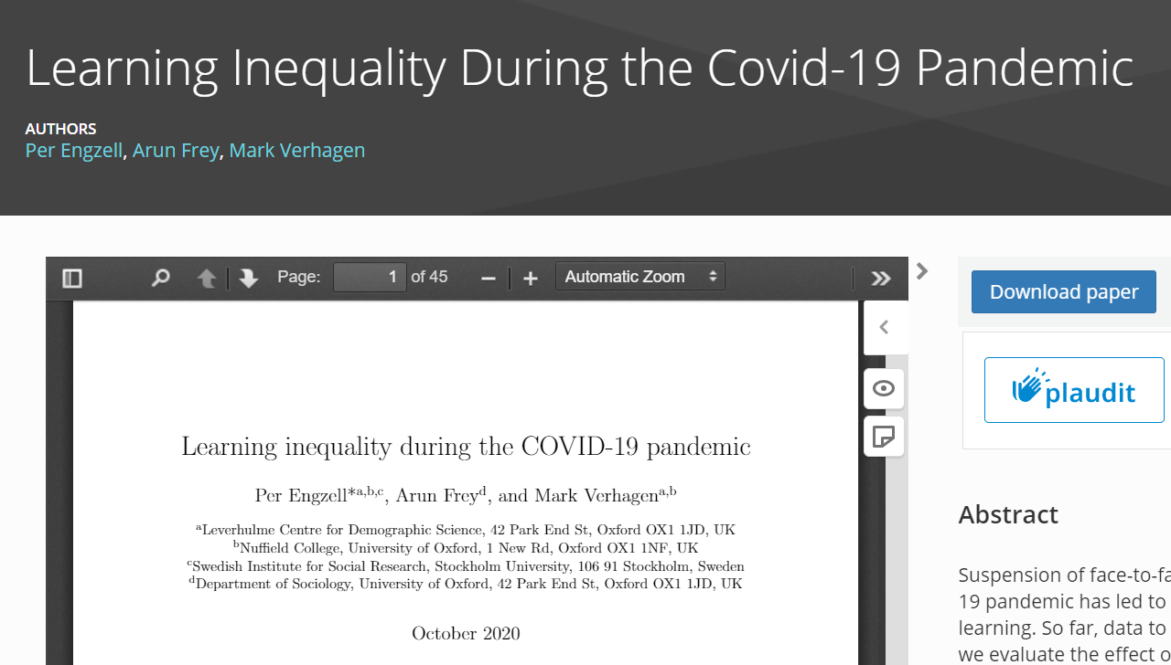
Learning Inequality during COVID19
Learning loss of about three percentile points
Learners from less educated home 55% more prone to learning loss
Source: https://osf.io/preprints/socarxiv/ve4z7/
Notes:
In Netherlands, during the COVID19 pandemic, learning loss of about 3 percentile points or 0.08 standard deviations was recorded in a study. Losses are up to 55% larger among students from less-educated homes.

Slide 12
Emerging Landscape

Slide 13

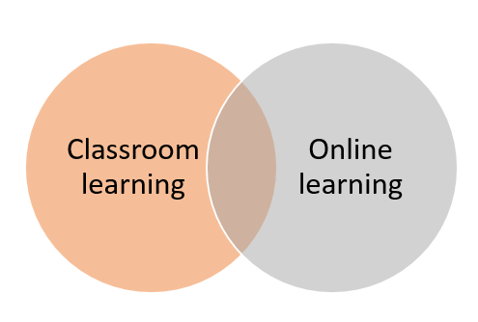

Hybrid learning
Blended learning
E-learning

Slide 14
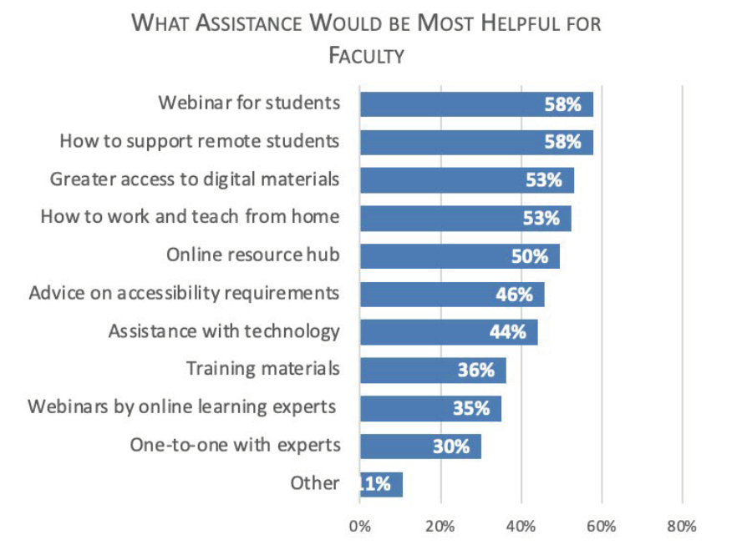
Teachers needed more assistance during pandemic
Source: Johnson, et al. (2021). Teaching during pandemic. Bayview Analytics

Slide 15
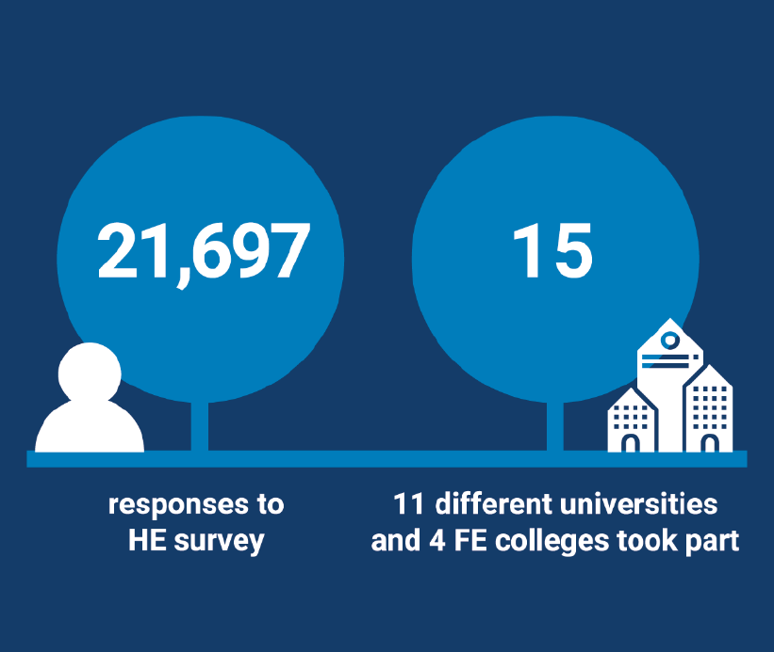
Positive quality
rating
81% of students were learning online
68% of students rated the quality of online digital learning as ‘best imaginable’, ‘excellent’ or ‘good’
62% also rated the support they received for online learning equally highly.
Source: JISC (2021). Student digital experience insights survey 2020/21 https://repository.jisc.ac.uk/8338/1/DEI%20P1%202021%20student%20data%20for%20HE-FINAL.pdf
Notes:
UK study shows positive rating for online learning.

Slide 16
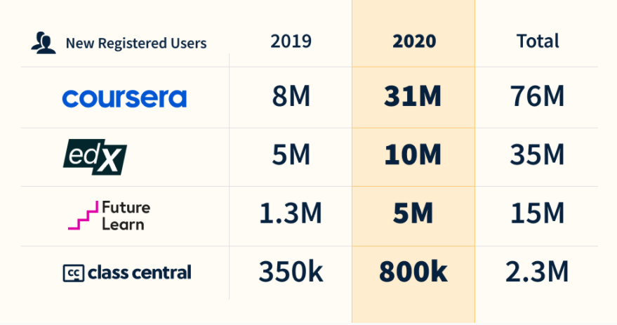
A range of new online courses
Universities started many online courses
Increased adoption of online distance education
Increased acceptability of online training for professional development
Source: https://www.classcentral.com/report/the-second-year-of-the-mooc/

Slide 17
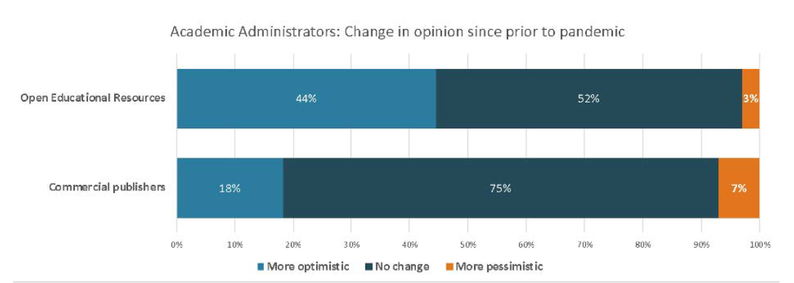
Increased use of Open Educational Resources (OER)
Source: Johnson, et al. (2021). Teaching during pandemic. Bayview Analytics

Slide 18
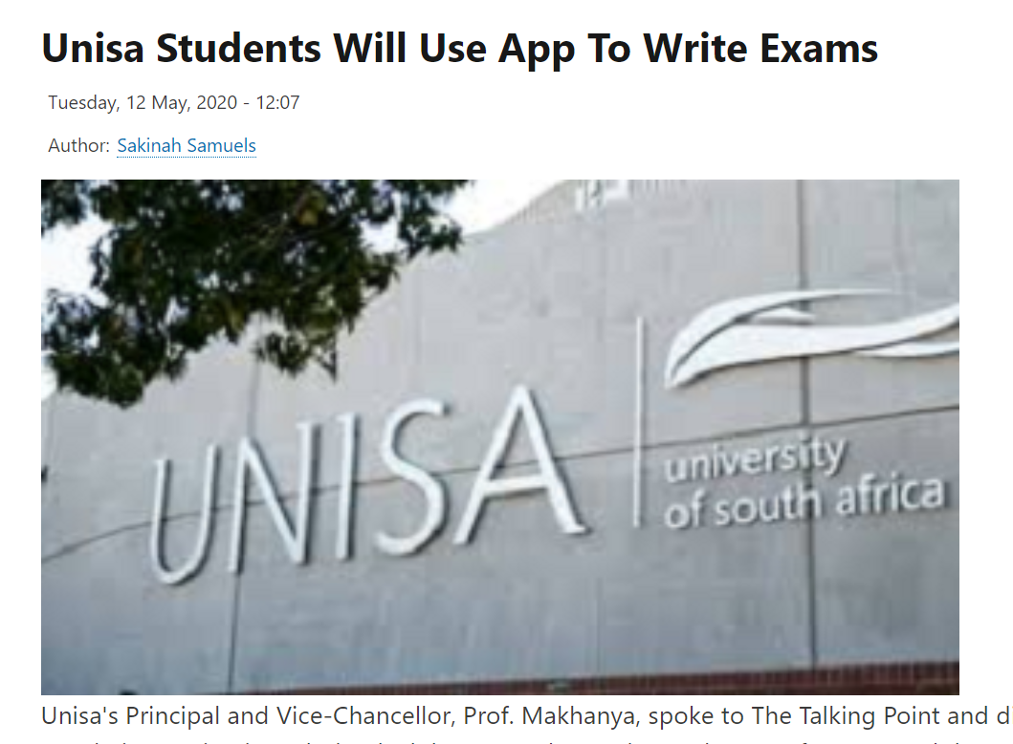
New ways of student assessment
Alternative assessment
Open book examination
Oral assessment
Online proctored examination
Mobile apps
Source: https://www.careersportal.co.za/news/unisa-students-will-use-app-to-write-exams
Notes:
Open book – India
Oral assessment in Business School, Griffith University, Australia
Mobile Apps in South Africa
Online proctoring software in many places.
A study in the North America revealed 64% of teachers changed assignments and exam during the COVID-19, whereas 46% also dropped some assignment or exam. (Johnson etal, 2021)

Slide 19

Educause Horizon Report 2021:
Trends in Higher Education
Social
Technological
Economic
Environmental
Political
Widening digital divide
Adoption of hybrid learning
Demand for new workforce skills
Sustainable development focus
Decrease in funding for higher education
Source: Kathe Pelletier, Malcolm Brown, D. Christopher Brooks, Mark McCormack, Jamie Reeves, and Nichole Arbino, with Aras Bozkurt, Steven Crawford, Laura Czerniewicz, Rob Gibson, Katie Linder, Jon Mason, and Victoria Mondelli, 2021 EDUCAUSE Horizon Report, Teaching and Learning Edition (Boulder, CO: EDUCAUSE, 2021).

Slide 20
How will these developments impact QA?
QA has operated in structured contexts
—how will it embrace openness--OER, open access, open learning?
Is the QA system ready to recognize and accredit new ways of teaching and learning that the pandemic/ICTs have introduced?
How will external and internal QA processes need to change?

Slide 21
Implications for
Quality Assurance

Slide 22
Traditional Quality Assurance
INPUT
Resources
PROCESS
Education practices
OUTPUT
Credential

Slide 23

Four Pillars of Quality Assurance in Distance Education the ‘new normal’
Personal support
to each student
High
quality multi-media materials
Efficient logistics
and administration
Teaching rooted
in research
(John Daniel, 1998)

Slide 24
Emerging Developments
Emerging | Current
Open Education/OER | For-profit colleges/ copyrighted course materials?
MOOC/Blended learning | Classroom/Lecture
Micro-credentials/Badges | Degree?

Slide 25

Issues in Quality Assurance for OER
Who is responsible for the quality of repurposed content?
How do institutions ensure the integrity of content?
What is the role of QA agencies?

Slide 26
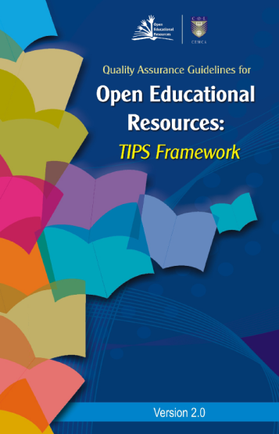
Issues Specific to OER
Accessibility
Localisation
Technological barriers
Discoverability
Interoperability
Notes:
Technology and learning processes; Information and material contents; Presentation products and formats; Systems, technical and technology (TIPS) with 36 criteria to choose and adopt.

Slide 27
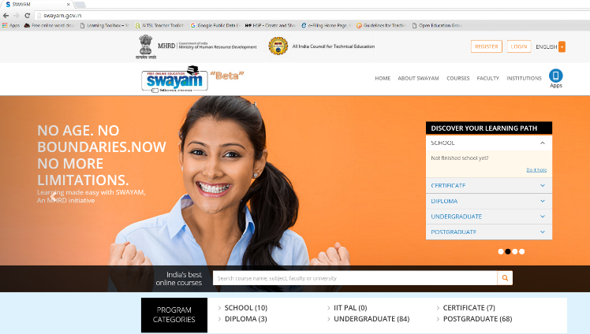
Accreditation and Recognition: India
Centralised directory of courses
Institutions decide the courses for which they provide credit
Transfer of credit up to 40%
Host institution to communicate the grade directly to the students of the participating institutions

Slide 28
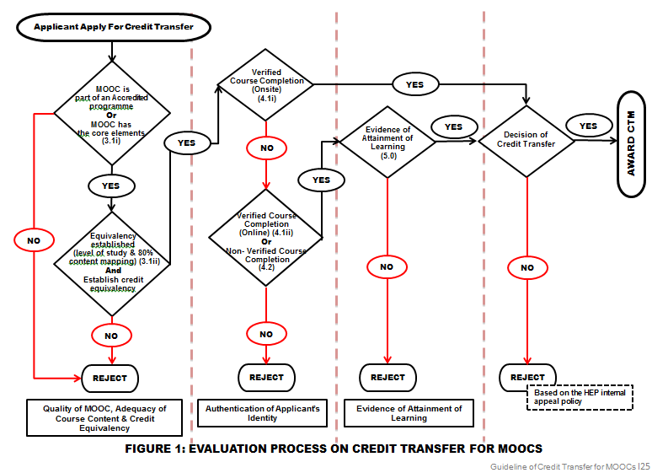
Accreditation and Recognition: Malaysia
Malaysian MOOC Credit Transfer
Source: Prof. Dato’ Dr. Mohamed Amin Embi (UKM)

Slide 29

Guidelines for Quality
One size does not fit all
Context critical
Accreditation/QA agencies need to consider credit equivalence
Notes:
Technology and learning processes; Information and material contents; Presentation products and formats; Systems, technical and technology (TIPS) with 36 criteria to choose and adopt.

Slide 30

Micro-credentials
Industry-Academic Partnership
Online Learning
Proctored Test
Credits for formal learning and/or Employment
Short duration
Modular approach
Skills based
Community learning
Self-paced
Mentoring support
Verifiable credential
Project-based
Job-ready
Reduced cost
Blended with F2F for formal degree

Slide 31
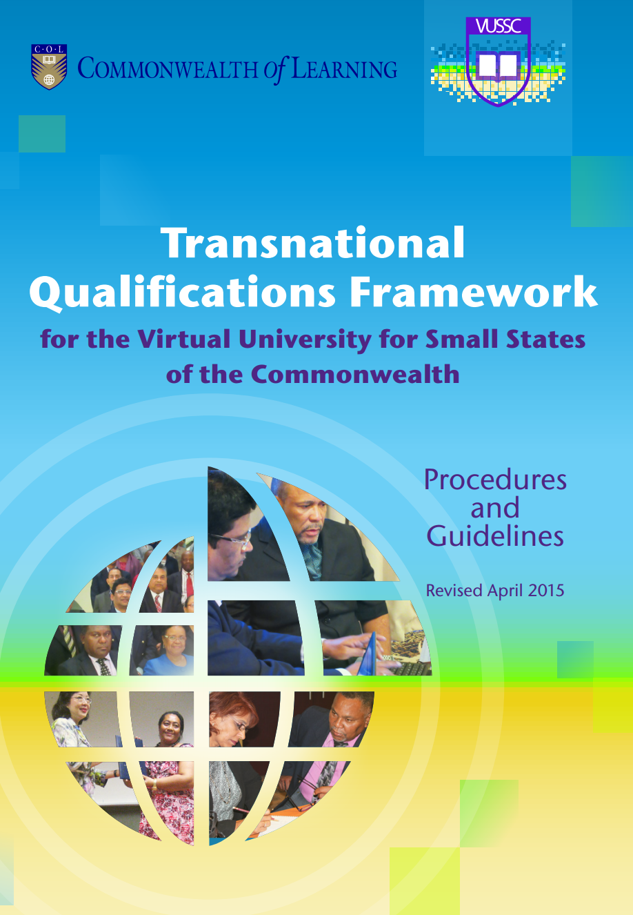
Implications for
Quality Assurance
Recognition of badges/micro-credentials
Accrediting prior learning
Transnational Qualifications Frameworks for mobility
Notes:
Technology and learning processes; Information and material contents; Presentation products and formats; Systems, technical and technology (TIPS) with 36 criteria to choose and adopt.

Slide 32
Issues in Quality Assurance
Who regulates?
What are the standards of curriculum, learner support, assessment and certification?
What of faculty quality?

Slide 33
Towards Quality

Slide 34
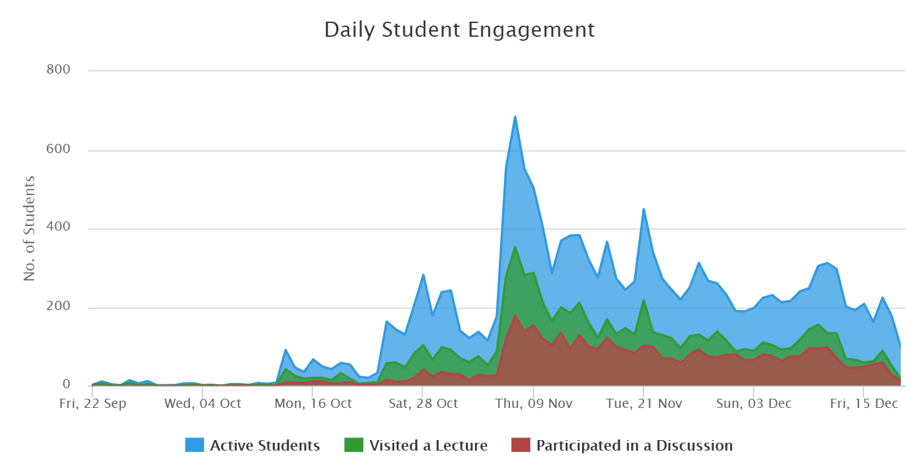
Harnessing ICTs: Learning Analytics
Identify at-risk learners
Provide personal guidance and support
Identify and address difficulties
Promote learning outcomes
Notes:
Using learning analytics in our teaching and learning scenario will empower the teachers to provide personalized support and guidance to the learners. It will identify at risk learners and where they are not performing well. Learning analytics will help strengthen overall learning outcomes by fostering mastery learning.

Slide 35

Instant feedback
Jill Watson
Teaching Assistant
Deployed in four offerings of an online course in Computer Science in Georgia Tech (Instructor: Ashok Goel)
A conversational chatbot built on AI
Source: Goel, A. K., & Polepeddi, L. (2016). Jill Watson: A Virtual Teaching Assistant for Online Education. Georgia Institute of Technology
Image credit: https://news.gatech.edu/news/2017/01/09/jill-watson-round-three
Notes:
A popular example of AI in education is the Virtual Teaching Assistant. During 2014-16, Professor Goyal at the Gerogia Inst of Technology offered an online course in computer science. He designed and deployed a virtual teaching assistant called Jill Watson who became famous globally. This Ai-powered assistant is an example of a chatbot that converses using text. In subsequent offerings of the same course, he and his team refined the chatbot and the new versions were called by different names. Jill Watson conversed with students like a real life TA. So much as that many students thought that Jill Watson was a human.

Slide 36

Quality in Education: Blockchain
Integrity of records and identities of learners critical in Quality Assurance
Blockchain entries cannot be modified
Deployment in online learning is a rapidly emerging possibility
Notes:
Blockchain is emerging as the backbone of Web 3- a transactional web with immutable records
Major interests in education
Issuing certificates
In accreditation
To track intellectual property
Learner ID verification
Credentialing
Notarisation and authentication of certificates
Also for tracing payments made to teachers/institutions by learners
Covers both non-formal as well as formal learning

Slide 37
Employability Pathways
Sensitisation
Career Counselling
Evaluation Drills
Career Support
Before Admission
After Induction
Penultimate Year
Upon Graduation

Slide 38
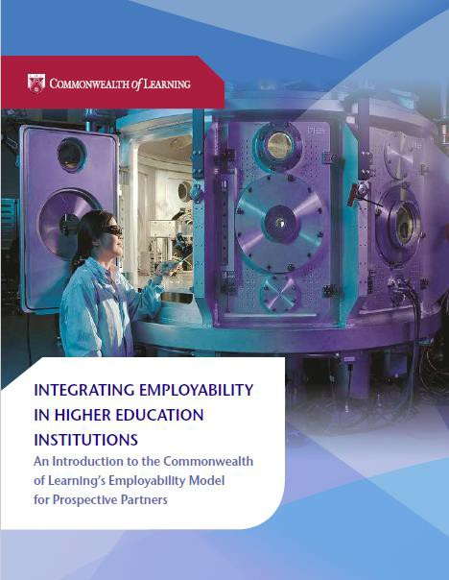

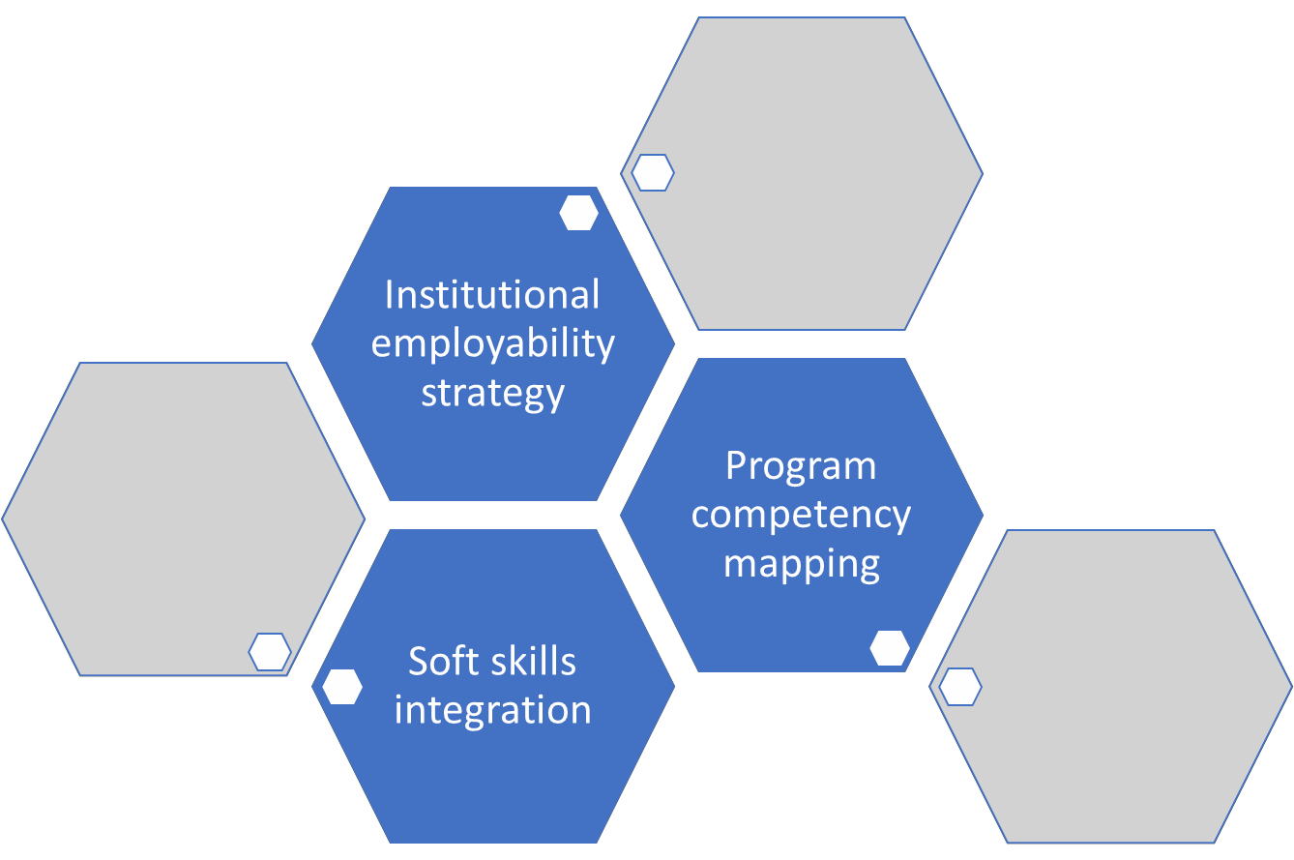
Institutional Employability Framework

Slide 39
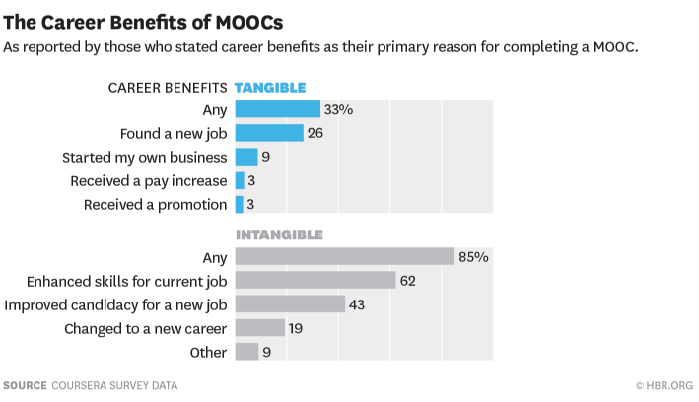
Technology & Employability
Source: https://hbr.org/2015/09/whos-benefiting-from-moocs-and-why

Slide 40
Capacity-building of teachers
Learning to learn online
Creating an ecosystem for lifelong learning
Providing just-in-time training for livelihoods
Source: https://www.classcentral.com/report/the-second-year-of-the-mooc/

Slide 41

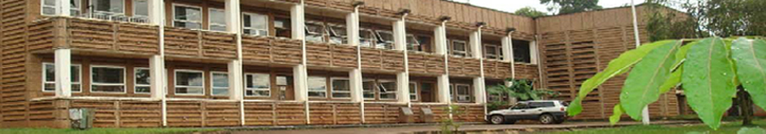
Leaving no one behind:
Resource-poor contexts
Kyambogo University, Uganda
Culture of quality = culture of care

Slide 42
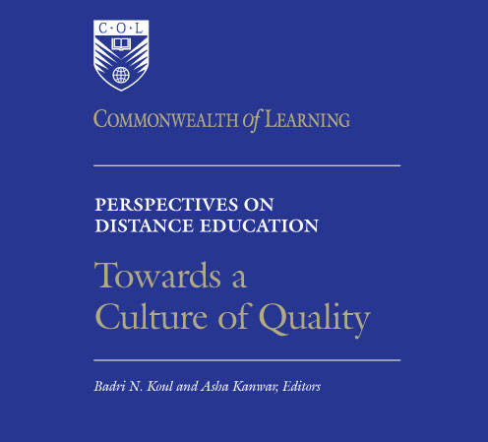

Slide 43
A culture of quality is an institutional culture that:
Promotes an internal QA system where everyone takes ownership
Values capacity building
Stresses accountability to stakeholders
Focuses on learning

Slide 44

A new agenda for
Quality Assurance
Pedagogy of cooperation and solidarity
Curricula for the learning commons
Education across times and spaces

Slide 45


Thank you
www.col.org
The contents of this presentation, with the exception of logos and graphics which are the property of the respective owners, is made available under Attribution-ShareAlike 4.0 International (CC BY-SA 4.0).

