Slide 1




Supporting learners in distance and online learning: lessons for educators
KKSHOU Foundation Day Lecture: December 11, 2021
Sanjaya Mishra
Education Specialist, eLearning
Commonwealth of Learning, Canada

Slide 2

THE PLAN
Context
Designing learner support
Monitoring and evaluation
Lessons for educators

Slide 3

Context
What are the key issues?

Slide 4
Access: GER Status
86.2%
71.5%
50.6%
45.12%
27.1%
Source: UNESCO Institute of Statistics: http://data.uis.unesco.org/Index.aspx?DataSetCode=EDULIT_DS and AISHE for India.

Slide 5
One of the Largest Higher Education Systems in the World
Notes:
In comparison, US has 4298 degree granting institutions.

Slide 6
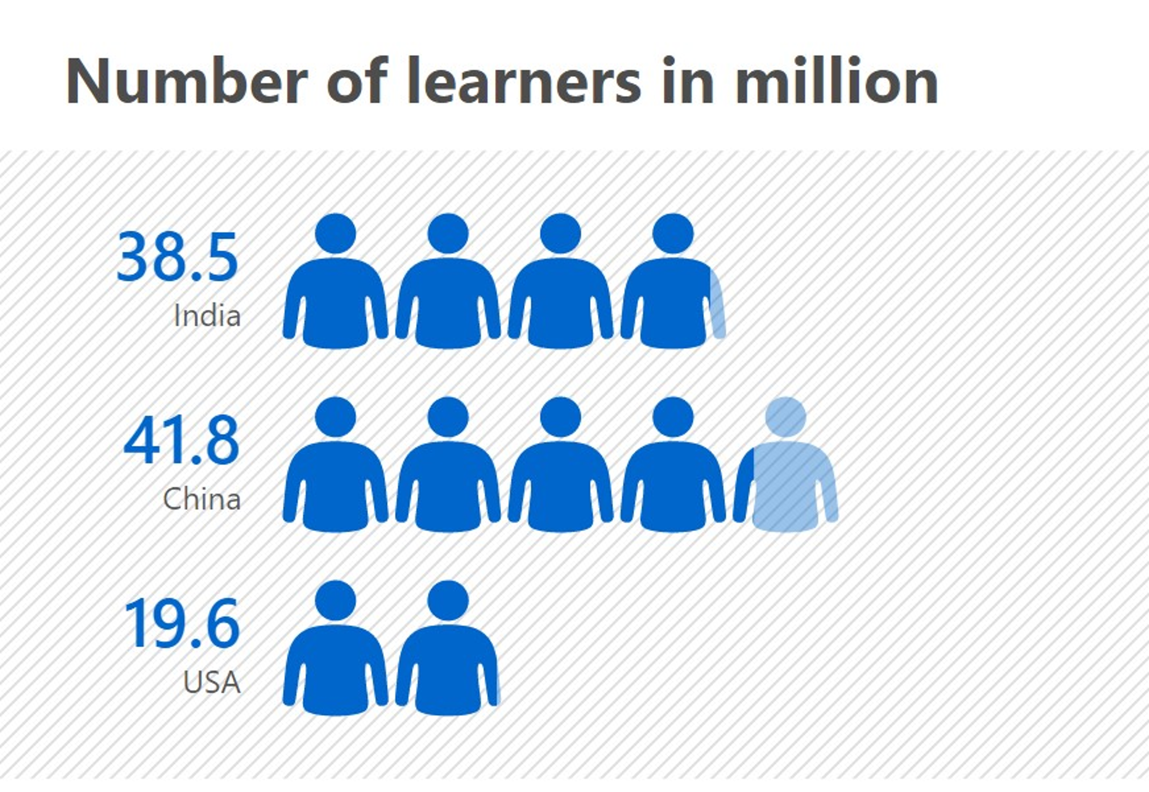
One of the Largest Higher Education System in the World

Slide 7
Cost of higher education
Source: https://www.eiuperspectives.economist.com/sites/default/files/EIU_Yidan%20prize%20forecast_Education%20to%202030.pdf
Notes:
https://www.eiuperspectives.economist.com/sites/default/files/EIU_Yidan%20prize%20forecast_Education%20to%202030.pdf
Yidan Prize Forecast: Education to 2030

Slide 8
Textbook Expenditure
Annual Expenditure
INR 3,654,419,020
INR 1526
Over 49.7 million USD per year
Notes:
365.4 crore in Indian rupees or 3.6 billion INR.

Slide 9
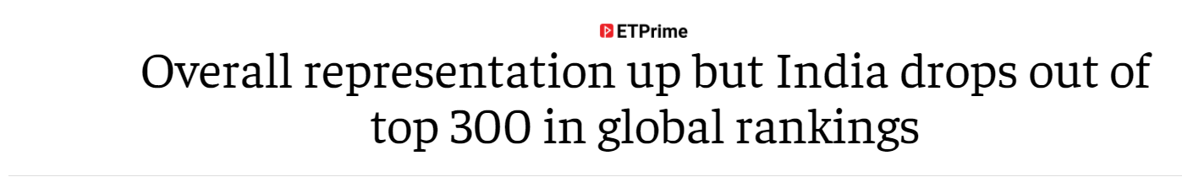
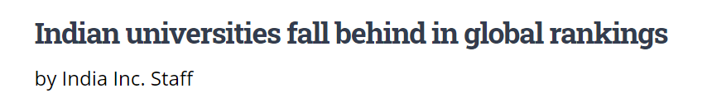


Quality of education
Low employability of graduates
Poor quality of teaching
Weak governance
Insufficient funding
Complex regulatory norms
Source: https://www.brookings.edu/research/reviving-higher-education-in-india/
Notes:
Low employability of graduates, poor quality of teaching, weak governance, insufficient funding, and complex regulatory norms continue to plague the sector
It is important to realise that ranking is a business and compare apple and oranges. They do not reflect the true picture of the quality of education in the country.

Slide 10
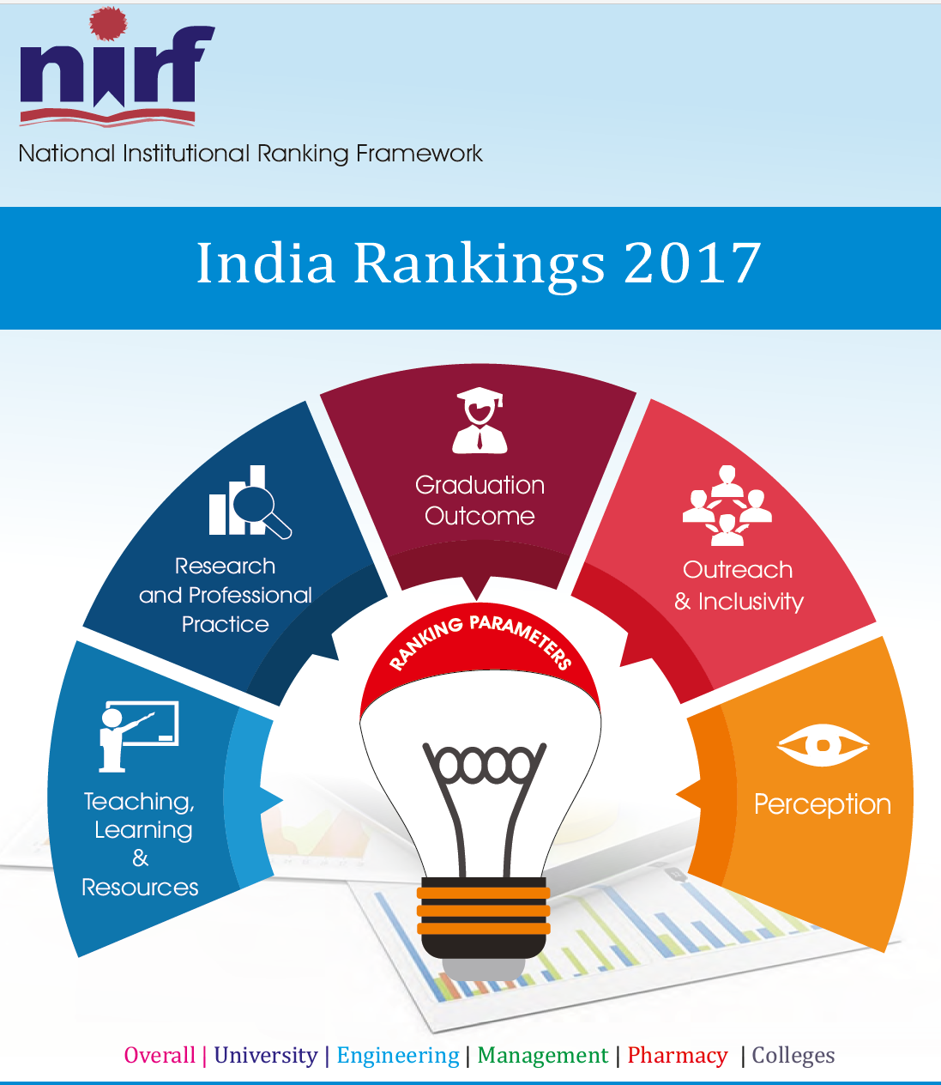
The fallacy of rankings
Rural vs urban bias
Availability of best teachers and students
Funding support of research and innovations
Create categories amongst institutions
Question the parity of qualifications

Slide 11

Quality enhancement
Inputs
Student and teacher recruitment
Infrastructure and budget
Processes
Fostering inquisitive minds
Relevant curriculum
Outcomes
Impact on society
Graduate employability and earnings
Organisational culture
Academic freedom and autonomy
Adding value to institutional reputation
http://www.naac.gov.in/docs/Quality%20Assurance%20in%20Higher%20Education%20An%20Introduction.pdf

Slide 12

National Education Policy 2020
50% GER by 2035
NEFT to promote digital education
Focus on equitable use of technology
Suitable training and development to be effective online educators
Notes:
Open Universities are not mentioned in NEP, but it provides a new framework of multi-modal and multi-disciplinary universities.

Slide 13
National Education Policy 2020: Recommendations for Online Education
Pilot studies on online education
Invest on digital infrastructure
Support online platforms for interactive teaching
Digital repositories for content creation and dissemination
Addressing digital divide
Virtual labs for practical
Training and incentives to teachers
Develop online assessment and examination frameworks
Promote Blended Learning
Setting standards for content, technology and pedagogy of online learning

Slide 14
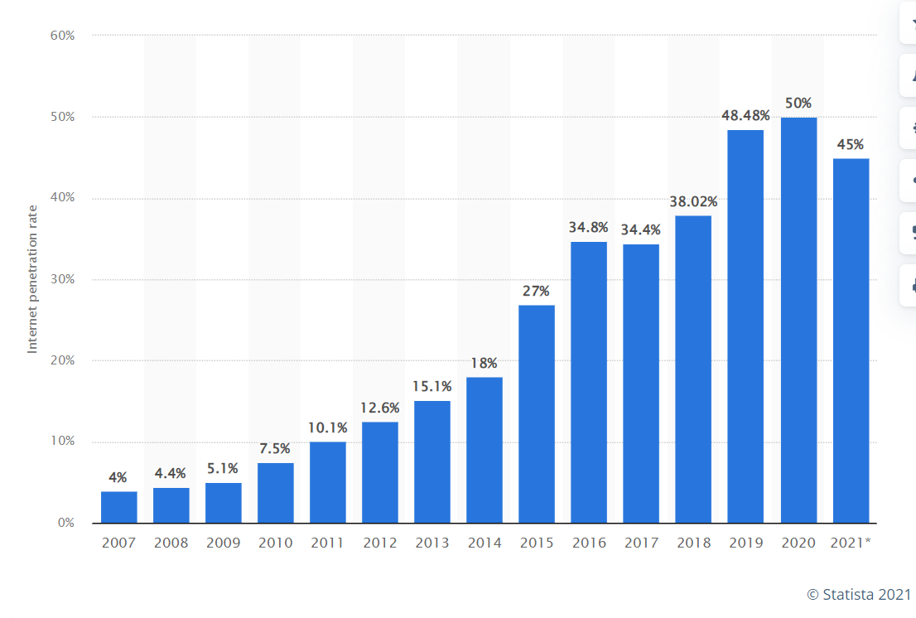
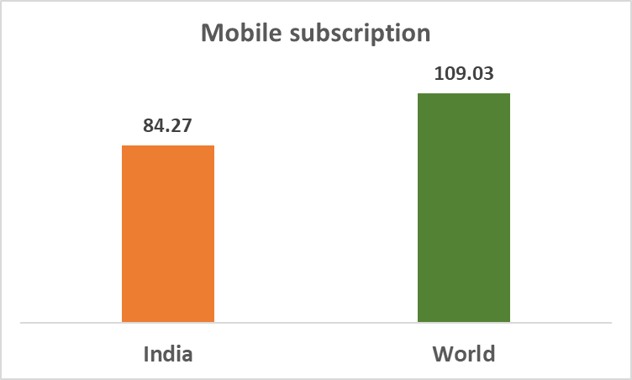

Access to technology
Source: https://www.statista.com/statistics/792074/india-internet-penetration-rate/

Slide 15
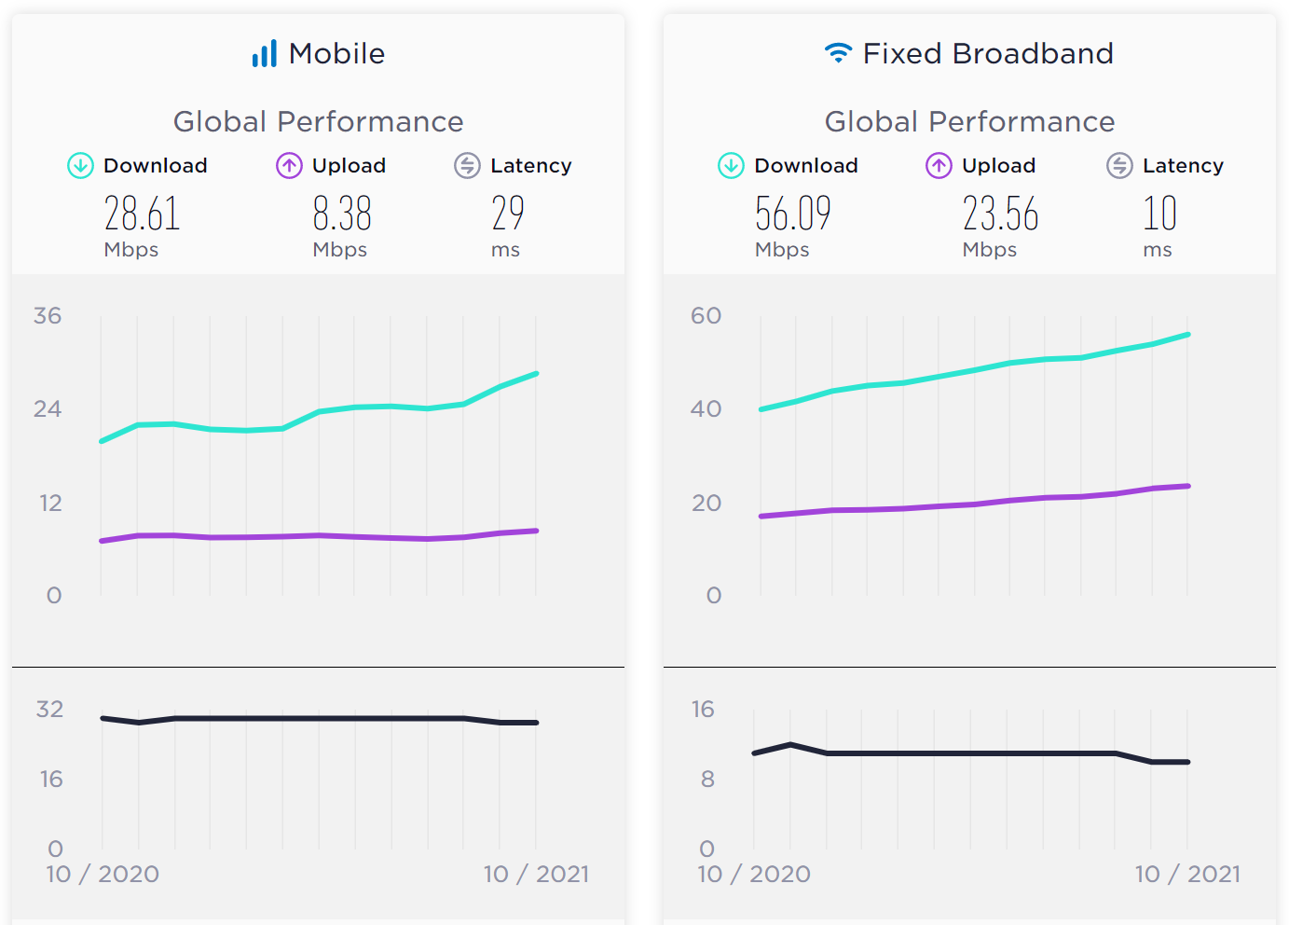
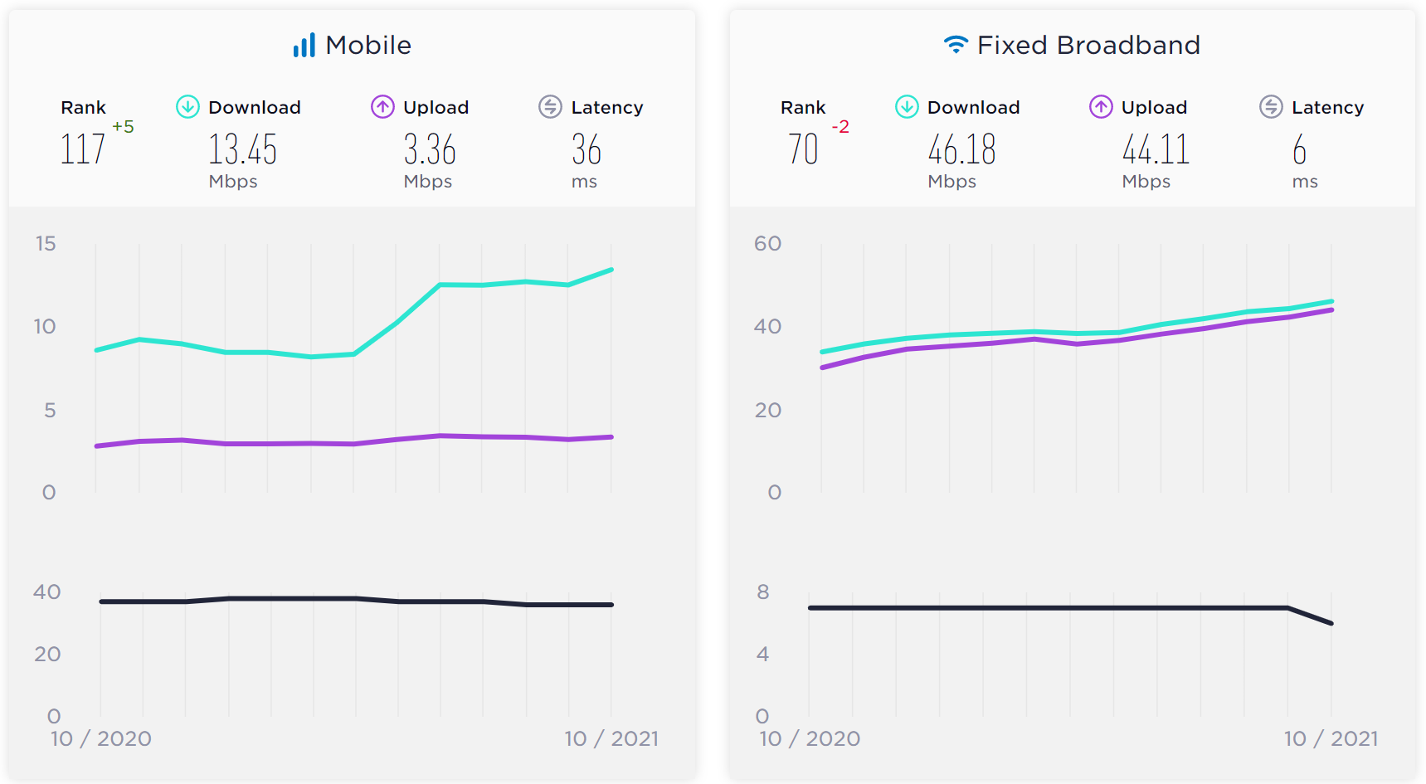
Internet Bandwidth
Sources: https://www.speedtest.net/global-index/india
https://www.speedtest.net/global-index
Notes:
Internet bandwidth has several bottlenecks before it reaches the consumer. However, the fixed bandwidth available to Indians on average is comparable with global bandwidth available.

Slide 16

University of Hyderabad Experience: During COVID19
40% students indicated “unreliable connectivity”
30% worried about cost of data
18% can’t access online classes at all
Source: https://www.newindianexpress.com/cities/hyderabad/2020/apr/20/covid-19-lockdown-digital-divide-among-students-forces-university-of-hyderabad-to-drop-e-classes-2132571.html

Slide 17

COVID-19: Impact on students’ mental health
Heavy workloads
50% felt their performance had declined
Inequitable access to tools and internet
Psychological and emotional well-being
Photo by engin akyurt on Unsplash
Source: European Union (2021). The impact of COVID-19 on higher education: a review of emerging evidence.
Notes:
Several Indian studies during the COVID-19 also indicated challenges for students in higher education. One study reported 68.7 % having mild anxiety and 61 % having mild depression, while another study reported 28.7% had moderate to severe depression, and 51.5% had mild to severe anxiety.
https://www.ncbi.nlm.nih.gov/pmc/articles/PMC7458048/
https://xmed.jmir.org/2021/3/e28158

Slide 18

How can we support learners?
Provide
  Inclusive education
  Equitable opportunities
  Empathy
  Quality
Photo by Wes Hicks on Unsplash

Slide 19

Designing Learner Support
It is a deliberate practice. Either we do it or we don’t.

Slide 20

Emergency Remote Teaching vs. Online Learning

Slide 21

Online learning is not video conferencing
Notes:
Online learning covers both synchronous and asynchronous activities on the part of both students and teachers.

Slide 22

Distance Education
separation of teacher and learner in the learning process;
influence of an educational organization in the planning, designing and delivering of learning resources and opportunities;
use of technical media for delivery of learning content;
provision of two-way communication between student and teacher, and student and students;
absence of regular learning groups.
Source: Keegan, 1996.

Slide 23
Learner Support
Academic support
Non-academic support
Explaining
Assessing
Chasing progress
Developing skills
Advising
Counselling
Administration
Inspiring
Via different media
Photo by Neil Thomas on Unsplash
Source: Adapted from Simpson,2002

Slide 24
Three-tier model of Learner Support
HQ
Regional Centres
Study Centres
Admission and examination
Material supply
Clarification on content
Supporting counsellors
Admission and examination
Material supply
Supporting study centres
Providing library support
Organising face-to-face counselling
Library and lab facilities

Slide 25
Media and Technology for Learner Support
Printed text/guides
Telephone
Radio
Television
SMS
Chat
Online services
Social media

Slide 26
Types of Learner Support
One-to-one support
Group support
Chatbot
Online self-service
Tutoring
Student study guide
Radio and TV
Telephone

Slide 27
Learners Support: three stages
Pre-entry
During the course
End of course
Choice of courses
Preparing for learning
Financial support
Navigating and using technologies
Timely information
Academic support
Feedback on assignments
Administrative and technical issues
Results
Verification and supply of transcripts
Accreditation issues
Placement services
Practical and internship
Alumni and social groups
Communication
Library services
Photo by Priscilla Du Preez on Unsplash
Photo by Pang Yuhao on Unsplash

Slide 28



Effective Learner Support: From Content to Course
Build interaction.
Encourage discussion.
Practice + Expert feedback necessary.
Notes:
That's why we have coaches in sports and one to one sessions in medicine. But, prior to practice there is need of theoretical knowledge and understanding. Without a theoretical
knowledge, skills development will remain only at the level of craftsmanship.

Slide 29
Skills for Learner Support
Assessment skills
Warmth
Subject knowledge and skills
Empathy
Group skills
Openness
Exposition skills
Facilitation skills
Stress management
Listening skills
Presentation skills
Academic Support Skills
Non-academic Support Skills
Source: Adapted from Simpson,2002

Slide 30
Learner Support is key to Student Success
Student
Learning materials
=
SUCCESS
Notes:
Retrieval of dropouts and at-risk students important for learner support

Slide 31
Learner Support is key to Student Success
Student
Learning materials
Learner Support
=
SUCCESS
Notes:
Retrieval of dropouts and at-risk students important for learner support

Slide 32

Monitoring and Evaluation of Learner Support
How good are we at providing learner support?

Slide 33
Service Quality in Learner Support
Systems quality
Materials and teaching quality
Administrative and support quality
Learner satisfaction
Course completion

Slide 34

Dimensions of Learner Service Quality
Reliability: e.g., ability to perform counselling sessions without cancellation
Responsiveness: Quick and timely delivery of services
Assurances: Ensuring trust on the systems and practices
Empathy: Personalised services with warmth
Tangibles: Welcoming environment, both in physical and online space, including accessibility

Slide 35

Ways to monitoring
Observation of counselling sessions
Monitoring of functioning of study centres
Tracking assignments submission and return
Tracking material dispatch
Monitoring of evaluated assignments
Student course experience surveys
Learner dropout
Notes:
How often we manage data to improve student support? Is lerner support even a matter of concern? How much financial loss do institutions accrue due to poor learner support?

Slide 36

Lessons for Educators
ODL has several best practices to share.

Slide 37

If we build it, they will come

Slide 38

The core expertise of teachers come from content knowledge

Slide 39
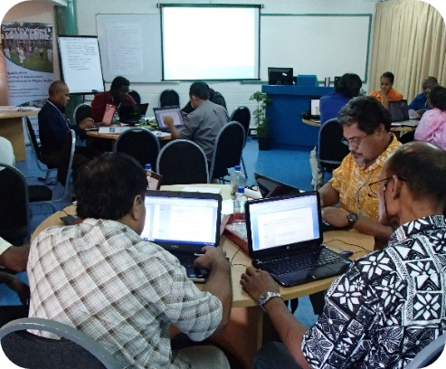
Technology is a poor substitute for face-to-face learning
Notes:
ODL teachers always knew that media suitably used can teach well and is not a poor substitute. A recent survey in the UK,68% of students rated the quality of online digital learning as ‘best imaginable’, ‘excellent’ or ‘good’; and 62% also rated the support they received for online learning equally highly.
Source: JISC (2021). Student digital experience insights survey 2020/21 https://repository.jisc.ac.uk/8338/1/DEI%20P1%202021%20student%20data%20for%20HE-FINAL.pdf

Slide 40

Today’s learners do not need digital skills

Slide 41

Higher education is all about stress management

Slide 42
Some Questions
Is there adequate learner support system in place in your institution?
Does your course integrate learner support?
Do you have a benchmark for providing quality support?
Do you know how the learner support provided by you impact learner success/progress?
Does your learner support system contribute lowering dropout and thereby support financial sustainability?

Slide 43


THANK YOU
The contents of this presentation, except logos/ graphics which are property of the respective owners, is made available under Attribution-ShareAlike 4.0 International (CC BY-SA 4.0).

