Slide 1
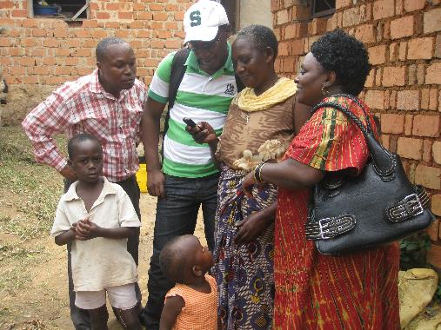
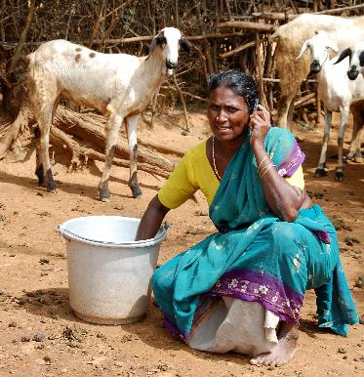
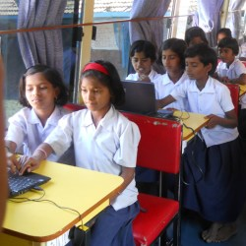
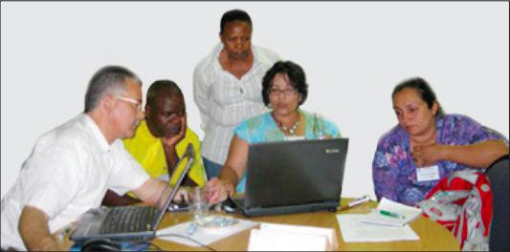

Learning to live together: Can technology help?
Professor Asha Kanwar, President & CEO; Dr. K. Balasubramanian, Vice President; Alexis Carr, Research Coordinator,
Commonwealth of Learning
September 14, 2017

Slide 2
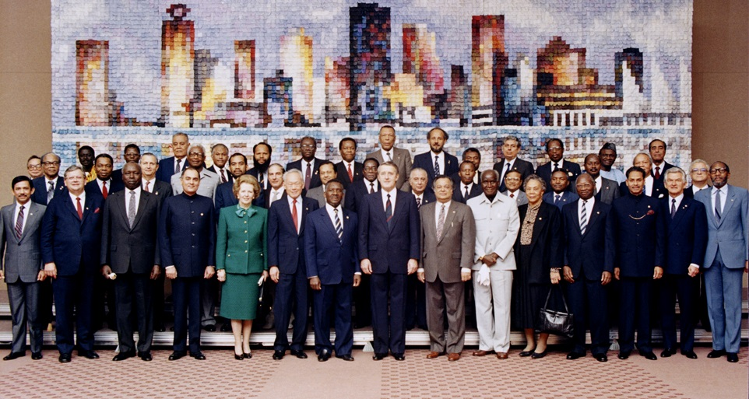
Commonwealth Heads of Government Meeting
Vancouver, 1987
Notes:
We invite you to engage us; tap into our thought leadership, expertise, networks and resources

Slide 3

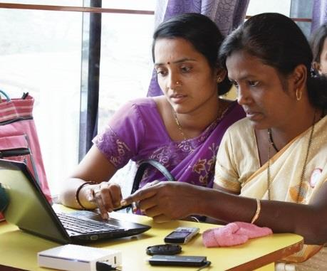
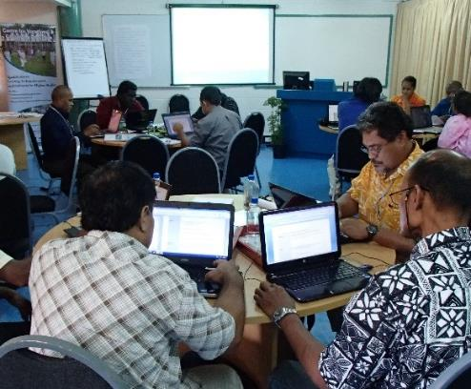
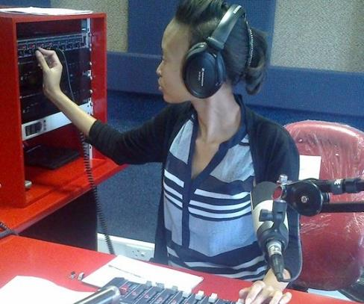
What is it For?
To help Commonwealth governments
and institutions use distance education and technologies for education & training

Slide 4

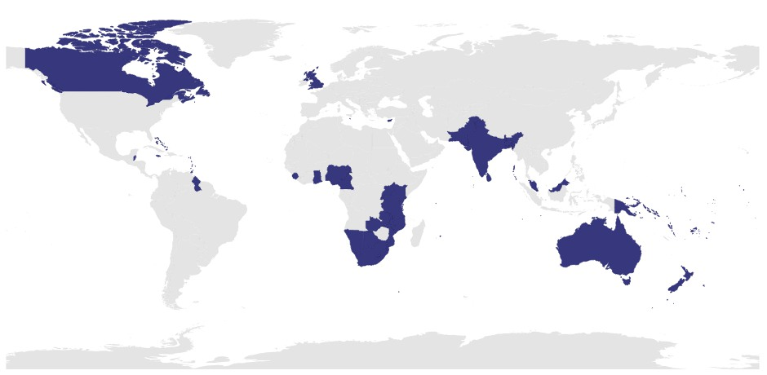
Commonwealth Member States

Slide 5

Outline
Context
Social Capital & Empathy
Technology and its Uses
COL Case Study
The Way Forward

Slide 6
Context

Slide 7


Learning to Live Together is …
"developing an understanding of others... guided by recognition of our growing interdependence and a common analysis of the risks and challenges of the future"
- Jaques Delors
Notes:
- Jaques Delors

Slide 8



An age of information;
an age of conflict
Notes:
We have incredible access to information and are more connected than ever before, yet there is still conflict, discord and violence

Slide 9
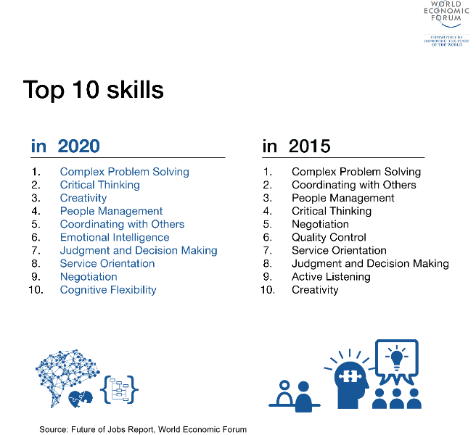
The growing importance of empathy
WEF Report
Empathy related skills will be amongst
the top ten skills workers will need
Notes:
Source: https://www.weforum.org/agenda/2016/01/the-10-skills-you-need-to-thrive-in-the-fourth-industrial-revolution/

Slide 10


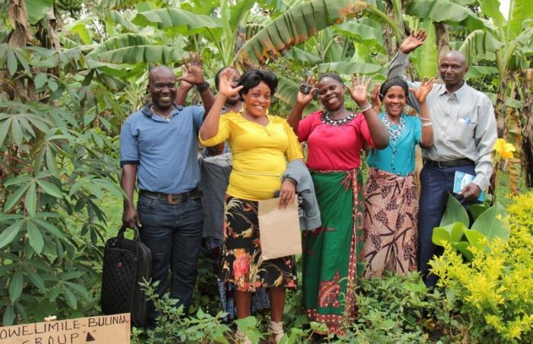

The Socialisation of Sapiens
Notes:
Homo Sapiens have evolved with the unique ability to form groups, collaborate and cooperate.
Socialisation processes build cohesion and understanding within groups. In other words, socialisation is how we learn to live together.

Slide 11

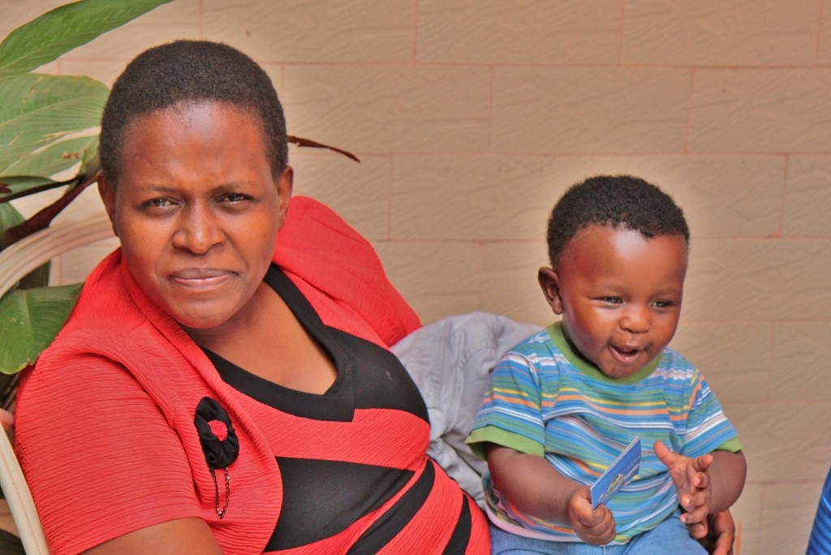
Informal socialisation

Slide 12

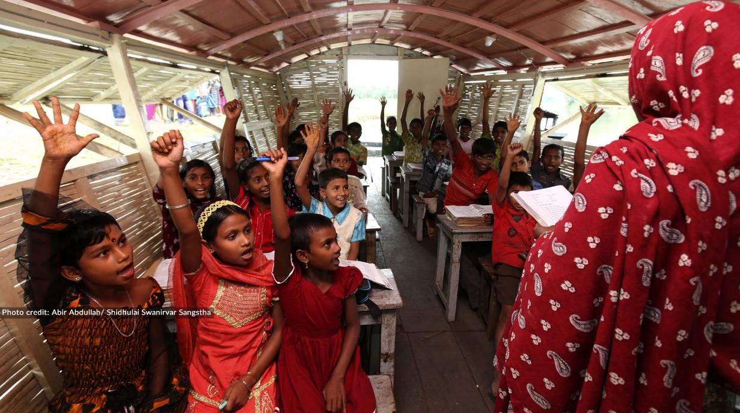
Formal socialisation

Slide 13

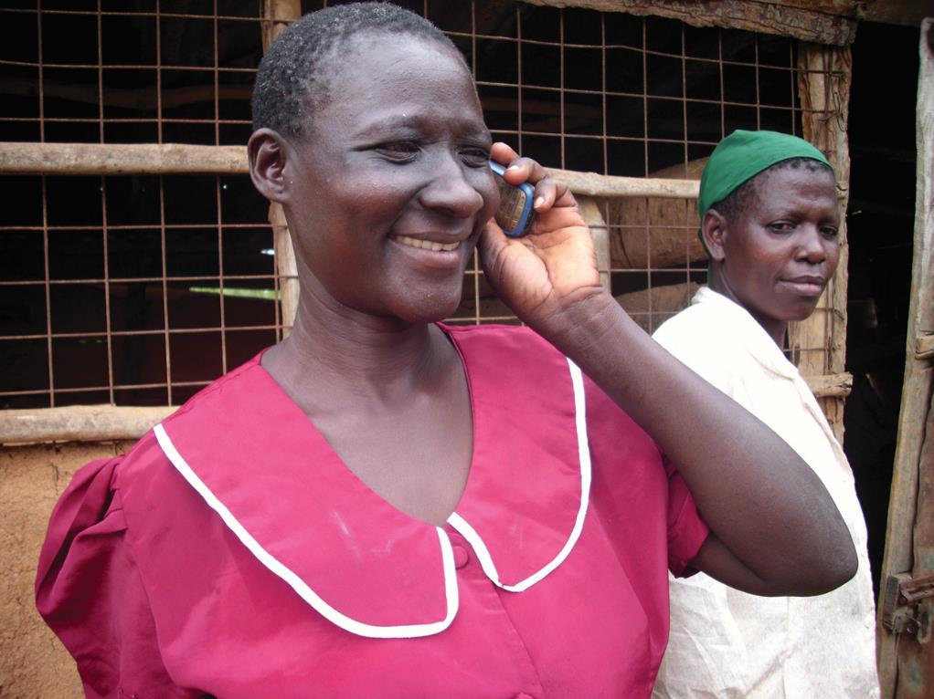
Technology-enabled socialisation

Slide 14
Social capital and empathy

Slide 15


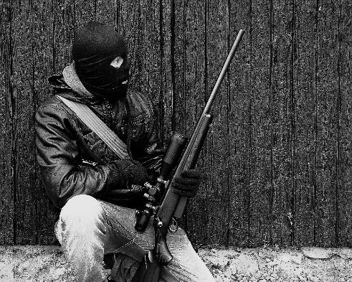
Social Capital
Trust
Reciprocity
Networks
Notes:
When we become part of a group, through a socialisation process, we build our social capital.
Social capital includes trust, reciprocity and networks. There can be both positive and negative social capital.
By measuring positive social capital we can capture the ability to 'live together'.

Slide 16

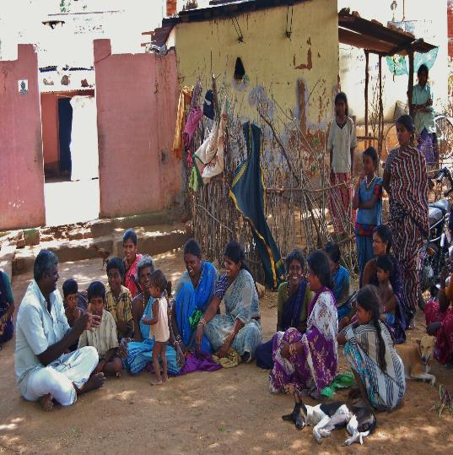
Lifelong Learning for Farmers
The L3F programme uses information and communication technologies to build the capacity of farmers, and links this process with social and financial capital building.

Slide 17











L3F Presence
Antigua & Barbuda
Ghana
India
Jamaica
Kenya
Mauritius
Seychelles
Sri Lanka
Tanzania
Tonga
Uganda

Slide 18
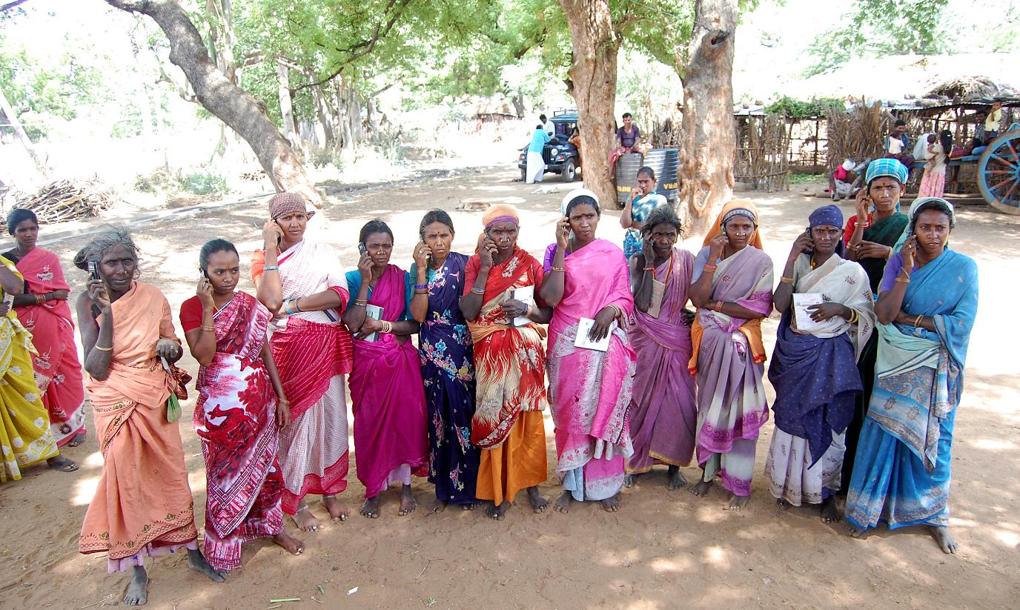

Slide 19
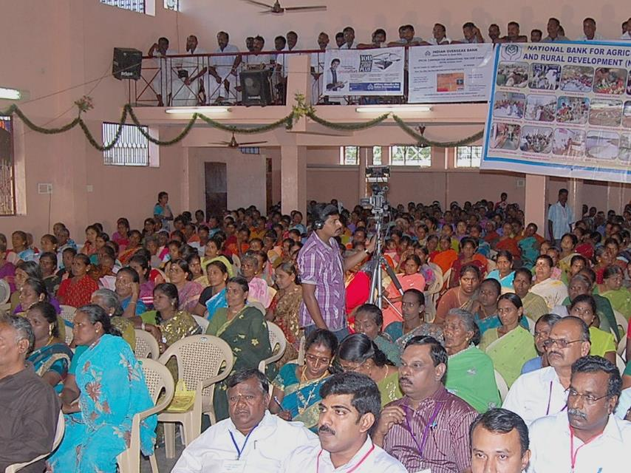

Companies established by women at the bottom of the pyramid
Notes:
These women are part of COL’s L3F under which they have learnt agriculture and enterprise development skills using basic mobile phones. Because of this they have established companies in agriculture and livestock in which they are shareholders. They have generated enough assest within a space of three years.

Slide 20
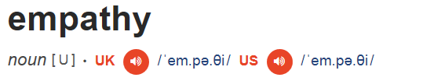
The ability to share someone else’s feelings or experiences by imagining what it would be like to be in that person’s situation.
Notes:
Empathy allows us to feel what another person might feel
Empathy can help to build social capital, and is key to living together
Empathy for action as opposed to bystander empathy is necessary to affect change and bring about positive outcomes like peace, justice and equality

Slide 21
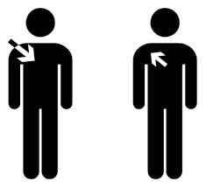


Empathy
Action-oriented empathy
Bystander empathy
Notes:
Empathy allows us to feel what another person might feel
Empathy can help to build social capital, and is key to living together
Empathy for action as opposed to bystander empathy is necessary to affect change and bring about positive outcomes like peace, justice and equality

Slide 22


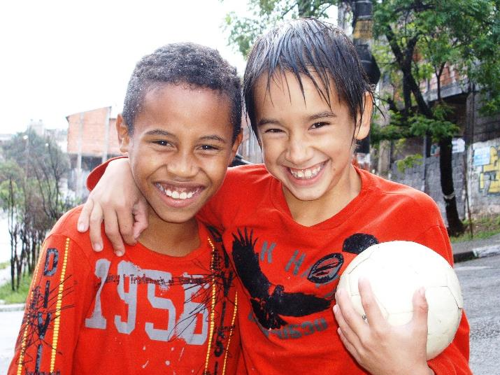
Does Education build empathy?
Empathy education: Relationship building, compassion and cooperation
Formal education: Competition over collaboration
Notes:
Formal education plays an important role in socialisation
Criticised as antithetical to empathy, cooperation and collaboration
Promotes competition as opposed to living together
Empathy education is growing in popularity
-Has shown positive outcomes in terms of learning to live together including, reduction in bullying and violence in schools.
-However, it is still not being integrated in many systems

Slide 23
Technology and its uses

Slide 24
Global ICT Statistics 2005-2017
Source: ITU ICT Facts and Figures 2017, last accessed on September 13, 2017

Slide 26



Negative effects
23 minutes
1 hour

Slide 27



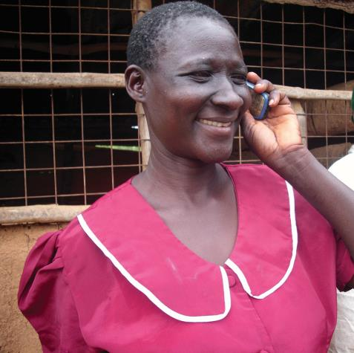
Positive effects
Bonding
Bridging

Slide 28
COL
Case Study

Slide 29


RSGA Facebook Group
Notes:
One of COL’s L3F partners has developed a facebook group to share information on farming practices. The page has attracted many followers who watch yuoutbe videos, look at photos, and engage with others in the community on farming practices.

Slide 30


The Survey
350 respondents
Canvassed via Facebook
Questions on empathy, social capital and use of social media for learning
Notes:
Surveys were available in English and in Tamil, the main language of the region.
Surveys were opt-in, so this should be considered when looking at representativeness of the sample.
It is important to note that gender roles regarding technology means that the users are largely male. Further research is planned to delve into this further.

Slide 31


Research Questions
?
Is there a relationship between empathy, social capital online and face-to-face social capital?
Does empathy promote learning to live together?

Slide 32

Empathy, face-to-face social capital and online social capital are all positively correlated

Slide 33
Empathy and online social capital are the most significant predictors of face-to-face social capital.
.

Slide 34
Years of formal education is not a significant predictor of social capital.

Slide 35

Conclusions
Notes:
Social interactions online are an extension of our ability to interact with others, or live together, in our communities.
Face-to-face social interactions remain important, and strongly predict the quality of our online interactions.
Empathy plays an important role in developing our face-to-face social capital
Technology itself does not lead to increased empathy, social capital, or ability to live together - it is how we use it that determines its efficacy and impact.
If formal education is not a significant predictor of social capital, we must rethink the role of formal education in helping future generations to learn to live together.

Slide 36
Conclusions
Technology is a tool, not a panacea
Empathy is important in learning to live together
Online and face-to-face social capital can strengthen each other
Notes:
Technology should be integrated into formal education and used to promote collaboration rather than competition
Specific empathy education programmes should be developed and integrated into all areas of teaching and learning, with a focus on empathy for action.
Teachers should become allies in using technology appropriately, to teach skills like empathy and collaboration which can help us to live together

Slide 37
The way forward

Slide 38

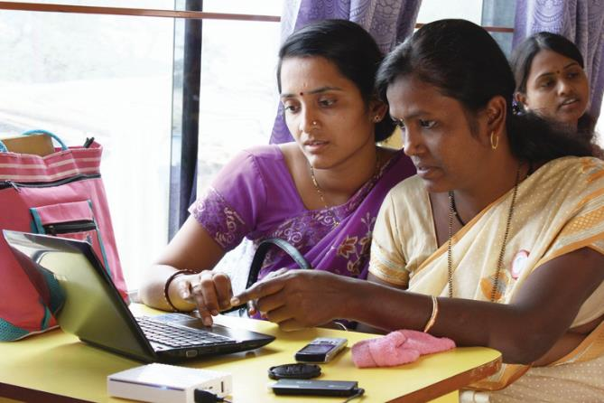
Technology should be integrated into formal education and used to promote collaboration rather than competition
1

Slide 39



Students in North Carolina, collaborated with a Swedish classroom on a science project using a combination of Skype, Crocodoc (similar to Google Docs), Voice Threads and a Wiki to connect the two classrooms.
http://www.channelpronetwork.com/slideshow/5-examples-collaborative-technology-k-12-classrooms?page=1

Slide 40
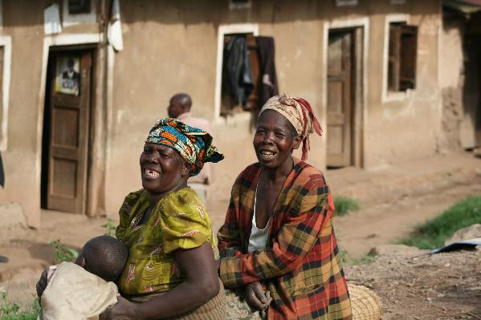
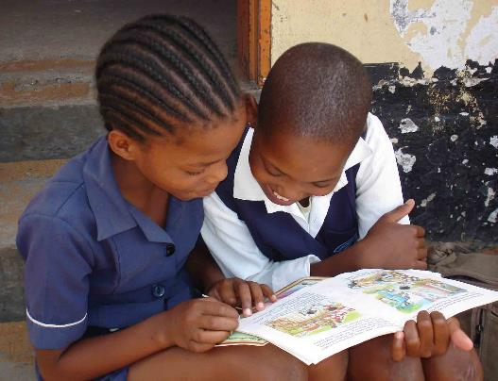
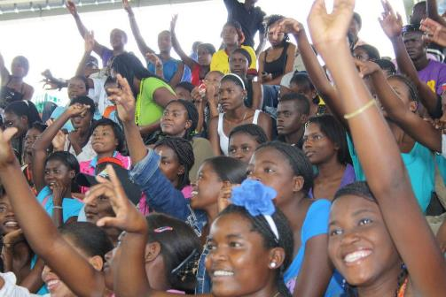
Specific empathy education programmes should be developed and integrated into all areas of teaching and learning, with a focus on empathy for action.
2

Slide 41

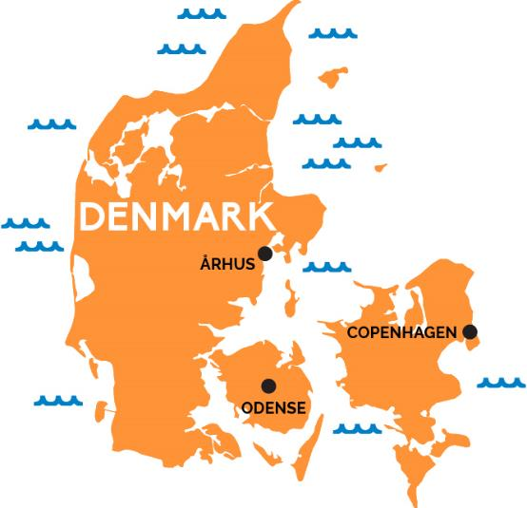

Literary fiction to teach doctors about empathy
Integrating empathy into preschool and elementary curriculum
Empathy programmes to prevent bullying
1. America's Insensitive Children? https://www.theatlantic.com/education/archive/2016/08/the-us-empathy-gap/494975/
2.Colvin, Geoff. Humans are Underrated. 2015. Porfolio/Penguin: New York.
3. Roots of Empathy. http://www.rootsofempathy.org/
Notes:
-For example, countries like Denmark are making empathy education mandatory for all schools, and in the USA doctors are being trained in empathy through classic literature
-Has shown positive outcomes in terms of learning to live together including, reduction in bullying and violence in schools.

Slide 42

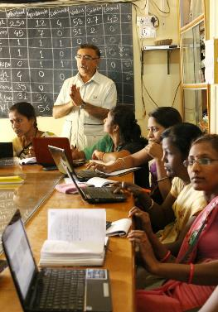

Teachers should become allies in using technology appropriately, to teach skills like empathy and collaboration which can help us to live together. They should be supported to develop these skills.
3

Slide 43


Support for a ‘culture of collaboration’
-Pasi Sahlberg
In Shanghai teachers will not be promoted unless they give evidence of collaboration

Slide 44
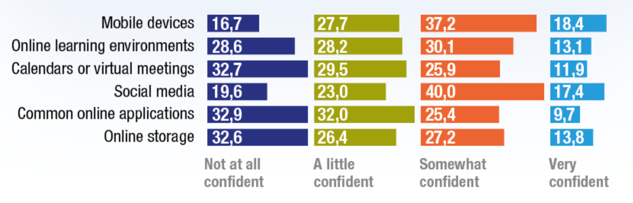
Support for Teacher Confidence with Online Collaborative Tools

Slide 45
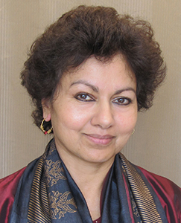
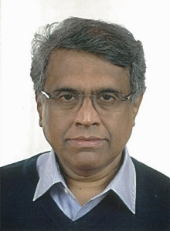

Thank you!
Professor Asha Kanwar
President & CEO
Commonwealth of Learning
Dr. K Balasubramanian
Vice President
Commonwealth of Learning
Alexis Carr
Research Coordinator
Commonwealth of Learning
www.col.org

