Slide 1













































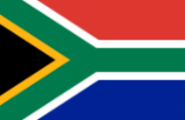










Dr Balaji Venkataraman
Vice President, Commonwealth of Learning
38th Commonwealth Diplomats Induction
Programme | 9 March 2022
Commonwealth’s Support to Member States in Achieving SDGs: Emerging Gaps in Education
W W W . U R T E A . C O M

Slide 2
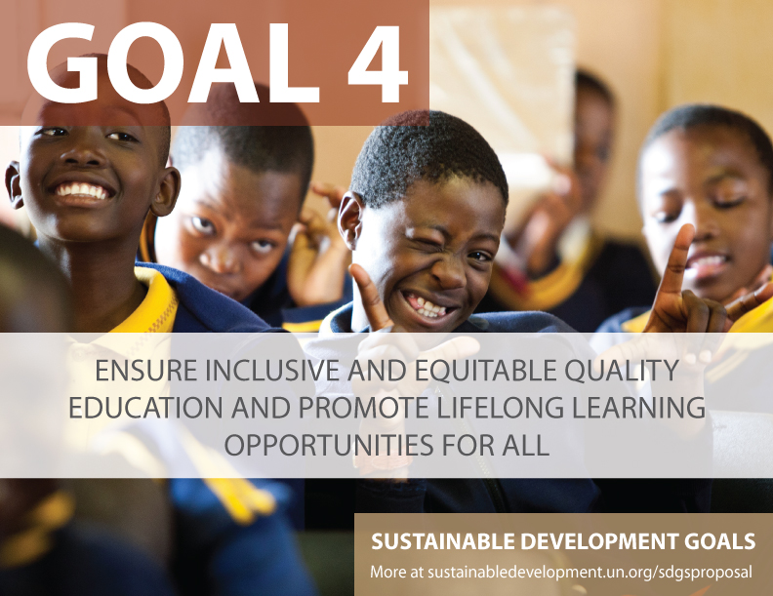

Seven Targets and Three Means of Implementation
Progress is measured using a group of indicators
There are a total of 45 indicators

Slide 3
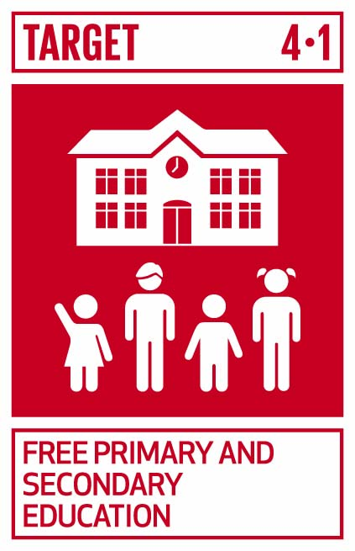
Target 4.1
By 2030, ensure that all girls and boys complete free, equitable and quality primary and secondary education leading to relevant and effective learning outcomes
  Indicator 4.1.3
  Gross intake ratio to the last grade (primary education, lower secondary education)
Notes:
Mean year of schooling for persons with disabilities in select 49 countries in the UNESCO report is 4.8, whereas in general is 7 years. For female PWD, the mean years of schooling reduces to 4.3. ( see UIS, 2018: http://uis.unesco.org/sites/default/files/documents/ip49-education-disability-2018-en.pdf
People with disabilities are often disadvantaged in terms of access to tertiary education. Of the 18 countries for which data is available, 15 report disability prevalence under 3 per cent and half report rates under 2 per cent.
No info on students with disabilities in tertiary education.
United states
Source: https://nces.ed.gov/fastfacts/display.asp?id=60
11.1% (students with disabilities enrolled in post-secondary institutions) in 2011-2012
Canada
Source: http://publications.gc.ca/collections/collection_2009/rhdcc-hrsdc/HS61-1-2009E.pdf
10.7%
Australia:
Source: https://www.cdu.edu.au/sites/default/files/the-northern-institute/10.18793-lcj215.17.02.pdf
5.5%
India
https://timesofindia.indiatimes.com/home/education/news/Disabled-get-only-0-56-of-seats-in-higher-education/articleshow/46810639.cms
0.56%
South Africa
https://www.dailymaverick.co.za/article/2017-08-15-students-with-disabilities-disadvantaged-at-higher-education-level/#.WhSt_lWnGUk
http://www.statssa.gov.za/publications/Report-03-01-59/Report-03-01-592011.pdf
According to Stats SA, 80% of disabled people aged 20-24 are not attending tertiary education. Put another way, around 7,5% of South Africans have a disability. Yet the number of disabled students at tertiary institutions is far from representative: just 1%.

Slide 4
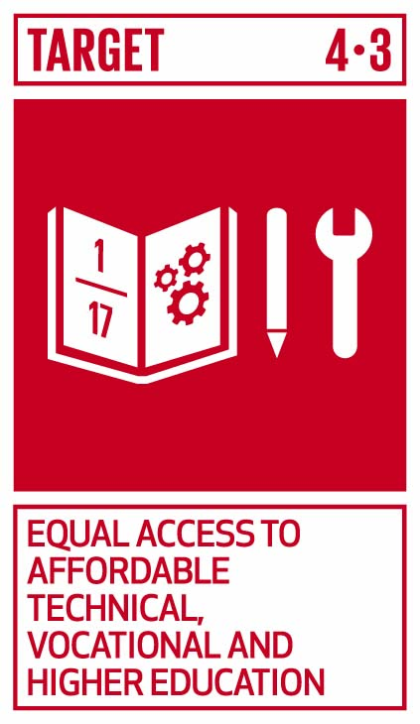
Target 4.3
By 2030, ensure equal access for all women and men to affordable and quality technical, vocational and tertiary education, including university
  Indicator 4.3.2
  Gross enrolment ratio for tertiary education by sex
Notes:
Mean year of schooling for persons with disabilities in select 49 countries in the UNESCO report is 4.8, whereas in general is 7 years. For female PWD, the mean years of schooling reduces to 4.3. ( see UIS, 2018: http://uis.unesco.org/sites/default/files/documents/ip49-education-disability-2018-en.pdf
People with disabilities are often disadvantaged in terms of access to tertiary education. Of the 18 countries for which data is available, 15 report disability prevalence under 3 per cent and half report rates under 2 per cent.
No info on students with disabilities in tertiary education.
United states
Source: https://nces.ed.gov/fastfacts/display.asp?id=60
11.1% (students with disabilities enrolled in post-secondary institutions) in 2011-2012
Canada
Source: http://publications.gc.ca/collections/collection_2009/rhdcc-hrsdc/HS61-1-2009E.pdf
10.7%
Australia:
Source: https://www.cdu.edu.au/sites/default/files/the-northern-institute/10.18793-lcj215.17.02.pdf
5.5%
India
https://timesofindia.indiatimes.com/home/education/news/Disabled-get-only-0-56-of-seats-in-higher-education/articleshow/46810639.cms
0.56%
South Africa
https://www.dailymaverick.co.za/article/2017-08-15-students-with-disabilities-disadvantaged-at-higher-education-level/#.WhSt_lWnGUk
http://www.statssa.gov.za/publications/Report-03-01-59/Report-03-01-592011.pdf
According to Stats SA, 80% of disabled people aged 20-24 are not attending tertiary education. Put another way, around 7,5% of South Africans have a disability. Yet the number of disabled students at tertiary institutions is far from representative: just 1%.

Slide 5
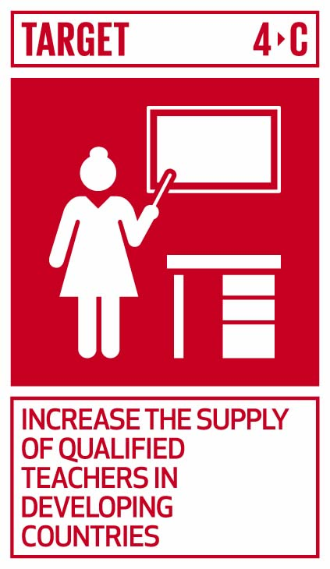
Target 4.c
By 2030, substantially increase the supply of qualified teachers, including through international cooperation for teacher training in developing countries, especially least developed countries and small island developing States
  Indicator 4.c.3
  Percentage of Qualified Teachers in Primary Education
Notes:
Mean year of schooling for persons with disabilities in select 49 countries in the UNESCO report is 4.8, whereas in general is 7 years. For female PWD, the mean years of schooling reduces to 4.3. ( see UIS, 2018: http://uis.unesco.org/sites/default/files/documents/ip49-education-disability-2018-en.pdf
People with disabilities are often disadvantaged in terms of access to tertiary education. Of the 18 countries for which data is available, 15 report disability prevalence under 3 per cent and half report rates under 2 per cent.
No info on students with disabilities in tertiary education.
United states
Source: https://nces.ed.gov/fastfacts/display.asp?id=60
11.1% (students with disabilities enrolled in post-secondary institutions) in 2011-2012
Canada
Source: http://publications.gc.ca/collections/collection_2009/rhdcc-hrsdc/HS61-1-2009E.pdf
10.7%
Australia:
Source: https://www.cdu.edu.au/sites/default/files/the-northern-institute/10.18793-lcj215.17.02.pdf
5.5%
India
https://timesofindia.indiatimes.com/home/education/news/Disabled-get-only-0-56-of-seats-in-higher-education/articleshow/46810639.cms
0.56%
South Africa
https://www.dailymaverick.co.za/article/2017-08-15-students-with-disabilities-disadvantaged-at-higher-education-level/#.WhSt_lWnGUk
http://www.statssa.gov.za/publications/Report-03-01-59/Report-03-01-592011.pdf
According to Stats SA, 80% of disabled people aged 20-24 are not attending tertiary education. Put another way, around 7,5% of South Africans have a disability. Yet the number of disabled students at tertiary institutions is far from representative: just 1%.

Slide 6
Trends over 2015-2020
Comparison is between the aggregates of world as a whole and Commonwealth countries as a group
Period: The last five years since the launch of SDG’s
Sources
  UNESCO Institute of Statistics (primary)
  World Bank Open Data
  Data for 2021 not yet available

Slide 7
4.1.3 Gross Intake Ratio to the Last Grade – Lower Secondary
Source: Compiled from UNESCO UIS, retrieved on 16 February 2022.
Notes:
Missing data from following Commonwealth countries:
Australia
Canada
Guyana
New Zealand
Nigeria
Trinidad and Tobago
Zambia

Slide 8
4.3.2 Gross Enrolment Ratio for Tertiary Education
Source: Compiled from UNESCO UIS , retrieved on 16 February 2022.
Notes:
Missing data from the following Commonwealth countries:
Antigua and Barbuda
Bahamas
Barbados
Dominica
Eswatini
Gambia
Guyana
Kiribati
Nauru
Nigeria
PNG
Sierra Leone
Solomon Islands
Trinidad and Tobago
Tuvalu
Vanuatu
Zambia

Slide 9
4.3.2 Gross Enrolment Ratio for Tertiary Education by Sex – Commonwealth Countries
Source: Compiled from UNESCO UIS , retrieved on 16 February 2022.
Notes:
Missing data from the following Commonwealth countries:
Antigua and Barbuda
Bahamas
Barbados
Dominica
Eswatini
Gambia
Guyana
Kiribati
Nauru
Nigeria
PNG
Sierra Leone
Solomon Islands
Trinidad and Tobago
Tuvalu
Vanuatu
Zambia

Slide 10
4.c.3 Percentage of Qualified Teachers in Primary Education
Source: Compiled from UNESCO UIS, retrieved on 16 February 2022.
Notes:
Missing data from the following Commonwealth countries:
Cyprus
Guyana
Kenya
Malta
New Zealand
PNG
South Africa
Trinidad and Tobago
UK

Slide 11
Gaps between Commonwealth Countries and World as a whole
Commonwealth is lagging behind the world in all three selected indicators
The gap is particularly wide in Gross Enrolment Ratio for Tertiary Education
It is reasonably large in the percentage of qualified teachers

Slide 12
Also Noted: Gaps in Supply of Data
In each indicator, we have noted that data from some Commonwealth countries is missing
  Some of the countries are large
  Some are OECD countries
Implication: the trend of gaps may not hold if all Commonwealth countries reported data for the indicators
General implication: for data-driven decision making this poses a challenge

Slide 13
Data Available in National Systems and Missing in UN Systems
Example 1: Data on teachers with qualifications
UK Government sources have the data
  It is missing in the IGO data

Slide 14
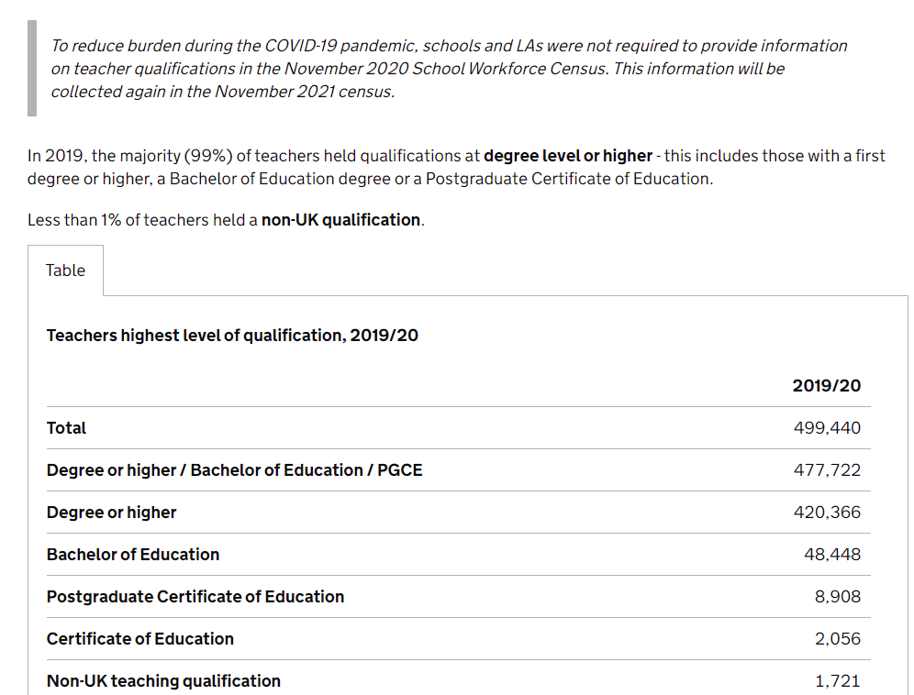
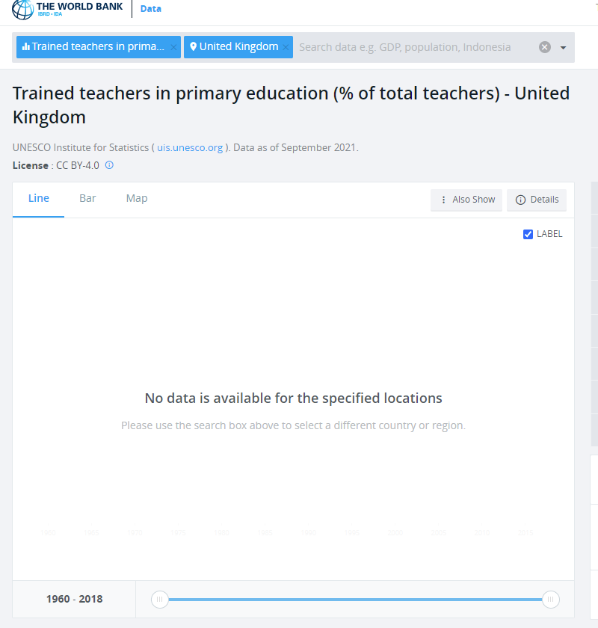
Gap in Data in the UN Systems
Example 1
Notes:
https://data.worldbank.org/indicator/SE.PRM.TCAQ.ZS?locations=GB
https://explore-education-statistics.service.gov.uk/find-statistics/school-workforce-in-england

Slide 15
Data Available in National Systems and Missing in UN Systems
Example 2: Data on secondary school enrollment
Available in the national portal of Trinidad and Tobago
  Missing in the UN systems data

Slide 16
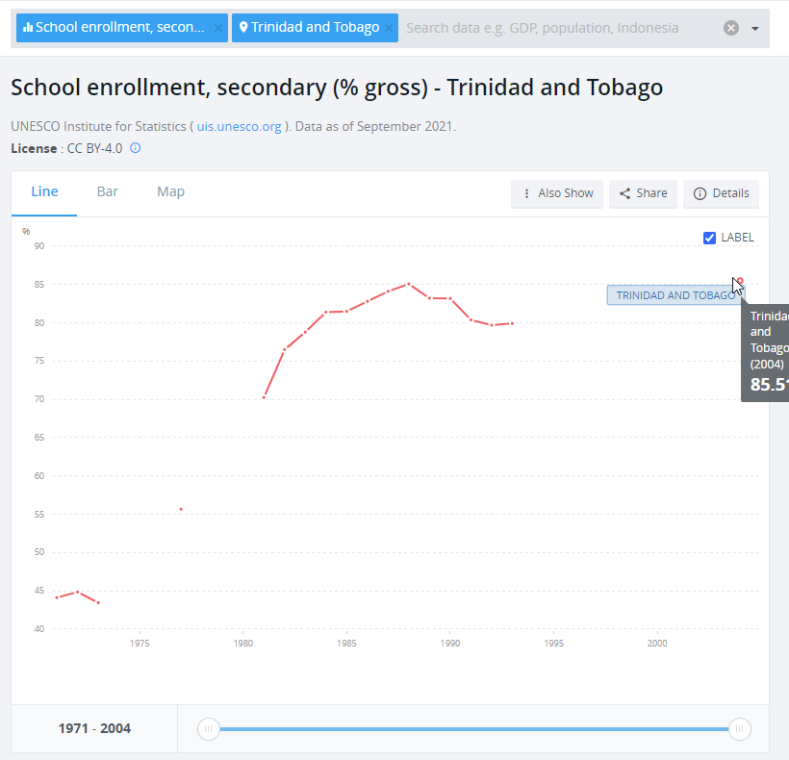
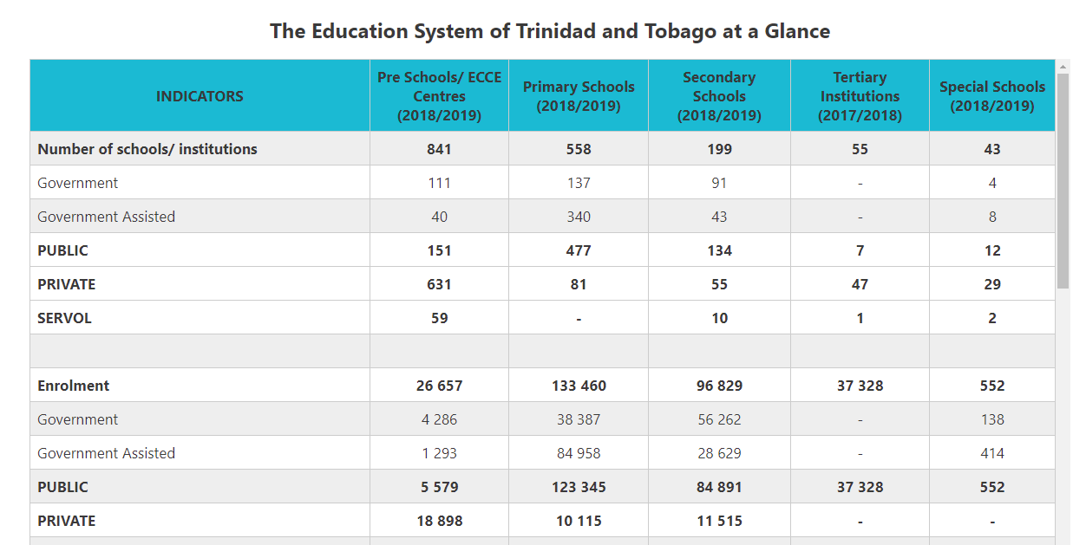
Gap in Data in the UN Systems
Example 2
Notes:
https://data.worldbank.org/indicator/SE.SEC.ENRR?locations=TT
https://cso.gov.tt/subjects/population-and-vital-statistics/education-statistics/

Slide 17



































Commonwealth Support
Targeted support to member countries, especially SIDS in making available core national data for SDG4 indicators to data portals of Inter-Governmental Organisations
Capacity building
Essential technology for data interchange

Slide 18



Acknowledgement of support received from
Mr. Ricky Cheng: data analysis; Ms. Helen Askounis: graphics design
www.col.org
The contents of this presentation, with the exception of logos and graphics which are the property of the respective owners, is made available under Attribution-ShareAlike 4.0 International (CC BY-SA 4.0).

