Slide 1


Commonwealth of Learning
PROMOTING LEARNING
FOR SUSTAINABLE DEVELOPMENT
Professor Asha Kanwar
COL President & CEO
Commonwealth Secretariat Annual Meeting
of the Board of Governors
17 May, 2023

Slide 2
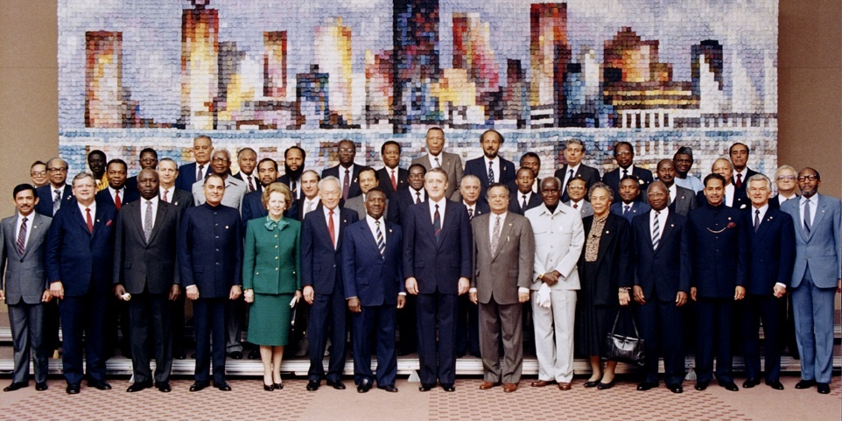
Commonwealth Heads of Government Meeting
Vancouver, 1987

Slide 3
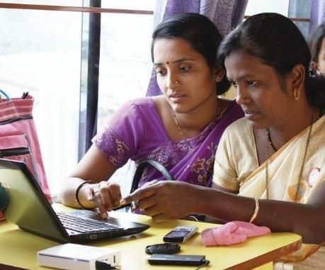
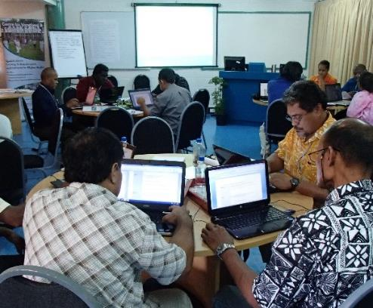
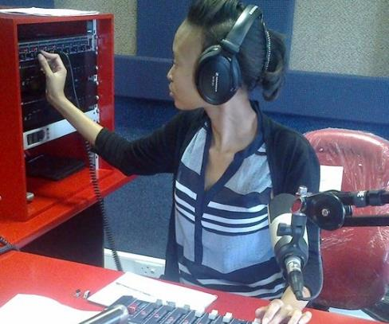
To help Commonwealth governments and institutions use technologies to improve and expand access to education and training

Slide 4

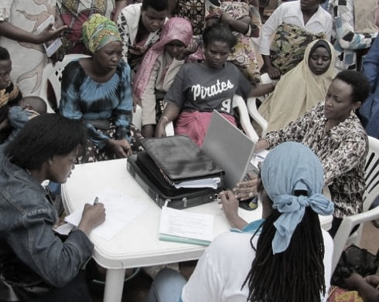
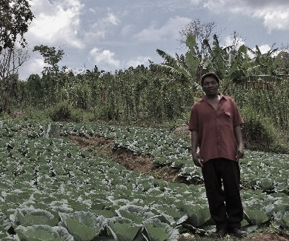


ECONOMIC EMPOWERMENT
SOCIAL
INCLUSION
ENVIRONMENTAL CONSERVATION
$
Notes:
COL continues to promote ‘learning for sustainable development’. Learning must lead to economic growth, social inclusion and environmental conservation.

Slide 5
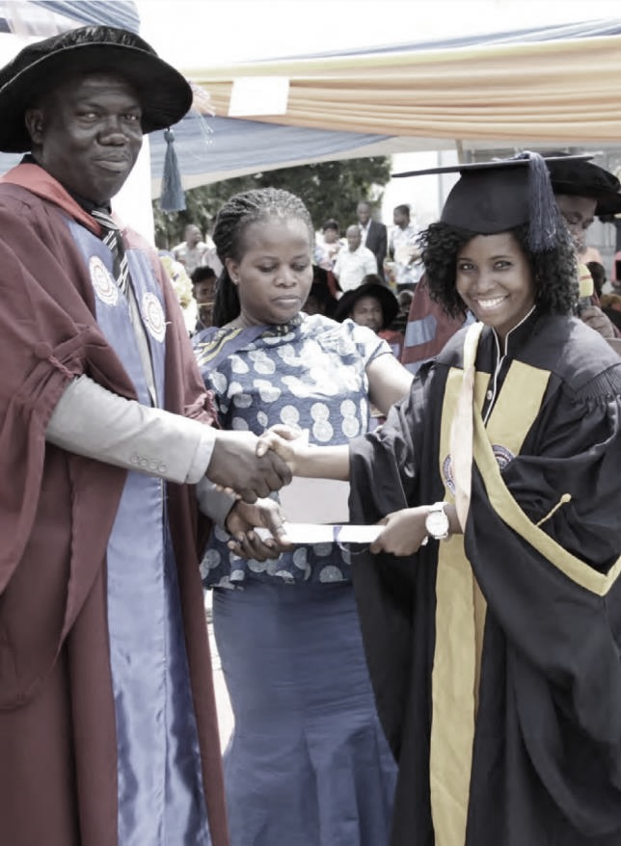
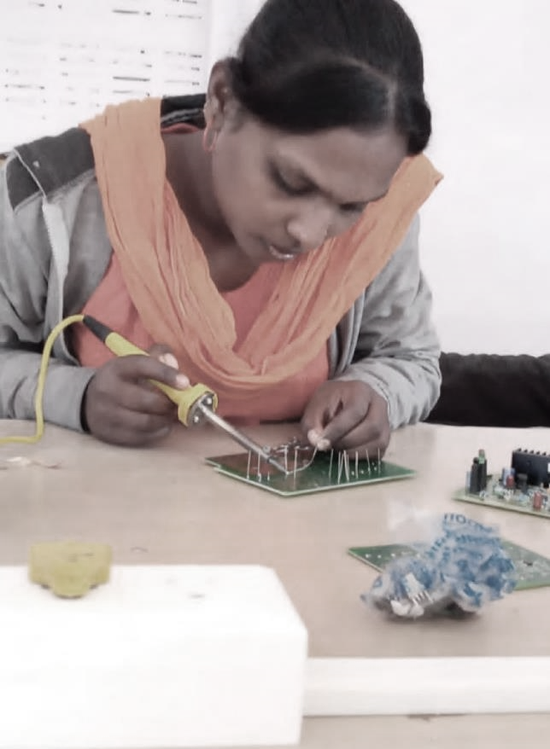
PROGRAMME SECTORS
Education
Skills
Gender Equality

Slide 6
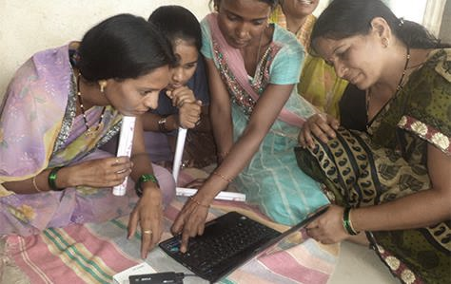
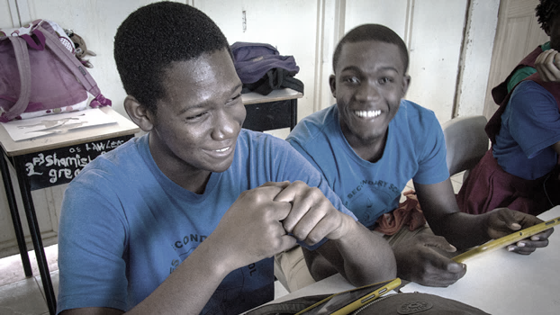
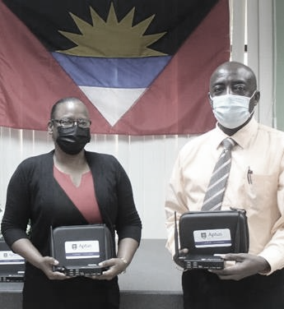
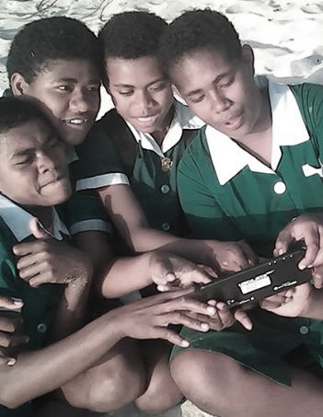
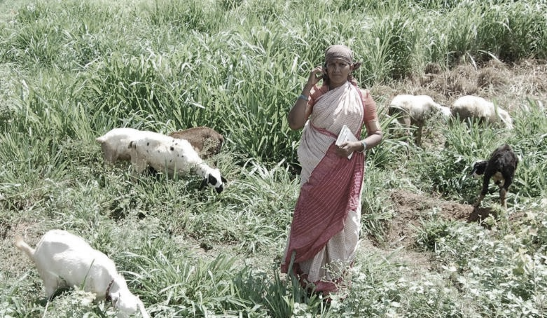
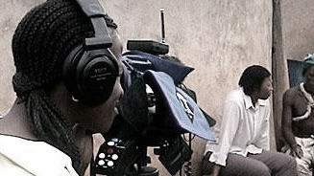
Leveraging new and existing technologies

Slide 7

Building National Resilience

Slide 8




National Policy Development
National Open Educational Resources Policy, Mauritius
Open and Distance Learning Policy for Tertiary Education Institutions,
Sierra Leone
ICT in Education and Training Policy, Seychelles
MAURITIUS
SEYCHELLES
SIERRA LEONE
Notes:
COL supported the Ministry of Education, Tertiary Education, Science and Technology. Mauritius to develop the national OER policy and assisted the revision and implementation of ICT in education and training policy for Seychelles. In Sierra Leone, a national policy for open and distance learning in tertiary education was developed along with building the capacity of the Tertiary Education Commission to ensure systematic implementation of the policy in educational institutions.

Slide 9
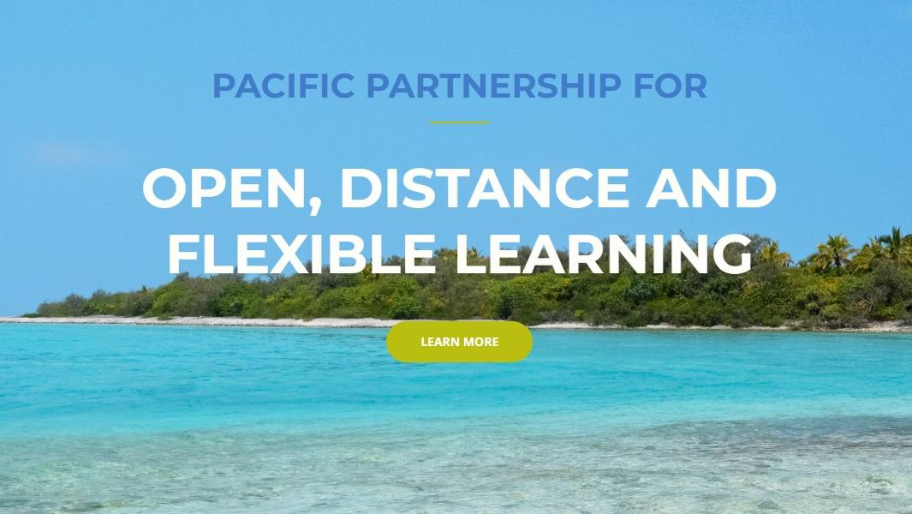









pacificpartnership.col.org
FIJI
KIRIBATI
NAURU
PAPUA NEW GUINEA
SAMOA
SOLOMON ISLANDS
TONGA
TUVALU
VANUATU
Notes:
This is the first of several presentations each of which summarises the key issues in different chapters of COL’s new publication Addressing the Needs of Out of School Children through Expansion of
Open Schooling. This first presentation discusses Chapter 1 by Tony Mays.

Slide 10
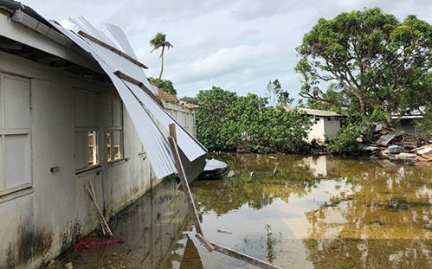

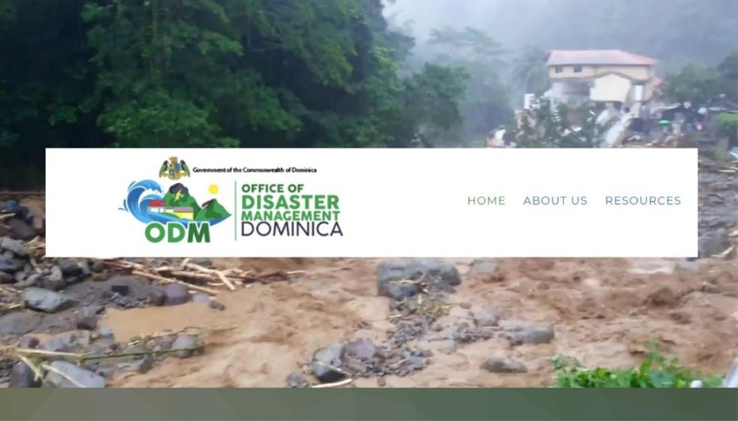

DOMINICA
Dominica launches online platform to boost disaster preparedness with COL’s support
TONGA
COL deploys Aptus in cyclone-hit Tonga

Slide 11

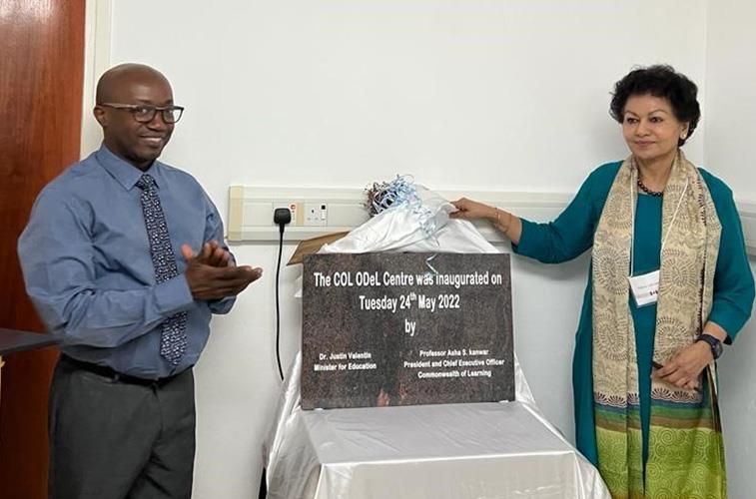
‘COL is an invaluable partner…. Seychelles has gained a high income status, and whilst almost all international organisations have disengaged their support, COL is still with Seychelles because of its conviction that small states of the Commonwealth need continuous support.’
SEYCHELLES
Dr Justin Valentin
Minister of Education, Seychelles

Slide 12
Strengthening Institutions

Slide 13

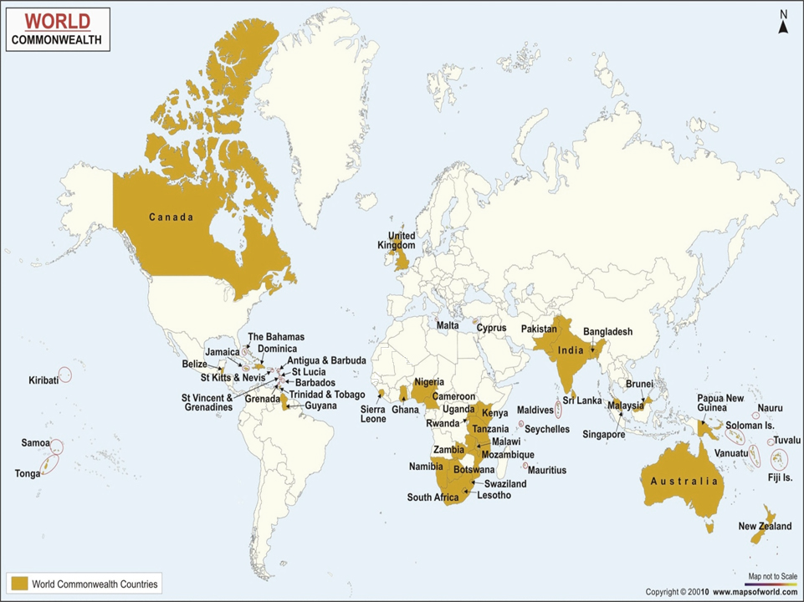

Virtual Universities for Small States of the Commonwealth

Slide 14
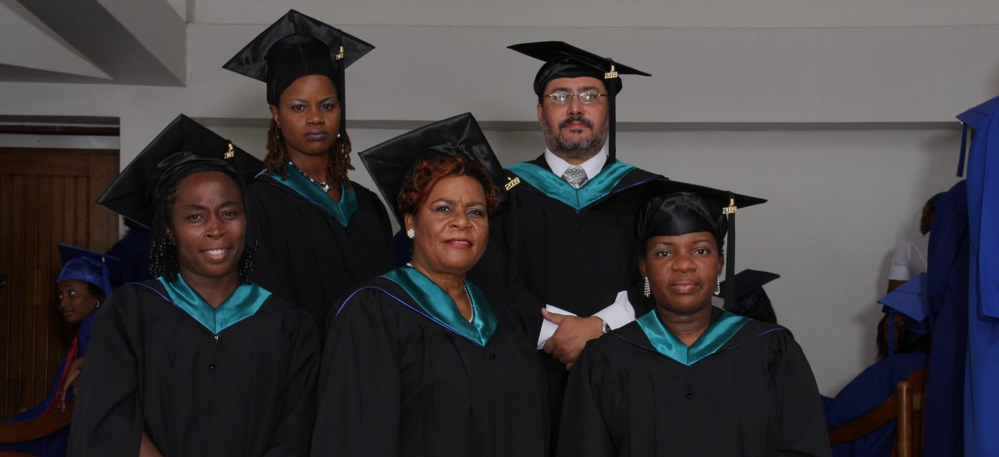



Commonwealth Executive MBA/MPA
Graduates saw on increase of 38% in monthly income
For every $1 invested, learners received $3.40 in direct returns
1:3.4

Slide 15

ICT Augmentation for Small States/LDCs
Addressing ICT resources and capacities
Build national resilience for education by supporting disaster preparedness in small states
Introduce and model the use of environmentally sustainable green technologies

Slide 16
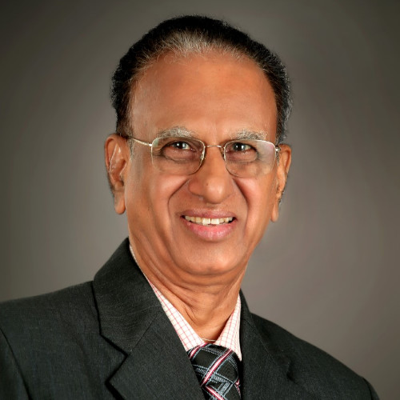

More than material contributions, associational pride, prestige and learning are significant contributions to all institutions engaged with COL
Professor V.S. Prasad
former Vice Chancellor, Dr. B.R. Ambedkar Open University
INDIA

Slide 17
Improving lives and livelihoods

Slide 18
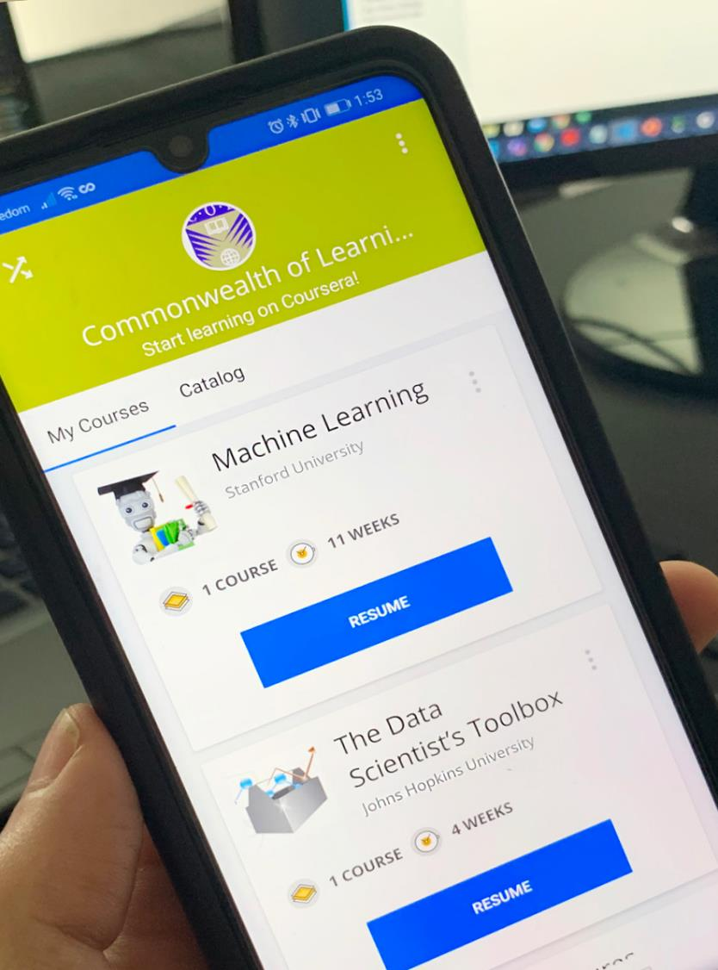



Skilling and re-skilling
COL has admitted over 350,742 citizens
of the Commonwealth to gain skills for employability and entrepreneurship
Notes:
# taken from Shadrach presentation at PUM April 2023. Enrolments since July 2021 for all three platforms.

Slide 19

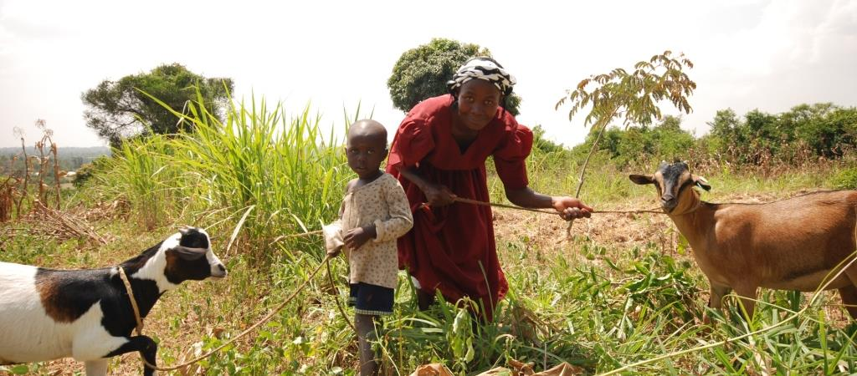


Lifelong Learning for Farmers (Kenya, Tanzania, Uganda):
1% increase in empowerment 2.3% increase in profit
Notes:
Belize
Benefits: skills, expected income
Social Return on Investment of an Open School showed that every US$ invested resulted in US$8 worth of benefits to students.

Slide 20

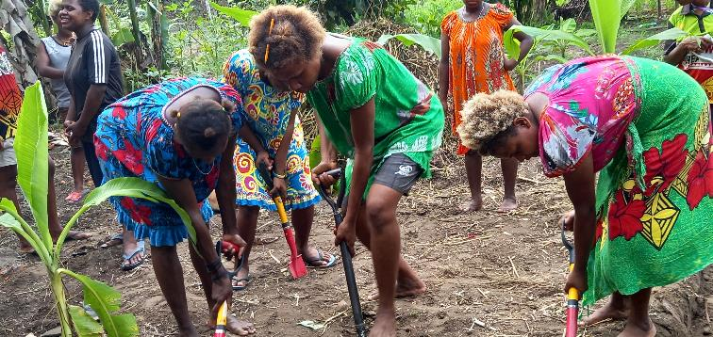
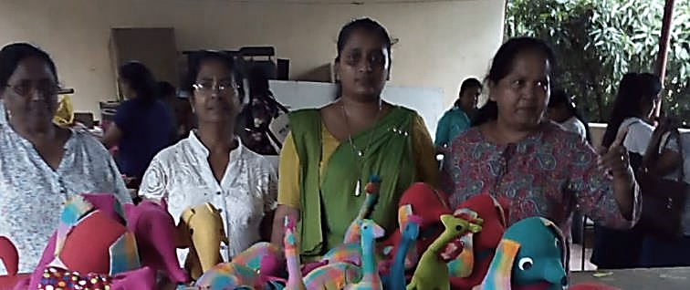









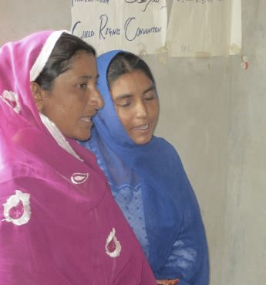
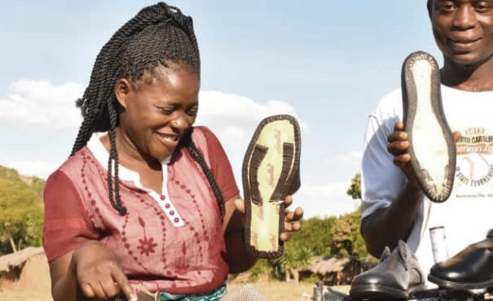
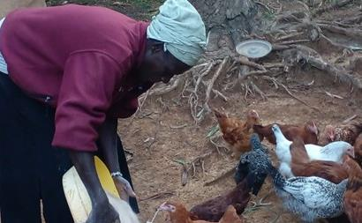
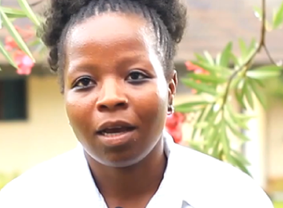
GIRLS Inspire
126,895 trained
BANGLADESH | KENYA | MALAWI | MOZAMBIQUE | NAMIBIA | PAKISTAN | PAPUA NEW GUINEA | SOLOMON ISLANDS | SRI LANKA | UGANDA

Slide 21
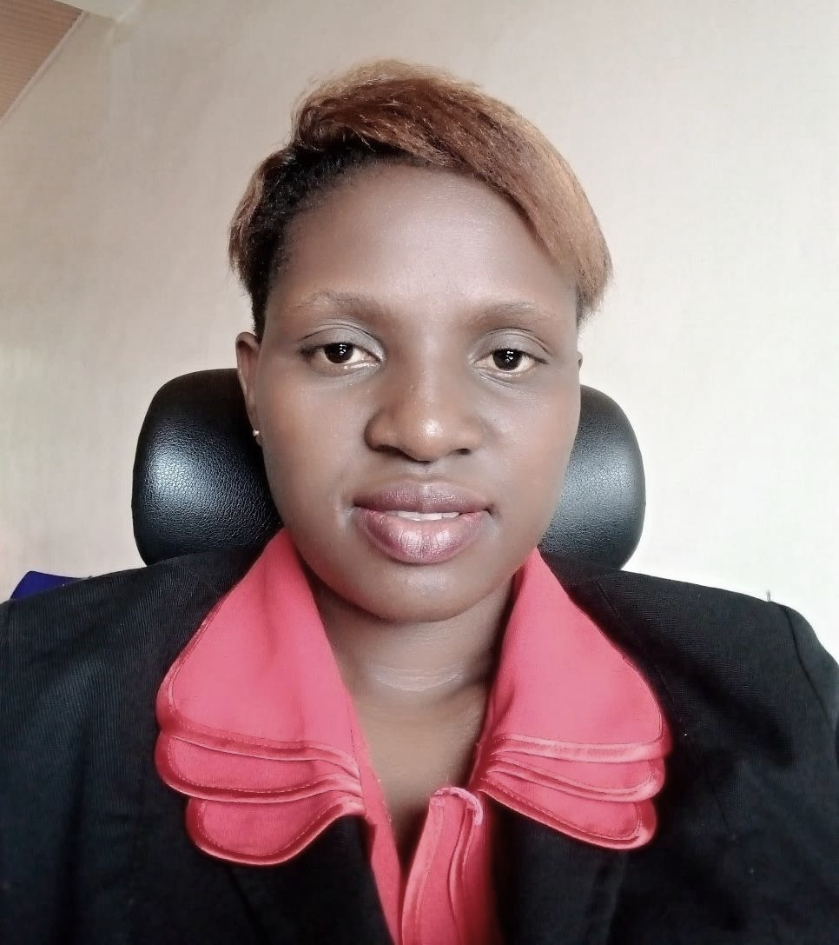


“My customer base and revenues have increased and I have regained confidence. I am giving back to my community by training youth, women and people with disabilities equipping them with digital literacy skills because these skills help us change our life for the better.”
Martine Benemariya, Rwanda

Slide 22
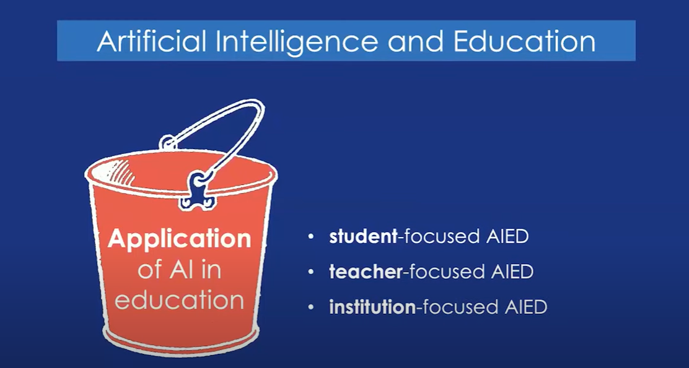
Dr Wayne Holmes, Associate Professor in the UCL Knowledge Lab at University College London, Webinar on Artificial Intelligence and Open Education: A critical studies approach

Slide 23


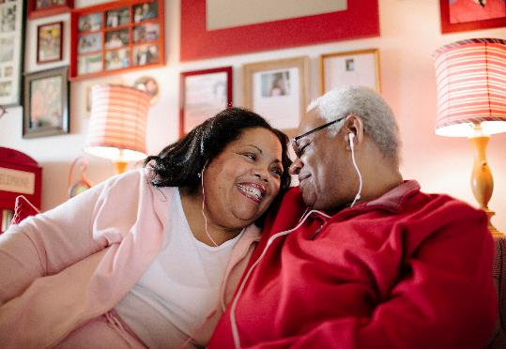

Even with AI, the world will still need…
Blue collar
skills
Skills relating to empathy
Skills with Creativity and Innovation
Notes:
Blue collar skills are required for jobs in industries that involve manual labor, such as construction, manufacturing, transportation, and agriculture (Technical, physical, spatial, time management, teamwork, and safety). As the workforce evolves and new technologies emerge, blue collar workers will need to continually update their skills to keep up with changing job demands.
Empathy skills enable workforce to build strong relationships, provide effective care and support, and to work collaboratively with others, especially in professions like healthcare, education, social work, counseling, and customer service (Active listening, emotional intelligence, communication, cultural competence, patience and tolerance, and problem solving).
Creativity and innovation – Creativity enable workforce to generate new and original ideas, while innovation enables them to turn the ideas created into practical solutions that add value (complex problem solving, adaptability, curiosity, open mindedness, collaboration and entrepreneurship).

Slide 24
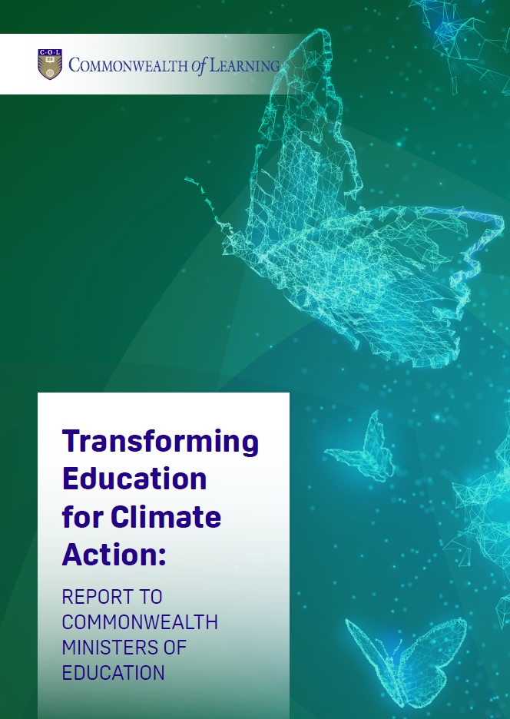

Slide 25


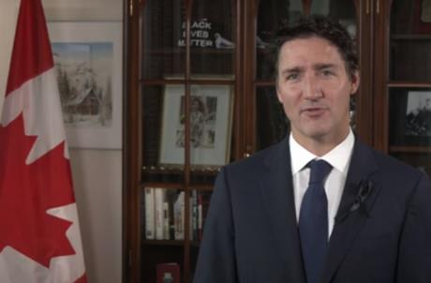
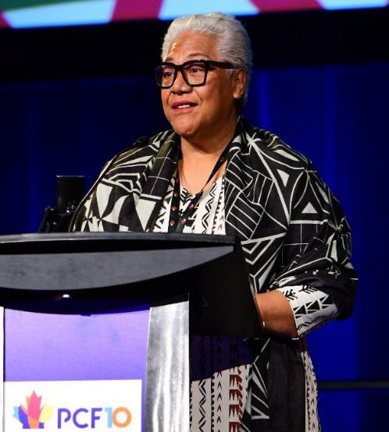
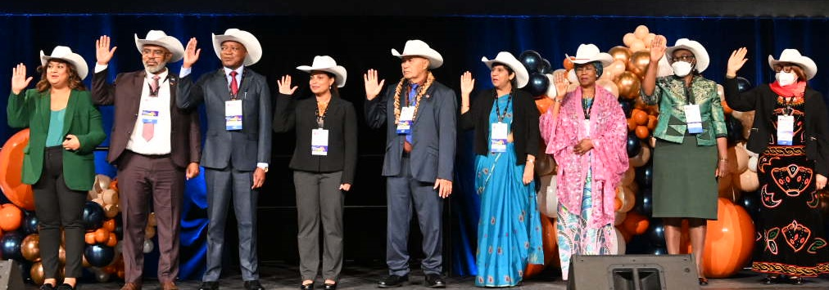
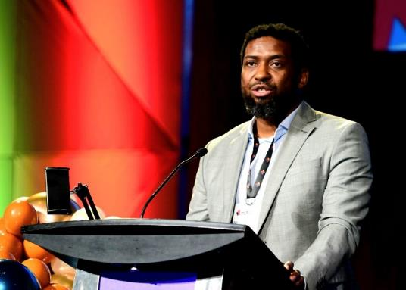
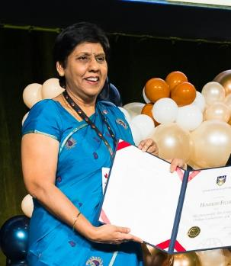
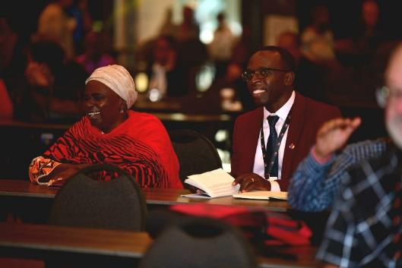
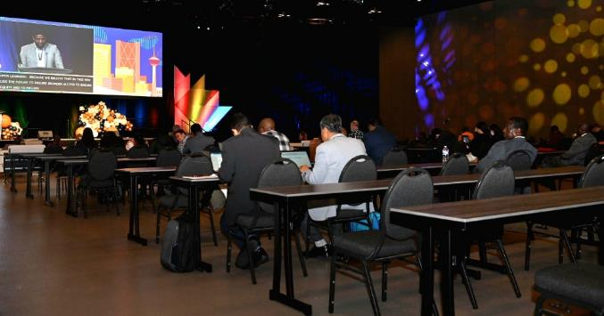
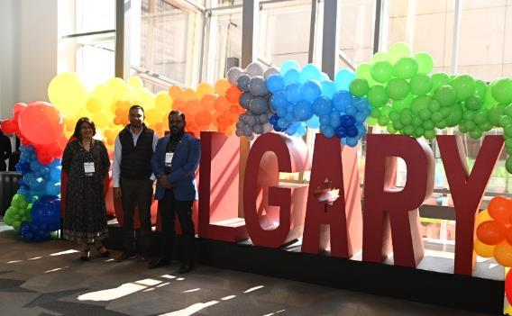
14 to 16 September 2022
Innovations for Educational Resilience
14 – 16 September 2022

Slide 26
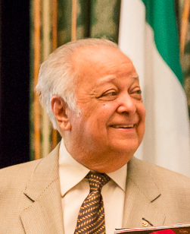
‘Learning for Sustainable Development’
is one of the higher purposes toward which the Commonwealth can reach. As the world itself strives toward… ‘a new social contract’, ‘a new global deal’, COL’s mandate and vision are ever more important. I have elsewhere described the Commonwealth of Learning as ‘a jewel in the crown of the Commonwealth’.
We need to keep it ever exceptional.’
Sir Shridath Ramphal GCMG AC ONZ OE OCC QC Secretary General Commonwealth 1975-1990

Slide 27


Thank you
www.col.org
The contents of this presentation, with the exception of logos and graphics which are the property of the respective owners, is made available under Attribution-ShareAlike 4.0 International (CC BY-SA 4.0).

