Slide 1
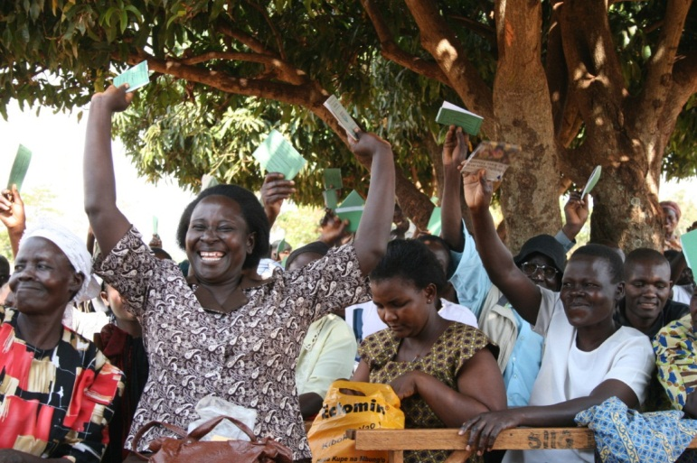


K. Balasubramanian
&
Alexis Carr
Group 5
Parallel Workshop,
Women’s Forum
CHOGM 2015
Malta
Learning to Empowerment: A Roadmap
Based on the Experiences of the Commonwealth of Learning (COL)’s Lifelong Learning for Farmers (L3F) Programme

Slide 2
Relationship between Education and Empowerment
Enigmatic Relationship
Empowerment is more than building skills and competencies- Paulo Freire
No positive linear relationship between education and the economic, social and political empowerment of women in Asia- Jayaweera, 1997

Slide 3
Non-Formal Learning
Followed the traditions of formal education
Yet to show that non-formal learning can empower particularly women

Slide 4
Definition of Empowerment
Plethora of definitions and hence the confusion
COL used Naila Kabeer’s definition “the expansion in people’s ability to make strategic life choices in a context where this ability was previously denied to them”- in the context of resources, agency and achievements

Slide 5
Measuring Empowerment- Empowerment Index
Women’s Empowerment in Agriculture Index (IFPRI, 2012), the Women’s Empowerment Matrix (Charmes, & Wieringa, 2010) and the Women Empowerment Index of CARE International (Njuki, Kruger, & Starr, 2013)
COL further developed an index both for women and men
“patriarchal structures and stereotyped notions of gender hide the increasing disempowerment of many men” (Silberschmidt,2001)

Slide 6
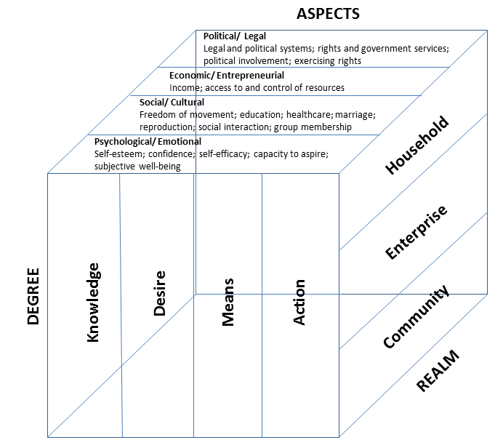
COL 3 Dimensional Model of Empowerment

Slide 7
Lifelong Learning for Farmers (L3F) Model implemented in 7 Commonwealth Countries
Social Capital
ICT Based ODL
ICT Based ODL
Natural
Physical
Empowerment
Livelihood Outcome
Policy
Institutions
Investments
Financial Capital
ICT Based ODL
Human Capital
ICT based Open and Distance Learning reduces the opportunity costs in learning

Slide 8
Based on Studies in Uganda and Kenya
In Uganda, the study compared L3F village and Non-L3F village within the same socio-economic, cultural and agro-climatic zone.
In Kenya compared three groups of households with backyard poultry: L3F households, Association member but not in L3F, neither in L3F nor a member in associations.
Empowerment index ranges from 0 to 1, with 0 depicting least empowered or highly disempowered and one reflecting highly empowered.

Slide 9
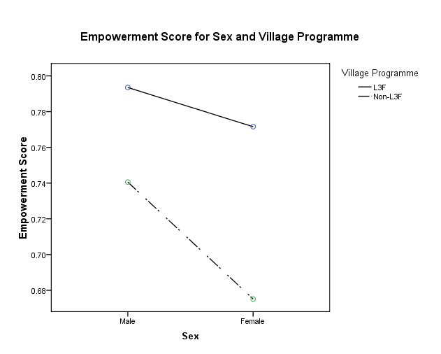
In Uganda
Male
Empowerment scores are higher for the L3F village than the Non-L3F village
Female empowerment scores are lower than the Male scores- though in L3F the margin is less
Women in the L3F village have a higher mean empowerment score than men in the Non-L3F village.
Female
Male
Female

Slide 10
In Uganda
The process of empowerment is not uniform at the household, community and enterprise levels.
Women in L3F have a higher empowerment score at the community level and enterprise level but at the household level, less empowered.

Slide 11
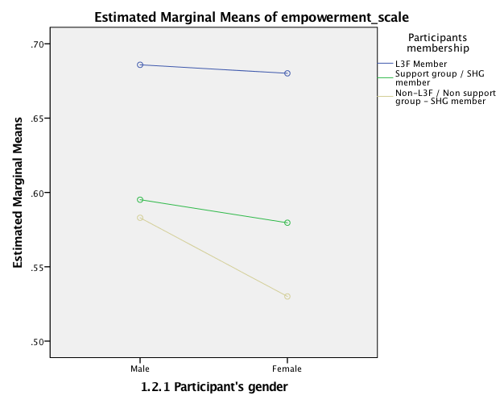
In Kenya
Male
Female
Empowerment scores are higher for the L3F Households compared to other two control groups
Female empowerment scores are almost equivalent to Male L3F
Female empowerment scores in L3F is much higher than male empowerment in other two groups
Male
Male
Female
Female

Slide 12
Determinants of Empowerment based on Regression Analysis in
Uganda & Kenya
Education (particularly primary and secondary) has not emerged as a significant factor
Age , family income, reproductive role, years of farming are also not significant
Social capital by itself is not enough
Learning ( in the context of social capital and financial capital) significant determinant of empowerment.

Slide 13
Conclusion
Education by itself is not learning
Learning cannot be a sectoral activity. Need to have a holistic approach.
Learning linked to social and financial capital offer potentials for women empowerment at the community and enterprise levels.
Men’s empowerment may be required for strengthening the women’s empowerment at the household level.
Programmes & institutions such as banks, microfinance, financial literacy need to invest on enabling the community particularly women in learning in the context of social and financial capital since it offers a win-win framework
Empowerment is not a zero-sum game

Slide 14

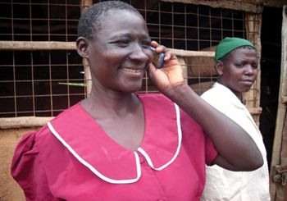
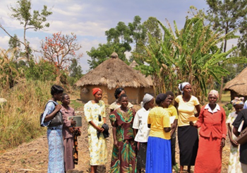
Thank You
For full details on empowerment index and analysis of Uganda read the paper in the online Journal, “Journal of Learning for Development http://jl4d.org/index.php/ejl4d/article/view/124

