Slide 1
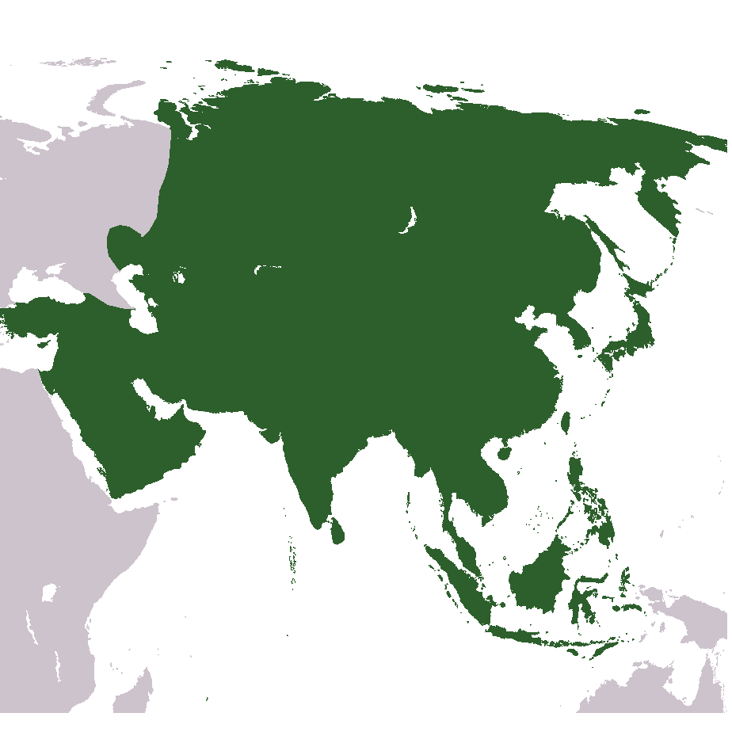




Rethinking Openness: Experiences from the Commonwealth
ODL 2020 and beyond
Sanjaya Mishra
Education Specialist, eLearning
Commonwealth of Learning, Canada
XXVII International Conference on Distance Education
2-6 December 2019, Guadalajara, Mexico

Slide 2
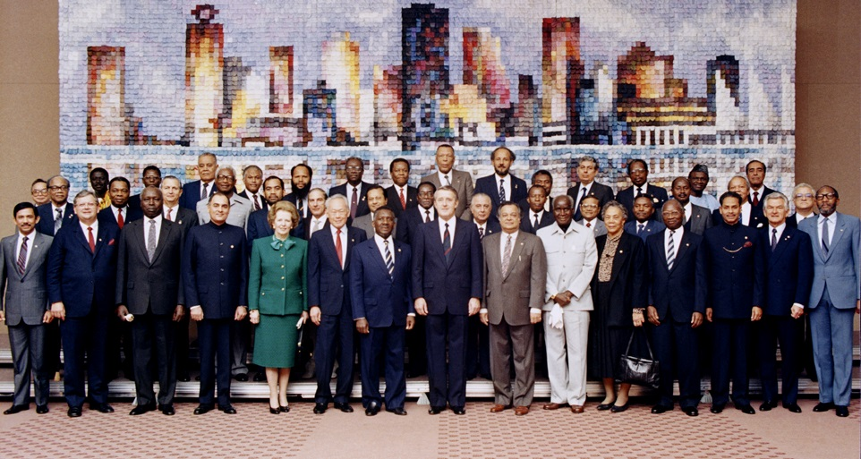
Commonwealth Heads of Government Meeting
Vancouver, 1987

Slide 3

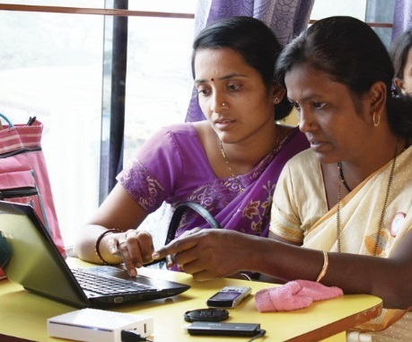
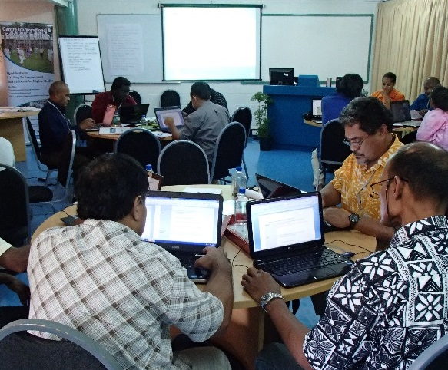
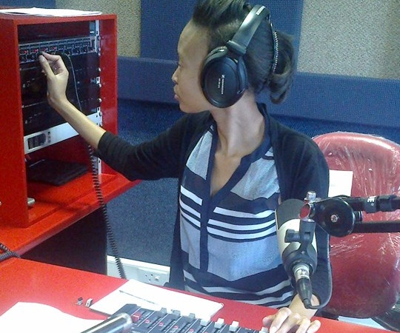
To help Commonwealth governments and institutions use technologies to improve and expand access to education and training

Slide 4

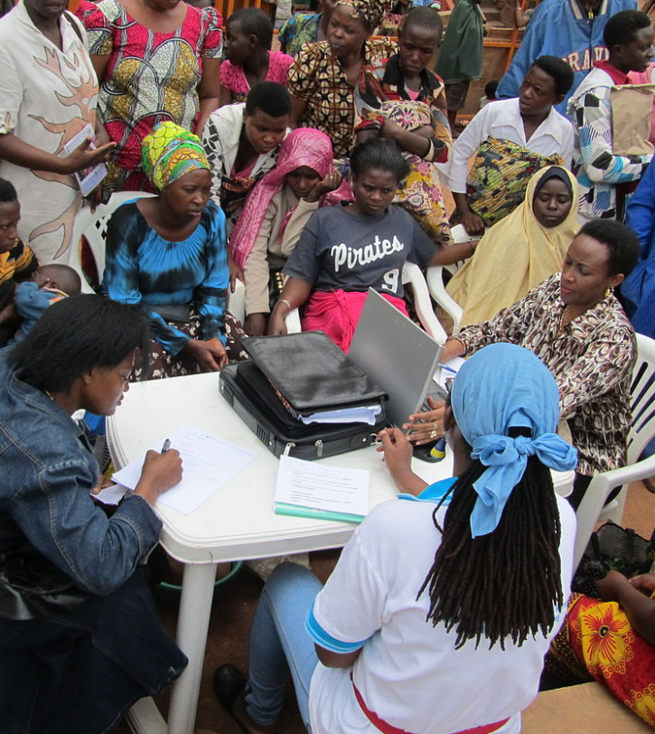
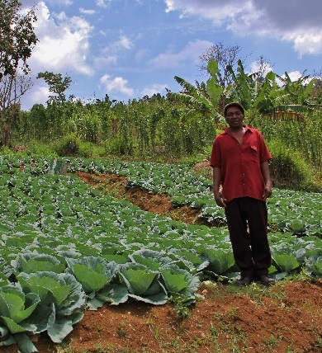



Learning for Sustainable Development
ECONOMIC
GROWTH
SOCIAL
INCLUSION
ENVIRONMENTAL CONSERVATION

Slide 5
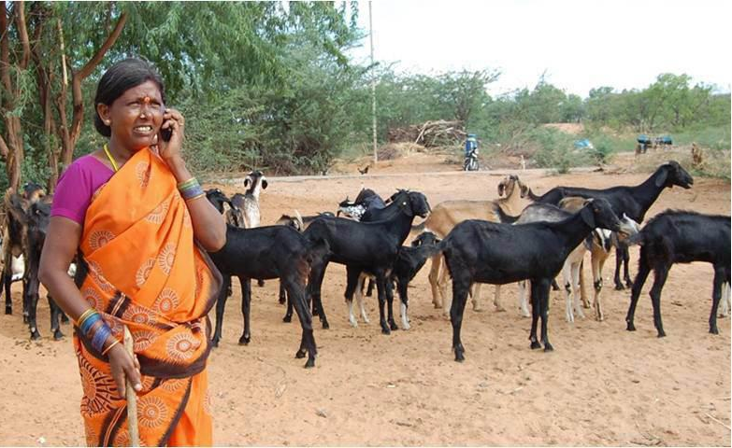
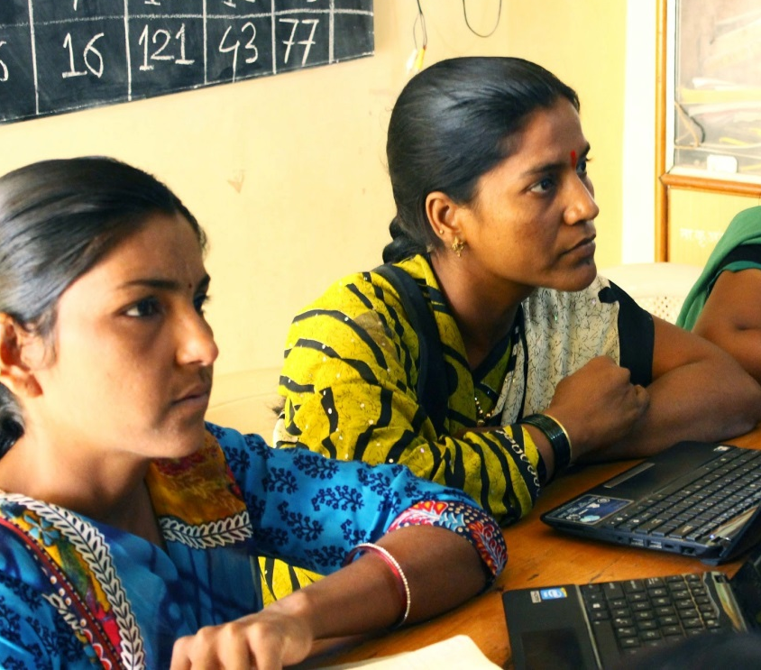
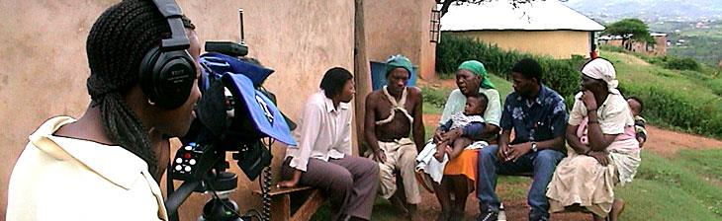

Leveraging
New & Existing Technologies

Slide 6

Overview
Context
Evolution of ODL
ODL in the Commonwealth
Rethinking openness in Distance Education

Slide 7
Context

Slide 8
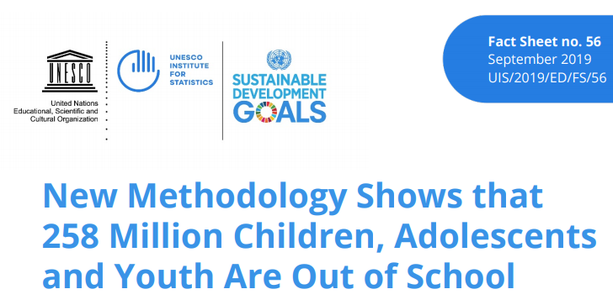
Access to education
258 million children out co school
More than 50% of young people in 58 out of 133 countries have not completed upper secondary school
Source: http://data.uis.unesco.org/

Slide 9
Tertiary enrollment rate
Source: https://data.worldbank.org/indicator/se.ter.enrr
Notes:
(2017)

Slide 10
Access to ICTs

Slide 11
Access to learning resources
1 reading textbook for 12 students and only 1 mathematics textbook for 14 students in grade 2 in Cameroon. (UNESCO GEMR Policy Paper 23)
3 students for every reading textbook, compared with 8 students for every mathematics textbook in Togo. (UNESCO GEMR Policy Paper 23)
Average higher education students in Bangladesh spend BDT 1850 per year on books and supplies. (COL, 2017)
In Malaysia 76.4% learners decide not to buy textbooks due to high costs (COL, 2017)
Notes:
In the Unites states students spend USD 1200 per year. Over 5.2 million students use
financial aid to purchase their textbooks. About 65% students inform that their grades are affected due to non-purchase of required textbooks.

Slide 12
Cost of tertiary education
Source: https://www.eiuperspectives.economist.com/sites/default/files/EIU_Yidan%20prize%20forecast_Education%20to%202030.pdf

Slide 13
Skills shortage
45% of employers can’t find skilled individuals to recruit¹
Digitalisation is transforming the way many jobs are carried out.² There is a skills shift happening towards digital.
By 2020 there will be a global shortfall of 85 million high- and middle-skilled workers³
Source: https://insights.manpowergroupsolutions.com/2018-talent-shortage-survey/
Source: https://www.oecd.org/education/oecd-skills-outlook-2019-df80bc12-en.htm
Source: McKinsey, https://tinyurl.com/y79fqao8
Notes:
Convinced that higher education leads to higher earnings and social mobility, most governments have invested heavily in higher education. But even where there is increased access to tertiary education, it is not a passport to employment. Half the youth surveyed by a McKinsey report were not sure that their post-secondary qualifications would lead to a job—58% employers did not believe that new graduates were well prepared for work.

Slide 14
Youth unemployment
Source: https://data.worldbank.org/indicator/SL.UEM.1524.ZS?most_recent_value_desc=false
Notes:
The Commonwealth is young with 60% of its population under the age of 30. Youth unemployment in some Commonwealth countries is exceptionally high. The global youth unemployment average is nearly 13% in many Commonwealth it is well over 40%. What do we need to differently to make our youth ready for employment and entrepreneurship?

Slide 15

Global educational Challenges
Access
Quality
Gender inequality
Unemployment
Lifelong and life-wide learning
Notes:
Increasing access
Improving quality
Reducing gender inequality
Reducing unemployment
Providing lifelong and life-wide learning opportunities

Slide 16
Evolution of ODL

Slide 17
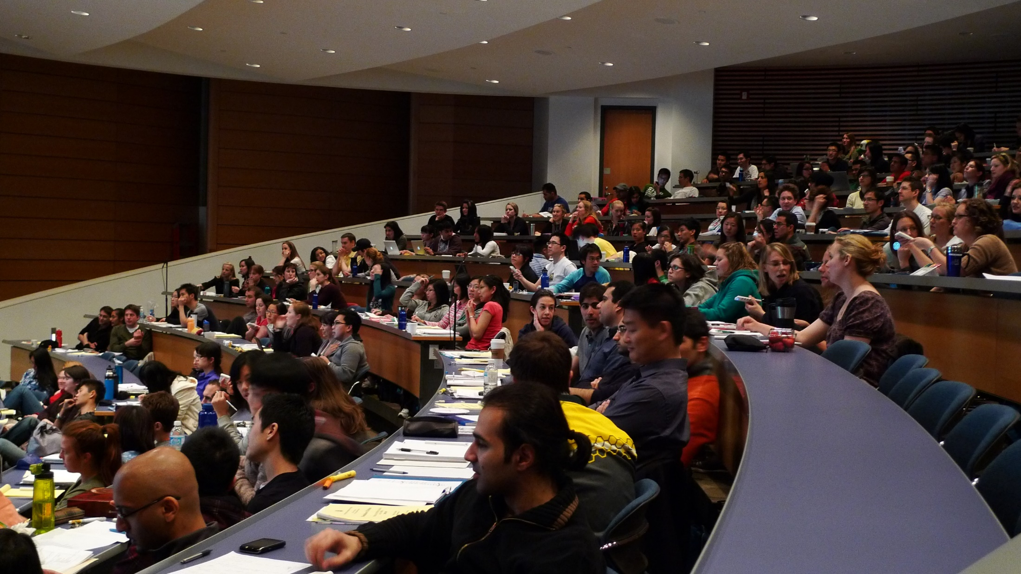
Source: https://www.flickr.com/photos/velkr0/3472576304 (CC BY)
business as usual continues…

Slide 18
Models of universities
Knowledge-for-itself
ivory tower OXBRIDGE TYPE | (b) the ‘professionalised university’ DISCIPLINE BASED UNIVERSITY
(c) the ‘entrepreneurial university’ PRIVATE/ CORPORATE UNIVERSITIES | (d) the ‘developmental university’ OPEN UNIVERSITIES/ VIRTUAL UNIVERSITIES
Knowledge-in-itself
Knowledge-in-the-world
Knowledge-for-the-world
Source: Barnett, R. (2011). Being a university, London: Routledge

Slide 19

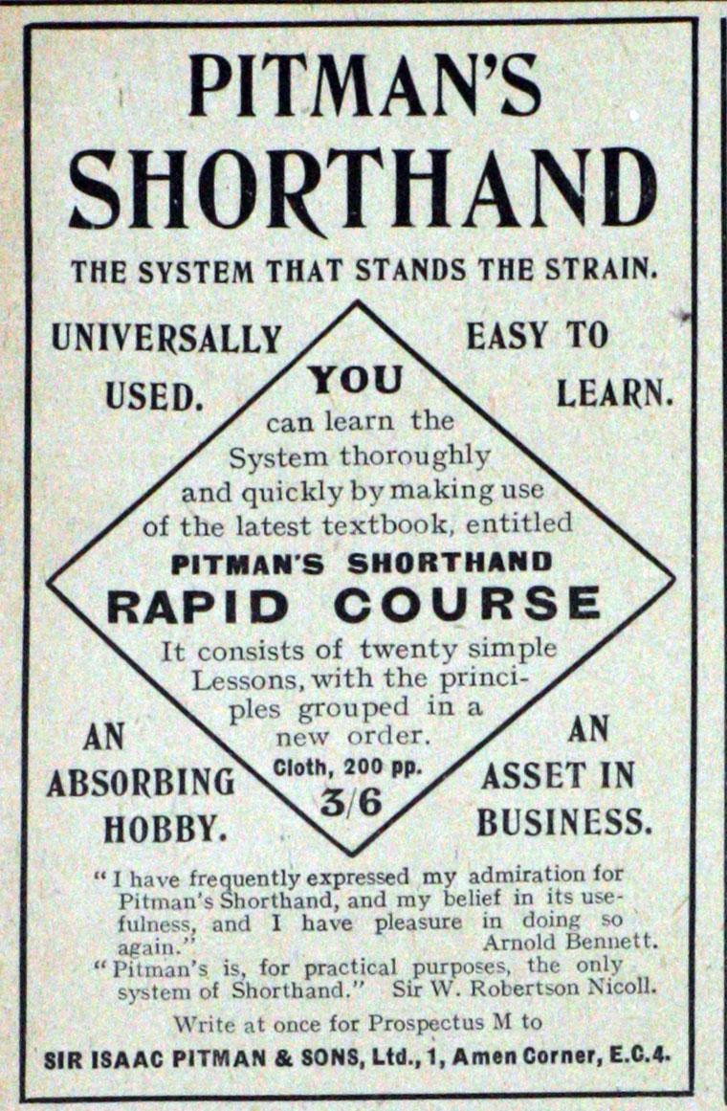
Innovations in teaching and learning
Boston Gazette 1728
Pitman’s Shorthand 1840
UNISA as the first distance teaching university in 1946
UK Open University in 1969

Slide 20


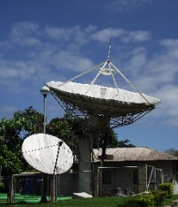


ODL Over the Five Stages
Correspondence model
Multi-media model
Tele-learning model
Flexible learning model
Intelligent flexible learning model
Gen 1
Gen 2
Gen 3
Gen 4
Gen 5
Notes:
CC BY-SA by David Right https://commons.wikimedia.org/wiki/File:E_II_R_Postbox,_Burgate,_Barton_Upon_Humber_-_geograph.org.uk_-_1064916.jpg

Slide 21
Disruption in Higher Education
Top-tier F2F Higher Education institutions
High-end
MOOCs
Face-to-face teaching: sustaining trajectory
Mainstream F2F Higher Education
Online and blended courses
ODL as innovation
Open Universities and Dual-mode institutions
Low-end
Time

Slide 22
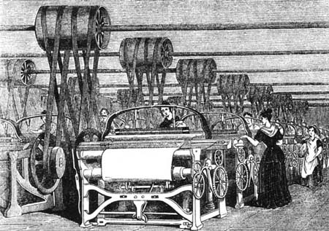
Industrial Model
Division of labour
Mass production
Planning and organisation
Otto Peters, 1967
This Photo by Unknown Author is licensed under CC BY-SA-NC

Slide 23
Models of Open Universities
Single-Mode Open University
AIOU, BOU, IGNOU, OUSL
Multimedia
University of Delhi
Dual-Mode University
Blended/ Online
Most universities in North America
Consortium Model
Collaborative
VUSSC, OERu, Open Universities Australia
Degree Oriented
Open University Malaysia
Virtual University Model
Virtual University Pakistan, African Virtual University
Multi-Modal Institutions
The Open University

Slide 24
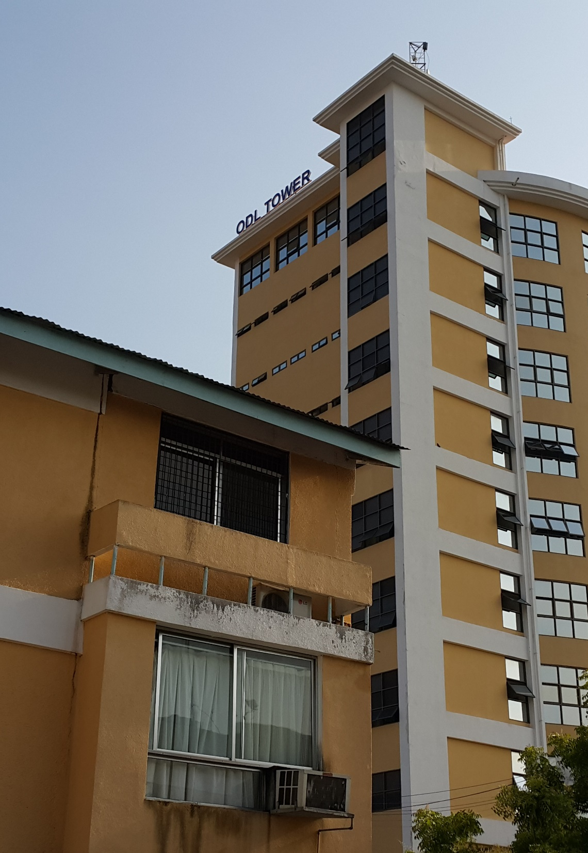
Single Mode Open Universities
Content: Self-learning materials in multiple media
Delivery: Use technology and study centres
Recognition: Formal credentials
Flexibility: Anytime, anywhere learning possible
Openness: Limited to certain programmes
Notes:
While single mode open universities started in 1969, the model promoted by them are still relevant in many countries due to lack of access to technology. They provide a cost-effective way to increase access and improve quality of education anywhere, anytime.

Slide 25
Dual-Mode Universities (Multimedia/Blended/ Online)
Content: Self-learning materials in print and digital formats
Delivery: Use campus-based face-to- face contact and use of online technologies
Recognition: Formal credentials
Flexibility: Programmes replicate face-to-face mode
Openness: Limited
Notes:
Increasingly, the conventional face-to-face institutions are adopting online technologies to offer online/ blended programmes. In the US, the Babson Survey 2018 reported that 31.6% students were taking at least one distance course on campus. This model normally uses the strengths of the existing faculty to reach more learners, and increasingly seen as a new business model for universities.

Slide 26



Consortium Model
Content: Digital learning materials
Delivery: Use of learning management system and other technologies
Recognition: Credentials through collaborative institutions
Flexibility: Anytime, anywhere learning possible
Openness: Mostly supported by open content and technologies for course development and delivery
Notes:
The Open University Malaysia is an interesting example of consortium model, where 11 public universities joined together to start another university specializing in offering distance and online courses. This model has further seen new ways of collaboration by bringing in several other initiatives such as COL’s own Virtual University for Small States of the Commonwealth (VUSSC), the Open Universities Australia and OER universitas. The strength of the collaborative model is the power of network – that reduces time and efforts and optimizes existing resources.

Slide 27


Virtual Universities
Content: Digital learning materials
Delivery: Use of learning management system and other technologies
Recognition: Formal credentials
Flexibility: Anytime, anywhere learning possible
Openness: Supported by technology and open content
Notes:
Many countries have also started virtual universities to leverage the potential of technologies, and especially the power of the increased access to internet and mobile technologies. Such models like the Virtual University Pakistan is an example for other countries to follow.

Slide 28
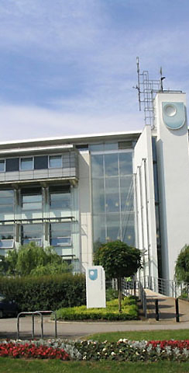

Multi-modal Universities
Content: Digital learning materials
Delivery: Use of learning management system, MOOCs
Recognition: Formal credentials; often recognizing MOOCs
Flexibility: Anytime, anywhere learning possible
Openness: Use of open content and technologies for course development and delivery
Notes:
The Open University is an example of an emerging new model that uses multiple strategies and has moved from its single mode approach to use of a range of technologies, including MOOCs. Its FutureLearn platform provide social learning opportunities that are accredited to provide formal credentials. Many of the courses are now offered in collaboration with other universities.

Slide 29
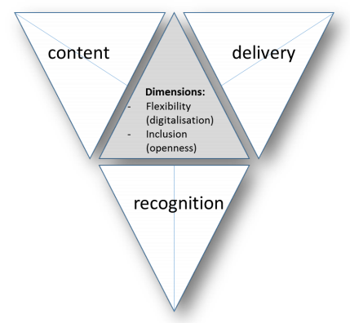
Open Online Flexible and Technology-enhanced Models
Source: https://oofat.oerhub.net/OOFAT/
Notes:
The ICDE study on open online flexible and technology-enhanced models in higher education provides a framework for analyzing different institutions. This framework provides five areas to critical analysis: Content, Delivery, Recognition, Flexibility and Openness.

Slide 30
ODL in the Commonwealth

Slide 31
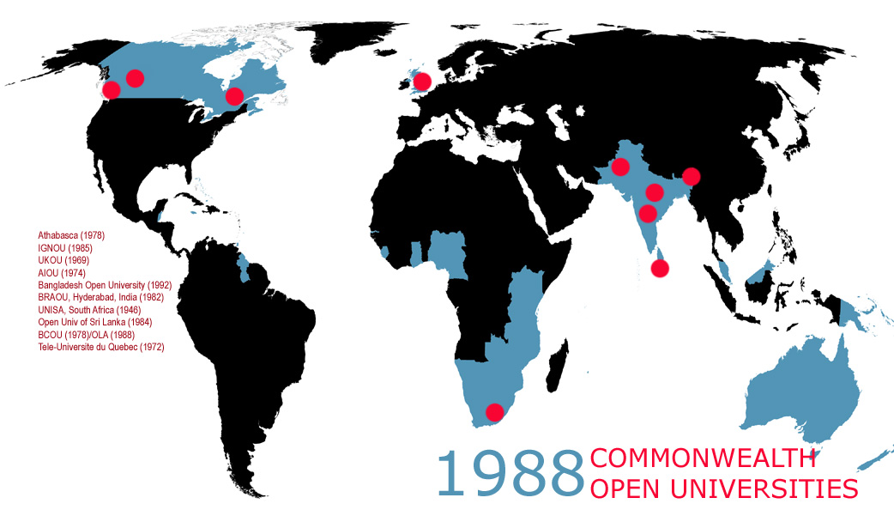
10
COMMONWEALTH
OPEN UNIVERSITIES
(1988)

Slide 32
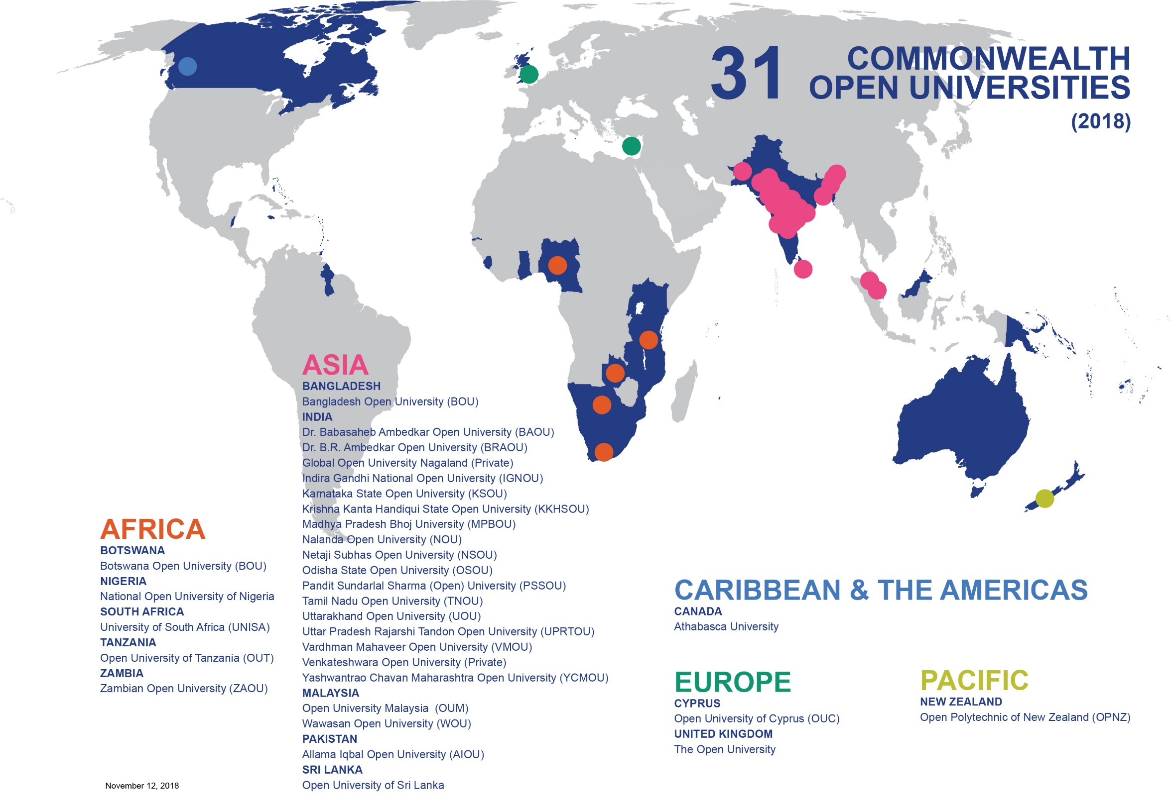
(2018)

Slide 33
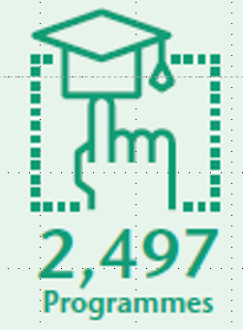
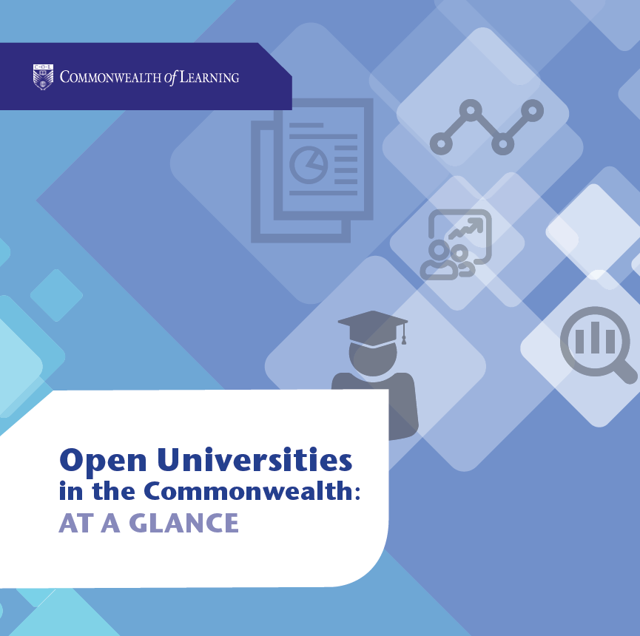
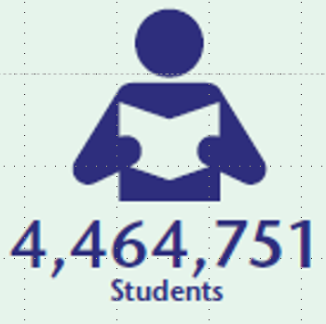
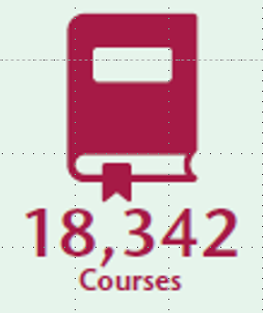
Open Universities at a Glance

Slide 34
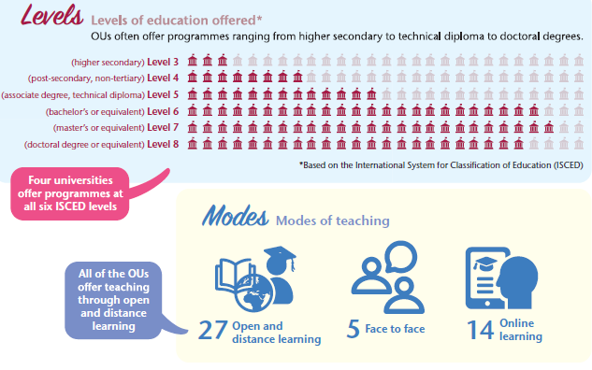
Open Universities at a Glance

Slide 35
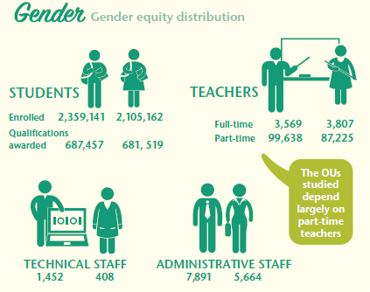
Open Universities at a Glance

Slide 36
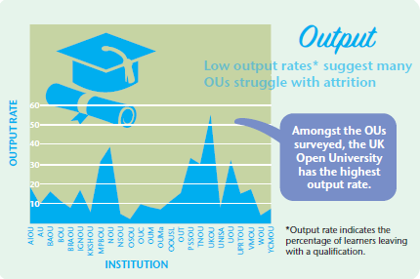
Open Universities at a Glance

Slide 37
Challenges for Universities
Emergence of new educational delivery models
Changes in management and accountability
Demands for knowledge creation
Demands from the learner community (digital natives) to change and adapt ICTs
More social responsibilities, including improving employability of graduates
Notes:
Universities today are facing multiple challenges. New emerging models of educational delivery such as MOOCs are both an opportunity for new business models and a threat to status quo. There is an increased pressure on Vice-Chancellors and Presidents to show results within reduced budget. Learners today are digital natives, and thus universities need to adapt new technologies efficiently and effectively. Moreover, there is also a strong societal pressure to excel as a centre for knowledge creation and provide relevant skills to produce employable graduates. In such a challenging environment, how are the open universities preparing themselves?

Slide 38
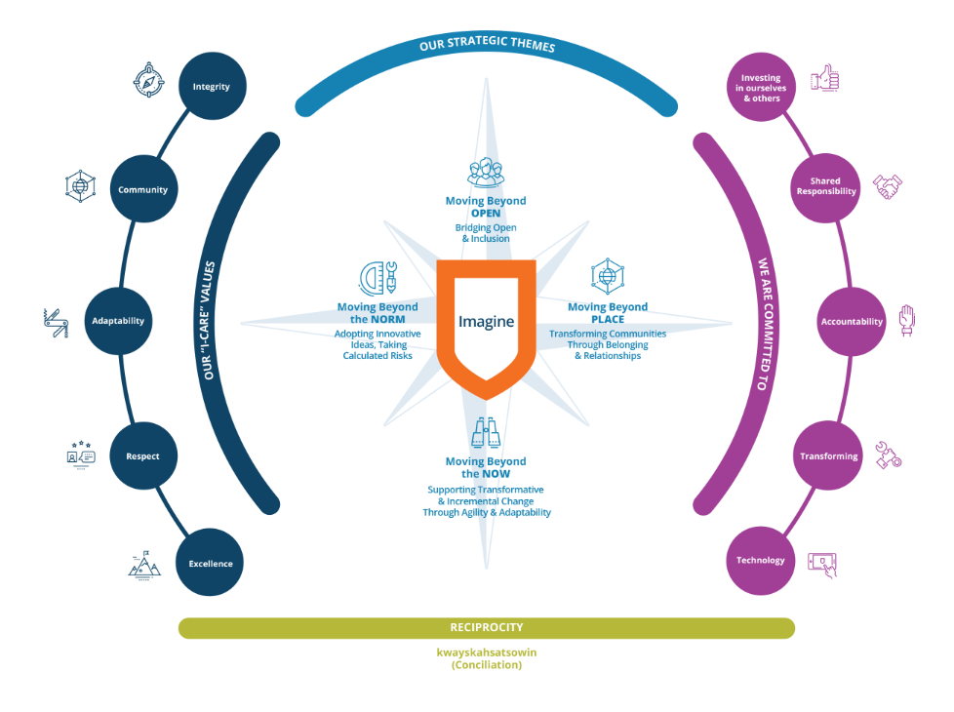
Athabasca University, Canada
Teaching and learning framework that supports lifelong self-paced learning
National enrollment growth through pathways, credential completion and non-credit courses
Data informed student service
Agile course development using open educational resources
Focus on digital strategy, innovation, research and collaboration
Source: http://imagine.athabascau.ca/

Slide 39

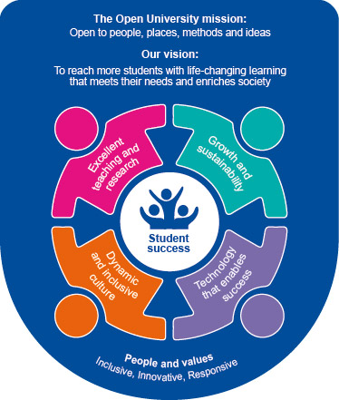
The Open University, UK
Increased enrollment and student satisfaction
Extending reach through FutureLearn
Enhancing use of multiple media channels such as iTunes and YouTube
Extending global foot-prints through partnership with international development agencies
Upgrade and improve student support systems and processes

Slide 40


University of South Africa
Ensure every student has suitable access to the internet.
Promoting a paperless environment ensuring every student having access to an electronic device (PC or tablet).
Increasing implementation of e-books and online learning including the use of e-tutors and e-mentors.
Supporting an open licensing regime to provide students with access to a wide range of study materials
Source: https://www.unisa.ac.za/sites/corporate/default/About/Who-we-are/Our-future

Slide 41



Other Examples
Supporting learners with disabilities to improve access and equity (Open University of Tanzania)
Using Technology-Enabled Learning to increase participation rate (National Open University of Nigeria)
Increasing collaboration and reaching out to other African countries (Open University of Mauritius)

Slide 42

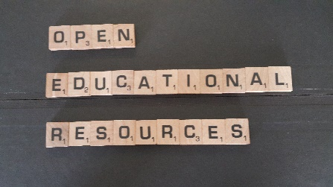


Key Strategies
Use of technology to enhance access and reach
Using openly licences resources to reduce costs
Building partnerships to expand and optimise resources
Strengthening learner support for success
Using data to drive innovation and research

Slide 43
Rethinking Openness in Distance Education

Slide 44

Distance Learning
Separation of teacher and learner
Institutional accreditation
Use of mixed media courseware
Two-way communication
Possibility of face-to-face meeting of leaners
Industrial process of operation
(Keegan, 1996)

Slide 45

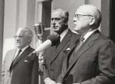
Philosophy of Open-ness
Open as to people,
Open as to places,
Open as to methods, and, finally,
Open as to ideas
  Lord Crowther

Slide 46
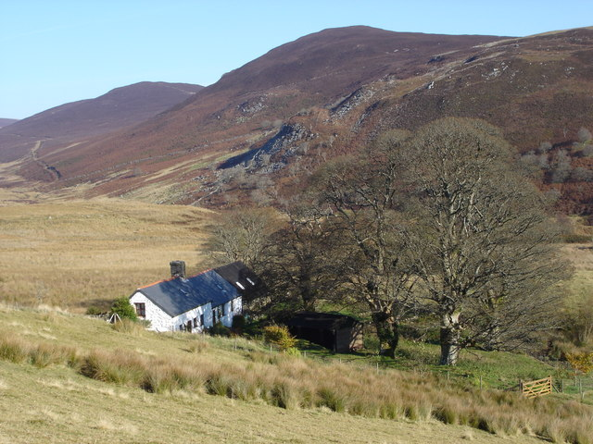
Open learning in practice
Open entry
Study anywhere
Start and study anytime
Flexible choice of courses
(Kember, 2007)
Image: Roger Brooks / A Remote Habitation / CC BY-SA 2.0 https://commons.wikimedia.org/wiki/File:A_Remote_Habitation_-_geograph.org.uk_-_595352.jpg

Slide 47


Emerging areas of openness
Open source software
Open access to scientific information
Open educational resources
Open science

Slide 48
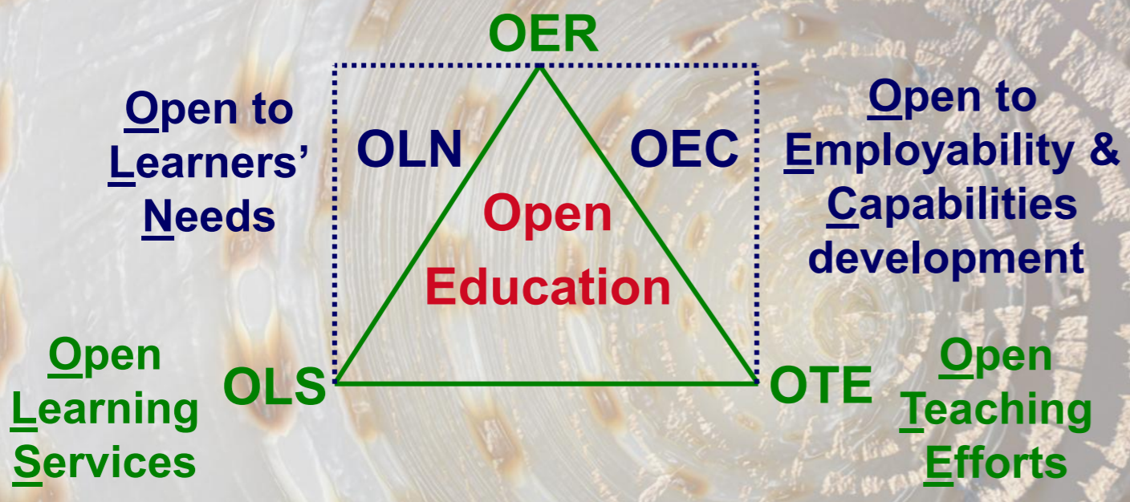
Ecosystem approach to open education
(Mulder, 2013)
Notes:
http://www.aca-secretariat.be/fileadmin/aca_docs/images/members/Fred_Mulder.pdf

Slide 49
Access-Learning-Scholarship
Open access which is inclusive and equal access to educational opportunities without barriers such as entry qualifications and ability to pay.
Open learning which is the ability to study and learn at anytime, anywhere and at any pace, and
Open scholarship which comprises releasing educational resources under an open license that permits no-cost access, use, adaptation and redistribution by others.
(Naidu, 2016)

Slide 50
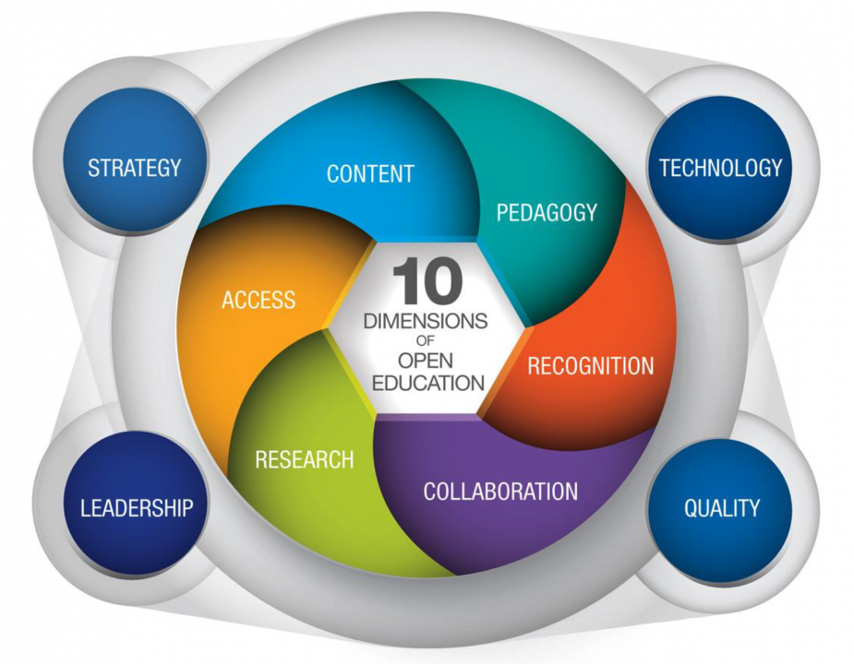
European opening-up education framework
Source: Inamorato dos Santos, A., Punie, Y., Castaño-Muñoz, J. (2016) Opening up Education: A Support Framework for Higher Education Institutions. JRC Science for Policy Report, EUR 27938 EN; doi:10.2791/293408

Slide 51
How open is our distance education?
Exclusive entry | 1 | 2 | 3 | 4 | 5 | Entry | 6 | 7 | 8 | 9 | 10 | Anyone can join
Only from one location | 1 | 2 | 3 | 4 | 5 | Space | 6 | 7 | 8 | 9 | 10 | Anywhere
Specific sechedule | 1 | 2 | 3 | 4 | 5 | Time | 6 | 7 | 8 | 9 | 10 | Anytime
Fixed courses | 1 | 2 | 3 | 4 | 5 | Subject of study | 6 | 7 | 8 | 9 | 10 | A la carte
Sage on the stage | 1 | 2 | 3 | 4 | 5 | Pedagogy | 6 | 7 | 8 | 9 | 10 | Highly collaborative
Proprietory tools; less options | 1 | 2 | 3 | 4 | 5 | Technology | 6 | 7 | 8 | 9 | 10 | Open tools; more options
Copyrighted | 1 | 2 | 3 | 4 | 5 | Learning resources | 6 | 7 | 8 | 9 | 10 | Openly licensed
Institution paced; fixed | 1 | 2 | 3 | 4 | 5 | Assessment | 6 | 7 | 8 | 9 | 10 | Learner paced; multiple pathways
Less recognition | 1 | 2 | 3 | 4 | 5 | Credentials | 6 | 7 | 8 | 9 | 10 | Recognised everywhere
High | 1 | 2 | 3 | 4 | 5 | Cost | 6 | 7 | 8 | 9 | 10 | Zero; low

Slide 52
How open is our distance education?
Exclusive entry | 1 | 2 | 3 | 4 | 5 | Entry | 6 | 7 | 8 | 9 | 10 | Anyone can join
Only from one location | 1 | 2 | 3 | 4 | 5 | Space | 6 | 7 | 8 | 9 | 10 | Anywhere
Specific sechedule | 1 | 2 | 3 | 4 | 5 | Time | 6 | 7 | 8 | 9 | 10 | Anytime
Fixed courses | 1 | 2 | 3 | 4 | 5 | Subject of study | 6 | 7 | 8 | 9 | 10 | A la carte
Sage on the stage | 1 | 2 | 3 | 4 | 5 | Pedagogy | 6 | 7 | 8 | 9 | 10 | Highly collaborative
Proprietory tools; less options | 1 | 2 | 3 | 4 | 5 | Technology | 6 | 7 | 8 | 9 | 10 | Open tools; more options
Copyrighted | 1 | 2 | 3 | 4 | 5 | Learning resources | 6 | 7 | 8 | 9 | 10 | Openly licensed
Institution paced; fixed | 1 | 2 | 3 | 4 | 5 | Assessment | 6 | 7 | 8 | 9 | 10 | Learner paced; multiple pathways
Less recognition | 1 | 2 | 3 | 4 | 5 | Credentials | 6 | 7 | 8 | 9 | 10 | Recognised everywhere
High | 1 | 2 | 3 | 4 | 5 | Cost | 6 | 7 | 8 | 9 | 10 | Zero; low
Score of a hypothetical DE institution: 57

Slide 53



Three Foundations of Openness
Fairness
Flexibility
Freedom

Slide 54
Thank you
www.col.org

