Slide 1


Quality Assurance in Blended Learning
Designing blended learning programs
Romeela Mohee
Education Specialist: Higher Education
PEBL workshop
Nairobi 17-20 April 2018

Slide 2
Overview
Contents
Learning outcomes
Designing quality blended learning programs
Define the 7 steps to designing good quality blended learning programs
Describe the structure of learning outcomes
Define the modes of assessment

Slide 3
How do I Design Good Quality Blended-learning Programs?

Slide 4
Steps to designing good quality blended learning programs
Keep QA in mind
Choose Good Learning Objectives
  Learning outcomes are direct statements that describe the essential and enduring disciplinary knowledge and abilities that students should possess, and the depth of learning that is expected upon completion of a program or course (Anderson et al., 2001; Harden, 2002).
  Learning outcomes answer these questions
    How would you describe the attributes of an ideal graduate of the program? What unique strengths should students who complete this program possess?
    What is essential that students know and be able to do at the end of their learning experiences? What key knowledge, skills and values/attitudes should students who complete the program possess?

Slide 5
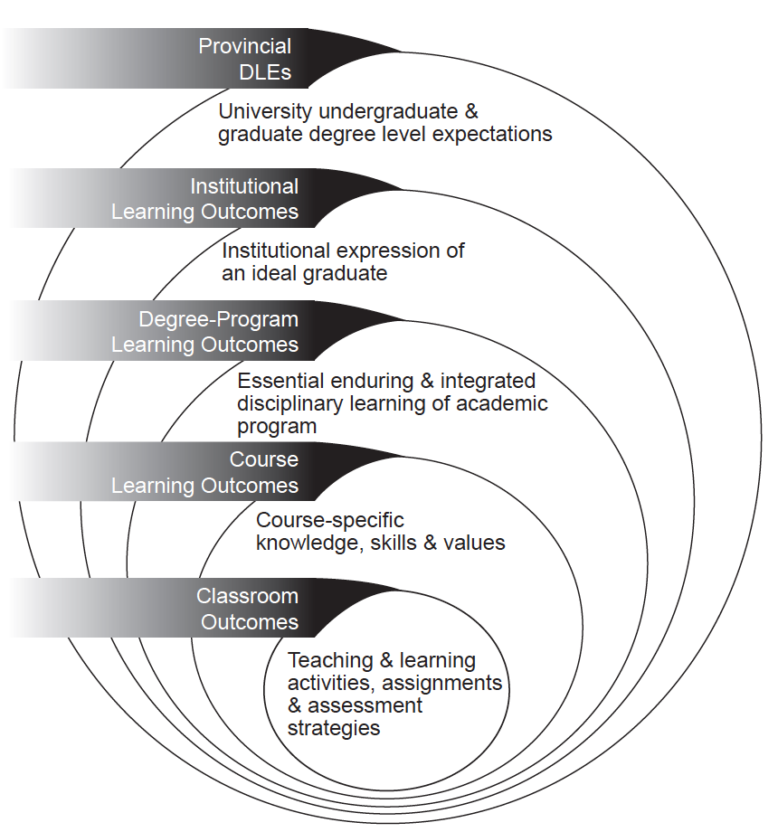
Articulation of level outcomes
A Guide to Developing and Assessing Learning Outcomes
at the University of Guelph: http://www.uoguelph.ca/vpacademic/avpa/pdf/learning outcomes.pdf

Slide 6
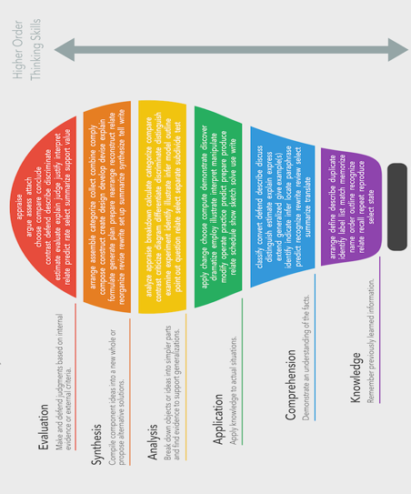
Learning outcomes
Learning outcomes should:
• complete a phrase describing what students should know and/or be able to do by the end of the program or course (e.g. “By the end of this program, successful students will be able to...”).
• start with an action verb that specifying the depth of learning expected followed by a statement describing the knowledge and abilities to be demonstrated, and finally a statement (or statements) to provide context within the discipline.
• be concise, direct and clearly stated. Terms such as know, understand, learn, appreciate and to be aware of should be avoided, and the specific level of achievement should be clearly identified. ( should be measurable)
Bloom’s taxonomy
Source: Bloom's taxonomy verbs - free classroom chart. (2016).
Retrieved from https://www.fractuslearning.com/2016/01/25/blooms-taxonomy-verbs-free-chart/

Slide 7
Example of Learning outcomes (levels)
Beginning language course
By the end of this course students will be able to:
  identify the most frequently encountered endings for nouns, adjectives and verbs
  read basic material relating to current affairs using appropriate reference works, where necessary
Graduate research methodologies class
By the end of this course, students will be able to:
  assess the strengths and weaknesses of alternative strategies for collecting, analyzing and interpreting data from needs analyses and evaluations in direct practice, program and policy interventions
  identify specific strategies for collaborating with practitioners in developmental projects, formulation of research questions, and selection of designs and measurement tools so as to produce findings usable by practitioners at all levels
  analyze qualitative data systematically by selecting appropriate interpretive or quantified content analysis strategies
  articulate implications of research findings for explanatory and practice theory development and for practice/program implementation
  instruct classmates and others in an advanced statistical or qualitative data analysis procedure

Slide 8
Example learning outcomes
Teaching development course for faculty
By the end of the course you will be able to:
  identify several learning style models and know how to use these models in your teaching
  construct and use learning objectives
  design a course and a syllabus
  implement the principles of Universal Instructional Design in the design of a course
  use strategies and instructional methods for effective teaching of small classes and large classes
  identify the advantages and disadvantages of different assessment methods
  construct a teaching portfolio
[Learning outcomes for OTA course designed by Prof. Susan McCahan, “Fundamentals of University Teaching”]

Slide 9
3 Choose Appropriate Learning Assessments
What assessment strategies can be effectively completed online?
What is best mix for assessment?
QA issues: Alignment of assessment to learning outcomes
  Example of alignment as follows (QA matters rubric)
    A problem analysis demonstrates critical thinking skills
    A multiple choice quiz verifies vocabulary knowledge
    A composition shows writing skills
    A video of a learner presentation shows mastery of the language
Formative Assessments
  In-Class or Online Discussions
  Polls
  Quizzes
  Low-Stakes Group Work
  Weekly Quizzes
  Short Reflective Writing
  Homework
Summative Assessments
  Instructor Created Exams
  Standardized Tests
  Major Projects
  Final Essays
  Final Presentations
  Final/Mid-Term Examinations

Slide 10
Activity
Write assessments based on your level outcomes

Slide 11
4 Choose a Blended-learning Format and Schedule – 10 Questions to Consider
What do you want students to know when they have finished taking your blended-learning course?
As you think about learning objectives, which would be better achieved online and which would be best achieved face-to-face?
What types of learning activities do you think you will be using for the online portion of your course?
Online asynchronous discussion is often an important part of hybrid courses. What new learning opportunities will arise as a result of using asynchronous discussion? What challenges do you anticipate in using online discussions? How would you address these?
How will the face-to-face and time out of class components be integrated into a single course? In other words, how will the work done in each component feed back into and support the other?
When working online, students frequently have problems scheduling their work and managing their time, and understanding the implications of the hybrid course module as related to learning. What do you plan to do to help your students address these issues?
How will you divide the percent of time between the face-to-face and online portion of your course?
How will you divide the course-grading scheme between face-to-face and online activities? What means will you use to assess student work in each of these two components?
Students sometimes have difficulty acclimating to the course Web site and to other instructional technologies you may be using for face-to-face and online activities. What specific technologies will you use for the online and face-to-face portions of your course? What proactive steps can you take to assist students to become familiar with your Web site and those instructional technologies? If students need help with technology later in the course, how will you provide support?
There is a tendency for faculty to require students to do more work in a hybrid course than they normally would complete in a purely traditional course. What are you going to do to ensure that you have not created a course and one-half? How will you evaluate the student workload as compared to a traditional class
Adapted from the University of Wisconsin Milwaukee, 2018

Slide 12
5 & 6: Choose Context Appropriate Resources
5. Choose context appropriate resources
  For example; limited connectivity ; use RACHEL, OER2Go
6. Establish netiquette and online communications expectations
  How frequently you will check email
  How quickly students will receive feedback
  Outline good netiquette

Slide 13
7 Write a Clear and Detailed Syllabus
Dates for when classes meet face-to-face and when classes meet online
Clear expectations for online communication, both for students and the instructor
Information for how to contact the instructor for regular inquiries;
Information for how to contact the instructor for urgent inquiries
How quickly you expect to respond to emails
How quickly you expect students to respond to emails
Basic troubleshooting help
Information for who to contact with technical difficulties
The hours of the campus computer lab
Important URLS or Database

