Slide 1

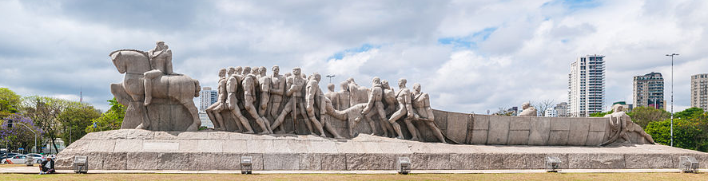


OER Regional Consultation
3-4 April, 2017 | Sao Paulo, Brazil
OER for Inclusive and Equitable Quality Education: From Commitment to Action
Professor Asha Kanwar,
Dr Sanjaya Mishra & Dr. Ishan Abeywardena
Commonwealth of Learning, Canada
Notes:
Source: https://commons.wikimedia.org/wiki/File:Malta_Valletta_Panorama_10.jpg

Slide 2
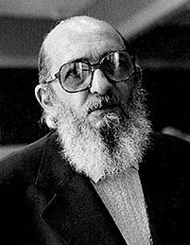

Remembering Paulo Freire
Knowledge emerges only through invention and re-invention, through the restless, impatient, continuing, hopeful inquiry human beings pursue in the world, with the world, and with each other.
- Paulo Freire
https://en.wikipedia.org/wiki/Paulo_Freire#/media/File:Paulo_Freire.jpg

Slide 3
Plan
Background
Government & Stakeholder Surveys
Regional Consultations:
  Asia, Europe, Middle East and North Africa, and Africa
Towards the 2nd World OER Congress & Beyond

Slide 4


Slide 5
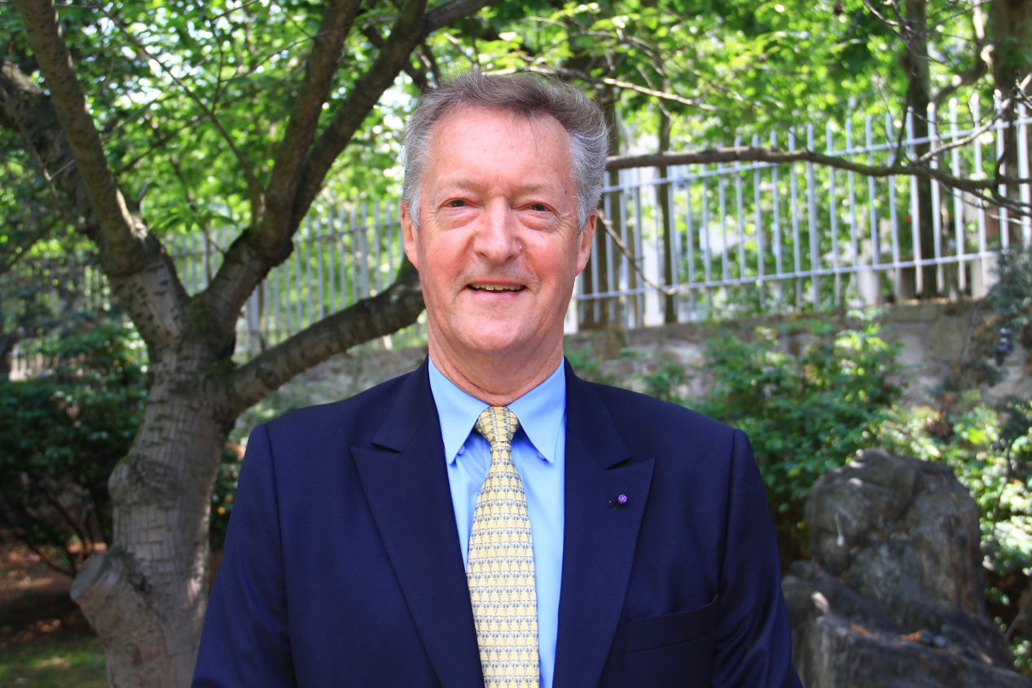
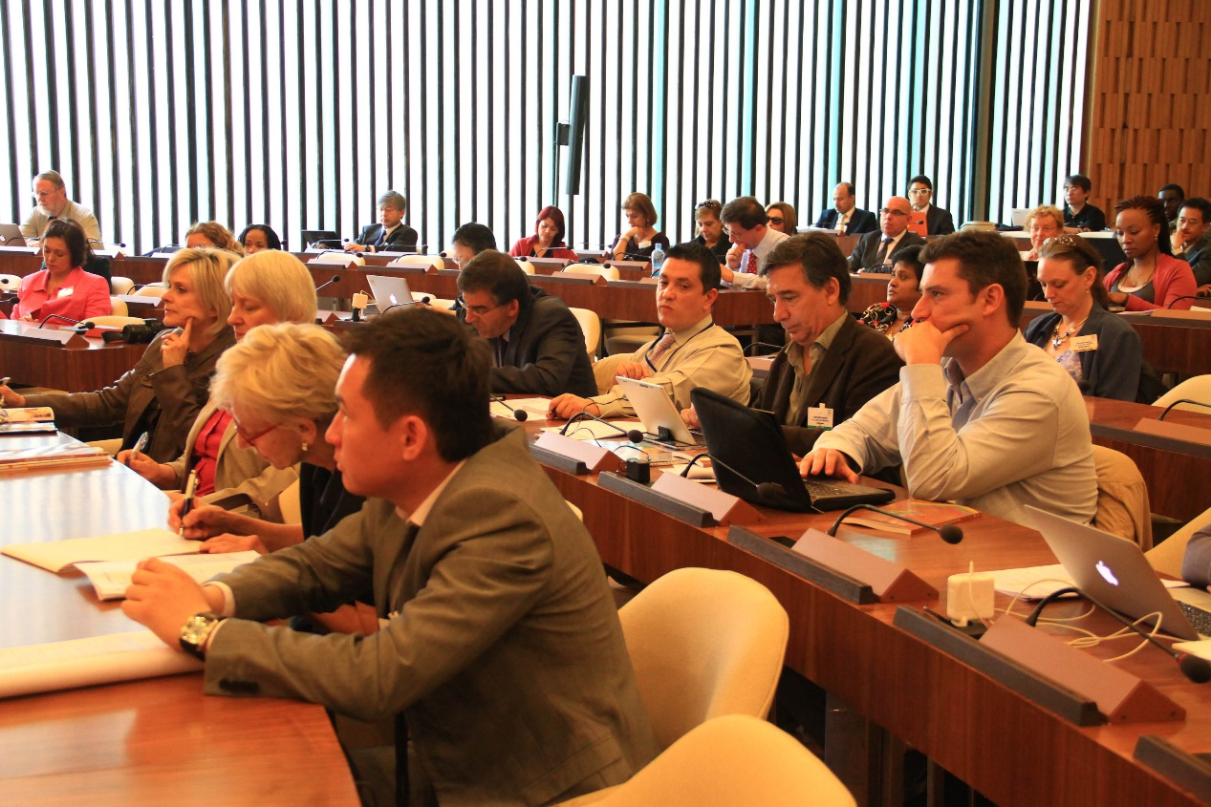
World OER Congress – Paris 2012
Sir John Daniel, Former President of COL
The Congress at UNESCO HQ Paris
Image source (CC-BY): http://www.unesco.org/new/en/communication-and-information/resources/multimedia/photo-galleries/open-educational-resources/world-open-educational-resources-congress-in-photos/

Slide 6

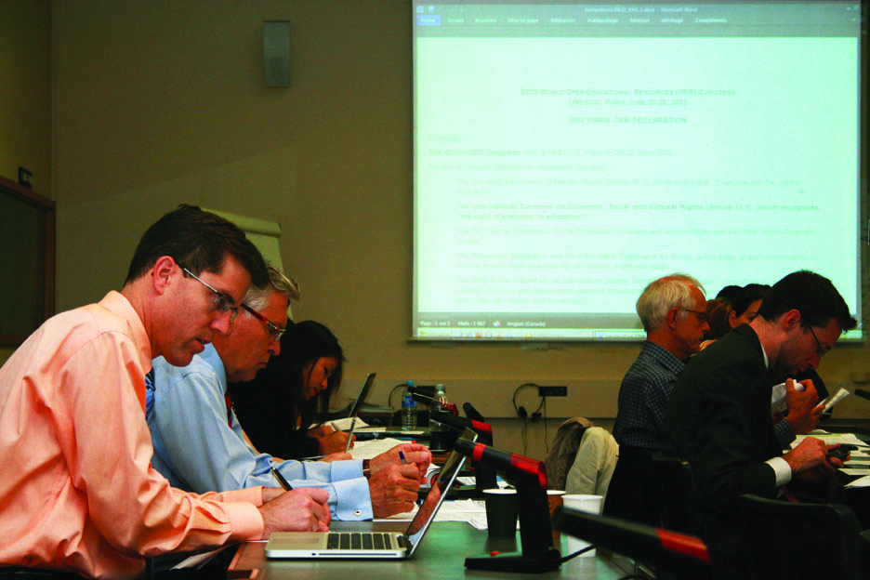
Paris OER Declaration 2012
Foster awareness and use of OER
Encourage the development and adaptation of OER in a variety of languages and cultural contexts
Encourage the open licensing of educational materials produced with public funds
The 2012 Paris OER Declaration drafting group at UNESCO Headquarters, Paris, France
^{Photo: CC-BY Davide Storti}

Slide 7
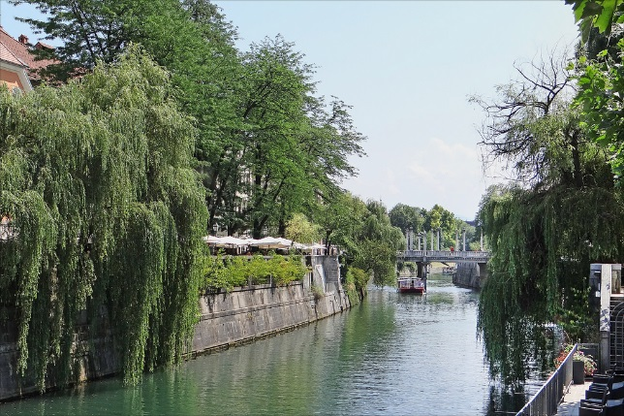
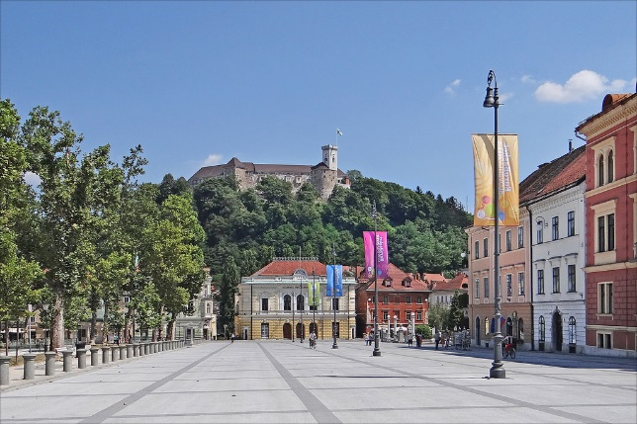
2nd World OER Congress
Image Source (CC BY):https://www.flickr.com
Ljubljana, Slovenia – 18-20 September 2017

Slide 8






The Road to Ljubljana
ASIA
Asia eUniversity: ​​1-2 December, 2016
EUROPE
Malta Ministry for Education and Employment:
​​23-24 February, 2017
MIDDLE EAST & NORTH AFRICA
Qatar Foundation: ​​27-28 February, 2017
AFRICA
Ministry of Education, Mauritius:
​​2-3 March, 2017
LATIN AMERICA & CARIBBEAN
UNICAMP: ​​3-4 April, 2017
​
PACIFIC
Open Polytechnic of New Zealand:
​​29-30 May, 2017
​

Slide 9


Slide 10
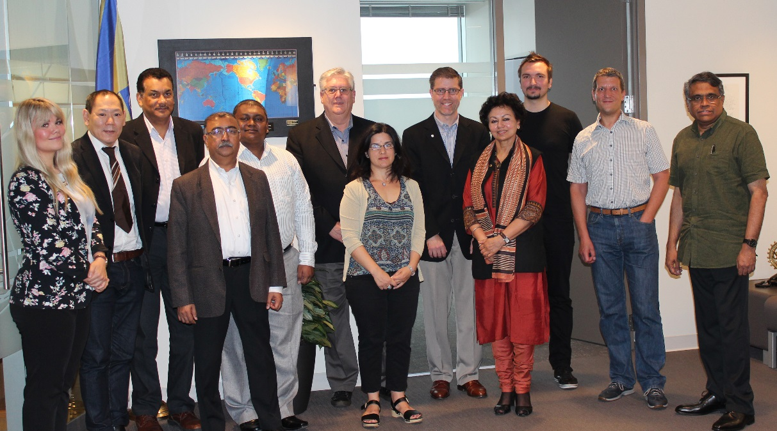
Task Team
Notes:
Dr. Venkataraman Balaji, Director: Technology and Knowledge Management, Commonwealth of Learning (Chair of Task Team)
Mr. John Lesperance, Education Specialist: Virtual University for Small States of the Commonwealth, Commonwealth of Learning
Dr. Ishan Abeywardena, Adviser: Open Educational Resources, Commonwealth of Learning
Mr. Joe Hironaka, Programme Specialist, Communication and Information Sector, UNESCO
Ms. Zeynep Varoglu, Programme Specialist, Communication and Information Sector, UNESCO
Dr. Cable Green, Director of Open Education, Creative Commons Global
Dr. David Porter, Associate Vice President, Education Support and Innovation, BCIT and incoming CEO of eCampusOntario
Dr. TJ Bliss, Program Officer, Education Program, Hewlett Foundation

Slide 11
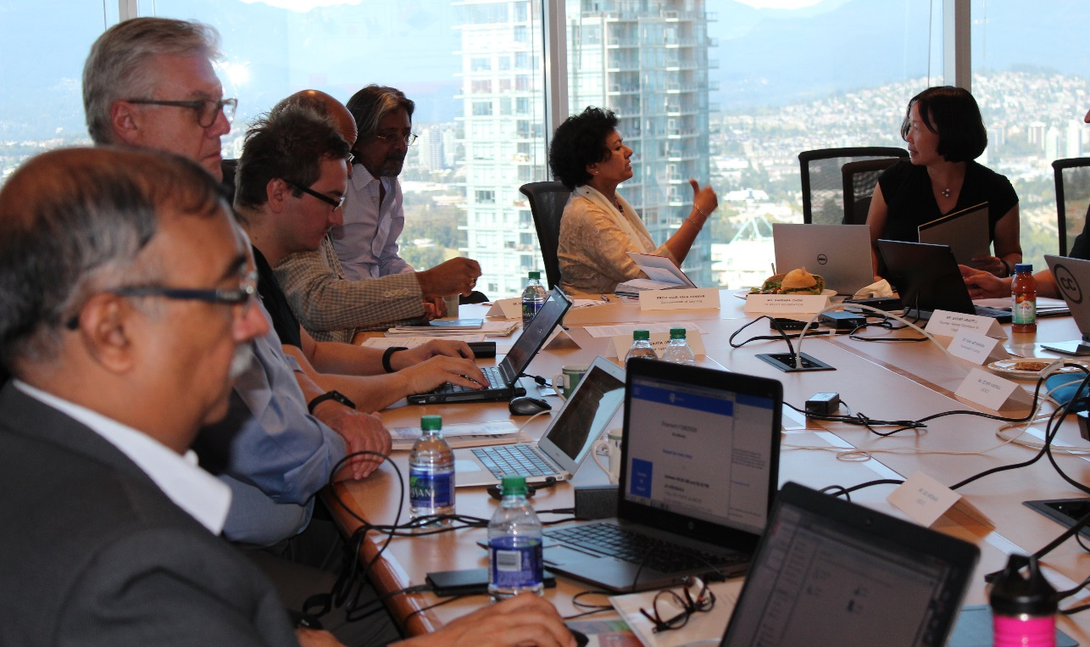
Steering Committee
Notes:
Professor Asha Kanwar, President and CEO, Commonwealth of Learning (Chair)
Dr. K Balasubramanian, Vice President, Commonwealth of Learning
Dr. Indrajit Banerjee, Director: Knowledge Societies Division, Communication and Information Sector, UNESCO
Dr. David Atchoarena, Director: Division for Policies and Lifelong Learning Systems, UNESCO
Mr. Gasper Hrastelj, Deputy Secretary-General, Slovenian National Commission for UNESCO
Mr. Davor Orlic, UNESCO Chair Team on Open Technologies for OER and Open Learning

Slide 12




Partners

Slide 13

OER: Then and Now
2017
2012
Focus was on Governments
Policies
Commitment
Additional focus on stakeholders
Strategies
Concrete action

Slide 14
Objectives of RCOER
Raise regional awareness about the importance of OER and its relationship to SDG4
Identify strategies and solutions to overcome the challenges or barriers to mainstreaming OER
Agree on actions for consideration at the 2nd World OER Congress
Notes:
Where

Slide 15
The Surveys

Slide 16
Two Surveys
  A government survey sent by COL to Member States
  UNESCO sent the survey in English & French to Member States
  A stakeholder survey, which COL posted online at http://fluidsurveys.com/s/rcoer-stakeholdersurvey/ and publicized via social media.
Notes:
made available to COL Focal Points and to National Delegations in UNESCO.

Slide 17
Government Responses: 70 countries
Region | Government
Africa | 30
Middle East and North Africa | 7
Asia and Pacific | 14
Europe and North America | 14
Latin America and Caribbean | 5

Slide 18
Key Findings from Government Survey

Slide 19
Key Findings from Government Survey

Slide 20
Key Findings from Government Survey

Slide 21
Key Findings from Government Survey
Benefits
Promote flexible learning
Increase efficiency and quality of resources
Improve access to resources
Notes:
Reasons for OER Activities

Slide 22
Key Findings from Government Survey
Barriers
Insufficient access to quality content (86%)
Lack of users’ capacity (84%)
Lack of appropriate policies (79%)
Changing business models (71%)
Language and cultural barriers (59%)
Notes:
Government Survey Barriers

Slide 23
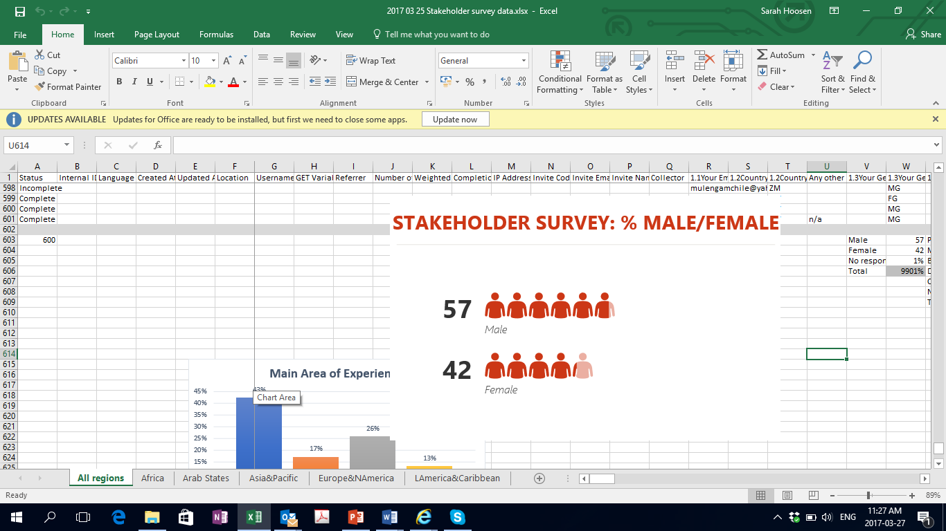
Stakeholder Responses: 600
Region | Stakeholder
Africa | 126
Middle East and North Africa | 26
Asia and Pacific | 267
Europe and North America | 147
Latin America and Caribbean | 34

Slide 24
Stakeholder Responses

Slide 25
Stakeholder Responses

Slide 26
Stakeholder Responses

Slide 27
Stakeholder Responses
Benefits
Reduced costs of learning materials
Provides access to quality materials
Enables continuous quality enhancement
Save teachers time

Slide 28
Stakeholder Responses
Barriers
Lack of policy (71%)
Lack of Capacity (68%)
Changing business models (66%)

Slide 29
Governments and Stakeholders:
Commonalities
Provides access to quality materials
Lack of appropriate policy solutions
Poor awareness and capacity of users
Changing business models

Slide 30
Different Focus?
Governments
Governments:
Language & Cultural Issues
Stakeholders:
Saves time for teachers
Enables continuous quality improvement

Slide 31
Regional Consultations

Slide 32
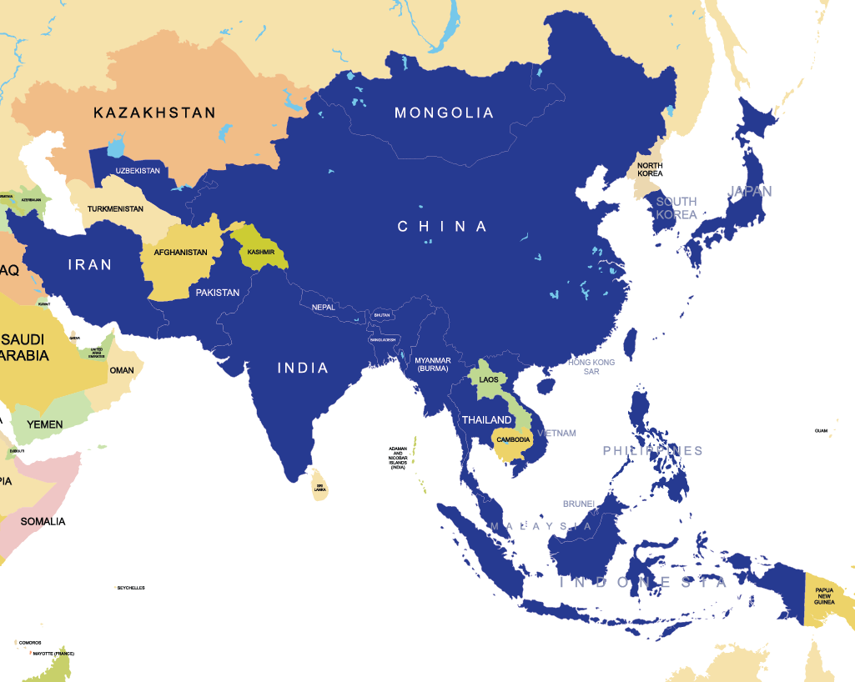
ASIA
Regional Consultation
1-2 December, 2016
20
Notes:
48 participants from 24 countries participated, including 20 countries from Asia.

Slide 33
Key Practices - Asia
Free supply of textbooks at school Level (Bangladesh)
NME-ICT follows CC BY-SA licence (India)
Commitment to OpenCourseWare in eLearning policy (Malaysia)
OER repositories in India, Indonesia, Malaysia, Pakistan, Philippines, Vietnam.

Slide 34
Barriers to OER - Asia
Low bandwidth and Internet access
Low attention to content for people with disabilities
Lack of awareness and capacity to use and contribute to OER
Lack of availability of OER in local languages
No national policy to guide OER

Slide 35
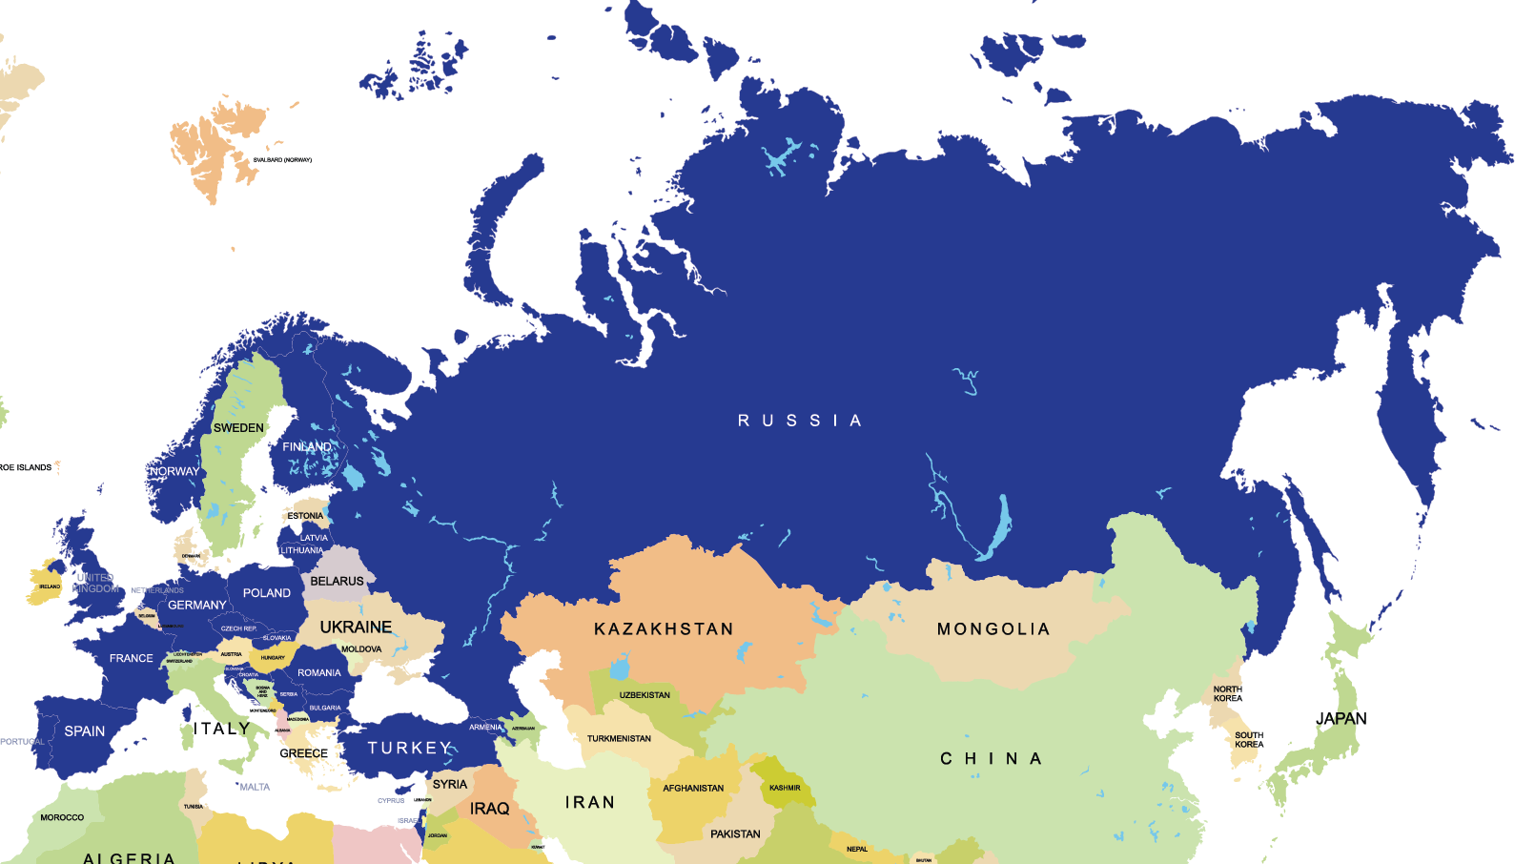
24
EUROPE
Regional Consultation
23-24 February, 2017
Notes:
48 participants from 24 countries participated, including 20 countries from Asia.

Slide 36
Rich & Diverse initiatives- Europe
Mostly led by institutions/project mode
Advanced technologies for multi-lingual searches possible
OER as part of a wider Open ecosystem
Many initiatives but fragmented

Slide 37
Actions- Europe
Need for political will and national level policies
Teachers critical in mainstreaming OER
Need for business models
Invite publishers to enter the world of ‘open’
Institutions must invest in QA and evidence

Slide 38
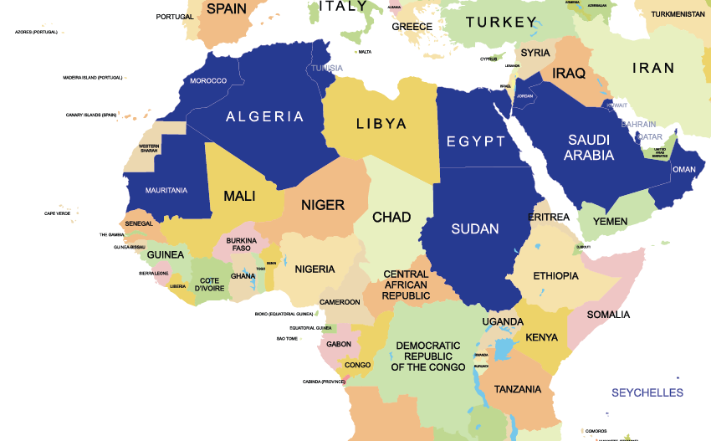
13
MIDDLE EAST/N. AFRICA
Regional Consultation | 27-28 February, 2017

Slide 39
Key Practices – Middle East/N. Africa
National OER Policies: Bahrain & Oman
Institutional initiatives: Open University of Sudan
Portals: Morocco, Jordan
Emphasis on translating content into Arabic

Slide 40
Needs: Middle East/N. Africa
More awareness
Capacity-building
Policies at national and institutional levels
Regional cooperation

Slide 41
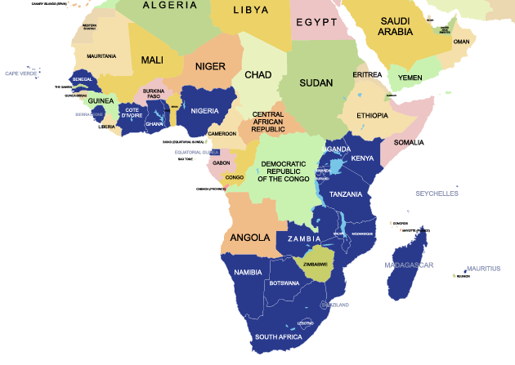
23
AFRICA
Regional Consultation
2-3 March, 2017

Slide 42
Key Practices – Africa
National OER Policies: South Africa, Seychelles &
Institutional initiatives: Several institutional initiatives, National Open University of Nigeria, and Open University of Tanzania
Siyavula courses (developed with philanthropic support) adopted by South Africa
OER Africa supporting institutions to mainstream OER
Notes:
While OER policies are in place in only three countries, the notion of policy is contested. For example, in Mauritius there is mention of OER in the national development plan as a strategic objective, but officials do not consider the same as equivalent to policy statement of the government.

Slide 43
Barriers to OER: Africa
Access to Internet and electricity
Poor awareness and capacity to use and contribute OER
Lack of policies at national and institutional levels
Lack of local language resources

Slide 44
Actions: Stakeholders Identified
Governments
Educational Institutions
Teachers
Learners
QA Agencies
Publishers
Civil Society
Associations
International Cooperation

Slide 45
Towards 2nd World OER Congress & Beyond

Slide 46
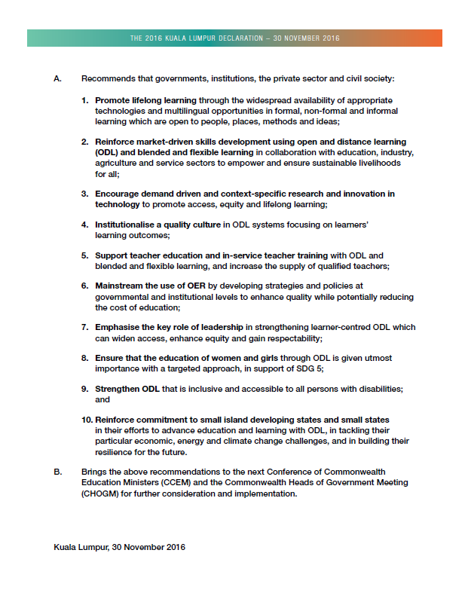

2016 KL Declaration
Mainstream the use of OER by developing strategies and policies at governmental and institutional levels to enhance quality while potentially reducing the cost of education

Slide 47
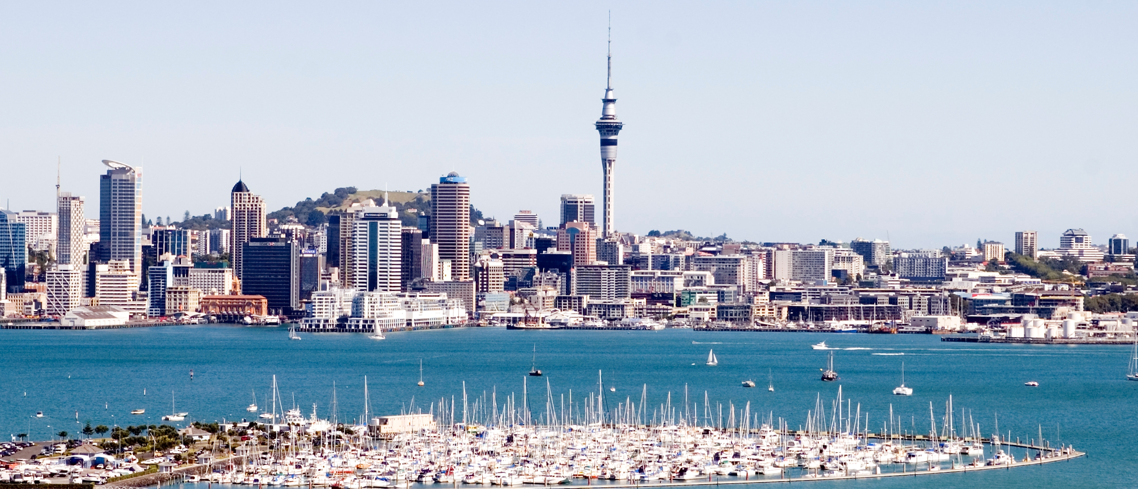
Final Regional Meeting
Auckland, NZ
Notes:
https://c1.staticflickr.com/4/3004/2863546891_ce2053ceab_b.jpg
https://upload.wikimedia.org/wikipedia/commons/6/60/Bayswater_Marina_Auckland_New_Zealand.jpg

Slide 48

Outcomes of the Regional Consultations
Global OER Survey Report
Synthesis of Actions
for consideration/ adoption

Slide 49
Progress after 2012?
More policies—institutional level
More awareness about the benefits of OER
More champions and advocates
More content available—repositories; but low awareness of repositories
Better ICT infrastructure and connectivity

Slide 50
What next?
Evidence-based advocacy
More capacity building
Targeted interventions
Continue to build and strengthen collaborations

Slide 51
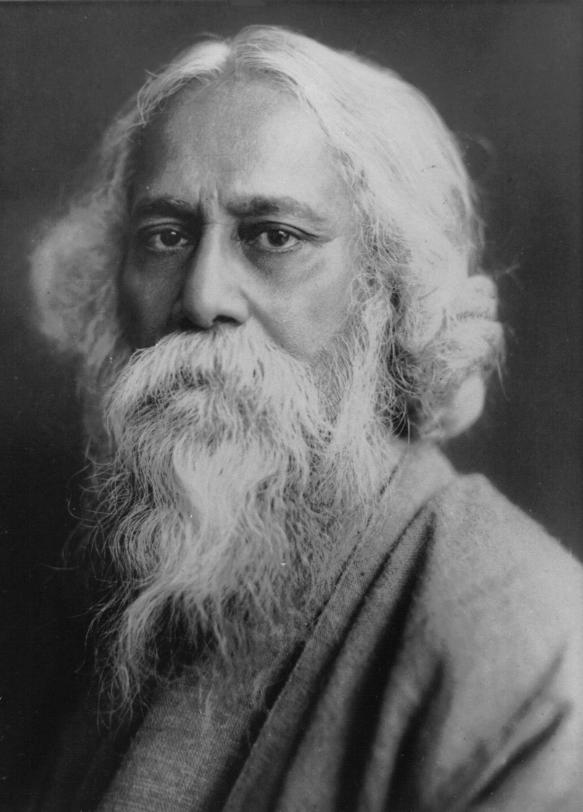
Where the mind is without fear and the head is held high
Where knowledge is free
Tagore, 1910
OER for Inclusive and Equitable Quality Education:
From Commitment to Action
Photo credit: https://commons.wikimedia.org/wiki/File:Rabindranath_Tagore.jpg

Slide 52
rcoer.col.org

