Slide 1



ONLINE EDUCATION
A catalyst for Reforming Higher Education
ETMA-GNDU Webinar: March 06, 2021
Sanjaya Mishra
Education Specialist, eLearning
Commonwealth of Learning, Canada

Slide 2

THE PLAN
CONTEXTS
ONLINE EDUCATION
DESIGNS AND TECHNOLOGIES
ONLINE LEARNING MYTHS
REFORMS FOR FUTURE

Slide 3
A Premise

Slide 4
What is Higher Education?
Research
Extension
Teaching
University
Research Centre
College
University

Slide 5
Higher Education is…
A genuine higher education is unsettling; it is not meant to be a cosy experience. It is disturbing because, ultimately, the student comes to see that things could always be other than they are. A higher education experience is not complete unless the student realizes that, no matter how much effort is put in, or how much library research, there are no final answers.
- Barnett (1990)

Slide 6
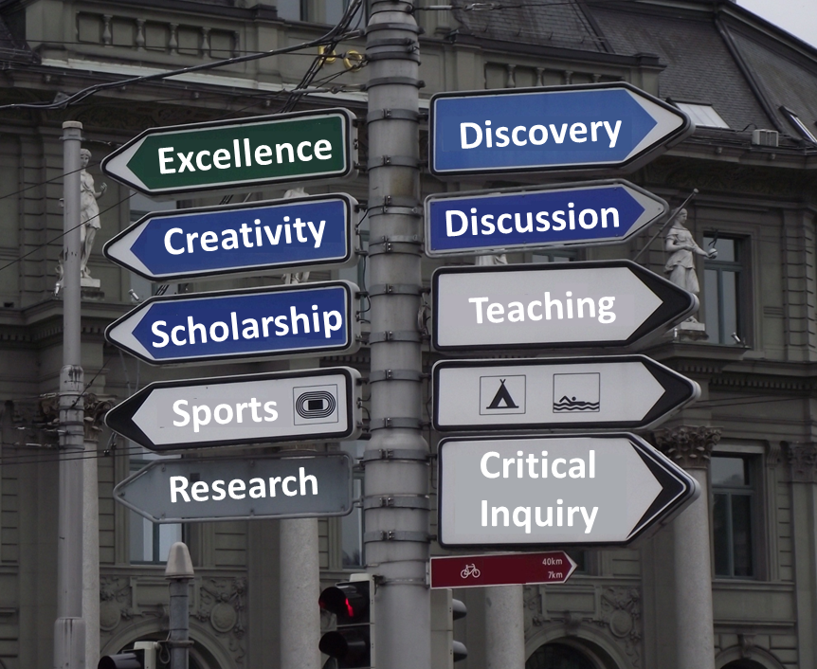
Higher Education is…
Quest for excellence
Creativity
Critical inquiry
Exploration of truth
Discovery
Discussion, debate and dialogue
Development
Scholarship

Slide 7
CONTEXTS

Slide 8
Access: GER Status
86.2%
71.5%
50.6%
45.12%
28.6%
Source: UNESCO Institute of Statistics: http://data.uis.unesco.org/Index.aspx?DataSetCode=EDULIT_DS
Notes:
Higher education is important for innovation and economic development. Most developed countries have high gross enrollment ratio in higher education. In the National Education Policy 2020, the target has been set as 50% GER in by 2035. In about 15 years, we want to almost double the GER. So, what would be our growth rate per year? On average, if our growth rate would be about 5%, then we can achieve this target. That is almost 50 universities and 2000 colleges per year, keeping the population constant!

Slide 9
One of the Largest Higher Education Systems in the World
Notes:
In comparison, US has 4298 degree granting institutions.

Slide 10
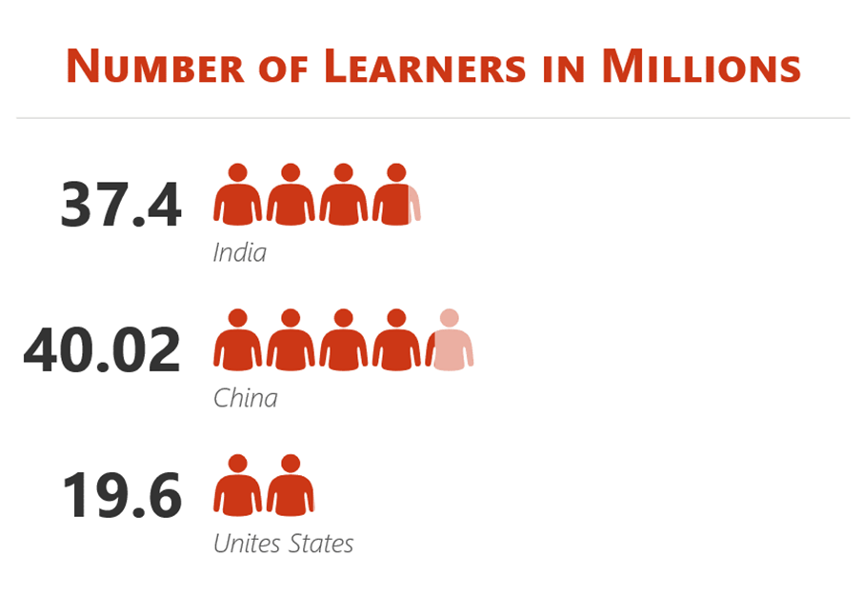
One of the Largest Higher Education System in the World

Slide 11
Cost of higher education
Source: https://www.eiuperspectives.economist.com/sites/default/files/EIU_Yidan%20prize%20forecast_Education%20to%202030.pdf
Notes:
https://www.eiuperspectives.economist.com/sites/default/files/EIU_Yidan%20prize%20forecast_Education%20to%202030.pdf
Yidan Prize Forecast: Education to 2030

Slide 12
Cost of Higher Education (India, 2014)
INR 5,539
INR 72,720
General Education
Professional Education
Notes:
6% of the expenditure for general education; and 78% for professional education. (2014 report)

Slide 13
Textbook Expenditure
Annual Expenditure
INR 3,654,419,020
INR 1526
Over 49.7 million USD per year
Notes:
365.4 crore in Indian rupees or 3.6 billion INR.

Slide 14




Quality of education
Low employability of graduates
Poor quality of teaching
Weak governance
Insufficient funding
Complex regulatory norms
Source: https://www.brookings.edu/research/reviving-higher-education-in-india/
Notes:
Low employability of graduates, poor quality of teaching, weak governance, insufficient funding, and complex regulatory norms continue to plague the sector
It is important to realise that ranking is a business and compare apple and oranges. They do not reflect the true picture of the quality of education in the country.

Slide 15
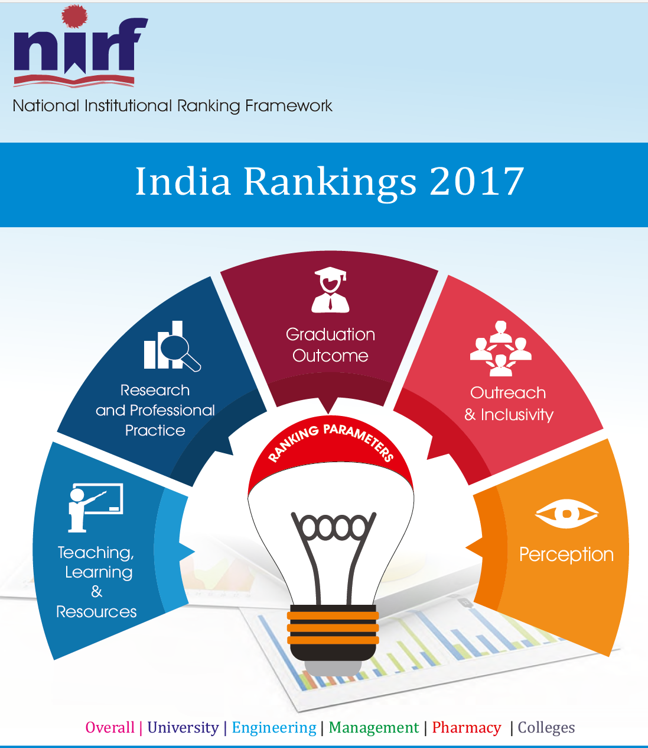
The fallacy of rankings
Rural vs urban bias
Availability of best teachers and students
Funding support of research and innovations
Create categories amongst institutions
Question the parity of qualifications

Slide 16

Quality enhancement
Inputs
Student and teacher recruitment
Infrastructure and budget
Processes
Fostering inquisitive minds
Relevant curriculum
Outcomes
Impact on society
Graduate employability and earnings
Organisational culture
Academic freedom and autonomy
Adding value to institutional reputation
http://www.naac.gov.in/docs/Quality%20Assurance%20in%20Higher%20Education%20An%20Introduction.pdf

Slide 17
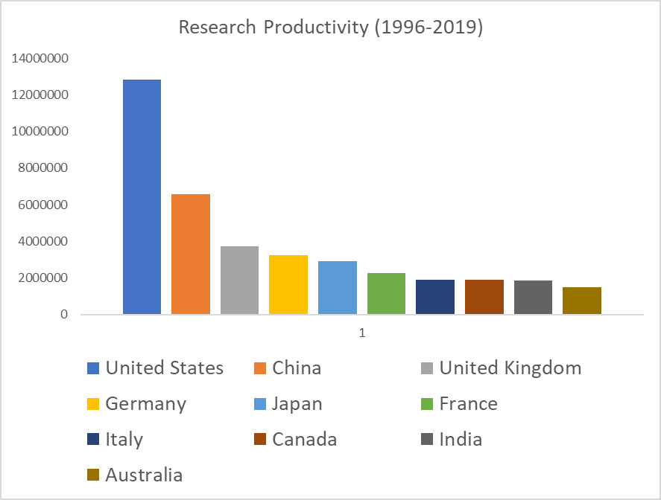
India in top 10 countries for research productivity

Slide 18
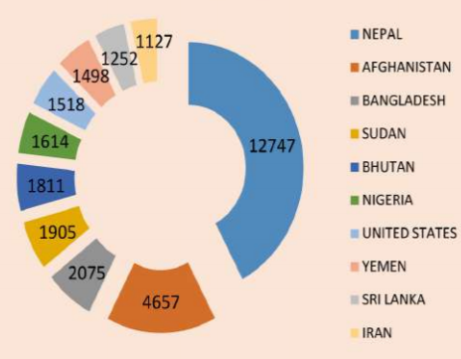
Foreign student enrolment in India
47,427 Foreign students from 164 countries

Slide 19

National Education Policy 2020
50% GER by 2035
NEFT to promote digital education
Focus on equitable use of technology
Suitable training and development to be effective online educators

Slide 20
National Education Policy 2020: Recommendations for Online Education
Pilot studies on online education
Invest on digital infrastructure
Support online platforms for interactive teaching
Digital repositories for content creation and dissemination
Addressing digital divide
Virtual labs for practical
Training and incentives to teachers
Develop online assessment and examination frameworks
Promote Blended Learning
Setting standards for content, technology and pedagogy of online learning

Slide 21
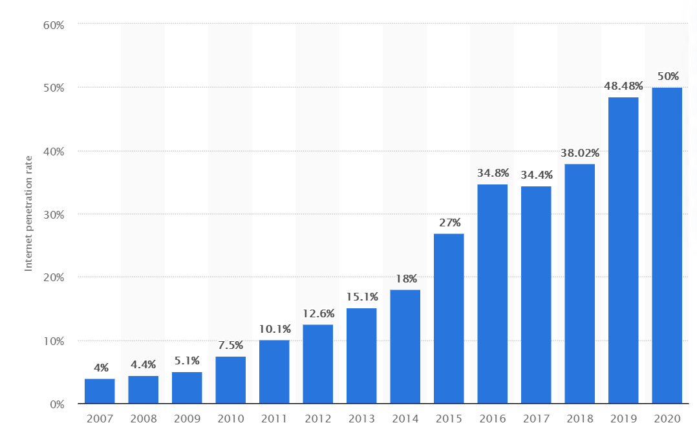
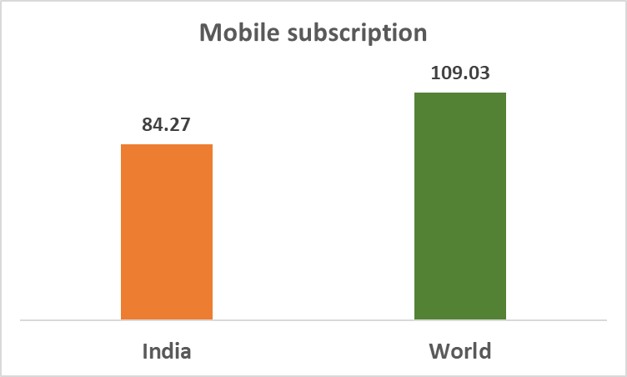

Access to technology
Source: https://www.statista.com/statistics/792074/india-internet-penetration-rate/
Notes:
65% of children entering primary school today will work in completely new job types that don’t yet exist.

Slide 22
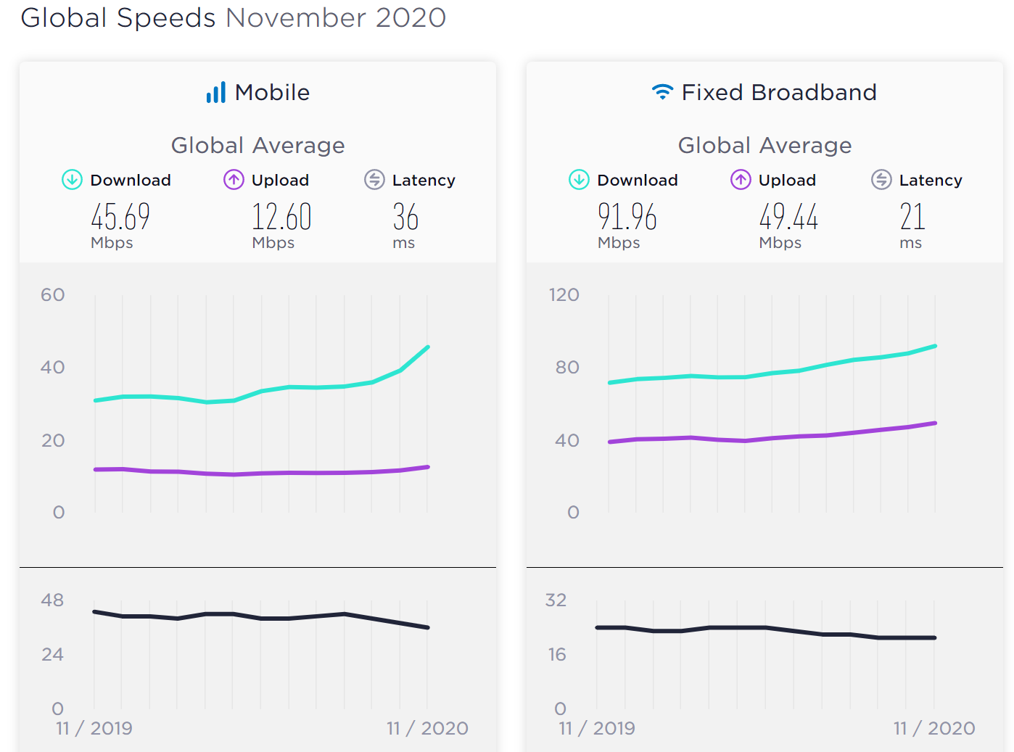
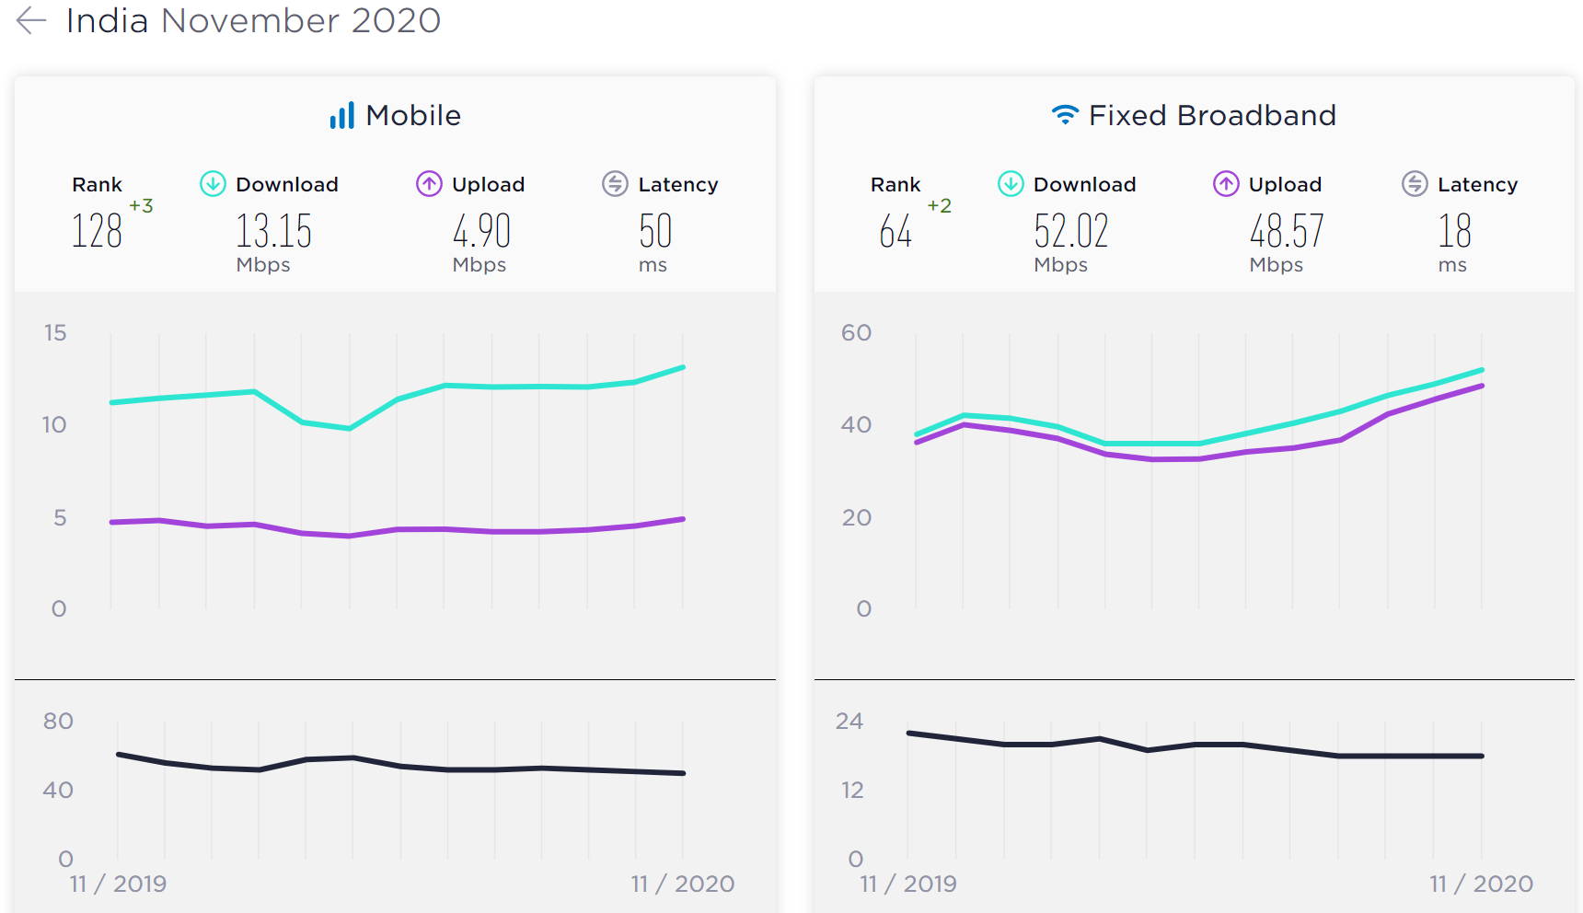
Internet Bandwidth
Sources: https://www.speedtest.net/global-index/india
https://www.speedtest.net/global-index

Slide 23

University of Hyderabad Experience: During COVID19
40% students indicated “unreliable connectivity
30% worried about cost of data
18% can’t access online classes at all
Source: https://www.newindianexpress.com/cities/hyderabad/2020/apr/20/covid-19-lockdown-digital-divide-among-students-forces-university-of-hyderabad-to-drop-e-classes-2132571.html

Slide 24
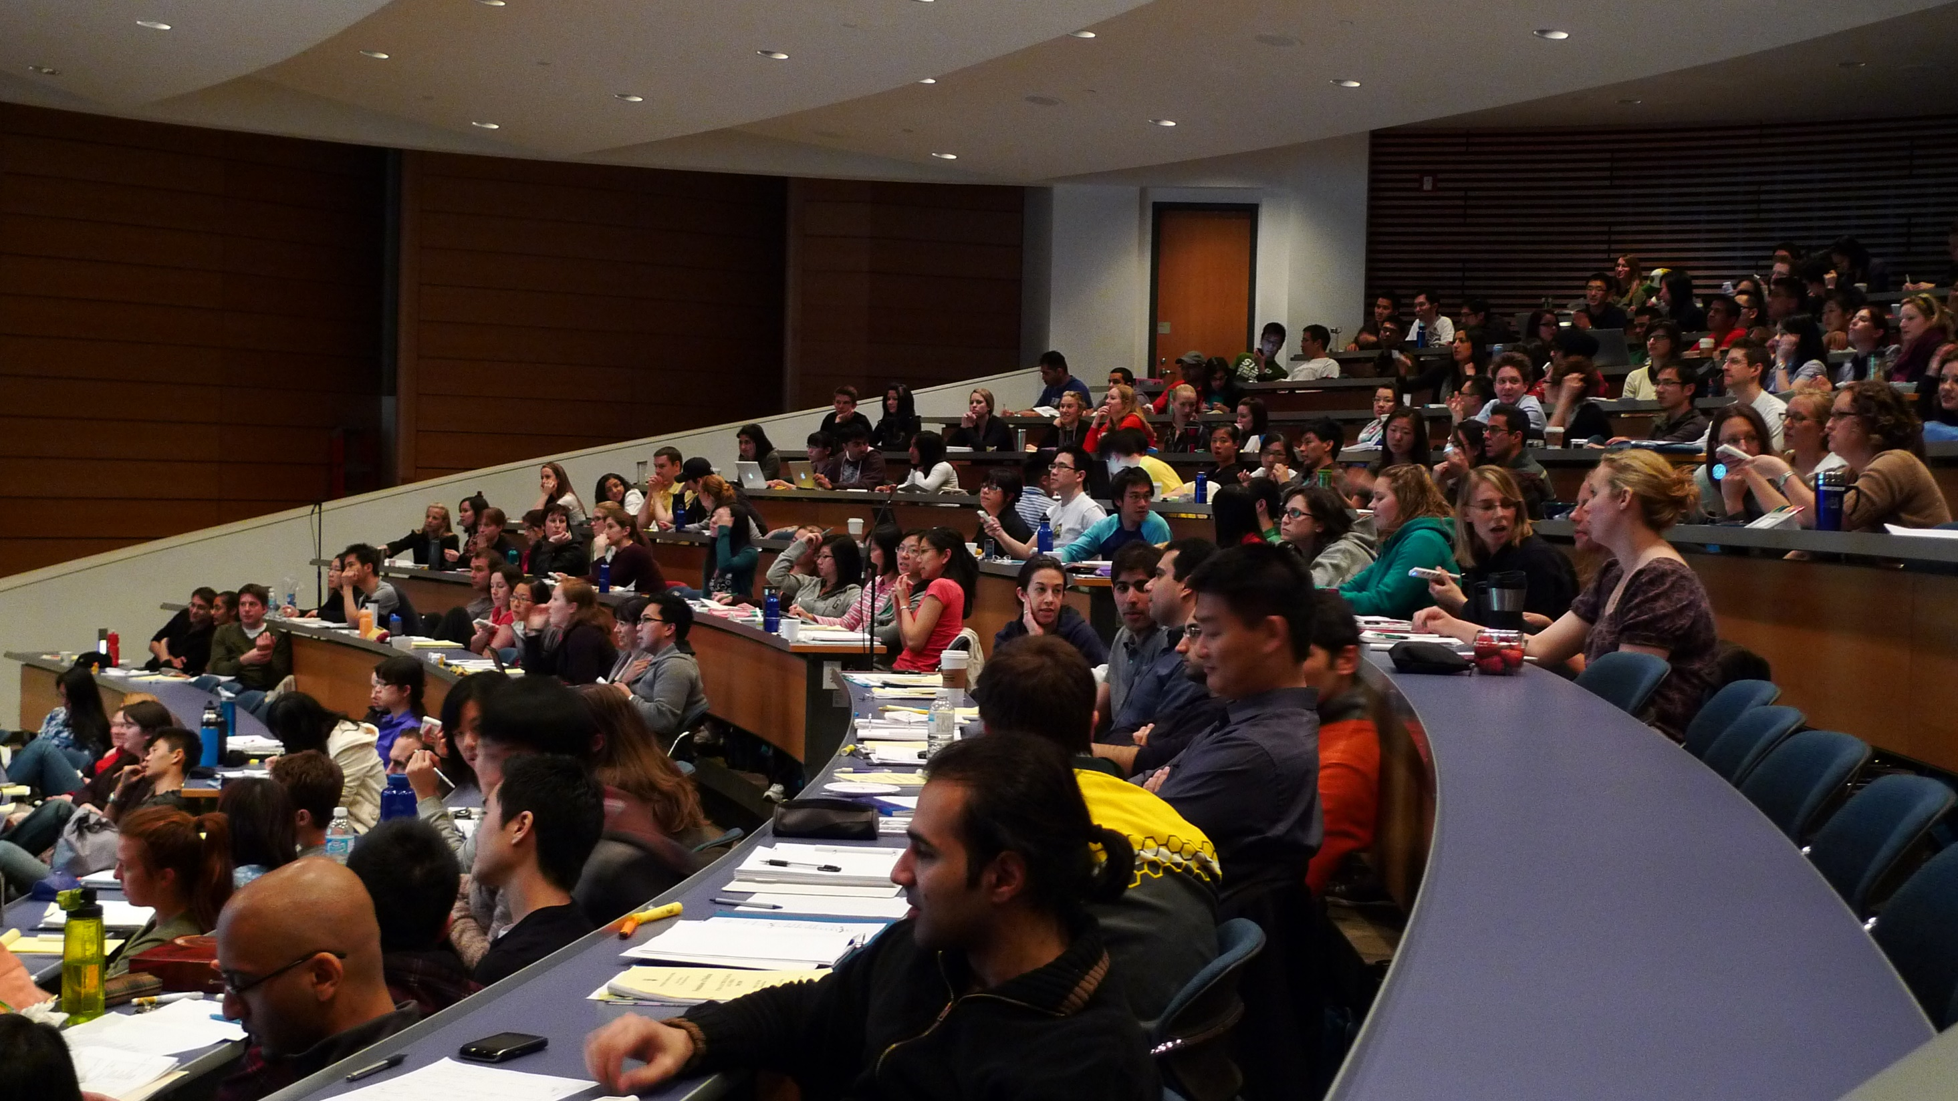
… Are we ready for a change?
Source: https://www.flickr.com/photos/velkr0/3472576304 (CC BY)

Slide 25
ONLINE EDUCATION

Slide 26

Emergency Remote Teaching vs. Online Learning
Notes:
What we are witnessing during the current pandemic is not online learning. This is emergency remote teaching. I am afraid much of these experiences will be attributed to online learning without appropriate evaluation and based on anecdotal experiences. Online learning is a planned and deliberate approach to use networked technologies to design and deliver teaching and learning.

Slide 27
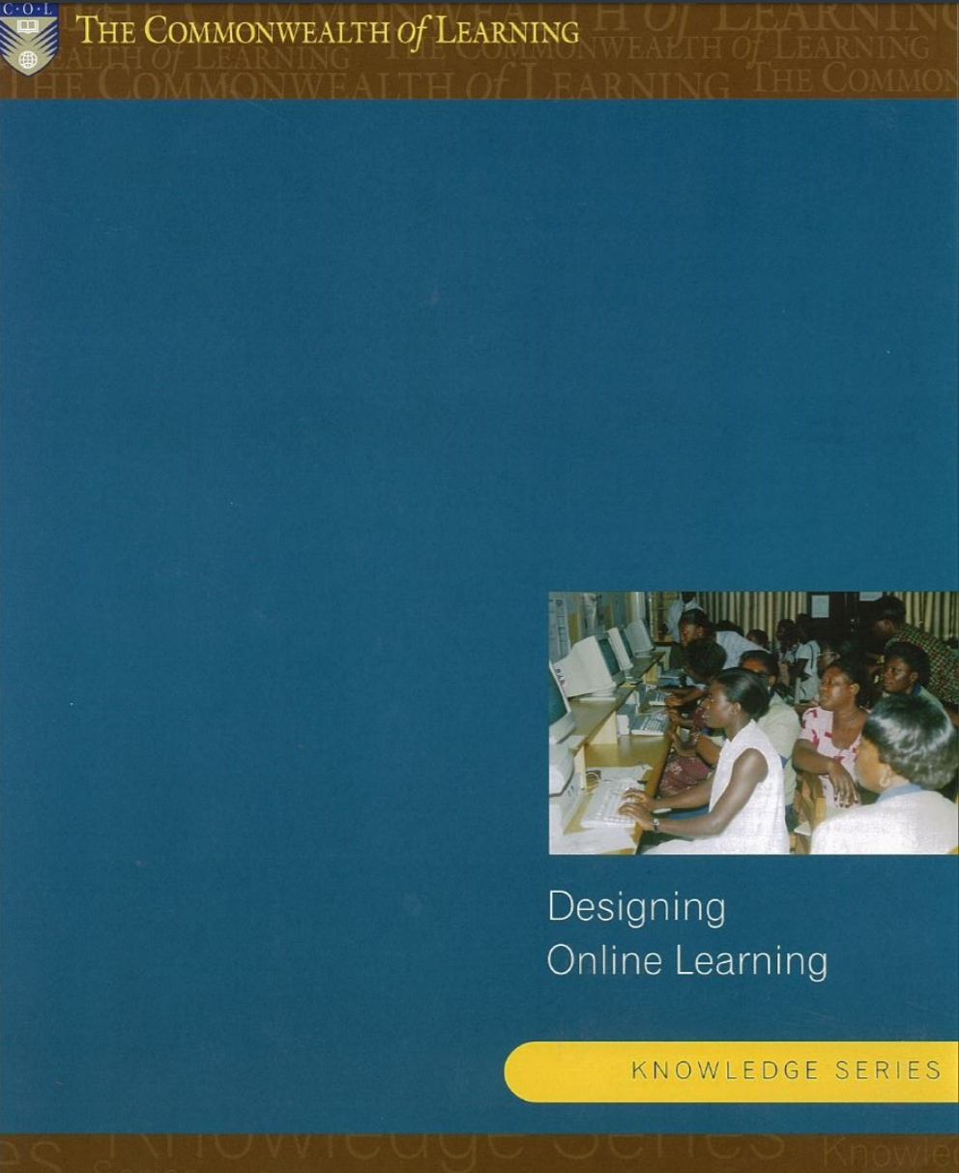
9 Steps to Online Learning
http://oasis.col.org/handle/11599/47
Needs analysis
Understanding the learners
Organisational capacity
Learning environment blueprint
Preparing institutional capacities
Material development
Evaluation
Promotion
Maintenance and updating
2001

Slide 28

Online learning is not video conferencing
Notes:
Online learning covers both synchronous and asynchronous activities on the part of both students and teachers.

Slide 29


Synchronous Activities
Asynchronous Activities
Video conference
Online chat
Live podcast (Radio)
Live Television
Polling, Presentations, etc.
Discussion Forum
Online reading
Watching a video
Listening to a recorded podcast
Working on assignments
Online quizzes
Email

Slide 30

Start with Assessment in mind
Authentic
Criteria-oriented
Need to focus more on continuous assessment than final year-end examination. Rethink weight of internal/continuous assessment and Final/External examination.
Evidence-based
Objective Types

Slide 31
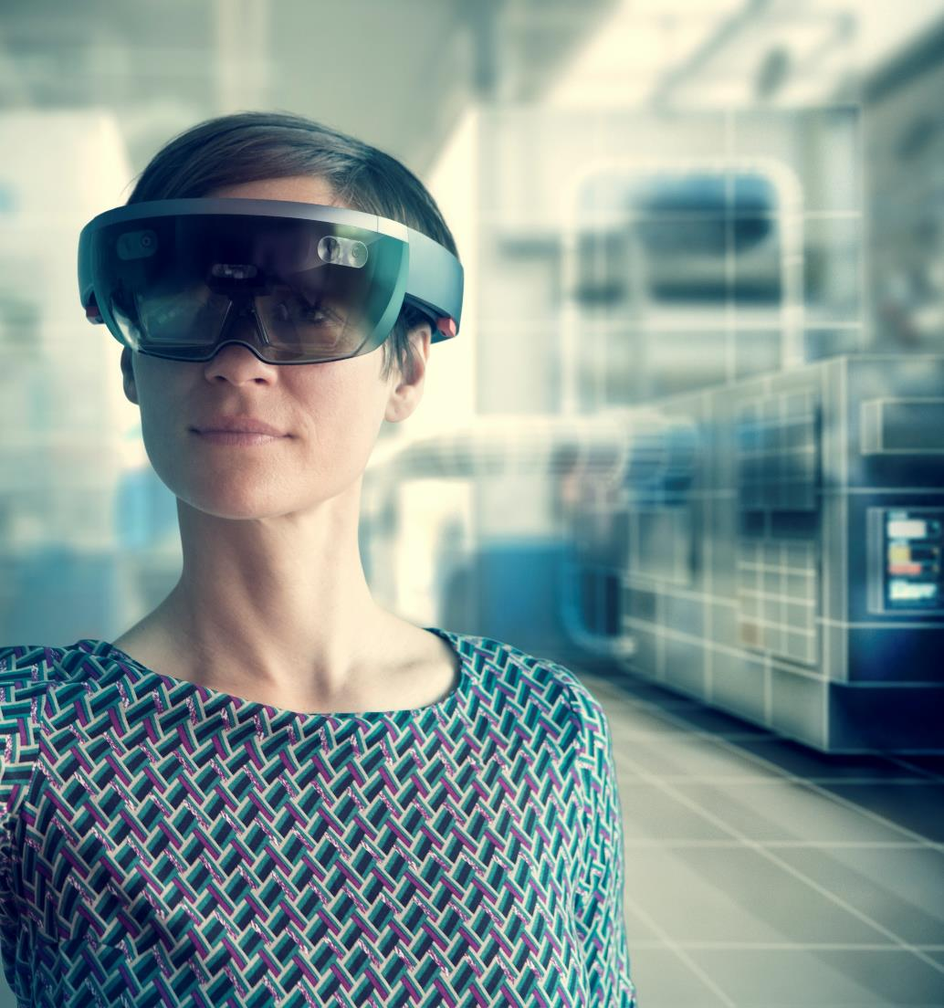





Choose Media
Swapping video for existing
teaching methods led to small improvements in student learning (g = 0.28). Adding video to existing teaching led to strong learning benefits (g = 0.80).
Noetel, M., Griffith, S., Delaney, O., Sanders, T., Parker, P., Cruz, B., Lonsdale, C. (2021). Video improves learning in higher education: A systematic review. Review of Educational Research. Prepublished February 17, 2021. https://doi.org/10.3102/0034654321990713

Slide 32

Find, reuse and create

Slide 33



From Content to Course
Build interaction.
Encourage discussion.
Practice + Expert feedback necessary.
Notes:
That's why we have coaches in sports and one to one sessions in medicine. But, prior to practice there is need of theoretical knowledge and understanding. Without a theoretical
knowledge, skills development will remain only at the level of craftsmanship.

Slide 34
Convergence of Technology
Face-to-Face Courses
Blended Courses
Distance/Online Courses
ICT integration in teaching and learning
MOOC
Mobile learning
Open and Distance Learning

Slide 35

Blended Strategy
TEL as Backbone of HE
Access
Equity and Inclusion
Training both students and teachers
Appropriate mix for online and face-to-face
Build student-student and student-teacher interaction
Mix asynchronous and synchronous activities

Slide 36
Levels of Blending
Activity-Level
Course-Level
Programme-Level
Institutional-Level
Notes:
Activity-Level Blending. Blending at the activity level occurs when a learning activity contains both face-to-face and CM elements
Course-Level Blending. Course-level blending is one of the most common ways to blend. It entails a combination of distinct face-to-face and CM activities used as part of a course.
Program-Level Blending. observe that blends in higher education are often occurring at the degree program level.
Institutional-Level Blending. Some institutions have made an organizational commitment to blending face-to-face and CM instruction.

Slide 37
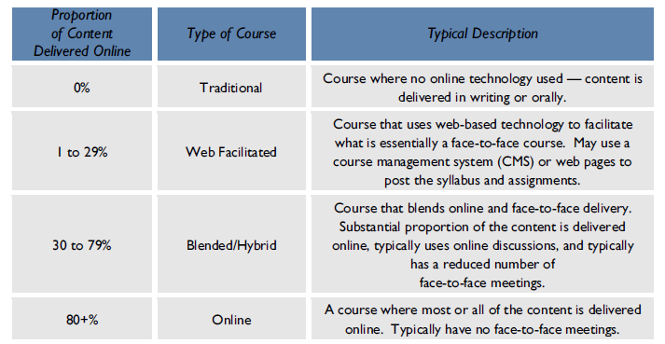
How much of blending?
Source: Allen, & Seaman (2014). Grade Change: Tracking Online Education in the United States, Babson Survey Research Group and Quahog Research Group. Retrieved from https://www.onlinelearningsurvey.com/reports/gradechange.pdf

Slide 38
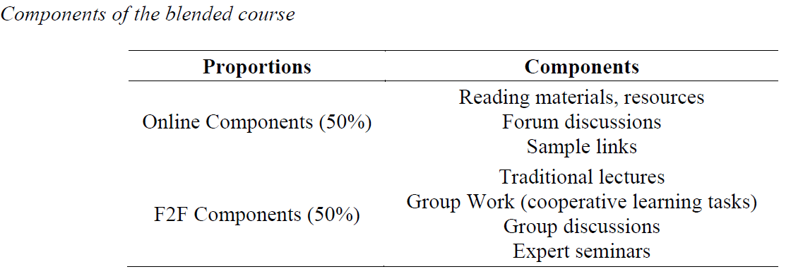
Example
Source: Gedik, N., Kiraz, E., & Ozden, M. Y. (2013). Design of a blended learning environment: Considerations and implementation issues. Australasian Journal of Educational Technology. 29(1), 1-19

Slide 39
A course is a course…
The strongest predictor of success is in previous academic performance (Dziuban, 2011). Historically, students who have done well in courses do well in any mode; a course is a course.
Source: Dziuban, C., & Moskal, P. (2011). A course is a course is a course: Factor invariance in student evaluation of online, blended and face-to-face learning environments, Internet and Higher Education, 14, 236–241

Slide 40
DESIGNS AND
TECHNOLOGIES
Think Instruction, before Technology

Slide 41
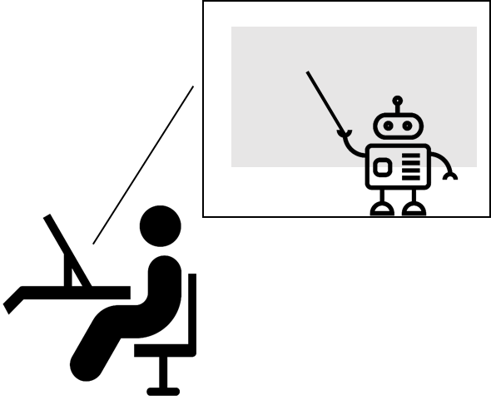
Online Technologies
Interaction Methods | Learner-Content | Learner-Teacher | Learner-Learner
One-Alone | Interactive web-pages, interactive video, simulation-based learning content, Quizzes and tests
One-to-one |  | E-mail, Chat, | Email, Chat
One-to-many |  | E-mail, Mailing lists, Discussion Forums, Blogs, Social Networks, Web conferences | E-mail, Mailing lists, Discussion Forums, Blogs, Social Networks,
Many-to-many |  | Group Chat, Discussion Forum, Blogs, Wikis, Social Networks, Web conferences | Group Chat, Discussion Forum, Blogs, Wikis, Social Networks

Slide 42


Advance technologies
Artificial intelligence
Blockchain?
Chatbots
Augmented Reality/Virtual Reality
Microcredentials
Learning analytics supported personalised learning
Context specific support
Experiential learning

Slide 43
Gagne’s Nine Events of Instruction
Gagne’s Nine Events of Instruction | Online technologies
Gain attention | SMS alert, Social media, pop-ups, highlight balloons
Inform learners of objectives | Web page, LMS
Stimulate recall of prior learning | Prior learning quiz
Present the content | Video, PDF, HTML pages for reading
Provide “learning guidance” | Short tips via audio; discussion forum
Elicit performance (practice) | Simulation, drill and practice exercises
Provide feedback | One-to-one message, email
Assess performance | Assignments, quizzes
Enhance retention and transfer to the job | Blogs, Wikis, collaboration projects

Slide 44
Community of Inquiry
Supporting
Discourse
Social
Presence
Cognitive
Presence
Educational
Experience
Setting
Climate
Selecting
Content
Teaching
Presence
Communication Medium
Source: Garrison, Anderson, & Archer (2000)

Slide 45
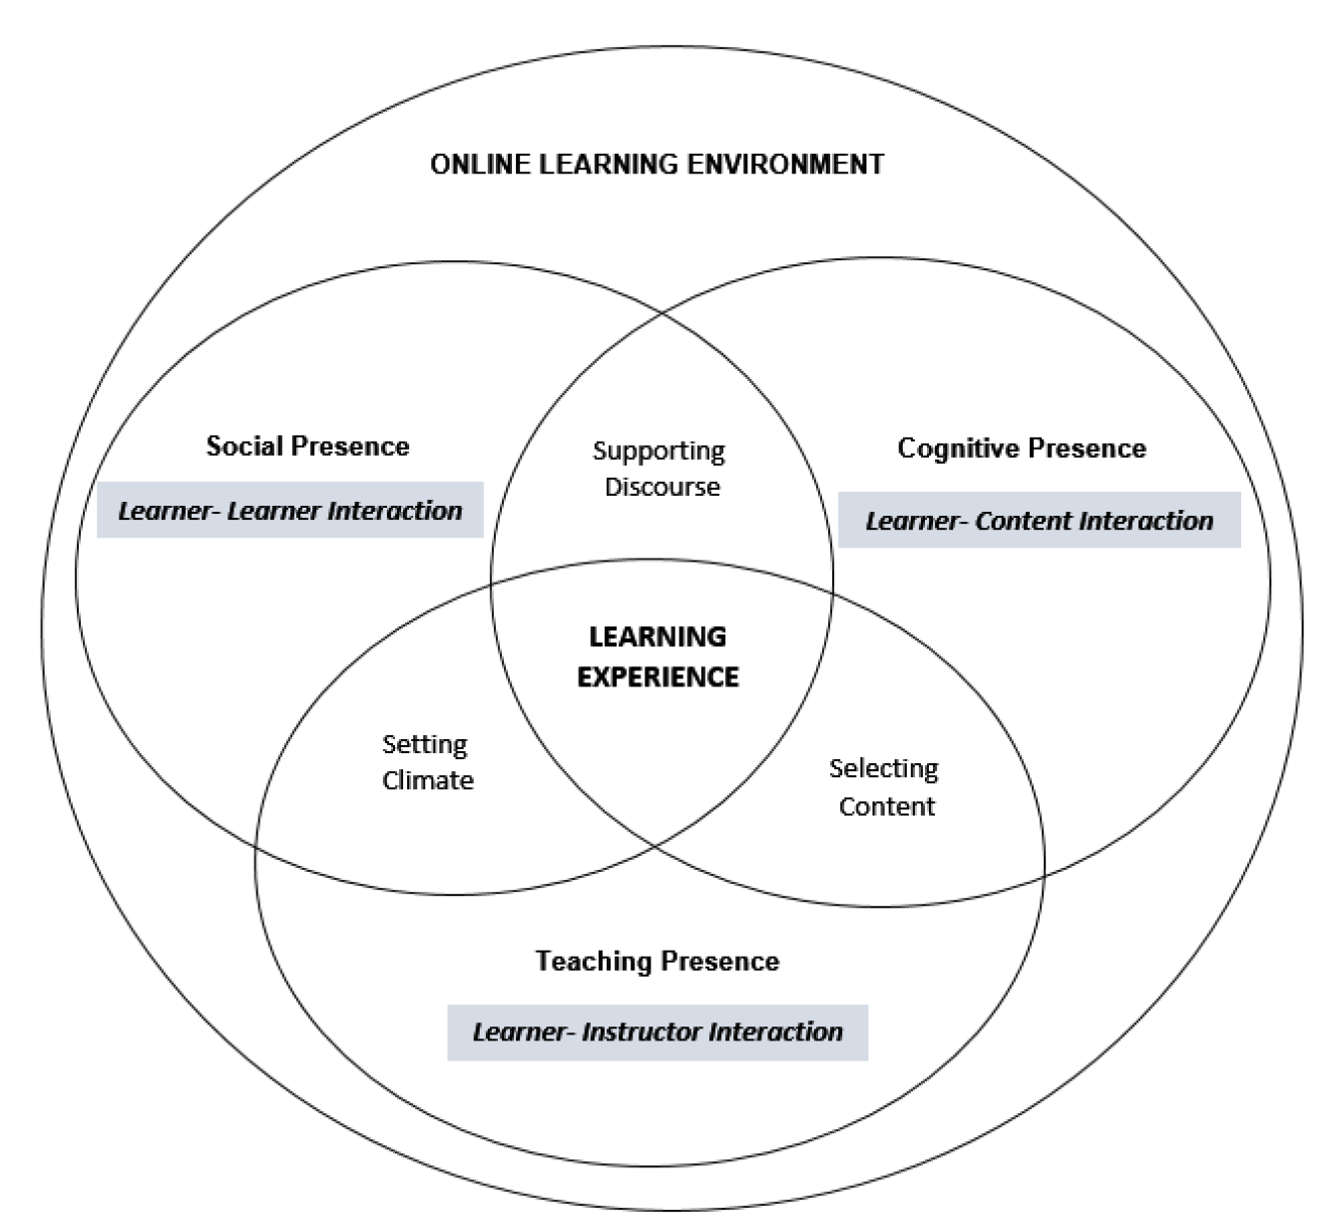
CoI and Types of Interactions
Source: Saadatmand et al. (2017)

Slide 46
Online Environment Design
Participation in discussion forum
Email contact
Reading of lessons
Learning activities
Objective-based course units
Self-assessment online
Constructivism
Behaviourism
Cognitivism
Learner guide
Mentor support
Online library
Social interaction
Synchronous chat -counselling
Content
Learner support
(Source: Mishra, 2002)‏

Slide 47
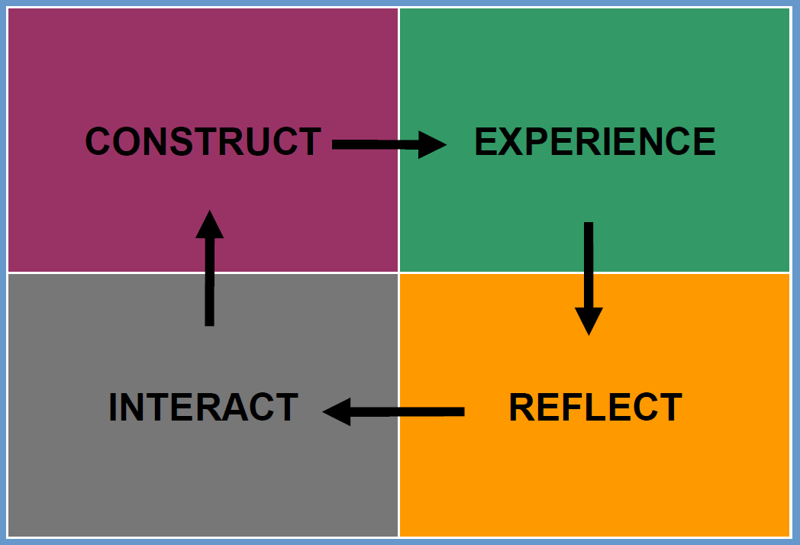
ERIC Model
(Source: Sharma, & Mishra, 2007)‏

Slide 48
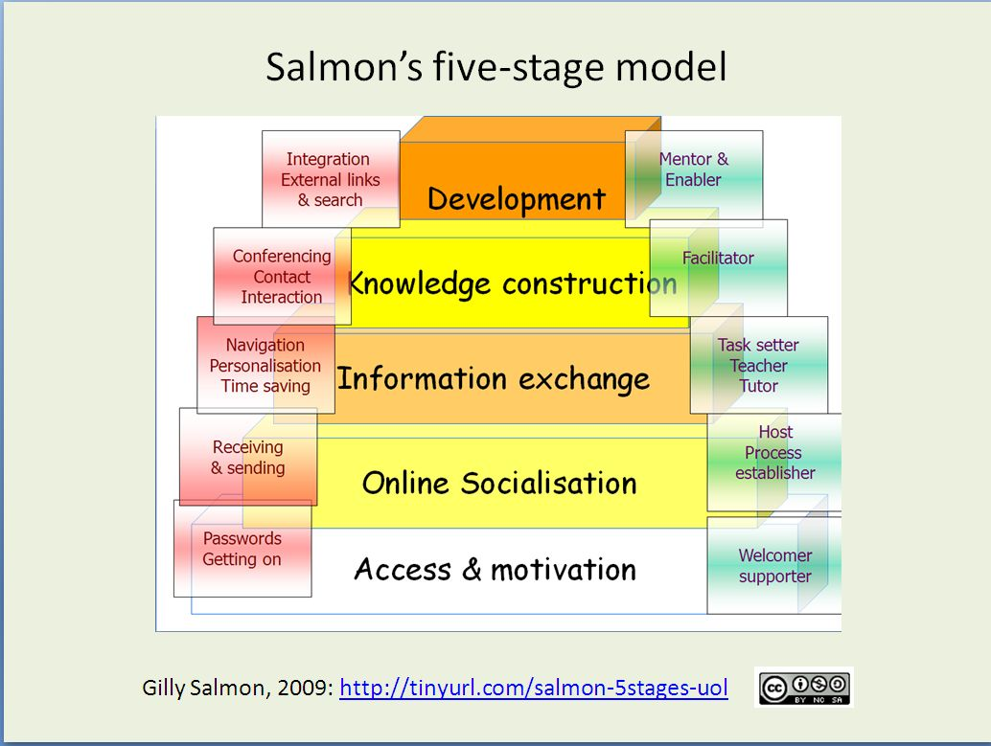
Gilly Salmon’s 5-Stage Model
INTERACTIVITY
LEARNING

Slide 49
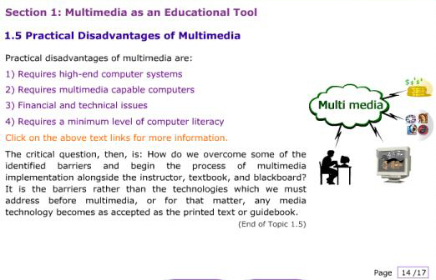
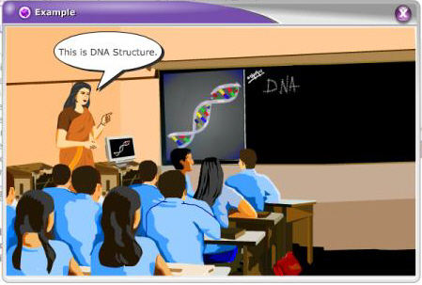
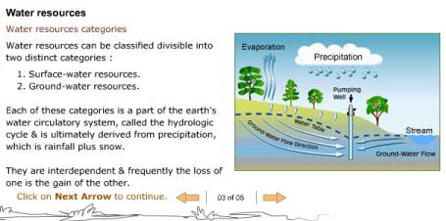
Principles of Multimedia Design
Multimedia principle: Use both graphics and words
Contiguity principle: Place related words and graphics together
Modality principle: Present words as speech rather than on screen text (along side graphics)
Redundancy principle: Avoid presenting words as narration and text together, while using animation
Coherence principle: Avoid extraneous sound and pictures
Personalization principle: Use conversational style and learning agents
Practice principle: Give opportunities for interactions related to authentic events
Source: Mayer, R.E. (2008). Applying the science of learning: Evidence-based principles for the design of multimedia instruction. American Psychologist, 63(8), 760-769

Slide 50
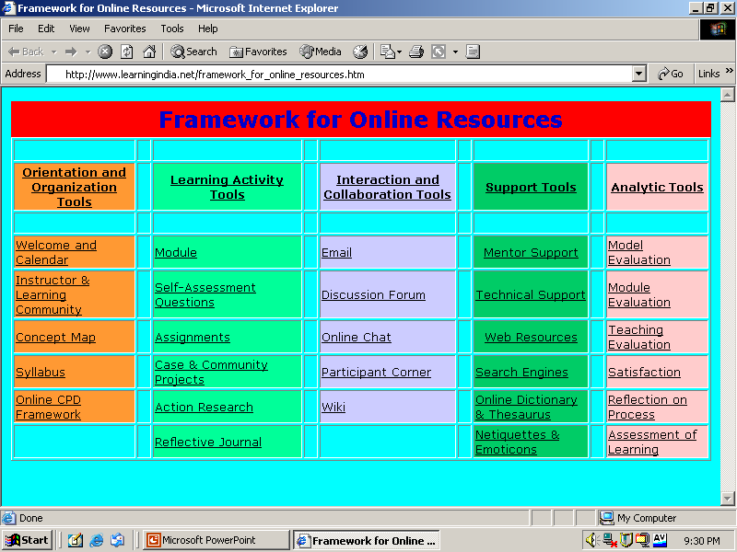
Interactive Online Resources
(Source: Panda & Mishra, 2008)

Slide 51
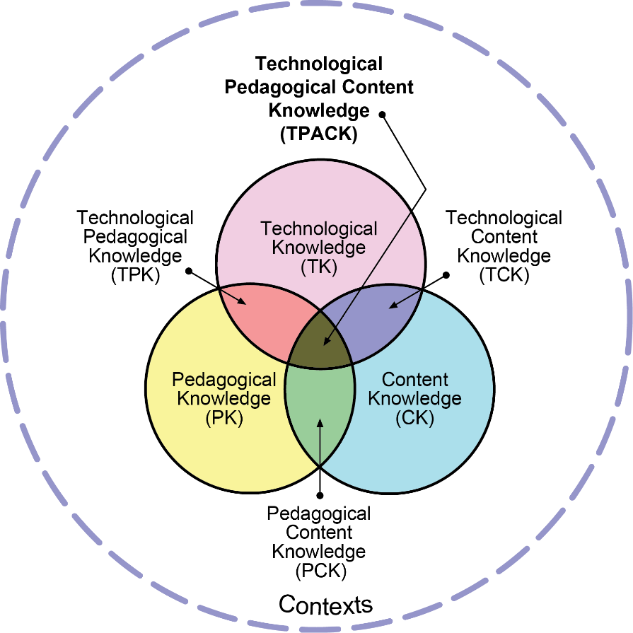
Technological Pedagogical Content Knowledge
Source: Reproduced by permission of the publisher, © 2012 by tpack.org

Slide 52
ONLINE LEARNING MYTHS

Slide 53

Myth #1:
If we build it, they will come
Notes:
This is not going to happen. Institutions need to ensure that students have access to digital tools and appropriate bandwidth. If this is not, learners will not be able to access your digital platforms. In a way, there has been a deficit is service during transitioning into online learning. As the normal understanding of providing service was violated and learners had no choice. Most the time institutions though they have completed their duties, whereas they had not. No one challenged the deficiency in service as we are in a pandemic situation. This will not happen in future. Learners will seek more, and institutions will have to clearly indicate who will access a course, and what are the essential tools to access.

Slide 54

Myth #2:
The core expertise of teachers come from content knowledge
Notes:
With the use of and integration of ICTs into teaching and learning, what is needed is Technological-Pedagogical-Content Knowledge. Just having content expertise is not sufficient to deliver online and blended learning experiences. Teachers need to adapt to the new normal.

Slide 55
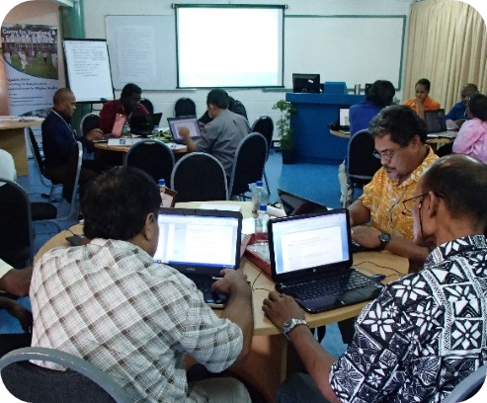
Myth #3: Technology is a poor substitute for face-to-face learning

Slide 56

Myth #4: Synchronous video conferencing is online learning

Slide 57

Myth #5: Technology use does not improve learning
Notes:
Research shows technology itself can't improve learning. You need good teachers who are capable of using technology effectively to help students learn.
All students do not learn equally
in F2F situations. Self-directed learning skills are also key in student learning outcomes.
Comparative research shows either no significant difference or better learning outcomes, where technology is integrated well.

Slide 58

Myth #6: Today’s learners do not need digital skills
Notes:
There is an implicit assumption that the learners today use technology effortlessly, and thus they have the skills to use technology for learning. In fact, there is not evidence of that. Student still need self-directed learning skills and digital education skills to engage in the technology-enabled learning environment. So, if you are planning to use technology or using technology, engage in preparing students to effectively use ICTs for learning.

Slide 59
REFORMS FOR FUTURE

Slide 60
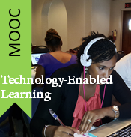


Institutional Model for TEL
Technology
Capacity
Policy
Content
Advanced ICT Skills Development
TEL
C-DELTA
Technology-Enabled Learning

Slide 61

Institutional success factors
Aligned to organisational needs rather than using a generic approach
Organisational readiness, sufficient technical resources, motivated faculty, policy in place
Freedom to adopt different models of blended learning
Blended learning should be introduced as a scholarly and transformative redesign process
Carrying out regular evaluations and sharing the results
Source: Stacey, E. & Gerbic, P. (2008). Success factors for blended learning. In Hello! Where are you in the landscape of educational technology? Proceedings ascilite Melbourne 2008. Retrieved from http://www.ascilite.org.au/conferences/melbourne08/procs/stacey.pdf

Slide 62

Teachers
Continuing professional development for teachers with sufficient time for development
Ongoing pedagogical and technical support
Dealing with teachers’ fears of loss of control, and general uneasiness about the impact of online learning on classroom
The impact on teachers’ workloads must be taken into account
Use and creation of shareable and reusable digital resources to ensure that blended learning is sustainable
Source: Stacey, E. & Gerbic, P. (2008). Success factors for blended learning. In Hello! Where are you in the landscape of educational technology? Proceedings ascilite Melbourne 2008. Retrieved from http://www.ascilite.org.au/conferences/melbourne08/procs/stacey.pdf

Slide 63

Students
Students’ readiness for blending learning
Increased self-regulation in learning and time management skills
Consistent and transparent communication around the new expectations to use technology in teaching and learning
Clarity on assessment
Source: Stacey, E. & Gerbic, P. (2008). Success factors for blended learning. In Hello! Where are you in the landscape of educational technology? Proceedings ascilite Melbourne 2008. Retrieved from http://www.ascilite.org.au/conferences/melbourne08/procs/stacey.pdf

Slide 64

Pedagogic Considerations
Combination of the virtual and physical environments should be made on the basis of subject need and learning outcomes
Utilise the strengths of the different media and add value to the learning activities
The central role of the face-to-face environment along with activities for before, during and after class needs to be designed
Make the blend relevant to the learners need
Source: Stacey, E. & Gerbic, P. (2008). Success factors for blended learning. In Hello! Where are you in the landscape of educational technology? Proceedings ascilite Melbourne 2008.
http://www.ascilite.org.au/conferences/melbourne08/procs/stacey.pdf
Teaching by Nick Youngson CC BY-SA 3.0 Alpha Stock Images

Slide 65
In conclusion
Knowing is not enough, doing is necessary for success.
In online education, learning on the go is a successful plan for failure. Instead, learn to do is right, the first time.
The devil is in the details.

Slide 66


THANK YOU
The contents of this presentation, except logos/ graphics which are property of the respective owners, is made available under Attribution-ShareAlike 4.0 International (CC BY-SA 4.0).

