Slide 1
Professor G Ram Reddy Memorial Lecture
Dr B R Ambedkar Open University
Open Universities and Education 4.0
B. Shadrach
Director, Commonwealth Educational Media Centre for Asia
12 January 2024

Slide 2

Agenda
Tribute to Professor G Ram Reddy
Open and Distance Learning- Journey
Open Universities in current times
Education 4.0 Framework
Open Universities and Education 4.0

Slide 3
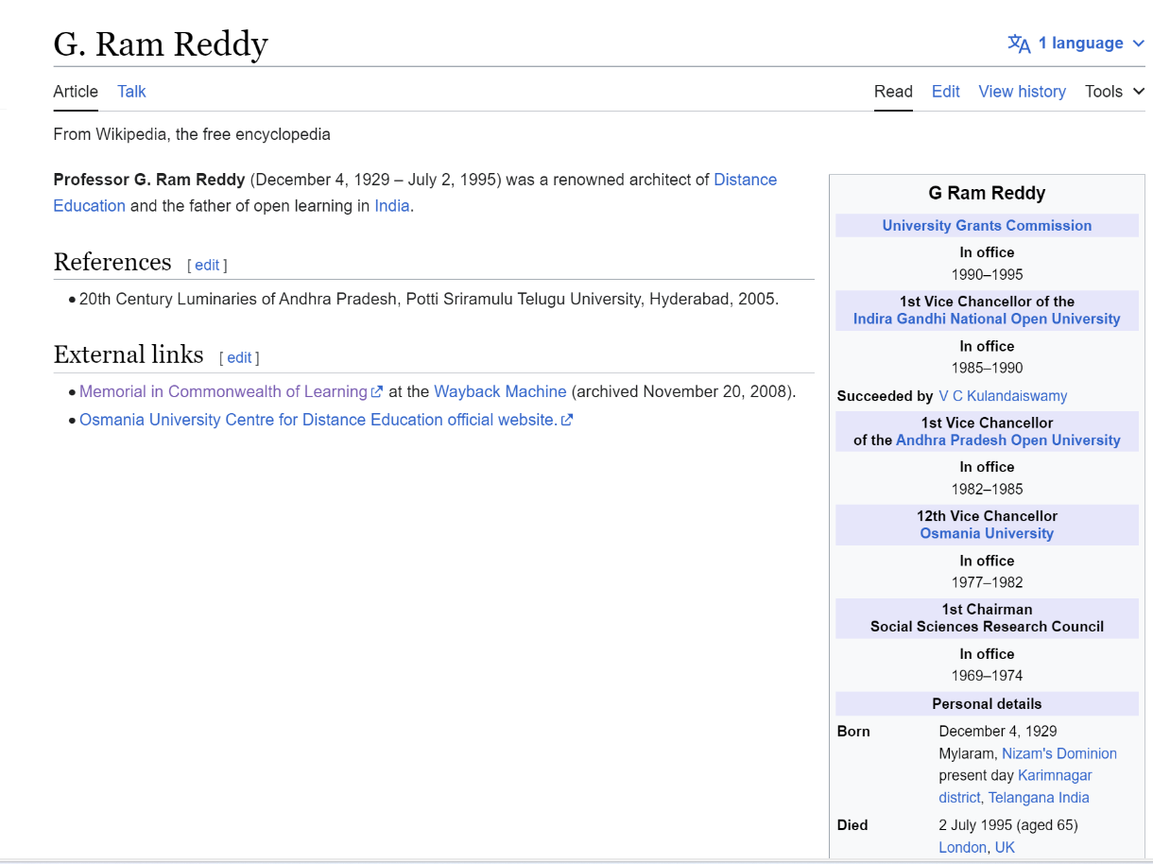
1. Professor Ram Reddy
Notes:
Professor G Ram Reddy, who left the education community some 29 years ago, just a few days after receiving the Meritorious Award of Excellence, co-sponsored by the Commonwealth of Learning (COL) and the International Council for Distance Education (ICDE) in England at the age of 65, left a huge void in the world of open and distance learning.
Rising to the level of being the first Vice President of COL for a person born in a small village was a testament to his caliber. No doubt, he was known to be the father of Indian ODL landscape!
Founded India’s first Open University (OU) in Hyderabad; IGNOU; AOU; COL and ICDE. - bringing education to the doorsteps of individuals wherever they might be, and the spread and scale of that education in a qualitative manner. This was evident when he helped to establish NAAC
Young age - becoming a full Professor, or the VC of his alma mater, the Osmania University at the age of 48 or being the founding father of India’s first state Open University and then a national Open University. At Osmania University itself, his passion for distance education was evident.
Had he continued to lend his leadership for two more decades, I am sure the Open and Distance world would have benefited enormously. However, his vision and his legacy are still our guiding force. I offer my gratitude to his family members and to the family of BRAOU, and the Vice Chancellor who continues to commemorate his birthday in the form of organising a memorial lecture in his name. I feel extremely pleased to be delivering this year’s lecture.
For almost three decades, we have been following his vision, and I wish to delve into an aspect that would have surely been his pet theme – Open Universities and Education 4.0. Kindly allow me to share my thoughts in the next 30 minutes or so.
While the Open Universities have evolved into more of Open to Online and Distance to Digital Universities, embracing technologies and blended and HyFlex techniques in teaching and learning practices, let me first speak about the idea of Open Universities that Professor G Ram Reddy envisioned and lived through.

Slide 4


2. Open and Distance Learning progress thus far
First era – 1960s-80s
Second era – 1980s-1990s
Third era – 1990s – 2010s
Fourth era – 2010s – 2020s
Notes:
Open University in the UK and the Labour government’s agenda - people from all backgrounds should have access to higher education. Cost-effective Vs expensive! Millions of students testified. In the UK and other geographies, such as Australia and Canada, it was a response to reaching the remote populace.
In India, Delhi University introduced its bachelor's degree in 1962 whose success resulted in the UGC formulating guidelines. Institutes of correspondence studies were established in the late 1960s. The 1970s witnessed postgraduate programmes being offered in distance mode. And in the 1980s, many more institutions came up with correspondence courses, thus liberalising the strict formula for education for over a century and half. More people aspired to gain tertiary education and certification; economic systems required more educated individuals and the societal necessities demanded people with knowledge and skills.
It was not just that. The first era also produced the Open Universities in India, starting with the Andhra Pradesh Open University (APOU), followed by IGNOU and then in the states of Bihar, Rajasthan, and Maharashtra. These catered to a diverse set of learners. Young and older learners; full-time and part-time learners; abled and disabled learners; formal and flexible learners; and those who could not otherwise access education.
Secondly, the learner support systems were more reliant on learning material and tutorial support. The learning material was to be produced based on an instructional design for an invisible learner, keeping the cultural context and the content needs in mind; therefore, the format had to be appealing and engaging. Although the economy of scale model was meant to bring down the cost of producing this material, the challenge remained in producing material for personalised and specialised learning needs.

Slide 5
2. Open and Distance Learning progress thus far
First era – 1960s-80s
Second era – 1980s-1990s
Third era – 1990s – 2010s
Fourth era – 2010s – 2020s
Notes:
The second era marked the introduction of need-based courses and the flexibility of pace at which learners can complete the courses. This was coupled with the integration of a generation of educational technologies such as radio, television and video cassettes that provided learning material and instruction to learners. The broadcasts through All India Radio in 16 languages through 14 of their stations were joined by transmission through INSAT 1-B on the national TV network. A network of study centres extended their learners’ support systems.
The second era that embraced technology also opened education to the masses; thus, reducing the pressure on conventional universities. The objective was also to provide second chance education to those who discontinued formal education and democratise education for the larger sections of society. The second era was also the beginning of diversifying degree, certificate and diploma courses related to employment and one that was necessary for building the human resource potential of the nation. Rather, this was also the beginning of the notion of lifelong learning to enrich people’s lives and livelihoods.
The second era also marked the beginning of an innovative culture in the provision of higher education. While the first era could be termed as the era of disruption, the second era could be termed as the era of innovation in being flexible and open in terms of methods and pace of learning, eligibility criteria, conduct of examination, assessment techniques and the introduction of employment-oriented and combination of courses. As of the early 1990s, of the 4.2 million students in higher education, almost half a million were learning remotely, with IGNOU and the APOU (now BRAOU) at the leading edge.

Slide 6
2. Open and Distance Learning progress thus far
First era – 1960s-80s
Second era – 1980s-1990s
Third era – 1990s – 2010s
Fourth era – 2010s – 2020s
Notes:
Going global – COL – The Daniel Report and CHOGM 1987
Educational Technology Conference in 1996 in Singapore- 200 participants from 38 nations and the first Pan Commonwealth Forum in 1999 were the beginning of the much-required international collaboration in open and distance learning.
Education for our Common Future: the Halifax Statement on Education in the Commonwealth in November 2000 promoted an inclusive agenda in a collaborative manner. The statement emphasised upon a) resources for learning; qualifications, standards and equivalencies, School Improvements and Programmes in the Small States; Education to combat HIV/AIDS; Education in difficult circumstances; ICTs in Education; Scholarships, Fellowships and Exchange Schemes; Teacher Training and Professional Development.
Halifax statement became a reality when the Virtual University for Small States of the Commonwealth (VUSSC) was launched in 2004 with 20 small states responding to the invitation. Regional and local level collaborations were initiated. Regional Training and Research Institute for Open and Distance Learning (RETRIDOL) was initiated in Nigeria and the Southern African Regional Distance Education Centre (SARDC) in Botswana and similar initiative in the Pacific called Pacific Centre for Flexible and Open Learning for Development (PACFOLD) came into being.
The Indian government and the likes of Professor Reddy and Professor Abdul Waheed Khan produced CEMCA. UNESCO and COL mooted the idea of Open Educational Resources (OER) and brought out the Paris Declaration in 2012. The Declaration was approved at the OER Congress in June the same year.
Importance of OER and the call for market-driven skill development using ODL and blended and flexible learning in collaboration with industry and other service sectors. The Kuala Lumpur Declaration of 2016 emphasised innovation in technology to promote access, equity and lifelong learning, calling the institutions to create a culture to embrace innovation and change.
By then, with Sustainable Development Goals (SDGs) 4 and 5 becoming prominent, the KL declaration sought to ensure the education of women and girls through ODL. The discourse also moved to ODL not only addressing the market needs, but also global challenges spelt out in the 17 SDGs.

Slide 7
2. Open and Distance Learning progress thus far
First era – 1960s-80s
Second era – 1980s-1990s
Third era – 1990s – 2010s
Fourth era – 2010s – 2020s
Notes:
Two transformations – COVID 19 and in India, the NEP 2020
Is learning effective enough? Twin reports of the World Bank: a) availability of technology is a necessary but not a sufficient condition for effective remote learning; b) teachers are more critical than ever; c) education is an intense human interaction endeavor; d) parents are key partners of teachers at the early stages of education; e) need for dynamic ecosystem of collaboration between multi-lateral, public, private and academic institutions.
No doubt, the NEP 2020 is a transformational policy document that has the potential to change the landscape of education in India and put India on the education map of the world. As ODL institutions, we considered the importance of the Open Universities when we gathered in Ahmedabad for two full days to deliberate upon the opportunities facing the OUs. And, the Ahmedabad Declaration is worth noting here.
The Declaration recognises the transformative nature of NEP 2020 for its commitment to all-round development of learners in alignment with the 21st Century Skills, capable of rational thought and action, possessing compassion and empathy, courage and resilience, scientific temper, and creative imagination with sound ethical moorings and values. The Declaration also recommitted to the national target of achieving 50 percent of Gross Enrollment Ratio (GER) by 2035. In doing so, the OUs are aware of their role in reaching the unreached and catering to the marginalised.

Slide 8




3. Open Universities in current times
Ahmedabad Declaration and the NEP 2020
Notes:
Open Universities’ commitment to achieving the Sustainable Development Goals
Open Universities’ commitment to developing learners with 21st Century Skills
Open Universities’ commitment to scaling up of education and to include the excluded.
Open Universities’ commitment to skilling, upskilling and reskilling
Open Universities’ commitment to quality education through ODL
Open Universities’ commitment to sharing resources
Open Universities’ Credit Transfer Framework
Open Universities to be at the forefront of Blended Learning
Overcoming digital divide by using appropriate technologies
Commitment to innovation and creativity

Slide 9

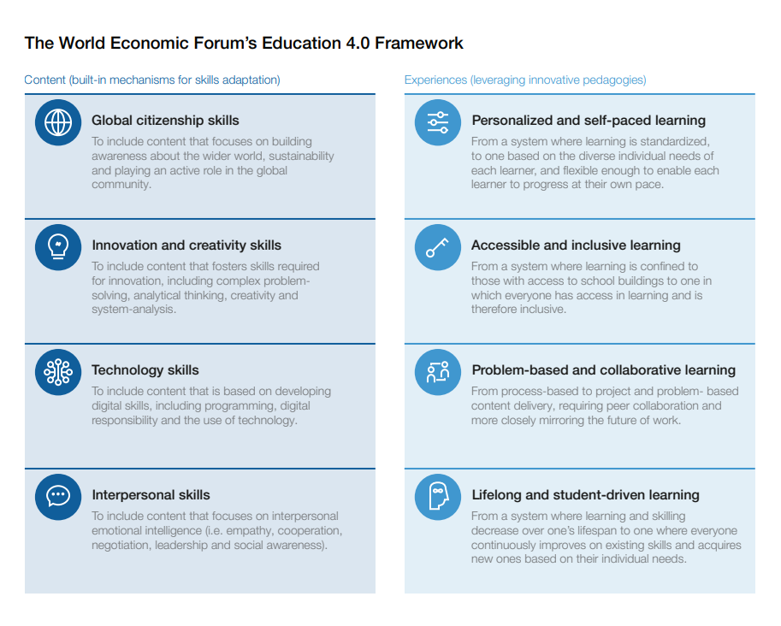


4. Education 4.0 Framework
Notes:
WEF – Education 4.0 Framework - skill development from a very young age! Early childhood schooling and primary education and critical cognitive development among children, building skills; multiplied through learning later in life.
Investing in just one skill – collaborative problem-solving skill – alone can add as much as USD 2.54 trillion dollars to the global GDP.
The Education 4.0 framework recognises the following: Global Citizenship Skills, Innovation and Creativity Skills, Technology Skills, Interpersonal Skills.
To help develop these skills, the education system is required to develop mechanisms to embed skill development in their educational content.
Need for certain competencies, skills, and abilities among our learners. These would include personalised and self-paced learning, accessible and inclusive learning, problem solving-based and collaborative learning, lifelong and student driven learning. The Education 4.0 framework calls for attention towards building certain abilities and skills as well as attitudes and values among our learners apart from the aspect of discipline in specific knowledge build-up.
What are these abilities, skills, attitudes, and values that are referred to here? The abilities and skills are largely defined as cognitive, social, and physical skills leading to acquiring the following skills in the long run. The cognitive skills imparted through education can lead to the aspects of creativity, critical thinking, digital skills programming, problem solving and systems analysis. Social skills imparted through education can lead to the aspects of collaboration, communication, negotiation, socio-emotional awareness, and the physical skills can lead to balance, coordination, positional awareness, and strength.
Attitudes and values are largely defined as self-regulatory and societal skills. In other words, these are referred to as intra-personal and extra-personal skills. While the intra-personal self-regulatory skills lead to adaptability, consciousness, curiosity, grit, growth mindset and take initiatives, the extra-personal societal skills lead to civic responsibility, environmental stewardship, empathy, kindness, and global citizenship.

Slide 10
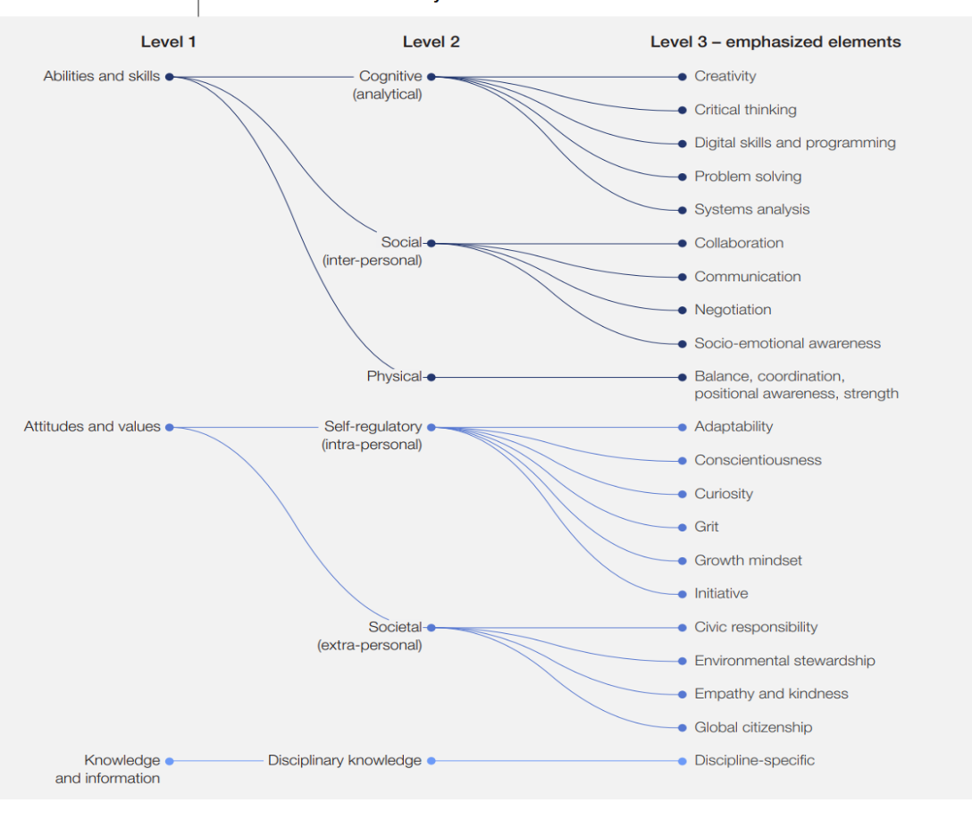
4. Education 4.0 Framework
Notes:
Abilities and Skills
Creativity An iterative process embodying the ability to innovate, to think across disciplines and domains (interdisciplinarity), and to imagine novel solutions to meaningful problems, especially in unexpected ways.29 Creativity is defined as a cognitive aptitude.
Critical thinking Deductive reasoning to infer logical conclusions, and inductive reasoning to infer greater generalized understanding, with respect to making sound judgements, including those related to decision-making and comparisons of potential outcomes of hypothetical scenarios;31 the ability to engage with seemingly contradictory sets of information, for instance, with regard to media literacy.
Digital skills and programming Skills relating to the creation and use of technology, including digital technologies, the internet and new forms of networked information; especially emphasizing skills in deductive reasoning, algorithm design and abstract concepts relating to data and information.
Problem solving The ability to break down large, complex problems into smaller, simpler tasks for systematic resolution.
Systems analysis The ability to apply abstract models of varying levels of complexity to empirical phenomena to facilitate the understanding of systemic outcomes. The capacity to understand how concepts work together, what is the bigger whole of which something is a part, and how to identify patterns over time.
Collaboration The ability to cooperate with others and to coordinate complex tasks in groups of individuals to ensure that tasks are completed effectively;35 adjusting one’s actions in relation to others’.
Communication Clear communication, in both verbal and written form; involving active speaking and writing, reading and active listening
Negotiation The ability to find common ground and reconcile differences among disparate points of view,38 especially without losing sight of one’s own or others’ intentions or goals.
Socio-emotional awareness The ability to read and understand the emotions and desires of others, distinguish correctly between them and observe how they can influence one’s environment and social interaction, and what can be done about it;40 the ability to empathize; emotional intelligence
Balance, coordination, positional awareness, strength The set of abilities to use physical tools, operations and functions.

Slide 11
4. Education 4.0 Framework
Notes:
Attitudes and Values
Adaptability The willingness to expose oneself to new situations, and comfort in dealing with uncertainty.43 Demonstrating sufficient self-reflection to understand when a particular approach is not working, and a willingness to readily change course.
Conscientiousness Diligence, efficiency and organization in accomplishing tasks; also, honesty, ownership, responsibility and accountability with respect to their successful execution.
Curiosity The quality of experiencing wonder, the desire to ask questions, the willingness to experiment, the openness to experiencing and actively exploring and discovering new areas.
Grit Passion and perseverance for long-term goals.47 Resilience in the face of adversity
Growth mindset The belief that [intellectual] ability can be developed;49 paired with the confidence to attempt a task and risk being wrong;50 and the humility to accept and learn from one’s mistakes, while not being impaired by an inflated ego. Setbacks are interpreted as “not yet” rather than failure. Research indicates that “perceived selfefficacy and personal goals enhance motivation and performance
Initiative The vision to imagine new goals and the drive to attempt to reach them. The willingness to take on responsibilities and challenges.52 Being proactive and taking the first step without waiting for what others say or do.
Civic responsibility The demonstrable regard for: justice, pluralism, political engagement, integrity of civic institutions and respect for political processes; all in the name of promoting solidarity with neighbours, and the development of cohesive communities.54 The desire and ability to play an active role in the global and local communities and the application of civic value
Environmental stewardship The respect for the fragility and finiteness of natural ecosystems and natural resources, and an understanding of how to interact with them in sustainable ways,56 including conservation, restoration and sustainable use of resources
Empathy and kindness The capacity to understand the feelings and points of view of others.
Global citizenship Cultural competence. A universal respect and valuation (awareness and understanding) of people from other cultures, and their beliefs and practices;59 implies embracing diversity, equity and inclusion. Many other organizations also define global citizenship as respect for others.
Domain-specific skills Specific domains of knowledge and information are not listed, but this category is included for completeness

Slide 12
5. Open Universities and Education 4.0
Effective learning requires a comprehensive approach that involves appropriate curriculum, engaging pedagogy, continuous formative assessment, and adequate student support. The curriculum must be interesting and relevant, and updated regularly to align with the latest knowledge requirements and to meet specified learning outcomes. High-quality pedagogy is then necessary to successfully impart the curricular material to students; pedagogical practices determine the learning experiences that are provided to students, thus directly influencing learning outcomes. The assessment methods must be scientific, designed to continuously improve learning and test the application of knowledge. Finally, the development of capacities that promote student wellness such as fitness, good health, psycho-social well-being, and sound ethical grounding are also critical for high-quality learning. - NEP 2020

Slide 13
5. Open Universities and Education 4.0
Our OU faculty members should know to embed the Education 4.0 recognised abilities and skills in their teaching and learning processes, in their delivery methods, in their content and curriculum and in their practical orientation while imparting education to their learners.
To repeat, these abilities and skills are largely defined as cognitive, social, and physical skills leading to acquiring the following skills in the long run. The cognitive skills imparted through education can lead to the aspects of creativity, critical thinking, digital skills programming, problem solving and systems analysis. Social skills imparted through education can lead to the aspects of collaboration, communication, negotiation, socio-emotional awareness, and the Physical skills can lead to balance, coordination, positional awareness, and strength.
Attitudes and values are largely defined as self-regulatory and societal skills. In other words, these are referred to as intra-personal and extra-personal skills. While the intra-personal self-regulatory skills lead to adaptability, consciousness, curiosity, grit, growth mindset and take initiatives, the extra-personal societal skills lead to civic responsibility, environmental stewardship, empathy, kindness, and global citizenship.

Slide 14
Timeline
Professor G Ram Reddy and his vision
01
Open and Distance Learning – progress thus far
02
Open Universities in current times
03
Education 4.0 Framework – for human agency
04
Open Universities and Education 4.0
05

Slide 15
Thank you
B. Shadrach
bshadrach@col.org
www.col.org
www.cemca.org

