Slide 1


Skilling our youth: role of partnerships
Professor Asha Kanwar
COL President & CEO
Commonwealth Youth Ministers’ Meeting
13 September 2023

Slide 2

Commonwealth Heads of Government Meeting
Vancouver, 1987

Slide 3
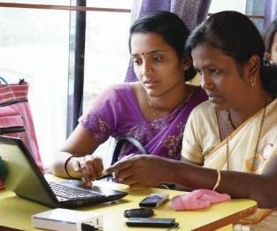
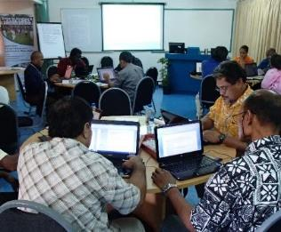
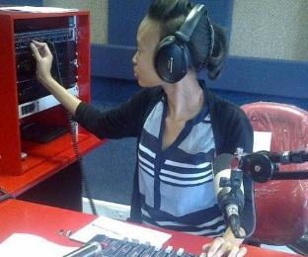
To help Commonwealth governments and institutions use technologies to improve and expand access to education and training

Slide 4

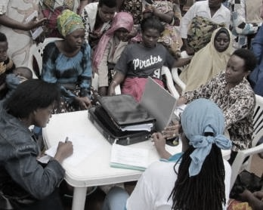
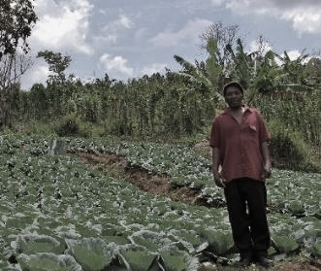


ECONOMIC EMPOWERMENT
SOCIAL
INCLUSION
ENVIRONMENTAL CONSERVATION
$
Notes:
COL continues to promote ‘learning for sustainable development’. Learning must lead to economic growth, social inclusion and environmental conservation.

Slide 5

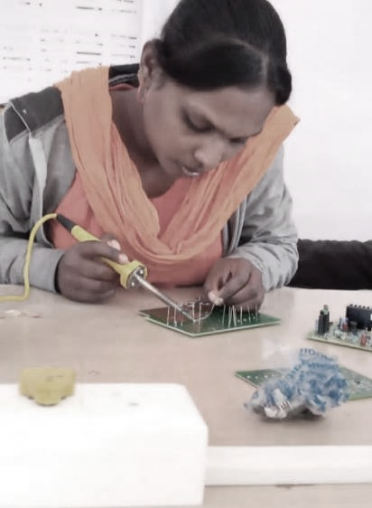

PROGRAMME SECTORS
Education
Skills
Gender Equality

Slide 6
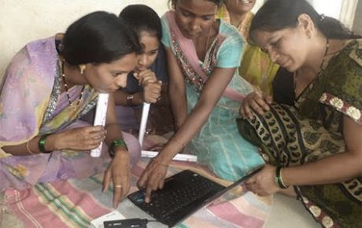
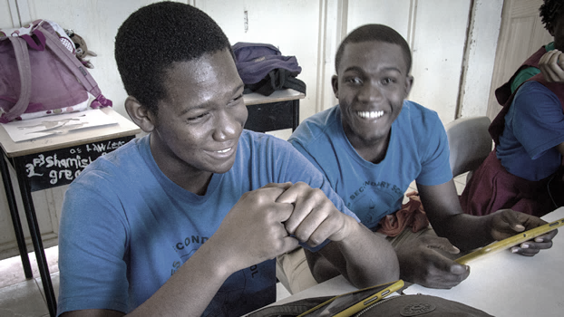
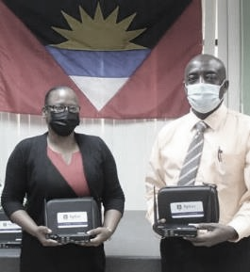
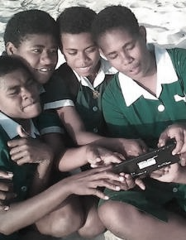


Leveraging new and existing technologies

Slide 7



Key Issues for Youth
By 2025, 85 million jobs may be displaced but 97 million more jobs may emerge
Skills required for the emerging green and blue economies
Phenomenal developments in AI
Source: The Future of Jobs Report 2020, WEF, Oct 2020

Slide 8
Youth Unemployment
Source: data.worldbank.org, retrieved and compiled on 7 September 2023
Notes:
The Commonwealth data was compiled using a weighted average based on each country’s population.

Slide 9




Commonwealth Higher Education Consortium for Youth Work (CHEC4YW)
Notes:
To transform and accelerate the professionalization of Youth Work by
Making available open-source materials for degree level programme
Strengthening the capacity of institutions and training agencies to prepare for and deliver the programme
Leading jointly on advocacy efforts at national, regional and Pan Commonwealth levels

Slide 10
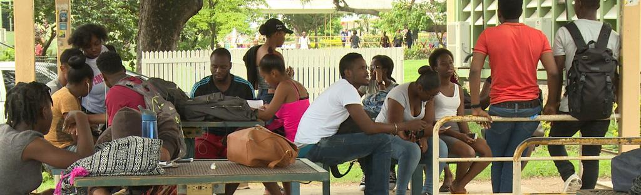
The Namibian College of Open Learning
”We’re exploring setting up our own Youth Association here in Namibia … I think we’re the groundbreakers.”
Oliver Mhuriro, BA: YCD Student
“Educating and developing people to work in the youth sector is vital to Namibia’s continued success”
NAMCOL President Dr Heroldt Murangi
Offering the Bachelor of Arts in Youth and Community Development Online
Photo by IMF Blog
Notes:
The Namibian College of Open Learning (NAMCOL) is offering the Bachelor of Arts in Youth and Community Development online; this programme was previously available as a print-based distance course only. 142 students are currently enrolled in the online programme and can now access 9 courses through the College’s LMS. In addition, 23 NAMCOL staff have strengthened their capacity to design, develop and facilitate courses for online delivery; this has led to an increase in the pool of online course developers and facilitators at the college.

Slide 11

Connecting
the Commonwealth
(32 small states)
Cyprus
Malta
Antigua & Barbuda, Bahamas, Barbados, Belize, Dominica, Grenada, Guyana, Jamaica, St.Kitts & Nevis, Saint Lucia,
St. Vincent and the Grenadines, Trinidad & Tobago
The Gambia
Fiji
Kiribati
Nauru
Papua New Guinea
Samoa
Solomon Islands
Tonga
Tuvalu
Vanuatu
Brunei
Darussalam
Botswana
Eswatini
Lesotho
Maldives
Mauritius
Namibia
Seychelles

Slide 12

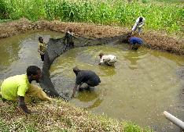
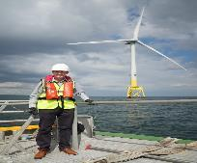
The Blue Economy: Youth Training and Career Opportunities
Collaborative Course Development
Seven competency-based courses that prepare learners for jobs in low carbon BE growth industries
Bluepreneurship
Aquaculture
Ocean Energy
Marine Biotechnology
Notes:
The Blue Economy offers significant offers career opportunities for youth in areas such as, marine biotechnology, ocean engineering, sustainable fishing and sustainable tourism. The Blue Economy also offers opportunity for youth-led entrepreneurship. Investing in training courses and materials allows young people to pursue these careers and at the same time contribute to the growth of the Blue Economy
Building on the popularity and interest that the MOOCs have generated, three institutions are collaborating to develop seven courses. These include a core course in Entrepreneurship with a focus on the Blue Economy and two courses in each of three areas: Aquaculture and Fisheries Ocean Energy and Marine Biotechnology . The three institutions involved are UniSey, University of Namibia and the Caribbean Maritime University.
By supporting the development of short, stackable, competency-based courses and ensuring a curriculum that combines soft skills and voc
ational training, the partners will prepare learners in their countries for jobs in low carbon Blue Economy growth industries

Slide 13
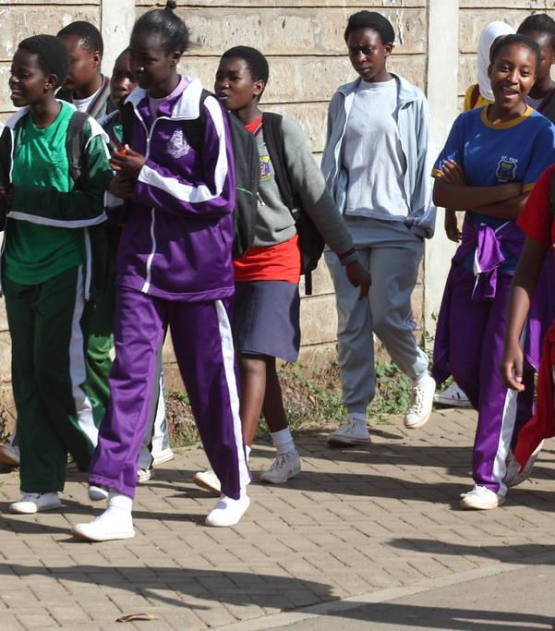
COL’s efforts in this regard
30,151 enrolled (60% female)
10,505 passed (63% female)
Strategies:
  Tanzania: Formal bridging programme
  Malawi: Targeted enrolment
  Botswana: Targeted learner support
  Nigeria: Community engagement: informal to formal learning
General:
  Recruitment of girls
  Gender responsive curriculum and content
  Gender responsive monitoring and intervention
School Girls by Kandukuru Nagarjun is licensed CC BY 2.0
Notes:
As noted in this useful report by the World Bank (2019), there are many reasons why children and youths cannot access or drop-put of schooling and so different strategies are needed to bring them back in depending on the context.
Rajasekaran, S., & Reyes, J. E. (2019). Back to School: Pathways for Reengagement of Out-of-School Youth in Education (English). International Development in Focus. Washington, D.C. : World Bank Group. http://documents.worldbank.org/curated/en/803861556726402678/Back-to-School-Pathways-for-Reengagement-of-Out-of-School-Youth-in-Education
In the first two years of the current strategic plan, 30,151 learners were enrolled in open schooling courses developed or improved with COL’s support and to date 10,505 have passed, with others still in process. As indicated, different strategies have been employed in different countries. In general, however, there is need for targeted enrolment campaigns, gender responsive curricula and continuous monitoring leading to interventions to improve enrolment, retention, pass rates and progression.

Slide 14
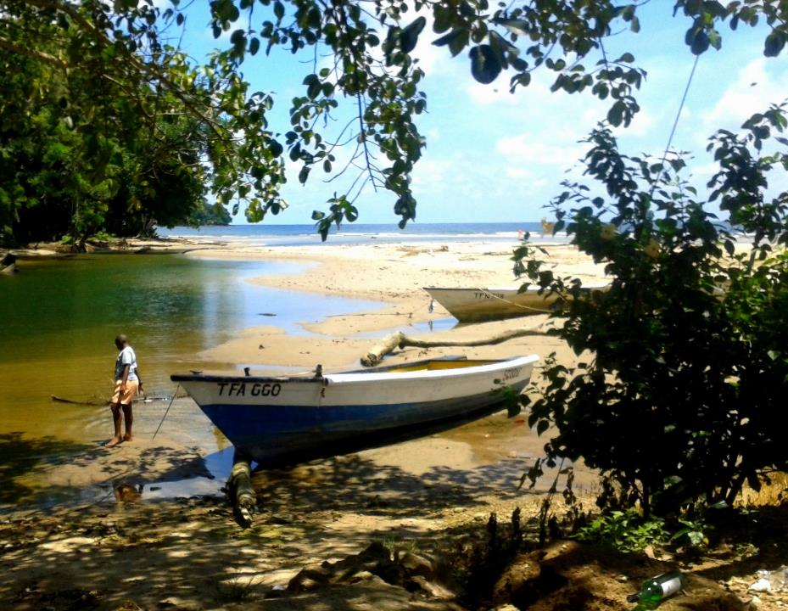
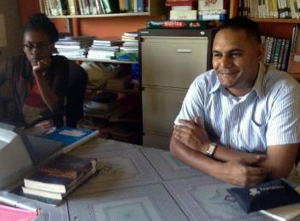

Out-of-school youth in a remote fishing village graduate
Notes:
Photo: Staff Matelot

Slide 15
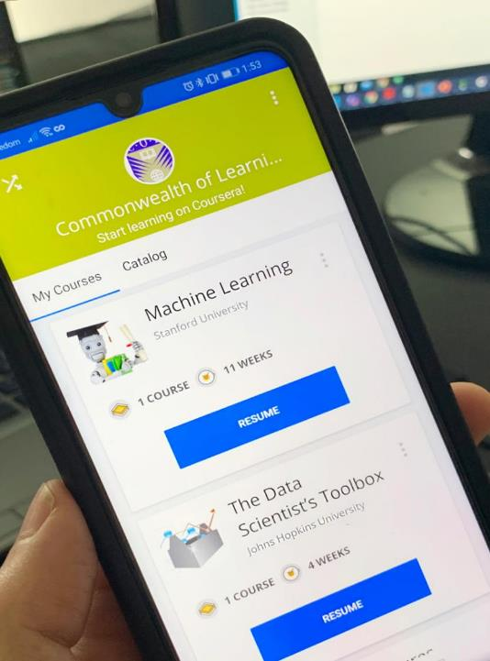




Skilling and re-skilling
COL has admitted over 350,742 youth
of the Commonwealth to gain skills for employability and entrepreneurship
Notes:
# taken from Shadrach presentation at PUM April 2023. Enrolments since July 2021 for all three platforms.

Slide 16


Slide 17

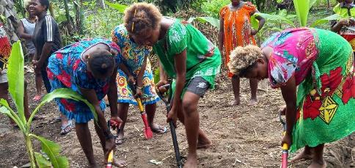
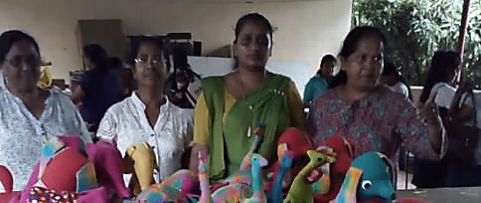










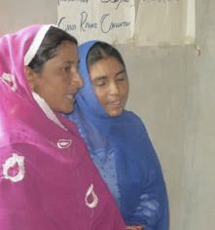
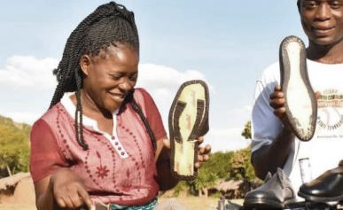
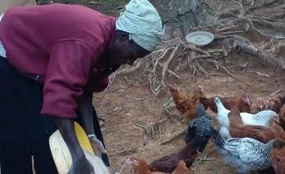
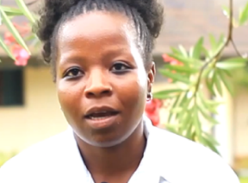
GIRLS Inspire
126,895 trained
BANGLADESH | KENYA | MALAWI | MOZAMBIQUE | NAMIBIA | PAKISTAN | PAPUA NEW GUINEA | SOLOMON ISLANDS | SRI LANKA | UGANDA

Slide 18
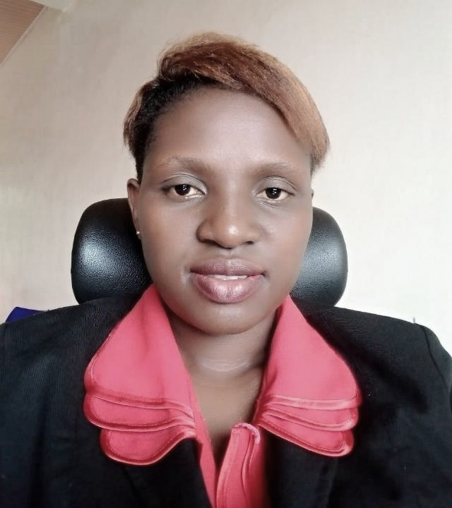

“My customer base and revenues have increased and I have regained confidence. I am giving back to my community by training youth, women and people with disabilities equipping them with digital literacy skills because these skills help us change our life for the better.”
Martine Benemariya, Rwanda

Slide 19
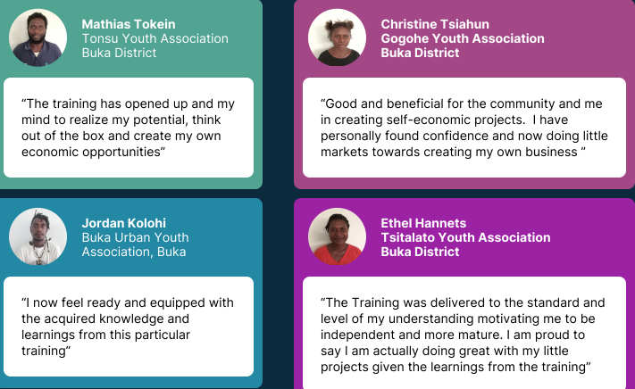
Skills Training for Youth
829 youths from Fiji, Papua New Guinea and Vanuatu receiving training in skills development.
Post-training survey results were positive. 93% of youths who attended the ‘Starting Own Business’ training felt they have improved their employability skills.

Slide 20
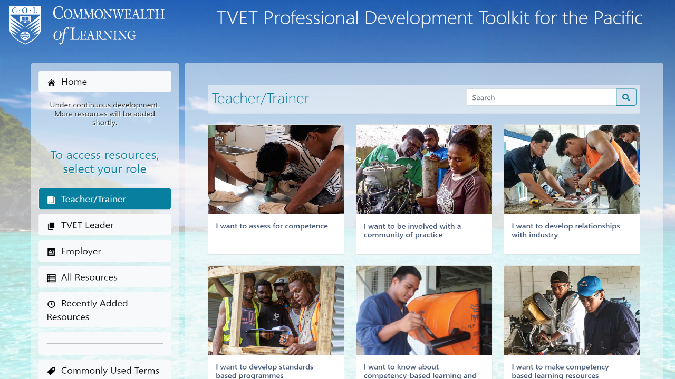

Slide 21


3 Courses on COL’s Moodle instance
Capability-building
Review of the Guidelines & Criteria for the Caribbean Vocational Qualification
Institutional strategies and action plans
  Barbados
  Dominica
  Jamaica
  Saint Lucia
  St Kitts & Nevis
Notes:
Building the capacity of TVET providers and strengthening the Caribbean Vocational Qualification framework to promote the recognition of qualifications and the mobility of qualified young people across the region

Slide 22
Sustainability and Resilience
Learning leads to livelihoods and resilience
Collaboration rather than competition
Use of appropriate technologies critical

Slide 23




Even with AI, the world will still need…
Blue collar
skills
Skills relating to empathy
Skills with Creativity and Innovation
Active listening, emotional intelligence, communication, cultural competence, patience and tolerance, and problem solving
complex problem solving, adaptability, curiosity, open mindedness, collaboration and entrepreneurship
Technical, physical,
spatial, time management, teamwork and safety
Notes:
Blue collar skills are required for jobs in industries that involve manual labor, such as construction, manufacturing, transportation, and agriculture (Technical, physical, spatial, time management, teamwork, and safety). As the workforce evolves and new technologies emerge, blue collar workers will need to continually update their skills to keep up with changing job demands.
Empathy skills enable workforce to build strong relationships, provide effective care and support, and to work collaboratively with others, especially in professions like healthcare, education, social work, counseling, and customer service (Active listening, emotional intelligence, communication, cultural competence, patience and tolerance, and problem solving).
Creativity and innovation – Creativity enable workforce to generate new and original ideas, while innovation enables them to turn the ideas created into practical solutions that add value (complex problem solving, adaptability, curiosity, open mindedness, collaboration and entrepreneurship).

Slide 24



Three Key Literacies
Human
Data
Technological
Source: Joseph Aoun (2017): Robot-proof, MIT Press, https://mitpress.mit.edu/books/robot-proof

Slide 25


Thank you
www.col.org
The contents of this presentation, with the exception of logos and graphics which are the property of the respective owners, is made available under Attribution-ShareAlike 4.0 International (CC BY-SA 4.0).

