Slide 1


Flexible Futures for Education in a post-Covid world
April 14, 2021
Professor Asha Kanwar
President & CEO, Commonwealth of Learning

Slide 2
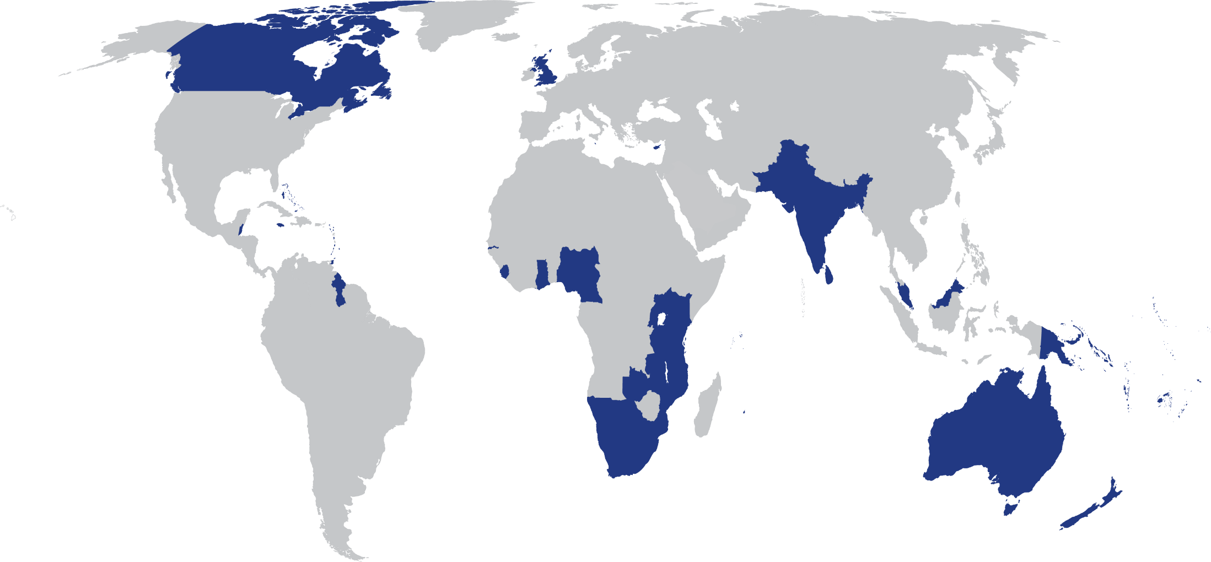
The Commonwealth
54 developed and developing nations around the world

Slide 3

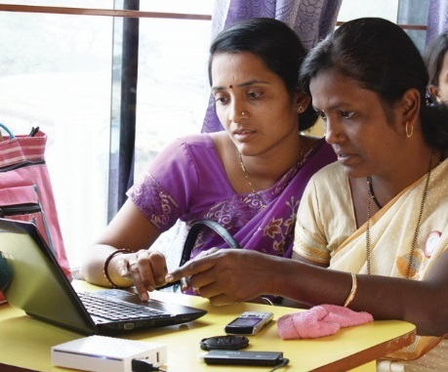
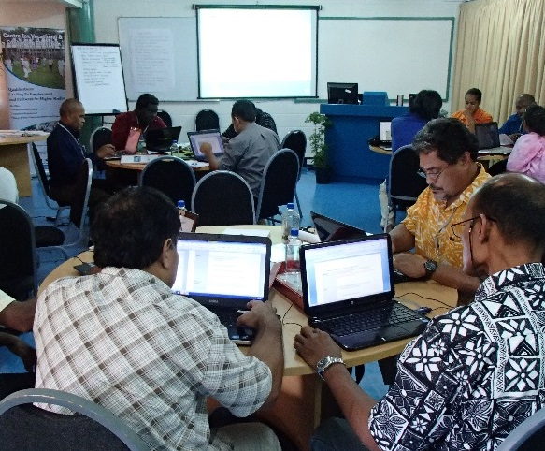
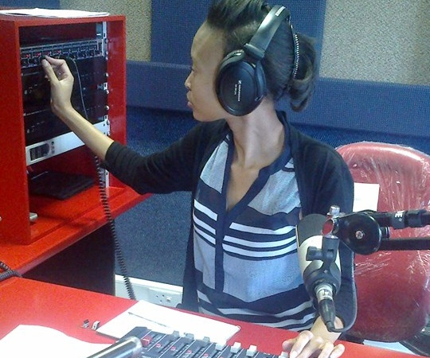
To help Commonwealth governments and institutions use technologies to improve and expand access to education and training

Slide 4
Plan
Issues during Covid-19
COL response
Understanding flexible learning
Futures of learning
Way forward

Slide 5
Issues during Covid-19

Slide 6

COVID19 and Education
Technology
Teacher Capacities
Inequalities

Slide 7
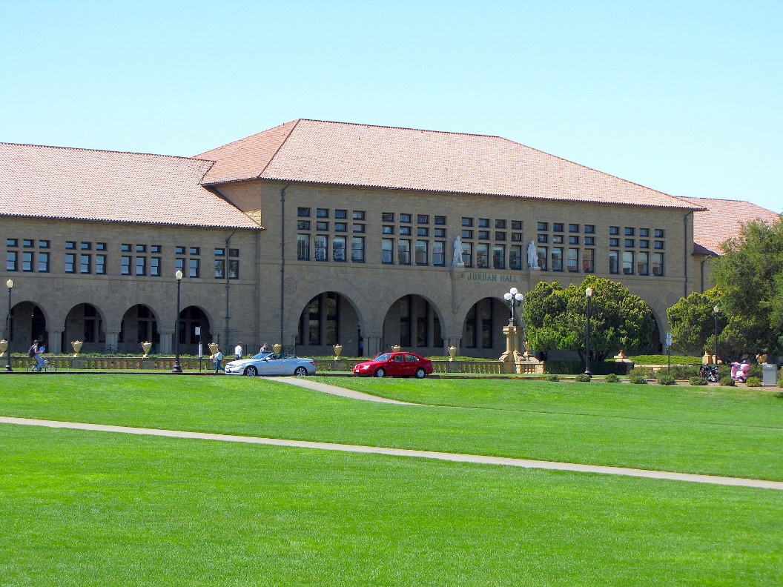
1 Technology issues: Stanford University
16% undergraduates did not have access to internet for half the time
60% of low-income students did not have a private place to study
Source: https://www.tonybates.ca/2020/08/30/lessons-from-stanford-universitys-move-to-remote-learning/

Slide 8
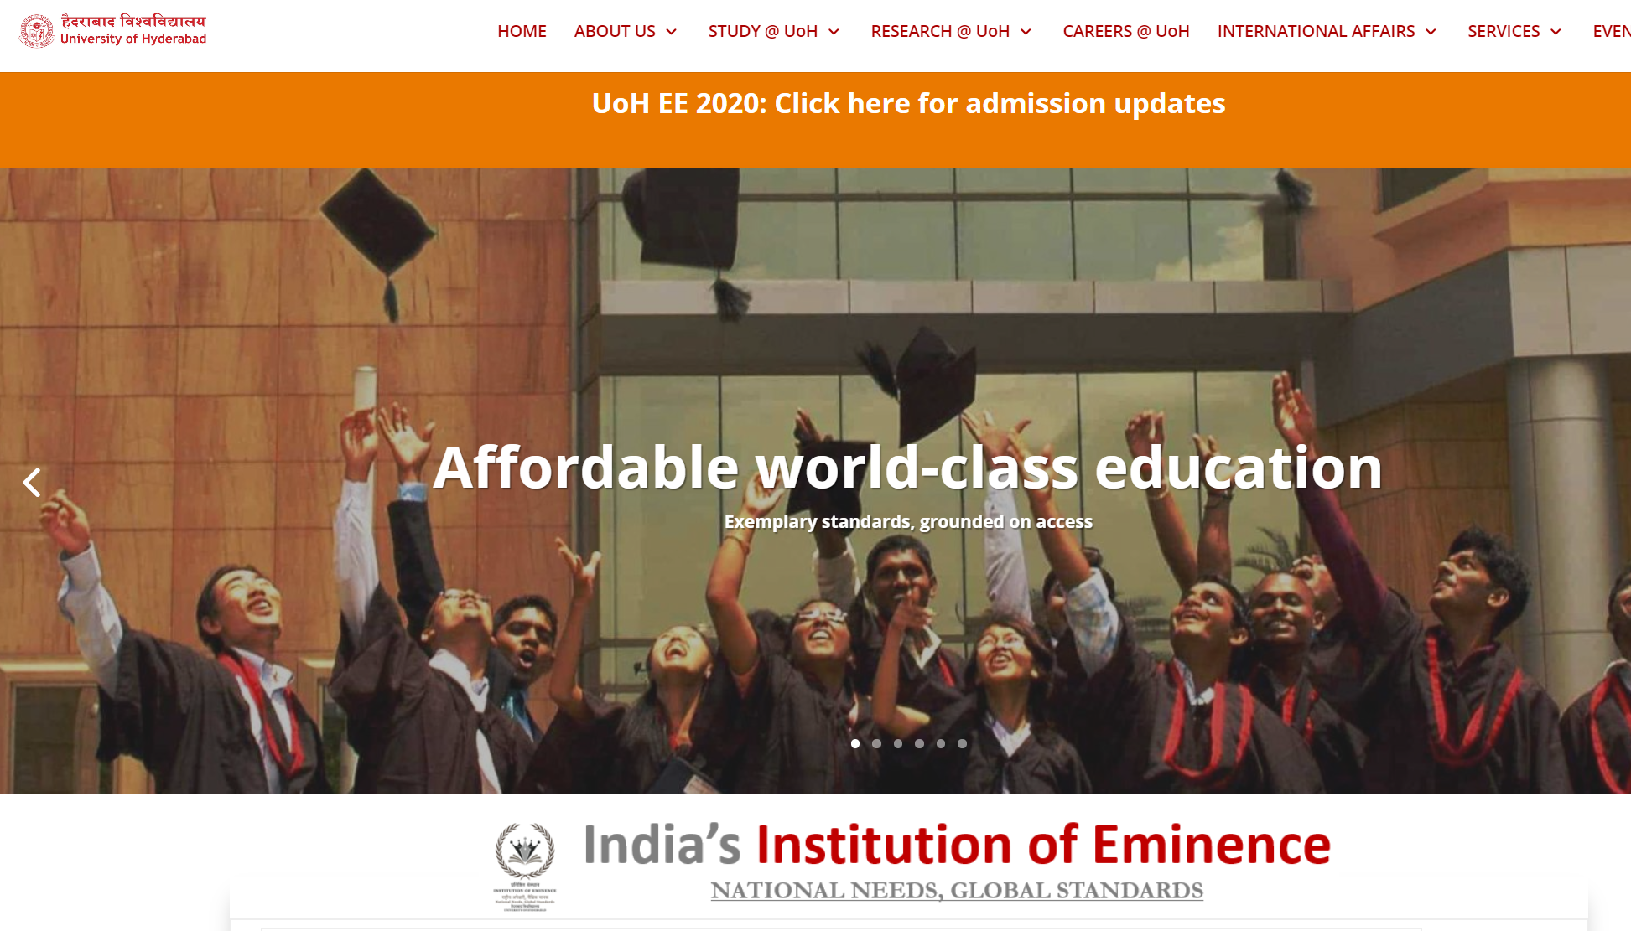
University of Hyderabad
40% students indicated “unreliable connectivity
30% worried about cost of data
18% can’t access online classes at all.
Source: https://www.newindianexpress.com/cities/hyderabad/2020/apr/20/covid-19-lockdown-digital-divide-among-students-forces-university-of-hyderabad-to-drop-e-classes-2132571.html

Slide 9
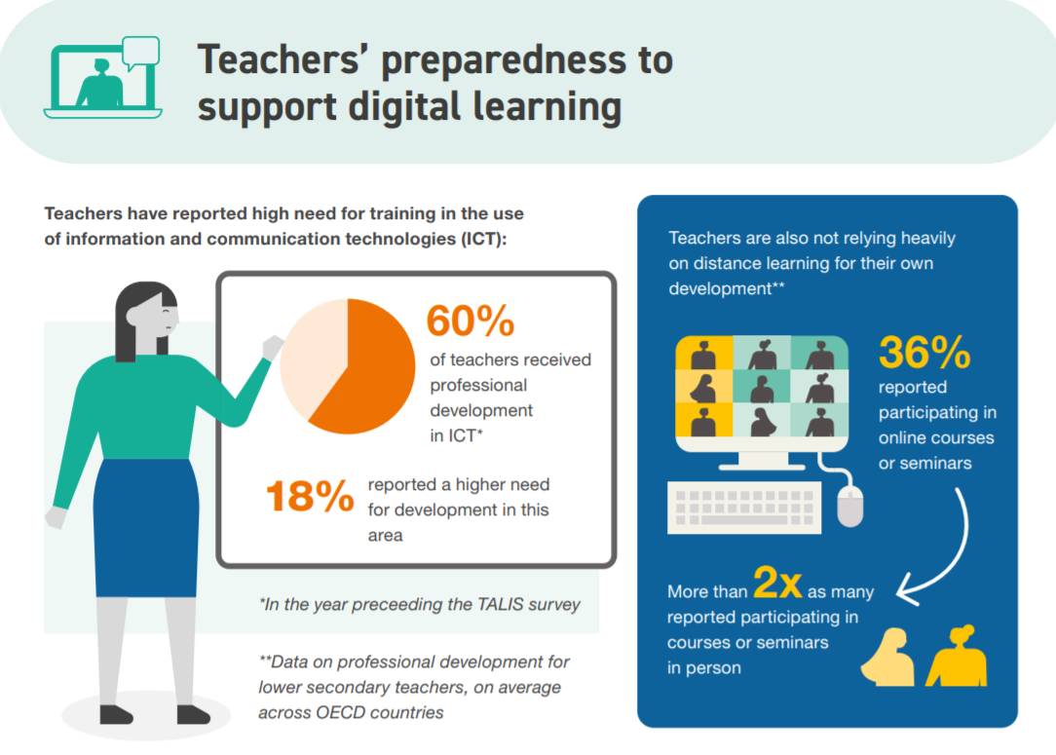
2. Teacher Capacities
ICT for teaching and learning
Assessment of learning outcomes
Access to technology
Source: https://www.oecd.org/education/the-impact-of-covid-19-on-education-insights-education-at-a-glance-2020.pdf

Slide 10
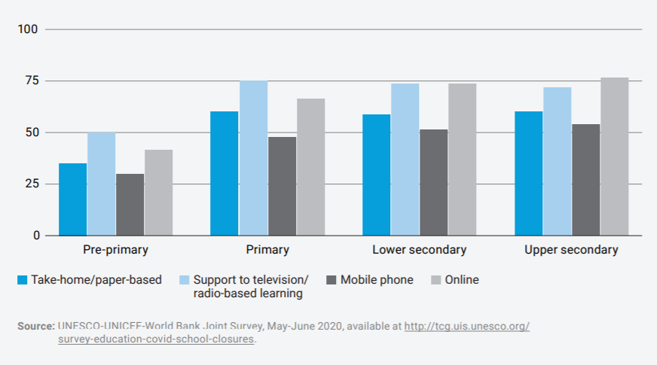
Teachers engaged in alternative teaching

Slide 11
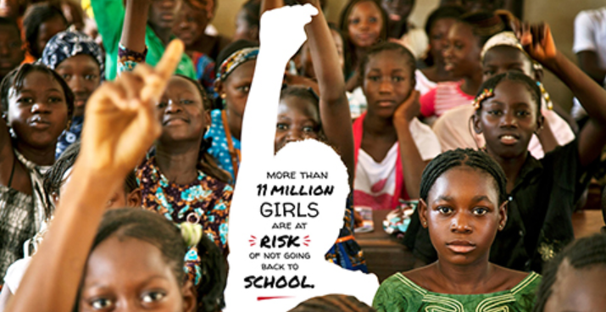
3. Inequalities
Source: https://en.unesco.org/covid19/educationresponse/girlseducation

Slide 12
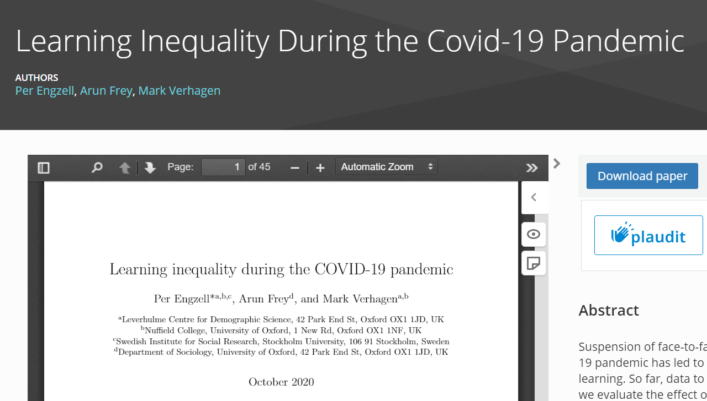
Learning Inequality during COVID19
Learning loss of about three percentile points
Learners from less educated home 55% more prone to learning loss
Source: https://osf.io/preprints/socarxiv/ve4z7/
Notes:
In Netherlands, during the COVID19 pandemic, learning loss of about 3 percentile points or 0.08 standard deviations was recorded in a study. Losses are up to 55% larger among students from less-educated homes.

Slide 13
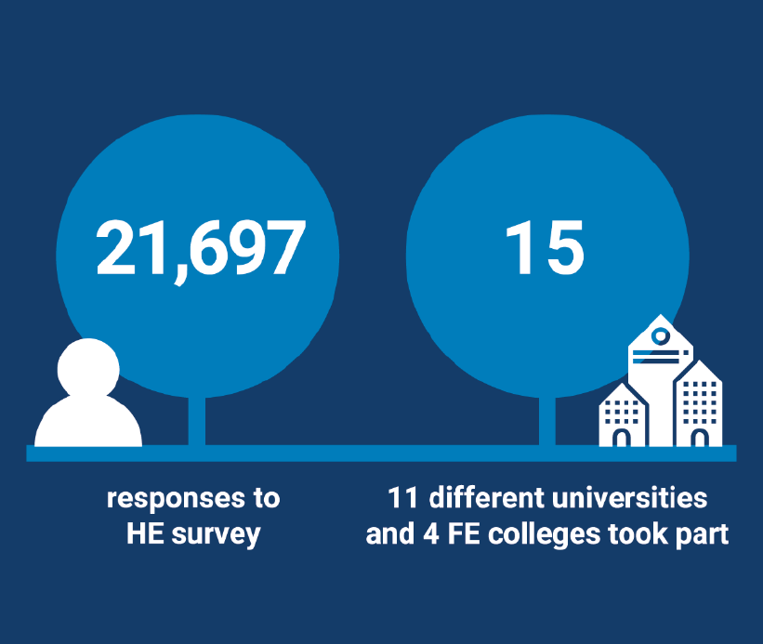
Positive quality rating
81% of students were learning online
68% of students rated the quality of online digital learning as ‘best imaginable’, ‘excellent’ or ‘good’
62% also rated the support they received for online learning equally highly.
Source: JISC (2021). Student digital experience insights survey 2020/21 https://repository.jisc.ac.uk/8338/1/DEI%20P1%202021%20student%20data%20for%20HE-FINAL.pdf
Notes:
UK study shows positive rating for online learning.

Slide 14
COL Response

Slide 15
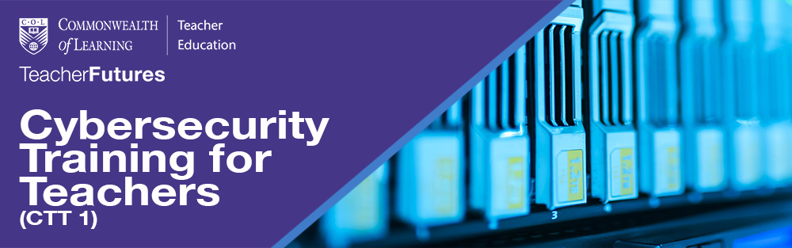
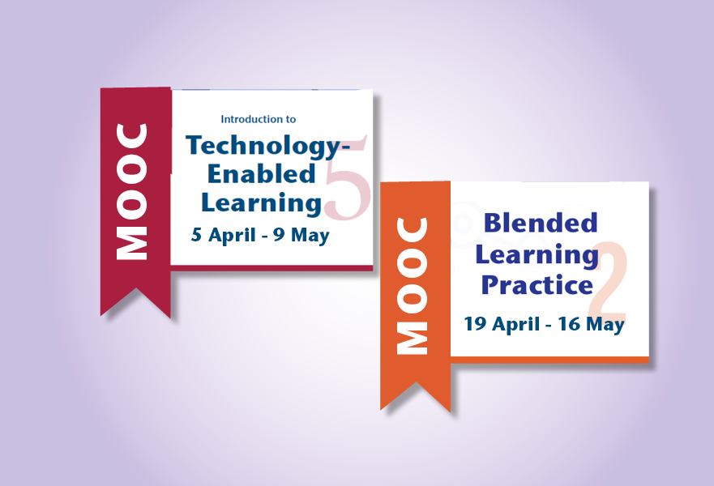
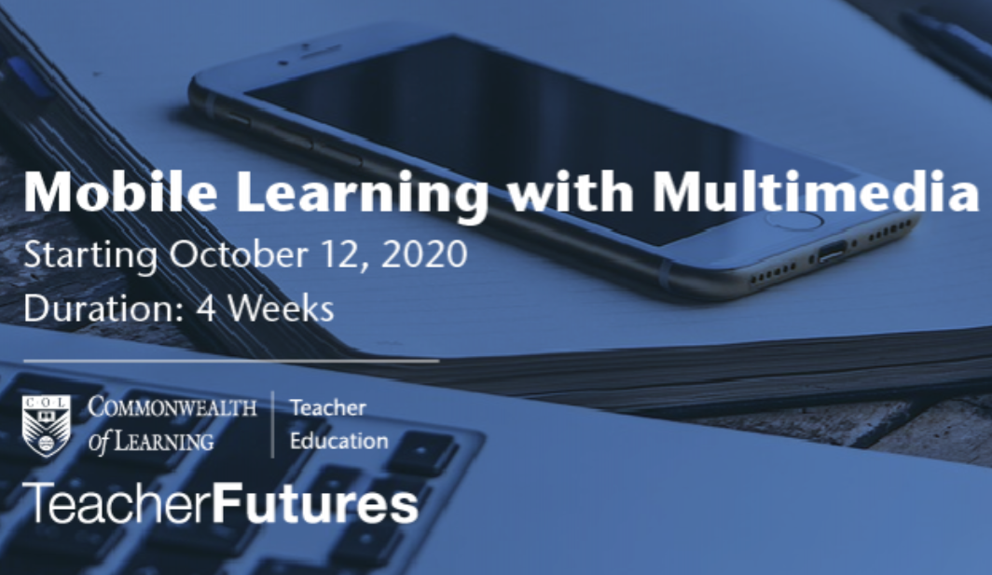
Capacity Building of Teachers
https://www.mooc4dev.org/CyberSecurity4Teachers1
http://www.telmooc.ca/
https://www.blpmooc.org/
https://www.mooc4dev.org/MLM_1

Slide 16
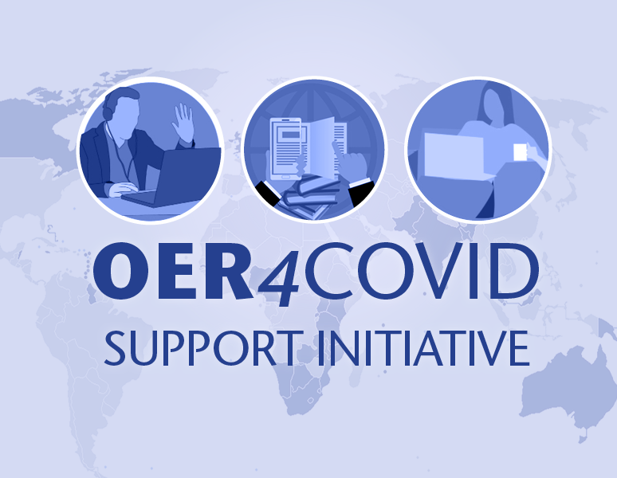
Promoting OER-based Online Learning
Support network for educators
Share online courses
Provide open technology tools
Build capacity
https://oer4covid.oeru.org/
Notes:
OER4Covid support initiative with OER Foundation, New Zealand attracted 1,349 participants from 89 Countries with
participation from 32 Commonwealth Countries including: Australia, Bangladesh, Barbados, Belize,
Botswana, Canada, Eswatini, Fiji, Ghana, India, Jamaica, Kenya, Kiribati, Malawi, Malaysia, Namibia,
New Zealand, Nigeria, Pakistan, Papua New Guinea, Saint Lucia, Samoa, Singapore, South Africa, Sri
Lanka, Tanzania, Tonga, Trinidad and Tobago, Uganda, United Kingdom, Vanuatu, and Zambia)
Zimbabwe.
when registering.)

Slide 17

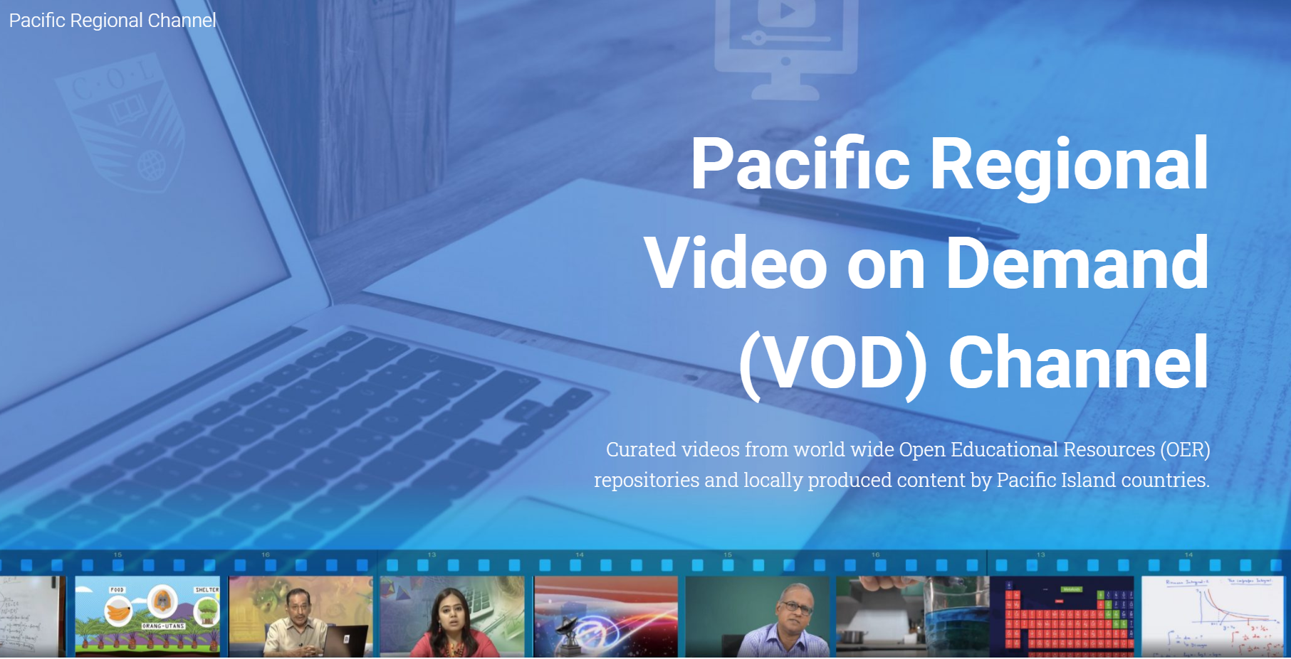
Content aligned to curriculum
Video-on-demand: Fiji, Nauru, Samoa, Tonga
STEM courses
https://pacificregionalchannel.org/

Slide 18
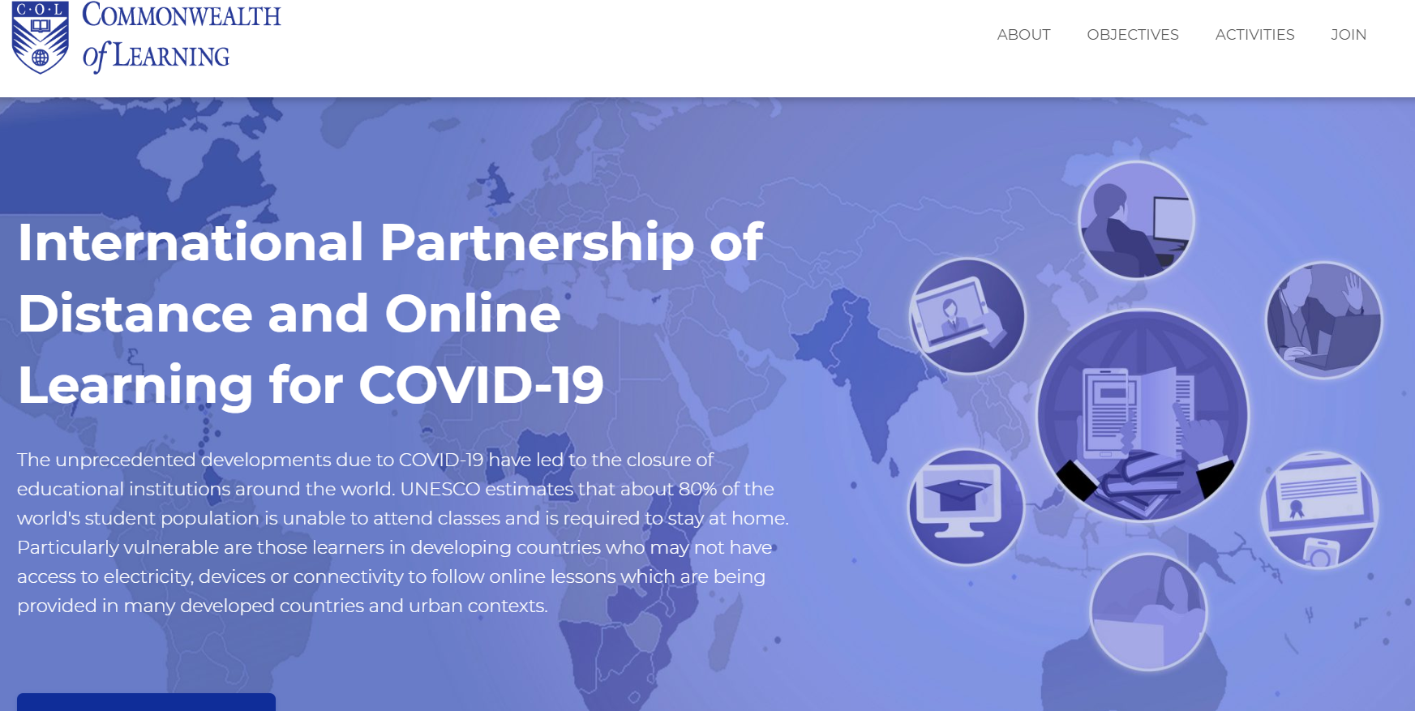
60+
https://opendoor.col.org/
Intergovernmental organisations
Universities and educational institutions
Associations and networks
Notes:
bring together institutions/organisations committed to supporting learning at this time of crisis;
share open educational resources (OER) and learning content;
provide tools for implementing affordable learning;
identify concrete collaborative activities;
build capacity in institutions offering distance and online learning; and
develop innovative technology solutions for reaching the unreached

Slide 19
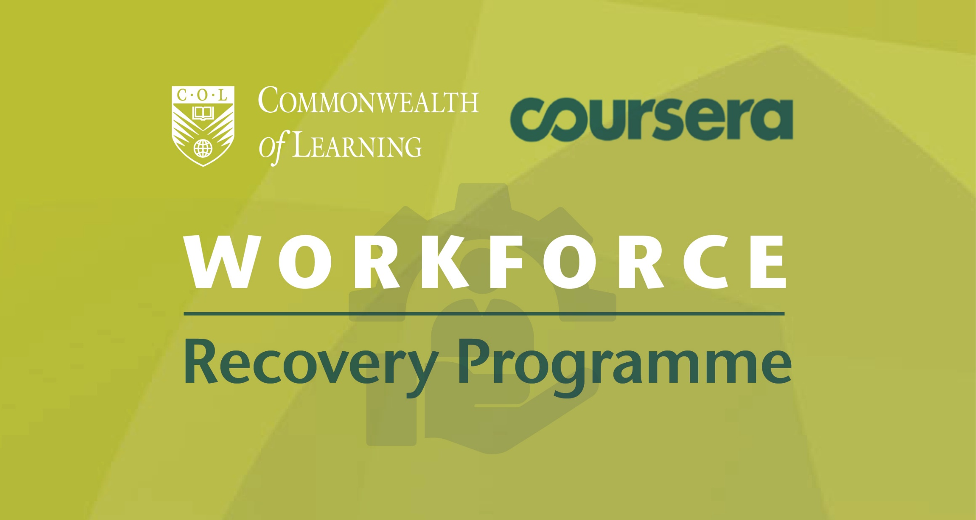

Skilling and re-skilling

Slide 20
Understanding Flexible Learning

Slide 21

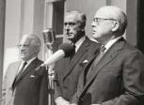
Philosophy of Open-ness
Open as to people,
Open as to places,
Open as to methods, and, finally,
Open as to ideas
  Lord Crowther

Slide 22
‘Open-ness’ in Practice
Open admission (no entry qualifications)
Multiple open channels (radio, TV, etc.)
Open curriculum
Open access (Anytime, anywhere)
Open participation
Open accreditation
(Wedemeyer, 1973)

Slide 23
Flexible Learning
FL expands choice on what, when, where and how people learn. It supports different styles of learning, including e-learning.
- Australian Flexible Learning Framework

Slide 24
Flexible Learning in Practice
Synchronous learning not the only option (Anytime, anywhere)
Duration of learning hours insignificant (outcomes-oriented curriculum)
Options to mix work-place based learning (internships)
Experiential learning opportunities (Recognition of Prior Learning)
Notes:
Flexibility for what? – empowering of students, global citizens, leaving no one behind
Work integrated learning

Slide 25
Evolution of flexibility: J Taylor
Models of Distance Education | Flexibility
 | Time | Place | Pace
Gen 1: Correspondence model (print) | Yes | Yes | Yes
Gen 2: Multimedia model (print, audio, video, computer-based) | Yes | Yes | Yes
Gen 3: Tele-learning model (broadcast TV/Radio, interactive TV/ Videoconferencing) | No | No | No
Gen 4: Flexible learning model (Interactive multimedia online, Internet-based courses, computer mediated communications) | Yes | Yes | Yes
Gen 5: Intelligent flexible learning model (Gen 4 plus, automated response system, automated portal access) | Yes | Yes | Yes
Source: Taylor, J. (1998). Flexible Delivery: The Globalisation of Lifelong Learning. Indian Journal of Open Learning, 7(1), 55-66.
Notes:
Way back in 1990s, Jim Taylor talked about flexible learning model and intelligent flexible learning. Distance education provided flexibility in terms of time, place and pace. But as synchronous delivery mechanism such as broadcast came into picture flexibility was lost. The Internet provides us the opportunity to deliver better interactive asynchronous learning that is flexible. New developments in AI and bid data helps us create the Gen 5 learning environment providing personalized learning.

Slide 26
Futures of Learning

Slide 27
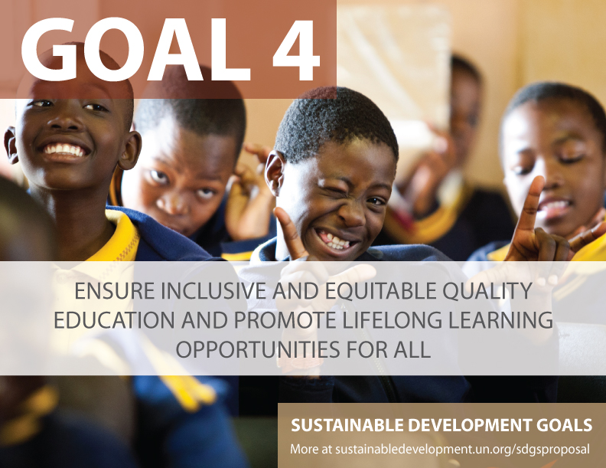
1. Preferrable Future
Universal primary completion will be achieved in 2042
Universal lower secondary completion in 2059
Universal upper secondary completion in 2084
Source: UNESCO (2016). Global Education Monitoring Report. https://unesdoc.unesco.org/ark:/48223/pf0000245752

Slide 28

Inclusion
Access to HE
Canada: 10.7%
India: .56%
South Africa: 1% . For example, in South Africa 80% of disabled people aged 20-24 are not in tertiary education.
Notes:
Mean year of schooling for persons with disabilities in select 49 countries in the UNESCO report is 4.8, whereas in general is 7 years. For female PWD, the mean years of schooling reduces to 4.3. ( see UIS, 2018: http://uis.unesco.org/sites/default/files/documents/ip49-education-disability-2018-en.pdf
People with disabilities are often disadvantaged in terms of access to tertiary education. Of the 18 countries for which data is available, 15 report disability prevalence under 3 per cent and half report rates under 2 per cent.
No info on students with disabilities in tertiary education.
United states
Source: https://nces.ed.gov/fastfacts/display.asp?id=60
11.1% (students with disabilities enrolled in post-secondary institutions) in 2011-2012
Canada
Source: http://publications.gc.ca/collections/collection_2009/rhdcc-hrsdc/HS61-1-2009E.pdf
10.7%
Australia:
Source: https://www.cdu.edu.au/sites/default/files/the-northern-institute/10.18793-lcj215.17.02.pdf
5.5%
India
https://timesofindia.indiatimes.com/home/education/news/Disabled-get-only-0-56-of-seats-in-higher-education/articleshow/46810639.cms
0.56%
South Africa
https://www.dailymaverick.co.za/article/2017-08-15-students-with-disabilities-disadvantaged-at-higher-education-level/#.WhSt_lWnGUk
http://www.statssa.gov.za/publications/Report-03-01-59/Report-03-01-592011.pdf
According to Stats SA, 80% of disabled people aged 20-24 are not attending tertiary education. Put another way, around 7,5% of South Africans have a disability. Yet the number of disabled students at tertiary institutions is far from representative: just 1%.

Slide 29
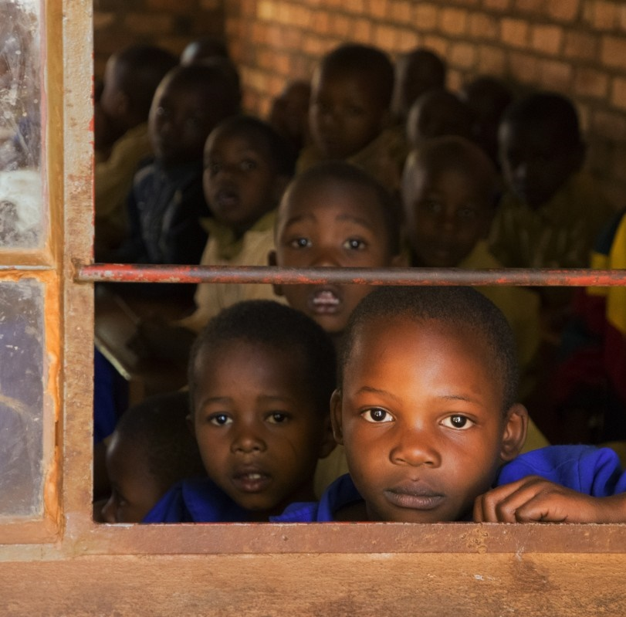
‘Learning Crisis & Learning Loss’
In South Africa, majority of Grade 4 students displayed the capacity of Grade 1
(World Bank, 2018)
Kenya allowing pupils to re-take a year¹
¹ Source: https://www.education.go.ke/images/Kenya_basic_Education_COVID-19_Emergency_Response_Plan-compressed.pdf#page=11
Notes:
According to estimates by UNICEF, in 2015, over 115 million children did not attend primary school
56% of children in school are not learning (World Bank)
In West & Central Africa, less than 45% students in Grade 6 achieved competency level in maths and reading
In SA, majority of Grade 4 students displayed the capacity of Grade 1 (World Bank, 2018)
Teacher absenteeism and ‘presenteeism’
World Bank (2018). Learning: To Realize Education’s Promise. Washington: The World Bank. Retrieved from https://www.worldbank.org/en/publication/wdr2018
Kenya is allowing pupils to re-take a year to ensure learning outcomes
https://www.devex.com/news/opinion-how-will-countries-make-up-for-lost-learning-during-the-pandemic-99453
https://www.nytimes.com/2020/08/05/world/africa/Kenya-cancels-school-year-coronavirus.html

Slide 30
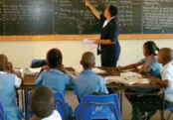
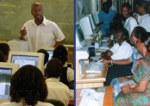
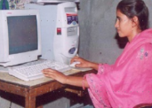
2. Probable Future
Face-to-Face Courses
Blended Courses
Distance/Online Courses
ICT integration in teaching and learning
MOOC
Mobile learning
Open and Distance Learning
Blended Learning

Slide 31


More Personalized Teaching: AI
Can provide an intelligent, personal tutor for every learner
Encourage intelligent support for collaborative learning
Adaptive group formation
Expert facilitation
Source: https://www.ibm.com/watson/advantage-reports/ai-social-good-education.html

Slide 32
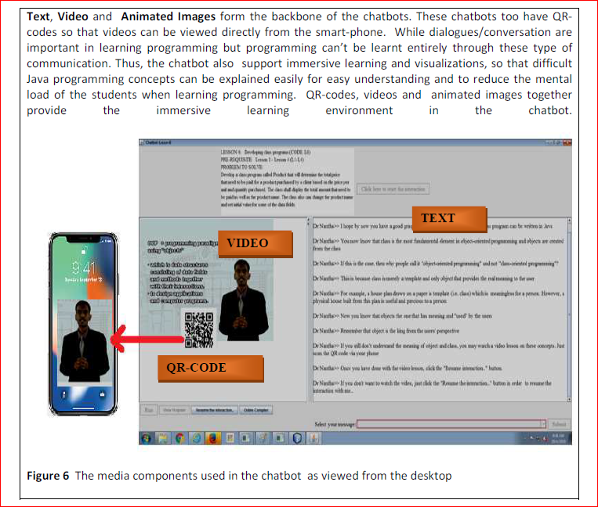
Use of Chatbots
Example of AI in Education

Slide 33
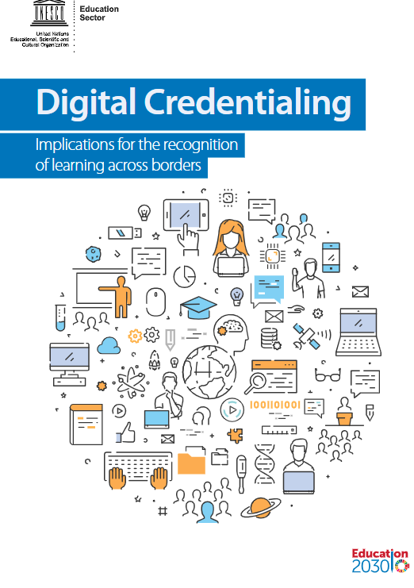
Assessment
Badges & micro-credentials
Recognition of prior learning
Transnational qualifications frameworks for mobility
On-demand examination
Authentic, project-based assessment
https://unesdoc.unesco.org/ark:/48223/pf0000264428?posInSet=4&queryId=N-e4559bf5-0bec-40c7-91a9-5cdea42e1ca4

Slide 34


3. Possible Future
Trends
Globally, the number of climate disasters has tripled since 1980, while, hot weather in 2016 broke the historic record set in 2015
At the current rate there will be larger and more frequent climate related disasters
Source: The Commonwealth Secretariat. 'Climate Change'. https://thecommonwealth.org/climate-change
This Photo by Unknown Author is licensed under CC BY-SA
Notes:
The climate crisis is one of the defining issues of our world today. The science is clear: the drastic changes in global climate patterns starting in the mid-to-late twentieth century are attributable to the increasing level of greenhouse gases in our atmosphere, produced by human activities. The result of this change in climate patterns is apparent in the devastating storms, floods, and other natural disasters that have become a regular occurrence across the globe today.
The Commonwealth, which comprises 53 countries, is disproportionately affected by climate change, as many of its members are amongst the small or least developed states.
According to the World Risk Index, calculated by the United Nations University Institute for Environment and Human Security (UNU-EHS) and featured in the 2016 World Risk Report (WRR 2016), 9 out of the top 20 countries most at risk for natural disaster are Commonwealth countries.
Climate related natural disasters have major, detrimental impacts on education. Events such as hurricanes, storms and floods can have catastrophic effects on the infrastructure, resources and systems of the education sector. Entire schools can be destroyed or irreparably damaged, leading to thousands of displaced students, unable to continue their education. Critical data and student records may be wiped out entirely, leaving the system in shambles, and learners and institutions in the dark. These impacts can effectively lead to the collapse of the education system in disaster affected areas.

Slide 35


Education and emissions
Direct
Emissions from construction of schools/infrastructure
Emissions from energy use in schools
Learner emissions
Indirect
Emissions from ‘development’ and economic growth associated with higher levels of education in a country
Notes:
The education sector, from primary to tertiary, contributes to both direct and indirect emissions, which impact on climate change, and environmental degradation, as well as incur associated economic costs. If we look strictly at contributions to emissions, the achievement of SDG4, under the current paradigm, could potentially worsen the climate crisis.

Slide 36








Research on Emissions and ODL
Travel – greatest contributor
Mode of delivery - determinant
Source: Carr et.al. Delivery Mode and Learner Emissions: Comparative Study from Botswana. W. Leal Filho and S. L. Hemstock (eds.), Climate Change and the Role of Education, Springer Nature. In Production.
Notes:
Perh

Slide 37
Way forward

Slide 38

1.Technology: the future is flexible
Appropriate technologies to create flexible learning opportunities
Multiple pathways to acquire qualifications
Using technology to personalise learning

Slide 39
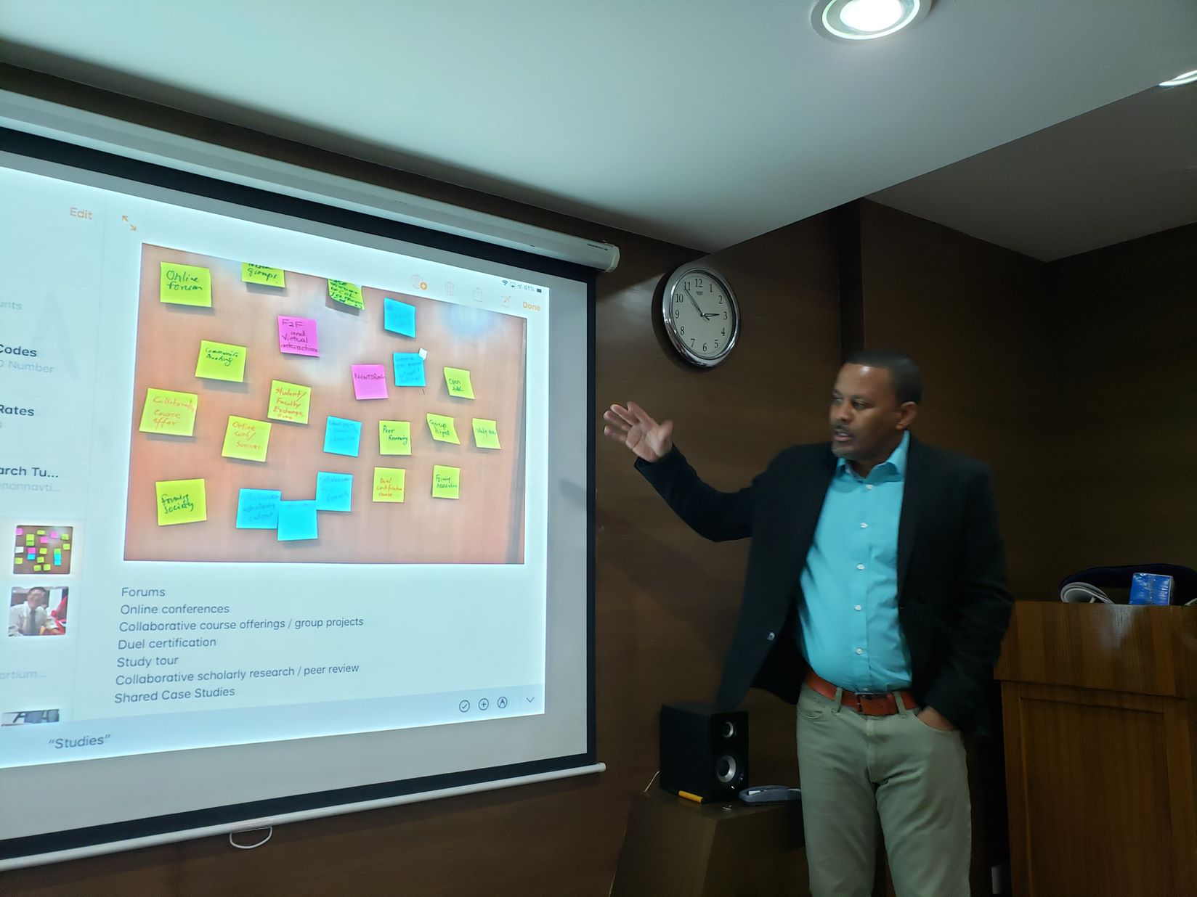
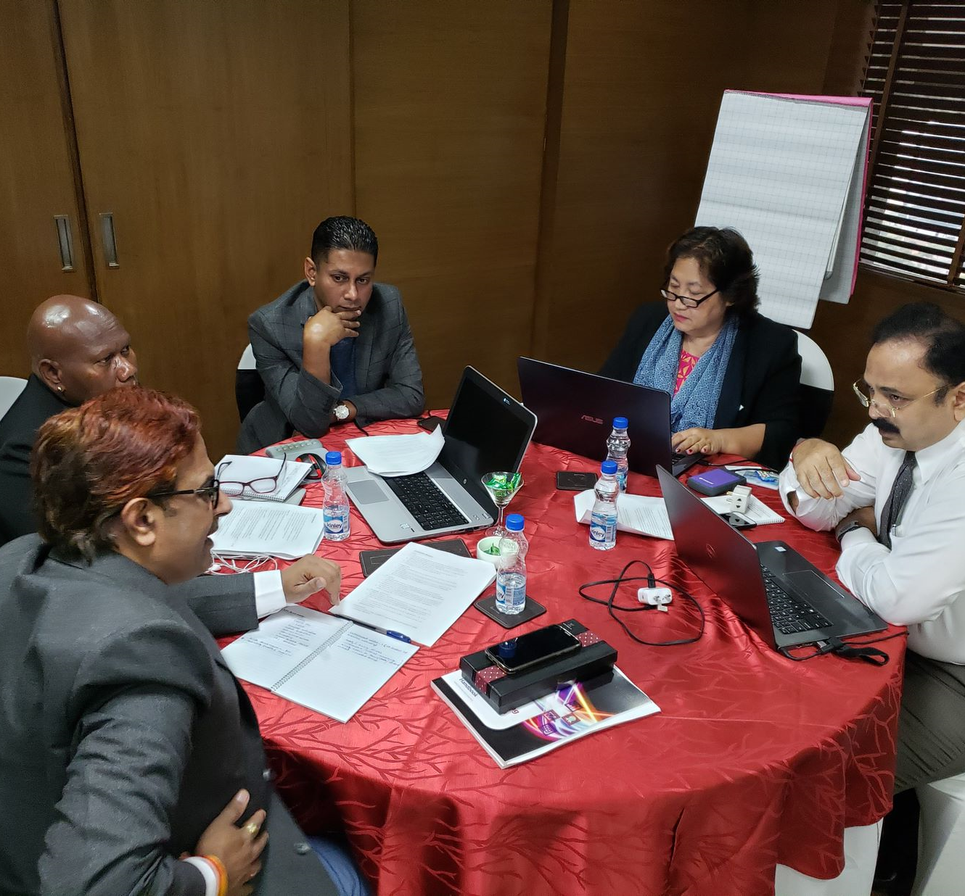
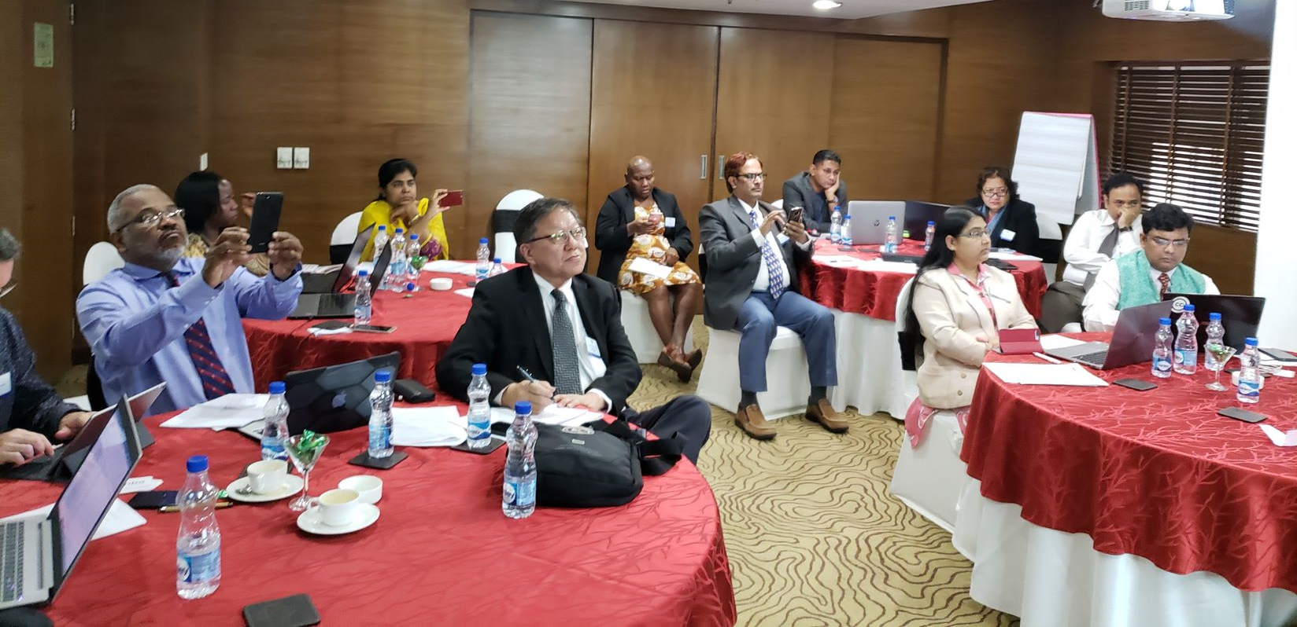
2.Content: mainstreaming OER
Building capacities of policy-makers
Developing capacity of teachers
Preparing learners to find and use OER

Slide 40
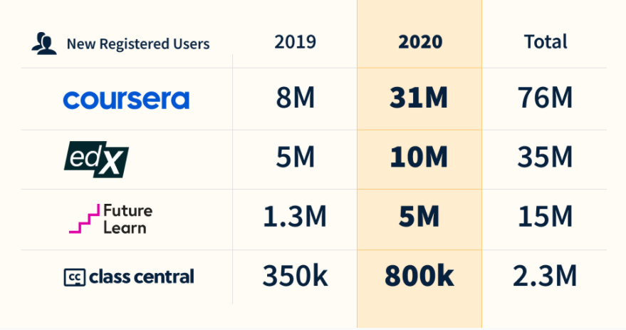
3. Rise of self-directed learning: boost for Lifelong Learning
Learning to learn online
Creating an ecosystem for lifelong learning
Providing just-in-time training for livelihoods
Source: https://www.classcentral.com/report/the-second-year-of-the-mooc/

Slide 41
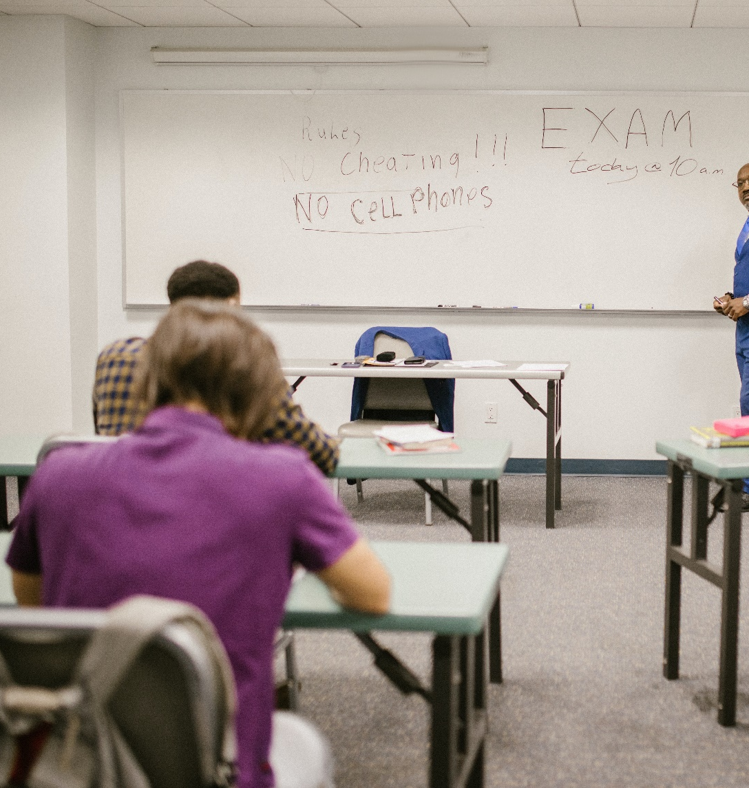
4. Assessment: alternative approaches
Beyond proctorial tests
Adopt authentic learning assessments
Recognition of prior-learning
Micro-credentials and credit stacking
Notes:
NZQA has developed a micro-credential framework to provide industry, employers, and/or the community to develop programmes and certify achievement of a coherent set of skills and knowledge and promote lifelong learning through an evidence-based measure of learning outcomes. See https://www.nzqa.govt.nz/providers-partners/approval-accreditation-and-registration/micro-credentials/
Authentic learning: project based, experiential, portfolios, term-papers, case studies, etc.

Slide 42



5. Parental inputs: new ecosystem of learner support
Empowering parents/siblings
Call Centres to support learning
Address mental health issues and non-academic challenges
Notes:
The National Institute of Open Schooling in India runs a 24X7 Call Centre to help learners solve their academic, administrative and technical issues.

Slide 43

6. Inequalities: leave no one behind
For persons with disabilities
Women and disadvantaged groups
People in remote areas
Policy by Nick Youngson CC BY-SA 3.0 Alpha Stock Images

Slide 44
Flexibility for a transformed future
Typical Approach:
Transformative Approach:
Skills /Competencies
Employability and Entrepreneurship
Achievement
Empowerment for Change
Environmental Conservation and Global Citizenship
Accomplishment
Notes:
According to Marc Prensky, the dominant educational paradigm emphasizes individual achievement, which is defined as “A person doing something that benefits only (or principally) him or her (=an achievement).” In the current paradigm, the focus is on the Acquisition of Skills and Competencies as well as Employability and Entrepreneurship – individualistic goals.
Under a transformative approach, the focus is on bettering soceity as a whole, what Prensky calls “real, world-improving accomplishment”. In contrast to an achievement an accomplishment is “A person doing something (or being a part of something) that benefits others and the world outside of that person (=an accomplishment).”
And Prensky claims that this model “is far better for us because it liberates huge amounts of unused potential – the potential of our students – to improve our communities and our planet.
Under the transformative approach, the focus is on Empowerment, Environmental Conservation, and Social Cohesion/Peace.
We need flexible learning (anytime, anywhere, any resource) that is affordable and accessible, that empowers learners to access quality educational opportunities to support social change, create global citizens, leave no one behind, and contribute to environmental conservation.

Slide 45

Thank you
www.col.org
The contents of this presentation, except logos/ graphics which are property of the respective owners, is made available under Attribution-ShareAlike 4.0 International (CC BY-SA 4.0).

