Slide 1

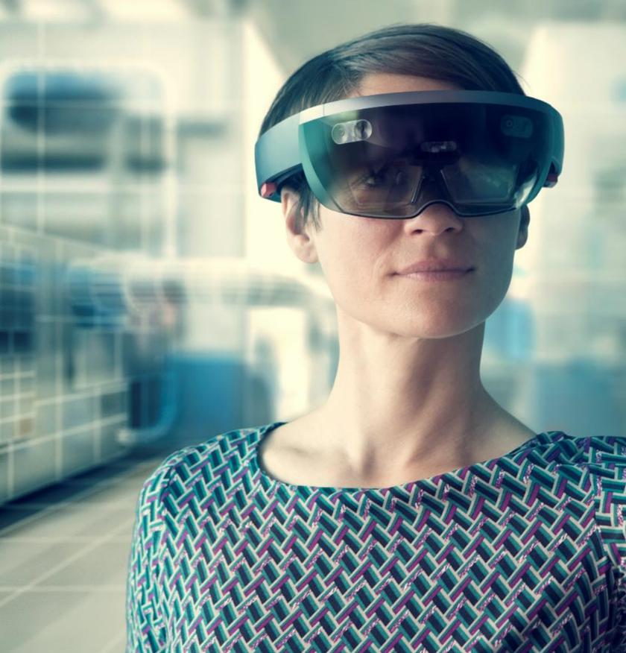
Achieving Sustainability
In Education: what will it take?
Professor Asha Kanwar
COL President & CEO
An International Tri-Conference: icODEL2023, ISEAC2023 and ASEANale 2023| 22-25 August, 2023

Slide 2
The Commonwealth
56 developed and developing nations around the world
Africa: Botswana, Cameroon, Eswatini, Gabon, The Gambia, Ghana, Kenya, Lesotho, Malawi, Mauritius, Mozambique, Namibia, Nigeria, Rwanda, Seychelles, Sierra Leone, South Africa, Tanzania, Togo, Uganda, Zambia
Asia: Bangladesh, Brunei Darussalam, India, Malaysia, Maldives, Pakistan, Singapore, Sri Lanka
Caribbean & Americas: Antigua and Barbuda, The Bahamas, Barbados, Belize, Canada, Dominica, Grenada, Guyana, Jamaica, St Kitts and Nevis, St Lucia, St Vincent and The Grenadines, Trinidad and Tobago
Europe: Cyprus, Malta, United Kingdom
Pacific: Australia, Fiji, Kiribati, Nauru, New Zealand, Papua New Guinea, Samoa, Solomon Islands, Tonga, Tuvalu, Vanuatu
Updated: December 2022

Slide 3
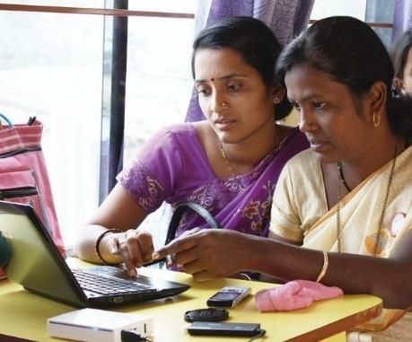
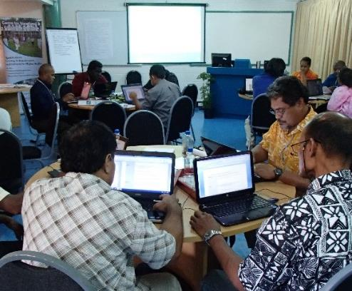
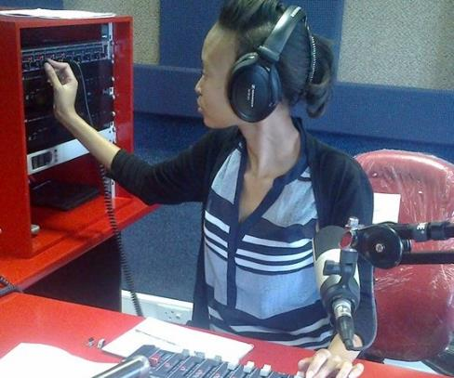
To help Commonwealth governments and institutions use technologies to improve and expand access to education and training

Slide 4
Plan
Context
Sustainability in Education
Models and Approaches
Way Forward

Slide 5
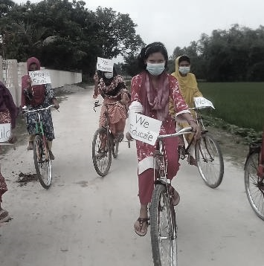

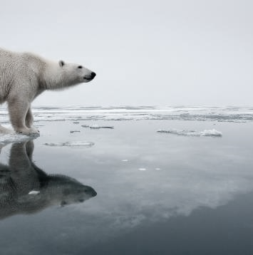

Age of Disruptions
COVID-19 PANDEMIC
TECHNOLOGY
CLIMATE CHANGE

Slide 6
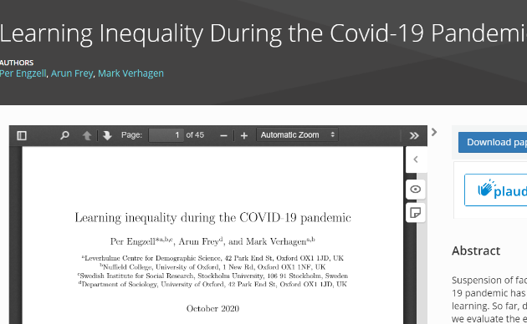
Learning Loss during Covid-19
Learning loss of about three percentile points
Learners from less educated home 55% more prone to learning loss
Source: https://osf.io/preprints/socarxiv/ve4z7/
Notes:
In Netherlands, during the COVID19 pandemic, learning loss of about 3 percentile points or 0.08 standard deviations was recorded in a study. Losses are up to 55% larger among students from less-educated homes.

Slide 7

AI Revolution
New essays, short articles, Tweets etc
Language translation
Text summarisation
Image generation from Text
Microlearning courses from text
Image Source: https://securitymea.com/2023/02/24/new-malware-stealing-social-media-credentials-under-chatgpt-app-disguise/
Notes:
An AI-based service that uses Natural Language Processing technology
A Large Language Model (LLM)
Trained on massive quantities of data
To generate human-like text
G(enerative) P(re-trained) T(ransformer)
Transformer is an advanced AI technology developed in 2017- an example is language translation
Much wider capabilities in May 2023 through plugins

Slide 8
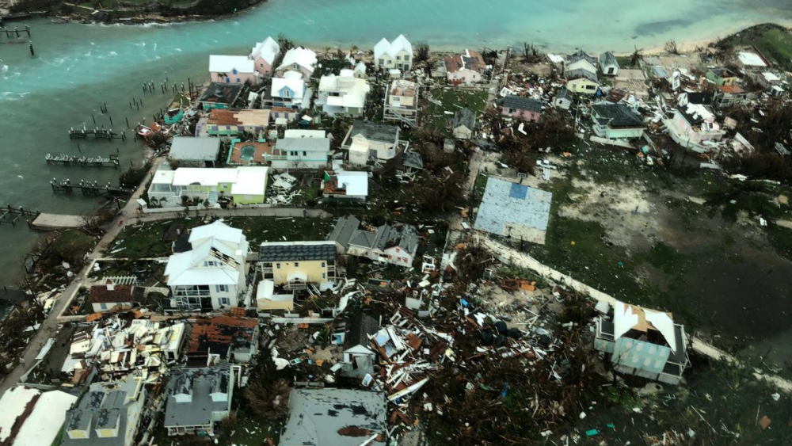
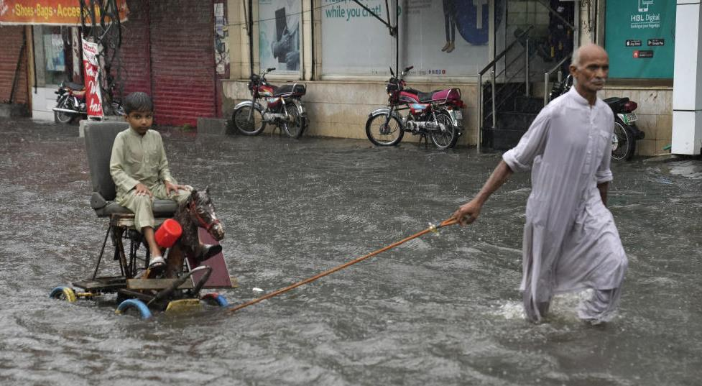


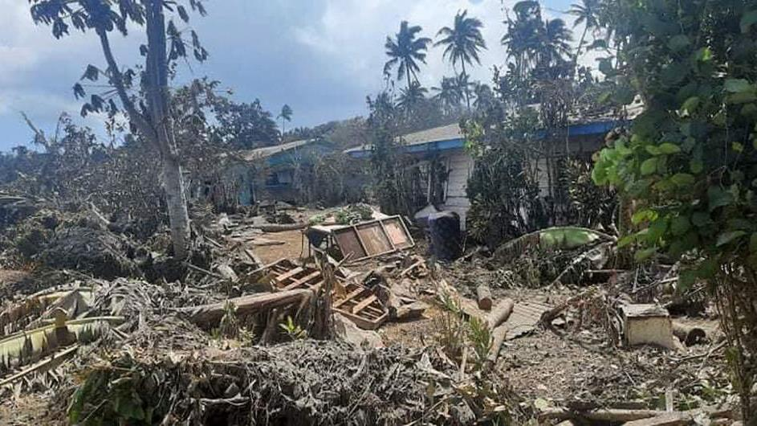
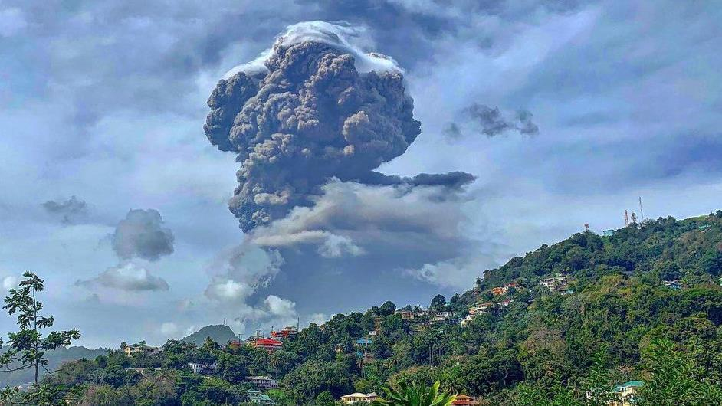


Record-breaking rainfall in Pakistan, turning roads into rivers leaving 35% of pop. without electricity and water.
Hurricane Dorian devastated schools on Grand Bahama and Abacos Islands in The Bahamas
https://www.cbsnews.com/news/pakistan-monsoon-2023-flooding-landslides-deaths/ Photo credit: K.M. CHAUDARY/AP
80 per cent of Tonga population impacted by eruption and tsunami
Volcanic eruption leaves ‘entire population’ of Saint Vincent without clean water
UN News, https://news.un.org/en/story/2022/01/1110162
UN News, https://news.un.org/en/story/2021/04/1089592
Notes:
How does the climate crisis effect the education sector specifically?
In recent years, Commonwealth countries have experienced severe impacts to their education systems as the result of climate related natural disasters.
Cyclone Idai, which hit eastern Mozambique on March 14, 2019 was the worst natural disaster to hit southern Africa in twenty years. According to UNICEF, from July 2019, more than 3000 classrooms and 330,000 students were affected by the Hurricane (https://www.unicef.org/mozambique/en/cyclone-idai-and-kenneth)
On September 1 2019, the eye of Hurricane Dorian made landfall on the Abaco Islands, reaching the island of Grand Bahamas the next day. It was the strongest hurricane on record to hit the Bahamas.
According to Mercy Corps, the Abaco Islands were the most affected with approximately 90 percent of housing and infrastructure left damaged or destroyed in its wake. In Grand Bahama, satellite data revealed that anywhere from 76 to 100 percent of buildings in certain areas were destroyed. The week after Hurricane Dorian hit was supposed to be the first week of classes in the Bahamas. Many families had just paid school fees and purchased uniforms, which were lost due to the hurricane. Many schools were deemed to be unsafe for students, halting classes.

Slide 9


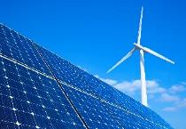
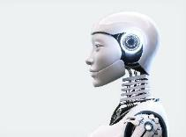

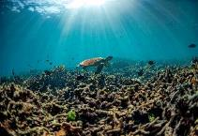
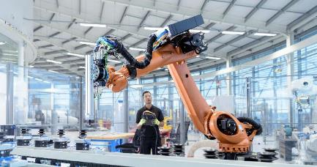

Are we prepared?
Population over 8 billion
Life expectancy: half the people born after 1997 could live up to 100
By 2025, 85 million jobs may be displaced but 97 million more jobs may emerge
Skills for the green and blue economies
Source: The Future of Jobs Report 2020, WEF, Oct 2020. McKinsey Quarterly, Beth Davies, Connor Diemand-Yauman, Nick van Dam, ‘Competitive advantage with a human dimension: from lifelong learning to lifelong employability’

Slide 10
Sustainability in Education
What is the relationship between sustainability and education?
How can we make education sustainable?
How can education lead to sustainable development?

Slide 11
Sustainability in Education

Slide 12

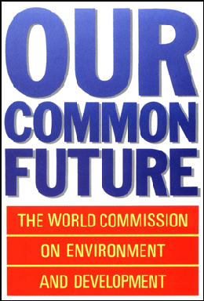
Sustainable development
'Sustainable development seeks to meet the needs and aspirations of the present without compromising the ability to meet those of the future.’
-Brundtland Commission Report, 1987
Source: https://sustainabledevelopment.un.org/content/documents/5987our-common-future.pdf
Notes:
The concept of Human ecology was influential in shaping discourse on sustainable development. Zena's ideas prefigured some of the seminal works on sustainable development, such as the report of the Brundtland commission out of which comes the often cited definition of Sustainable Development as "development that meets the needs of the present without compromising the ability of future generations to meet their own needs"

Slide 13
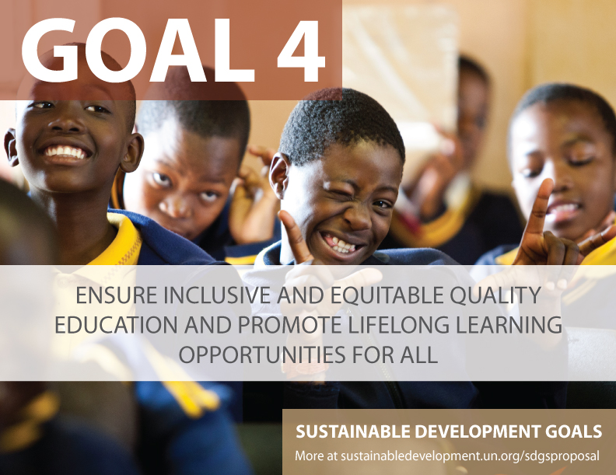

Slide 14

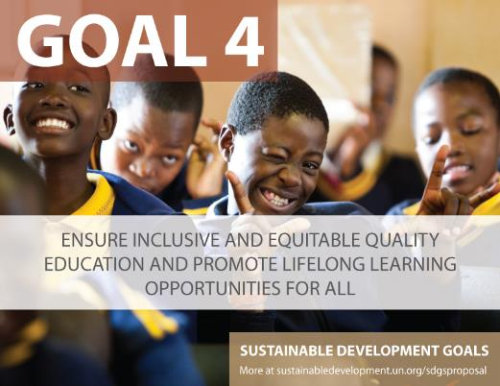
4.3: ensure equal access to affordable and quality tertiary education
4.7: integrate key sustainability concepts across the curriculum
Notes:
Mean year of schooling for persons with disabilities in select 49 countries in the UNESCO report is 4.8, whereas in general is 7 years. For female PWD, the mean years of schooling reduces to 4.3. ( see UIS, 2018: http://uis.unesco.org/sites/default/files/documents/ip49-education-disability-2018-en.pdf
People with disabilities are often disadvantaged in terms of access to tertiary education. Of the 18 countries for which data is available, 15 report disability prevalence under 3 per cent and half report rates under 2 per cent.
No info on students with disabilities in tertiary education.
United states
Source: https://nces.ed.gov/fastfacts/display.asp?id=60
11.1% (students with disabilities enrolled in post-secondary institutions) in 2011-2012
Canada
Source: http://publications.gc.ca/collections/collection_2009/rhdcc-hrsdc/HS61-1-2009E.pdf
10.7%
Australia:
Source: https://www.cdu.edu.au/sites/default/files/the-northern-institute/10.18793-lcj215.17.02.pdf
5.5%
India
https://timesofindia.indiatimes.com/home/education/news/Disabled-get-only-0-56-of-seats-in-higher-education/articleshow/46810639.cms
0.56%
South Africa
https://www.dailymaverick.co.za/article/2017-08-15-students-with-disabilities-disadvantaged-at-higher-education-level/#.WhSt_lWnGUk
http://www.statssa.gov.za/publications/Report-03-01-59/Report-03-01-592011.pdf
According to Stats SA, 80% of disabled people aged 20-24 are not attending tertiary education. Put another way, around 7,5% of South Africans have a disability. Yet the number of disabled students at tertiary institutions is far from representative: just 1%.

Slide 15
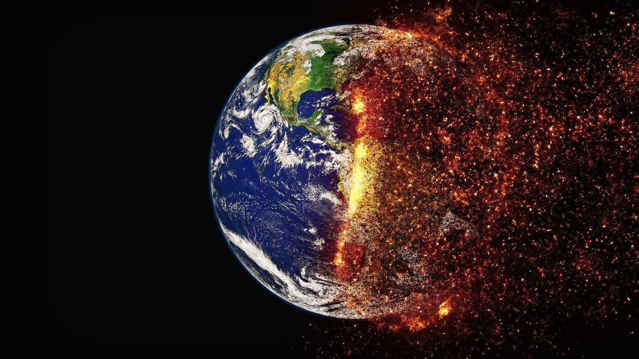
Sustainability: Environmental Conservation
Greening the Curriculum to integrate ESD
Greening campus and site operations
Using distance and online learning
Sally Caird & Robin Roy
Notes:
Flexibility for what? – empowering of students, global citizens, leaving no one behind
Work integrated learning

Slide 16
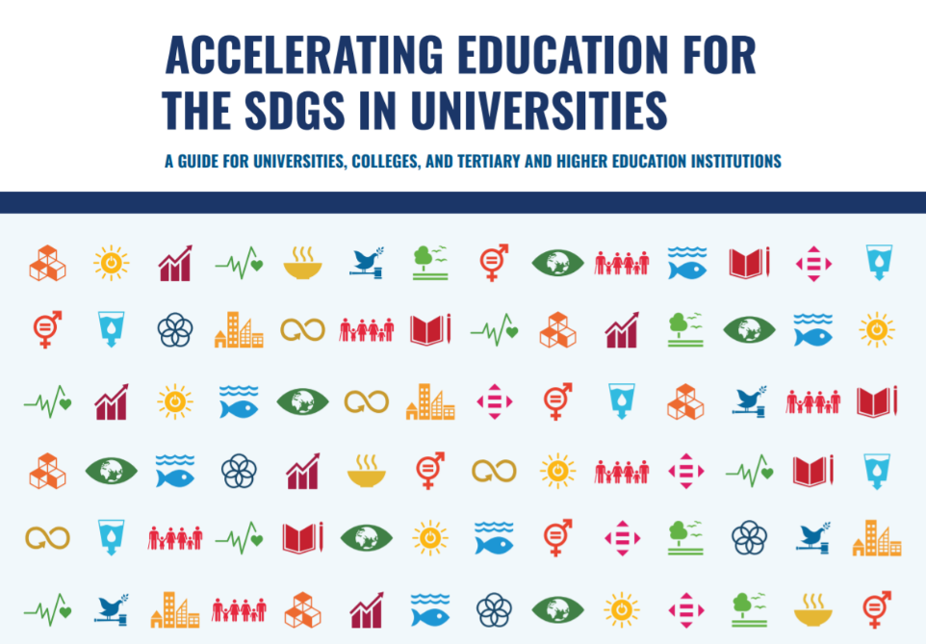
Greening the Curriculum
Environmental Literacy: SFU
Aligning with SDGs: University of Pretoria: trans-disciplinary approach to curriculum
Notes:
Higher education institutions are integrating sustainable development goals into their curriculum. For example, Simon Fraser University in Canada has an environmental literacy course that provides credits towards several programmes in the university. Sunway University in Malaysia has integrated SDGs into its mission and started the Sunway Smart Sustainable Campus Committee (SSCC) as part of its governing structure to brainstorm, innovate together and make recommendations to guide campus-wide policies and initiatives. The University of Pretoria as adopted a transdisciplinary approach to curriculum including next generation practices enhancing community-based learning experiences, using innovative audience interaction technologies, and the agile shift to virtual teaching for sustianbility.

Slide 17
Greening the Campus
Australian National University
Environmental Management Plan 2021—decrease carbon emissions by 30%; increase renewable energy generation by 50%; increase sustainable commuting to 80%
Groningen University
2015-2020 Roadmap to become carbon neutral through energy efficiency; renewable energy; water conservation

Slide 18
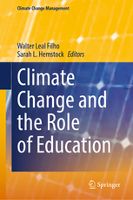






Research on Emissions and ODL
3x less carbon emissions
Travel – greatest contributor
Mode of delivery - determinant
Source: Carr et.al. Delivery Mode and Learner Emissions: Comparative Study from Botswana. W. Leal Filho and S. L. Hemstock (eds.), Climate Change and the Role of Education, Springer Nature. In Production.
Notes:
Mean year of schooling for persons with disabilities in select 49 countries in the UNESCO report is 4.8, whereas in general is 7 years. For female PWD, the mean years of schooling reduces to 4.3. ( see UIS, 2018: http://uis.unesco.org/sites/default/files/documents/ip49-education-disability-2018-en.pdf
People with disabilities are often disadvantaged in terms of access to tertiary education. Of the 18 countries for which data is available, 15 report disability prevalence under 3 per cent and half report rates under 2 per cent.
No info on students with disabilities in tertiary education.
United states
Source: https://nces.ed.gov/fastfacts/display.asp?id=60
11.1% (students with disabilities enrolled in post-secondary institutions) in 2011-2012
Canada
Source: http://publications.gc.ca/collections/collection_2009/rhdcc-hrsdc/HS61-1-2009E.pdf
10.7%
Australia:
Source: https://www.cdu.edu.au/sites/default/files/the-northern-institute/10.18793-lcj215.17.02.pdf
5.5%
India
https://timesofindia.indiatimes.com/home/education/news/Disabled-get-only-0-56-of-seats-in-higher-education/articleshow/46810639.cms
0.56%
South Africa
https://www.dailymaverick.co.za/article/2017-08-15-students-with-disabilities-disadvantaged-at-higher-education-level/#.WhSt_lWnGUk
http://www.statssa.gov.za/publications/Report-03-01-59/Report-03-01-592011.pdf
According to Stats SA, 80% of disabled people aged 20-24 are not attending tertiary education. Put another way, around 7,5% of South Africans have a disability. Yet the number of disabled students at tertiary institutions is far from representative: just 1%.

Slide 19
Terms
Sustainability Education: interdisciplinary, creates a space for values and goals of sustainability
Education for Sustainable Development: holistic and transformational lifelong learning process
Education for Sustainability: includes both process and vision of sustainability
Sustainable education: realise human potential in relation to economic, social and ecological wellbeing
Dr Eila Jeronen, ‘Sustainable Education’ Finland

Slide 20

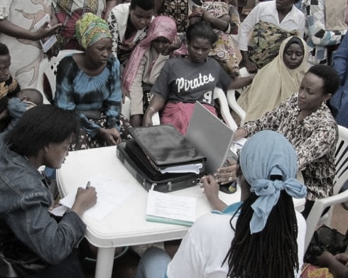
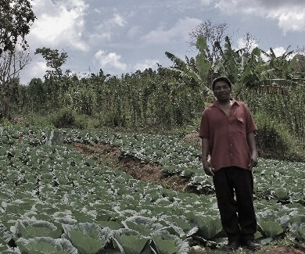


ECONOMIC EMPOWERMENT
SOCIAL
INCLUSION
ENVIRONMENTAL CONSERVATION
$
Notes:
COL continues to promote ‘learning for sustainable development’. Learning must lead to economic growth, social inclusion and environmental conservation.

Slide 21
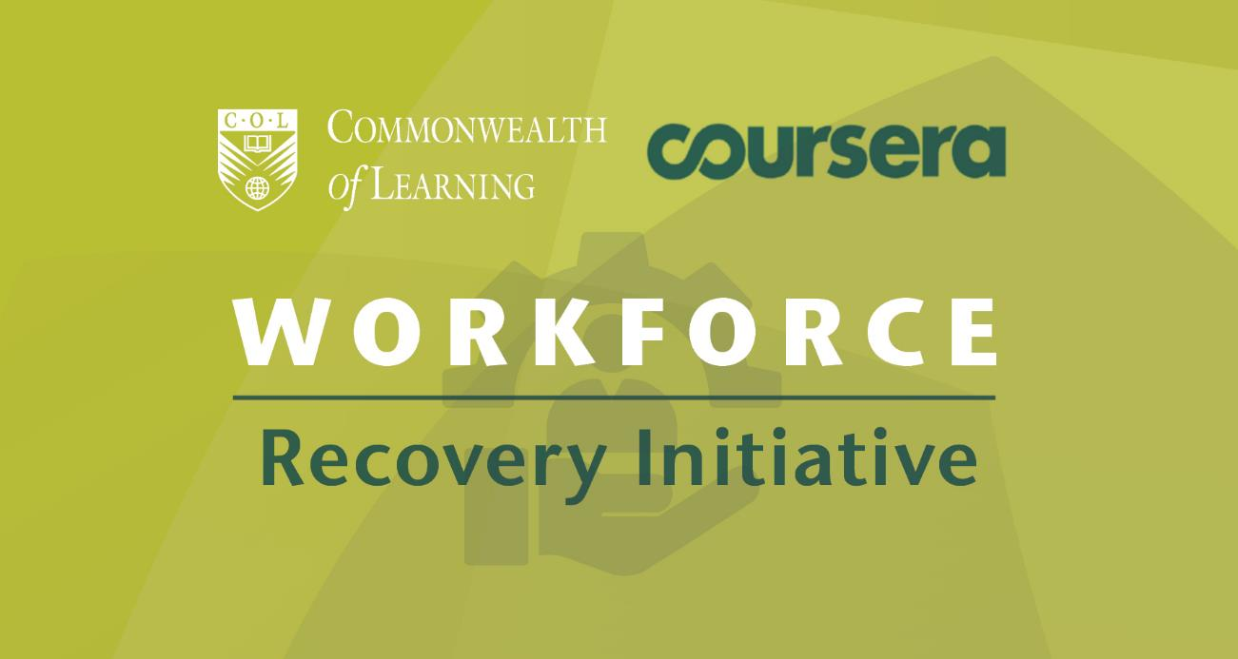
Economic growth: Skilling and re-skilling
COL’s partnership with Coursera facilitated free access to over 5,000 courses
COL admitted close to 150,000 citizens of the Commonwealth to gain skills to regain employment, with more than 42,000 of them graduating

Slide 22
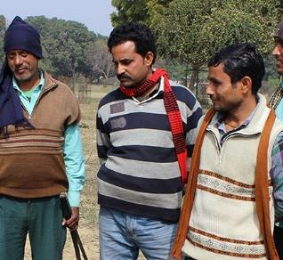
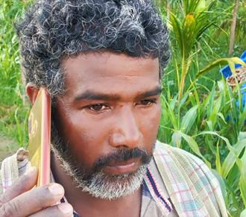
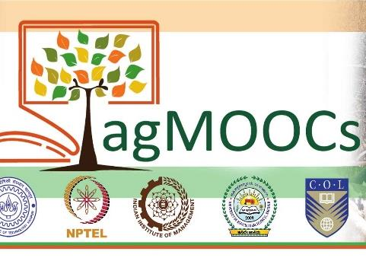
Social Inclusion:
Reaching the Bottom Billion
Use technologies that are
appropriate and affordable
Content designed for delivery
in low bandwidth situations
Open Content in local languages
ie. OER
Social media integration

Slide 23
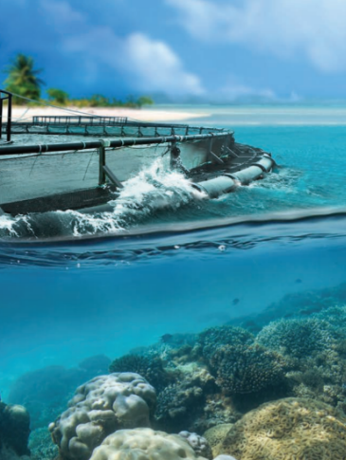
Environmental
Conservation
Green Teacher
Business for Sustainable Development
Training Climate champions

Slide 24
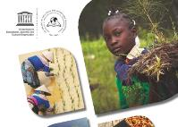

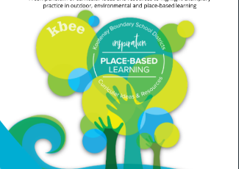
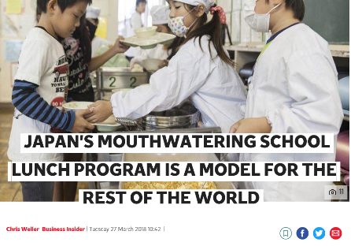
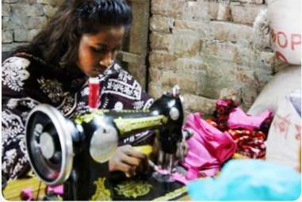
Models and Approaches
Notes:
Here are a few examples of current models and approaches which attempt to address sustainability through education.

Slide 25
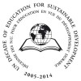
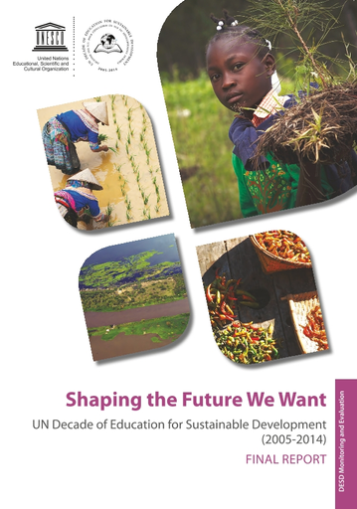
Education for Sustainable Development (2005-2014)
Increased visibility in national policies and international agreements
Ethos and values of ESD gaining acceptance, but not fully integrated into the education systems in most countries
Notes:
Education for Sustainable Development (ESD) aspires to be a holistic and transformational approach to education that addresses learning content and outcomes, pedagogy and the learning environment. The period 2005-2014 was dubbed the Decade of Education for Sustainable Development by the UN, and substantial efforts were made to mainstream the approach.
Has the aspiration been achieved?
Findings from a final report on the Decade of ESD suggest that ESD’s visibility in national policies and international agreements did indeed increase over the ten year period.
However, it also notes that "considerable challenges remain in realizing the full potential of ESD: the need for further alignment of education and sustainable development sectors; the need for more work towards institutionalizing ESD to ensure
strong political support for implementing ESD on a systemic level; and finally, the need for more research, innovation, monitoring and evaluation to develop and prove the effectiveness of ESD good practices. While much has been done
to advance the ethos and values of ESD, a full integration of ESD into education systems has yet to take place in most Countries."

Slide 26

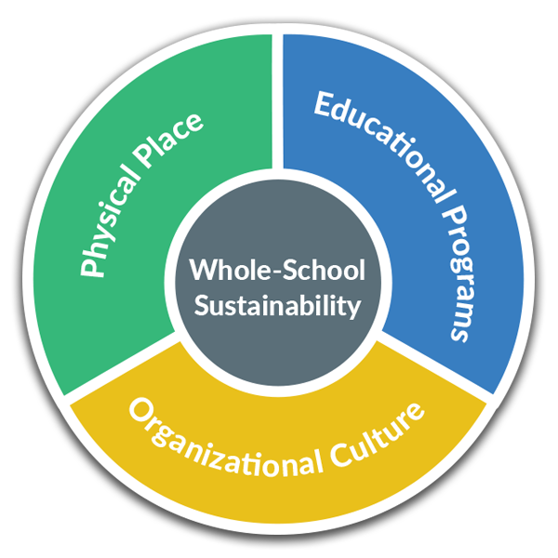
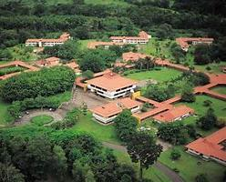
'Whole-School Sustainability'
Source: https://www.greenschoolsalliance.org/about
Notes:
Some schools and universities are taking a systems approach to addressing sustainability under a 'whole-school' model which addresses not only the content of education programmes, but also the organisational culture and the physical infrastructure.
Since 1990, EARTH University in Costs Rica has had the objective of preparing young people to contribute to the sustainable development of their home communities while constructing a prosperous and just global society. EARTH offers a scientific and technological education. emphasizing ethical entrepreneurship and strong socio-environmental commitment, all based out of a carbon neutral campus.
Other schools, including some elementary schools which are part of the "Green School Alliance" in the USA are using a similar 'whole school sustainaility approach' to integrate sustainability in the currciulum, culture and infrastructure of the school.

Slide 27
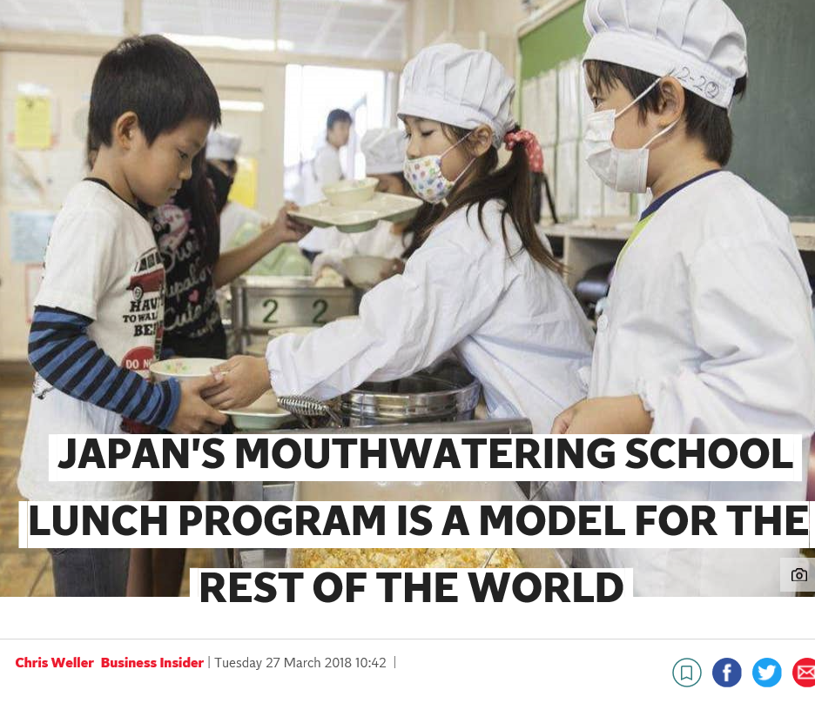
Linking activities to the environment and community
Fureai Lunches (Fureai means "interaction" in Japanese)
‘These enable school children to communicate directly with farmers over school lunch.’
Source: https://www.independent.co.uk/life-style/japan-school-lunch-program-children-food-model-countries-world-a8275616.html
Notes:
In Japan, there are numerous efforts to link students to the community and the environment through their daily experiences and interactions. One of the best examples of this approach is the school lunch programme, known as Fureai Lunches, or "interaction" lunches in Japanese. Through the lunchtime meal students are taught about where their food comes from. They also have a chance to speak directly to farmers from their communities to learn more about the process, and they serve one another, learning practical skills, responsibility and the importance of interdependence.

Slide 28
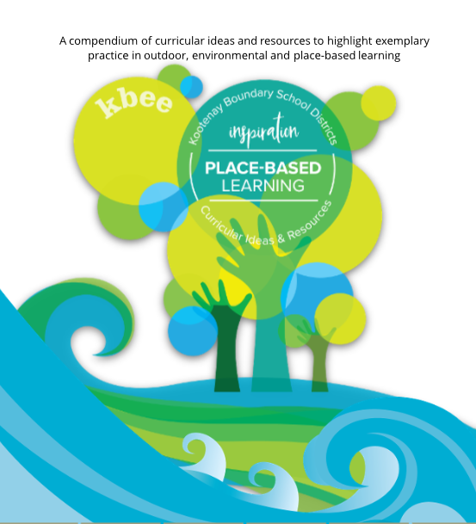
Outdoor Education
To better support students’ understanding of their local environment and empowering thoughtful action, through learning that is outdoor, experiential, place-based and place-conscious.
- The Kootenay-Boundary Environmental Education Initiative (KBEE) British Columbia
Source: http://kbee.ca/
Notes:
Outdoor education is an approach to schooling that brings students outside of the classroom. Learning is anchored in the local natural environment, and experiential in nature. Many schools and schools districts, including the Kootney Boundary School district in British Columbia, Canada, are implementing outdoor education programmes, and have developed resources of curricular ideas and materials for outdoor, environmental and place-based learning.
These examples highlight some of the innovative approaches to addressing environmental sustainability through education, but there are still some challenges in bringing them to scale.

Slide 29
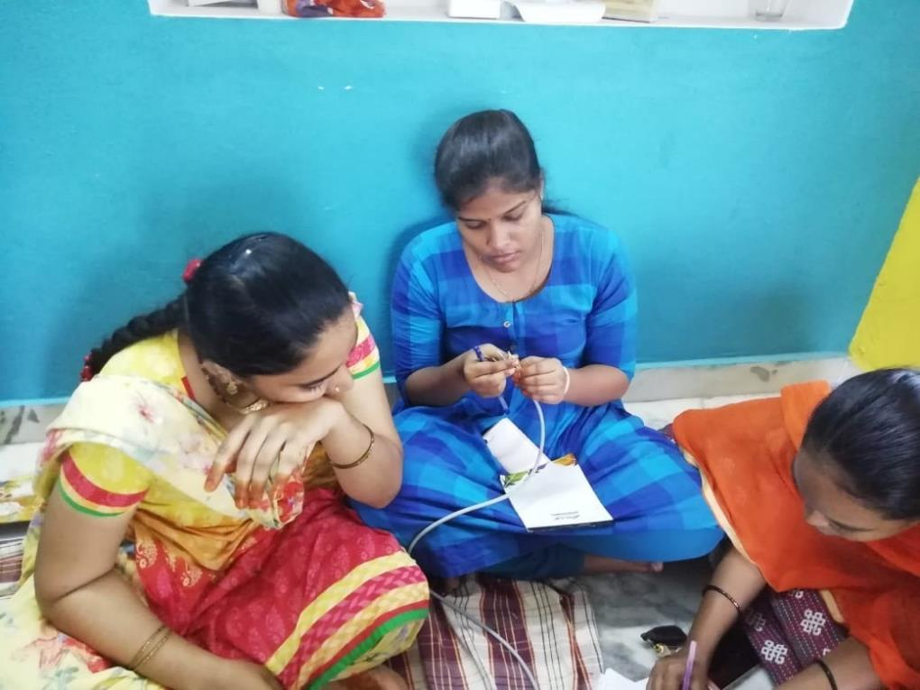
E-Apprenticeship Model
The majority of learning takes place in the learner's own community using technology
Barefoot wireless engineer training in India
Notes:
In Canada, community-based apprenticeship models have leveraged technology to improve the coordination of academic and experiential studies, track on the job learning, and allow students more time in a community-based setting. One such example is the E-Apprenticeship Alternate Delivery Design Initiative (EADDI) at Red River College in Manitoba. The learners attended an on-campus orientation session at the outset of the program. The learners then returned to their communities to work with an employer and simultaneously complete six months’ of part-time study (10– 12 hours a week) which incorporated online teaching (one half day per week, twice a week) and self-paced study. The learners were required to have access to a high-speed Internet connection, a computer, a headset/microphone and a webcam. At the end of the six-months they returned to the College to review their experience and take a final exam. Those who successfully completed were granted the same credentials as those given to apprentices who studied on campus (Little, 2017 ). The ICT-based instruction lowered the cost of study and allowed learners to stay in their communities and earn an income while working. More importantly, the model allowed learners to ‘ immediately apply what they learn online in their workplaces’ (Little, 2017 , p. 170). The apprentices were gaining valuable informal learning experiences through their day to day work, which they could connect to the theory they were learning. The simultaneous experience of learning on the job and in the classroom is a way to integrate informal/non-formal and formal learning,
while addressing the practical limitations and costs that extensive face-to-face learning in a formal environment can incur.

Slide 30
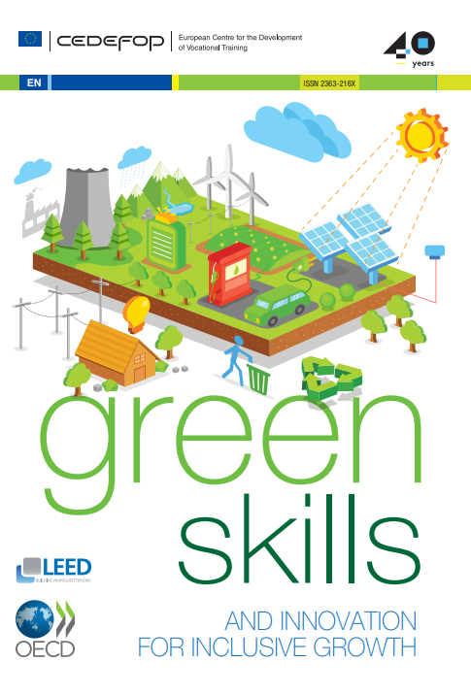
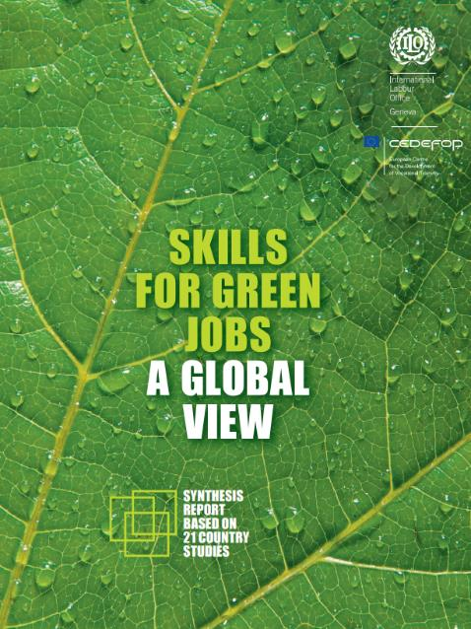
Focus on Green Skills
Renewable energy
Air pollution control
Sewage and waste management
Environmental control system
Financial skills to quantify environmental impact
Policy and leadership skills for green economy
Source: https://www.ilo.org/wcmsp5/groups/public/---dgreports/---dcomm/---publ/documents/publication/wcms_159585.pdf

Slide 31
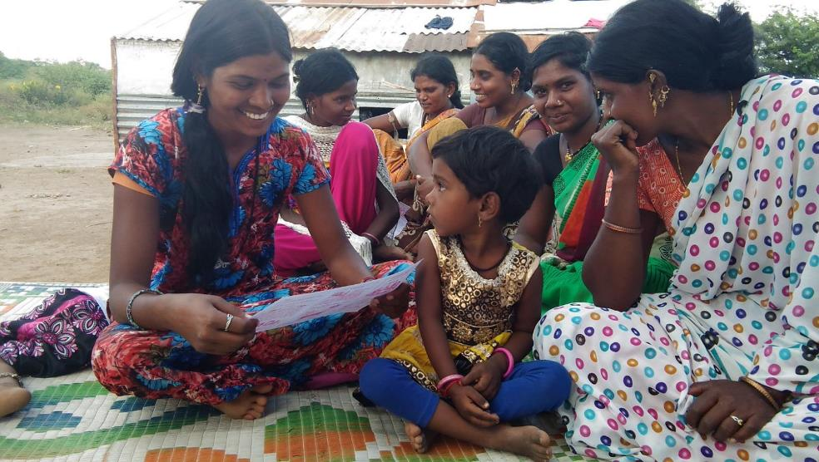
Community-based learning
Community-based learning instills a sense of interdependence and responsibility which is crucial to behavioral change for environmental conservation.
Notes:
Studies have shown that countries where individualist orientations are stronger tended to have higher per capita CO2 emissions. Adger et al. (2013) and Chuang et al. (2016) reported that people having ‘interdependent selves’ were more likely to engage in pro-environmental behaviors than ‘independent selves’
By linking learners to their communities, we can build this sense of interdependence. Community-based learning gives meaning, relevance and context to learning, and helps to inculcate a sense of responsibility in learners for their neighbors.

Slide 32
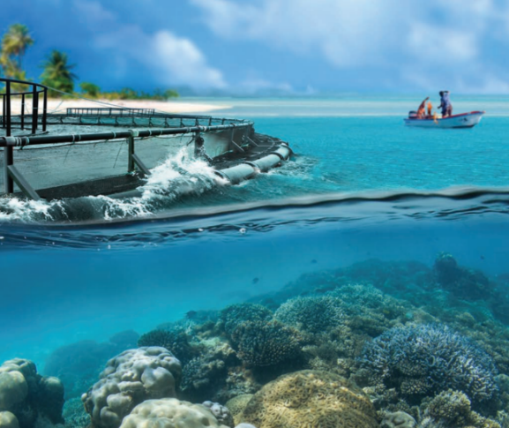


Understanding the Blue Economy
Blue Economy
Research Institute
Notes:
Working with the Blue Economy Institute in Seychelles, COL supported the development of an online course in this emerging field which was offered free by the University of Seychelles.

Slide 33
Open Universities
UPOU: Doctoral programme in Sustainability
OUSL: Centre for Environmental Studies and Sustainable Development
OU, UK: Sustainability Hub
AIOU: 485th among 956 universities on THE Impact Rankings

Slide 34

What have we learnt?
Sustainability needs to move from margins to centre
Dedicated resources, incentives, awards work
Partnerships and platforms
Leadership at both management, student and community levels

Slide 35
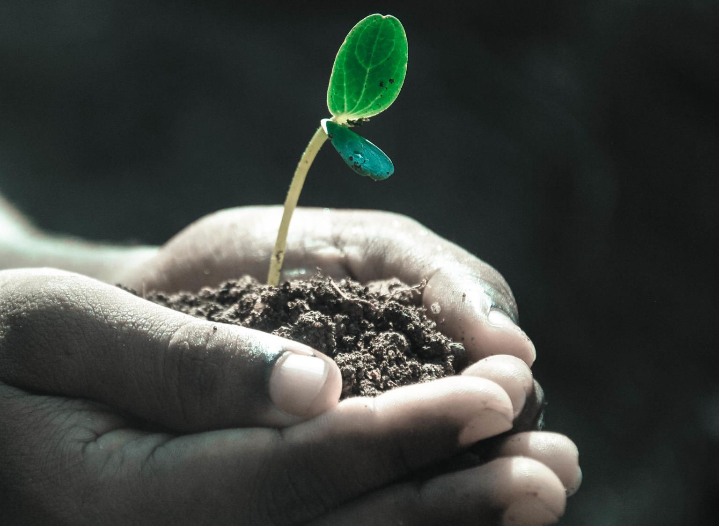
Towards
Sustainability in Education

Slide 36
Bill Gates: How to Avoid A Climate Disaster, 2021
5 big emitters of greenhouse gases
Construction: Cement, steel plastic: 31%
Electricity: 27%
Farming: plants and animals. 19%
Travel and transport: 16%
Airconditioning: 7%

Slide 37

Education: Impact on Climate
DIRECT
Emissions from construction of schools/infrastructure
Emissions from energy use in schools
Learner emissions
INDIRECT
Emissions from ‘development’ and economic growth associated with higher levels of education in a country
Notes:
The education sector, from primary to tertiary, contributes to both direct and indirect emissions, which impact on climate change, and environmental degradation, as well as incur associated economic costs. If we look strictly at contributions to emissions, the achievement of SDG4, under the current paradigm, could potentially worsen the climate crisis.

Slide 38
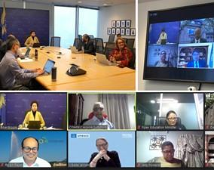
Views of the High-Level Panel
Urgent action required
Need for behavioural change for climate action
Engage and empower youth
Promote disaster response and recovery through education and lifelong learning
Promote collaboration esp with the private sector

Slide 39
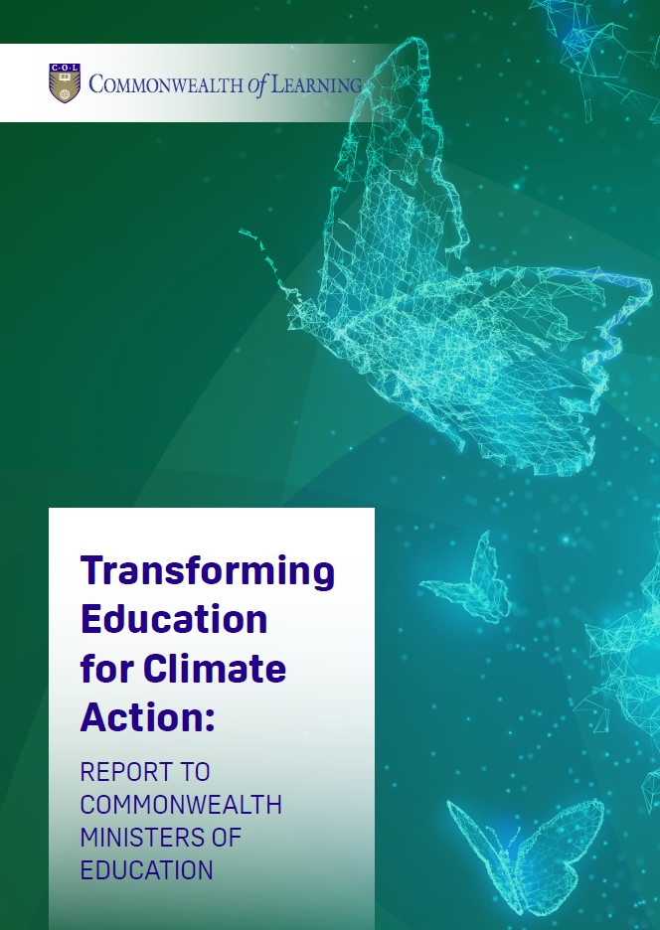
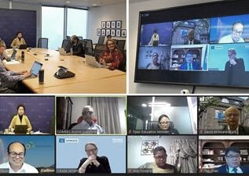

Recommendations
Resilient infrastructure
Skills for the blue and green economies
Promote climate justice

Slide 40
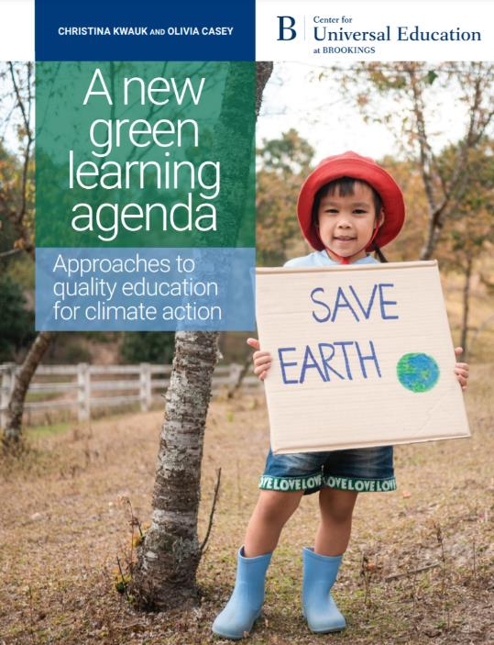
Green learning agenda
Skills for green jobs
Green life skills
Skills for a green transformation
Skills aimed at fulfilling the requirements of green jobs and supporting the transition to a low-carbon green economy
Cross-cutting skills that serve both technical, instrumental, and adaptive, transformative ends
Adaptive skills aimed at transforming unjust social and economic structures

Slide 41
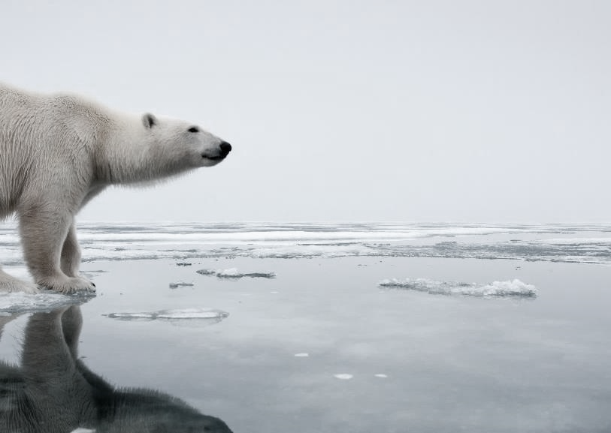
Climate Justice: addressing inequalities
Countries with harmful gender norms, gender discriminatory education policies are also countries with low levels of climate resilience and high levels of vulnerability to climate disasters.
Women and girls more vulnerable to disasters
Girls typically excluded from technical fields and STEM required by the green economy
Notes:
Make TVET more gender transformative—break stereotypes and target skills from caring to coding to construction
Prioritise ‘care’ in green jobs—uphold care for women’s rights and care for the environment
Create a supportive ecosystem for women and girls in the green economy.

Slide 42
Transformative pedagogy
Typical Approach:
Skills /Competencies
Employability and Entrepreneurship
Achievement
Transformative Approach:
Empowerment for Change
Environmental Conservation and Global Citizenship
Accomplishment
Notes:
According to Marc Prensky, the dominant educational paradigm emphasizes individual achievement, which is defined as “A person doing something that benefits only (or principally) him or her (=an achievement).” In the current paradigm, the focus is on the Acquisition of Skills and Competencies as well as Employability and Entrepreneurship – individualistic goals.
Under a transformative approach, the focus is on bettering soceity as a whole, what Prensky calls “real, world-improving accomplishment”. In contrast to an achievement an accomplishment is “A person doing something (or being a part of something) that benefits others and the world outside of that person (=an accomplishment).”
And Prensky claims that this model “is far better for us because it liberates huge amounts of unused potential – the potential of our students – to improve our communities and our planet.
Under the transformative approach, the focus is on Empowerment, Environmental Conservation, and Social Cohesion/Peace.

Slide 43
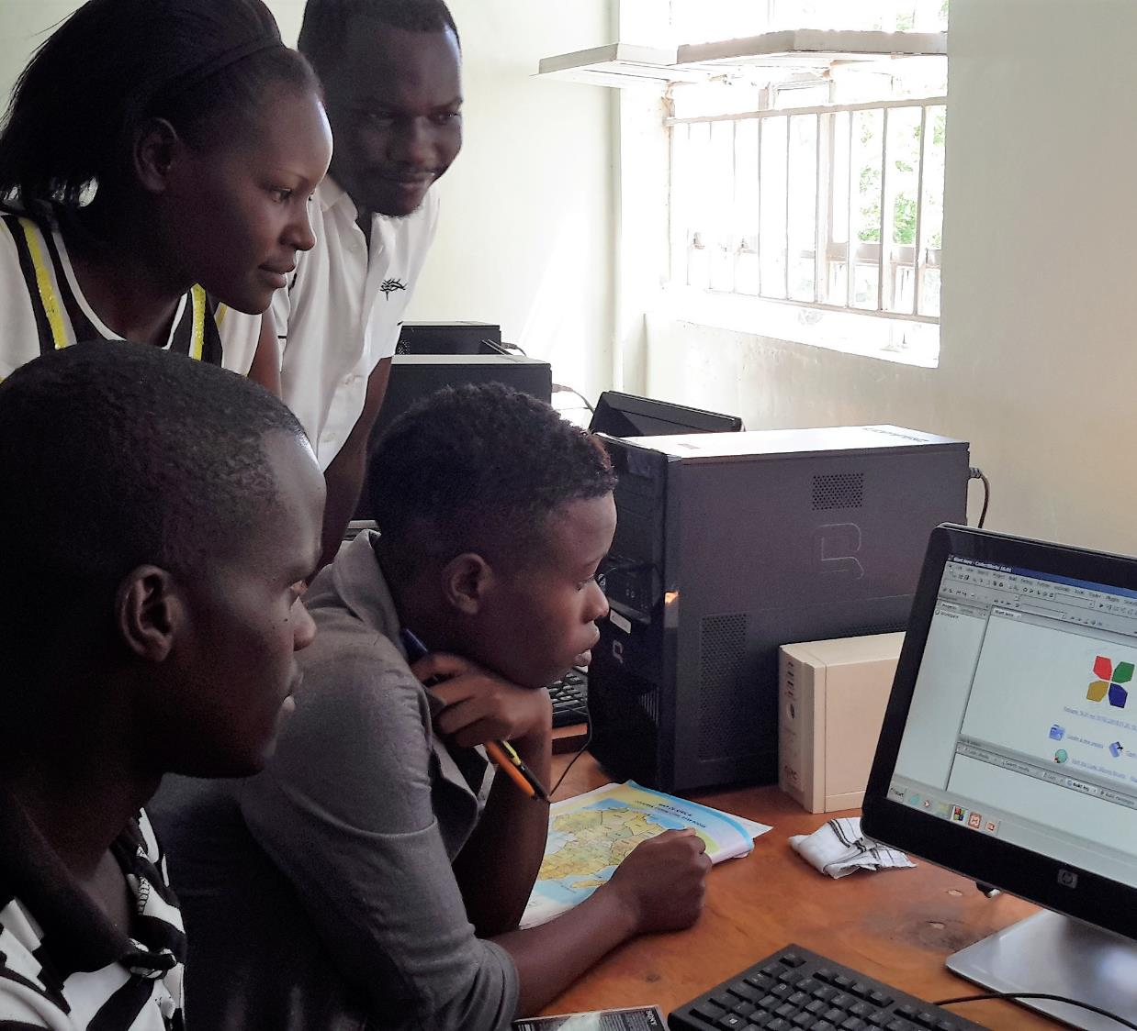
Real, World-Improving Projects
"Projects that produce actual...changes in our kids' local and global communities"
- Marc Prensky
Source: Prensky, M. 2016. Education to Better Their World. Teachers College Press, New York.
Notes:
Marc Prensky claims that learners should apply their skills and knowledge to real world problems, problems whose solutions can have a profound, positive impact on the world. He cites the example of High Tech High In San Diego California, which supported students to learn to use complex water-monitoring equipment when the government cut funding for trained water monitors. The students not only continued the extremely valuable practice of monitoring the water, but also published the data online to share with their entire community.

Slide 44
Evolution of sustainability education
Environmental education
Campus greening movement
Transformative and emancipatory pedagogies
Contemplative education
Jason Papenfuss et al, Journal of Sustainability Education, Vol 20, April 2019

Slide 45
Contemplative pedagogy
‘Ways of knowing that complements the rational and the sensory’ (Hart, 2004)
Pedagogical practices that cultivate the values of personal growth, creativity, empathy and caring for others
Mindfulness and meditation improve concentration, autonomy and interconnected yet liberated learners
Papenfuss, 2019

Slide 46




The Role of Technology
Scale
Access
Collaboration
Reduce emissions
Notes:
These examples have shown how the three elements of a paradigm shift are being implemented in COL programmes and how Technology can play a role in facilitating such a shift.
The experiences of the Commonwealth of Learning show that by leveraging technology for learning we can:
Reach larger numbers of people, faster and at a lower cost (speed and scale)
increase access, especially to the most marginalized, such as rural people and people with disabilities for whom participation in face to face training may be challenging
enhance sharing, social cooperation and collaboration
reduce carbon emissions
However Technology itself is not a silver bullet solution, it must go hand in hand with a fundamental shift in the way we approach education.

Slide 47

Digital divide
Internet usage / ownership of mobile phones
Globally: 60% | Africa: 40%
Men: 69% | Women: 63%
259 million more men than women were using the internet last year.
Women are 12% less likely to own a mobile phone than men.
Sources: International Telecommunication Union (ITU) - https://www.itu.int/en/ITU-D/Statistics/Pages/stat/default.aspx
Notes:
The digital divide continues to be a significant challenge in Africa.
Many schools and educators lack the resources and training necessary to utilise technology effectively.
Generic data
. Internet usage:
In 2021, only 28.2% of individuals in Africa used the internet, compared to the global average of 53.6%. Source: International Telecommunication Union (ITU) - https://www.itu.int/en/ITU-D/Statistics/Pages/stat/default.aspx
b. Mobile broadband subscriptions:
In 2020, there were 82 mobile broadband subscriptions per 100 inhabitants in Africa, compared to the global average of 111. Source: International Telecommunication Union (ITU) - https://www.itu.int/en/ITU-D/Statistics/Pages/stat/default.aspx
c. Access to electricity:
In 2019, only 48% of the population in Sub-Saharan Africa had access to electricity. Source: World Bank - https://data.worldbank.org/indicator/EG.ELC.ACCS.ZS?locations=ZG
Even where access to mobile devices among adults has reached 100% in some African countries (e.g., South Africa, Namibia and Zimbabwe), although a rural-urban divide persists in most, and women and girls often have less access than men
Laurillard D, Kennedy E, Wang T. How could digital learning at scale address the issue of equity in education? (Learning at Scale for the Global South). Foundation for Information Technology Education and Development; 2018. http://dl4d.or g/wp-content/uploads/2019/03/Learning-at-Scale-for-the-Global-South-Main- Paper.pdf.

Slide 48

Technology: the future is blended
Appropriate technologies to create blended learning opportunities
Multiple pathways to acquire qualifications
Using technology to personalise learning

Slide 49



Technology must be placed in an appropriate social, cultural and political context.
Notes:
Technology by itself cannot be a panacea for all that ails higher education today but must be placed in an appropriate social, cultural and political context.

Slide 50
ESD for 2030
Policy
Transforming learning environments
Capacity development of educators
Youth empowerment
Local level action
UNESCO World Conference on ESD, 2021

Slide 51

Reduction of carbon emissions
Raising awareness on sustainability
Reskilling people for a greener future
Resilience for the education sector
This Photo by Unknown Author is licensed under CC BY
Notes:
The next section will outline COL’s work in the following four areas:
Reduction of carbon emissions
Raising awareness on disaster preparedness
Reskilling people for a greener future
Resilience for the education sector

Slide 52

Sustainability in Education means
Providing affordable and accessible quality education for all
Modelling sustainable behaviours for the people and the planet
Promoting research and knowledge creation for the sustainable development of societies

Slide 53

Thank you
www.col.org
The contents of this presentation, with the exception of logos and graphics which are the property of the respective owners, is made available under Attribution-ShareAlike 4.0 International (CC BY-SA 4.0).

