Slide 1


CLOSING CEREMONY
Professor Asha Kanwar
President and CEO, Commonwealth of Learning
September 16, 2022

Slide 2



Participation
429
(297 in person + 122 online)
43 Countries
(37 Commonwealth)

Slide 3
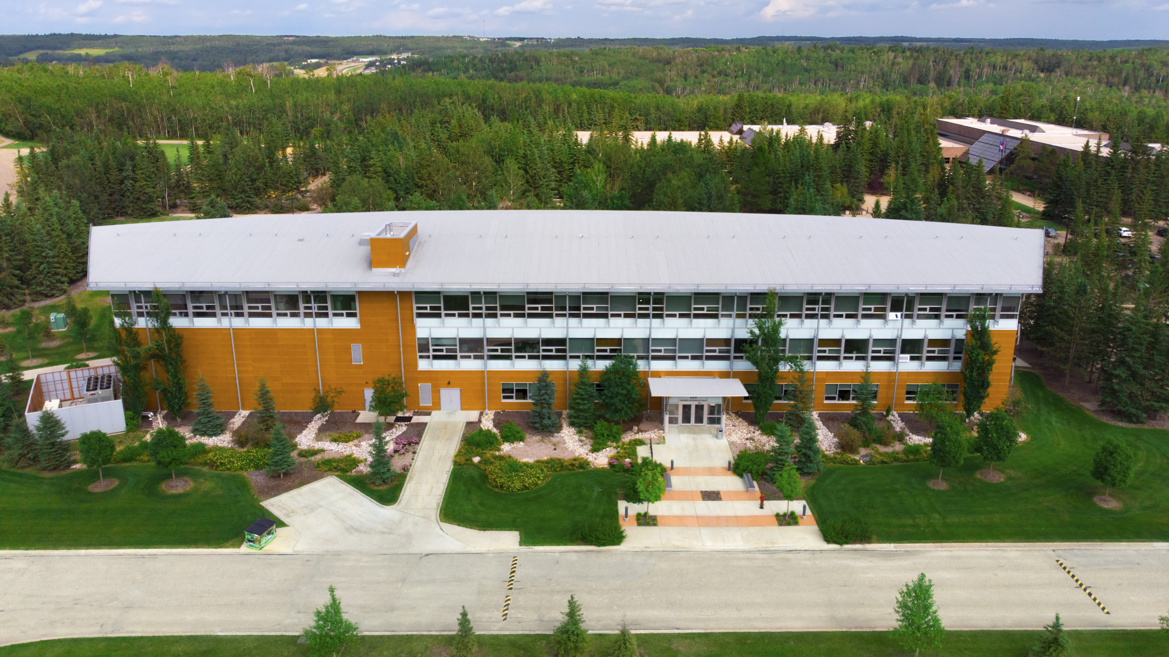

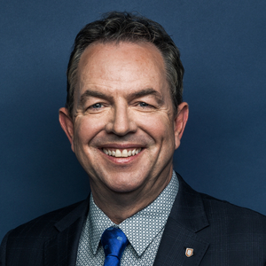
Dr. Peter Scott
President, Athabasca University

Slide 4
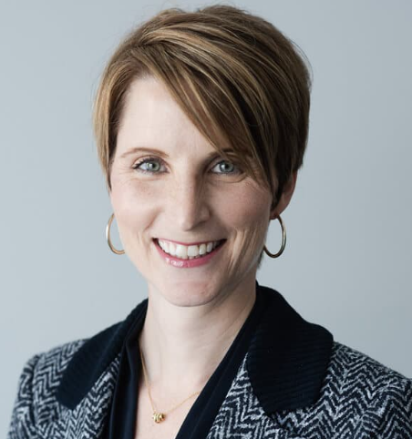
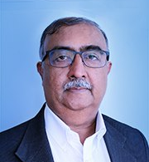
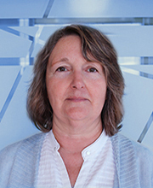
Kristine Williamson
Athabasca University
Dr V. Balaji
Commonwealth of Learning
Doris McEachern
Commonwealth of Learning

Slide 5
Frances Ferreira
Dr. Tony Mays
Dr. Sanjaya Mishra
Dave Jackson
Helen Askounis
Dr. Betty Ogange
Dr. Mairette Newman
Dr. Robert Okinda
Dr. Manas Ranjan Panigrahi
Carol Walker
Kexin Feng
Ray Lee
Naa Adjeley Sackey
Carole Stevenson-Roy
Leslie Bergin
Dr. Mohamed Ally
Jody Paulson
Doug Neuman
Lauren Mill
Caitlin McElhone
Chantal Hisey
Dr. Terry Beckman
Dr. Oscar Lin
Dr. Farook Al-Shamali
Dr. Ali Dewan
Corina Lasiuk
Carrie Anton
EMCEE
Alison Mead Richardson
PROGRAMME MANAGER

Slide 6
INNOVATIONS FOR EDUCATIONAL RESILIENCE
building resilience
fostering lifelong learning
inspiring innovations
promoting equity and inclusion

Slide 7

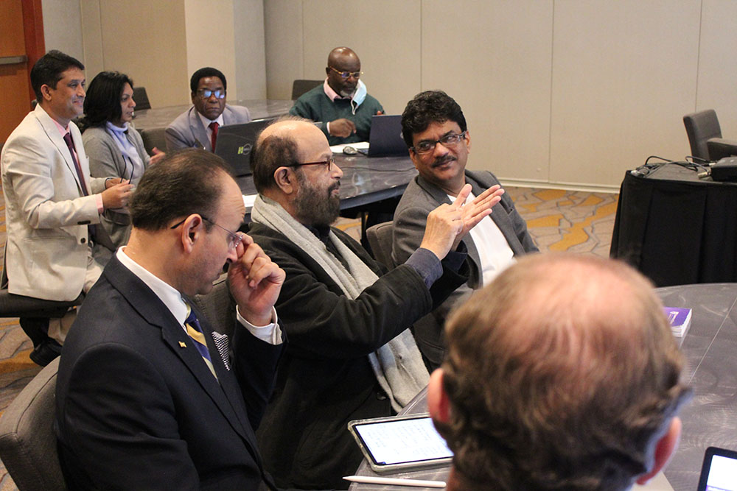
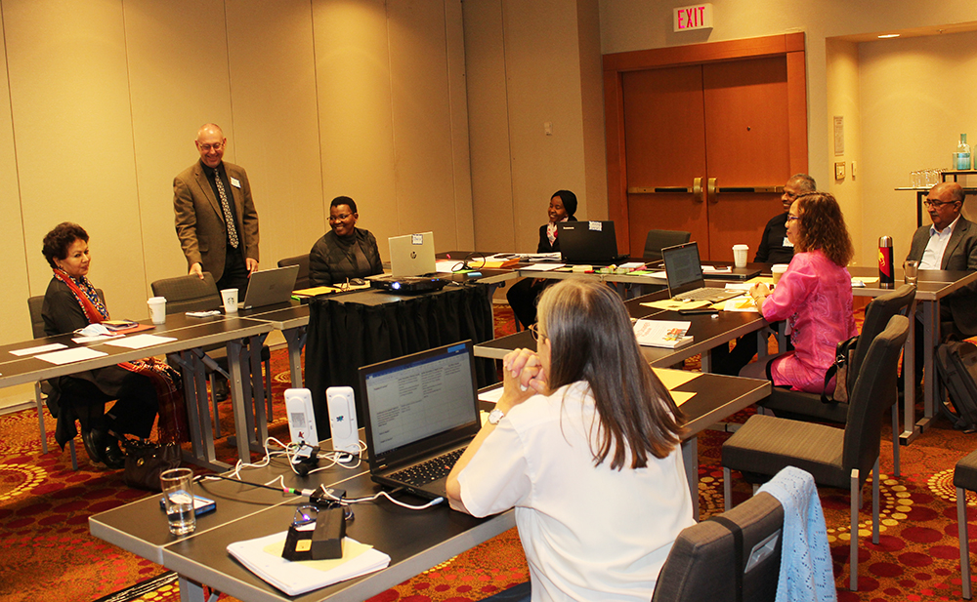
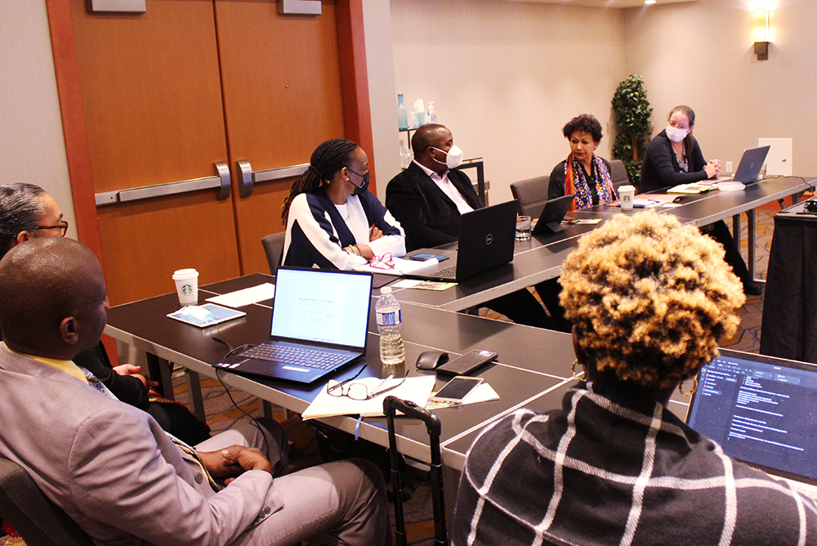
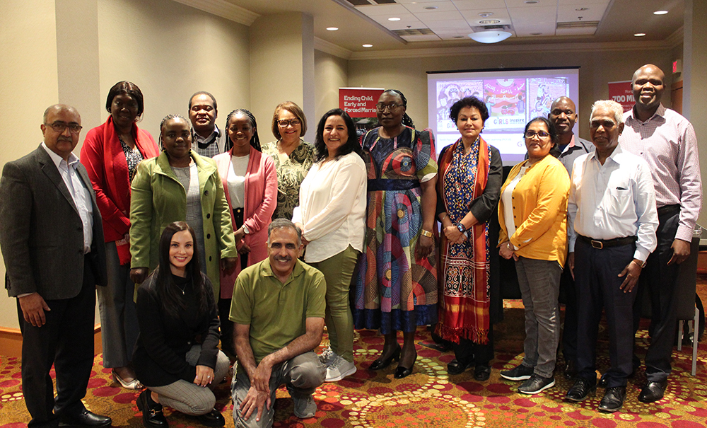
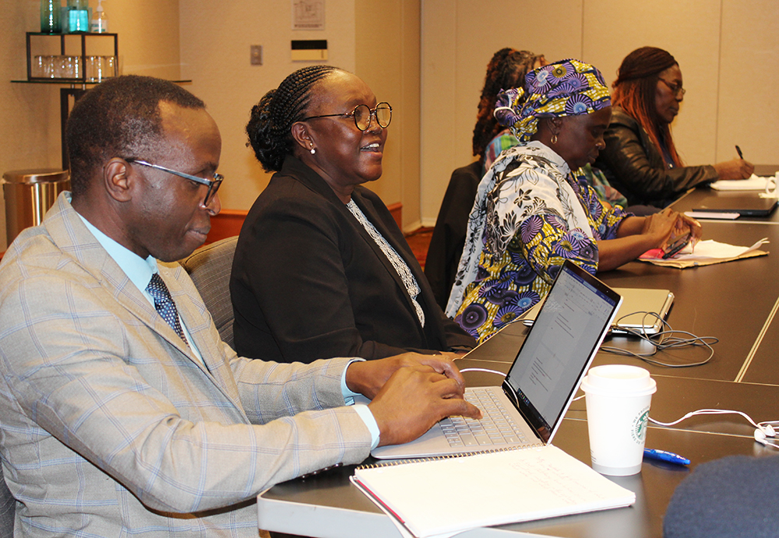
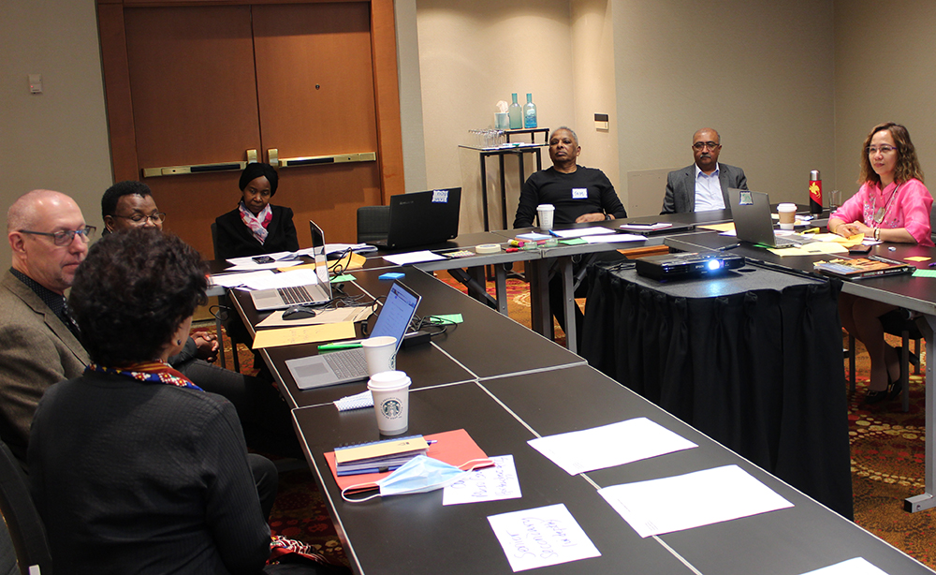
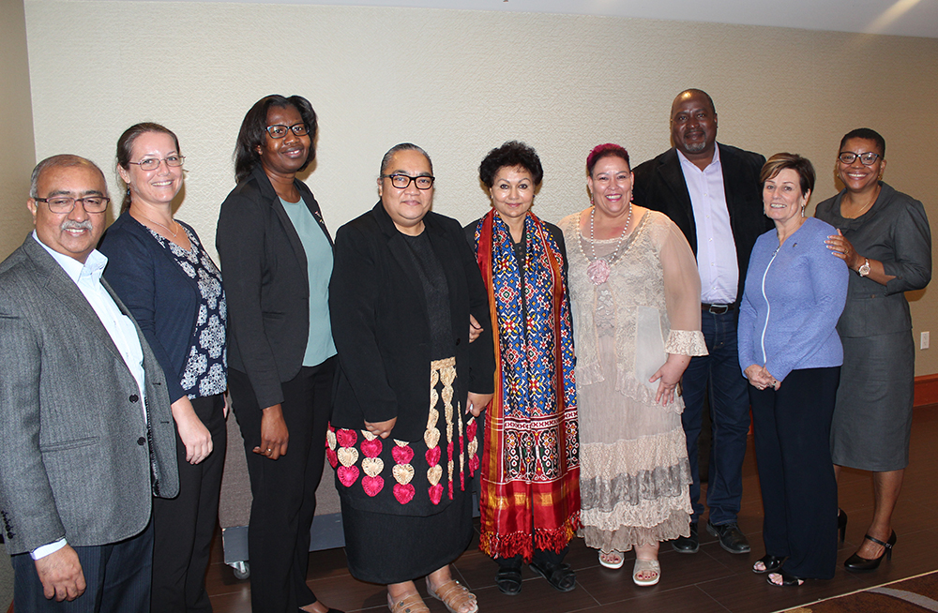
COL Pre-conference Meetings
Notes:
Training of Trainers for Implementing Technology-Enabled Learning in Higher Education Institutions
GIRLS Inspire
Lifelong Learning for Farmers (L3F): Positioning the L3F for the Challenge of Food security
Teacher Education
VUSSC: Collaborative Course Development For Blue Skills
Open Schooling

Slide 8
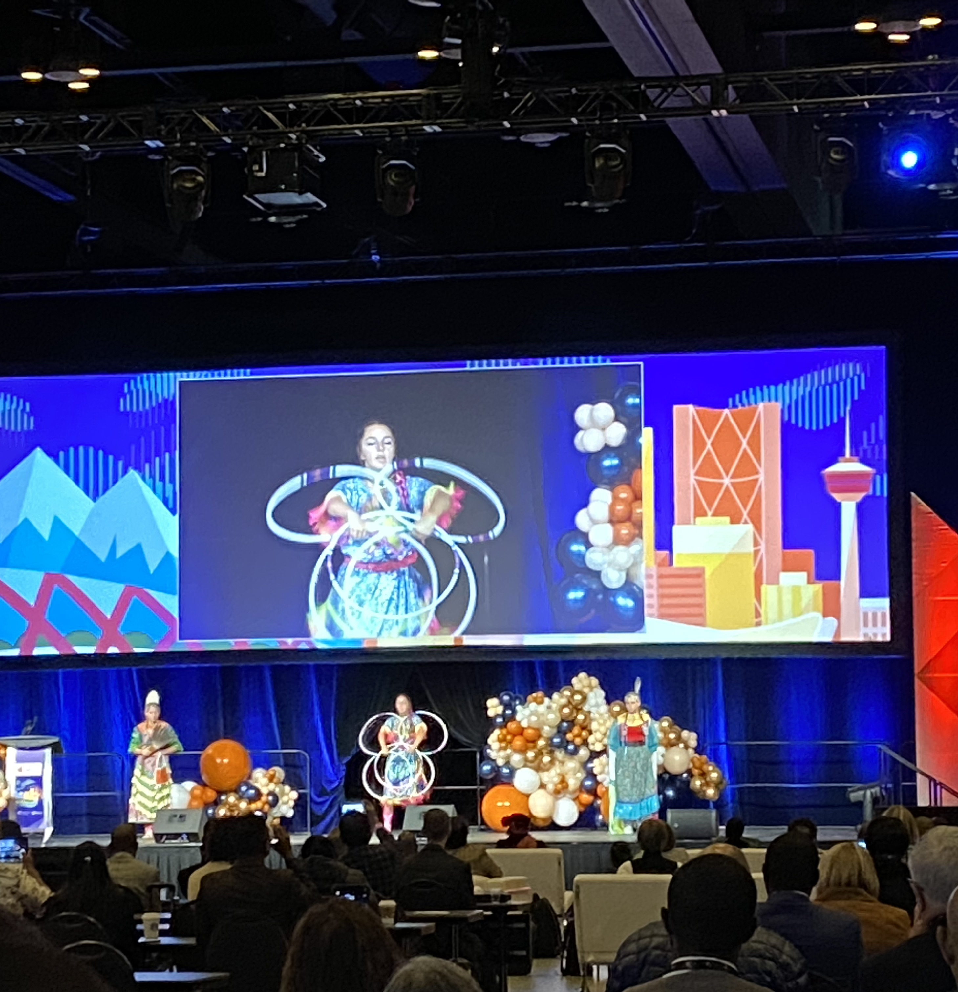
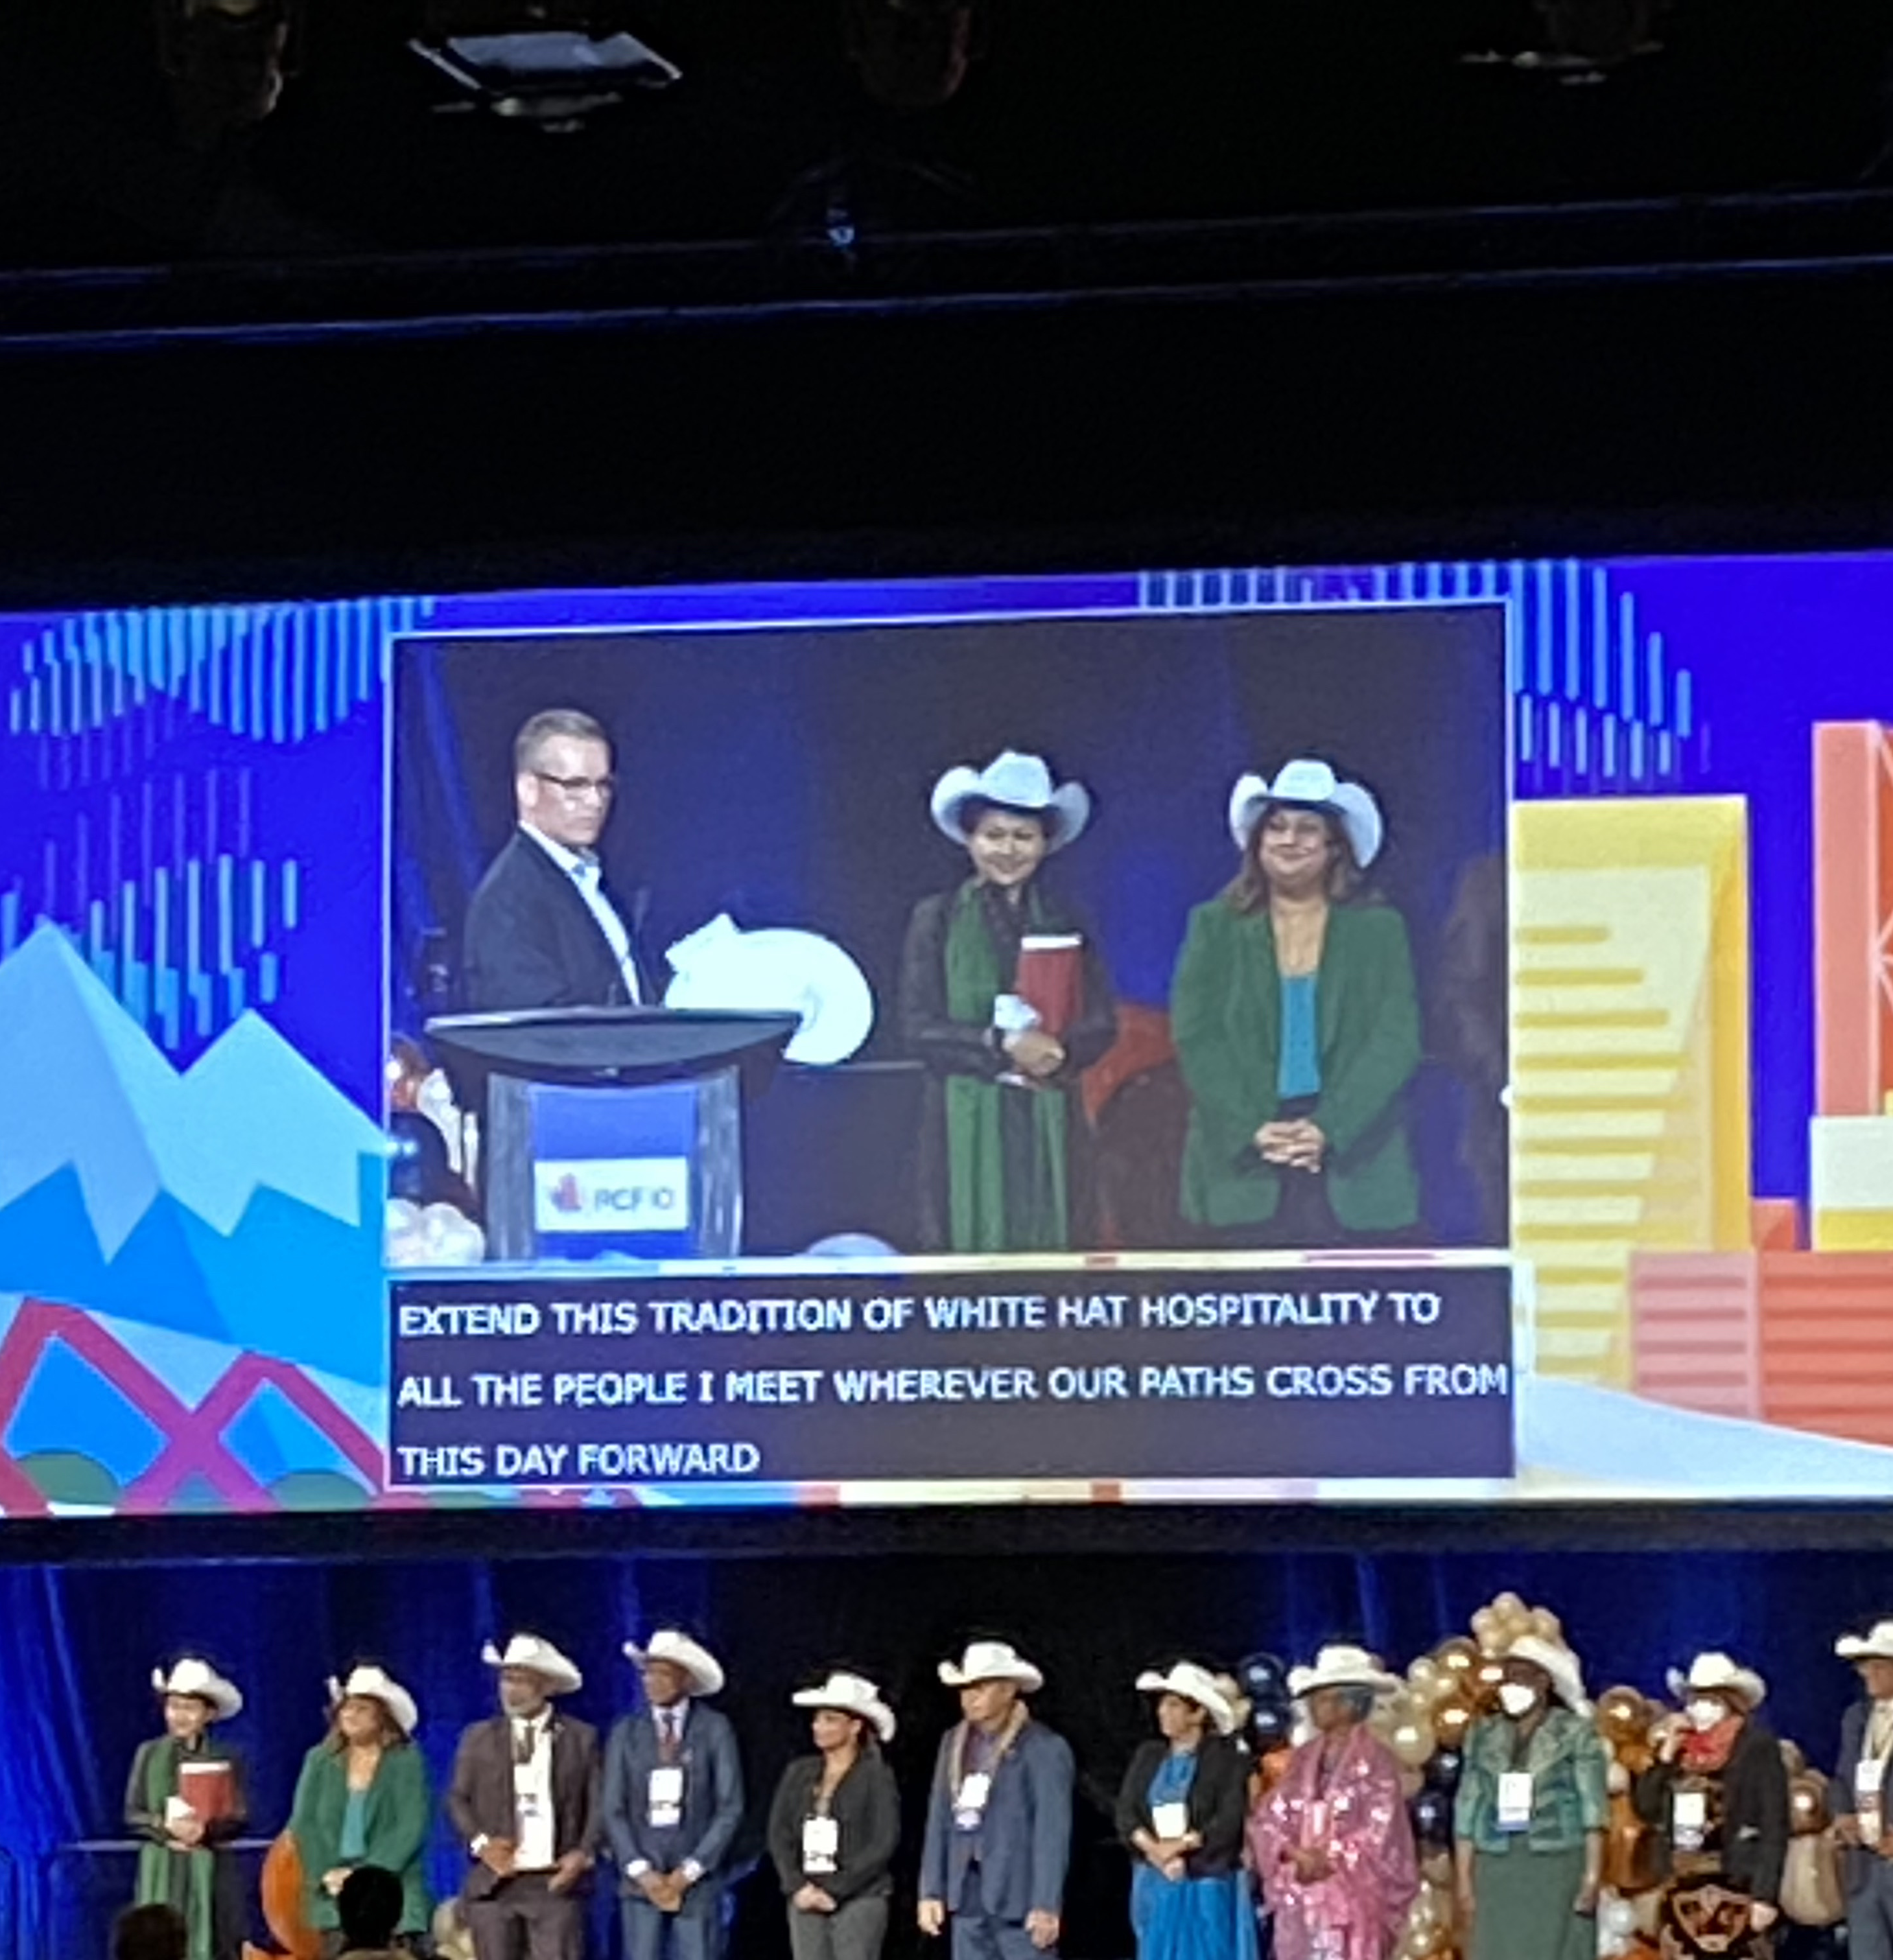
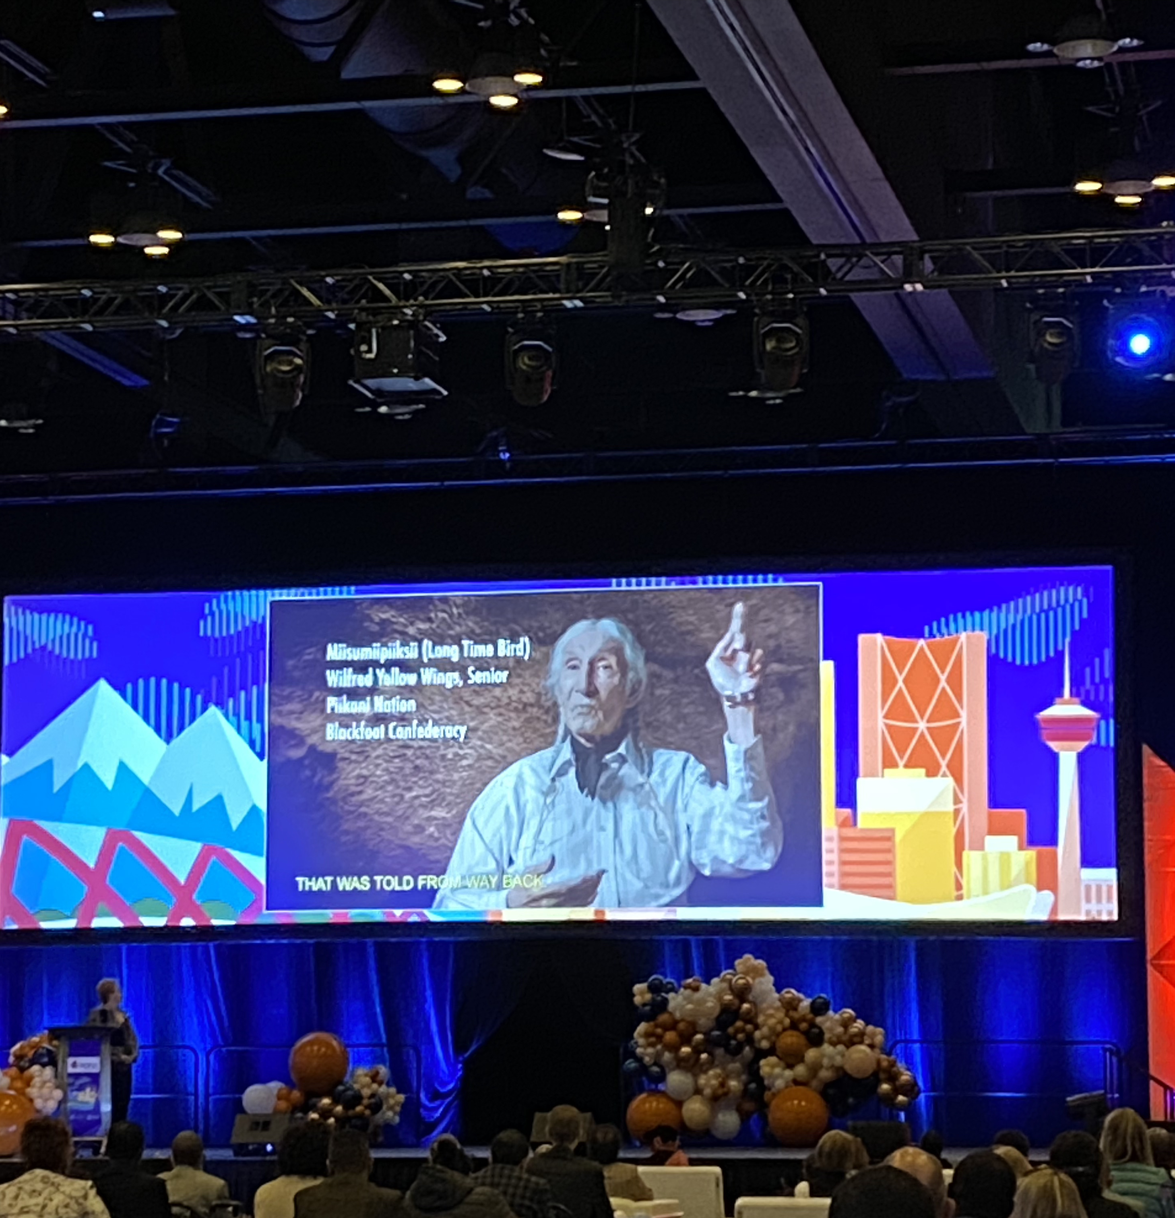
Opening Ceremony

Slide 9
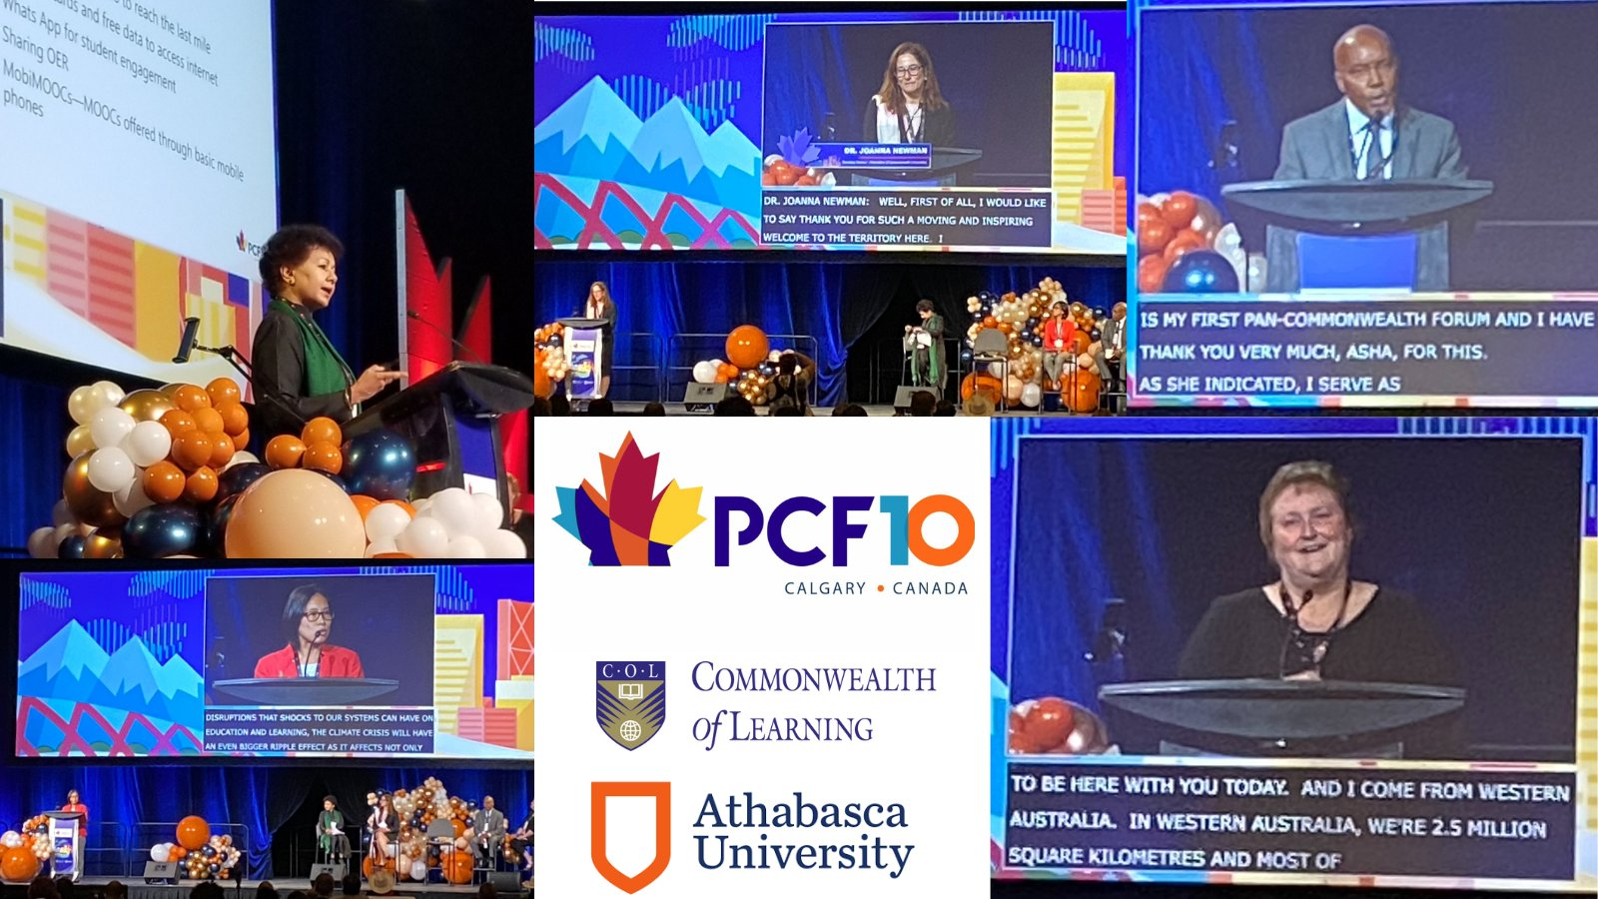
PANEL:
Innovations for Educational Resilience
Dr. Joanna Newman
Mr. Maxim Jean-Louis
Dr. Christina Kwauk
Dr. Diane Chambers
Moderated by
Professor Asha Kanwar

Slide 10
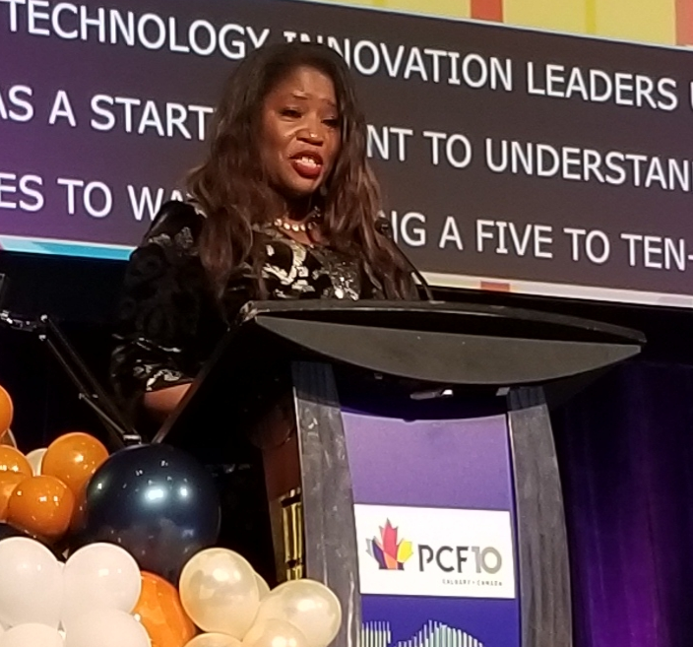

KEYNOTE:
COUNTRY SHOWCASE
Claudette McGowan, Global Executive Officer, TD Bank
CHAIR
Dr. Peter Scott, President, Athabasca University
I can’t emphasize how important cybersecurity is. Protecting data, protecting privacy – it’s critical to everything we do

Slide 11
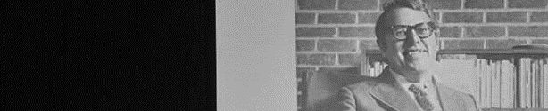
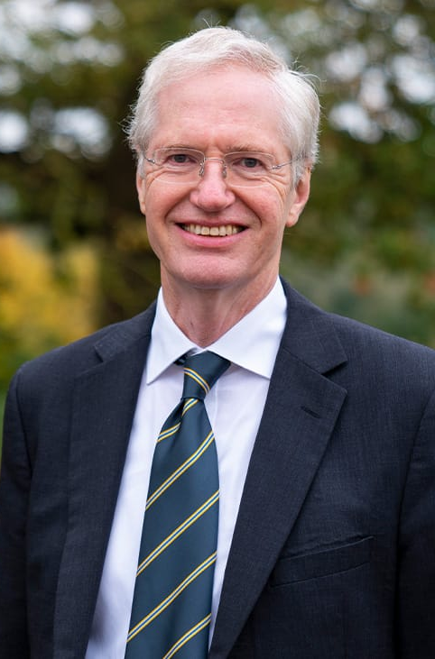

Asa Briggs Lecture
that open learning is the most modern, efficient and cost-effective pathway for underprivileged students seeking higher education opportunities”
CHAIR
Dr. Peter Scott, President, Athabasca University

Slide 12
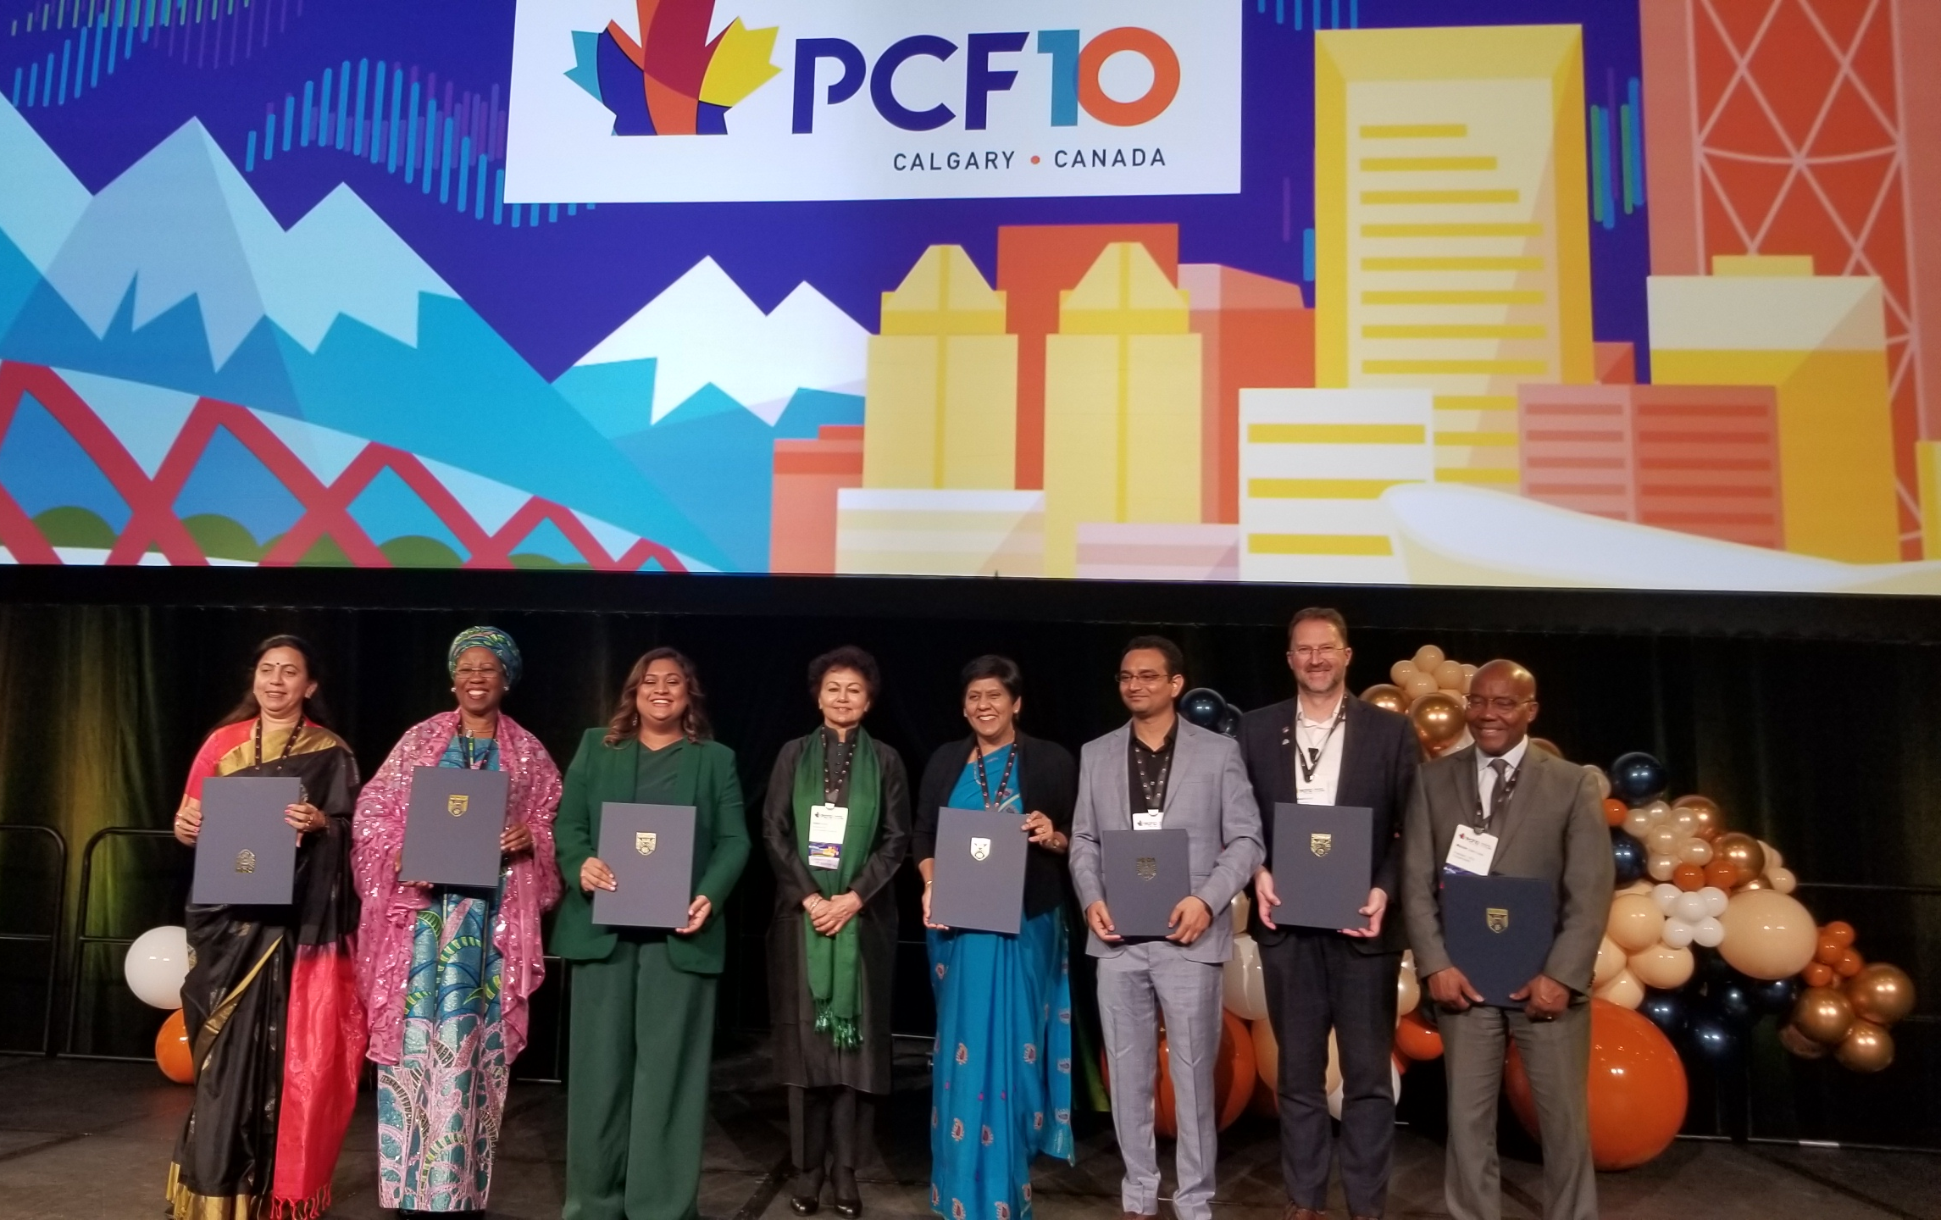
Conferment of COL Honorary Fellows & Excellence in Distance Education Awards

Slide 13


Slide 14
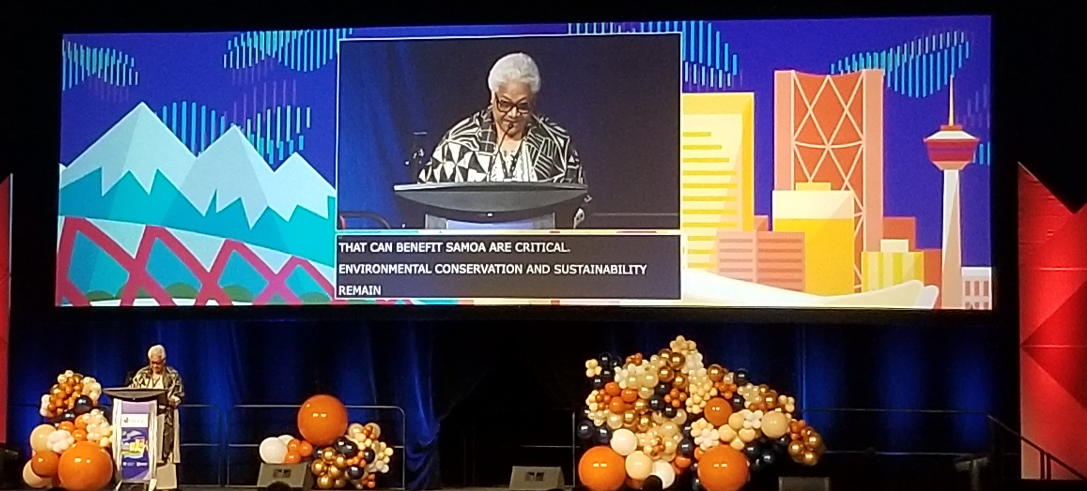
Inaugural Session

Slide 15
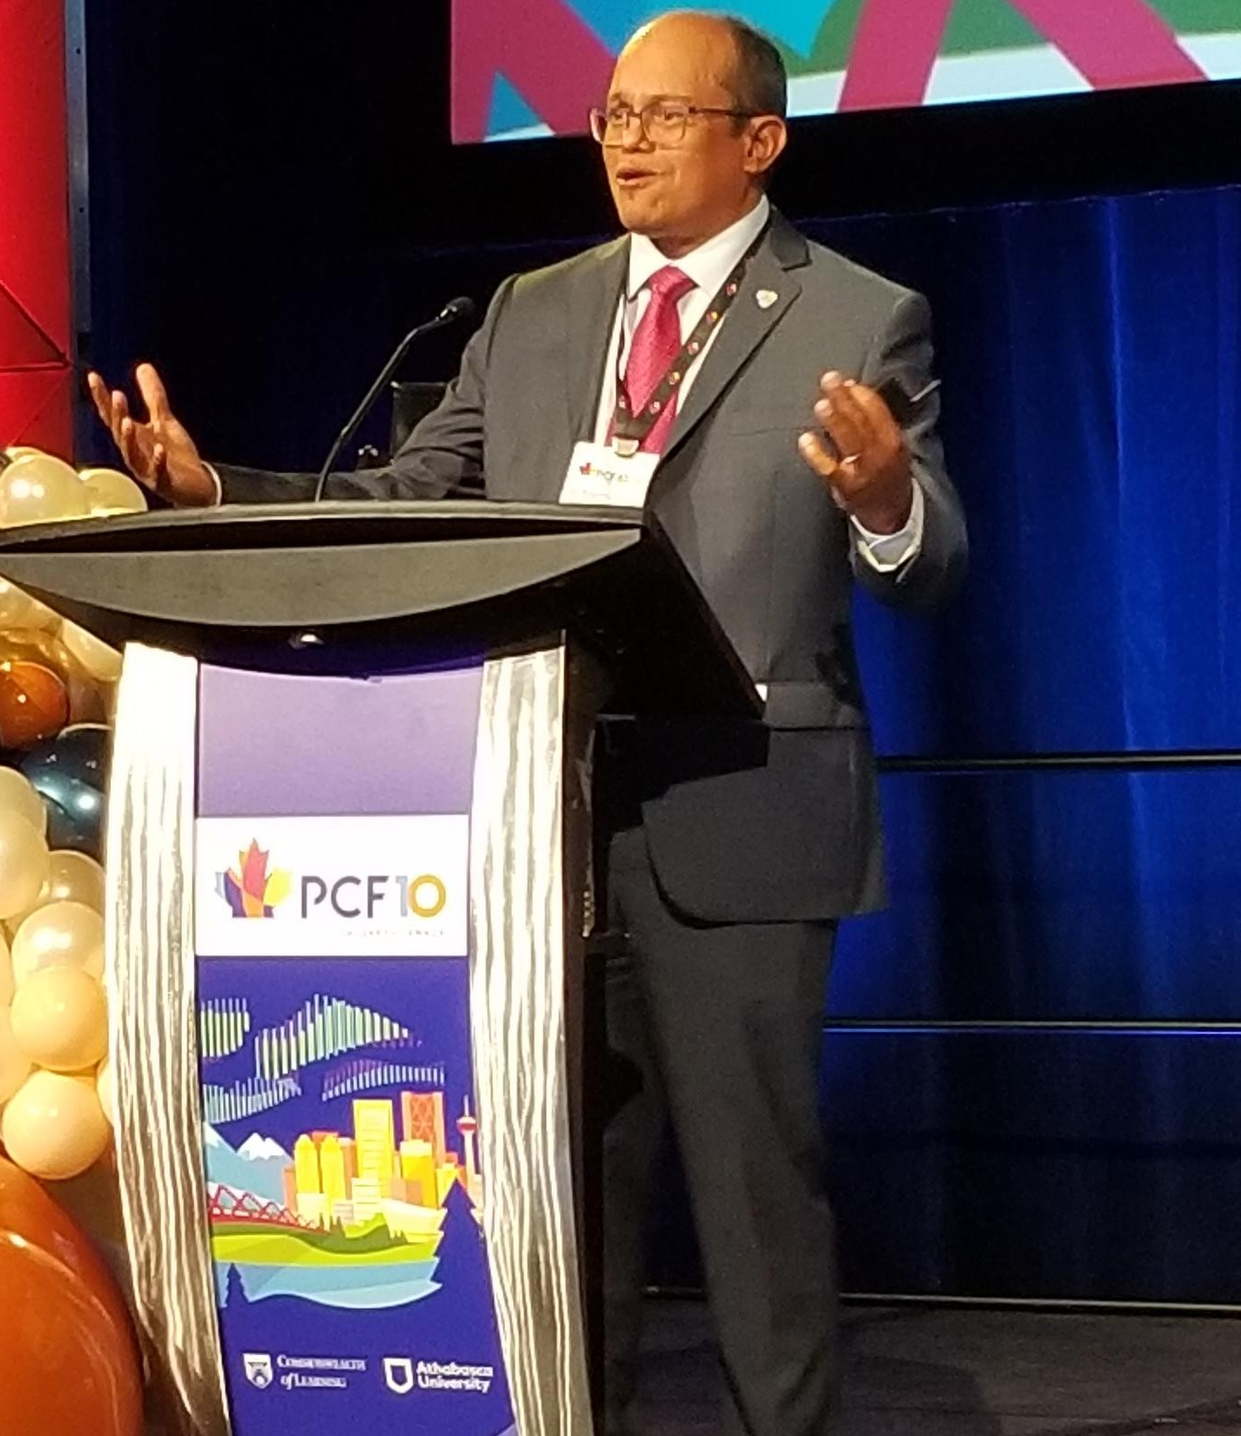
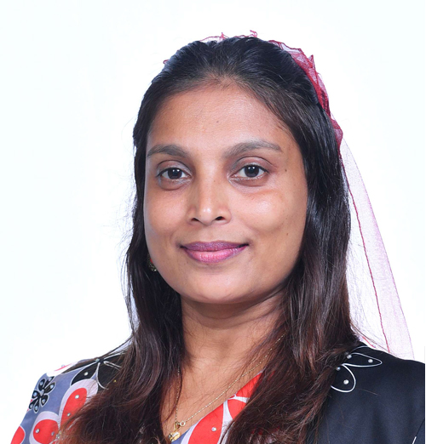
Keynote:
Building Resilience
Just like it takes a village to raise a child, it takes a village to build resilience
Dr. Rolph Payet, Executive Secretary, Basel Rotterdam and Stockholm Conventions
CHAIR
Hon. Dr. Aishath Ali, Minister,
Ministry of Education, Maldives

Slide 16
Building Resilience
HIGHLIGHTS
Political buy-in is critical for transforming the education sector
Focus on building institutional resilience by using ODL and emerging technologies
Build the resilience of students by developing 21st Century skills

Slide 17
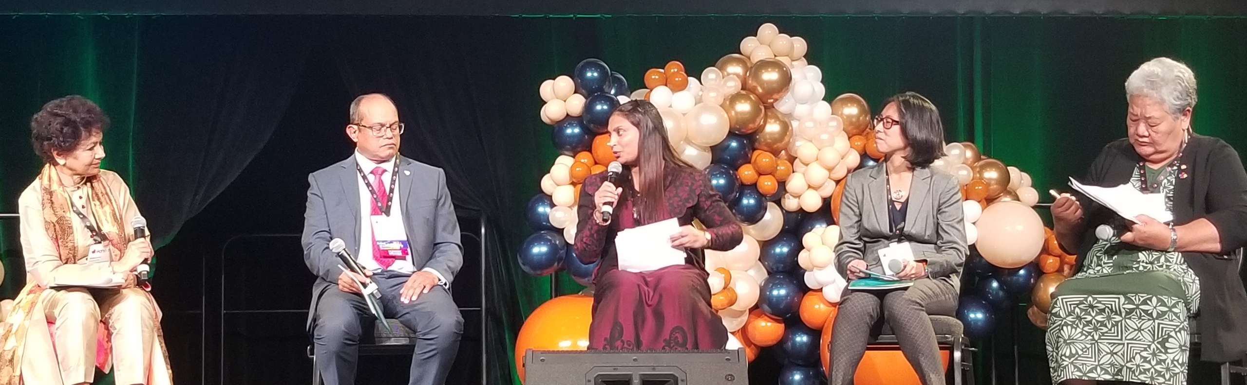
PANEL:
Transforming Education for Climate Change
Dr. Rolph Payet
Hon. Dr. Aishath Ali
Dr. Christina Kwauk
Peseta Noumea Simi
Moderated by
Professor Asha Kanwar

Slide 18
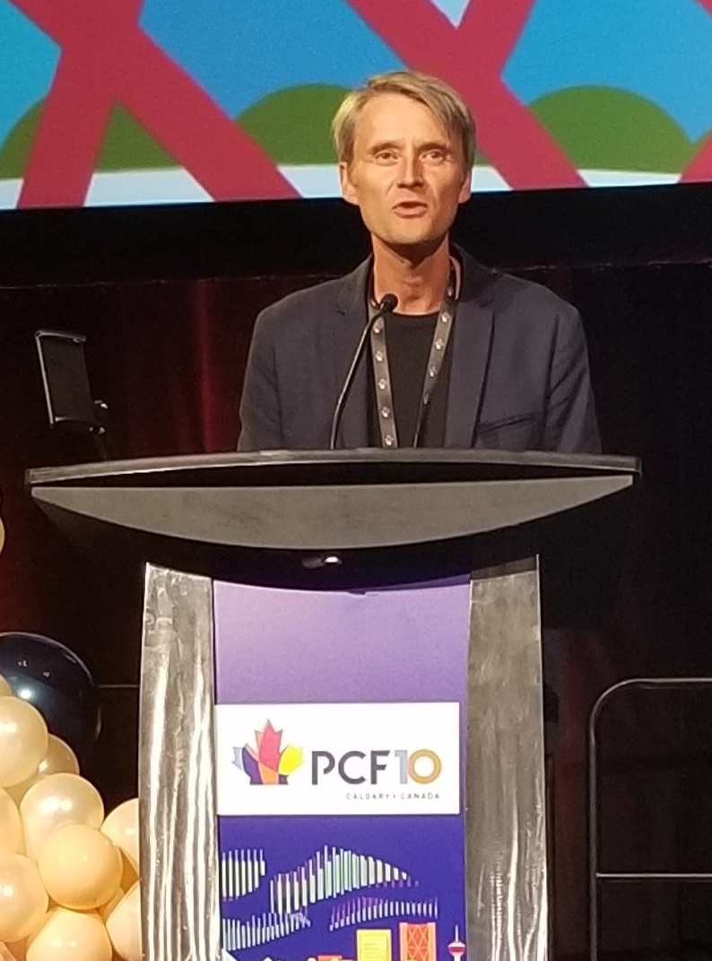
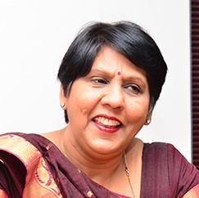
Keynote:
Fostering Lifelong Learning
getting the right mix of face-to-face and online asynchronous and synchronous modalities is essential to reach the target groups
Professor Olaf Zawacki-Richter, University of Oldenburg
CHAIR
Hon. Leela Devi Dookun Luchoomun, Vice Prime Minister and Minister of Education, Tertiary Education, Science and Technology, Republic of Mauritius

Slide 19
Fostering
Lifelong Learning
HIGHLIGHTS
Learn traditional lifelong learning practices from indigenous communities and integrate into formal systems
Implement the pathways between formal, non-formal and informal learning flexible and seamless
Implement strategies for skilling, re-skilling and up-skilling people for livelihoods within the spectrum of lifelong learning

Slide 20
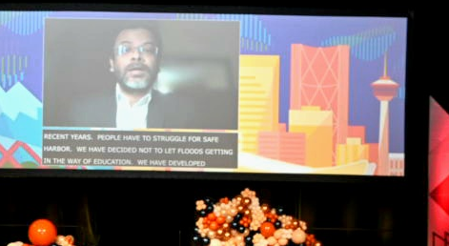
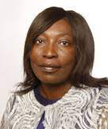
Keynote:
Inspiring
Innovations
I had seen our people struggle through floods and terrible cyclones, always picking themselves up and rebuilding their lives. This characteristics of resilience inspired me to design floating schools.... If the children can’t come to school… then the school should come to them by boat
Mr. Mohammed Rezwan
Founder and Executive Director, Shidhulai Swanirvar Sangstha, Bangladesh
CHAIR
Hon. Faustina Namutenya Caley, Deputy Minister, Advanced Education, Arts and Culture, Namibia

Slide 21
Inspiring Innovations
HIGHLIGHTS
Technology is an invention, but when it is domesticated to suit local contexts, it results in innovation
It is important to focus on ethics of innovation and its impact on lives of people
If we want to transform education system, we need innovation at scale

Slide 22
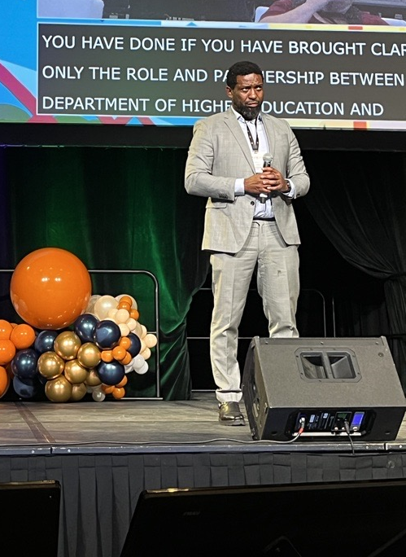
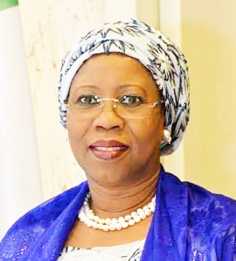
Keynote:
Promoting equity and inclusion
“…enhancing the capacity of previously disadvantaged academic institutions to contribute meaningfully to our nation’s human capital development needs and knowledge production priorities.”
Hon. Buti Kgwaridi Manamela, Deputy Minister of Higher Education, Science and Technology, South Africa
CHAIR
Hon. Mariam Yalwaji Katagum, Minister of State, Federal Ministry of Industry, Trade & Investment, Nigeria

Slide 23
Promoting equity and inclusion
HIGHLIGHTS
Policies that start with the margin are also more effective for the mainstream and the centre
Only targeted and tailored approach will help us reach the marginalised and unreached
Without equity and inclusion there can be no resilience

Slide 24
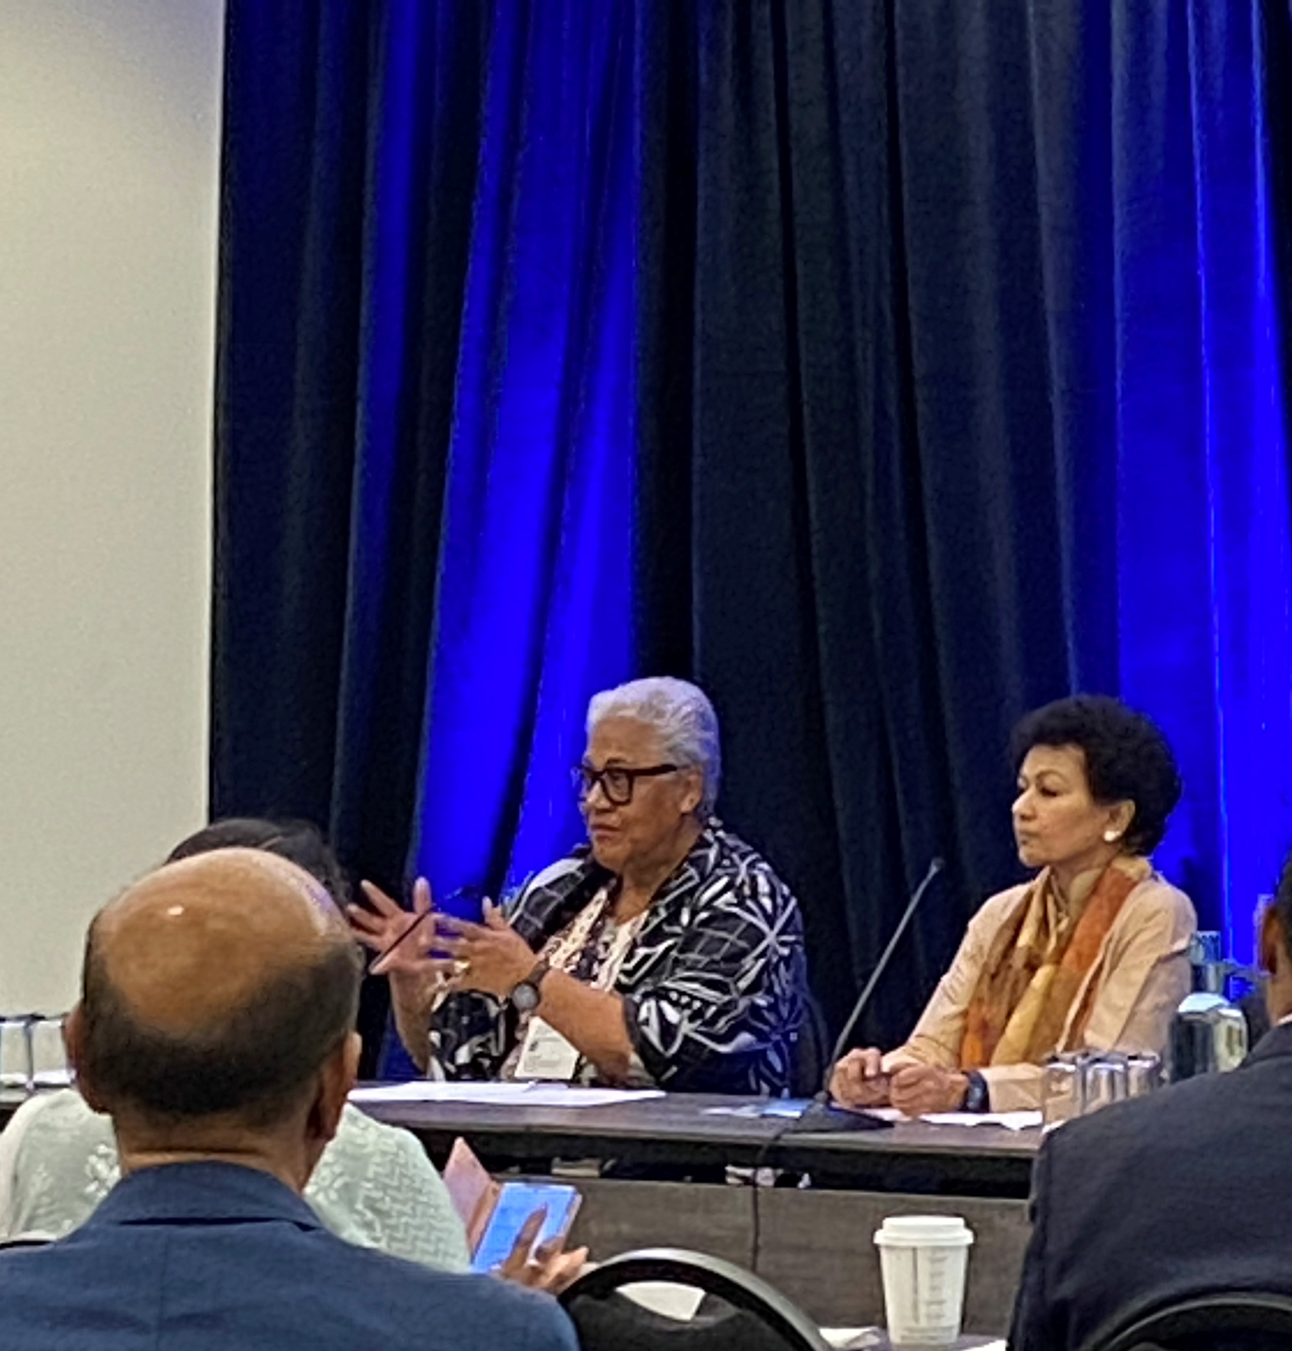
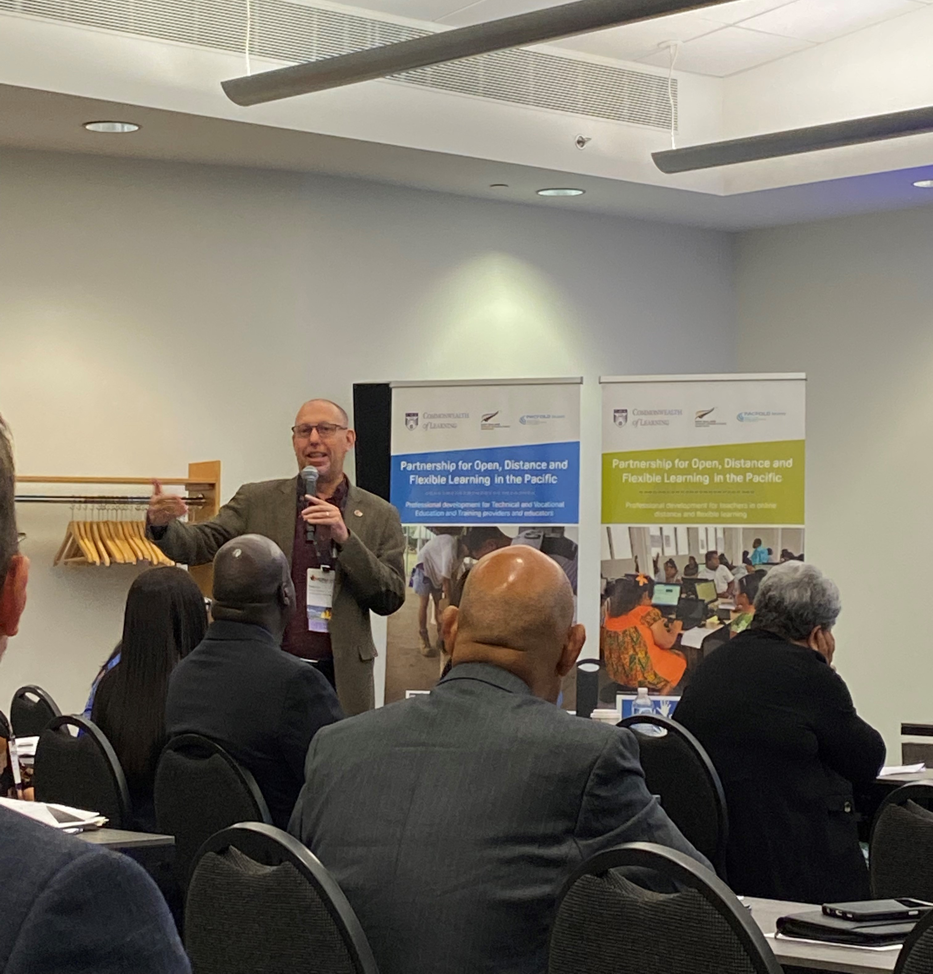
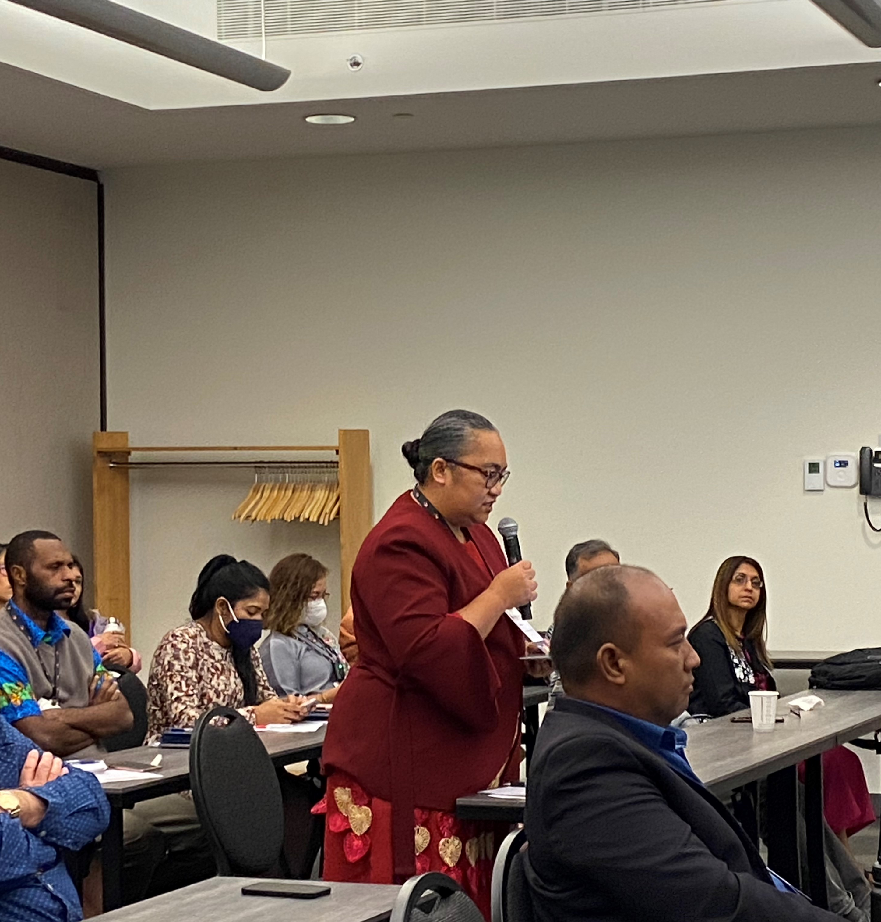
Panels and Workshops

Slide 25
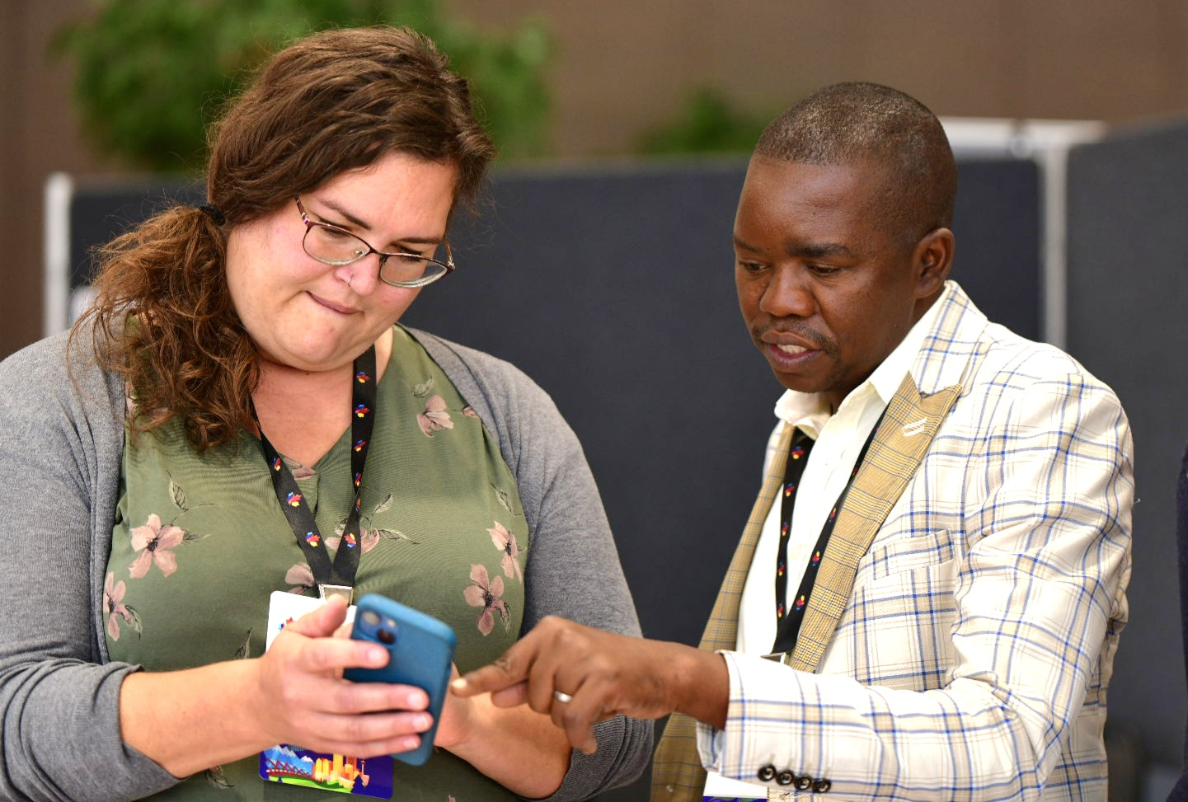
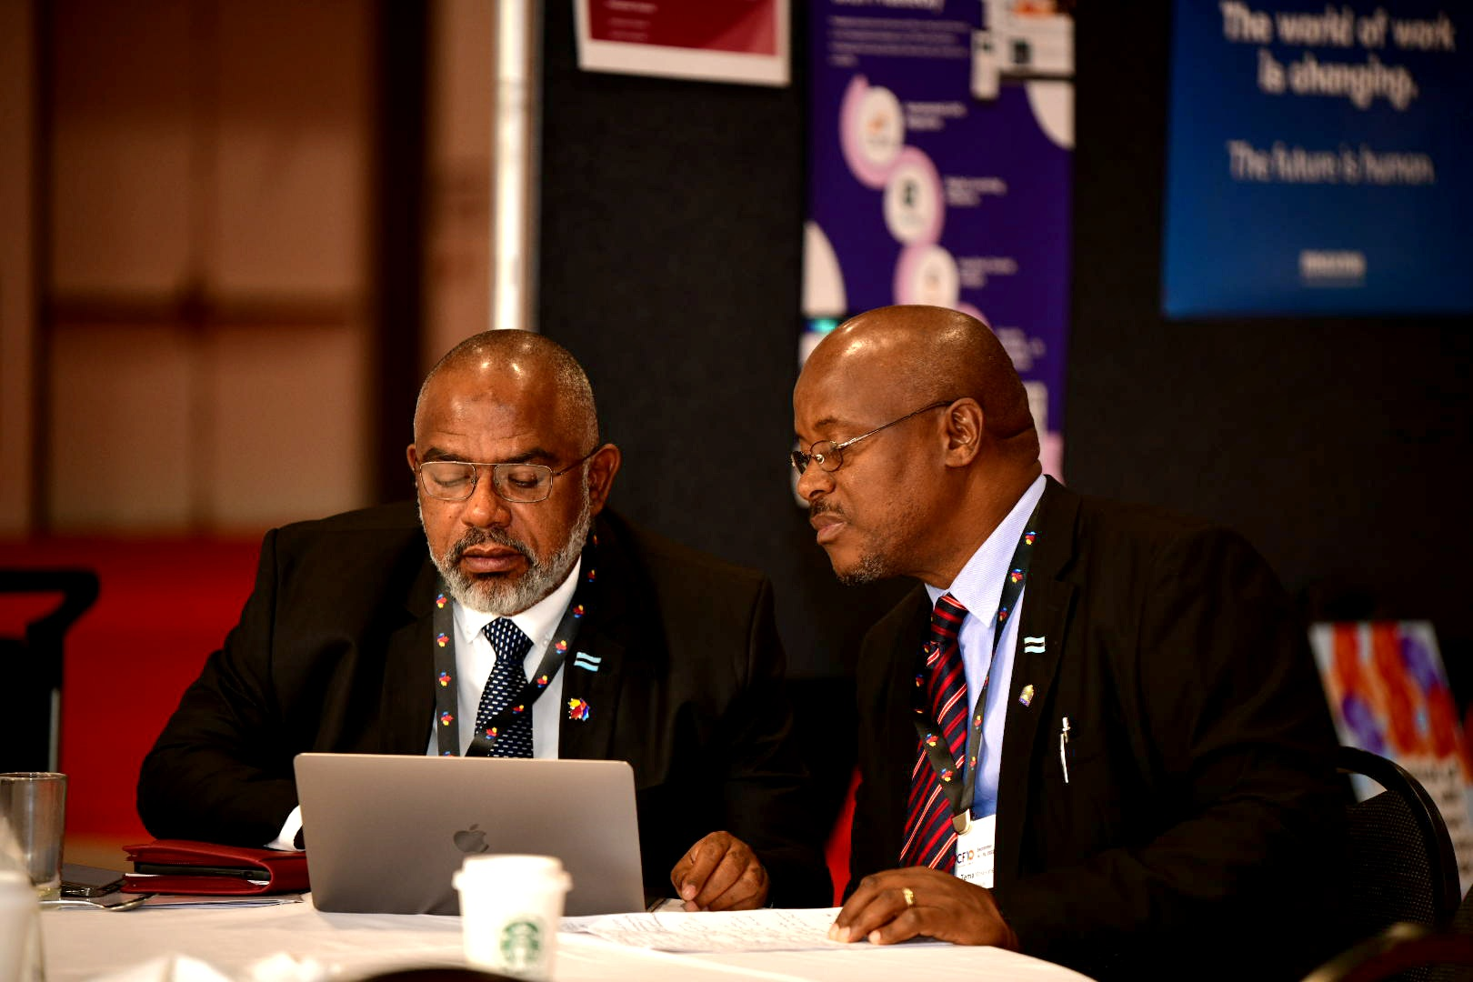
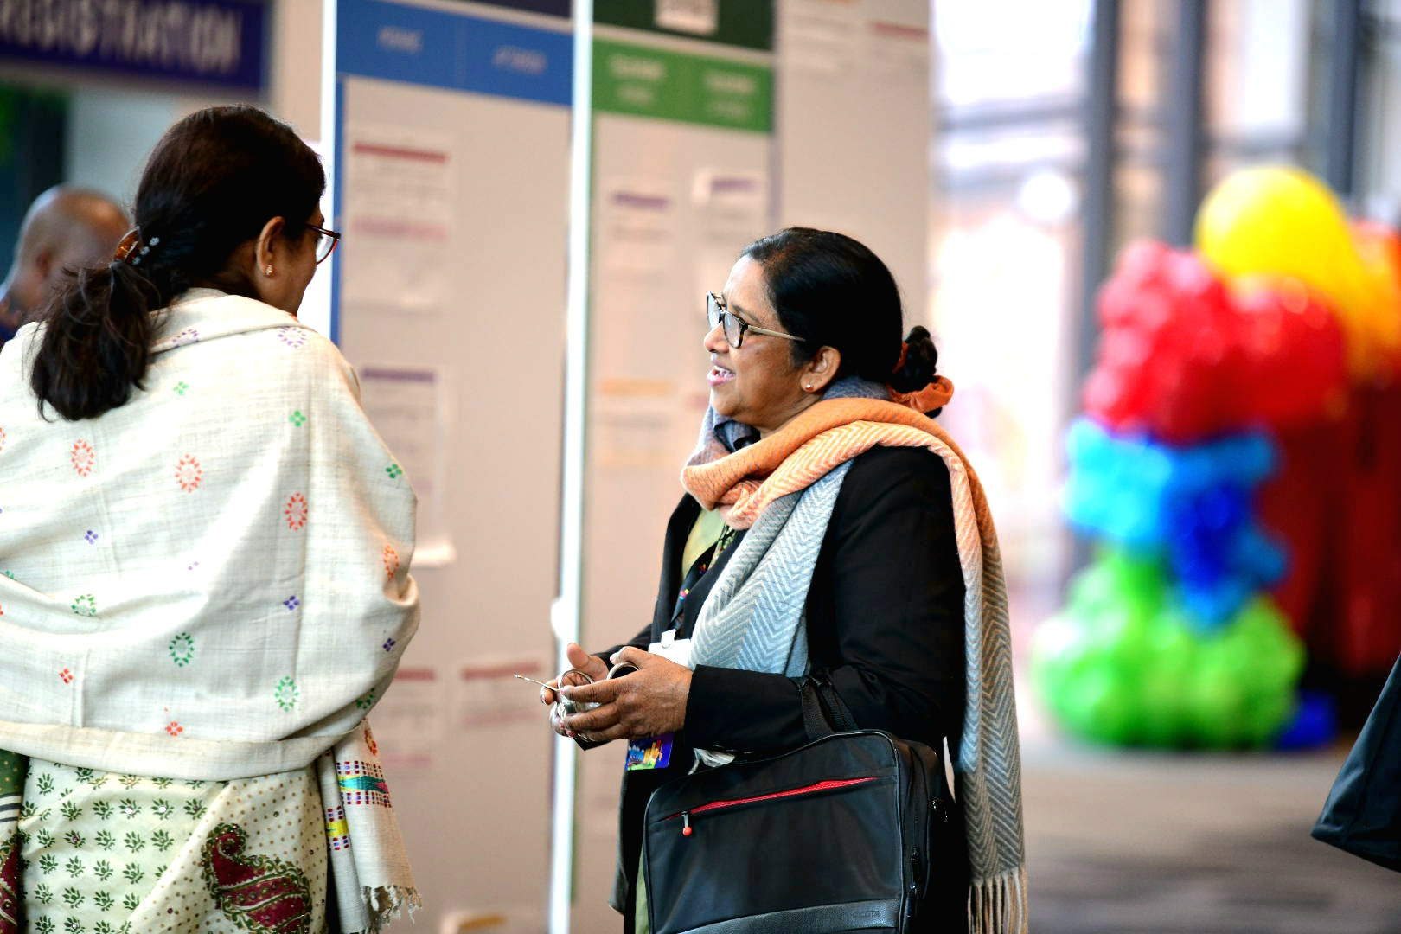
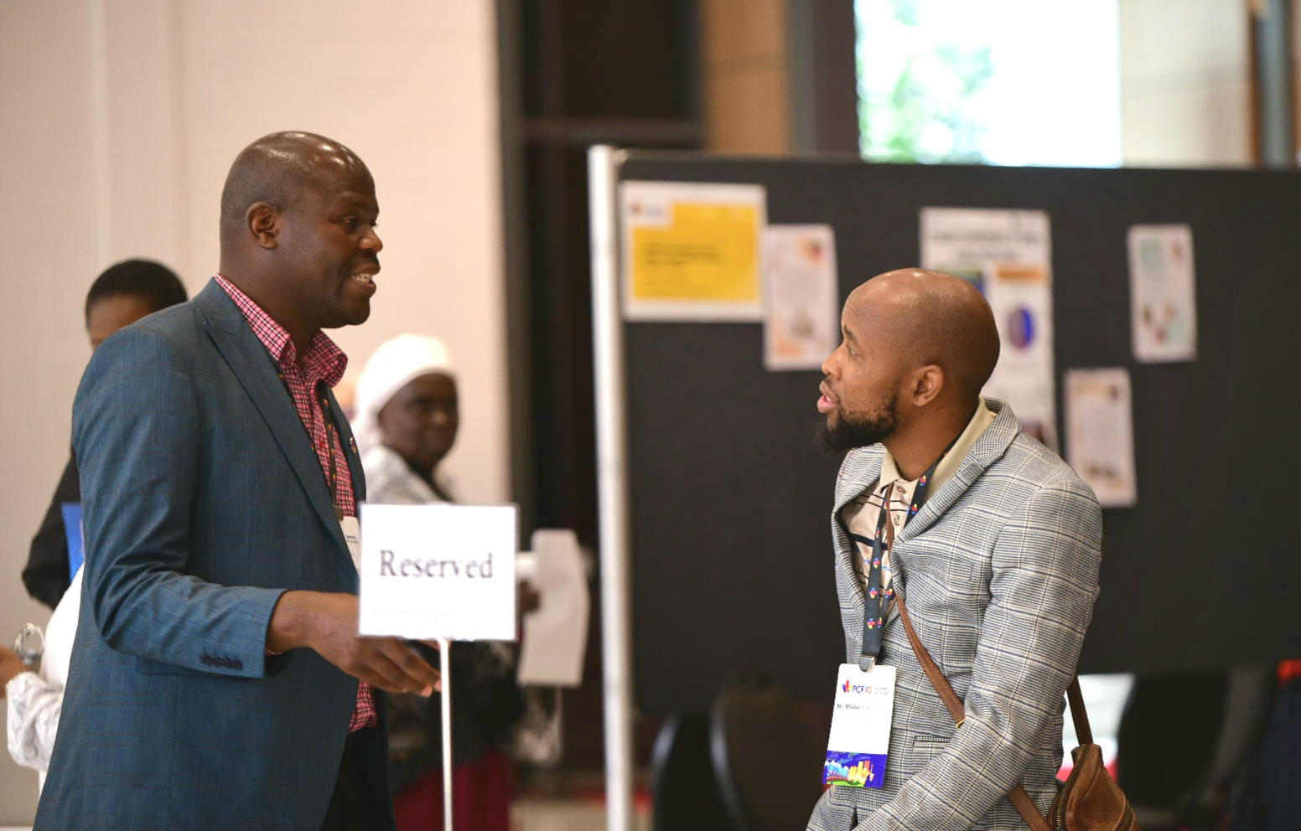
Poster Session
& Marketplace

Slide 26
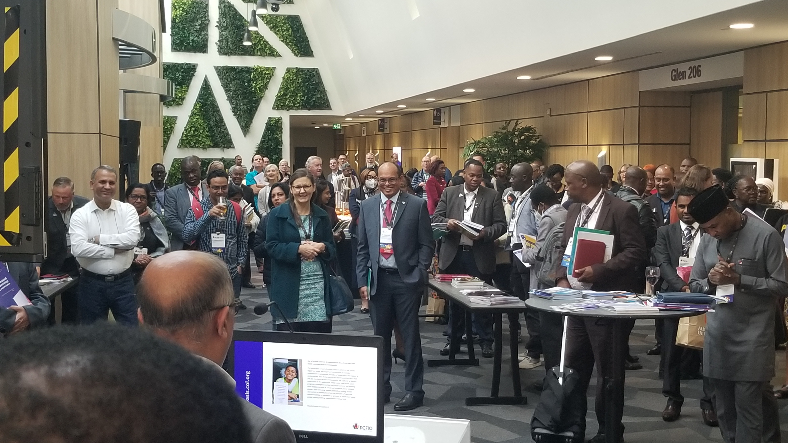
COL Publications Launch
Oasis.col.org

Slide 27
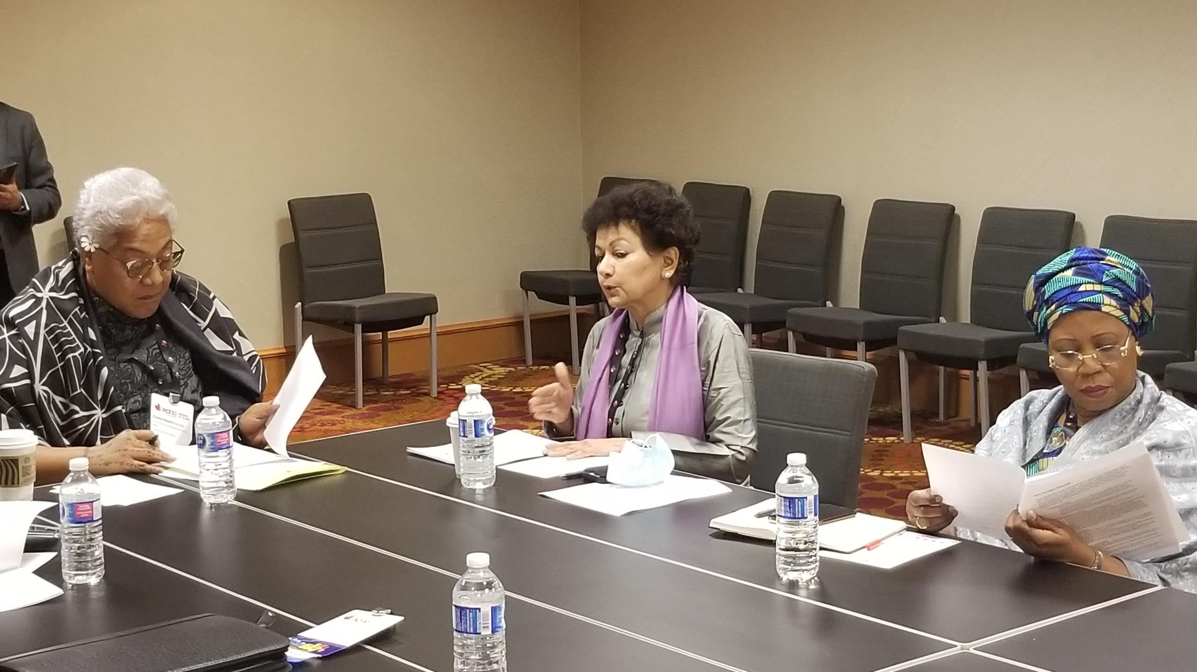
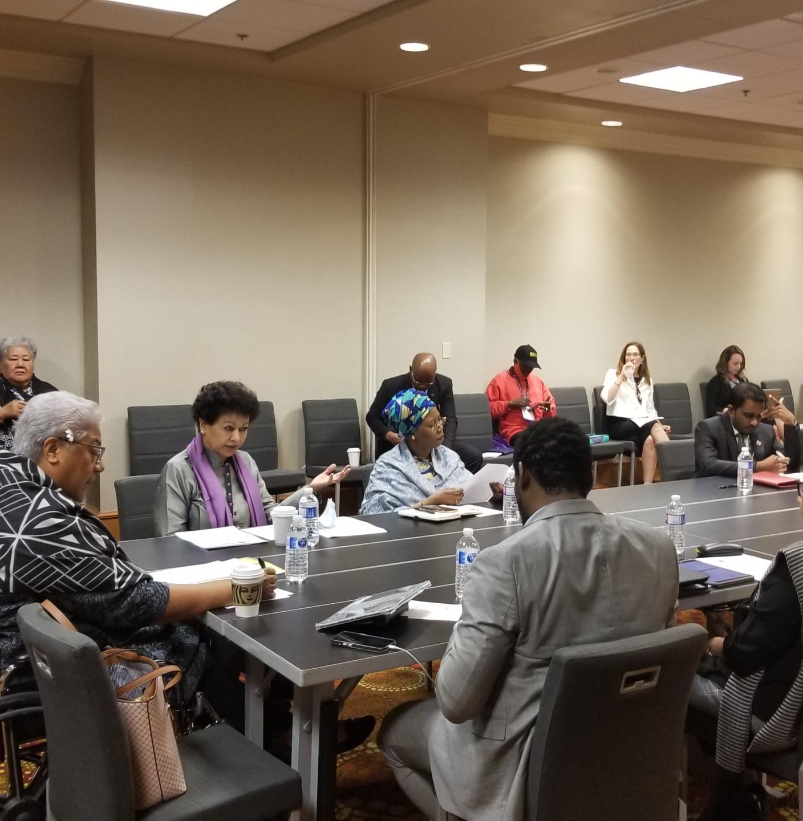
Ministerial Round Table

Slide 28

Calgary Communique

Slide 29
From PCF9 to PCF10
Disruption caused by Covid-19
Phenomenal increase in distance and online learning
The urgency of addressing Climate Change
Greater realization of transforming our system to make them more inclusive, especially for persons with disabilities
The role of parents and siblings has emerged as an important dimension of teaching and learning

Slide 30
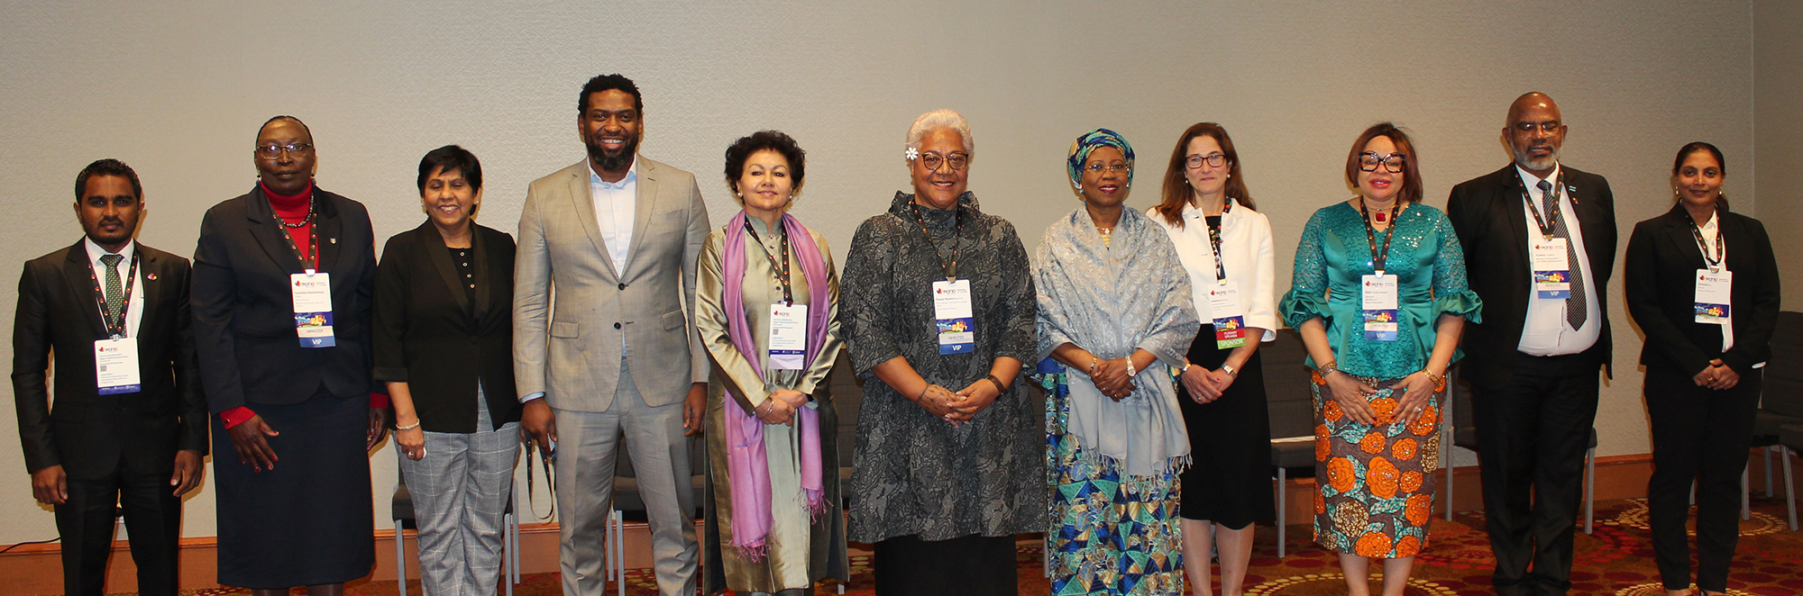
Thank you, Ministers

Slide 31


Sponsors

Slide 32
Thank you
and travel back safely

