Slide 1


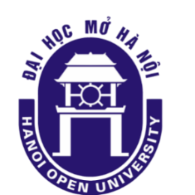

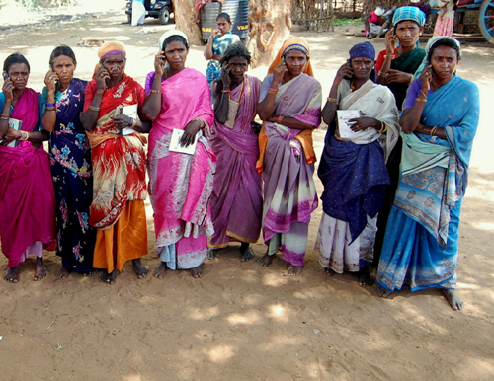


2
+
Human Resource
Development and Lifelong Learning for Open Universities
Professor Asha Kanwar President & CEO
Dr Sanjaya Mishra Education Specialist: eLearning
Asian Association of Open Universities Conference
24-26 October, 2018

Slide 2
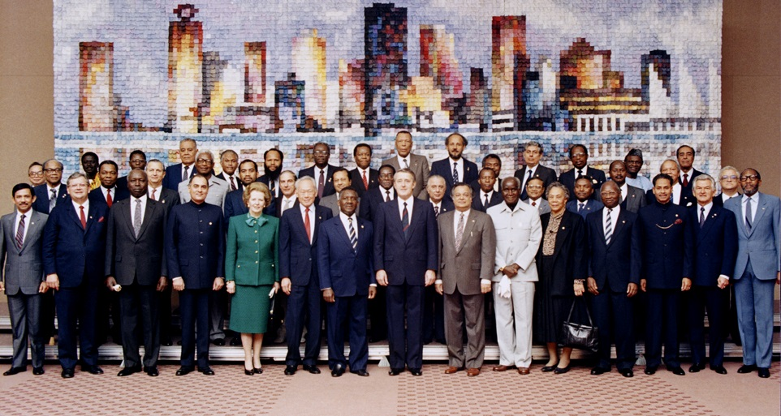
Commonwealth Heads of Government Meeting Vancouver, 1987
Notes:
We invite you to engage us; tap into our thought leadership, expertise, networks and resources

Slide 3

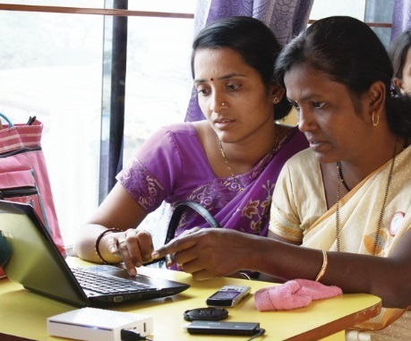
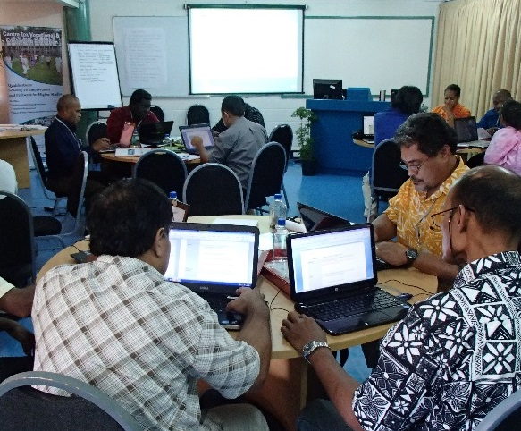
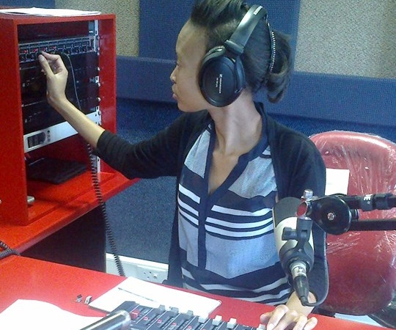
To help Commonwealth governments and institutions use technologies to improve and expand access to education and training

Slide 4

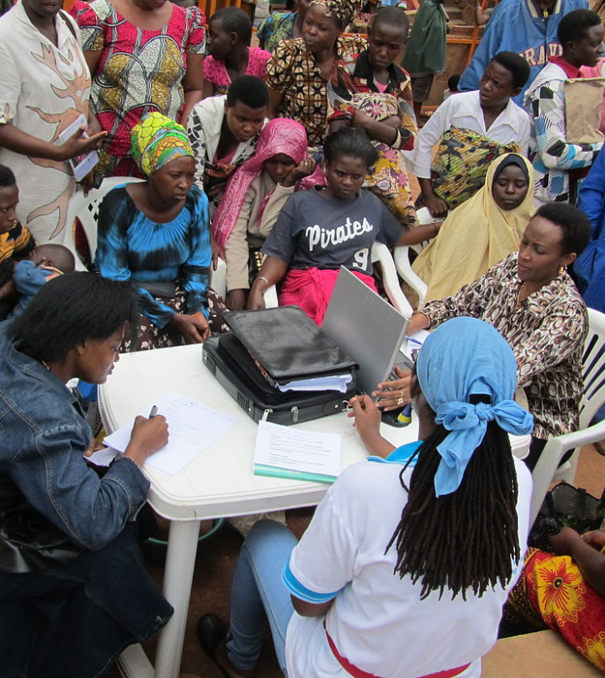
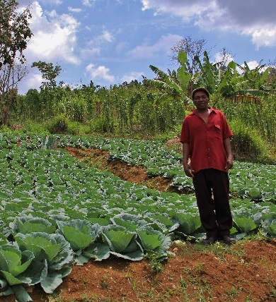



Learning for Sustainable Development
ECONOMIC
GROWTH
SOCIAL
INCLUSION
ENVIRONMENTAL CONSERVATION

Slide 5
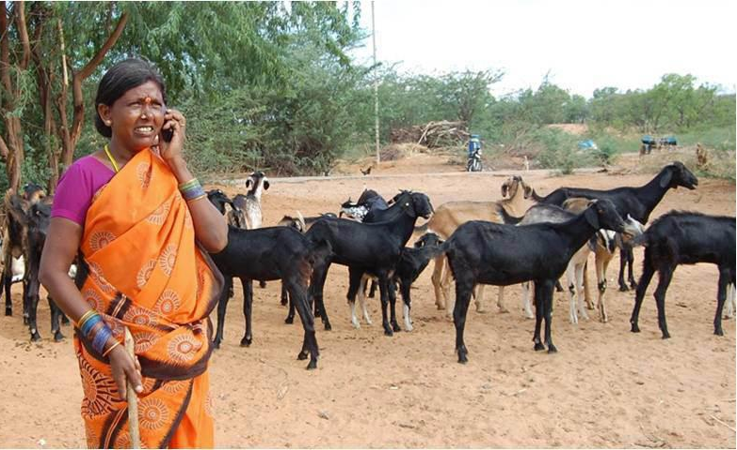
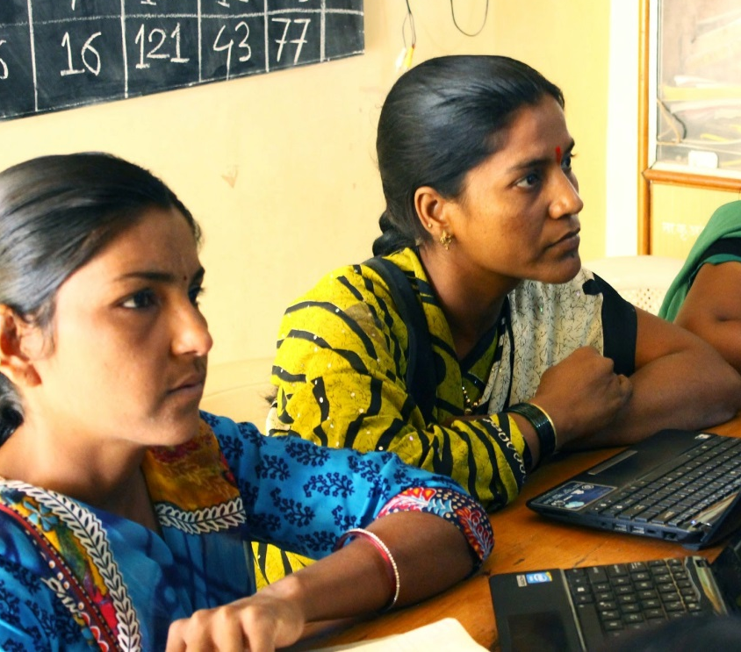
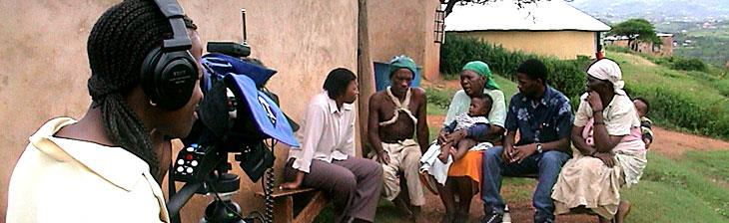
Leveraging New & Existing Technologies

Slide 6
Plan
Context
HRD in Asia
Lifelong Learning
Role of Open Universities
Road Ahead

Slide 7
Context

Slide 8
GER Tertiary Education- Global
Source: UNESCO Institute for Statistics, Retrieved on 12 October 2018.

Slide 9
Tertiary Education- East Asia and Pacific
Source: UNESCO Institute for Statistics, Retrieved on 12 October 2018.

Slide 10
Tertiary Education- South and West Asia
Source: UNESCO Institute for Statistics, Retrieved on 12 October 2018.

Slide 11
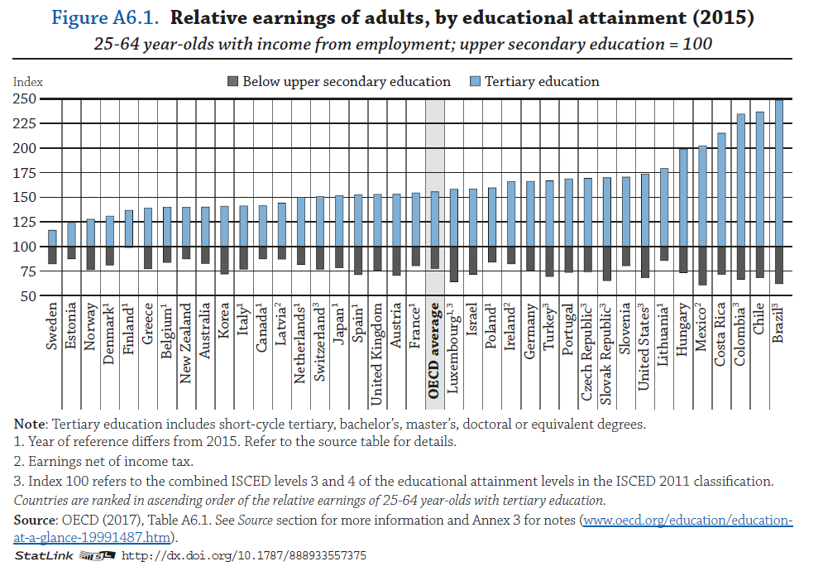
Graduate Premium

Slide 12



Countries with High GERs
93.26
88.34
57.29

Slide 13
Skills Shortage
‘Countries have skills shortages, not degree shortages’
Andreas Schleicher

Slide 14
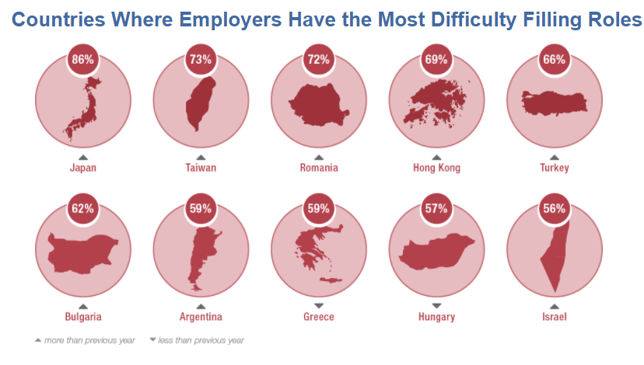
Skills Gap
Countries where employers have the most difficulty filling roles
Source: https://www.manpowergroup.com/talent-shortage-2016
Notes:
Employers are reporting difficulty in filling roles. a significant share of workers feel they are over- or under-educated for their jobs, while employers often lament a lack of qualified graduates.
A Manpower Group survey shows that 48% of employers had difficulty filling vacancies in Asia in 2015, compared to 28% in 2006.

Slide 15
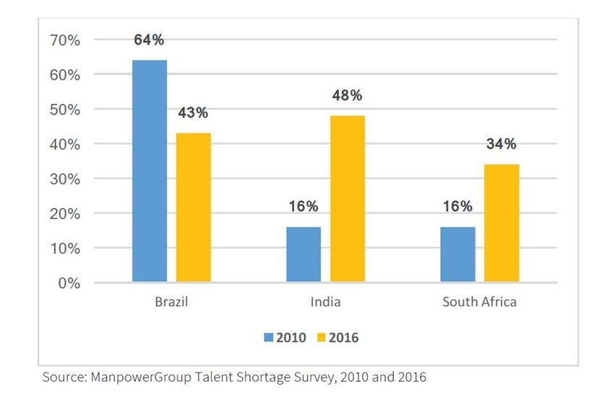
Employers with difficulty filling jobs
India
South Africa
Source: ManpowerGroup Talent Shortage Survey, 2010 and 2016 https://economicgraph.linkedin.com/research/skills-gap-or-signalling-gap page 28

Slide 16

Impact of Technology
The effect of today’s technology on tomorrow’s jobs will be immense
- The Economist
47% of today’s jobs could be automated in the next 20 years
- Oxford University Study
Notes:
http://www.economist.com/news/leaders/21594298-effect-todays-technology-tomorrows-jobs-will-be-immenseand-no-country-ready
Jan 18th , 2014
Source: http://www.oxfordmartin.ox.ac.uk/downloads/academic/The_Future_of_Employment.pdf

Slide 17
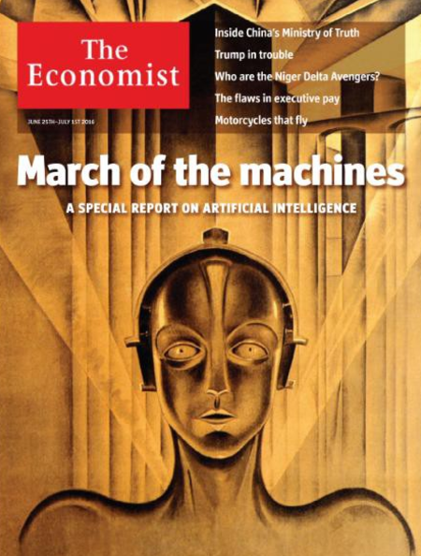
Re-educating Rita
Technological progress, and artificial intelligence in particular, will require big changes in the way education is delivered….
Automation could have a much bigger impact in developing economies …because much of what they provide is…embodied labour.
Notes:
Source: http://www.economist.com/news/special-report/21700760-artificial-intelligence-will-have-implications-policymakers-education-welfare-and

Slide 18
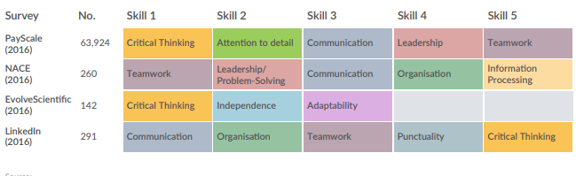
Skills in Demand
Source: http://www.reimagine-education.com/wp-content/uploads/2018/01/RE_White-Paper_Global-Skills-Gap-Employability.pdf
Notes:
Critical thinking, communication, leadership and teamwork

Slide 19
Human Resource Development Asia

Slide 20
Link between GDP and work
Growth will slow down, except for India (7.4%) and China (6.6%), to 1.9% in Asia-Pacific
Labour market will also slow down
Employers find it harder to attract and retain workers
Increased vacancies due to gap between skills required by industry and produced by universities
Source: The Hays Global Skill Index 2018 - Investing in the skills of tomorrow; Avoiding a spiralling skills crisis

Slide 21
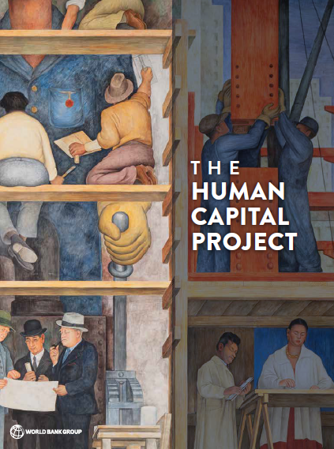
Human Capital in Asia
Asian countries top World Bank “human capital index” – a measure of youth mortality, schooling and health.
Singapore tops: universal healthcare, education results and life expectancy figures.
Top five include South Korea, Japan, Hong Kong.
Increasing health and education investment could double lifetime earnings.
Source: The Guardian - Asian countries dominate World Bank's new index of investment in 'human capital

Slide 22
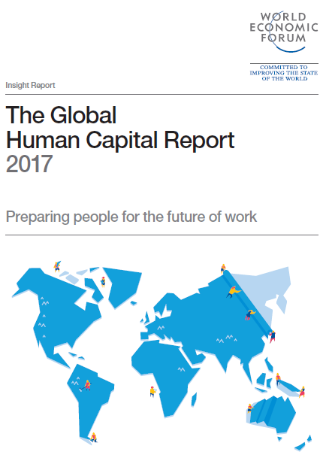
East Asia
Singapore, Japan , Korea, Rep. strongholds of human capital success,
Vietnam , Indonesia have made remarkable progress in educational attainment
Malaysia has strong scores in Capacity, Development and Know-how.
Source: http://www3.weforum.org/docs/WEF_Global_Human_Capital_Report_2017.pdf
Notes:
while countries such as Lao PDR (84), Myanmar (89) and Cambodia (92) trail the region despite their very high degree of human capital utilization across the Deployment subindex. By contrast, ASEAN economies such as Thailand (40) are managing to complement high Deployment scores with skill-intensive utilization of their human capital potential as evidenced by its strong performance on the Know-how subindex.

Slide 23
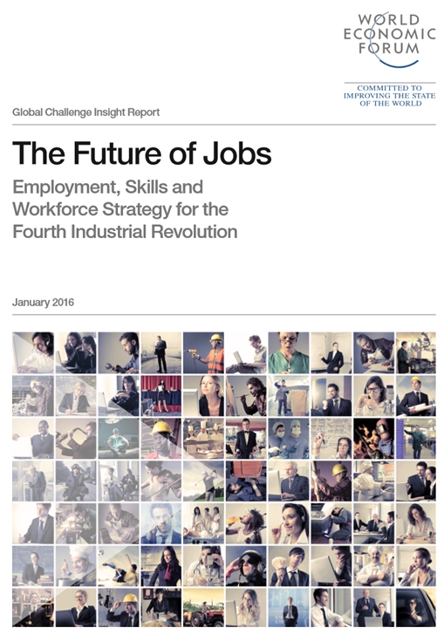
Future of Jobs
Sixty-five per cent children entering primary school today will ultimately end up working in completely new job types that don’t yet exist

Slide 24
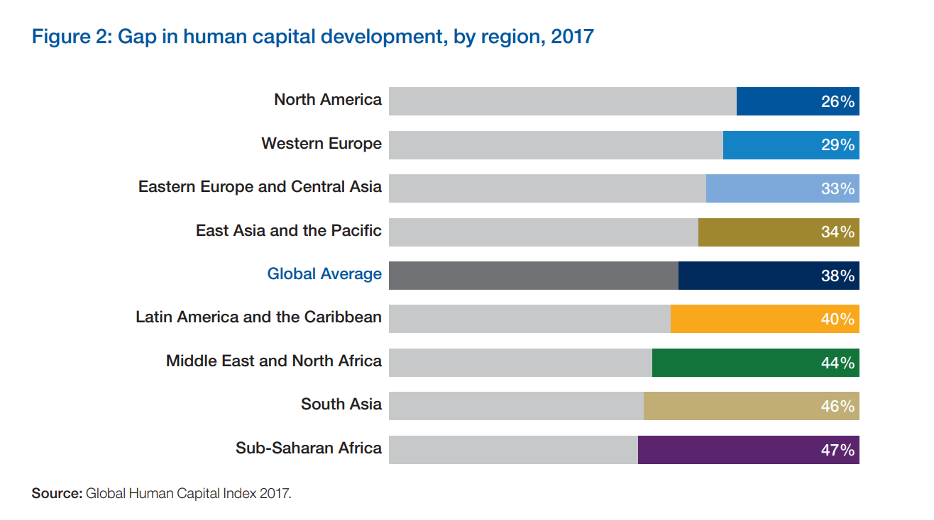
Preparing people for the future of work
Gap in human capital development, by region, 2017
Source: http://www3.weforum.org/docs/WEF_Global_Human_Capital_Report_2017.pdf

Slide 25
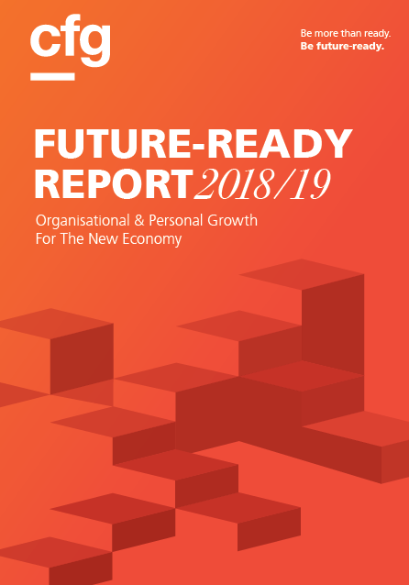
What kind of HRD for Millennials?
Purpose: meaningful work that they can connect easily
Growth: supporting environment
Well-being: flexibility of when and where to work
Trust: transparent leadership and open communication for employees to feel engaged and valued
Source: https://www.ey.com/Publication/vwLUAssets/EY-global-generations-a-global-study-on-work-life-challenges-across-generations/$FILE/EY-global-generations-a-global-study-on-work-life-challenges-across-generations.pdf
Notes:
Millennial will comprise will comprise three-quarters of the global workforce by 2025. According to the Future Ready Report 2019/19, National University of Singapore, “work in the 4th industrial revolution will be ‘fluid and boundary-less’, where individuals transition between employment, studying or upgrading their skillsets, taking a vacation or sabbatical, and even running their own businesses. Staying at a job for a long time may not be in line with their family and lifestyle goals; and organisations have to adapt to this change.” Millennials are looking towards workplace culture of “Purpose”, “Growth”, “Well-being”, and “Trust”

Slide 26
Strategic Human Resource Development
People focused approach for national development
Human resources viewed as capital needed for economic growth
Proactive system to prepare people for change
Preparing people for the future
Source: https://www.researchgate.net/publication/243999843_The_emergence_of_strategic_human_resource_development

Slide 27
From Human Resource to Human Capital
Production Economy
Knowledge Economy
Human resource as tools or facility
Development of skills through training
Focus is on optimizing use
Reactive
Human resource as value creation
Investing in people to create capital
Focus is on increasing ‘worth’
Proactive

Slide 28

“The Future Of Your Career Depends On Lifelong Learning”
https://www.forbes.com/sites/schoolboard/2017/10/09/the-future-of-your-career-depends-on-lifelong-learning/#4f8aaada1bd7
“Average human knowledge is doubling every 13 months, and IBM predicts that in the next couple of years, the volume of information will double every 11 hours.”

Slide 29
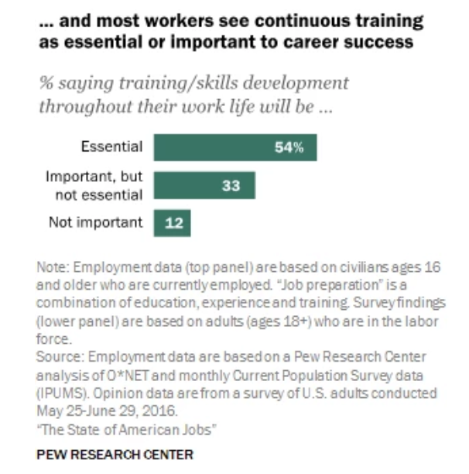
In USA
Source: http://www.pewsocialtrends.org/2016/10/06/the-state-of-american-jobs/st_2016-10-06_jobs-01/

Slide 30
Lifelong Learning

Slide 31
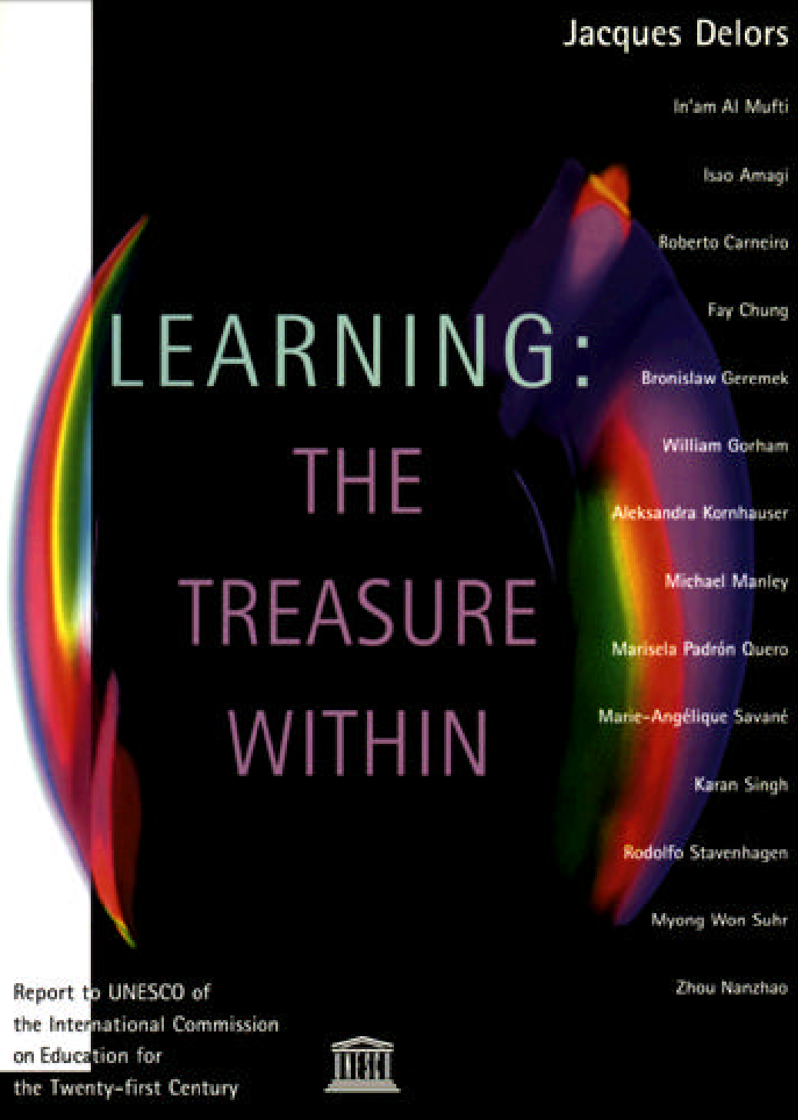
Lifelong Learning means
… shifting to learner-centric approaches, the need for self-directed learning and the view that learning can take place in a variety of settings and contexts.
Notes:
The Edgar Faure report spoke of ‘Lifelong Education’ in the 70’s while twenty years later, the Jacques Delors Report made the transition to ‘Lifelong Learning’. In the last four decades, we can see the shift to learner centric approaches, and the view that learning can take place in a variety of settings and contexts. The spectrum of lifelong learning includes the formal, non-formal and informal sectors.

Slide 32
Integration of Three Approaches
Andragogy
Pedagogy
Heutagogy
Notes:
Pedagogy: science of teaching and learning
Andragogy: how adults learn
Heutagogy: self-determined learning
Lifelong learning is a complex process that integrates all the three approaches and include pedagogy to andragogy and heutagogy.

Slide 33
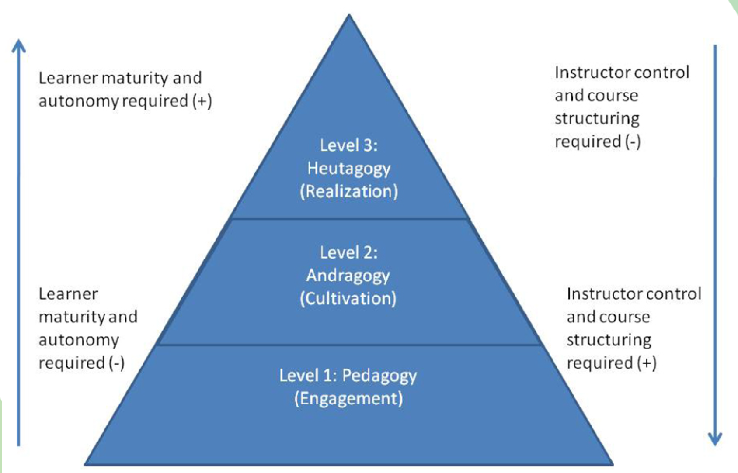
Three Levels
Source: http://www.irrodl.org/index.php/irrodl/article/viewFile/1076/2113
Notes:
Lifelong learning operates at three levels: (i) where there is high teacher control. (ii) self directed and (iii) self-determined, as progression of increased learner control and autonomy. Thus, having implications for course and programme design for lifelong learning.

Slide 34
Heutagogy in Practice
Nursing, engineering and education professions found heutagogy a credible response to the critical issues that the learners are faced with
The University of Western Sydney has implemented the heutagogical approach for teacher education
Heutagogical approach in three HEIs in the UK have led to reflective learning with learners demonstrating capacity and capability.

Slide 35
Implementing Lifelong Learning
Leaner defined outcomes
Flexible curriculum to match individual learner needs
Learner directed discussions and questions
Flexible assessment, including assessment of prior learning
Collaborative learning

Slide 36

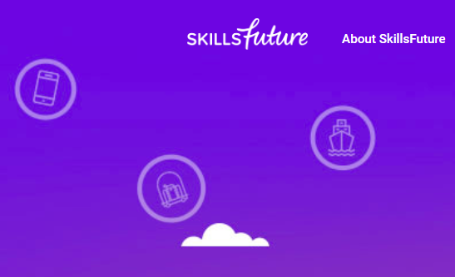
Lifelong Learning in Practice: Singapore
Lifelong learning policy (2015)
SkillsFuture
All Singaporeans aged 25 and above will receive an opening credit of S$500 from January 2016
Notes:
The SkillsFuture initiative in Singapore helps individuals make well-informed choices in education, training and careers; supports an integrated high-quality system of education and training that responds to constantly evolving needs; promote employer recognition and career development based on skills and mastery; and fosters a culture that supports and celebrates lifelong learning. Within the project every Singaporean aged 25 and above received S$500 credit for lifelong learning in designated courses for skills upgradation.

Slide 37

Lifelong Learning in OUs
" To widen access to quality education and provide lifelong learning opportunities by leveraging on technology… providing a conducive…learning environment at…affordable cost "
Source: http://www.oum.edu.my/?q=node/1

Slide 38

Lifelong Learning in OUs
Sukhothai Thammathirat Open University aims to be a world-class open university utilizing a distance education system to provide lifelong learning for all.
Source: http://www.stou.ac.th/Eng/Vision.aspx

Slide 39

Lifelong Learning in OUs
"To enhance access to high quality, affordable and relevant education …and ensure lifelong learning opportunities to face challenges in a knowledge society."
Source: http://www.ou.ac.lk/home/index.php/2013-12-19-09-04-42/introducing-ousl

Slide 40
Lifelong Learning is essential for human resource development and preparing for the future

Slide 41
Role of Open Universities

Slide 42
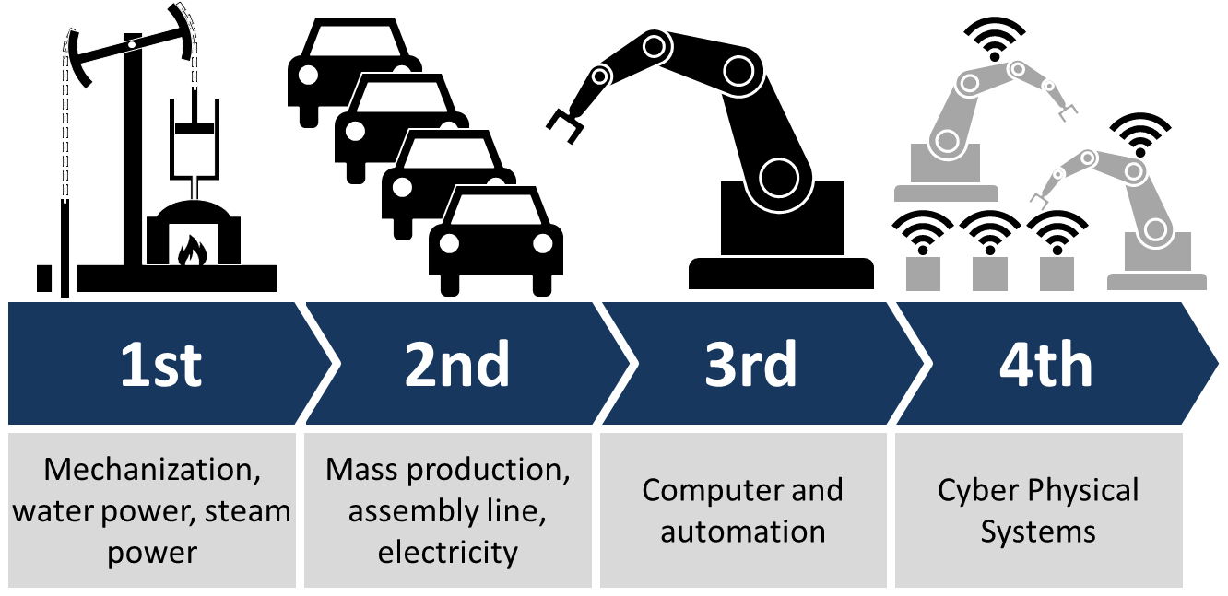
Fourth Industrial Revolution
CC BY-SA Source: https://commons.wikimedia.org/wiki/File:Industry_4.0.png (User:ChristophRoser)

Slide 43

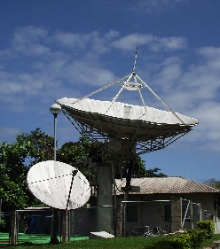
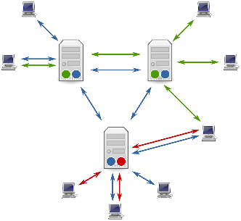

ODL in the Four Stages
From elite to mass
Correspondence model
Multi-media model
Intelligent flexible learning model
Gen 1
Gen 2
Gen 3
Gen 4
Notes:
CC BY-SA by David Right https://commons.wikimedia.org/wiki/File:E_II_R_Postbox,_Burgate,_Barton_Upon_Humber_-_geograph.org.uk_-_1064916.jpg

Slide 44
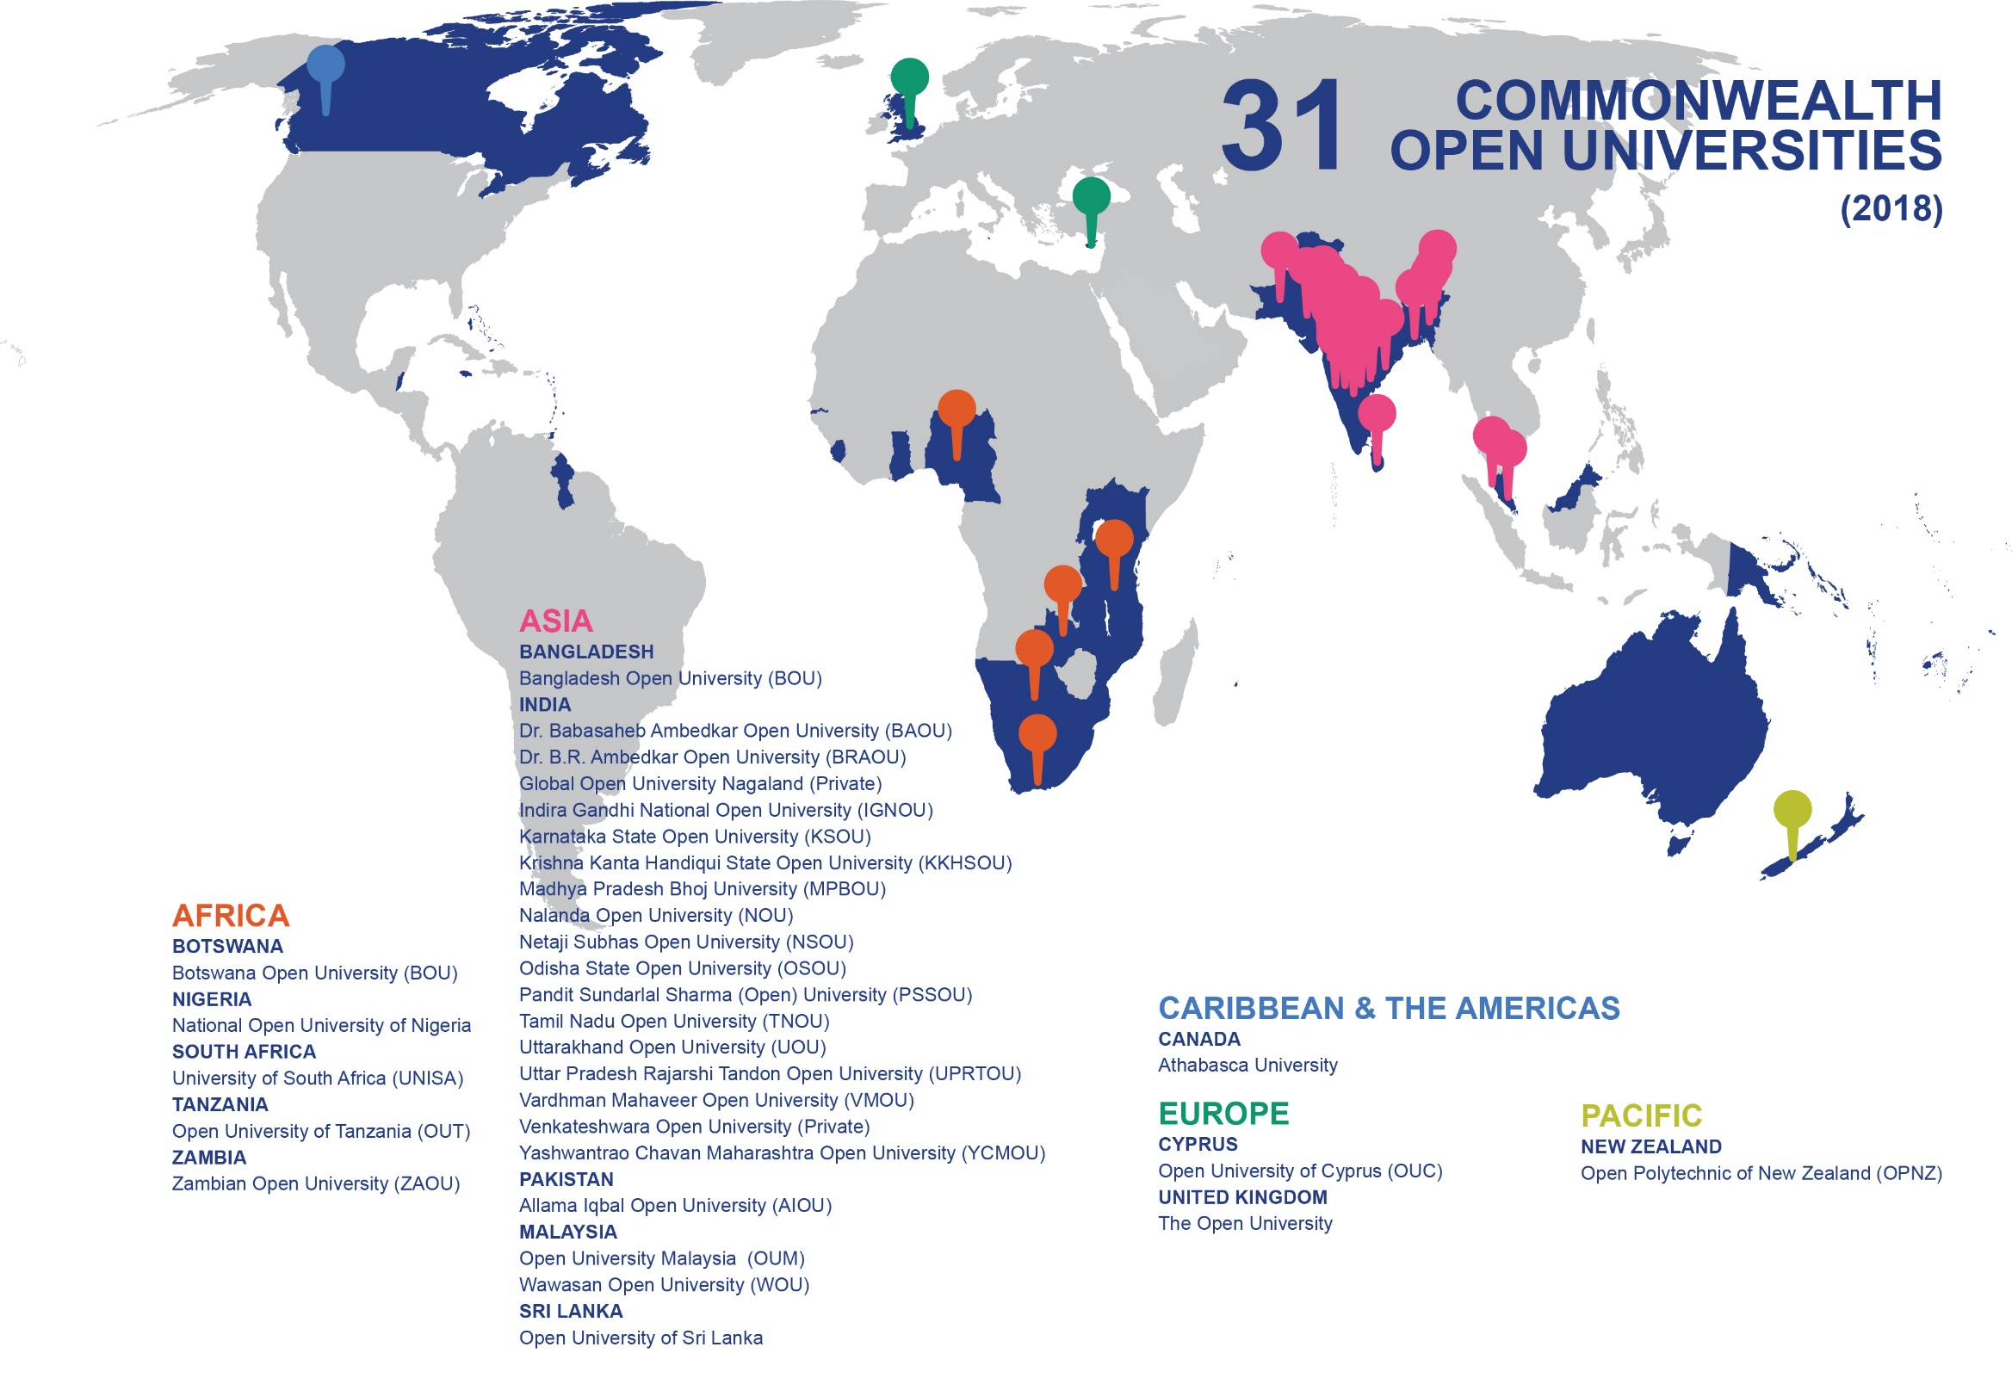

Slide 45
Strengths of Open Universities
Focus on social justice agenda
Expertise in technology use in education
Expertise in adult learning and material production
Innovation as open to new ideas
Caters to all level of education, including non-formal education

Slide 46
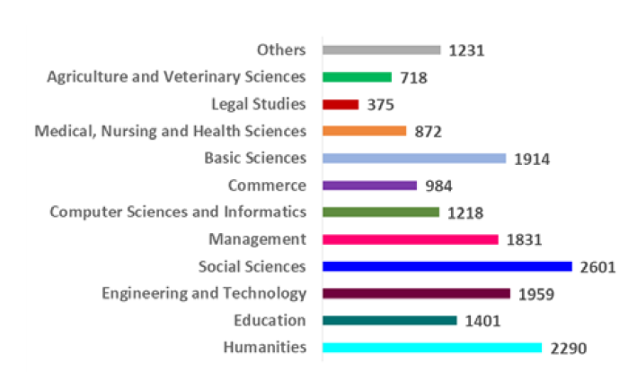
What Courses do we Offer?
Source: Open Universities in the Commonwealth: At a Glance.
Notes:
The Open Universities in the Commonwealth report indicated that 27 Open Universities offer over 18,000 courses. Of these, over 26% courses are in social sciences and humanities. But the range of courses offered include Agriculture, Health Science, Computer Science, Engineering and Technology etc.

Slide 47
Impact of ODL on Development
mission statements of 12 major open universities focus on: access, equity, equality, democratization, social justice, transforming society, with an emphasis on development;
“nowhere is there proposed a theoretical and substantive understanding of what [human] development is, or how it works, nor …what should be done in terms of curriculum and pedagogy to support such aims” (Tait, 2014, p.8).
Source: http://www.irrodl.org/index.php/irrodl/article/view/1526
Notes:
“the development of distance education models, including massive open online courses [MOOCs]), very few studies show how these changes have impacted development”.

Slide 48
Innovations for Lifelong Learning?
Emerging | Current
MOOC/Blended learning | Classroom/Lecture
Blockchain | Accreditation authority/ Degree mills?
Micro-credentials/Badges | Degree?
Open Education/OER | For-profit colleges/ copyrighted course materials?

Slide 49


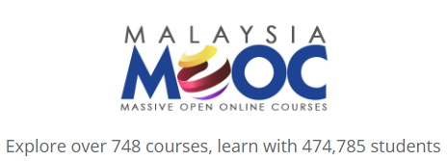


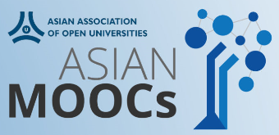
Asian MOOC initiatives
Major MOOC initiatives in China, India, Japan, Korea, Malaysia
Thousands of courses available in Asian languages: Chinese, Japanese, Korean, Thai
AAOU MOOC initiative
for members
Notes:
AAOU MOOC or Asian MOOCs are open online courses offered by member institutions of Asian Association of Open Universities (AAOU). Asian MOOCs serves as a portal for the Massive Open Online Courses (MOOCs) focusing on Open Enrollment, Massive Registration, Learner-Centered, Flexible, Multilingual, Multimedia support, Multi-platforms, Open License, and Quality Assurance of online courses.

Slide 50
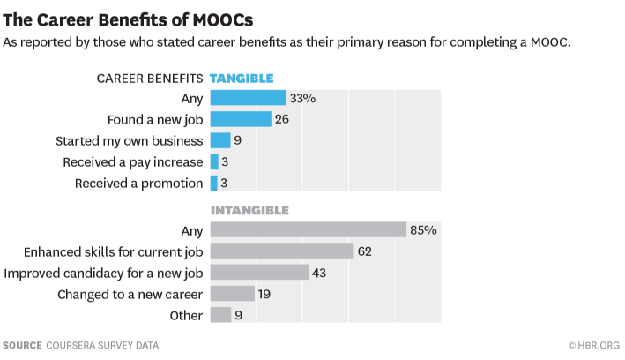
MOOCs & Employability
Source https://hbr.org/2015/09/whos-benefiting-from-moocs-and-why

Slide 51
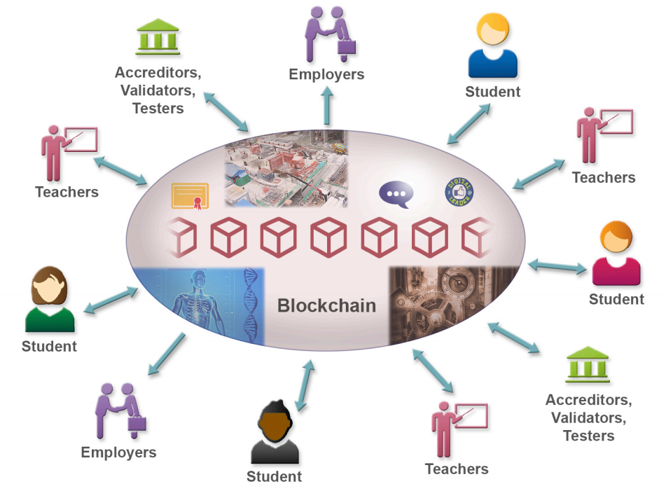
Blockchain
Credit: Knowledge Media Institute, The Open University

Slide 52


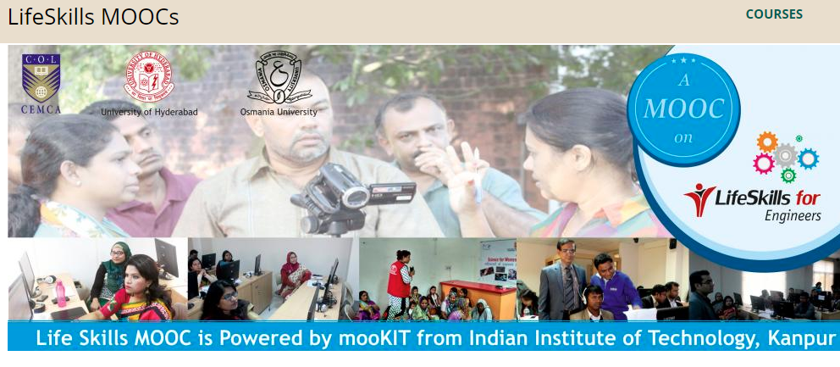
Some Examples
Life Skills for MOOC used blockchain for certification
Blockcerts from MIT Lab
Pagemajik and Authorship using blockchain that could help track reuse of OER
A Blockchain University coming up.
Notes:
Blockcerts is an open standard for creating, issuing, viewing, and verifying blockchain-based certificates developed by MIT Labs. These digital records are registered on a blockchain, cryptographically signed, tamper-proof, and shareable. The goal is to enable a wave of innovation that gives individuals the capacity to possess and share their own official records.
Woolf will be a fully-accredited, borderless, blockchain-powered university. Woolf uses a blockchain to enforce regulatory compliance, reduce bureaucracy, and manage the custodianship of sensitive financial and personal data. This makes it possible for Woolf to be open admissions on the faculty side, and selective admissions on the student side.

Slide 53
Implications of Blockchain
Present
Future
Paper certificates
Digital permanent certificates
Verification challenge
Complete online verification
Manual authentication of work (such a portfolios
E-Authentication of work (ePortfolios)

Slide 54

Micro-credentials
Industry-Academic Partnership
Online Learning
Proctored Test
Credits for formal learning and/or Employment
Short duration
Modular approach
Skills based
Community learning
Self-paced
Mentoring support
Verifiable credential
Project-based
Job-ready
Reduced cost
Blended with F2F for formal degree

Slide 55
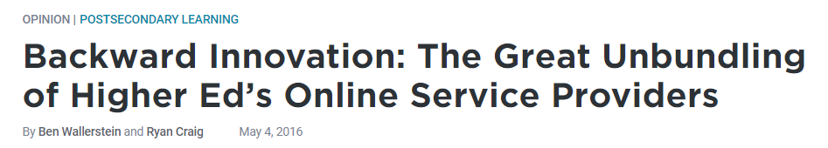
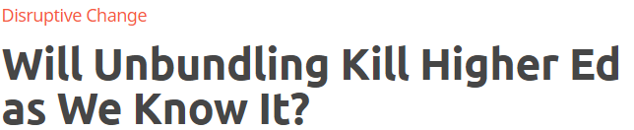
Unbundling higher education
Unbundling essential for lifelong learning
Competency-based just-in-time flexible learning
Cost-effective
Micro-credentials make it possible

Slide 56
Implications of Micro-credentials
Present
Future
Semester courses
Shorter courses
Less flexibility
Unbundling/
accumulation of credits
Limited mobility
Transferability of credentials

Slide 57




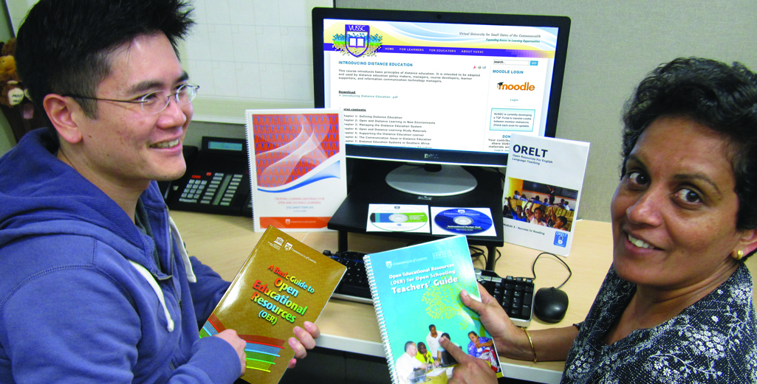


Open Educational Resources (OER)
Materials that are:
Free and freely available
Suitable for all levels
Reusable
Digital

Slide 58
Implications of OER
Present
Future
High costs of textbooks
Free quality content
Institutional Teams
Global Teams of course developers
Student as consumer
Student as producer

Slide 59



Implications for Open Universities
Rise of the Multi-Varsity network …learners can move from education to society and back
Micro-qualifications: rapid acquisition of highly specific knowledge and skills rather than a degree
The Faculty to become Lifelong Learners -- focus on new modes of delivery and pedagogy
Multi-versity: term introduced by Clark Kerr (1963) http://openvault.wgbh.org/catalog/A_0DF915F352B044EFB1A31CCC71E8F9BF
Notes:
In this scenario, learner mobility part of the landscape, not an exception. “Build-it-they-will-come” model not practical in this context. To help learners sustain their skills and thus livelihoods for longer than a generation there should be adequate pathways for learners to move back and forth from society to education. Mobilty is thus not limited to mobility across institutions. It is also about unlimited freedom and opportunities to move back and forth between education and employment. The concept of a unitary institution must be transformed into a network of mulit-versities. The term owes its origin to the wellknown educator Clark Kerr who was the President of the University of California system

Slide 60
Road Ahead

Slide 61
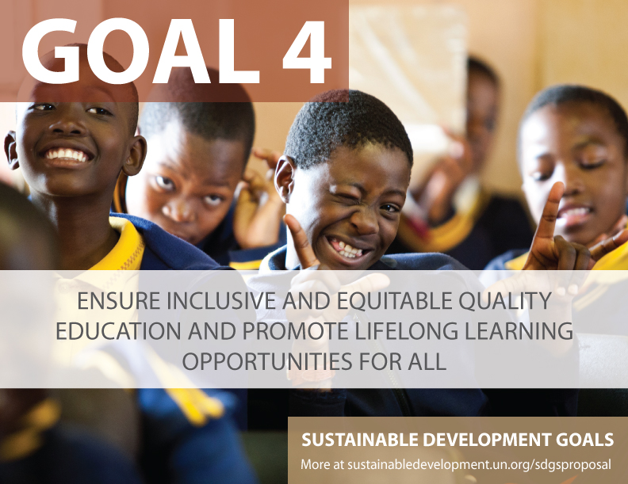

Slide 62
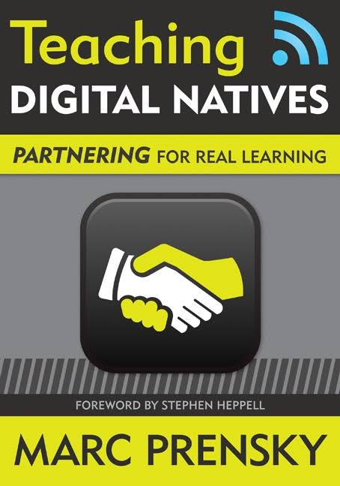
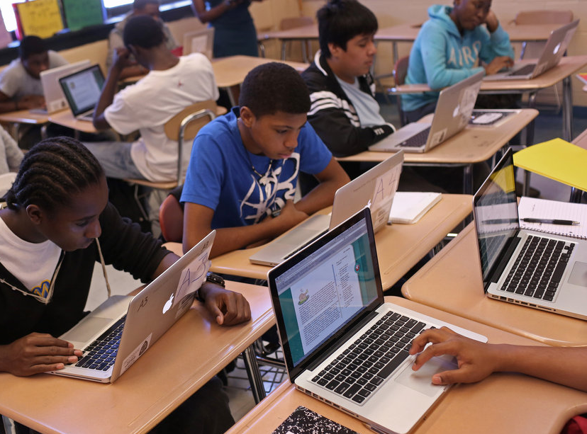
Digital Native: C21
‘Digital Native’: technology-savvy learners, usually young school-leavers
Photo licensed under CC BY-SA-NC. Teaching Digital Natives: Partnering for Real Learning by Marc Prensky

Slide 63
The Learner in 2035
Broadened classrooms & Blended
courses: linking of multiple f-f classes via technology (mega-pixel walls)
Artificial Intelligence: Holographic Advisor Bot
Advanced Communication: Language
translation implants
Division of Learning:“Maker, Doer,Thinker”
Learning at home: Immers- A-Casts
Micro-courses
Reference: BIG SHIFTS ARE COMING! LOOKING BACK FROM 2035 .
www.contactnorth.ca

Slide 64

Skills for the Future
Interdisciplinary skills
Creative & Analytical skills
Entrepreneurial skills
Leadership skills
Digital & technical skills
Global awareness and civic education
Source: Worldwide Education for the Future Index: The Economist Intelligence Unit, 2018

Slide 65
I. Embrace Lifelong learning
Simply reforming current education systems …to meet future skills requirements is not going to be enough….
Ageing countries …will need wholesale reskilling of existing workforces throughout their life
Notes:
https://www.weforum.org/agenda/2016/01/the-10-skills-you-need-to-thrive-in-the-fourth-industrial-revolution/

Slide 66


II. Integrate Employability
Balance between theory and practice; hard and soft skills
Engage industry: internships; apprenticeships
Link QA to employability
Career support
Measure competence rather than number of hours
Credit Hour
Range of skills

Slide 67
Employability pathway
Sensitisation
Career Counselling
Evaluation Drills
Career Support
Before Admission
After Induction
Penultimate Year
Upon Graduation

Slide 68
Vietnam Model
Partnerships: 21 colleges partnered with UK colleges to provide international education.
Focus on quality: development of quality assurance system for vocational training
Emphasis on global skills and employability: providing people with opportunities for livelihoods
Source: https://www.britishcouncil.vn/en/vocational-colleges-vietnam-have-effectively-used-uk-models-quality-assurance
Notes:
The partnerships formed under a signed MOU between the General Department of Vocational Training, Ministry of Labour, Invalids and Social Affairs and the British Council on a collaboration programme called “Development of vocational training quality assurance in some vocational colleges intensely invested to become high quality colleges”.

Slide 69
III. Focus on Innovation
Top-tier F2F Higher Education institutions
High-end
MOOCs
Face-to-face teaching: sustaining trajectory
Mainstream F2F Higher Education
Online and blended courses
ODL as innovation
Open Universities and Dual-mode institutions
Low-end
Time

Slide 70



Three Key Literacies for OU’s
Human
Data
Technological
Literacies
Source: Joseph Aoun (2017): Robot-proof, MIT Press, https://mitpress.mit.edu/books/robot-proof

Slide 71

Thank you
www.col.org

Slide 72




BT Murrayfield, Edinburgh, Scotland
9 - 12 September 2019
www.pcf9.org
Notes:
https://commons.wikimedia.org/wiki/File:Edinburgh_Overview03.jpg

