Slide 1
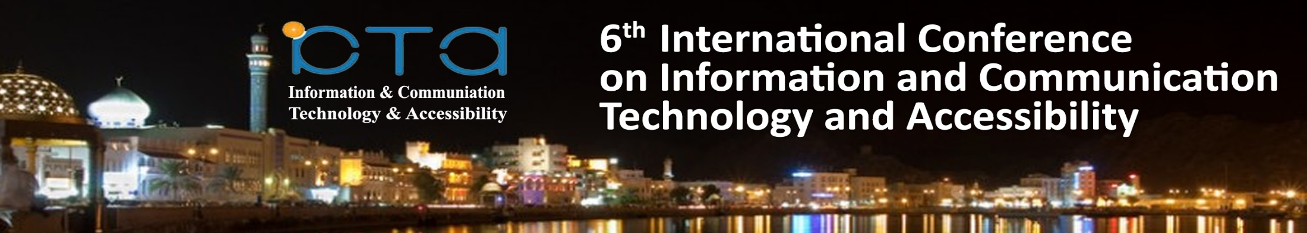


Accessible OER
Where to Start?
Professor Asha Kanwar
President & CEO
Dr Ishan Abeywardena, Advisor: OER
Dr Sanjaya Mishra, Education Specialist: eLearning
Muscat, Sultanate of Oman
December 20, 2017

Slide 2


OER for Inclusive and Equitable Quality Education
From Commitment to Action
2nd World OER Congress| 18-20 September, 2017 | Ljubljana, Slovenia

Slide 3






The
Road to
Ljubljana
ASIA
Asia eUniversity: ​​December 2016
EUROPE
Malta Ministry for Education and Employment:
​​February 2017
MIDDLE EAST & NORTH AFRICA
Qatar Foundation: ​​February 2017
AFRICA
Ministry of Education, Mauritius:
March 2017
LATIN AMERICA & CARIBBEAN
University of Campinas: April 2017
​
PACIFIC
Open Polytechnic of New Zealand:
​​May 2017

Slide 4
Government Responses:
102 countries
Region | Government
Africa | 28
Middle East and North Africa | 12
Asia and Pacific | 28
Europe and North America | 21
Latin America and Caribbean | 13

Slide 5

OER Global Report 2017
One-third of respondents indicated that their country had ensured that OER are accessible for persons with disabilities.
Notes:
considerations for persons with disabilities (Australia, Chile, Seychelles, Trinidad and Tobago);
use of Web accessibility guidelines (Netherlands, Spain).

Slide 6
Country initiatives
Special Considerations for persons with disabilities: Australia, Chile, Seychelles and Trinidad & Tobago
Sign Language & Braille: Madagascar, Malawi, Morocco, Nepal, Poland, Swaziland and Turkey
Web Accessibility Guidelines: Netherlands and Spain have adopted the use of web accessibility guidelines.

Slide 7
Survey of 12 Arab Countries
ICT accessible courses available in major universities in the country: 1.66/5
E-books: 1.25/5

Slide 8

Principles of Accessibility
Perceivable
Operable
Understandable
Robust
Source: WCAG 2.0, https://www.w3.org/TR/UNDERSTANDING-WCAG20/intro.html#introduction-fourprincs-head
Notes:
Perceivable - Information and user interface components must be presentable to users in ways they can perceive.
This means that users must be able to perceive the information being presented (it can't be invisible to all of their senses)
Operable - User interface components and navigation must be operable.
This means that users must be able to operate the interface (the interface cannot require interaction that a user cannot perform)
Understandable - Information and the operation of user interface must be understandable.
This means that users must be able to understand the information as well as the operation of the user interface (the content or operation cannot be beyond their understanding)
Robust - Content must be robust enough that it can be interpreted reliably by a wide variety of user agents, including assistive technologies.
This means that users must be able to access the content as technologies advance (as technologies and user agents evolve, the content should remain accessible)
Source: https://www.w3.org/TR/UNDERSTANDING-WCAG20/intro.html#introduction-fourprincs-head

Slide 9
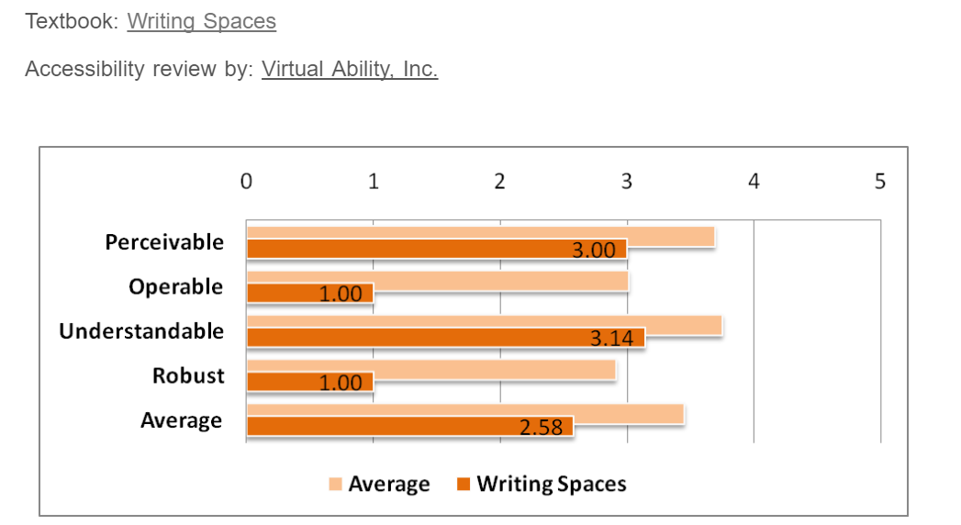
How Accessible are OER?
Source: http://www.collegeopentextbooks.org/textbook-listings/accessibility-reviews
Notes:
The College open textbook site in the USA reviews open textbooks for accessibility, and on an average, the POUR score is about 3.5 in a scale of 5. The major problem is with the robustness criteria, which has score below 3, which means that OER are less amenable to the use of assistive technologies.

Slide 10
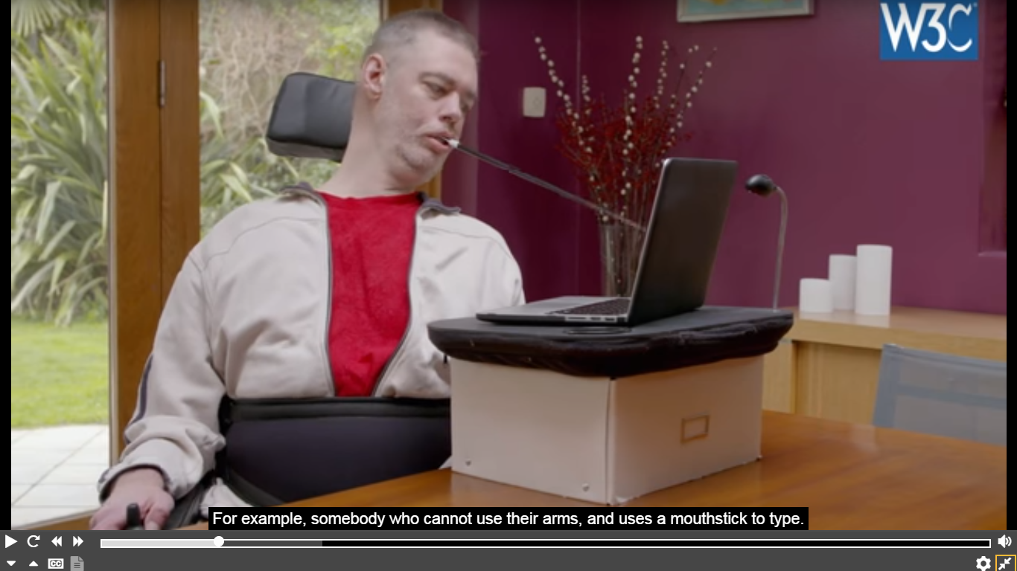
Web Content Accessibility Guidelines
(WCAG)
Makes content accessible to a wider range of people with disabilities, including blindness and low vision, deafness and hearing loss, learning disabilities, cognitive limitations, limited movement, speech disabilities, photosensitivity, and combinations of these.
Address accessibility of web content on desktops, laptops, tablets, and mobile devices.
Source: https://www.w3.org/TR/WCAG21/

Slide 11

LJUBLJANA OER ACTION PLAN 2017
Provide OER in accessible formats that support its effective use by all, including persons with disabilities, by using existing international guidelines for accessibility.

Slide 12
LJUBLJANA OER ACTION PLAN 2017
Ensure that OER accessed through different media, including mobile devices, are available and accessible in formats which allow for its use, adaptation, combination and sharing

Slide 13
Some Basic Accessibility Questions
Will the software used to view the OER disable the accessibility features of the computer’s operating system (Windows, Mac OSX, Linux)?
Is the software used to view the OER compatible with most assistive devices?
Is there text identification of non-text elements?
Is all text in the OER recognizable to a computer as text?
Is the OER accessible by the colorblind?
Source: https://www.affordablelearninggeorgia.org/open_resources/accessibility

Slide 14
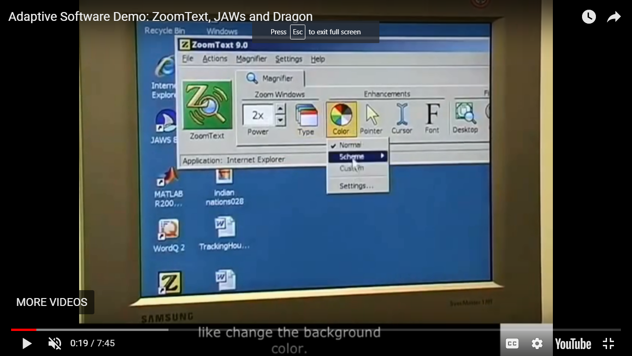
OER Accessibility Toolkit - UBC
Design resources and activities that can be accessed by learners in a variety of ways.
Provide multiple ways for learners to engage with information and demonstrate their knowledge.
Identify activities that require specific sensory or physical capability and for which it might be difficult or impossible to accommodate the accessibility needs of learners.
Source: https://open.ubc.ca/teach/oer-accessibility-toolkit/

Slide 15
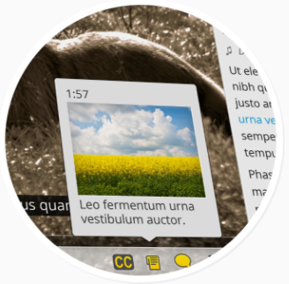
Flexible Learning for Open Education (FLOE Project)
Global, public infrastructure to deliver a learning experience that matches each learner’s individual needs.
Uses interoperability standard for describing learner needs and labelling resources that meet those needs.
Transform, augment, and select alternative educational resources to fit individual needs for an inclusive learning experience.
Source: https://floeproject.org/

Slide 16

What Can Be Done?
Advocacy: ‘Born Digital’ should be ‘Born Accessible’
Capacity building: Training on Accessibility issues and Accessibility guidelines
Technology: Convergence of ICTs and Assistive Technologies; use of OER Accessible Toolkit
Notes:
‘Born Digital’ should be ‘Born Accessible’ is a movement promoted by an technology non-profit – Benetech that hosts the largest accessible library Book Share (https://benetech.org/our-work/born-accessible/)

Slide 17
What Can Be Done?
Promote policy development at both regional/national and institutional levels.
Innovations on bridging the digital divide required
Mechanisms to monitor the progress of accessible OER needed

Slide 18
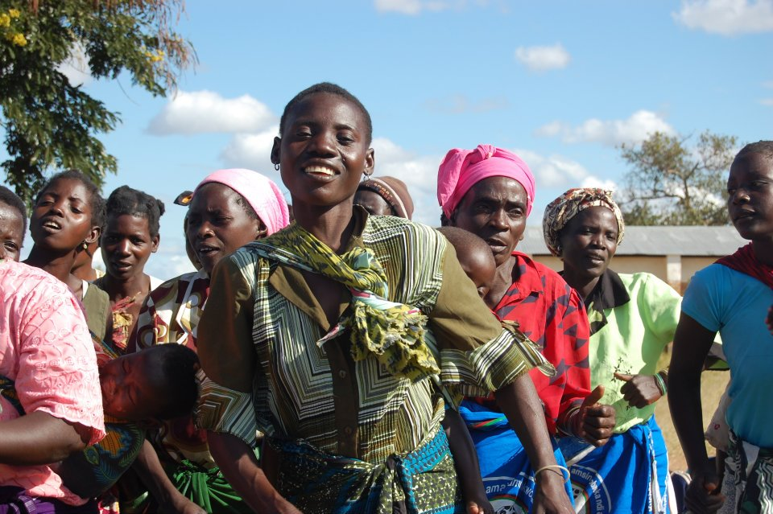
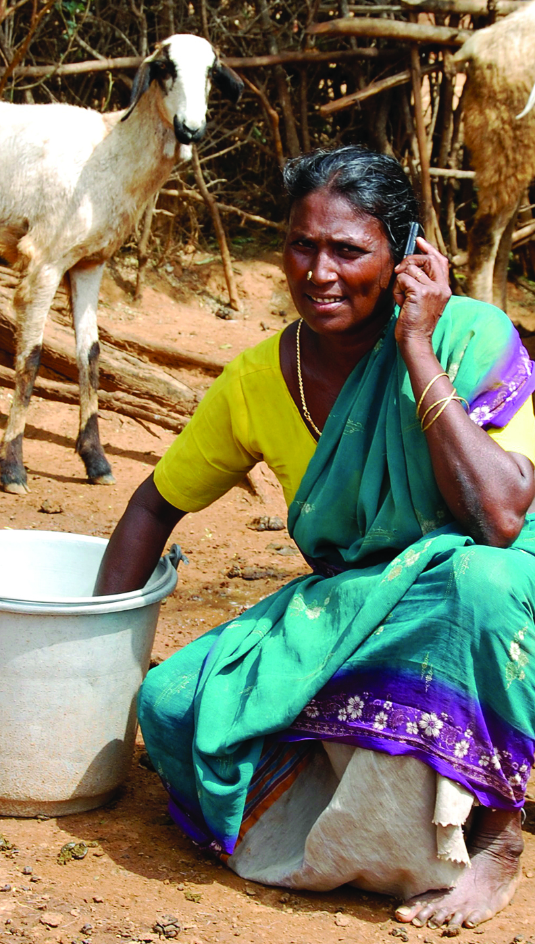
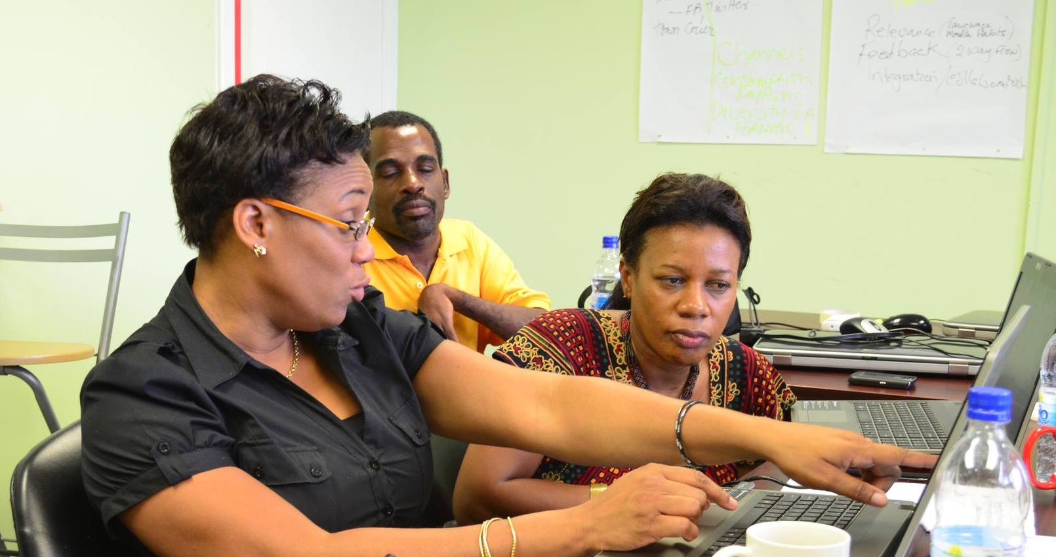
Thank you
Notes:
We invite you to engage us; tap into our thought leadership, expertise, networks and resources

