Slide 1

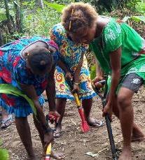




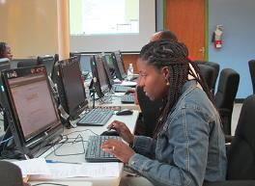
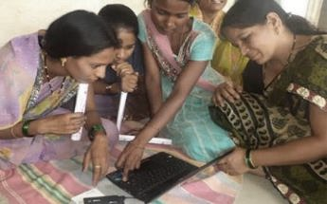

Skilling our youth at speed and scale
Professor Asha Kanwar
President and CEO, Commonwealth of Learning
Africa TVET Regulators Conference
30 November 2023

Slide 2

Commonwealth Heads of Government Meeting
Vancouver, 1987

Slide 3
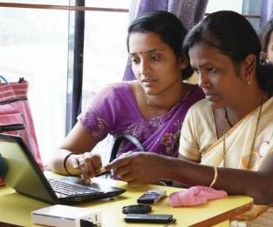
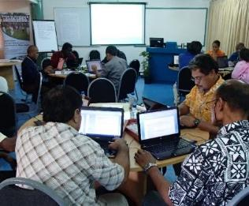
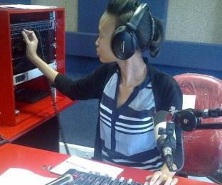
To help Commonwealth governments and institutions use technologies to improve and expand access to education and training

Slide 4





ECONOMIC EMPOWERMENT
SOCIAL
INCLUSION
ENVIRONMENTAL CONSERVATION
$
Notes:
COL continues to promote ‘learning for sustainable development’. Learning must lead to economic growth, social inclusion and environmental conservation.

Slide 5

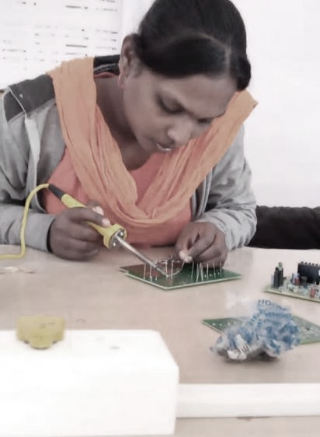

PROGRAMME SECTORS
Education
Skills
Gender Equality

Slide 6
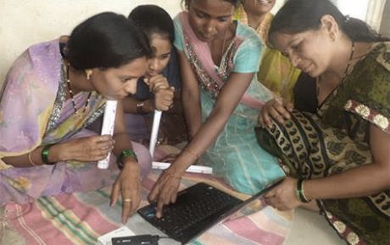
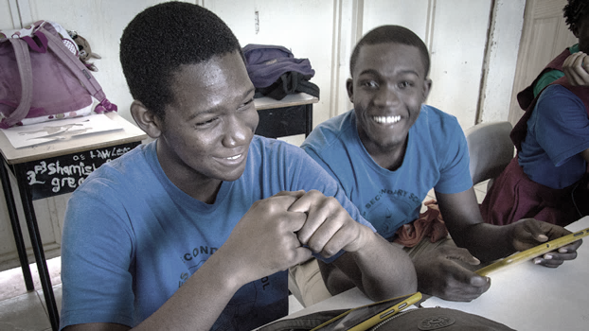
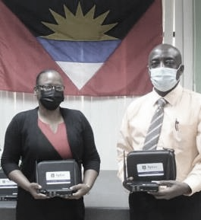
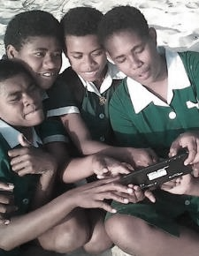


Leveraging new and existing technologies

Slide 7
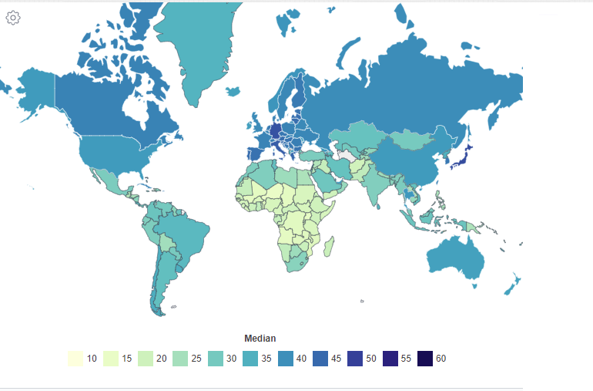
World Median Age by Country - 2020
Source: https://worldpopulationreview.com/country-rankings/median-age ,Retrieved on 20 November 2023

Slide 8

AU Agenda 2063
Well-developed ICT infrastructure for skills development
Guaranteed full access to education, training, skills for youth
Strengthen TVET through scaled up investments, establishment of a pool of high-quality TVET centres across Africa.
Improve the employability and entrepreneurship of especially youth and women, and closing the skills gap across the continent
Source: https://au.int/sites/default/files/documents/36204-doc-agenda2063_popular_version_en.pdf

Slide 9
Youth Unemployment - Kenya
Source: data.worldbank.org, retrieved and compiled on 27 October 2023

Slide 10
ICT Statistics - Kenya
Source: data.worldbank.org, retrieved and compiled on 27 October 2023

Slide 11



Key Issues for Youth
Phenomenal developments in AI
By 2025, 85 million jobs may be displaced but 97 million more jobs may emerge
Skills required for the emerging green and blue economies
Source: The Future of Jobs Report 2020, WEF, Oct 2020

Slide 12
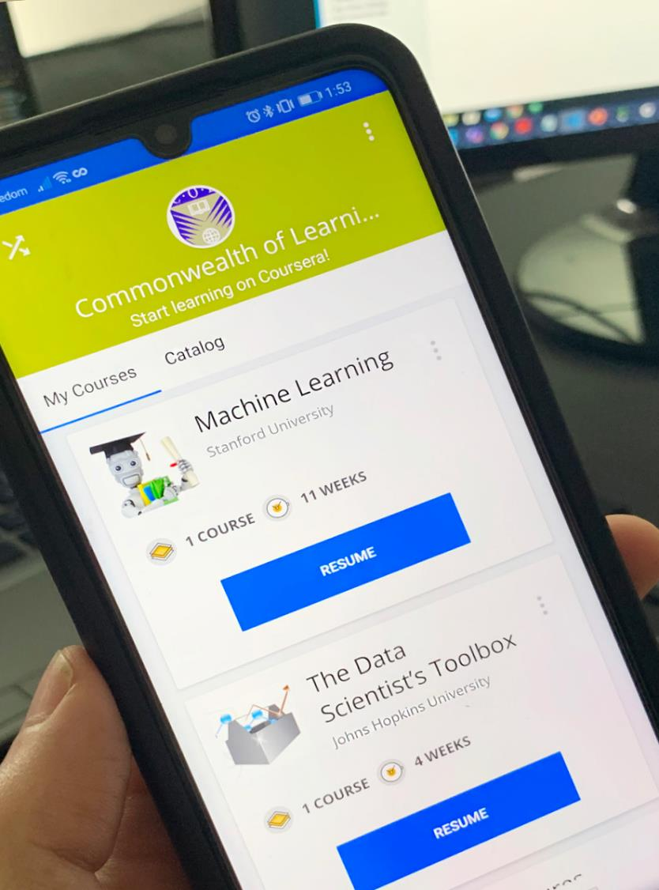




Blended skilling
and reskilling
Learning to learn online
Providing just-in-time training for livelihoods
Learner support essential

Slide 13
COL in Kenya: Skills Online
Over 20,000 enrollments from Kenya in COL-Coursera and COL-Udemy programmes, nearly 10% reaching certification

Slide 14

Blended Learning Model at the KSTVET
Term 1
On campus, face-to-face training for all trainees
(3 months)
Term 2
Off campus, virtual training for all trainees
(3 months)
Term 3
On campus, face-to-face training for all trainees
(3 months)
Term 4
Teaching practice at workplaces for all trainees
(3 months)
Technology integration
( LMS, Video conferencing, OER Repository & print materials)
Technology integration
( LMS, Video conferencing, OER Repository & print materials)
Technology integration
( LMS, Video conferencing, OER Repository & print materials)
Foundational
Knowledge and skills on TVET
Basic skills for blended TVET
Theories, models and comparative studies on TVET
Methodologies and technologies for blended TVET
Practice and application of multiple skill sets for blended TVET in safe environment
On-the-job training, coaching and mentoring in face-to-face/ hybrid/ blended workplaces

Slide 15
1
Capability building
of Master Trainers (MTs)
Partnerships between COL/TVETs/NTAs and community groups
Establishment of Industry Advisory Committees (IACs)
Design and development of courseware for pedagogical & technical upskilling of MCs
e-Apprenticeship
Model
Online training of MTs using COL’s course for pedagogical upskilling of MCs (1 month)
2
Capability building of Master Craftspersons (MCs)
Quality assurance of training by the IACs
Content on LMS, AptusPi, and print
Blended training using COL’s course(online + workspaces) (2 months)
Blended assessment (e-portfolio + practical tasks at workspaces)
Experienced MCs can undergo training to be MTs
Quality assurance of training by the IACs
Partnership with private sector for employment of the youth in decent jobs (green, blue & orange economies)
3
Apprenticeship Training
Blended training (workspaces +online) (up to 6 months)
Blended assessment (e-portfolio + practical tasks at workspaces)
Award of micro credentials and national qualifications
Mentoring at innovation/ incubation iHubs
Experienced apprentices can undergo training to be MCs
Notes:
COL’s e-Apprenticeship Model (YCT, Auchi, LTBC & KSTVET)
COL’s e-apprenticeship model seeks to help address two global challenges - high unemployment and low productivity in employment. Several factors reinforce present inequalities i.e., low or no skills, skills mismatch, low quality technical and vocational education and training (TVET), limited access to TVET and cultural stereotypes and discrimination.
The model’s logic is that:
formal qualifications in technical and vocational skills, can provide access to labour markets that in turn lead to improved lives and livelihoods
workplace plus distance and online learning can increase access to gaining such formal qualifications by increasing affordability and flexibility, at the same time ensuring relevance and giving learners the ability to achieve and demonstrate competence.
The model has three interventions:
Fostering collaborative partnerships between industry and educational institutions
Lifelong learners acquire credentials and national qualifications through workplace plus online learning,
Influence national skills and entrepreneurship systems through evidence-based advocacy and policy dialogue.
Capability building of Master Trainers (MTs)
TOT of MTs at COL’s partner TVET institutions for MCs training using COL’s course
Capability building of Master craftspersons (MCs)
Assessment of MC’s prior and current competencies at accredited TVET centers using approved Occupational Standards
Pedagogical upskilling of MCs at workspaces and online using COL’s self-paced, self-tutored course
Reskilling, upskilling, unskilling and newskilling of MCs using COL’s courses, other OER and through peer support at workspaces
Micro credentialing and award of national qualifications
Apprenticeship training
Technical skilling of apprentices at MC’s workspaces using blended approaches
Mentoring of apprentices at incubation and innovation iHubs for startups and accelerators
Competency based assessments by national or regional qualification agencies
Micro credentialing and award of national qualifications
Kenya - KSTVET, NITA & KNFJKA
Zambia – LTBC, Nakadoli Furniture Cooperative
Nigeria – Yaba College of Technology, COMTEAN & MTN
Nigeria – Auchi Polytechnic & Auchi Tailors Union

Slide 16

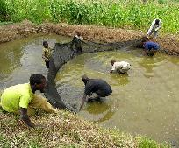
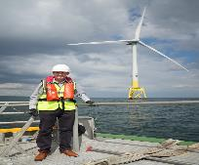

Green and Blue Economy:
Youth Training and Career Opportunities
Collaborative Course Development
Seven competency-based courses that prepare learners
for jobs in low carbon BE growth industries
Bluepreneurship
Aquaculture
Ocean Energy
Marine Biotechnology
Notes:
The Blue Economy offers significant offers career opportunities for youth in areas such as, marine biotechnology, ocean engineering, sustainable fishing and sustainable tourism. The Blue Economy also offers opportunity for youth-led entrepreneurship. Investing in training courses and materials allows young people to pursue these careers and at the same time contribute to the growth of the Blue Economy
Building on the popularity and interest that the MOOCs have generated, three institutions are collaborating to develop seven courses. These include a core course in Entrepreneurship with a focus on the Blue Economy and two courses in each of three areas: Aquaculture and Fisheries Ocean Energy and Marine Biotechnology . The three institutions involved are UniSey, University of Namibia and the Caribbean Maritime University.
By supporting the development of short, stackable, competency-based courses and ensuring a curriculum that combines soft skills and voc
ational training, the partners will prepare learners in their countries for jobs in low carbon Blue Economy growth industries

Slide 17

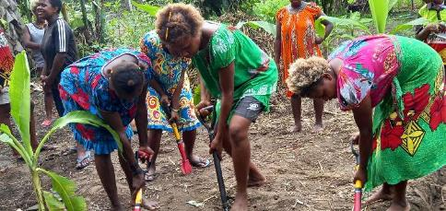
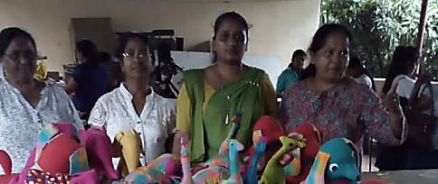










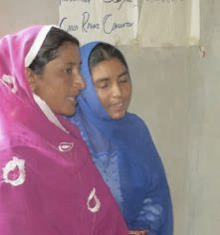

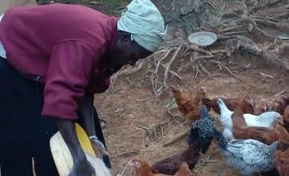

GIRLS Inspire
126,895 trained
BANGLADESH | KENYA | MALAWI | MOZAMBIQUE | NAMIBIA | PAKISTAN | PAPUA NEW GUINEA | SOLOMON ISLANDS | SRI LANKA | UGANDA

Slide 18


“My customer base and revenues have increased and I have regained confidence. I am giving back to my community by training youth, women and people with disabilities equipping them with digital literacy skills because these skills help us change our life for the better.”
Martine Benemariya, Rwanda

Slide 19
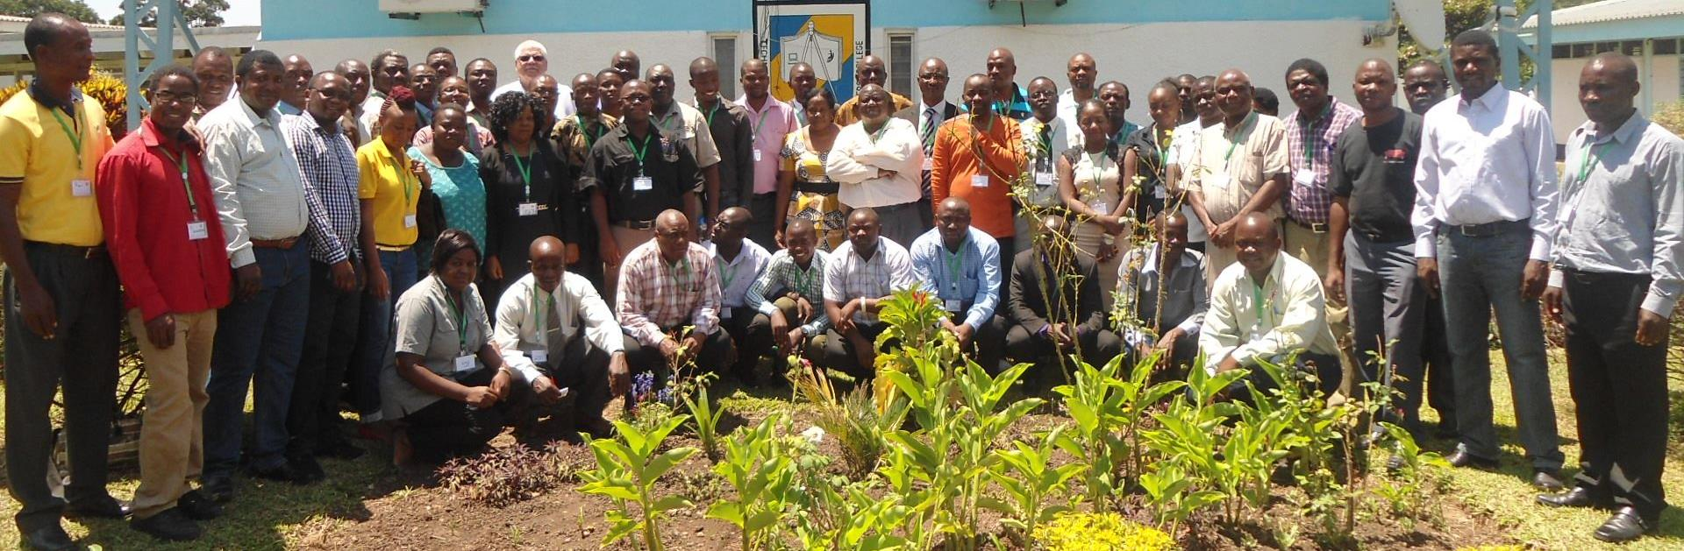
Zambia TVET teacher training
Ministry of Higher Education request in response to COVID 19
Three TVTC mentors, 28 online facilitators, 840 TVET teachers
On the job training
COL online OER available
Notes:
In response to COVID 19, Zambian’sMoHE approached COL to support them to train TVET teachers in online learning. COL has been partnering with Zambia’s Technical and Vocational Teachers College for ten years to build their capability in distance and online learning. TVTC has its own learning management system and trained staff.
With COL’s support, three of the capable people are presently training one person from each of the 28 public TVET institutes in how to facilitate online. In a few weeks, once these 28 have been trained, the existing experts will mentor the 28 facilitators to apply their leanring as they each teach 30 TVET teachers using COL’s Flexible Skills Development course. 840 TVET teachers will be quickly trained, and Zambia will have 28 new trainers who can independently train many more TVET teachers. Both the Facilitating Online Courses course and the Flexible Skills Development course are COL OER which COL has been using to train others across the Commonwealth, and could be easily sent to TVTC and installed in their learning management system ready to go.

Slide 20
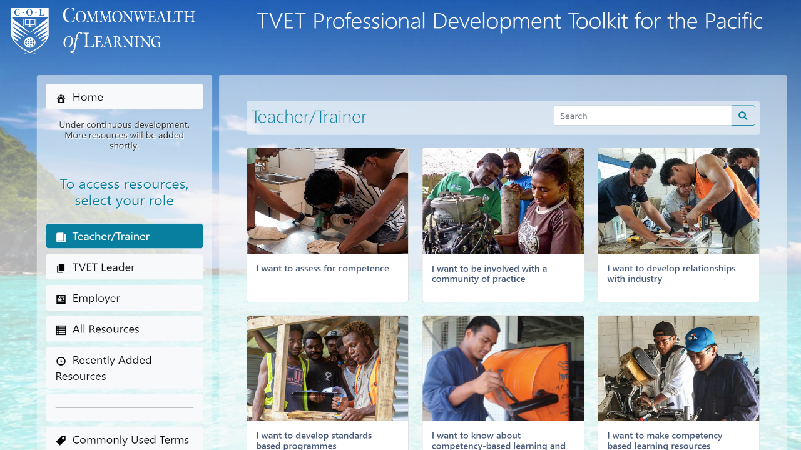

Slide 21

Artificial Intelligence (AI)
Provide an intelligent, personal tutor for every learner
Support for collaborative learning
Adaptive group formation
Expert facilitation
Image Source: https://securitymea.com/2023/02/24/new-malware-stealing-social-media-credentials-under-chatgpt-app-disguise/
Notes:
An AI-based service that uses Natural Language Processing technology
A Large Language Model (LLM)
Trained on massive quantities of data
To generate human-like text
G(enerative) P(re-trained) T(ransformer)
Transformer is an advanced AI technology developed in 2017- an example is language translation
Much wider capabilities in May 2023 through plugins

Slide 22


Slide 23




Even with AI, the world will still need…
Blue collar
skills
Skills relating to empathy
Skills with Creativity and Innovation
Active listening, emotional intelligence, communication, cultural competence, patience and tolerance, and problem solving
complex problem solving, adaptability, curiosity, open mindedness, collaboration and entrepreneurship
Technical, physical,
spatial, time management, teamwork and safety
Notes:
Blue collar skills are required for jobs in industries that involve manual labor, such as construction, manufacturing, transportation, and agriculture (Technical, physical, spatial, time management, teamwork, and safety). As the workforce evolves and new technologies emerge, blue collar workers will need to continually update their skills to keep up with changing job demands.
Empathy skills enable workforce to build strong relationships, provide effective care and support, and to work collaboratively with others, especially in professions like healthcare, education, social work, counseling, and customer service (Active listening, emotional intelligence, communication, cultural competence, patience and tolerance, and problem solving).
Creativity and innovation – Creativity enable workforce to generate new and original ideas, while innovation enables them to turn the ideas created into practical solutions that add value (complex problem solving, adaptability, curiosity, open mindedness, collaboration and entrepreneurship).

Slide 24

3 Courses on COL’s Moodle instance
Capability-building
Review of the Guidelines & Criteria for the Caribbean Vocational Qualification
Institutional strategies and action plans
  Barbados
  Dominica
  Jamaica
  Saint Lucia
  St Kitts & Nevis
Notes:
Building the capacity of TVET providers and strengthening the Caribbean Vocational Qualification framework to promote the recognition of qualifications and the mobility of qualified young people across the region

Slide 25
Blended TVET
Face-to-Face Courses
Blended Courses
Distance/Online Courses
MOOC
Mobile learning
ICT integration in teaching and learning
Open and Distance Learning

Slide 26
For Discussion
What are the QA mechanisms for blended learning?
How will we recognise prior learning?
Do we have provision for accrediting micro credentials?
Can we provide mobility for our students across borders and across formal, nonformal and informal learning?
What is the role of AI in ensuring quality and standards for blended TVET?

Slide 27


Thank you
www.col.org
The contents of this presentation, with the exception of logos and graphics which are the property of the respective owners, is made available under Attribution-ShareAlike 4.0 International (CC BY-SA 4.0).

