Slide 1

Connectivism, Self-Directed Learning, and MOOCs in Teacher Professional Development
Dr Betty Ogange
Education Specialist: Teacher Education
Commonwealth of Learning
Virtual presentation at the
10th Teaching and Learning Conference organised by the Africa Federation of Teaching Regulatory Authorities (AFTRA) on May 9 -12, 2023 in Namibia

Slide 2

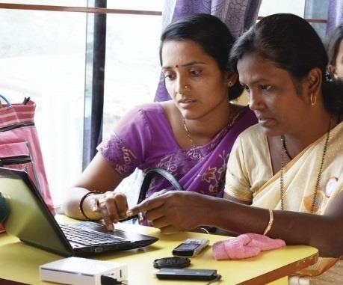
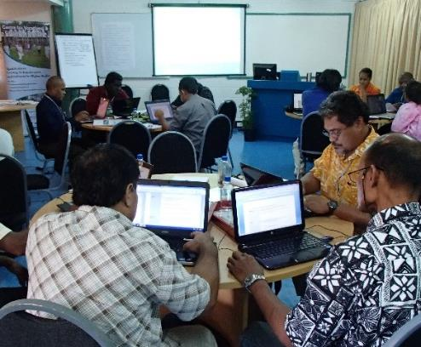
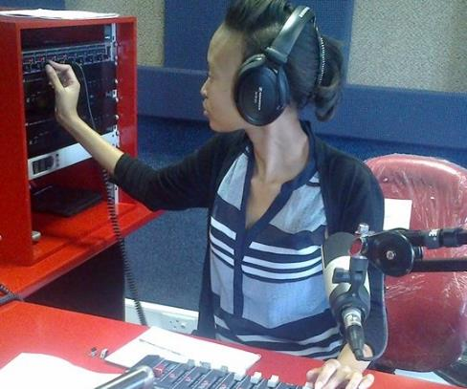
To help Commonwealth governments and institutions use technologies to improve and expand learning for sustainable development
Notes:
What do we do? Our mission is to help Commonwealth member states and institutions to use technologies for expanding access to quality education and training.

Slide 3

Connectivism, Self-Directed Learning, and MOOCs in Teacher Professional Development
What kind of teacher training is needed to build back better?

Slide 4
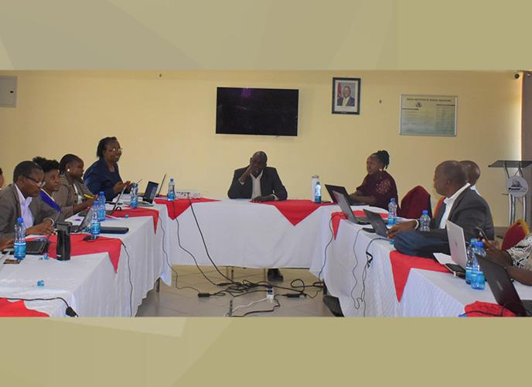

What did we learn during the pandemic?
Covid-19 Lessons
Purely online options do not work for everyone
Mainstreaming Open Educational Resources (OER) by building the capacity of teachers
We have seen a huge rise in self-directed learning, especially in MOOCs
Photo Credit: Facilitation Workshop at KISE

Slide 5
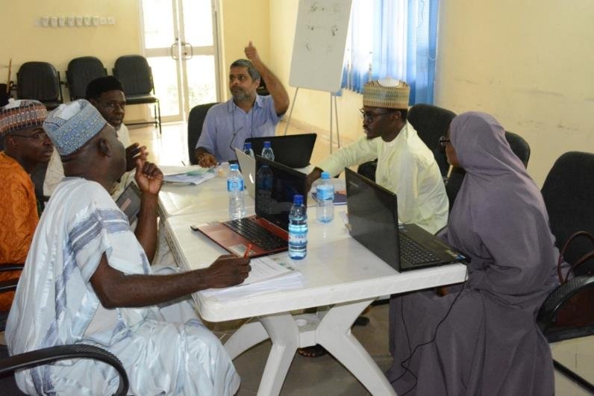
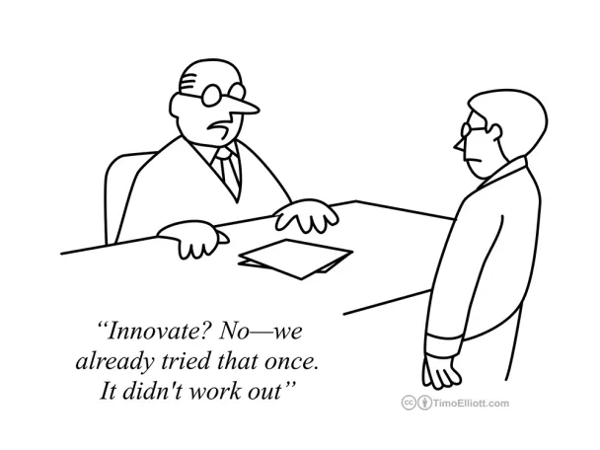
Some key
concepts
Innovation
‘…approaches that improve significantly upon the current state, and are scalable’
…Institutionalisation
Photo Credit: Green Teacher, Nigeria

Slide 6
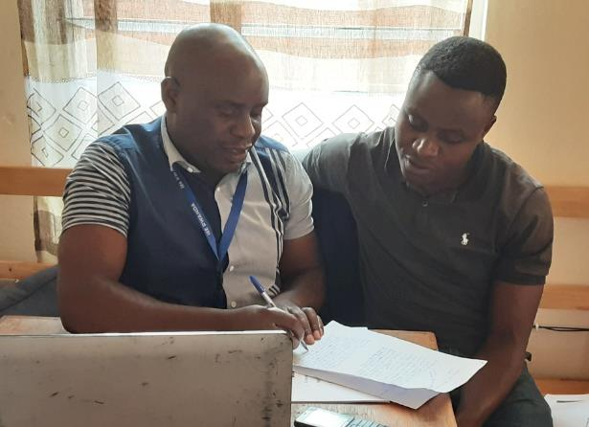
Some key
concepts
Connectivism
  Dynamic learning environment
  Importance of networks and connections in the learning process
  Teachers can adapt to rapidly changing educational landscapes
Photo Credit: Jean Bosco – ITL Course
Self-Directed Learning
  Teacher autonomy
  Setting goals, identifying learning opportunities, and evaluating own progress
  More empowered and motivated teaching workforce

Slide 7
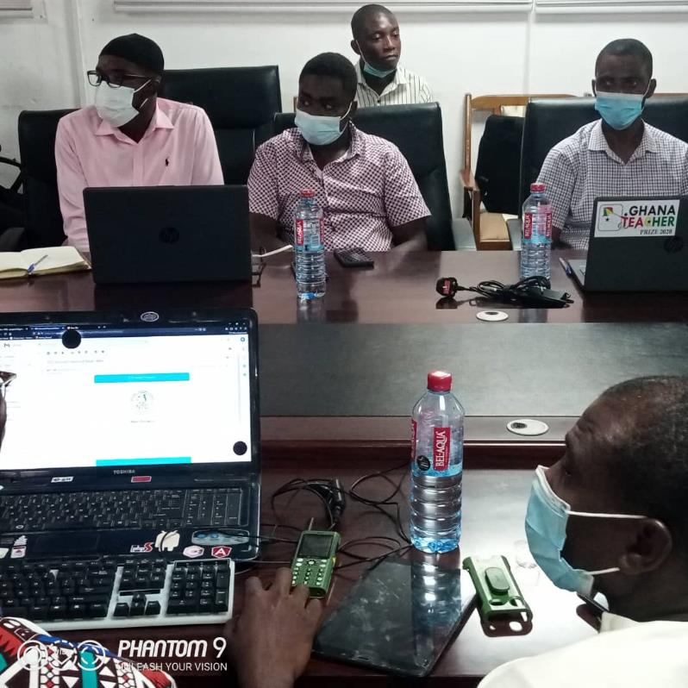
Some key
concepts
Massive Open Online Courses
Also known as ‘MOOCs’
MOOCs provide access to high-quality resources
Can offer teachers access to educational content from renowned institutions and experts worldwide
MOOCs propagate global best practices, enhancing the quality of teaching in the region
Example: Use of MOOCs by National Teaching Council of Ghana
Photo Credit: NTC Ghana

Slide 8
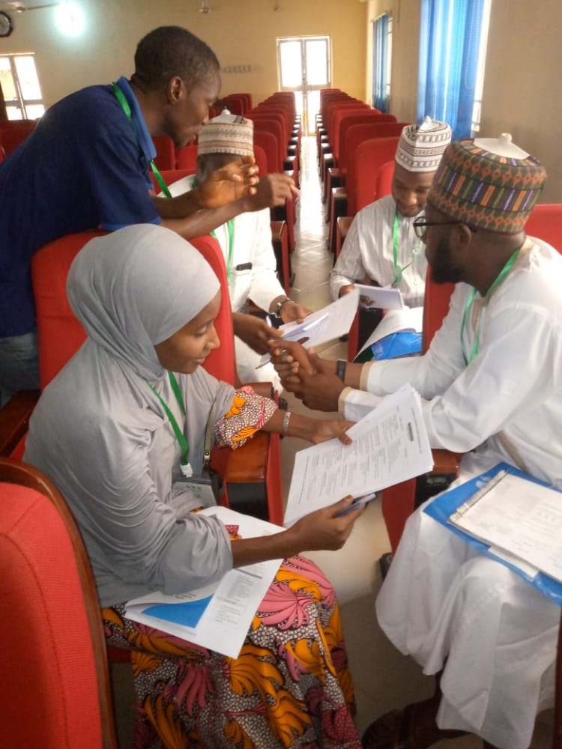
Data
1
Data
Gathered from MOOC platform: Course evaluation, enrolment figures, completion and participation
2
Course survey
Common across courses, common format and layout for subsequent evaluations
3
Longitudinal insights
Arbitrary anonymous identifiers in some instances for longitudinal insights
4
Cross-referencing
Against individual usage data from the platform
Photo Credit: NTI, Nigeria

Slide 9
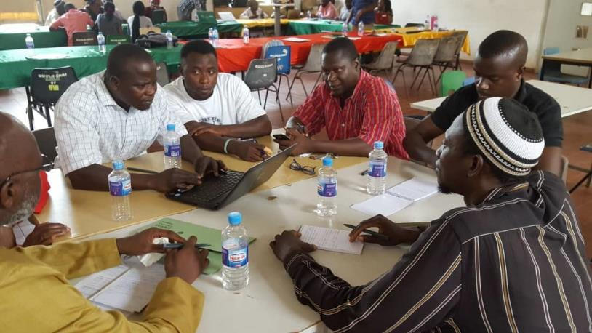
Some Key Findings
Discussion forums and support by teacher mentors helped to promote collaborative learning opportunities in the MOOCs
MOOCs allowed for self-directed learning, as the teachers engaged in professional development at their own time
Participants developed personalised learning experiences for themselves, including what aspects of the course to respond to
Teachers reported an improvement in their digital literacy skills, which are increasingly important in the 21st century classroom.
Notes:
Nigeria: NTI has won a government bid to train on Learning Recovery. Targeting xxx teachers
Ghana: NTC - World Bank trained 46,000 teachers using COL resources
GPE KIX trained 900 teachers using COL provided LMS
AFTRA Conference: Participation by high-level government officials and international organisations

Slide 10
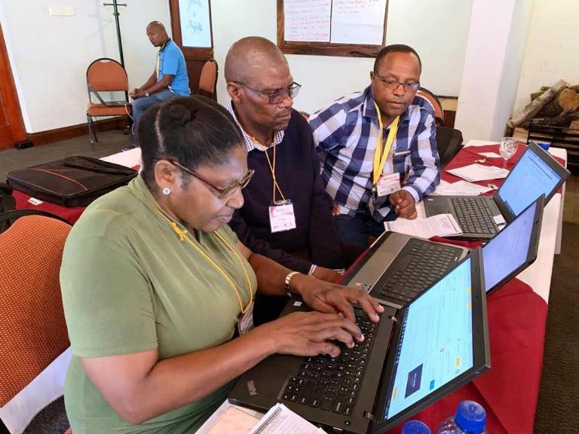
Implications for future studies on MOOCs
Enrollment data: Looking at enrolment figures, either for historical trends in any one course or for comparison amongst and across different courses of little value.
Completion and participation statistics: should be understood in the light of other factors
End of course surveys are not entirely reliable
The free text responses may be of more use
Non-teachers will enrol and then drop-out, thereby skewing the data on connectivism and communities of practice among teachers
Notes:
Nigeria: NTI has won a government bid to train on Learning Recovery. Targeting xxx teachers
Ghana: NTC - World Bank trained 46,000 teachers using COL resources
GPE KIX trained 900 teachers using COL provided LMS
AFTRA Conference: Participation by high-level government officials and international organisations

Slide 11
Conclusion
MOOCs are an ideal platform for collaborative and flexible learning among teachers; they can help in scaling TPD in the post Covid-19 period in Africa.
Self-directed learning allows teachers to take control of their own learning, pace, and direction.
To fully harness the potential of connectivism, self-directed learning, and MOOCs in teacher professional development, it is essential to address challenges such as limited internet access and digital literacy, as well as motivation.
Africa can create an environment in which connectivism, self-directed learning and MOOCs can truly transform teacher professional development in the region.

Slide 12
Opportunities and emerging partnerships
On-going partnerships and or discussions with various teaching councils / teacher agencies
To explore new partnerships, you may contact:
Dr Betty Ogange
Education Specialist: Teacher Education
Commonwealth of Learning
E-mail: bogange@col.org

Slide 13
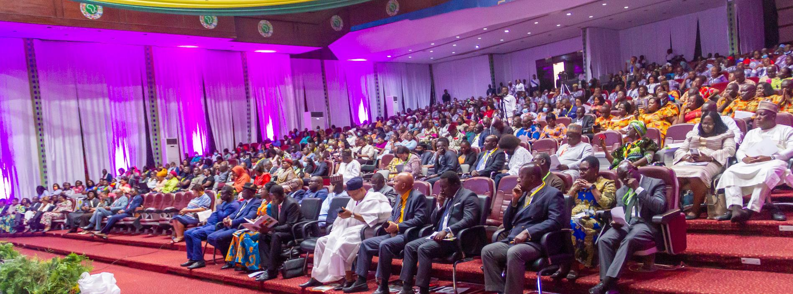
Thank you!
The contents of this presentation, with the exception of logos and graphics which are the property of the respective owners, is made available under Attribution-ShareAlike 4.0 International (CC BY-SA 4.0).

