Slide 1


Leadership and Innovation for the Future of ODL
Professor Asha Kanwar
President & CEO, Commonwealth of Learning
May 10, 2018 | Kuala Lumpur, Malaysia | 2nd High Level Roundtable
for Vice Chancellors & Heads of ODL Institutions

Slide 2
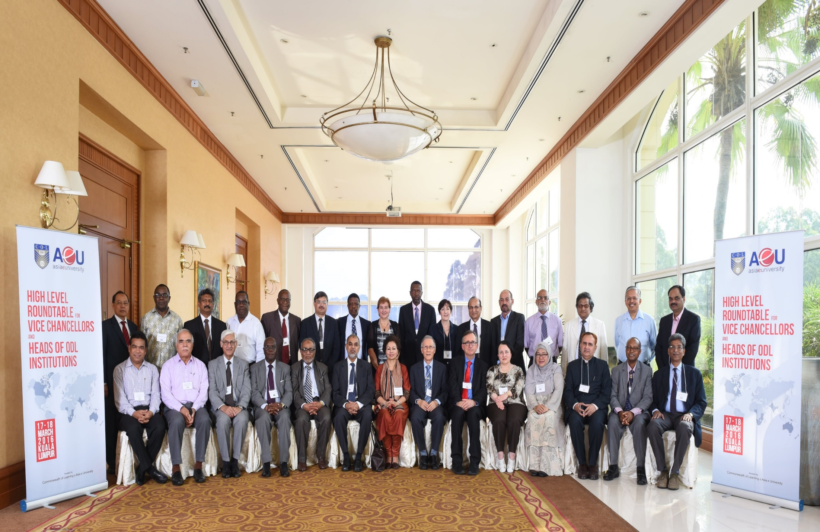
High Level Roundtable for Vice Chancellors
Kuala Lumpur, 2016

Slide 3
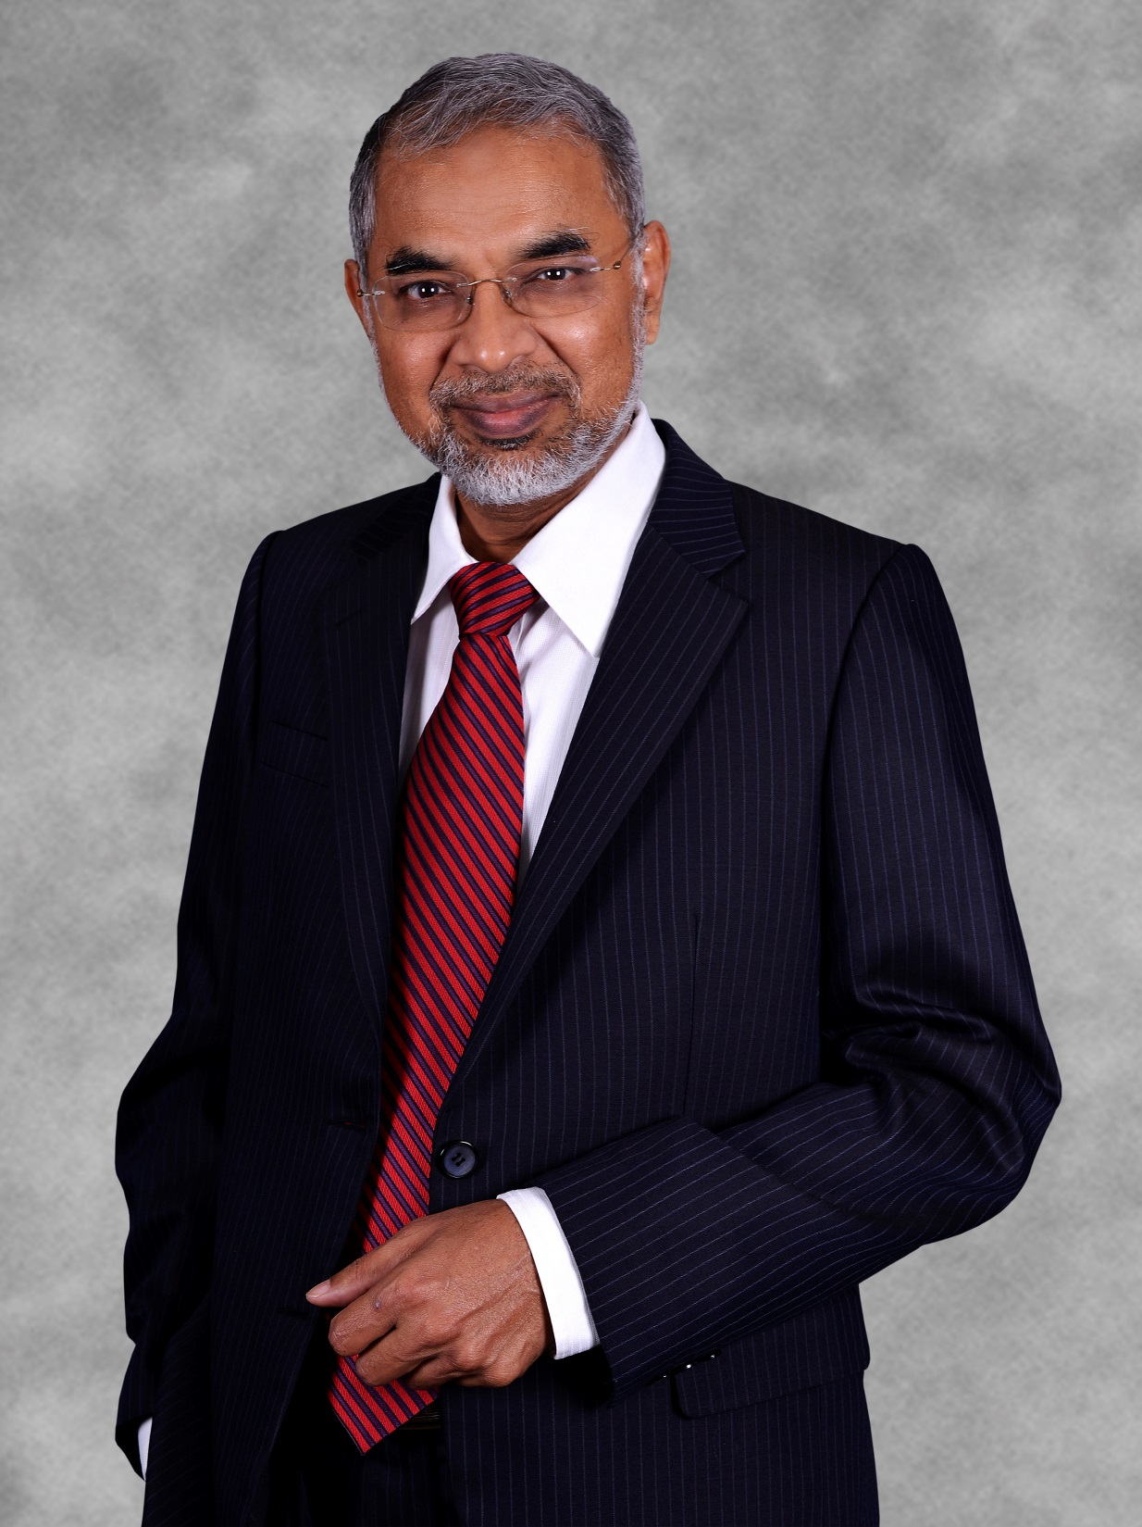
Thank you, Dato

Slide 4

Leadership
Quality
ICTs
Best Practice

Slide 5
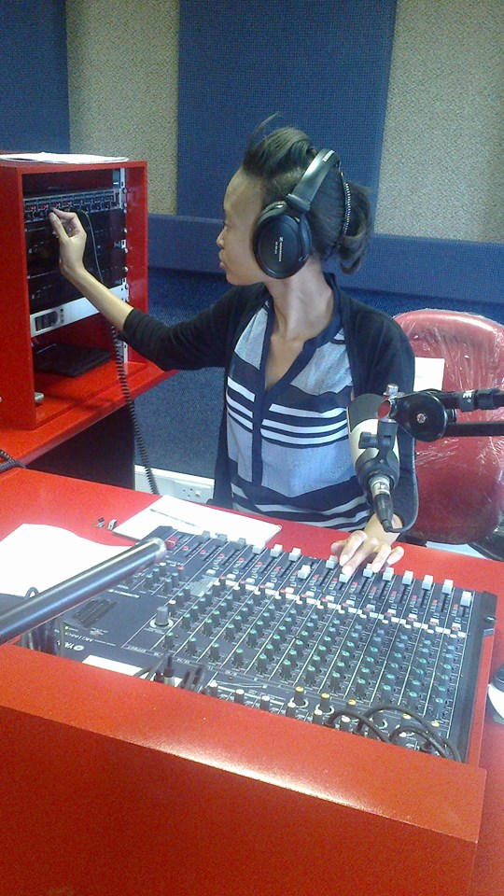
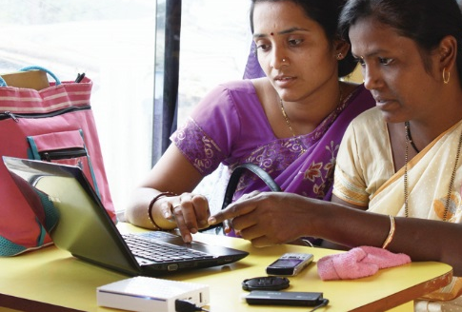
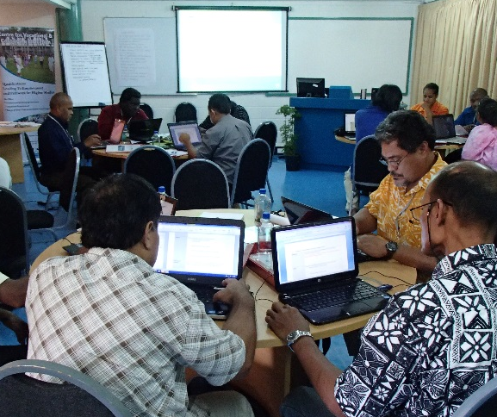
Leadership– Challenges
Autonomy
Policy
Funding
Resistance to Change
Competition

Slide 6
Key Recommendations
Gather and share evidence on student outcomes, employment outcomes,
Seek corporate sector endorsement
Remain agile and relevant by learning from other institutions
Manage change and overcome resistance by sharing continuous messages re the compelling reasons for the change

Slide 7
Plan
ODL as disruption
What type of leadership do we need?
Leadership and innovation
Way forward

Slide 8
ODL as disruption

Slide 9
Disruptive Innovation
‘…describes a process by which a product or service takes root initially in simple applications at the bottom of a market and then relentlessly moves up market, eventually displacing established competitors.’
C. Christensen
Source: http://www.claytonchristensen.com/key-concepts/

Slide 10
Characteristics of Disruptions
It is a process, not a product or service
Perceived lower quality in the beginning
Takes time to disrupt existing business
New business model/s emerge
Not all disruptions succeed

Slide 11
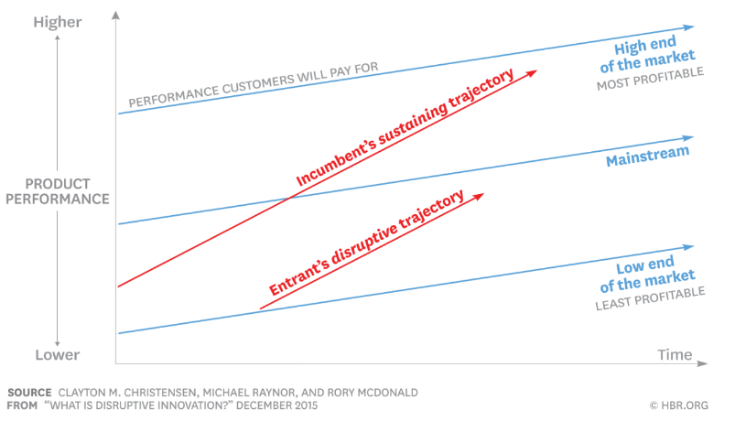
Disruptive Innovation Model
Source: https://hbr.org/2015/12/what-is-disruptive-innovation

Slide 12
Disruption in Higher Education
Top-tier F2F Higher Education institutions
High-end
MOOCs
Face-to-face teaching: sustaining trajectory
Mainstream F2F Higher Education
Online and blended courses
ODL as innovation
Open Universities and Dual-mode institutions
Low-end
Time

Slide 13
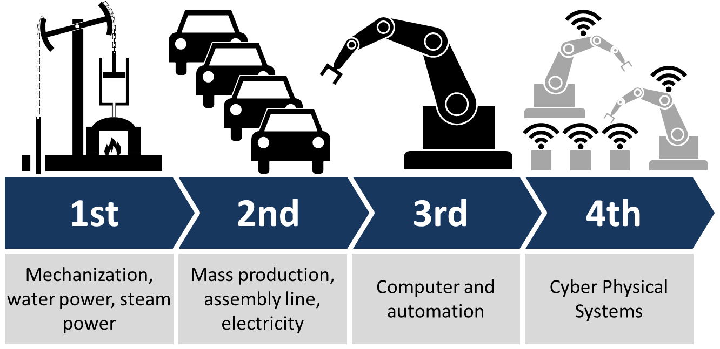
Fourth Industrial Revolution
CC BY-SA Source: https://commons.wikimedia.org/wiki/File:Industry_4.0.png (User:ChristophRoser)

Slide 14
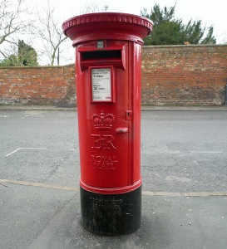
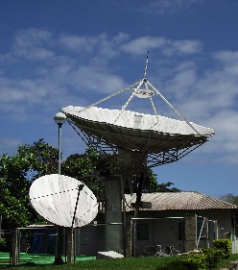
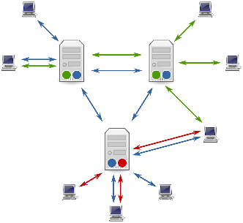

ODL as Disruption Over the Four Stages
From elite to mass
Correspondence model
Multi-media model
Intelligent flexible learning model
Gen 1
Gen 2
Gen 3
Gen 4
Notes:
CC BY-SA by David Right https://commons.wikimedia.org/wiki/File:E_II_R_Postbox,_Burgate,_Barton_Upon_Humber_-_geograph.org.uk_-_1064916.jpg

Slide 15
Influence of ODL on Higher Education
Face-to-Face Courses
Blended Courses
Distance/Online Courses
ICT integration in teaching and learning
MOOC
Mobile learning
Open and Distance Learning

Slide 16
Disruptions Happen
Demands of a learning society
When new technologies emerge
New providers emerge

Slide 17
What type of leadership do we need?

Slide 18
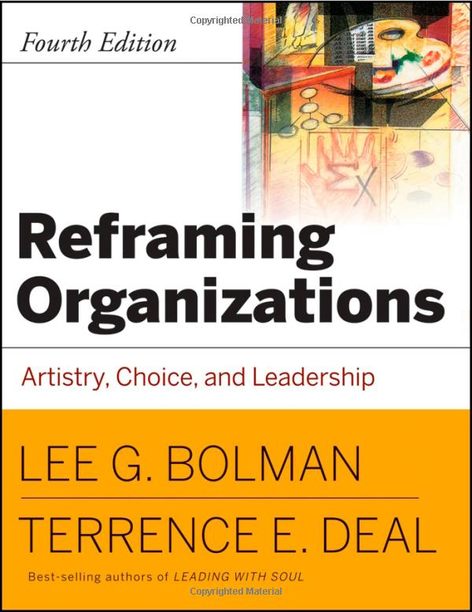

Slide 19
1. Structural Frame
Assumptions
Goals get results
Rules & policies; chains of command, specialisation
Analysis and data
Accountability
Behaviours:
goal setting; evaluation; budgeting; developing management & control systems

Slide 20
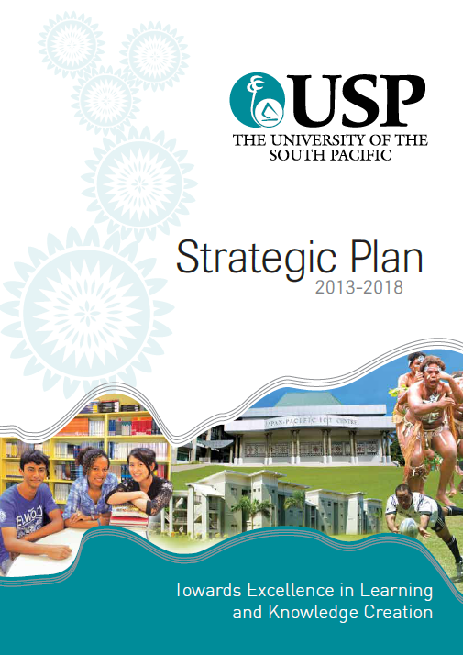
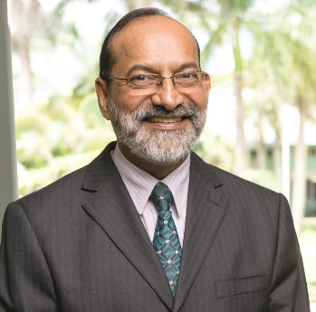
University of South Pacific
Rajesh Chandra

Slide 21
2. Human Resources Frame
Assumptions
People valued as important resource
Focus: meeting human needs; relationships
Facilitation & empowerment: consensus
Help employees fit into the organisation
Behaviours:
recruiting; training workshops and retreats; participative management; communication skills; coaching

Slide 22


Indira Gandhi National Open University (IGNOU)
Recruiting the best
Training and retraining
Inspiring and motivating through personal example
Ram Reddy

Slide 23
3. Political frame
Assumptions
Conflict and competition are a fact of life
Focus: securing critical resources
Reach agreement by negotiation
Need to understand ‘power’ relationships
Behaviours:
negotiating agreement; managing conflict; networking; creating coalitions; building a power base; managing the agenda

Slide 24



Canada: 2005
Télé-université du Québec
(TÉLUQ)
Université du Québec à Montréal (UQAM).
British Columbia Open University (BCOU) combined with University College of the Cariboo to become Thompson Rivers University

Slide 25
Lessons
the primordial importance of relationships with governments
the importance of relationship building with other institutions
the importance of cultivating communities of students and alumni
  Source: Strategic Issues in Single and Dual Mode Distance Education: the organizational blending of two Canadian distance universities with campus-based institutions Dominique A.M.X. Abrioux, Ph.D, 2006

Slide 26
4. Symbolic frame
Assumptions
Reality socially constructed: ‘multiple realities’
Focus: creating shared meaning
Organisational culture: use of symbolism; vision, mission, identity
Behaviours:
formal ceremonies; slogans; songs; images; rituals; visioning

Slide 27

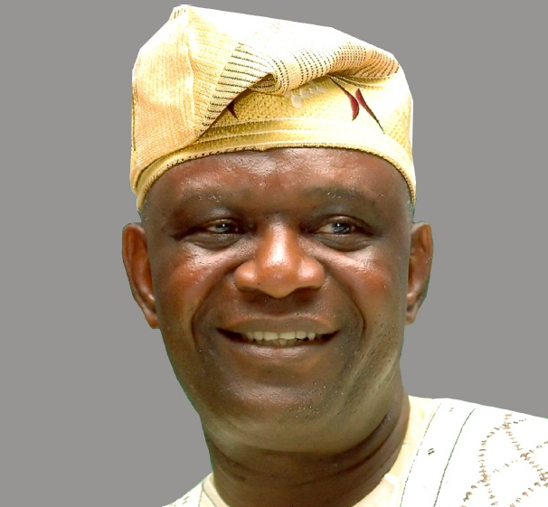
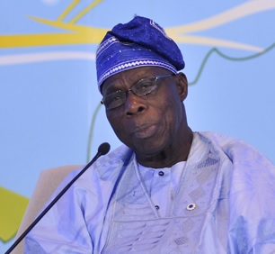
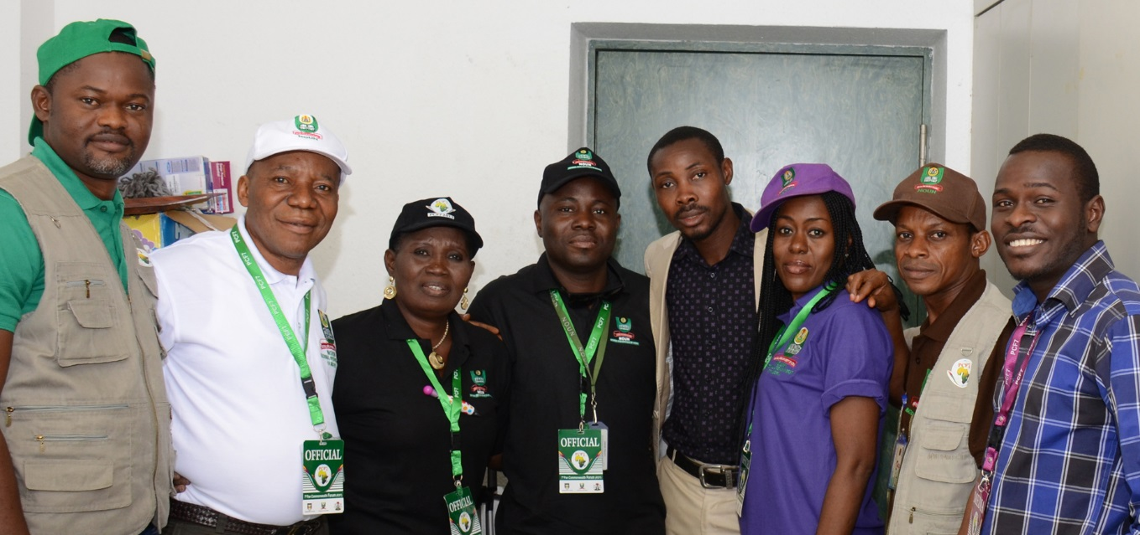

Slide 28

Do ODL leaders combine these frames?
Will a combination of these frames lead to ‘innovative leadership’?

Slide 29
Innovation
& Leadership

Slide 30
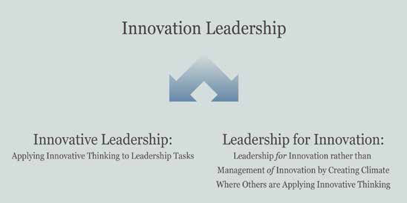
Source: David Horth and Dan Buchner, “Innovation Leadership: How to use innovation to lead effectively, work collaboratively, and drive results”, Centre for Creative Leadership, 2014 in http://insights.ccl.org/wp-content/uploads/2015/04/InnovationLeadership.pdf

Slide 31
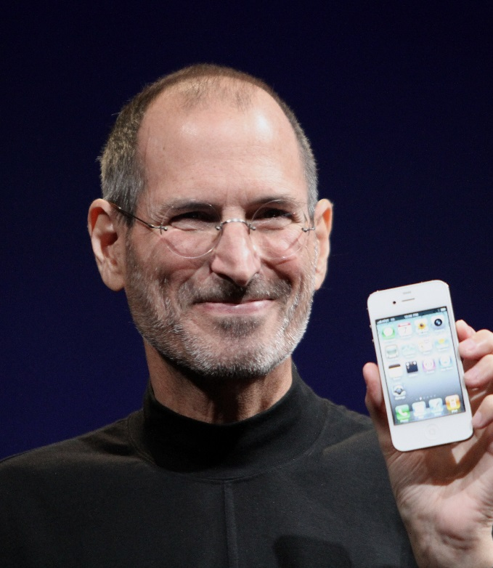
The Case of Steve Jobs
Do what you love
Make a difference
Creativity is connecting things
‘Say no to a thousand things’
Create insanely great experiences
Master the message
Sell dreams not products
Carmine Gallo, Forbes
Source: http://www.forbes.com/sites/carminegallo/2011/01/04/the-7-success-principles-of-steve-jobs/#56a9375a5bb7

Slide 32
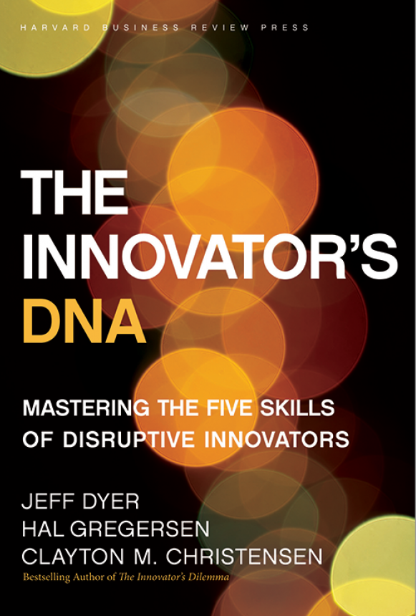
Skills for Innovation
Questioning
Observing
Networking
Experimenting
The Innovator's DNA: Mastering the Five Skills of Disruptive Innovators
by Jeffrey H. Dyer, Hal B. Gregersen, Clayton M. Christensen, Harvard Business Press
Notes:
Asking ‘why?’ or ‘what if?’
ODL Leaders must encourage a spirit of inquiry and a culture of research
Exposure to new technologies and environments to assess what works and what doesnt and why
Interactions of a social and intellectual nature with people from different disciplines/sectors
ODL Leaders must promote
interdisciplinary exchanges so that by connecting different disciplines and sectors, innovative ideas emerge
ODL Leaders must enable staff to visit other institutions and expose them to emerging technology developments
Try out new ideas by creating prototypes and launching pilots
ODL Leaders must encourage staff to construct interactive experiences and provoke out of the box solutions

Slide 33
What drives Research and Innovation in Industry?
http://www.arcusgroup.ca/CEO_view_strategic_planning.html

Slide 34
Way Forward

Slide 35
ODL Leaders
Philosophy
People
Processes
The Innovator's DNA: Mastering the Five Skills of Disruptive Innovators by Jeffrey H. Dyer, Hal B. Gregersen, Clayton M. Christensen, Harvard Business Press

Slide 36
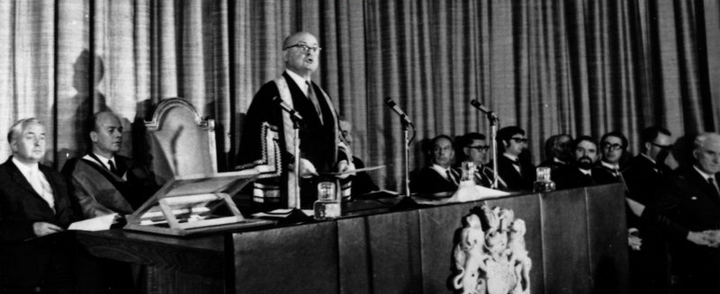
I. Philosophy of ‘Open-ness’
Open as to people,
Open as to places,
Open as to methods, and, finally,
Open as to ideas
Lord Crowther

Slide 37
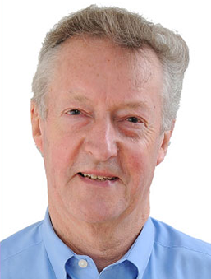
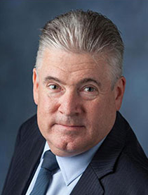

Inspire future leaders
Sir John Daniel
  Enrolling in the courses of his own university and promoting technology integration
Mr Martin Bean
  FutureLearn
Notes:
Believe in the social mission of ODL
Have a vision
Review mission statements
Keep abreast of new development in technologies

Slide 38
Are we effective advocates for ODL?

Slide 39
II. People
Motivate and inspire staff: be empathetic
Engage policy makers and stakeholders
Proactively support women leaders
Provide incentives

Slide 40


Universitas Terbuka
1995 internet came to Indonesia
1997 online courses
incentives
Tian Belawati

Slide 41
Do we cultivate Champions for Change?

Slide 42

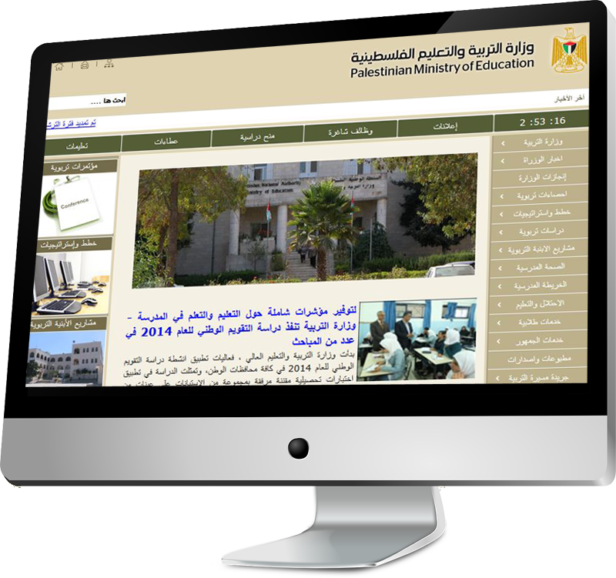
III. Processes
Create policies and systems
Encourage discussion and debate
Targeted approach

Slide 43

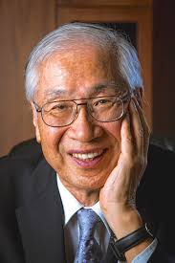
The Open University of Japan
One fourth of the students over 60
Declining government support
Cater to the Third Age
Yoichi Okabe

Slide 44
Are we evolving to remain relevant to the needs of stakeholders?

Slide 45
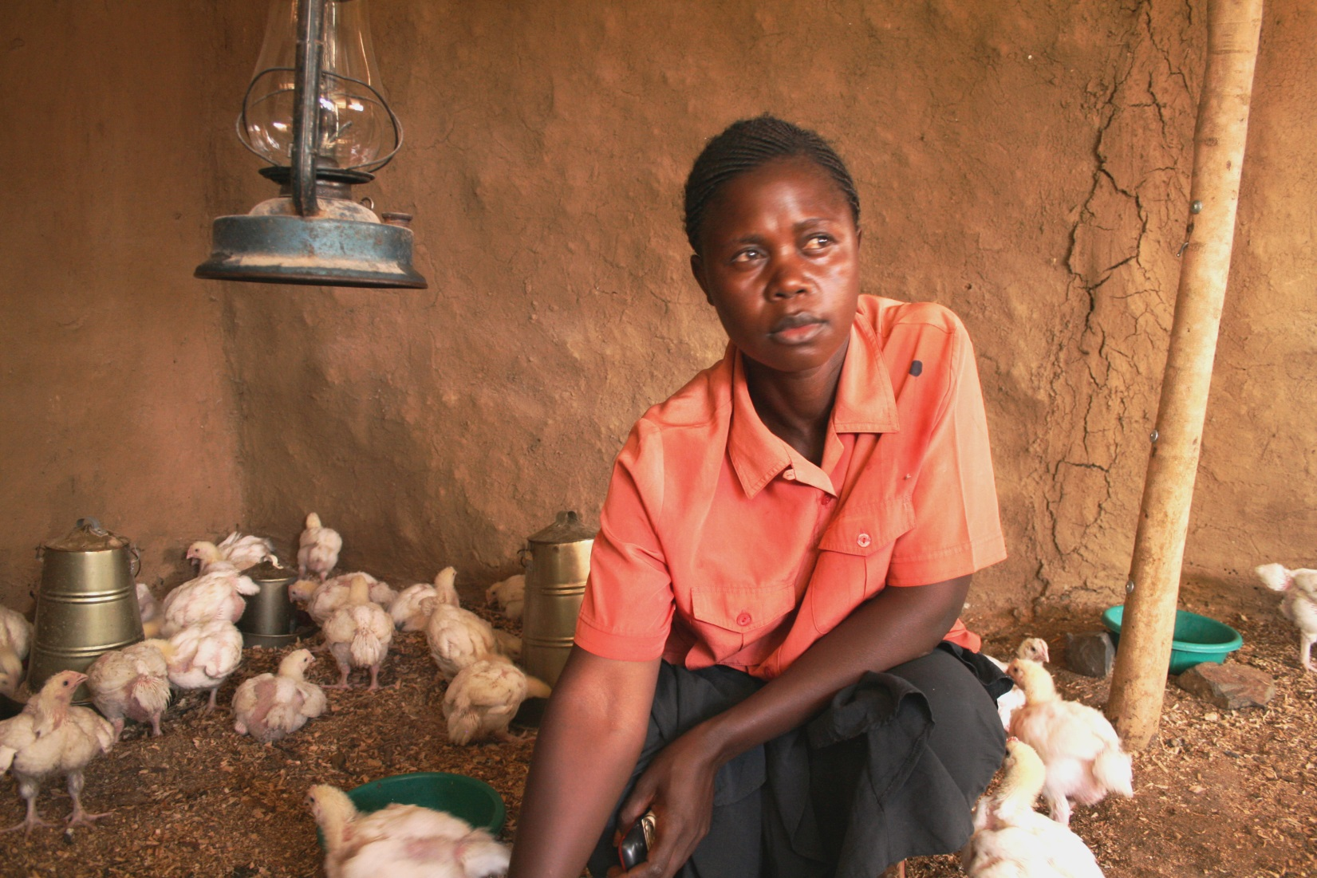
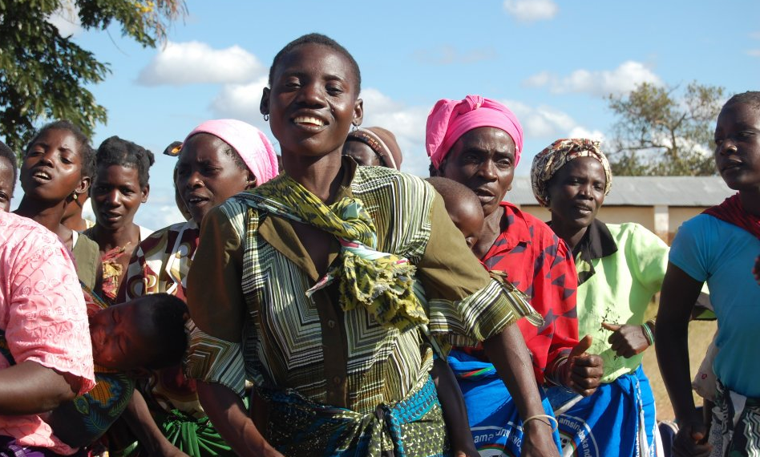
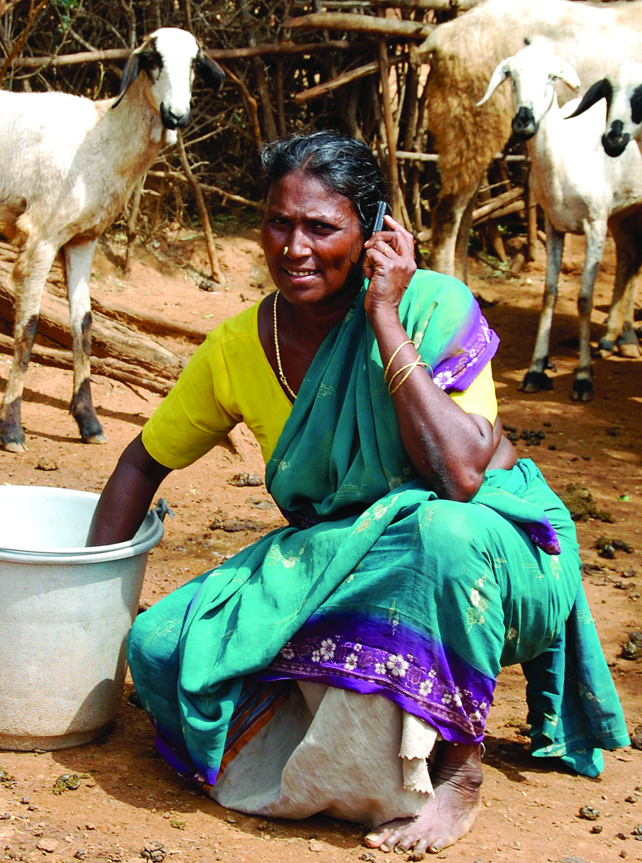
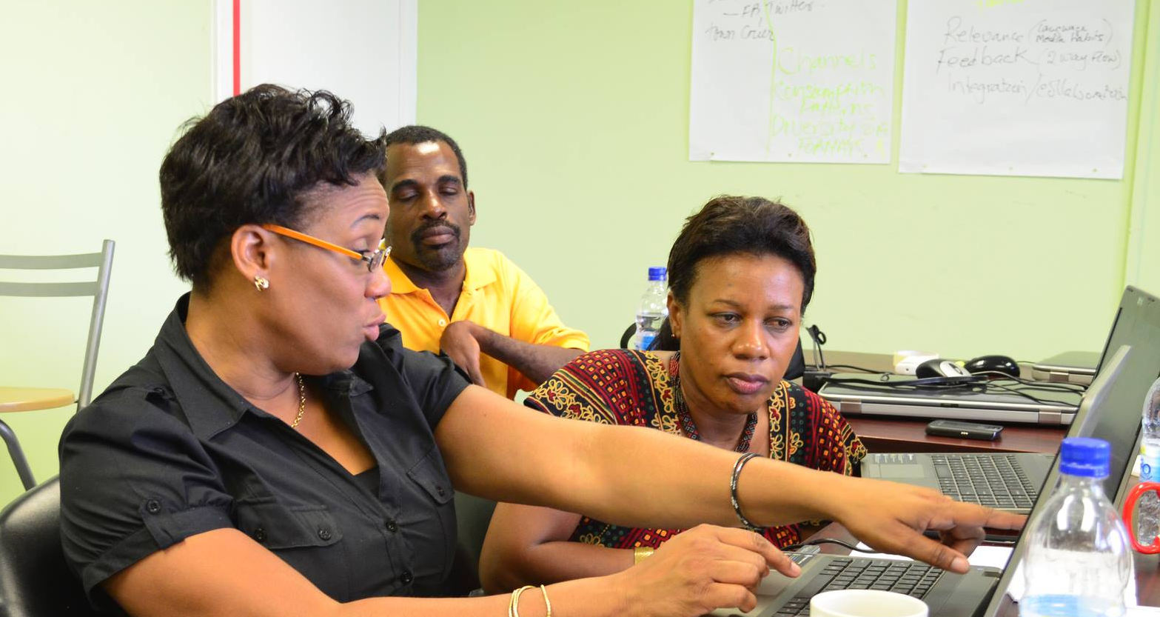
Thank You
www.col.org
Notes:
We invite you to engage us; tap into our thought leadership, expertise, networks and resources

