Slide 1





DIGITAL Education:
Unlocking the Potential of Every Mind
CARICOM DIGITAL SKILLS TASK FORCE WEBINARS 2023
Sanjaya Mishra
Director: Education Sector
Commonwealth of Learning, Canada
Notes:
November 11, 2022

Slide 2

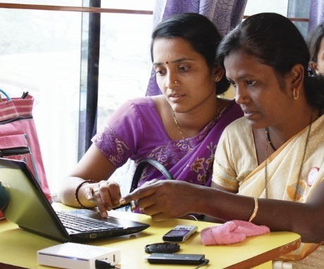
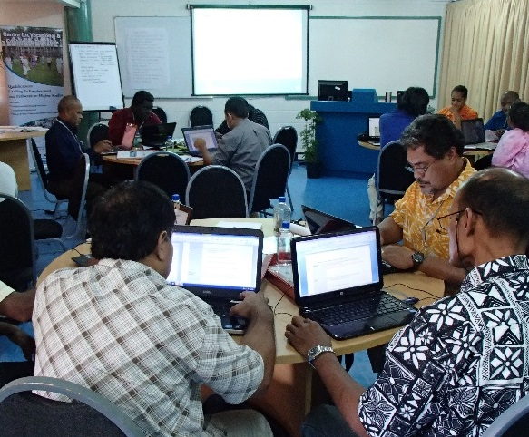
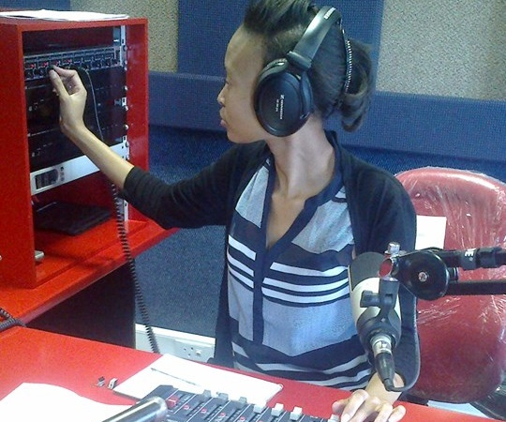
To help Commonwealth governments and institutions use technologies to improve and expand access to education and training

Slide 3
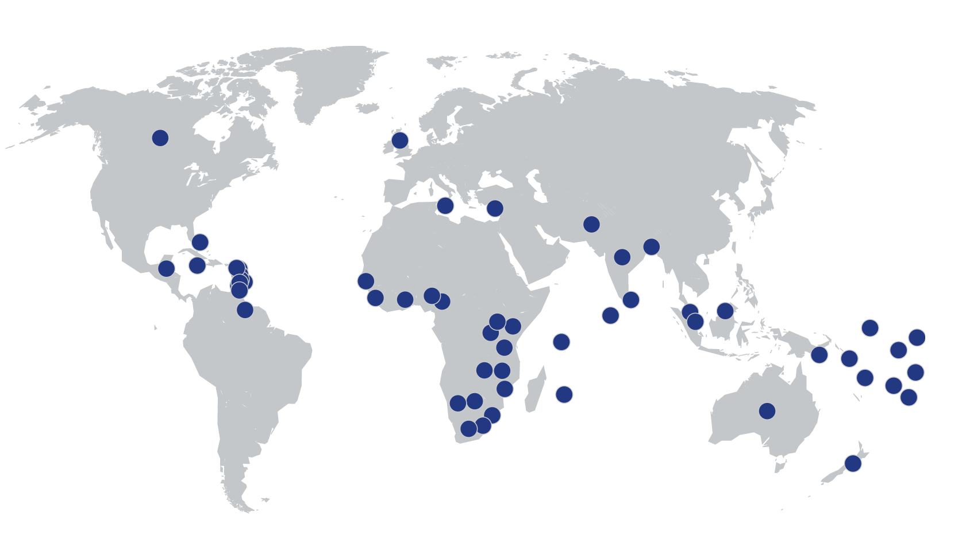












COL in the Caribbean

Slide 4

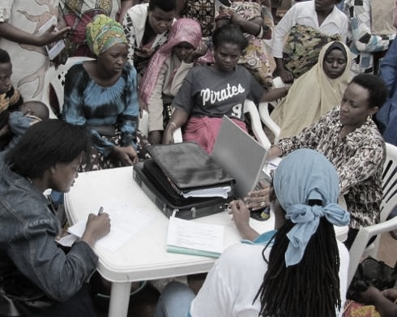
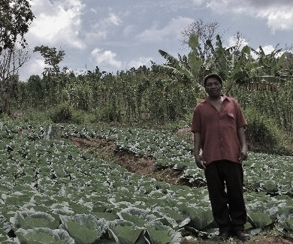


ECONOMIC EMPOWERMENT
SOCIAL
INCLUSION
ENVIRONMENTAL CONSERVATION
$

Slide 5

THE PLAN
Digital Age Contexts
Digital Education
Way Forward

Slide 6
Digital Age Contexts

Slide 7
Internet Access per 100 population
Source: https://www.itu.int/en/ITU-D/Statistics/Dashboards/Pages/Digital-Development.aspx

Slide 8
Mobile Subscription per 100 population
Source: https://www.itu.int/en/ITU-D/Statistics/Dashboards/Pages/Digital-Development.aspx

Slide 9
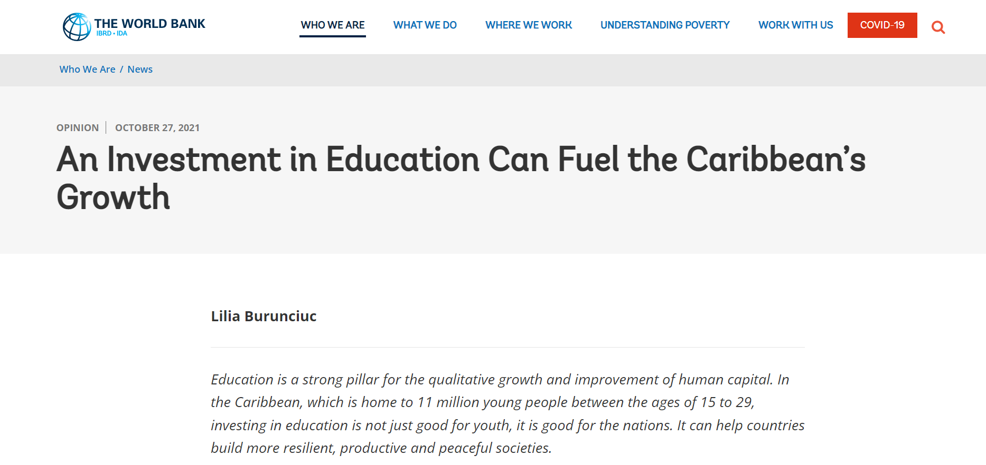
Education for Young People
Notes:
According to International Labour Organization data from 2019 and 2020, due to limited education and employment opportunities, about three out of every ten young people in the Caribbean are not in school, employed, or being trained.

Slide 10
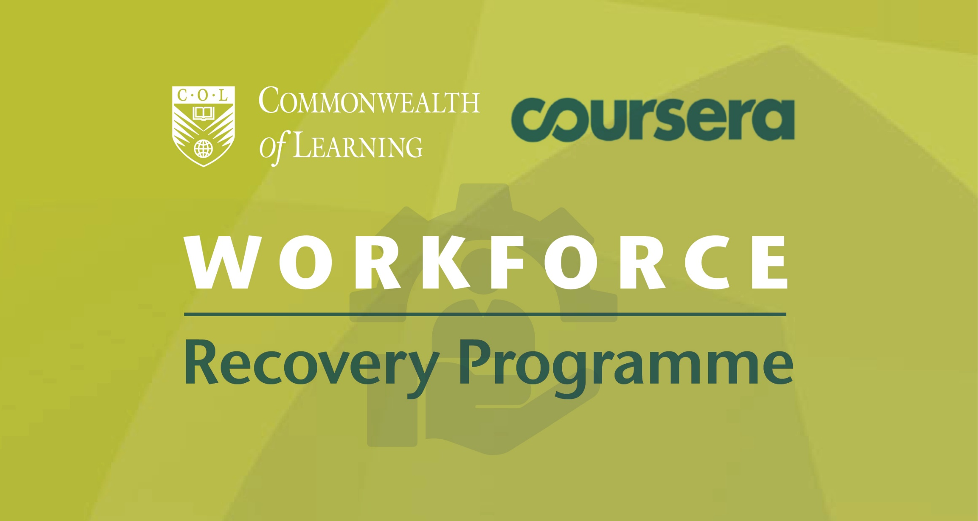
COVID-19 and its impact

Slide 11
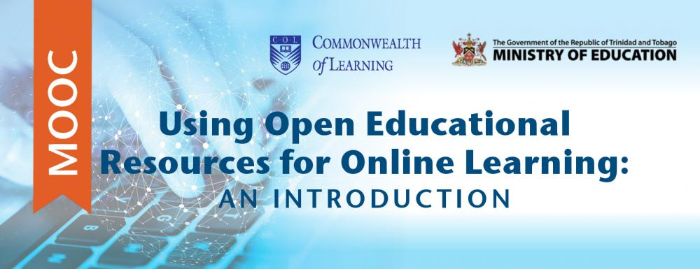
MOOC for Teachers
https://www.mooc4dev.org/Teaching4C2

Slide 12
ICT in Education
Antigua and Barbuda
Belize
Saint Lucia

Slide 13
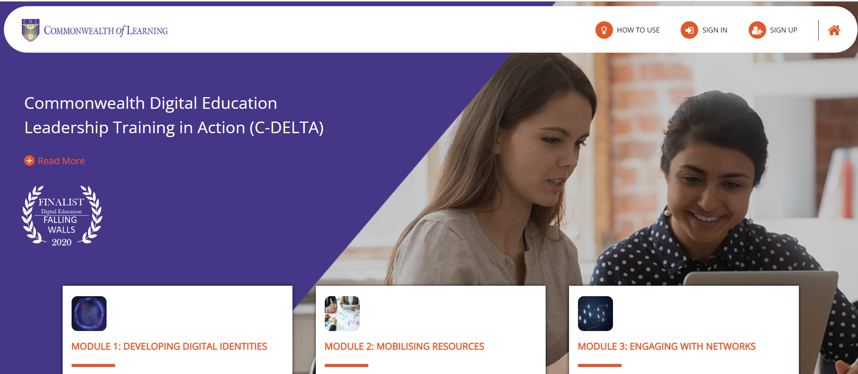
C-DELTA

Slide 14

Key Trends
High Internet and mobile penetration creating new opportunities for online/blended learning
Increased use and acceptance of online learning during Covid-19
Availability of open and free courses for teacher training on digital fluency (e.g., C-DELTA)
Need for skilling and re-skilling the youths
Policy development for ICT in education needed to build resilience of education systems

Slide 15
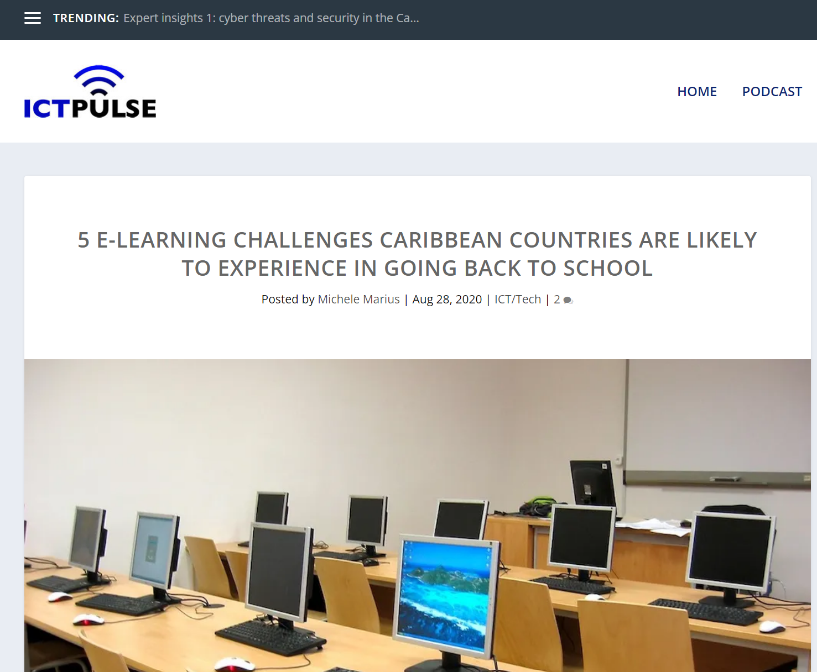
Key Challenges
Internet connectivity at schools
Internet access beyond administration in schools
Connectivity at home
Cost of Internet access
Teacher training

Slide 16
Digital Education

Slide 17
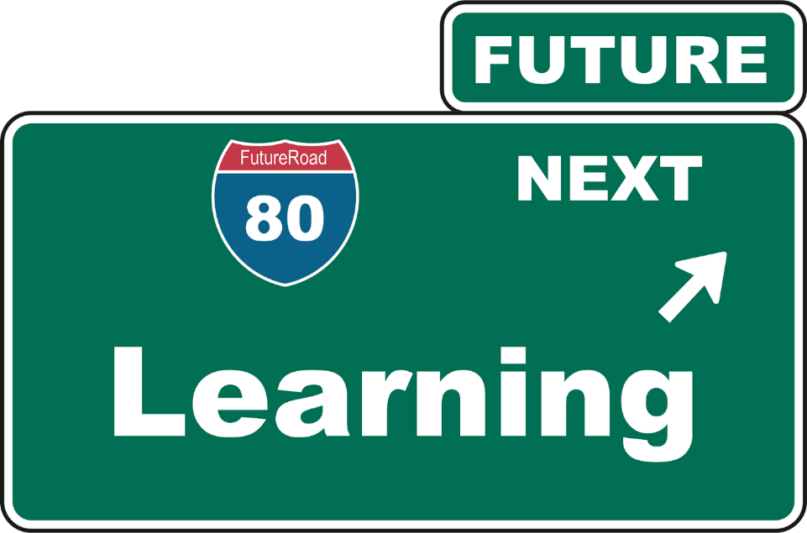
Making Education Smart
enjoyable, leading to the retention and transfer of knowledge to long-term memory;
engaging, with innovative application of technologies;
efficient, in terms of just-in-time learning and availability for right resources;
effective, in leading to the earning livelihoods and development of responsible citizenship; and
ethical, to address issues of privacy, cybersecurity and equity.
(Kanwar, 2021)

Slide 18
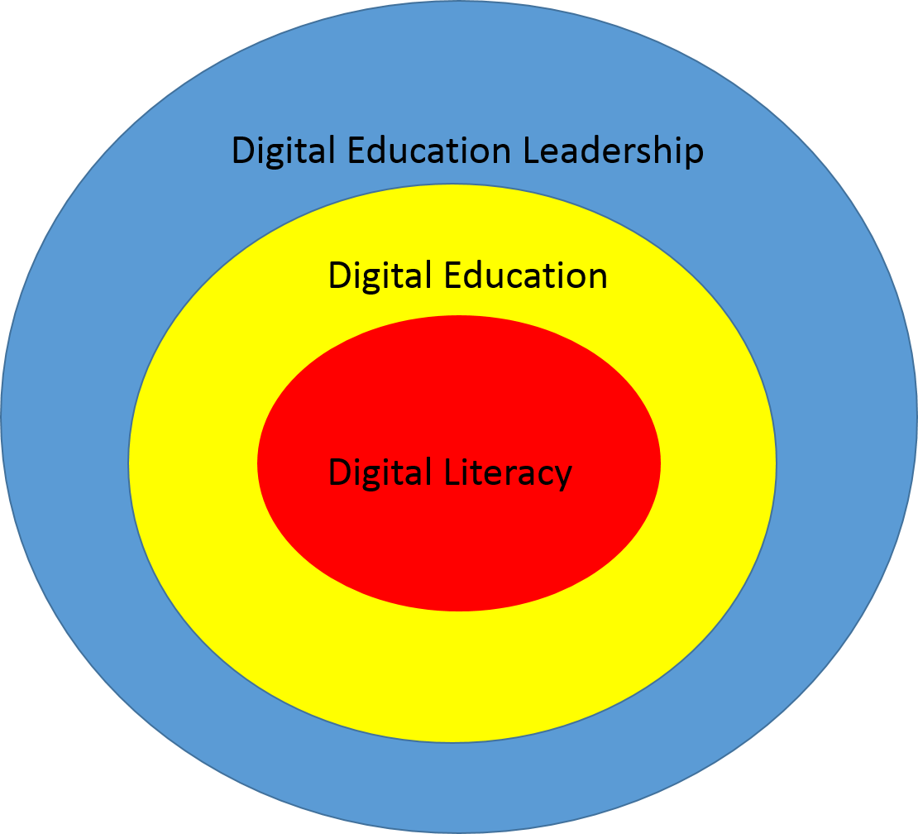
What is Digital Education Leadership?
Notes:
Digital literacy, as a social practice, is understood to be the core, as it is the outcome, the destination of digital education and digital education leadership. It is the purpose of digital education.
Digital education is the pedagogic intervention that goes into fostering digital literacies. It is the “how” of getting to digital literacy.
Digital education leadership is concerned with providing direction in terms of digital education by enhancing access, capacitating peers, making informed decisions and cultivating innovation, to achieve the learning goal (digital literacy).

Slide 19
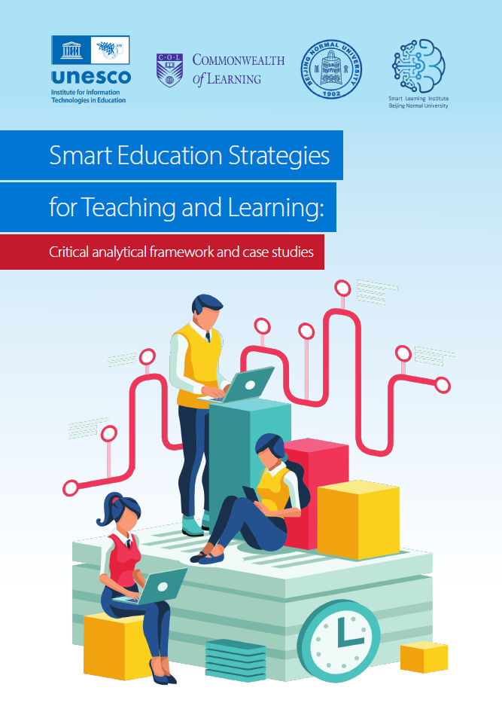
Context matters
How are policies situated?
Human capital development
Learning loss
Systemic inequalities
COVID-19 challenges
Emerging technological trends
EdTech global market
Cyber security and ethical challenges

Slide 20
Policy Theme 1: Infrastructure
Sustainable energy/power solutions for education institutions;
Low-cost affordable, safe, ubiquitous and meaningful connectivity;
Home internet access for staff and students;
Access to zero-rated platform ecosystems;
Smart classrooms and campuses that use technologies;
Technical support, upgrades and maintenance;
Carbon emission management of technology adoption for learning and teaching;
Managing responsible disposal of e-waste from educational technology investments; and
Promoting responsible, safe use of digital infrastructure to support learning.

Slide 21

Policy Theme 2: Curriculum and pedagogy
Shift towards competency-based curricula
Shift due to the impact of COVID-19
Datafication of teaching and learning practices
Lifelong learning implications
Impact of Artificial Intelligence

Slide 22
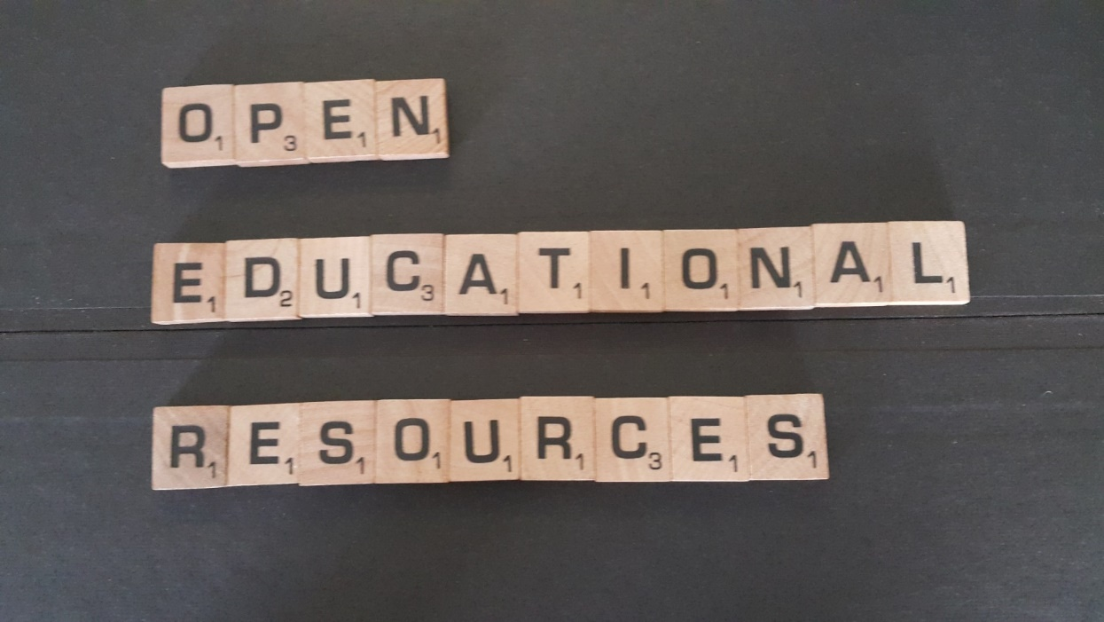
Policy Theme 3: Digital Education Resources
Open educational resources and practices
Learning management systems and digital platforms for education

Slide 23

Policy Theme 4: Skills and competencies
4th Industrial Revolution
Digital Education Skills
Teachers’ capacities
Preparing students for the future
Focus on STEM, especially for girls
Recognition of micro-credentials

Slide 24
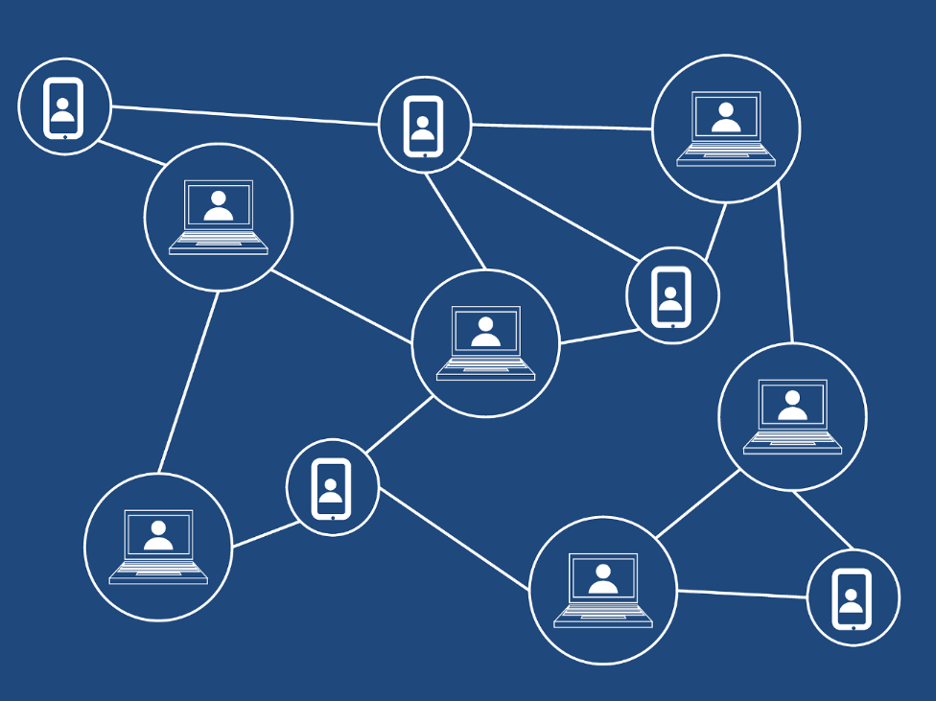
Policy Theme 5: Governance
Cybersecurity
Personal data protection
Funding models
Blockchain

Slide 25

Policy Theme 6: Administration and management
Big data and EMIS
Quality assurance
Planning and implementation
Digitization

Slide 26
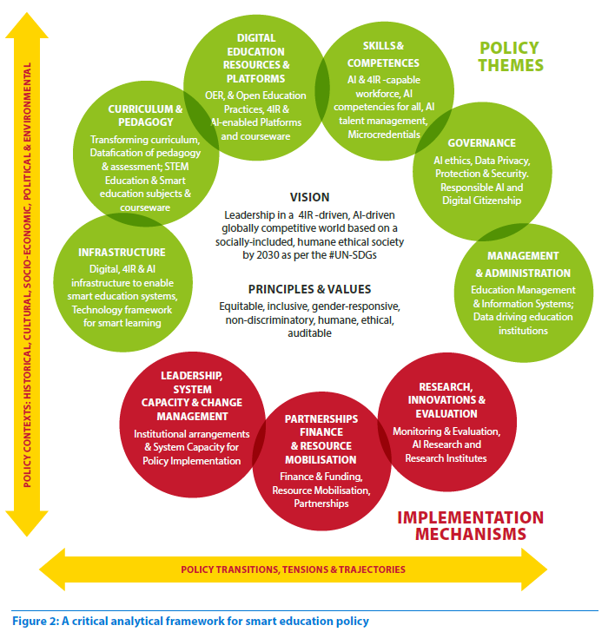
Smart Education Policy Framework

Slide 27
Way Forward

Slide 28
Convergence of Technology
Face-to-Face Courses
Blended Courses
Distance/Online Courses
MOOC
Mobile learning
ICT integration in teaching and learning
Open and Distance Learning

Slide 29
Implement Blended Learning
Technology
Capacity
Policy

Slide 30

TEL as Backbone of Blended Strategy
Access
Equity and Inclusion
Training both students and teachers
Appropriate mix for online and face-to-face
Build student-student and student-teacher interaction
Mix asynchronous and synchronous activities

Slide 31
Adopt UNESCO OER Recommendation
Building capacity of stakeholders to create, access, use, adapt and redistribute OER
Developing supportive policy
Encourage inclusive and equitable quality OER
Nurturing the creation of sustainability models for OER
Facilitating international cooperation
UNESCO Recommendation 2019

Slide 32
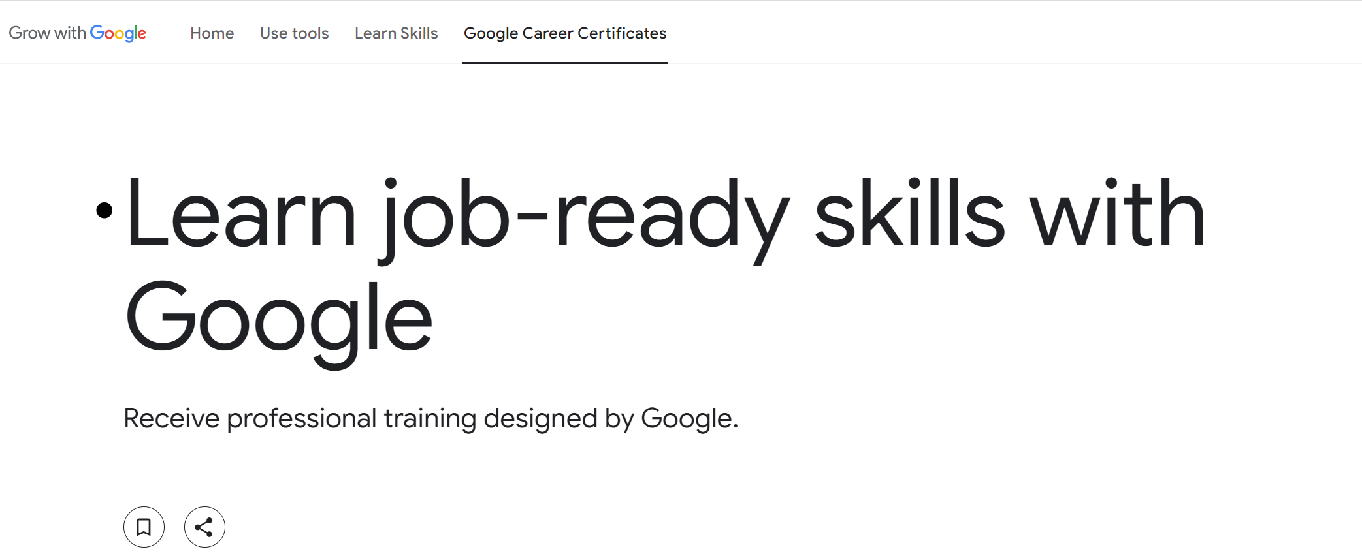
Provide Job-Ready Skills Training

Slide 33

Design Micro-credentials
Aligned to national/regional qualifications framework
Competency-based
Industry-oriented
Bite-sized
Assessed (including assessment of prior-learning)
Modality neutral
Stackable
Quality assured
Provider

Slide 34
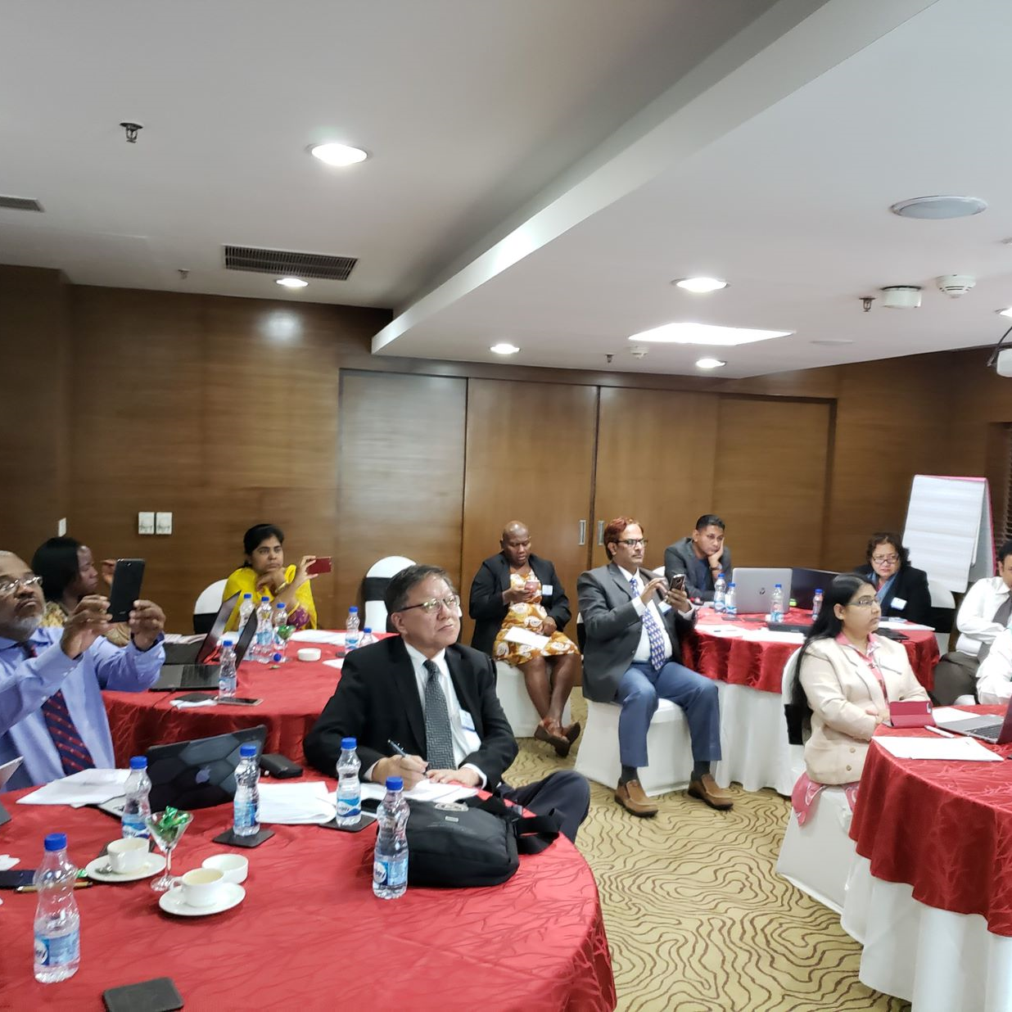
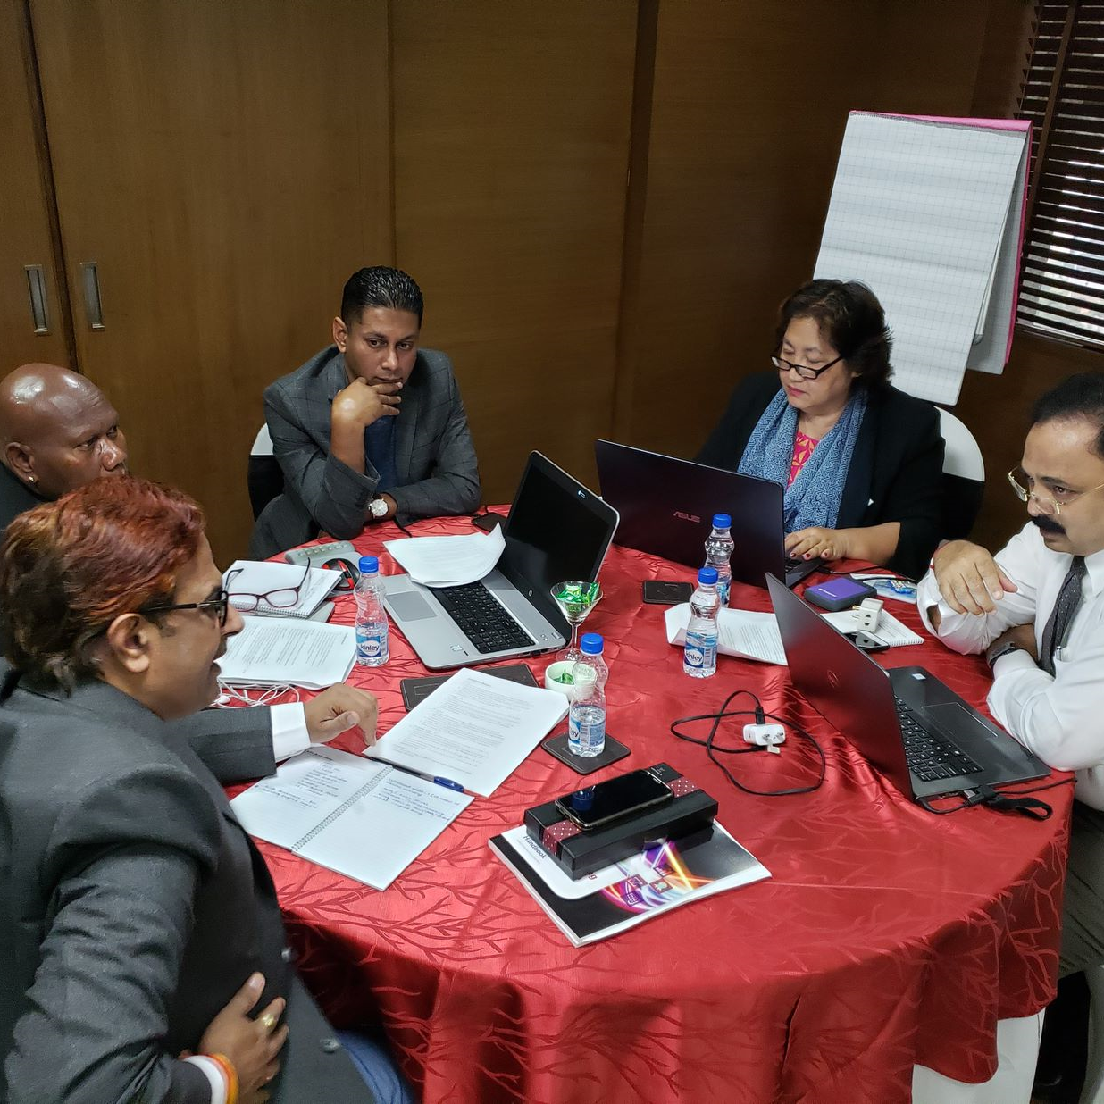
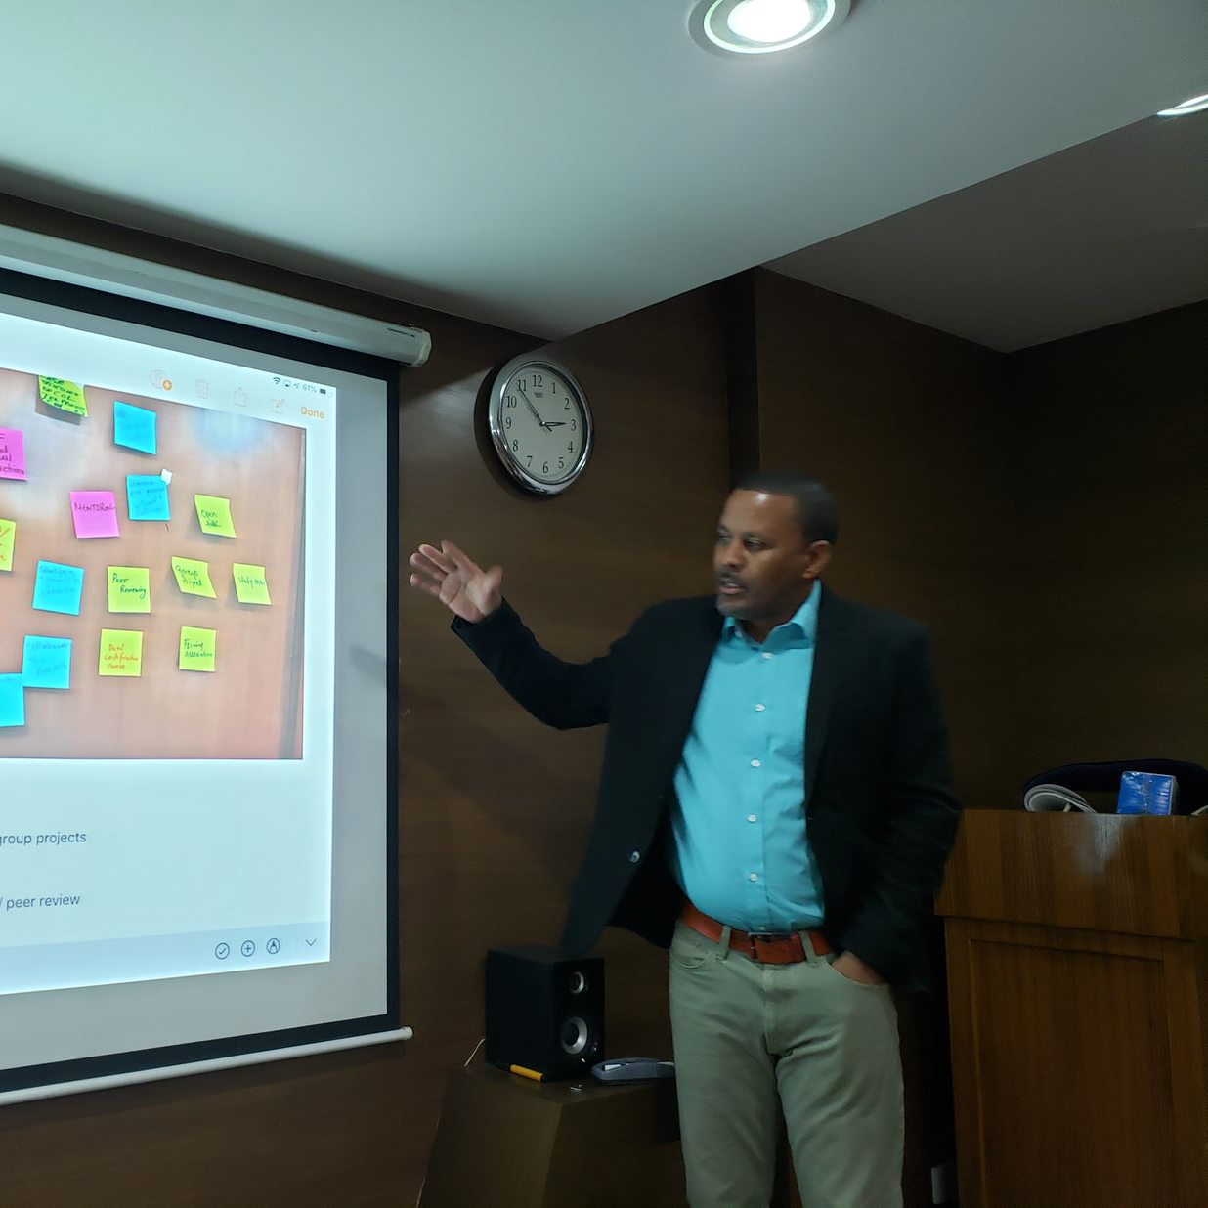
Invest on Digital Education Skills Development
Building capacities of policy-makers
Developing capacity of teachers
Preparing learners to find and use OER

Slide 35

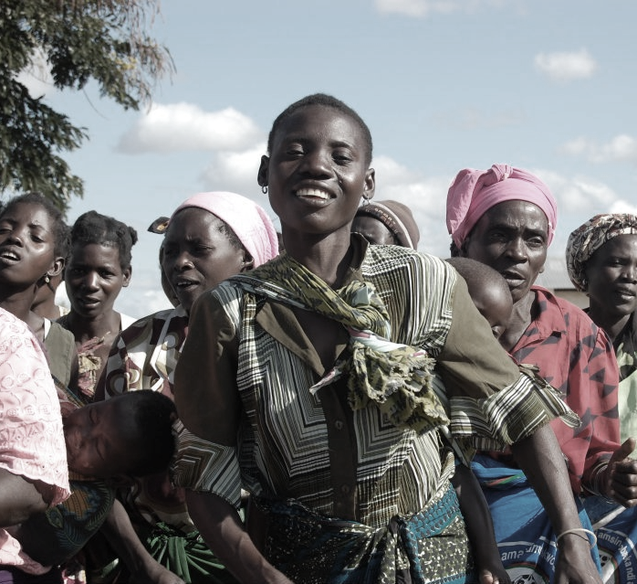
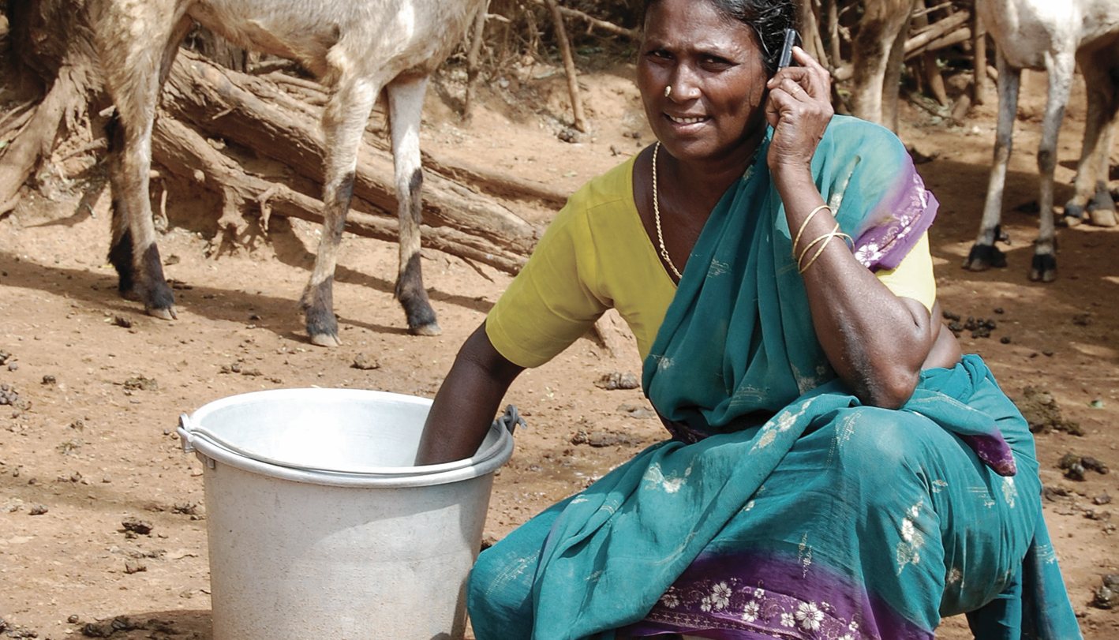
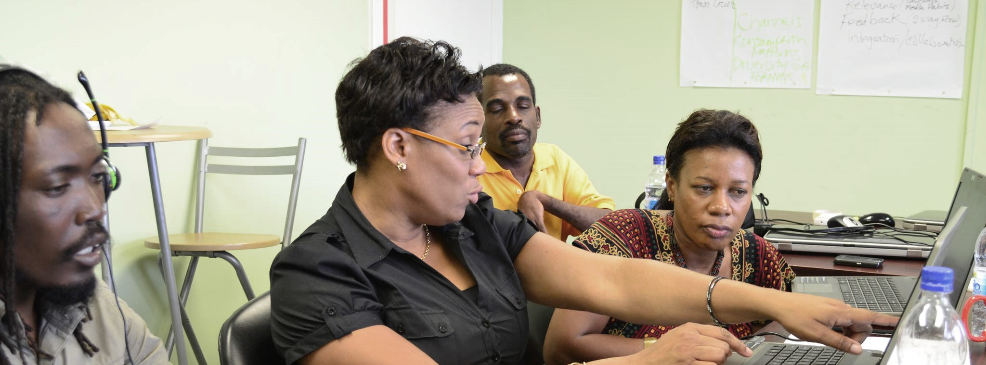


Thank you
www.col.org
The contents of this presentation, with the exception of logos and graphics which are the property of the respective owners, is made available under Attribution-ShareAlike 4.0 International (CC BY-SA 4.0).

