Slide 1



Development, Use and Assessment of OER
Professor Asha Kanwar, President & CEO
Dr Ishan Abeywardena, Adviser: OER

Slide 2
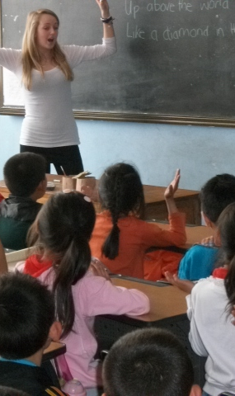
Learning outcomes
By the end of this workshop
you will be able to:
  Understand OER and open licences
  Explore how to adopt and adapt OER
  Understand quality assurance for OER
  Identify barriers to mainstreaming OER and strategies to overcome them
Image source: https://flic.kr/p/dq159W

Slide 3
Understanding OER

Slide 4
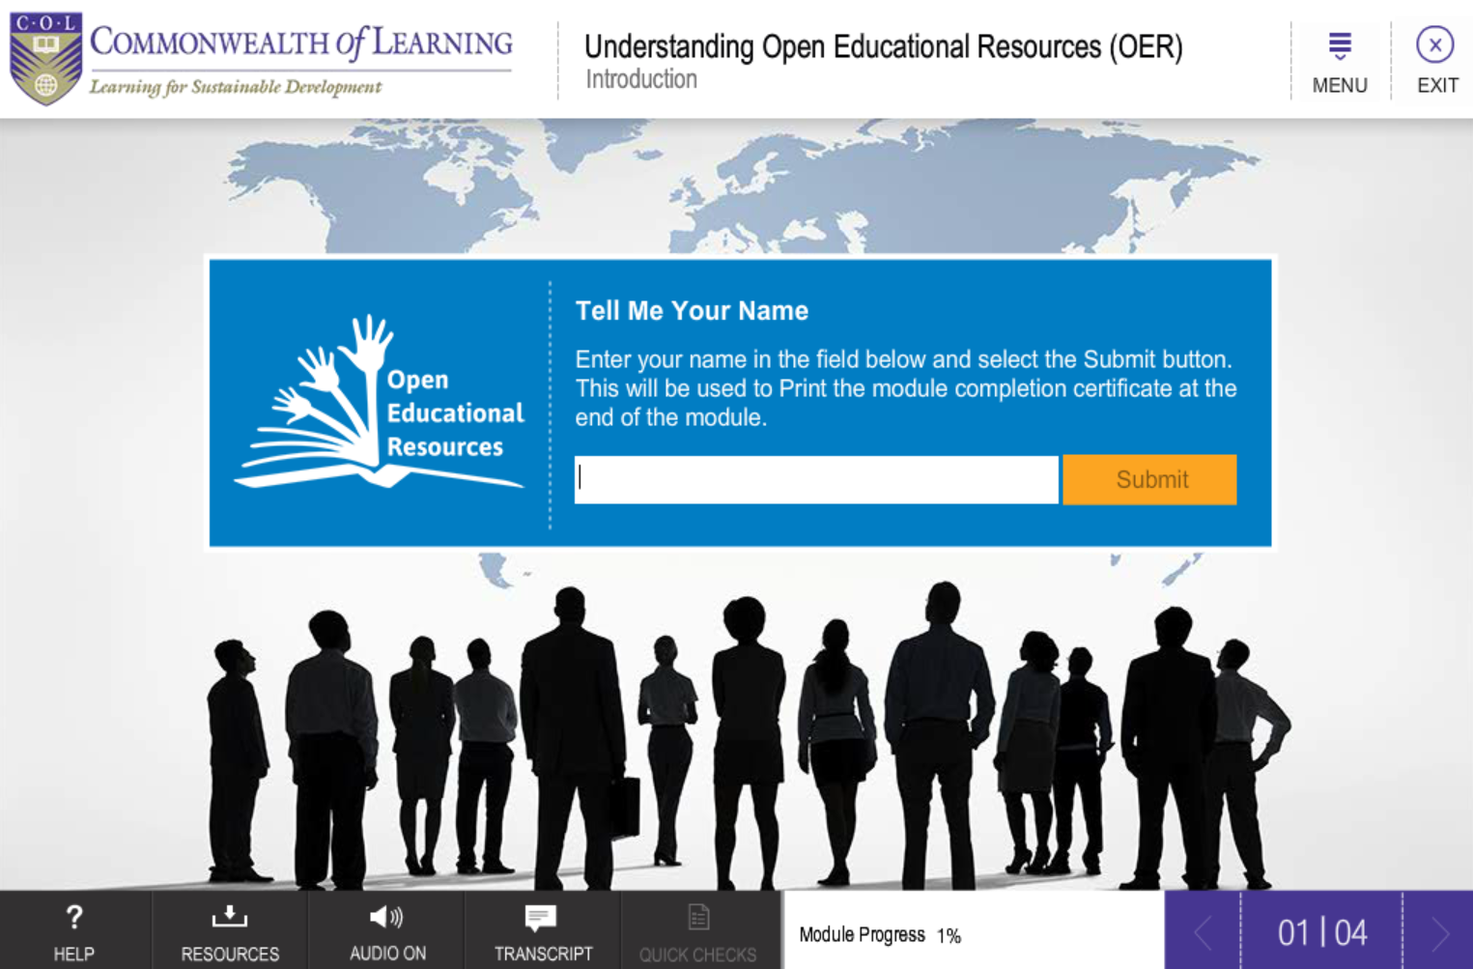
Understanding OER
Short OER Course: Accessed by 19,000 people

Slide 5

What are OER?
“OER are teaching, learning and research materials in any medium – digital or otherwise – that reside in the public domain or have been released under an open license that permits no-cost access, use, adaptation and redistribution by others with no or limited restrictions.” (UNESCO, 2017, p. 1).
UNESCO, 2017. Ljubljana OER Action Plan 2017, Paris: UNESCO.

Slide 6
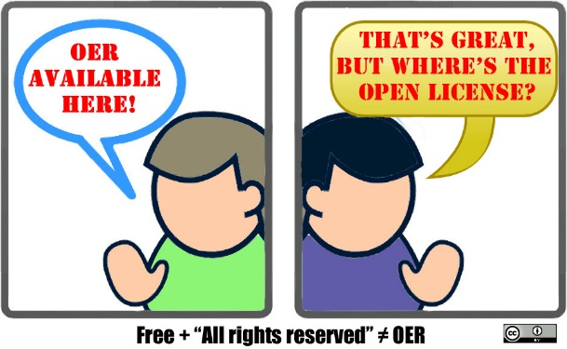

A Practical Definition of OER
Open Educational Resources (OER) are content (text, images, videos, audio, presentations etc.) with a Creative Commons license
Image source: https://flic.kr/p/r89iTe

Slide 7

Benefits of OER
OER can increase access and equity by reducing costs
Tap into global knowledge flows and improve quality
Appropriate technologies to enable stakeholders to be active participants

Slide 8

What is Open?
5R
Reuse
(copy verbatim)
Revise
(adapt and edit)
Remix
(combine with other materials)
Redistribute
(share with others)
Retain
(make, own and control copies)
It’s about open license used to share educational material
No permission required as long as the open license is respected

Slide 9
Why Consider Licensing?
Copyright and licensing issues are at the heart of OER as they have important implications for creators, users and institutions.
By default, copyright is automatic and ‘all rights reserved’ - thus permission is required by those who wish to use the work.

Slide 10

Copyright
Prohibits unauthorized use, distribution, performance, adaptation, sale, etc.
Requires permission of the Copyright holder for creating any derivative works
Fair use or fair dealing is permitted:
  Examples of fair use include commentary, search engines, criticism, news reporting, research, teaching, library archiving and scholarship.

Slide 11

Open Licences
Create more freely accessible materials
Open licences developed to make it easier for a creator to share works freely with the public.
There have been several efforts to adopt open licences:
  The Open Content Licence,
  GNU Free Documentation Licence,
  Open Publication Licence

Slide 12

Licences
CC licences offer a flexible and simple tool for people who value access to and use of their works over monetary incentives, while still maintaining some rights.
CC licences are not an alternative to copyright. They enable creators to distribute their content to a wide audience and specify the manner in which the work can be used while still maintaining their copyright.

Slide 13
Types of CC Licenses and Conditions
Creative Commons
Concepts
CC-BY
CC-BY-SA
CC-BY-NC
CC-BY-NC-SA
CC-BY-ND
CC-BY-NC-ND
Attribution
Share Alike
Non-Commercial
Non-Derivative

Slide 14

Attribution (CC-BY)
This licence lets others distribute, remix, tweak, and build upon your work, even commercially, as long as they credit you for the original creation.
This is the most accommodating of licences offered.
It is recommended for maximum dissemination and use of licensed materials.

Slide 15

Attribution-ShareAlike
(CC BY-SA)
This licence lets others remix, tweak, and build upon your work even for commercial purposes, as long as they credit you and license their new creations under the identical terms.
Often compared to “copyleft” free and open source software licences.
All new works based on yours will carry the same licence, so any derivatives will also allow commercial use. This is the licence used by Wikipedia.

Slide 16

Attribution-No Derivatives
(CC BY-ND)
This licence allows for redistribution, commercial and non-commercial, as long as it is passed along unchanged and in whole, with credit to you.

Slide 17

Attribution-Non Commercial
(CC BY-NC)
This licence lets others remix, tweak, and build upon your work non-commercially, and although their new works must also acknowledge you and be non-commercial, they don’t have to license their derivative works on the same terms.

Slide 18

Attribution-Non Commercial-No Derivatives (CC BY-NC-ND)
This licence is the most restrictive, only allowing others to download your works and share them with others as long as they credit you, but they can’t change them in any way or use them commercially.

Slide 19


Creative Commons
Public Domain Tools
CC’s public domain tools enable authors and copyright owners who want to dedicate their works to the worldwide public domain to do so.
  The CC-0 tool (“No Rights Reserved”) allows licensors to waive all rights and place a work in the public domain.
  The Public Domain mark identifies a work that is free of known copyright restrictions. It is not recommend for works that are restricted by copyright laws in one or more jurisdictions.

Slide 20







Open Licences- Summary
most freedom
OER
Not OER
least freedom
Notes:
20

Slide 21
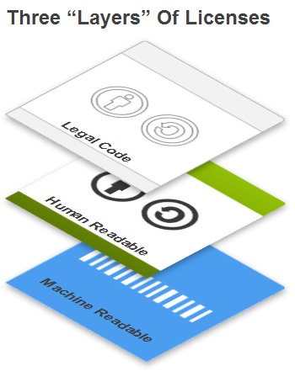
Why Use Creative Commons Licenses?
Legal Code: expansive legal languages tested in several cases
Commons Code: Simple icon-based approach to explain what you can do want you can’t
Digital Code: Enables search engines to search and locate through CC Rights Expression Language

Slide 22
CC Licence Chooser
https://creativecommons.org/choose/
Step 1: Choose License Feature
  Allow adaptations of your work to be shared?
    Yes
    No
    As long as others share alike
Step 2: Choose License Feature
  Allow commercial uses of your work?
    Yes
    No
Step 3: Select Licence
Step 4: Copy the Code to use

Slide 23
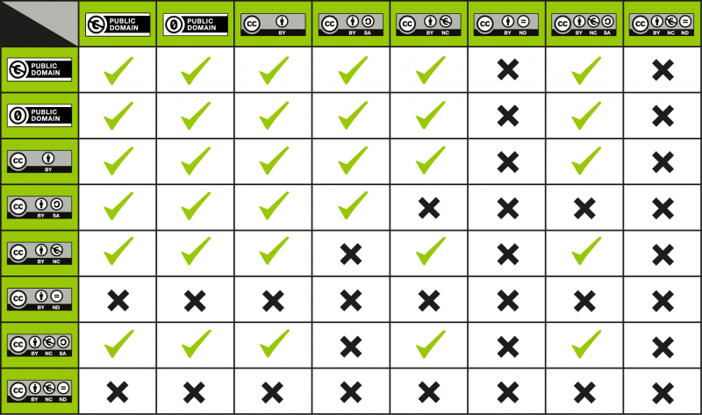
CC Licence Compatibility Chart

Slide 24
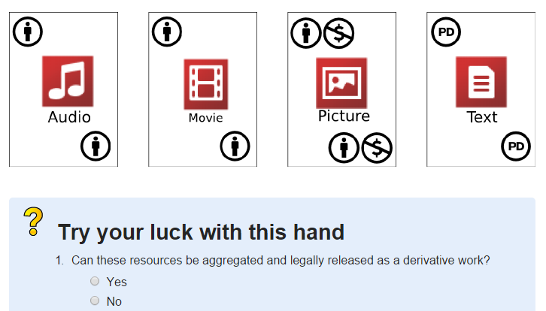
Activity
OER Remix Game
http://opencontent.org/game/

Slide 25
Where to Find OER

Slide 26
Where can we find OER?
Search Engines: Google, Bing, Creative Commons Search
Repositories: MIT OCW, OpenLearn
Directories: DOER,OER Commons

Slide 27
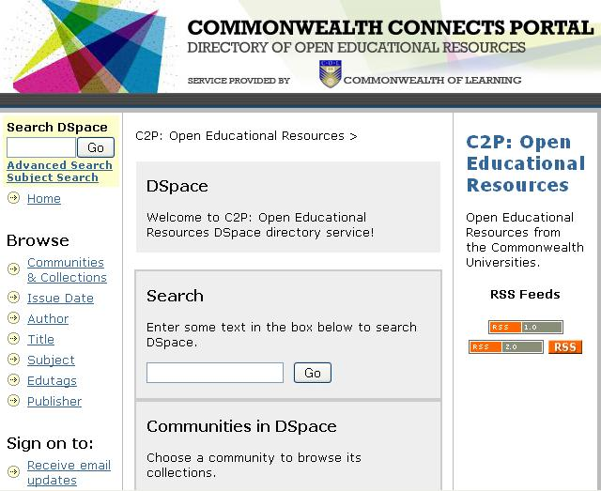
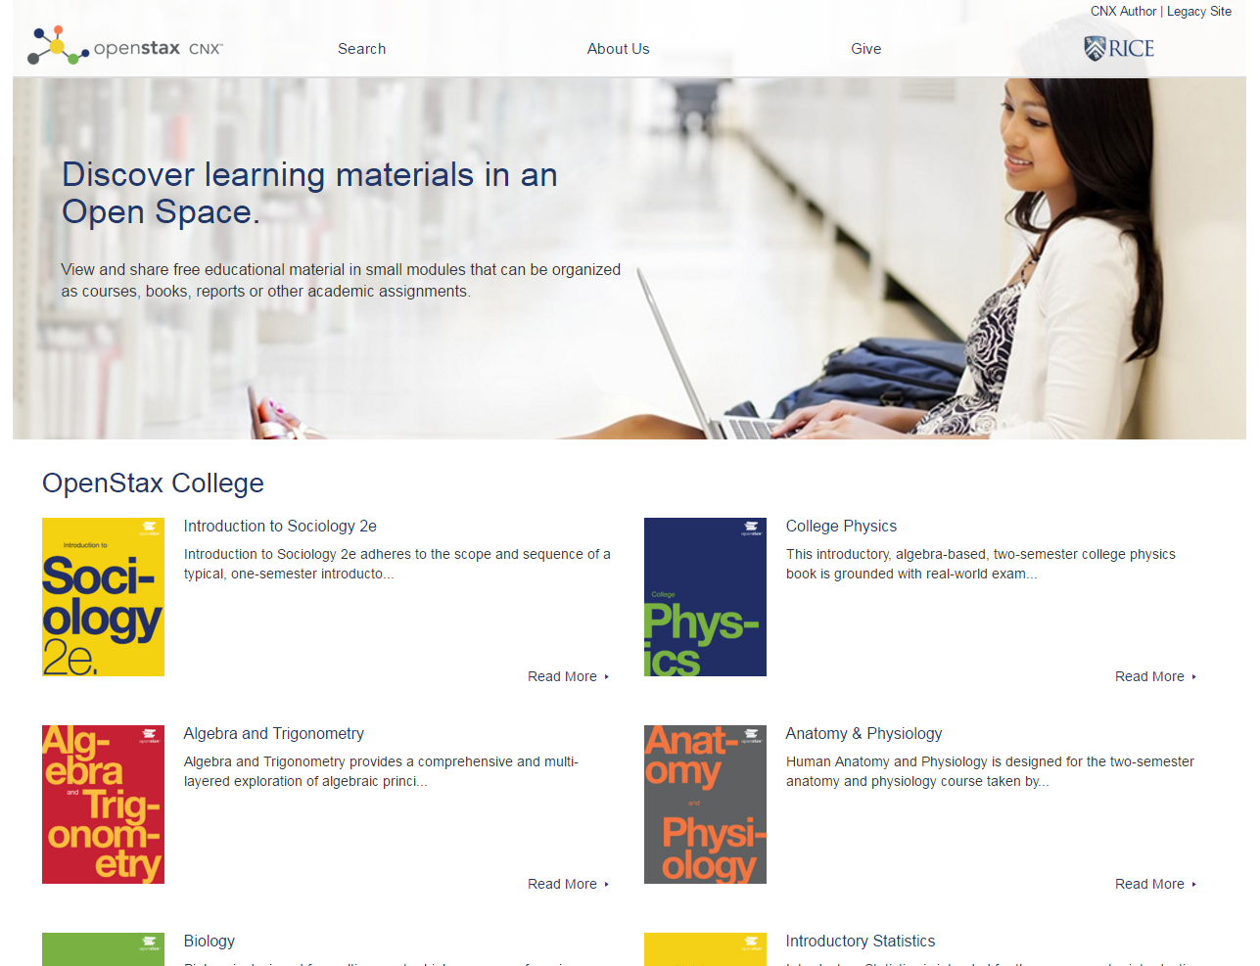
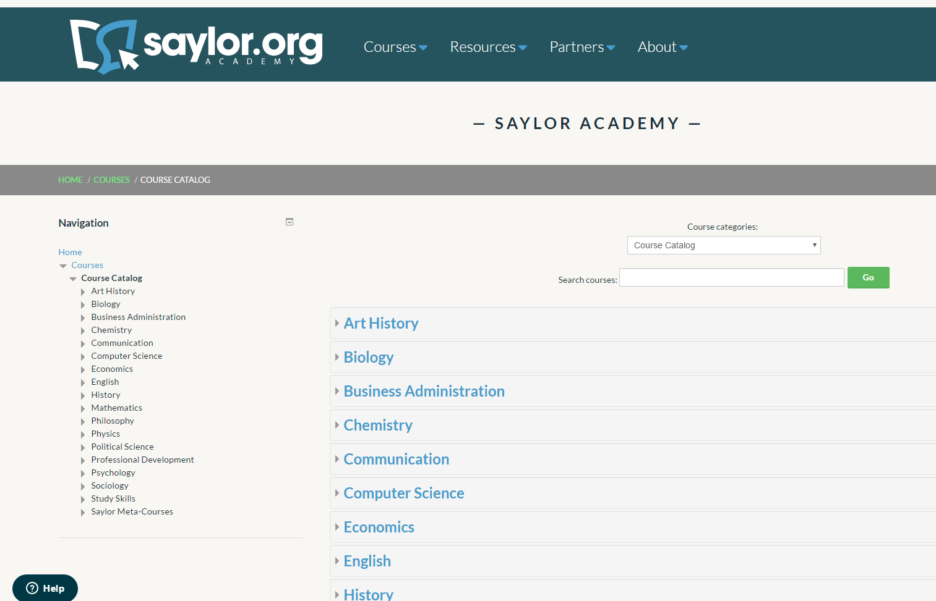
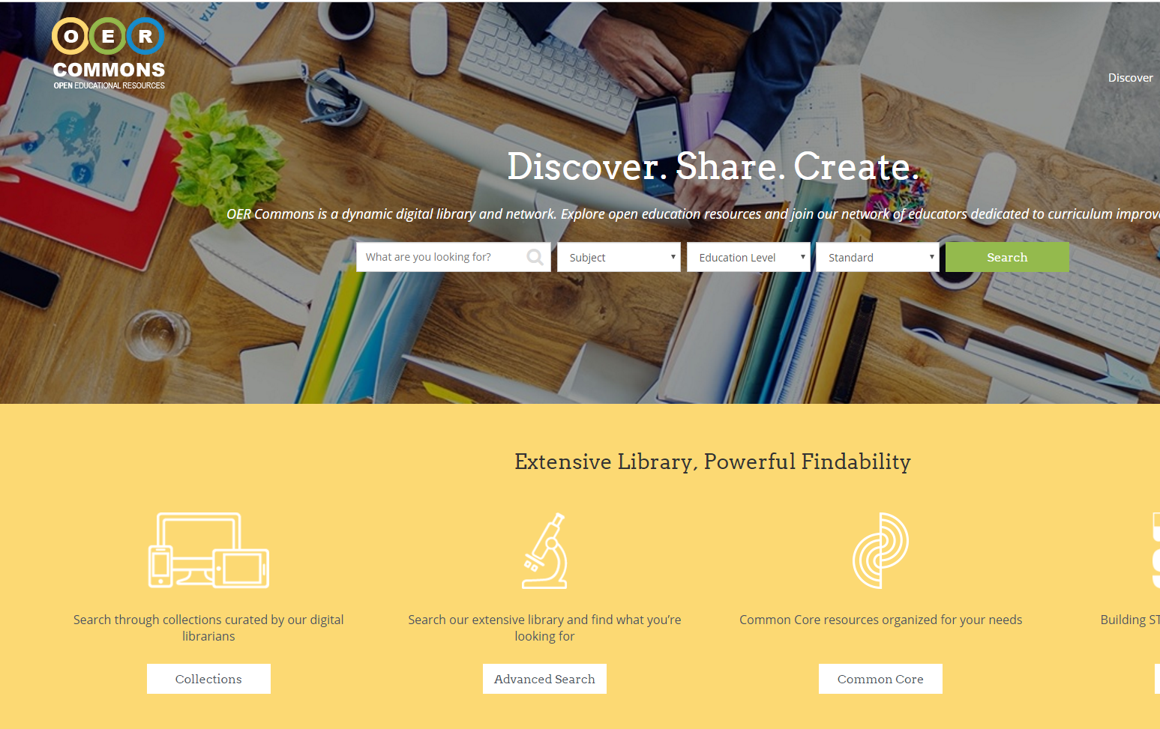
Course Materials
doer.col.org
cnx.org
www.saylor.org
oercommons.org

Slide 28
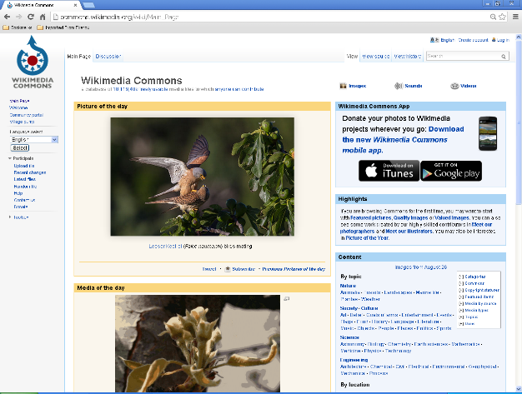
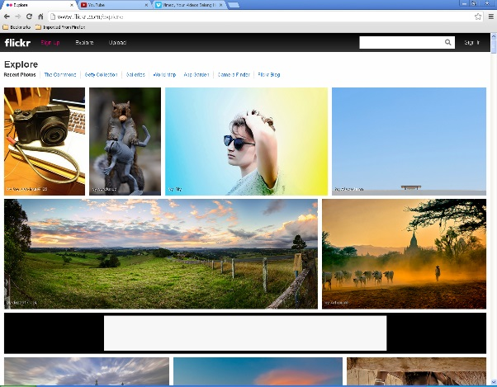
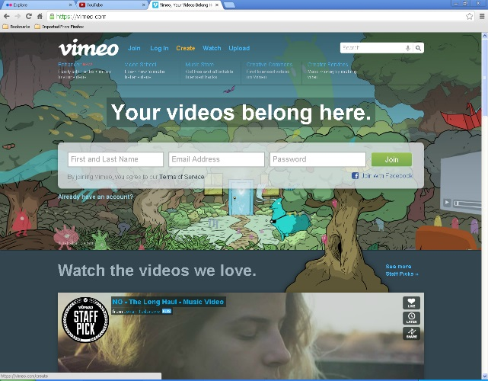
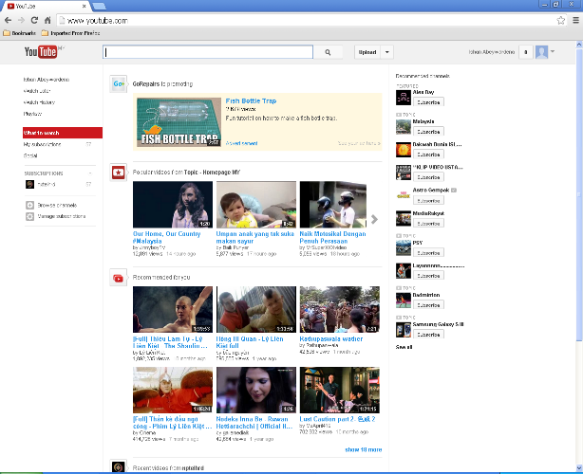
Multimedia
Commons.wikimedia.org
Flicker.com/creativecommons.org
Vimeo.com
Youtube.com

Slide 29
How do we Acknowledge?
Title
Author
Source
Link

Slide 30
How do we Share our OER?
Institutional / any open repository
www.oercommons.org/contribute
Build online e.g. http://cnx.org
Use social networks - www.youtube.com

Slide 31


Creating OER and Combining Licenses
https://www.youtube.com/watch?v=0LxD7xAcY3k

Slide 32
OER Course Design

Slide 33
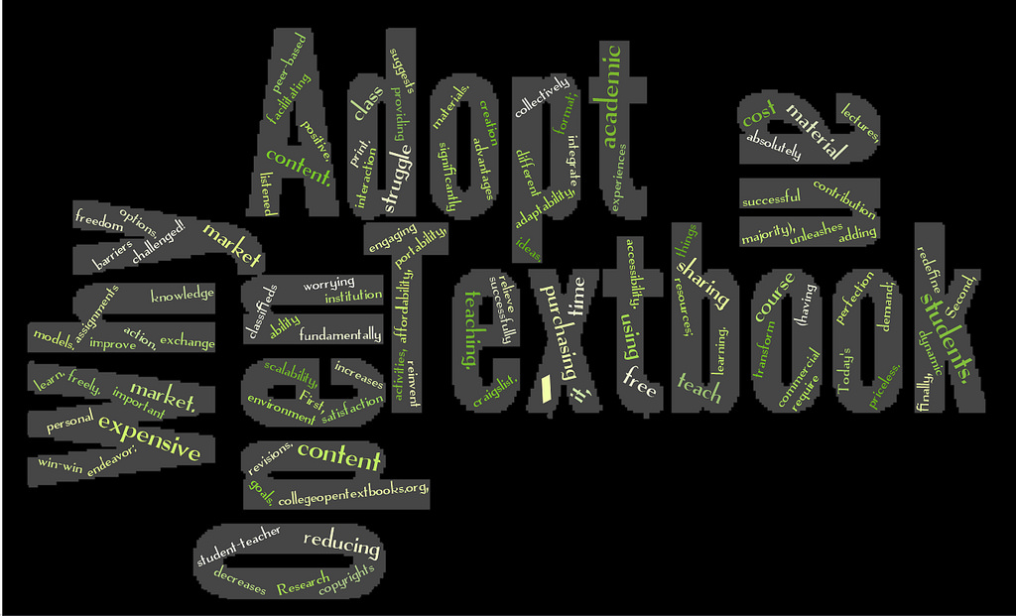
OER in Course Design
Move away from proprietary course material
Abandon the model based on costly textbooks
Develop course material based on OER
Rethink resource deployment
Image source: https://flic.kr/p/9spt8w

Slide 34

Choosing the right OER
Vast choice of material available as OER
Consult official technical manuals/reference books to cross-check integrity of the OER material
Ensure that the OER includes theory and practical exercises
Use own experts on subject matter for validation
This Photo by Unknown Author is licensed under CC BY-SA

Slide 35

Tackling Plagiarism in OER
Use OER from trusted and quality assured sources such as:
  accredited institutional repositories (e.g. Open Michigan, Open Learn)
  reputed portal repositories (e.g. OER Commons, DOER)
  quality assured OER federations (e.g. l3fpedia, eCampusOntario, OERu)
Run your OER through similarity check programme before use
Have subject matter experts in the course development team review
Educate teachers and learners about the difference between attribution and plagiarism
Build capacity on OER reuse and remix
Photo by Unknown Author is licensed under CC BY

Slide 36
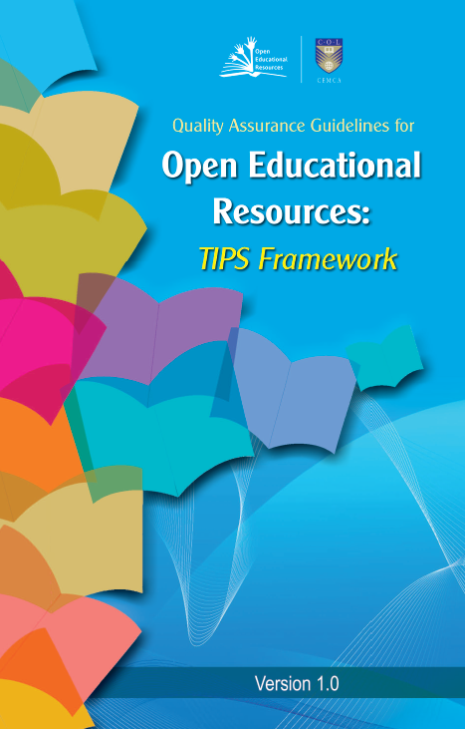
Quality Guidelines for OER
– TIPS framework
Teaching and learning processes
Information and material content
Presentation, products and formats
System, technical and technology
oasis.col.org/handle/11599/562

Slide 37
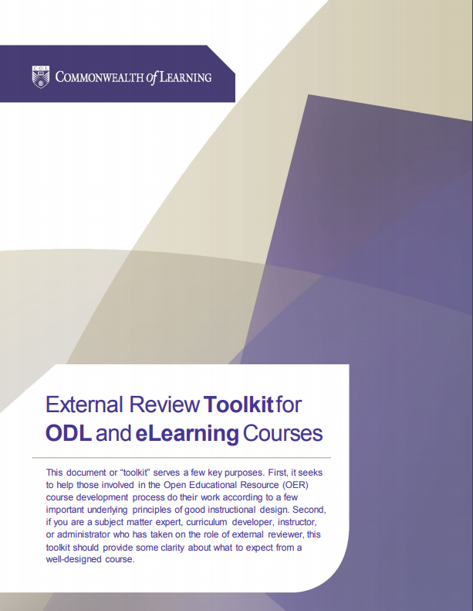
A Practical Toolkit
Course Planning
Orientation to Learning
Course Content
Multimedia
Learning Activities
Assessment
User-Friendly Design
Evaluation and Continuous Improvement
oasis.col.org/handle/11599/2338

Slide 38


Further Resources
A Basic Guide to OER oasis.col.org/handle/11599/36
Understanding OER oasis.col.org/handle/11599/1013
Online Course on OER tell.colvee.org/

Slide 39
Group Work

Slide 40

Key questions
Group 1: What is the need for OER in your country/institution? How do you propose to address this need? Identify 3-5 strategies
Group 2: What are the barriers to mainstreaming OER in your context? How can you overcome these barriers?
Group 3: Where will you find OER for course development? How will you ensure that the OER are of high quality?
Group 4: Review the case study and propose the appropriate licence.
oasis.col.org/handle/11599/2789

Slide 41


Remix Case 1
Consider a publication where the author has identified the following to be included. Decide what license should be needed and how you will go about it.
  Original texts plus, images from CC-BY-SA, also texts from CC-BY-NC.
  Author has also indicated use of some Copyrighted materials, and you have permission to be used by your institution
Notes:
CC BY SA and CC BY-NC materials can’t be mixed. So, you need to reconsider other materials for the CC BY-NC material.

Slide 42


Remix Case 2
Consider a publication where the author has identified the following to be included. Decide what license should be needed and how you will go about it.
  Original texts plus, images and texts from PD
  Author has also indicated use of some texts from CC-BY sources
  There are large number of images from online sources, the author has not credited
Notes:
Materials that are from online sources can’t be used. Otherwise, your license can be CC BY or anything else.

Slide 43

Strategies for Success
Be Open
Change mindset
If you take, please give back
Use open licenses
Practice first, policy will follow
Keep learner at the centre
oasis.col.org/handle/11599/1013

Slide 44

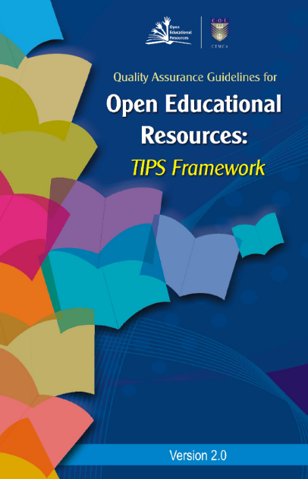



Publications

Slide 45
Thank you
www.col.org

