Slide 1



Fifteen years of OER: the road ahead
Professor Asha Kanwar
President & Chief Executive Officer

Slide 2
Plan
Fifteen Years of OER
COL Contributions
Regional Consultations
Global Surveys
Towards Inclusive and Equitable Quality Education

Slide 3
Fifteen years

Slide 4

UNESCO HQ Paris
2002 Forum on the Impact of Open CourseWare
for Higher Education in Developing Countries

Slide 5
Open Educational Resources (OER)
OER are teaching, learning and research materials in any medium that reside in the public domain or have been released under an open license that permits their free use and in some instances, re-purposing by others
Atkins, Brown & Hammond, 2007

Slide 6
Why OER?
Reduces costs
Enhance access
Improve quality

Slide 7

Antigua & Barbuda
Students saved between 75 to 88 ECD per course per semester by using open textbooks
Supplementing textbooks with OER improved student performance by 5.5%.

Slide 8

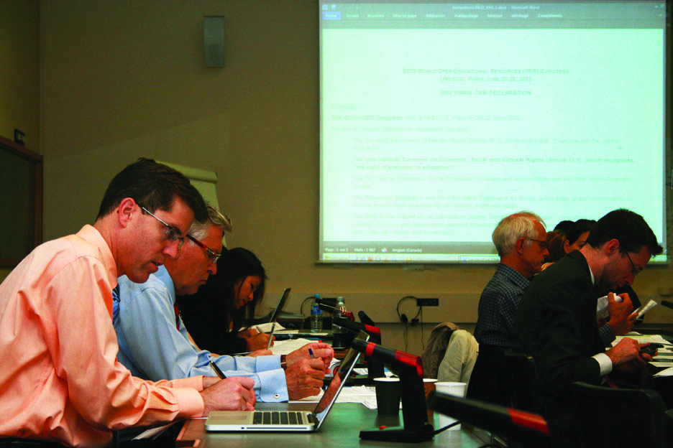
Paris Declaration on OER
Foster awareness and use of OER
Encourage the development and adaptation of OER in a variety of languages and cultural contexts
Encourage the open licensing of educational materials produced with public funds.
The 2012 Paris OER Declaration drafting group at UNESCO Headquarters, Paris, France
^{Photo: CC-BY Davide Storti}

Slide 9

18th CCEM Communique
Ministers emphasized
the need
‘to set up a common platform for OER materials for…ease of access’
‘for the development and use of OER in providing quality teaching and learning for all’.

Slide 10


OER for Inclusive and Equitable Quality Education
From Commitment to Action
2nd World OER Congress| 18-20 September, 2017 | Ljubljana, Slovenia

Slide 11






The
Road to
Ljubljana
ASIA
Asia eUniversity: ​​December 2016
EUROPE
Malta Ministry for Education and Employment:
​​February 2017
MIDDLE EAST & NORTH AFRICA
Qatar Foundation: ​​February 2017
AFRICA
Ministry of Education, Mauritius:
March 2017
LATIN AMERICA & CARIBBEAN
University of Campinas: April 2017
​
PACIFIC
Open Polytechnic of New Zealand:
​​May 2017

Slide 12

OER: Then and Now
2017
2012
Focus was on Governments
Policies
Commitment
Additional focus on stakeholders
Mainstreaming OER
Concrete Actions

Slide 13
COL
Contributions

Slide 14

Advocacy
Open Textbook Forum, October 2015 (Eastern Caribbean countries)
KL Declaration, 2016
OER Regional Consultations, 2017
Advocacy

Slide 15
Policy Development
ICT in Education policy at Antigua and Barbuda, April 2013
ICT in Education policy and Strategy (Belize and St Lucia)
Support for National OER policy (Bangladesh, Malaysia, Nigeria)
ODL policy development (Rwanda)
Provincial OER policy development (Sri Lanka, Botswana)

Slide 16






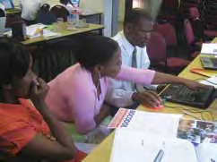
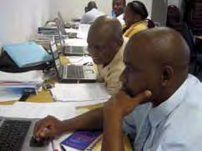
OER for open schooling (OER4OS)
Ministries
of Education
Schools
Teachers
Consultants

Slide 17




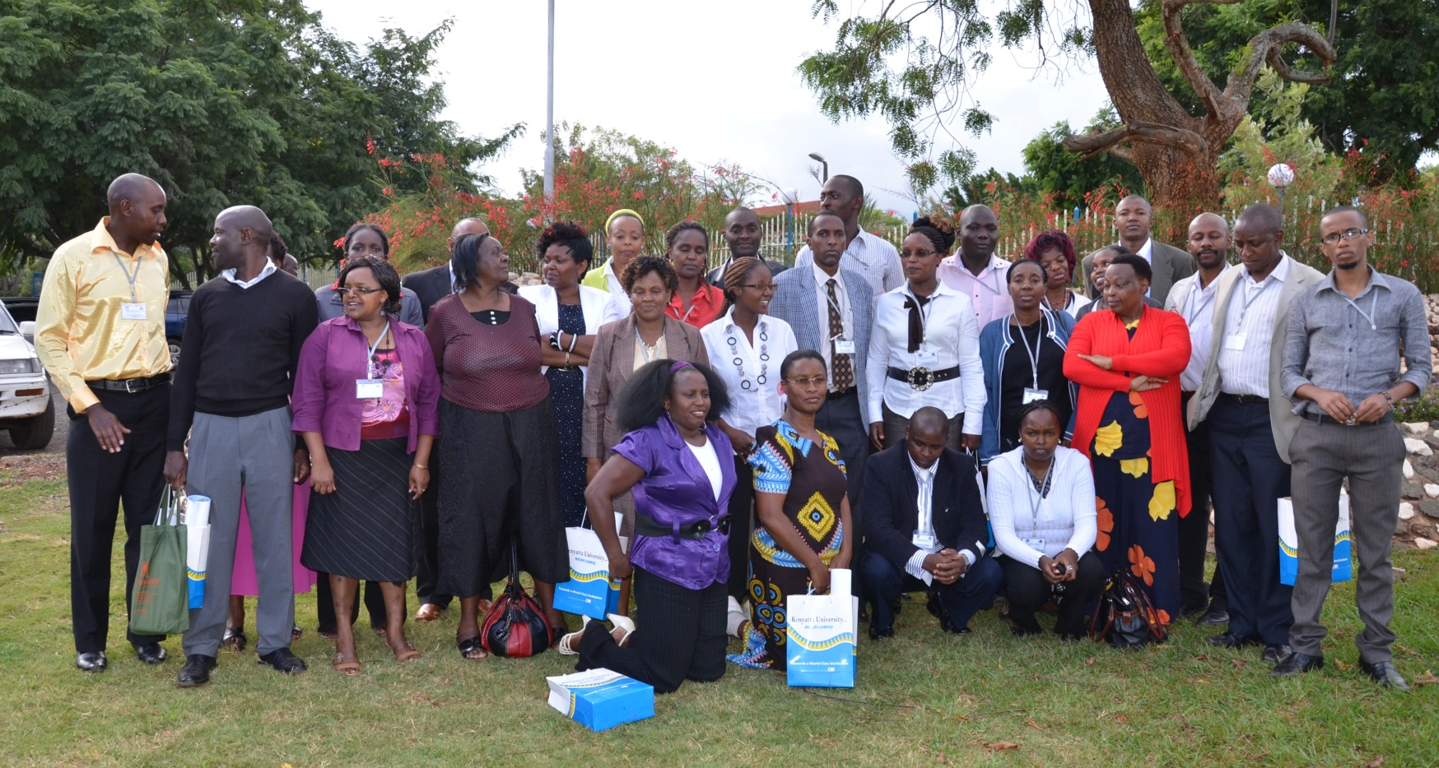
ORELT in Kenya
orelt.col.org
Notes:
COL has worked in partnership with a number of countries in Africa to develop materials that can help improve the teaching of English Language. The countries involved in this are: Tanzania, Kenya, Gambia, Nigeria and Ghana.
In all these countries, English is used as a medium of instruction in some or all levels of schooling. The learners’ English language skills therefor become central to their performance in other subjects as well.
These modules are therefore meant to help teachers support learners to acquire all the requisite skills (Listening, speaking, reading and writing)
These modules are being used in Kenya where we trained trainers and now these teachers are training other teachers in how to integrat these modules into their school curricula.
These teachers believe the materials are very beneficial and have recommended that the materials should be made available to all teachers JSS in Kenya.
COL is now working with the Kenya Institute of Curriculum Development (KICD) to have the materials vetted for use throughout the country.
This video clip expresses one teachers’ view of how valuable these modules are

Slide 18
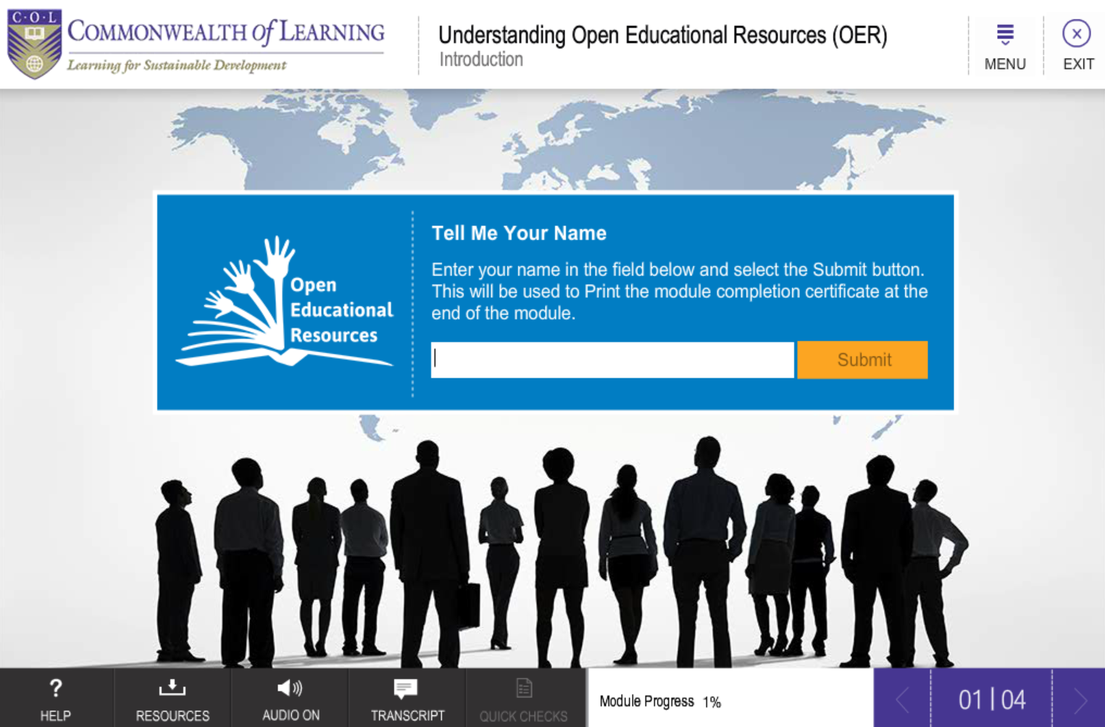
Online Course on OER
http://tell.colvee.org/course/view.php?id=3

Slide 19

Quality Guidelines for Open Educational Resources
Teaching and learning processes
Information and material contents
Presentation, products and formats
System, technical and technology
http://oasis.col.org/handle/11599/562

Slide 20
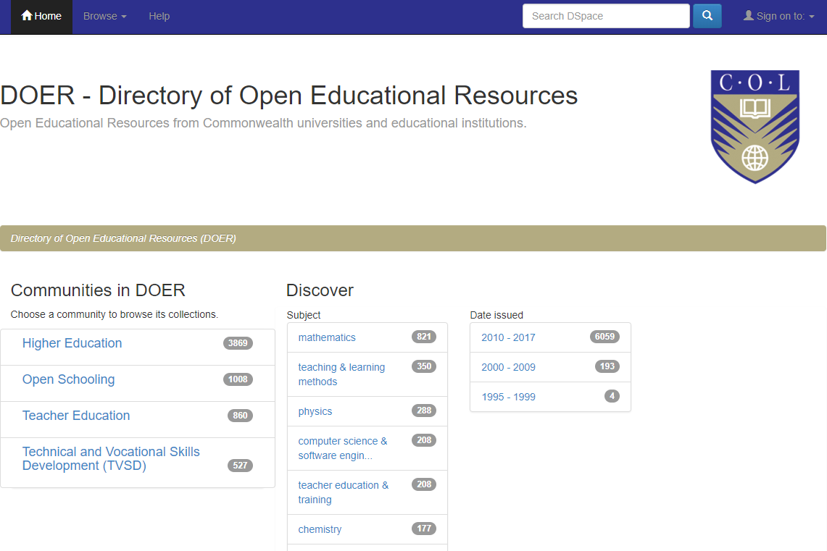
Directory of Open Educational Resource (DOER)
Open Educational Resources directory service
Only full courses catalogued
A service provided by COL
About 6000 resources
doer.col.org

Slide 21





Publications
oasis.col.org

Slide 22
Regional
Consultations

Slide 23
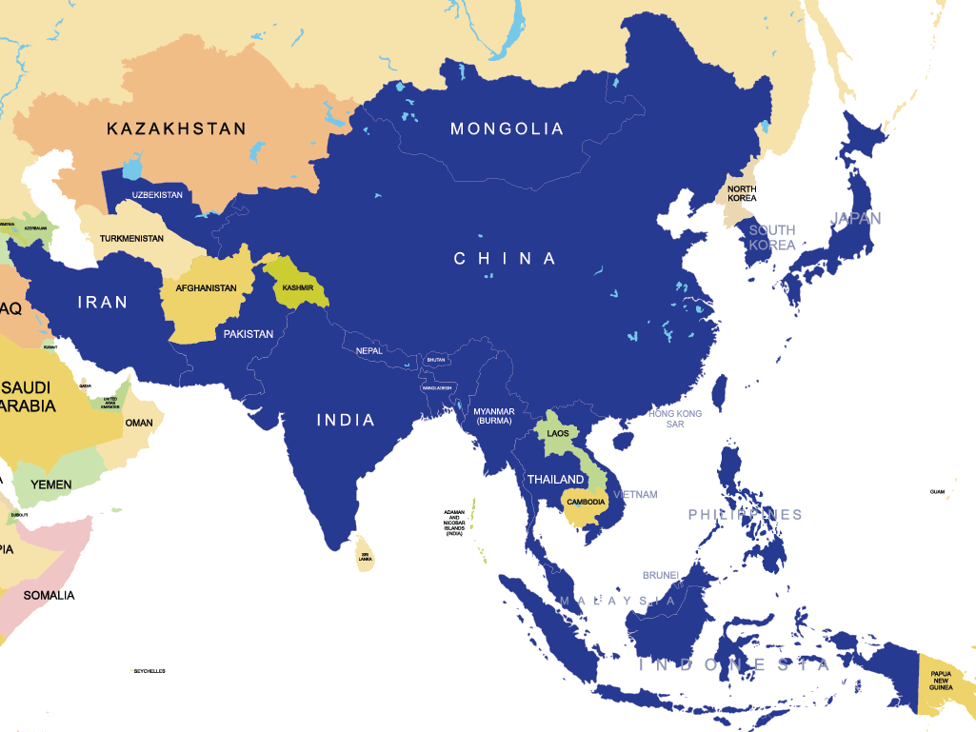

ASIA
20
Notes:
48 participants from 24 countries participated, including 20 countries from Asia.

Slide 24
Highlights: Asia
Free supply of textbooks at school level (Bangladesh)
NME-ICT follows CC BY-SA licence (India)
Commitment to OpenCourseWare in eLearning policy (Malaysia)
OER repositories in India, Indonesia, Malaysia, Pakistan, Philippines, Vietnam.

Slide 25
Priorities: Asia
Need for improved connectivity
More attention to content for people with disabilities
Increased awareness and capacity to use/ develop OER
Need for OER in local languages
National policies to guide OER

Slide 26
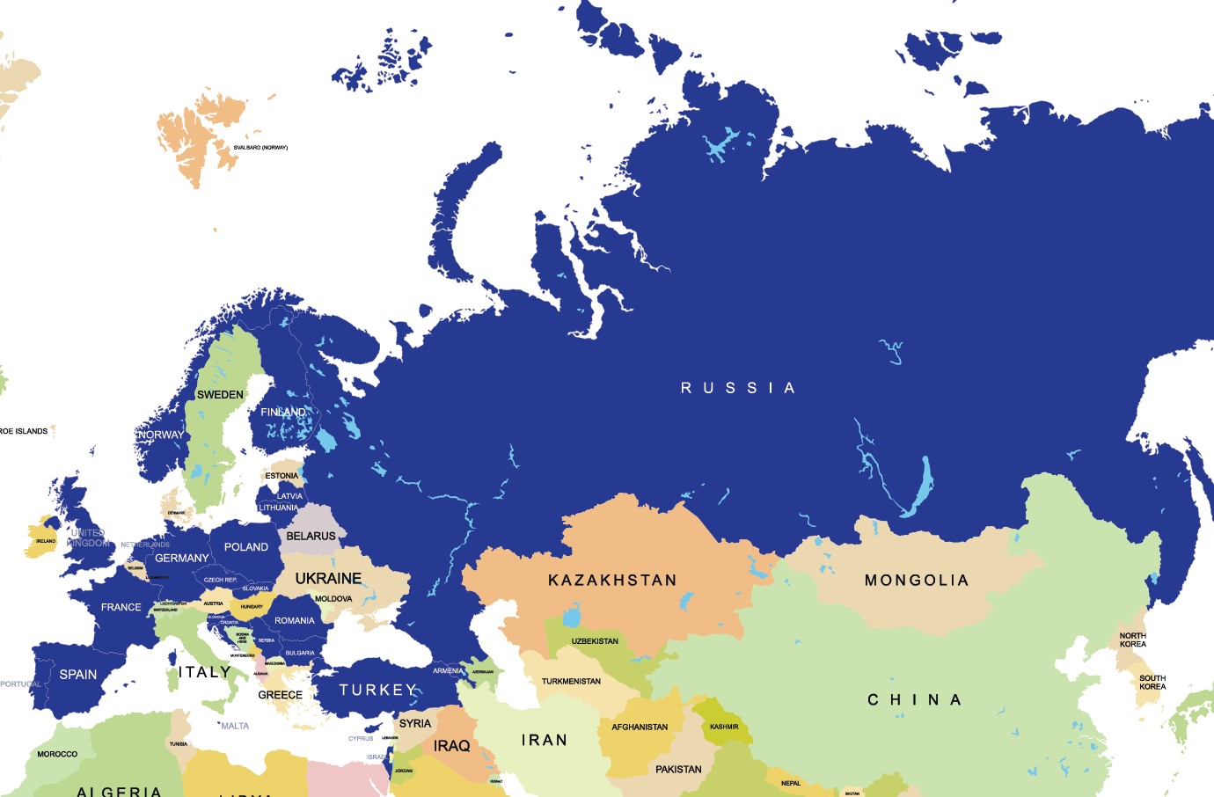

EUROPE
24
Notes:
48 participants from 24 countries participated, including 20 countries from Asia.

Slide 27
Highlights: Europe
Mostly led by institutions in project mode
Advanced technologies for multi-lingual searches possible
OER as part of a wider open ecosystem
Many initiatives but fragmented

Slide 28
Priorities: Europe
Need for political will and national level policies
Teachers critical in mainstreaming OER
Need for business models
Institutions must invest in QA and evidence
Move towards open education practices

Slide 29
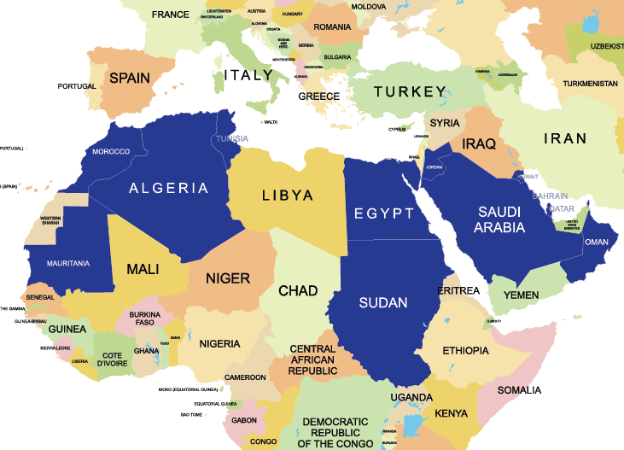

MIDDLE EAST & NORTH AFRICA
13
Notes:
48 participants from 24 countries participated, including 20 countries from Asia.

Slide 30
Highlights: Middle East & North Africa
National OER Policies: Bahrain & Oman
Institutional initiatives: Open University of Sudan
National Portals: Morocco, Jordan
Emphasis on translating content into Arabic

Slide 31
Priorities: Middle East & North Africa
More awareness
Capacity-building
Policies at national and institutional levels
Regional cooperation
More original content needed in Arabic

Slide 32
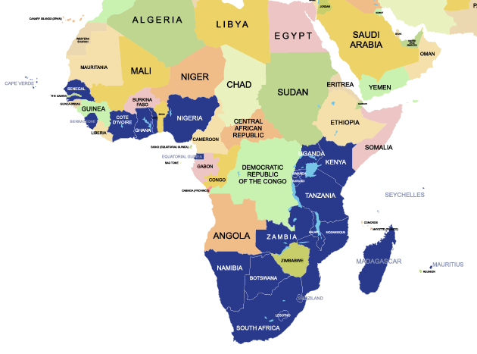

AFRICA
23
Notes:
48 participants from 24 countries participated, including 20 countries from Asia.

Slide 33
Highlights: Africa
National OER Policies: South Africa, Seychelles
Institutional initiatives: eg. National Open University of Nigeria, and Open University of Tanzania
Siyavula model in South Africa
OER Africa supporting institutions to mainstream OER

Slide 34
Priorities: Africa
Improved access to Internet and electricity
Enhanced awareness and capacity to use/develop OER
Policies required at national and institutional levels
Attention to local language resources

Slide 35
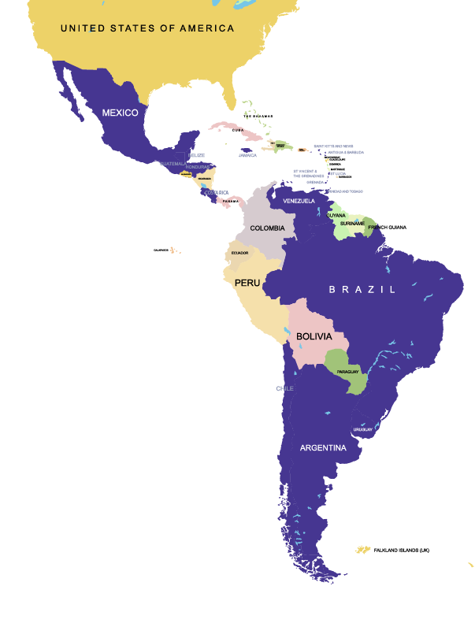

LATIN AMERICA & THE CARIBBEAN
18
Notes:
48 participants from 24 countries participated, including 20 countries from Asia.

Slide 36
Highlights: Latin America & the Caribbean
Public funded educational materials openly licensed (Antigua and Barbuda)
Institutional policy for Open Access and Open Data (Brazil and Chile)
Commitment to OER at provincial and city level
(Sao Paulo)
A general awareness and a willingness to pursue OER (Grenada, Guatemala, Honduras, Mexico)

Slide 37
Priorities: Latin America & the Caribbean
Need for OER in national languages
Better connectivity
Accessible content required for people with disabilities
Increased capacity to use and contribute to OER
National policies needed to guide OER

Slide 38
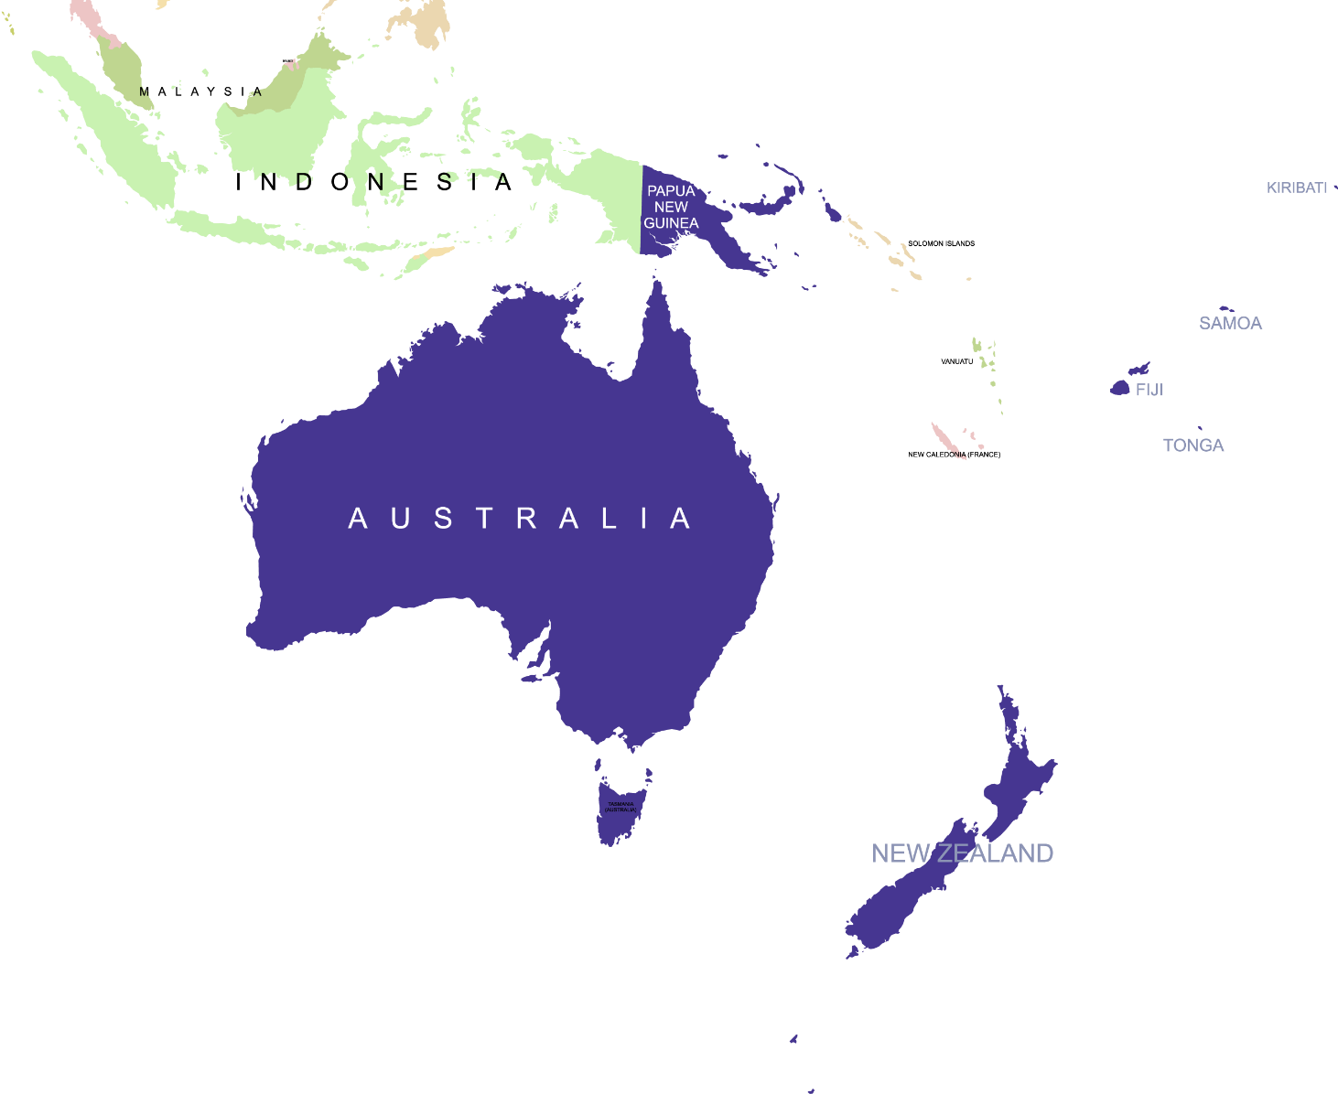

PACIFIC
7

Slide 39
Highlights: Pacific
National Policy in Australia, New Zealand, Fiji
Need to reduce spending on textbooks and copyright clearance
OER being used in Kiribati, Samoa, Solomon Islands, Vanuatu
OERu

Slide 40
Priorities: Pacific
OER policy to align to Regional Pacific Education Strategy
Emphasis on indigenous knowledge and culture
Better infrastructure and connectivity
OER as freedom, human rights and a people’s movement

Slide 41
Findings of the Regional Consultations
More governments commit to support OER
Specific projects on OER are supported mainly through government funds
Still focused on OER creation rather than OER use
All regions want more collaboration

Slide 42
The Surveys

Slide 43
Two Surveys
  A government survey
    sent by COL to Member States
    Sent by UNESCO to Member States in English and French
  COL: stakeholder survey posted online and publicised via social media.
Notes:
made available to COL Focal Points and to National Delegations in UNESCO.

Slide 44
Government Responses:
102 countries
Region | Government
Africa | 28
Middle East and North Africa | 12
Asia and Pacific | 28
Europe and North America | 21
Latin America and Caribbean | 13

Slide 45
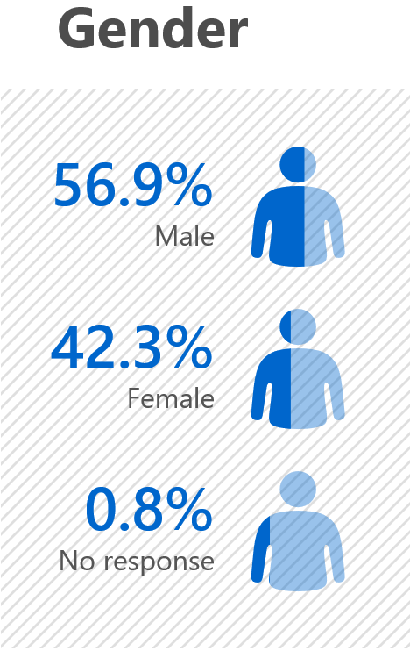
Stakeholder Responses: 638
Region | Stakeholder
Africa | 144
Middle East and North Africa | 26
Asia and Pacific | 253
Europe and North America | 145
Latin America and Caribbean | 70
Notes:
759 responses received; incomplete responses were deleted and only 638 were usable.

Slide 46
Governments and Stakeholders:
Commonalities
OER provides access to quality materials
Lack of appropriate policy solutions
Poor awareness and capacity of users
Changing business models

Slide 47


Different Focus?
Governments
Language & cultural issues
Cost efficiency
Stakeholders
Saves time for teachers
Enables continuous quality improvement

Slide 48
Towards Inclusive and Equitable Quality Education

Slide 49

Global Trends
Policies
Increasing support, not accompanied by policies
Despite lack of national OER policies, institutional policies have grown
Regions with extensive OER activities, not always reliant on national policy as the driving force

Slide 50
Global Trends
Repositories
OER repositories created in the global north more used than those from the global south
Majority of the repositories are at tertiary level
Repositories are available in diverse fields, including early childhood education

Slide 51
Global Trends
Awareness
Many governments and stakeholders not clear about OER
Increased focus on open textbooks has led to neglect of OER for lifelong learning
Governments are supporting MOOCs, which are not necessarily “open”

Slide 52
Way Forward
Greater effort needed in creating awareness of the meaning, purpose and advantages of OER
Capacity building for the use and integration of OER for teachers
Promote policy development at both regional/national and institutional levels.

Slide 53
Way Forward
Better communication strategies needed to convey the results of OER research
Business models for OER need to be explored
Innovations on bridging the digital divide required
Mechanisms to monitor the progress of OER needed

Slide 54


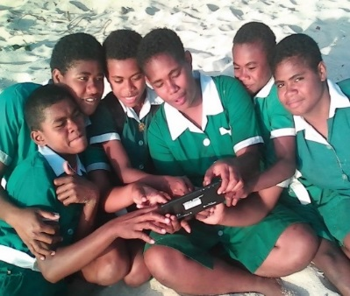
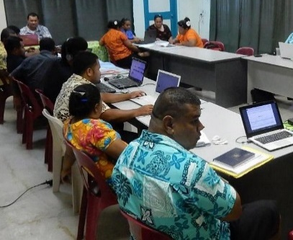
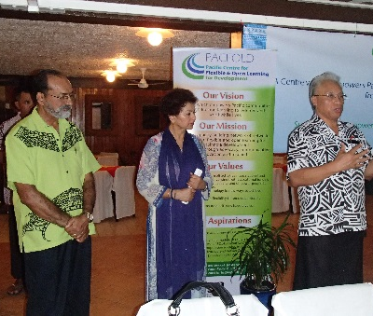
Thank You
col.org

