Slide 1























































Caribbean Focal Points Meeting : St Lucia
ANTIGUA & BARBUDA
AUSTRALIA
BAHAMAS
BANGLADESH
BARBADOS
BELIZE
BOTSWANA
BRUNEI DARUSSALAM
CAMEROON
CANADA
CYPRUS
DOMINICA
ESWATINI
FIJI
THE GAMBIA
GHANA
GRENADA
GUYANA
INDIA
JAMAICA
KENYA
KIRIBATI
LESOTHO
MALAWI
MALAYSIA
MALTA
MAURITIUS
MOZAMBIQUE
NAMIBIA
NAURU
NEW ZEALAND
NIGERIA
PAKISTAN
PAPUA NEW GUINEA
RWANDA
ST KITTS & NEVIS
SAINT LUCIA
ST VINCENT & GRENADINES
SAMOA
SEYCHELLES
SIERRA LEONE
SINGAPORE
SOLOMON ISLANDS
SOUTH AFRICA
SRI LANKA
TONGA
TRINIDAD & TOBAGO
TUVALU
UGANDA
UNITED KINGDOM
TANZANIA
VANUATU
ZAMBIA
Professor Asha Kanwar
President & CEO, Commonwealth of Learning
January 2020

Slide 2
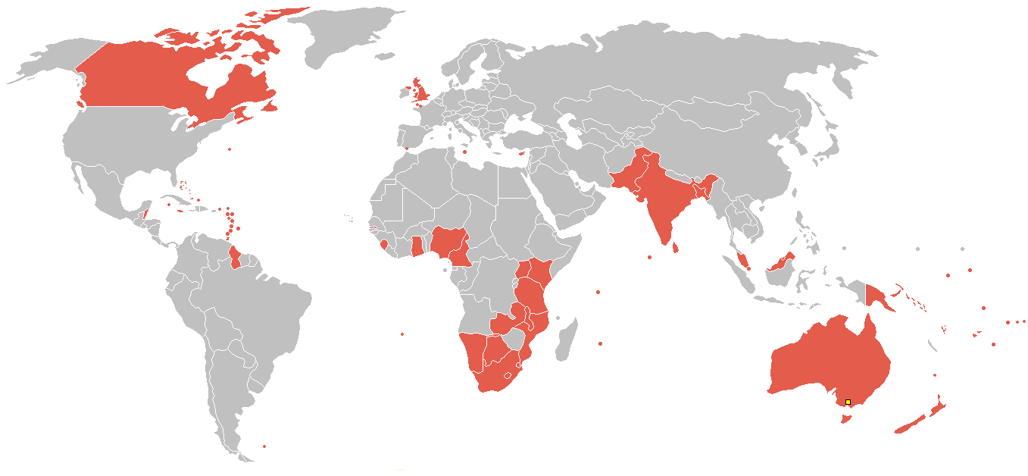
The Commonwealth
53 developed and developing nations around the world
Notes:
Maldives dropped out late 2016.

Slide 3
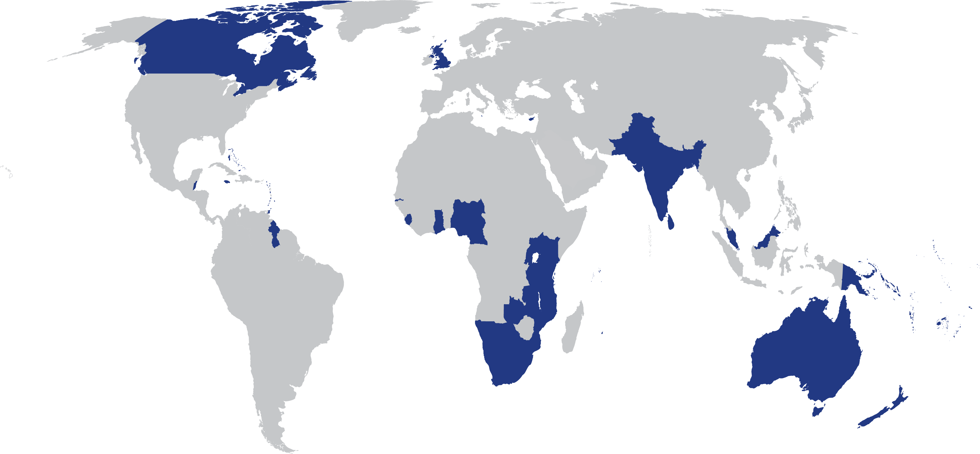
Our Commonwealth
Population 2.4 billion,
more than 60% under 30
Youth
unemployment high
60% of the Commonwealth=small states: affected by climate change

Slide 4
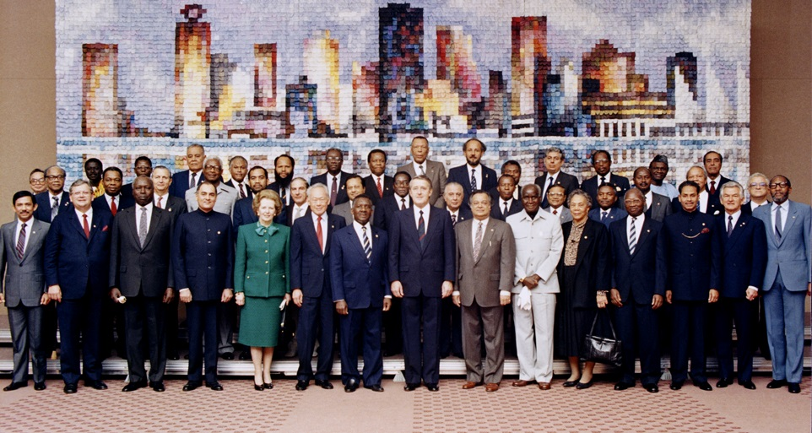
Commonwealth Heads of Government Meeting
Vancouver, 1987
Notes:
We invite you to engage us; tap into our thought leadership, expertise, networks and resources

Slide 5
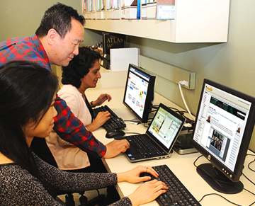
The Purpose of COL is
“…to create and widen access to opportunities for learning by promoting cooperation between universities and colleges… making use of the potential offered by distance education… and technologies…”
MOU, CHOGM 1988, amended 1995

Slide 6







Who supports COL?
Canada
UK
India
Australia
New Zealand
Nigeria
South Africa
The number of countries contributing
doubled from 23 in 2006 to 48 currently

Slide 7
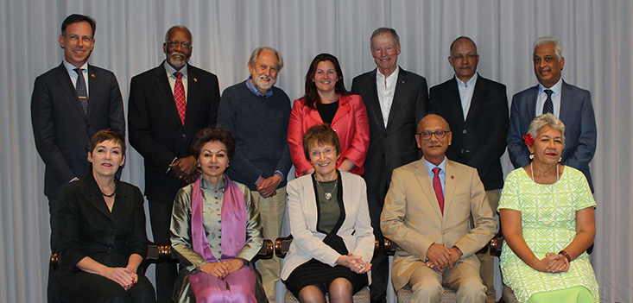
COL Board of Governors
June 2019

Slide 8
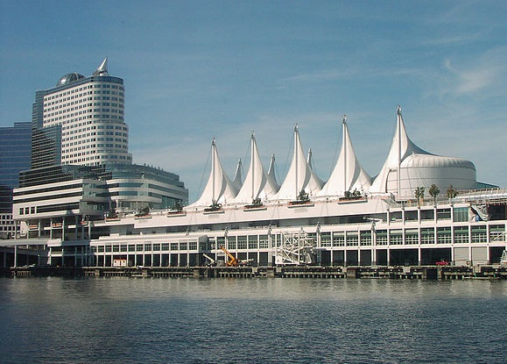
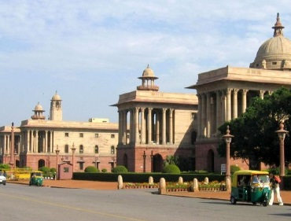

Where is it?
Metro Vancouver
(HQ)
New Delhi
(CEMCA)

Slide 9
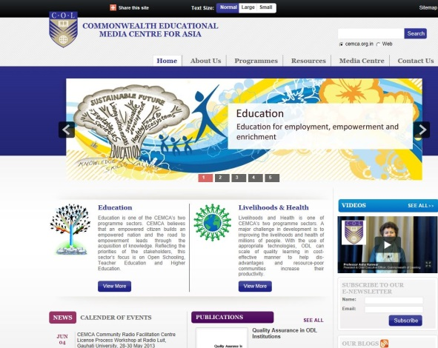
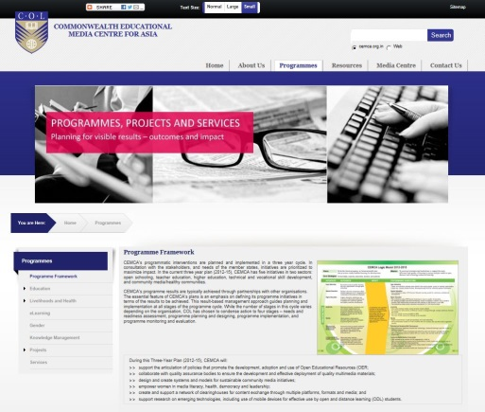
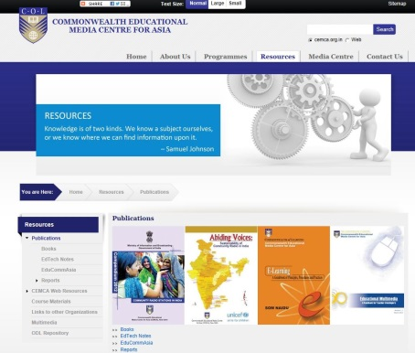







Regional Office
CEMCA
Bangladesh
Brunei Darussalam
India
Malaysia
Pakistan
Singapore
Sri Lanka

Slide 10



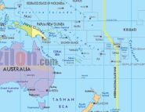
Regional Support
Southern African Development Community Centre for Distance Education (SADC-CDE)
Regional Training and Research Institute for Open and Distance Learning (RETRIDOL)
Commonwealth Centre for Connected Learning (CCCL)
Pacific Regional Centre (PACFOLD)

Slide 11
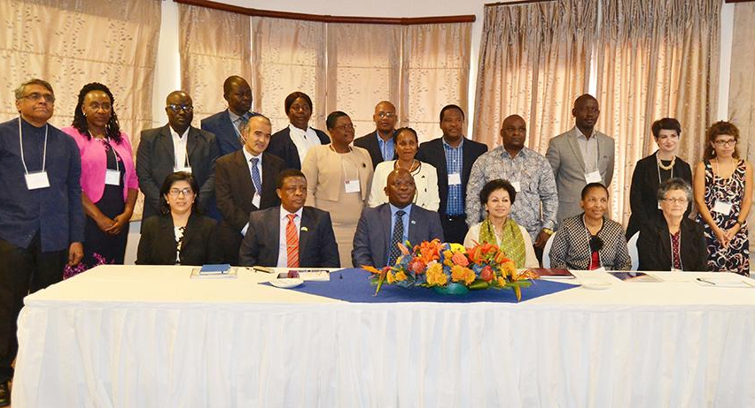
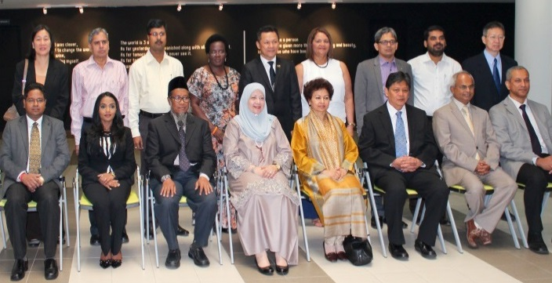
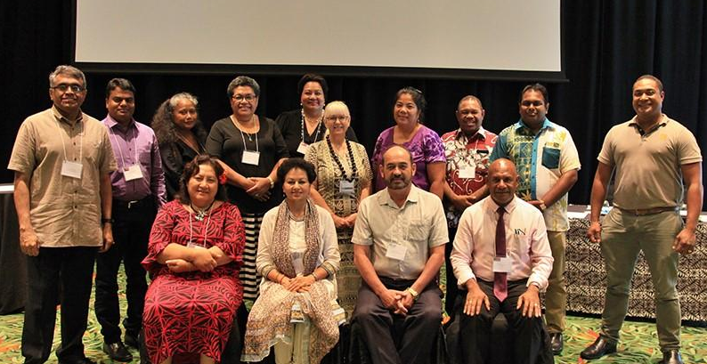
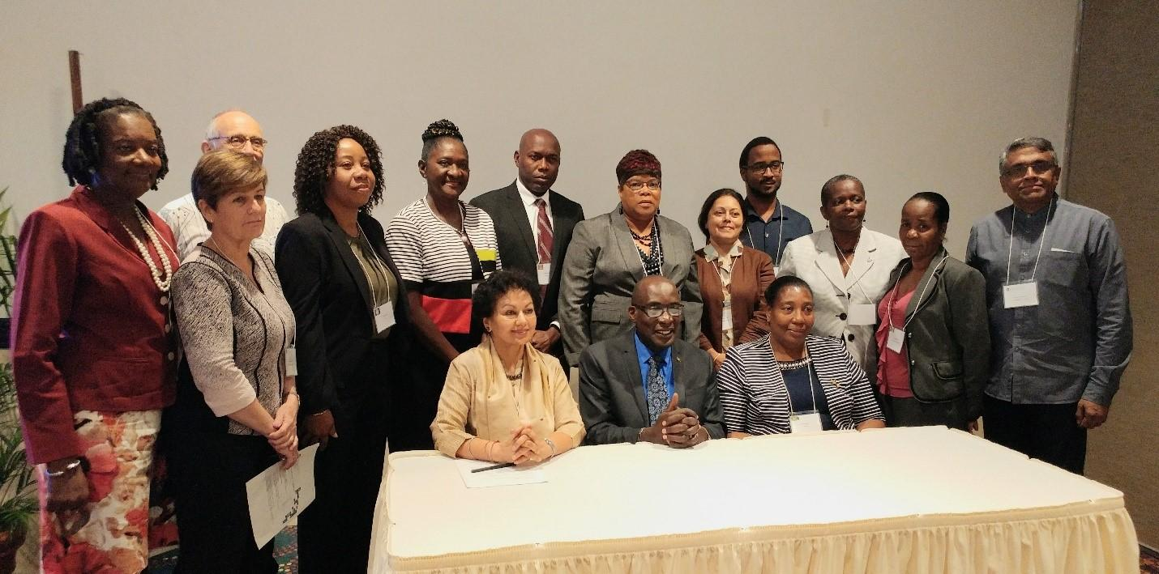
COL Focal Points
Our direct link to each country
Africa and Europe
Asia
Pacific
Caribbean
Notes:
Last updated: October 10, 2018

Slide 12
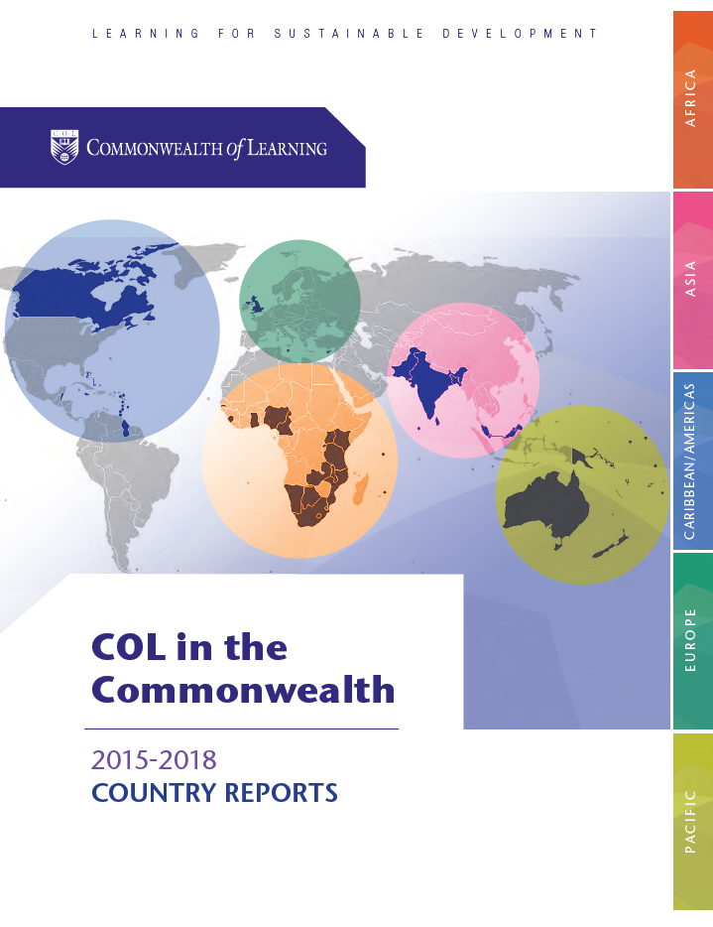

Slide 13

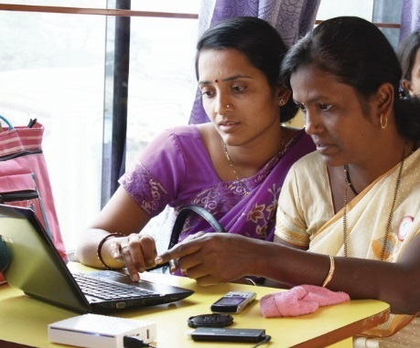
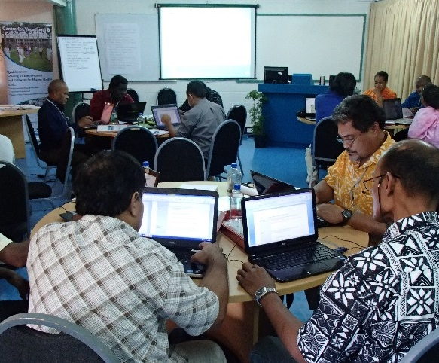
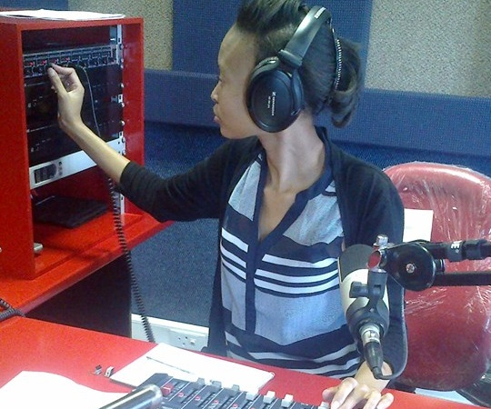
To help Commonwealth governments and institutions use technologies to improve and expand learning for sustainable development

Slide 14

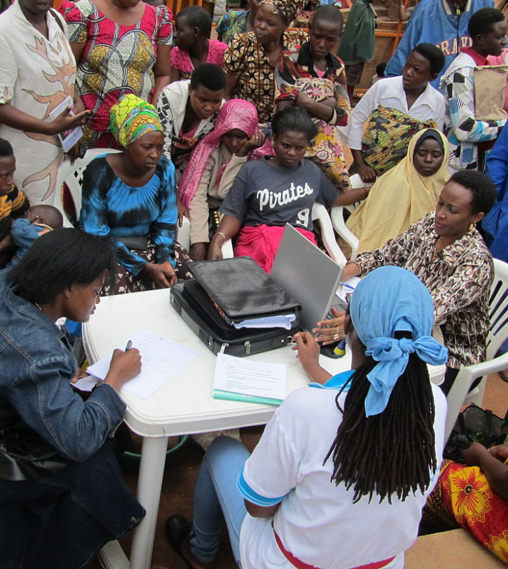
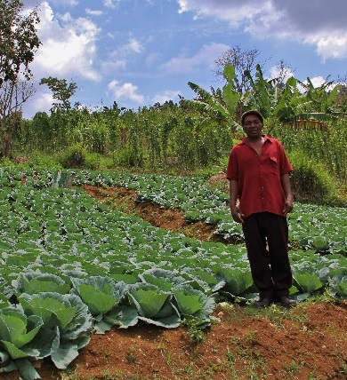



Learning for Sustainable Development
ECONOMIC
GROWTH
SOCIAL
INCLUSION
ENVIRONMENTAL CONSERVATION

Slide 15
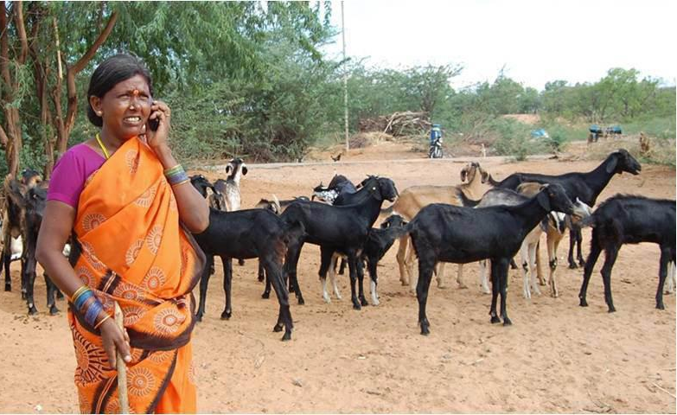
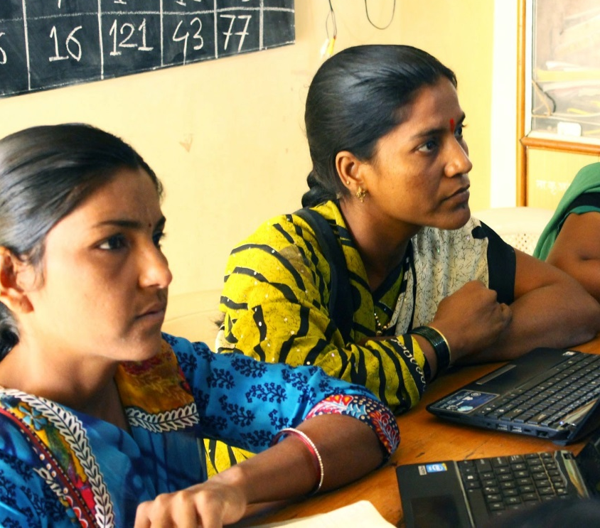
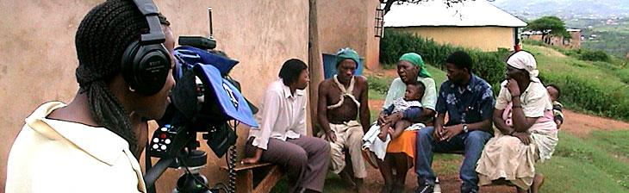

Leveraging
New & Existing Technologies

Slide 16
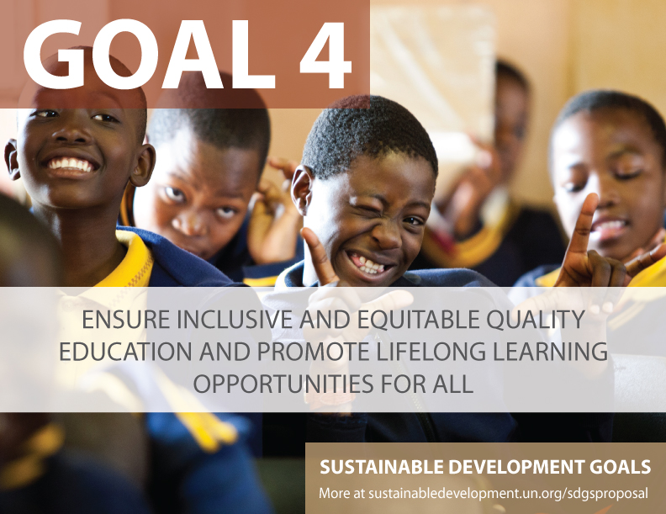

Slide 17
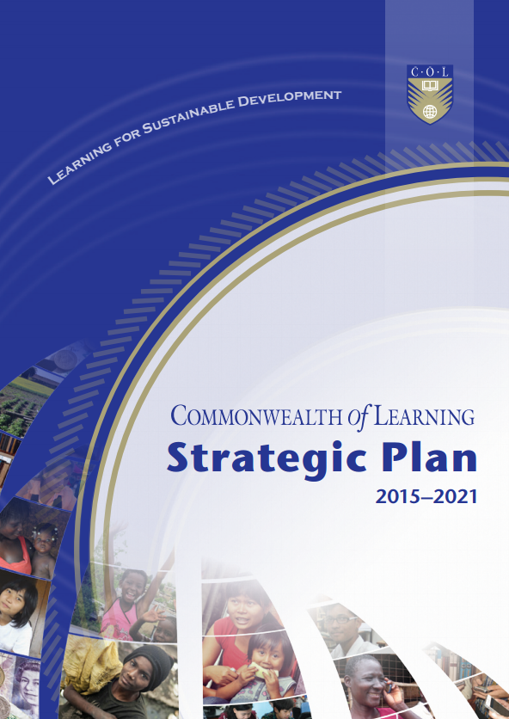

Slide 18
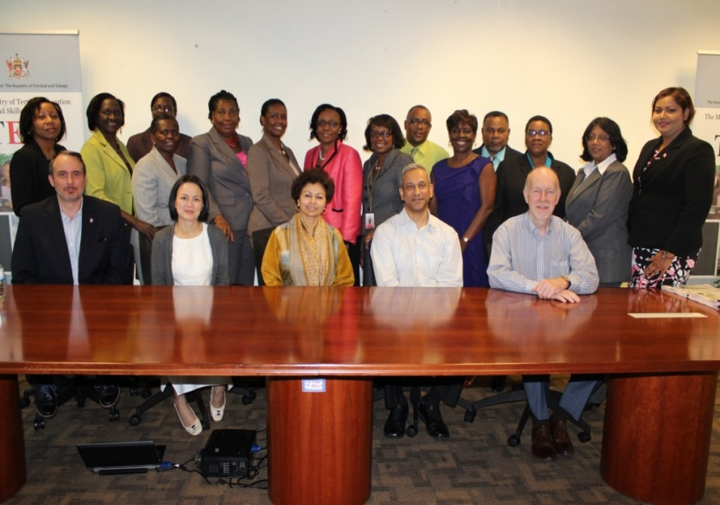
Caribbean Focal Points
2015-2021 Strategic Plan Input
Vision should include sustainability … ‘to be the foremost global agency that promotes learning for sustainable development’
Crime and violence
Soft skills
Sustainable tourism development
Open schools
Higher Education
Teacher Education

Slide 19
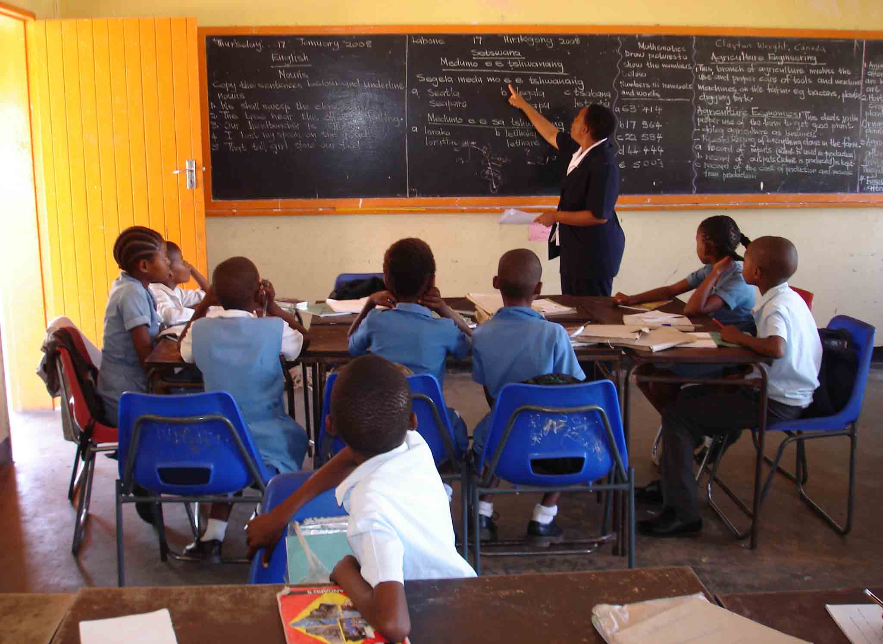
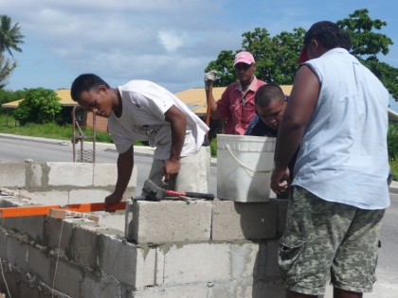
Two Sectors
EDUCATION
SKILLS
GENDER

Slide 20

COL Programme 2015-2021
Education
Skills
Open schooling
Teacher Education
Higher Education
VUSSC
TVSD
Lifelong Learning for Farmers
Technology Enabled Learning
Gender
Notes:
These are the areas that COL works in – you will see that skills development is just one of 8 main programme areas.
Support for TVET FOL is through the TVSD initiative managed by Alison Mead Richardson.
We have 4 main strategies and the application of these in terms of skills development:
We help to develop appropriate models of skills development using appropriate technologies.
We help countries take innovation to scale.
Scaling up in-country and between countries.
We are looking for replicable models.
We assist in institutional and national policy development relating to flexible delivery mechanisms. It helps to have a guiding framework on how the technology will be used
We offer capacity building opportunities including workshops and online courses. Help to build capacity to use the technology
We help institutions to develop materials – preferably open educational resources
We do all this through forming partnerships with ministries and institutions

Slide 21
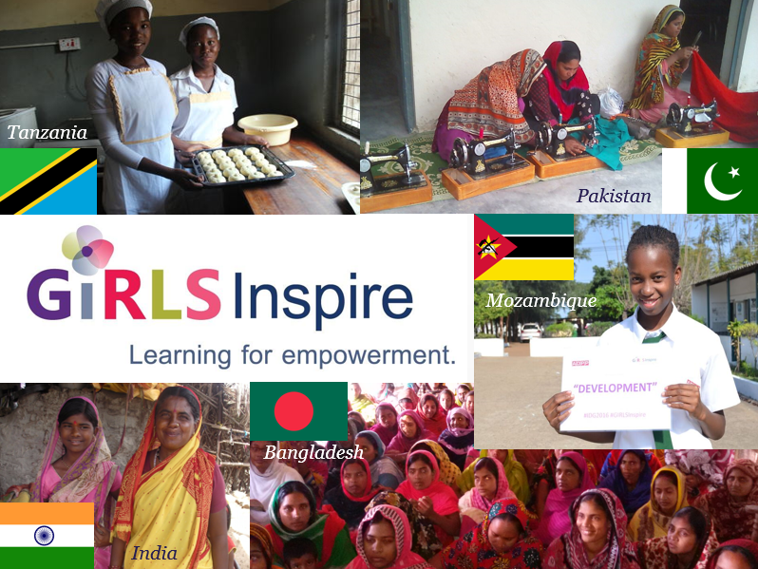
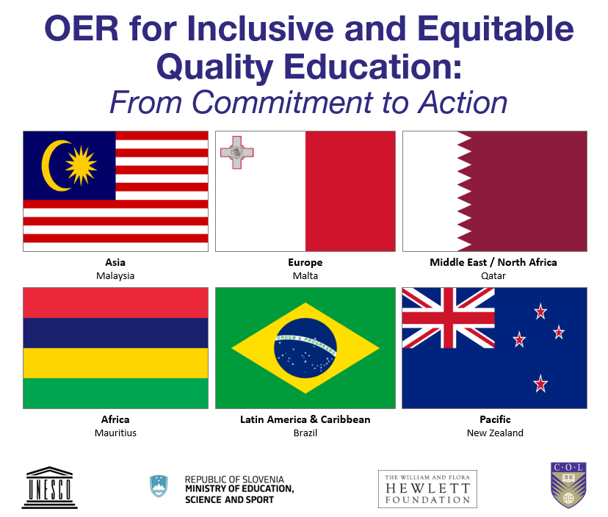
COL Priorities
Girls and Women’s Education
Open Educational Resources (OER)

Slide 22
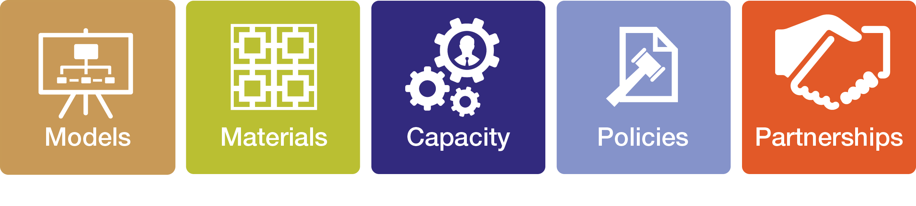
Strategies

Slide 23
COL’s Six Paradigm Shifts

Slide 24

1
If the child cannot go to school,
the school comes to the child
PARADIGM
SHIFT

Slide 25
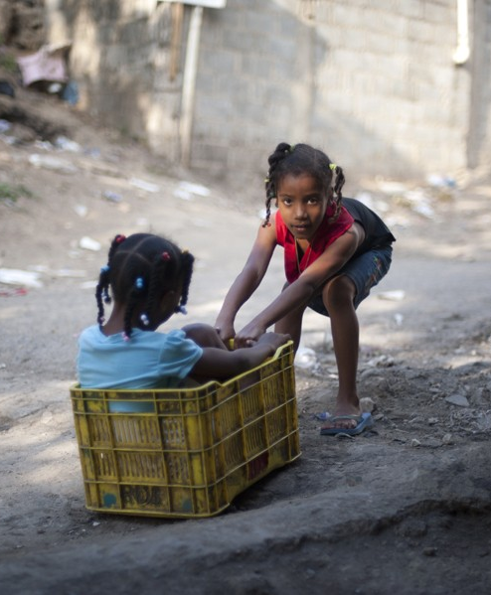
Education in the Commonwealth
17 million primary aged children not in school
16 million lower secondary youth out of school
3% more boys than girls enrolled in primary schools
but boys underrepresented
and underperforming at the secondary level
This Photo by Unknown Author is licensed under CC BY-SA

Slide 26
Open Schooling
The physical separation of learner from the teacher
The use of unconventional teaching methodologies, and information and communications technologies (ICTs) for scale
Flexible approach
Foster innovation
(e.g. on-demand exams; uses of ICT)

Slide 27
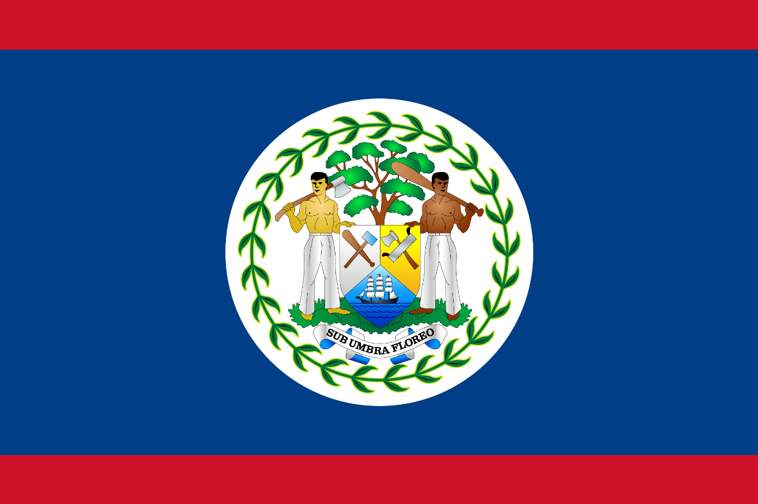
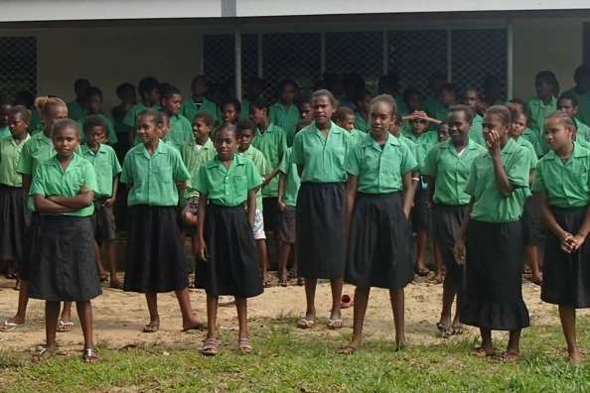

In Belize , Social Return on Investment in open schooling showed that every US$ invested resulted in US$8 worth of benefits to students.
Notes:
Belize
Benefits: skills, expected income
Social Return on Investment of an Open School showed that every US$ invested resulted in US$8 worth of benefits to students.

Slide 28
2
Technology-enabled learning can break open the ivory towers of tertiary education
PARADIGM
SHIFT

Slide 29
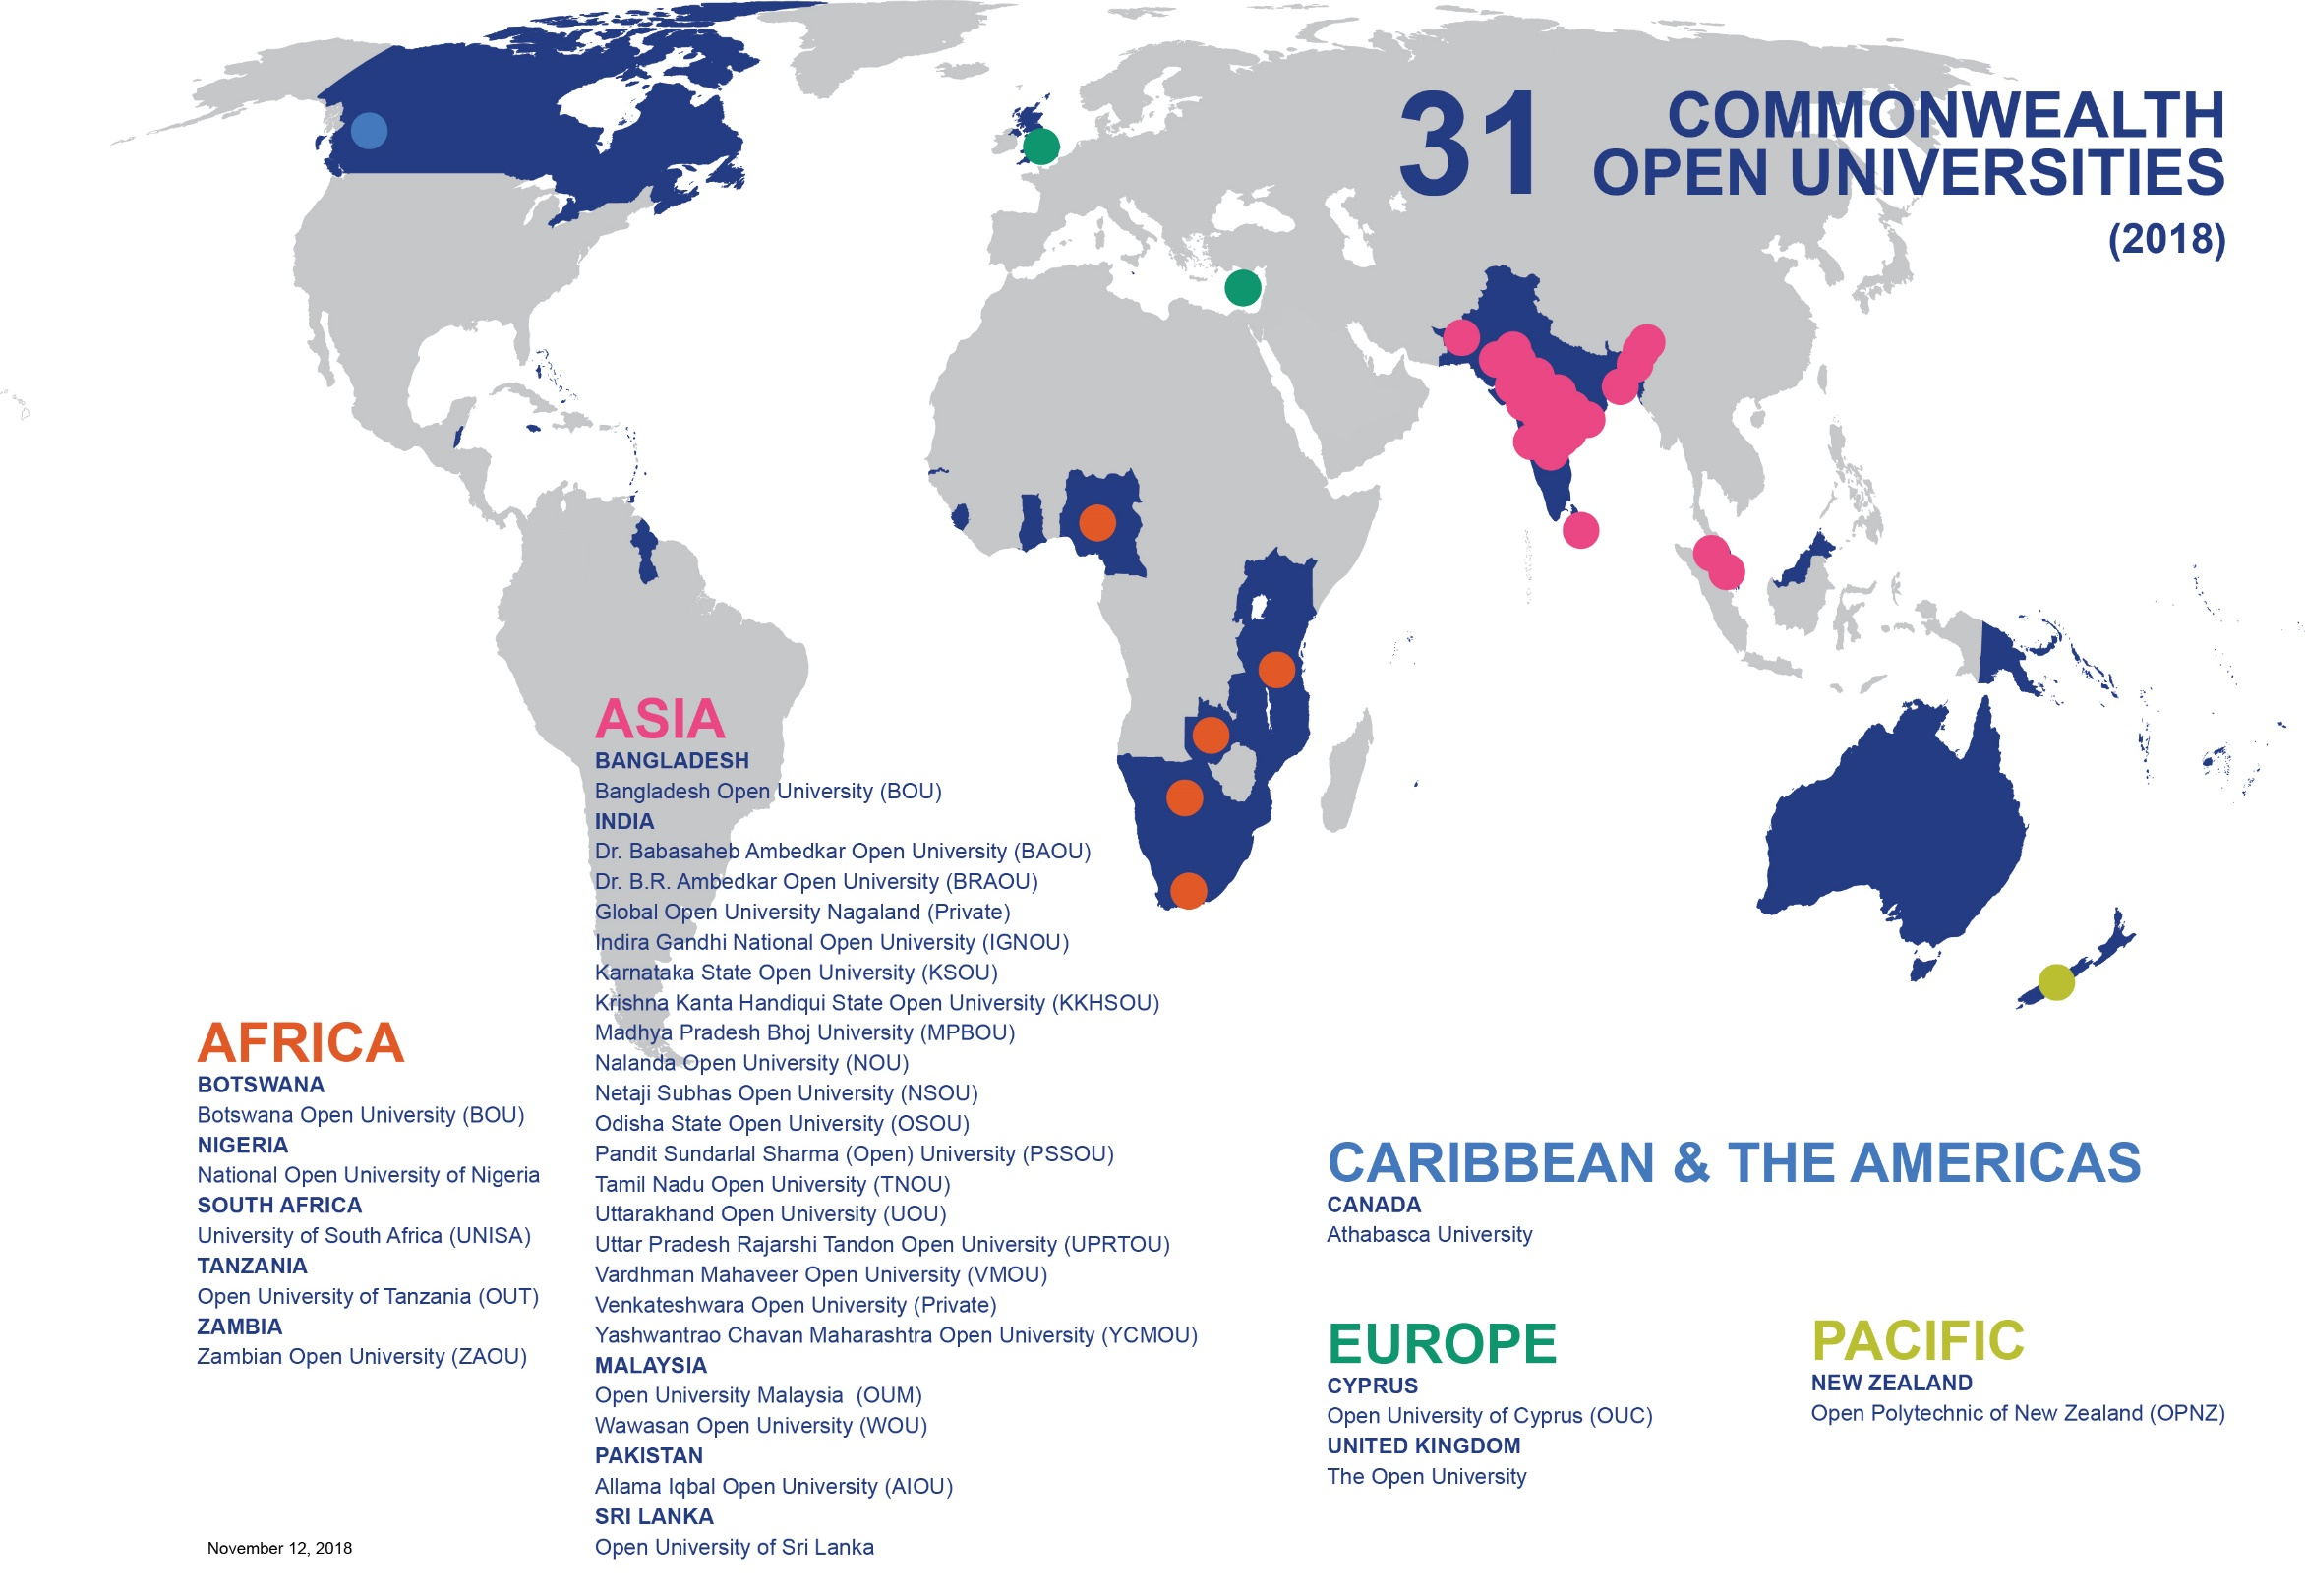


Slide 30





Benefits of CEMBA/MPA
Allama Iqbal Open University (AIOU), Pakistan
Graduates saw on increase of
38% in monthly income
An increase of 28.5 % points in
the probability of being promoted
For every $1 invested, learners received
$3.40 in direct returns
1:3.4
Notes:
Based on a conservative scenario where impact is expected to last 5 years, with a discount rate of 6% and decay rate of 70%

Slide 31

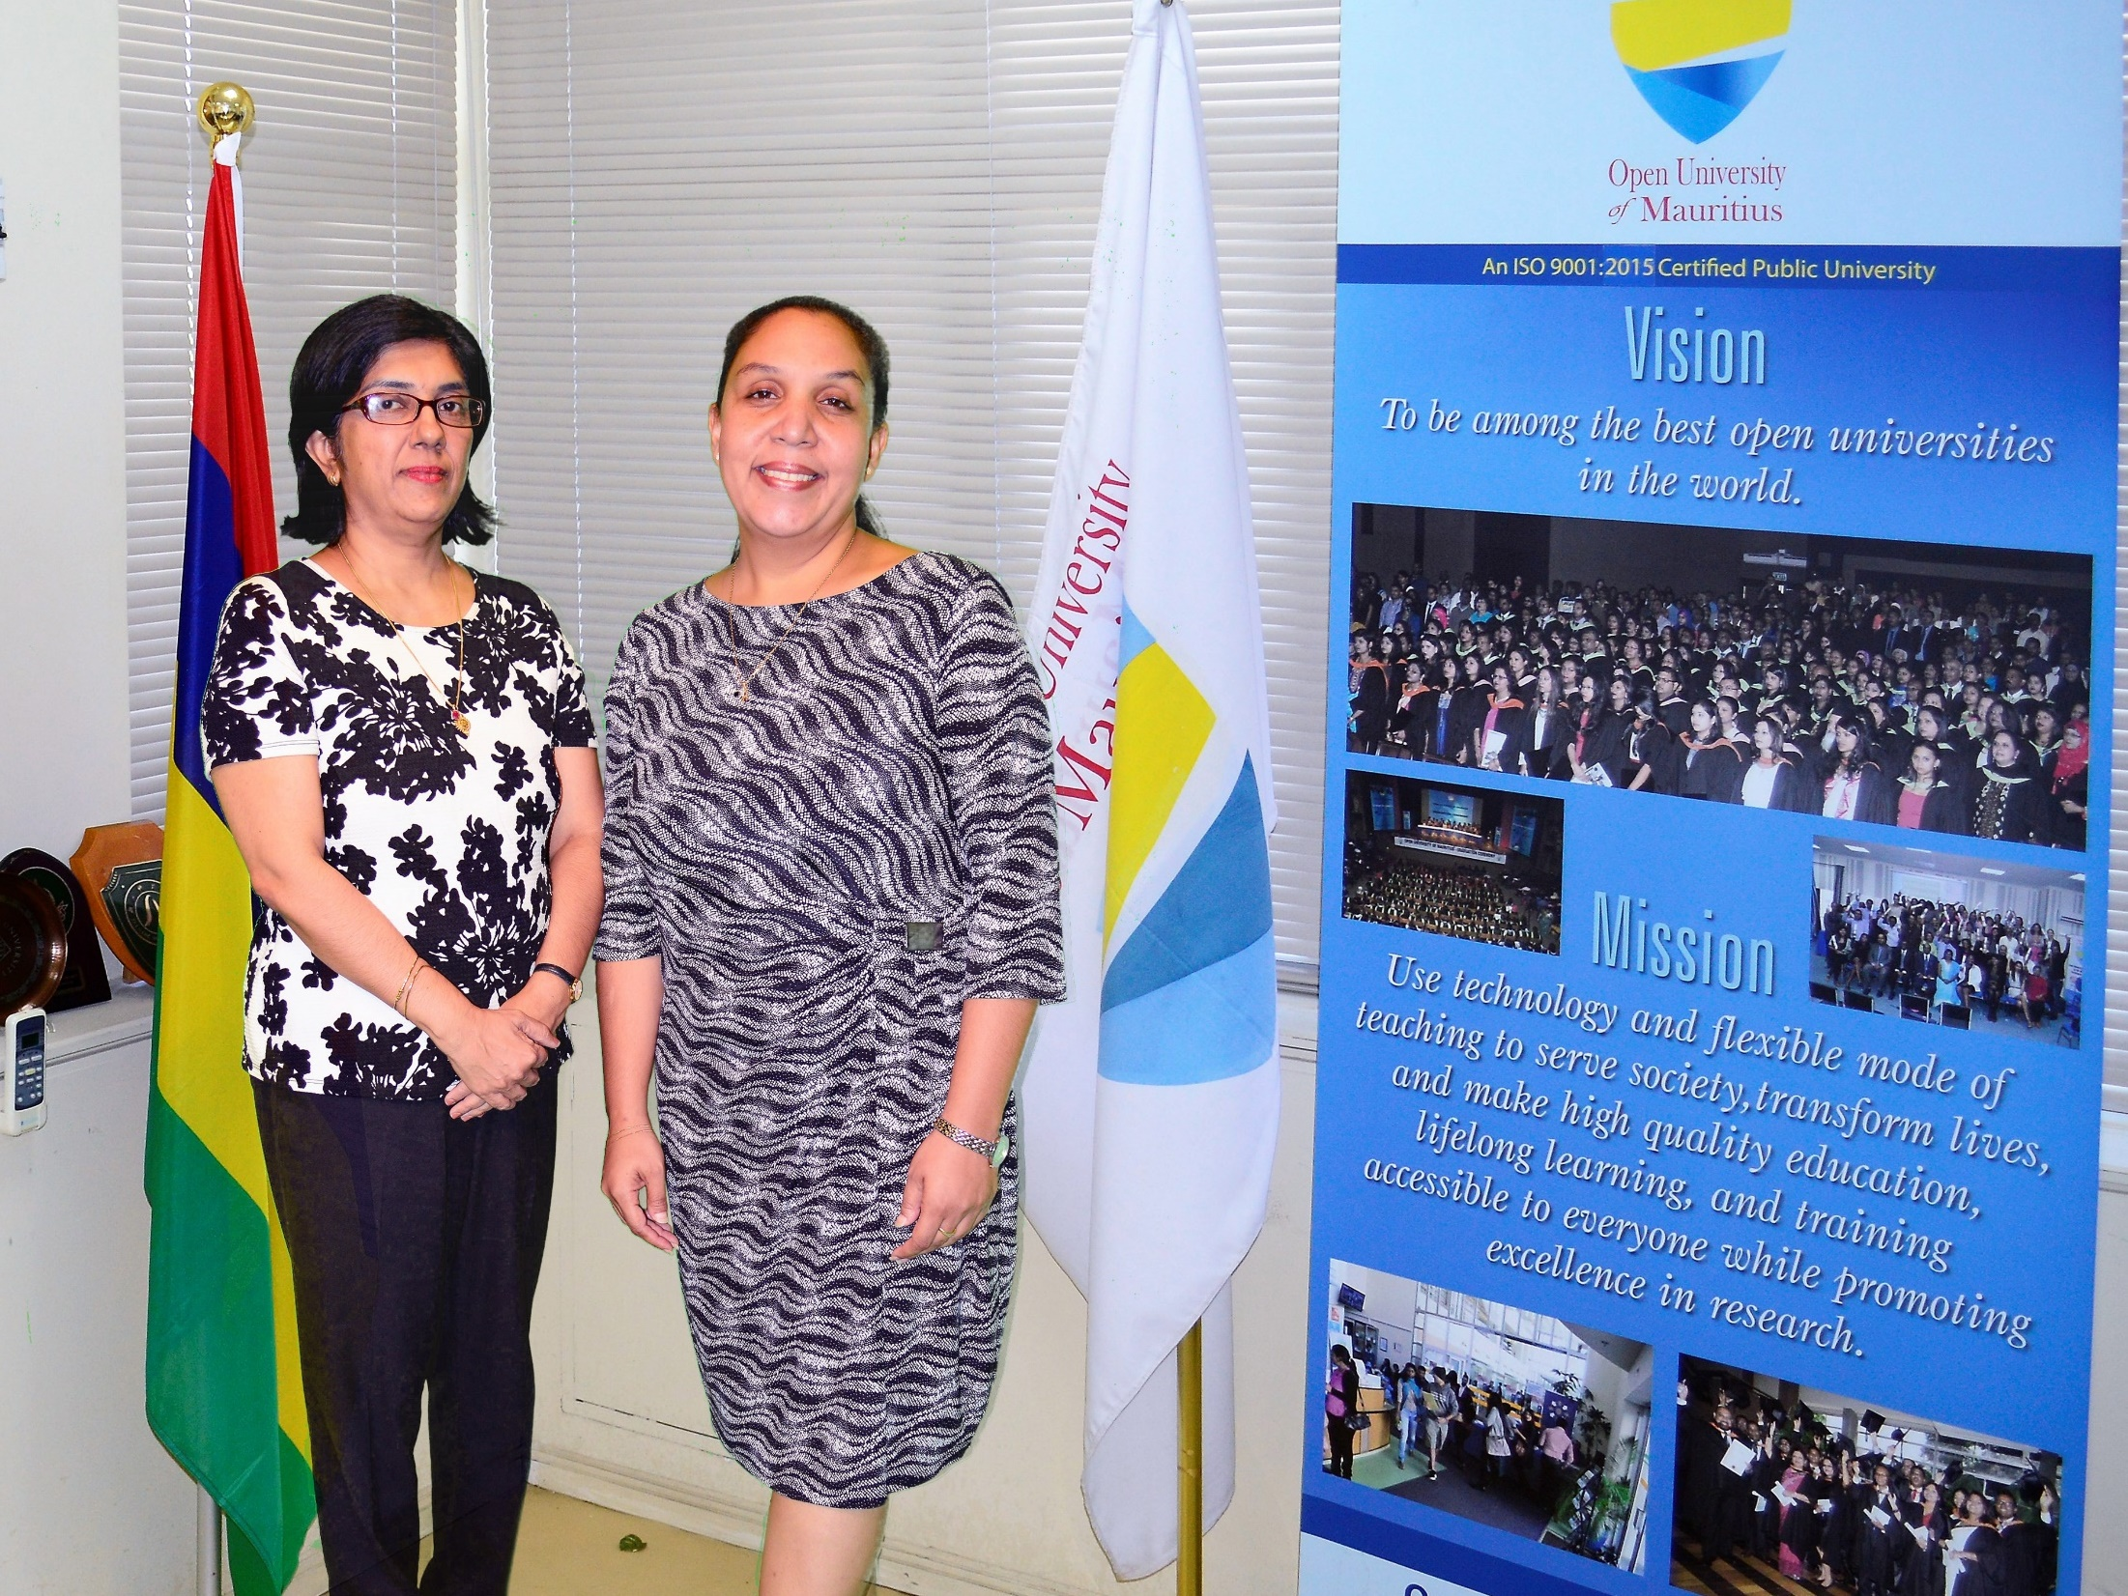

“As a Deputy Rector, I deal mostly with people whether it be students, parents, staff….Leadership and management skills, which I acquired during my CEMBA/CEMPA course, are proving very helpful.”
--Annelise, former mathematics educator
Commonwealth Executive MBA/MPA - 11 Countries
Notes:
Annelise was a mathematics educator at BPS College in Beau Bassin, Mauritius when she decided to enroll in the CEMBA/MPA programme at the Open University of Mauritius. She was limited in both time and financial resources and was attracted to the programme because of its flexibility, international recognition and approach to blended learning. Having graduated in 2015, Ms Lafrance is now a Deputy Rector of Saint Mary's College in Rose Hill, Mauritius. In speaking to COL in 2019 about how the programme prepared her for a career as a senior level school administrator, Ms Lafrance said, “As a Deputy Rector, I deal mostly with people whether it be students, parents, staff….Leadership and management skills, which I acquired during my CEMBA/CEMPA course, are proving very helpful.”

Slide 32
3
Open Educational Resources (OER) are the answer to closed and costly textbooks
PARADIGM
SHIFT

Slide 33




One Textbook per Child?
1 reading textbook for 12 students
1 math textbook for 14 students

Slide 34
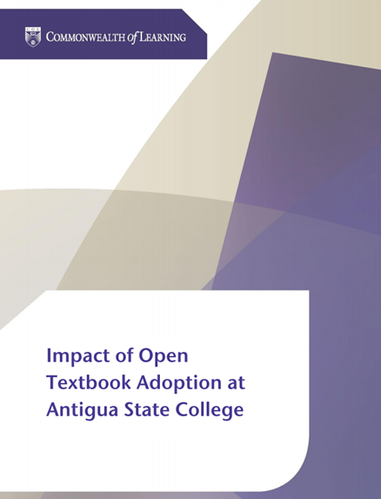

Antigua and Barbuda
Students saved between 75 to 88 ECD per course per semester by using open textbooks
Supplementing textbooks with OER improved student performance by 5.5%

Slide 35


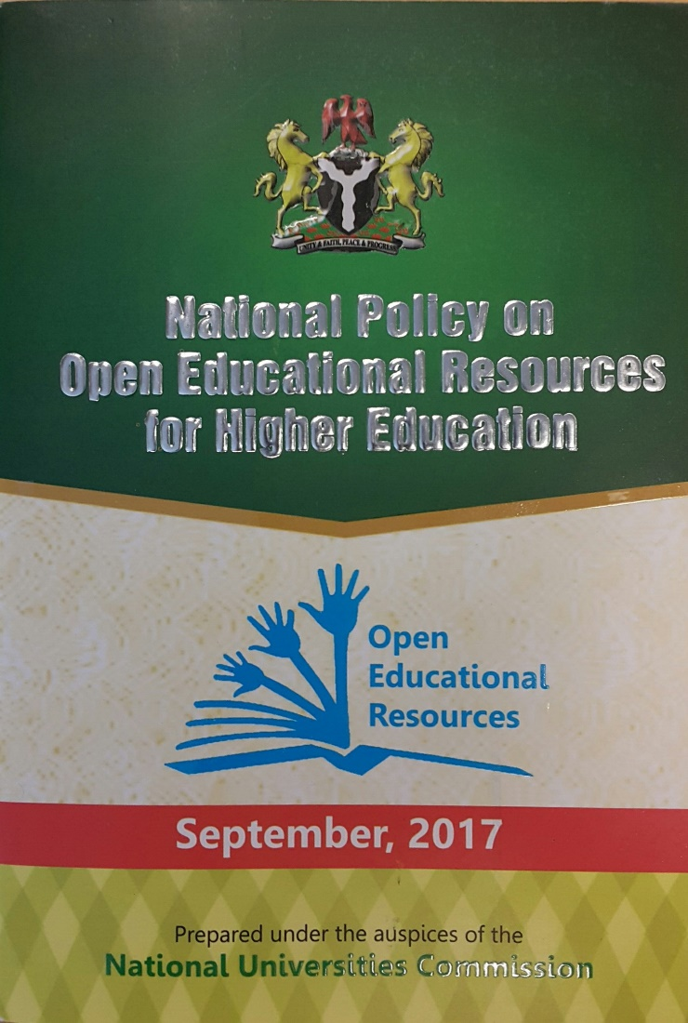
Impact of OER Policy
170+ universities participate in the OER curation, development and sharing

Slide 36
4
The digital divide can be transformed into a digital dividend
PARADIGM
SHIFT

Slide 37

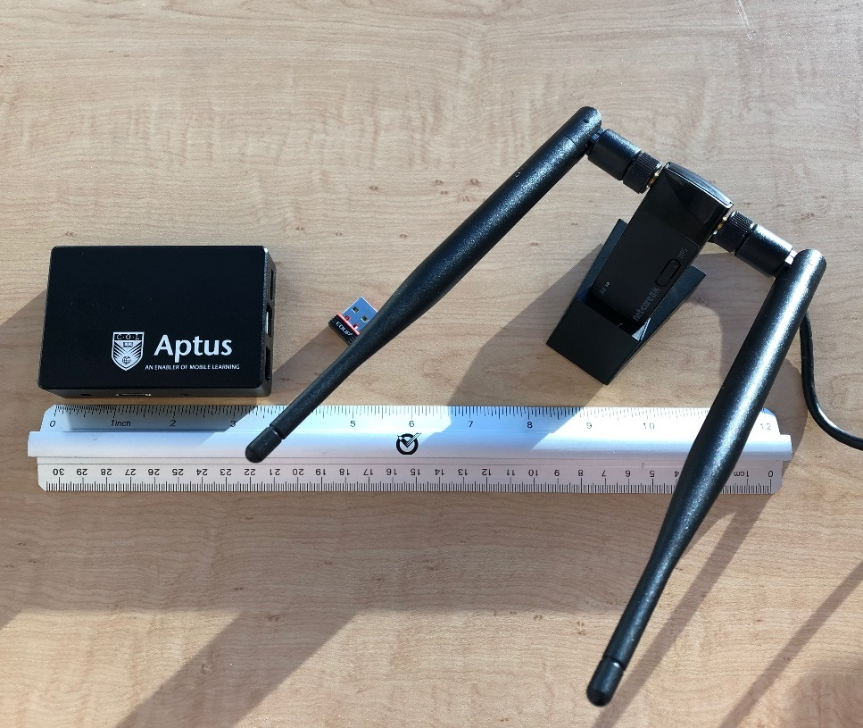
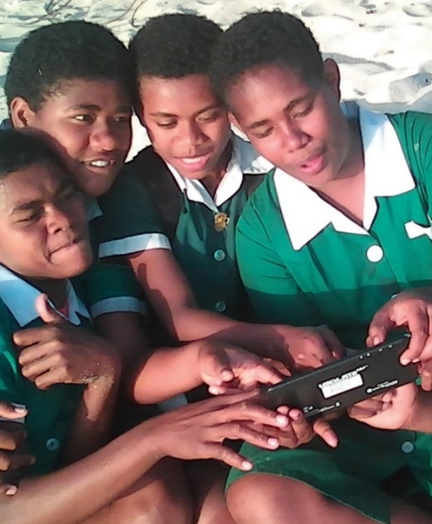

Slide 38
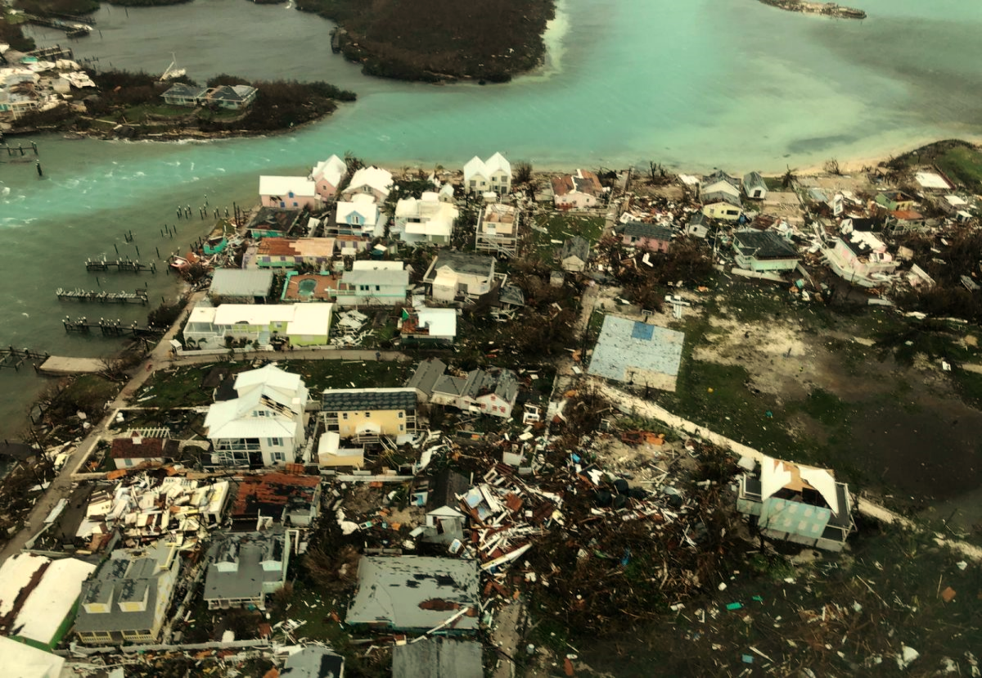


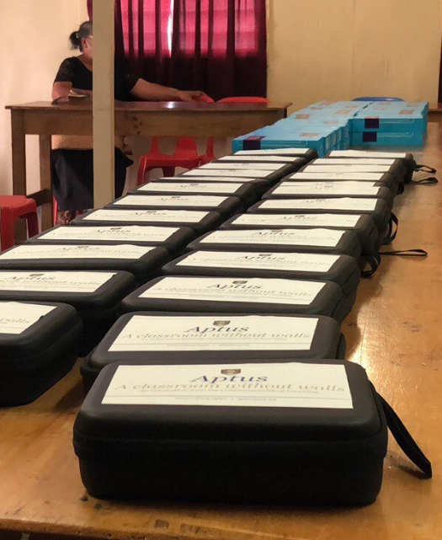


Aptus Deployment Following
Hurricane Dorian
The Bahamas
Notes:
How does the climate crisis effect the education sector specifically?
In recent years, Commonwealth countries have experienced severe impacts to their education systems as the result of climate related natural disasters.
Cyclone Idai, which hit eastern Mozambique on March 14, 2019 was the worst natural disaster to hit southern Africa in twenty years. According to UNICEF, from July 2019, more than 3000 classrooms and 330,000 students were affected by the Hurricane (https://www.unicef.org/mozambique/en/cyclone-idai-and-kenneth)
On September 1 2019, the eye of Hurricane Dorian made landfall on the Abaco Islands, reaching the island of Grand Bahamas the next day. It was the strongest hurricane on record to hit the Bahamas.
According to Mercy Corps, the Abaco Islands were the most affected with approximately 90 percent of housing and infrastructure left damaged or destroyed in its wake. In Grand Bahama, satellite data revealed that anywhere from 76 to 100 percent of buildings in certain areas were destroyed. The week after Hurricane Dorian hit was supposed to be the first week of classes in the Bahamas. Many families had just paid school fees and purchased uniforms, which were lost due to the hurricane. Many schools were deemed to be unsafe for students, halting classes.

Slide 39


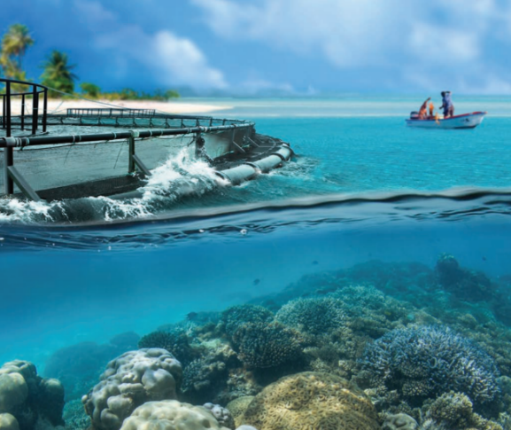
Understanding the Blue Economy
Blue Economy
Research Institute

Slide 40
5
Literacy is not always a precondition for Learning
PARADIGM
SHIFT

Slide 41
Literacy in the Commonwealth
400 million illiterate adults
Notes:
Of the 750 million illiterates in the world about 400 million are in the Commonwalth

Slide 42

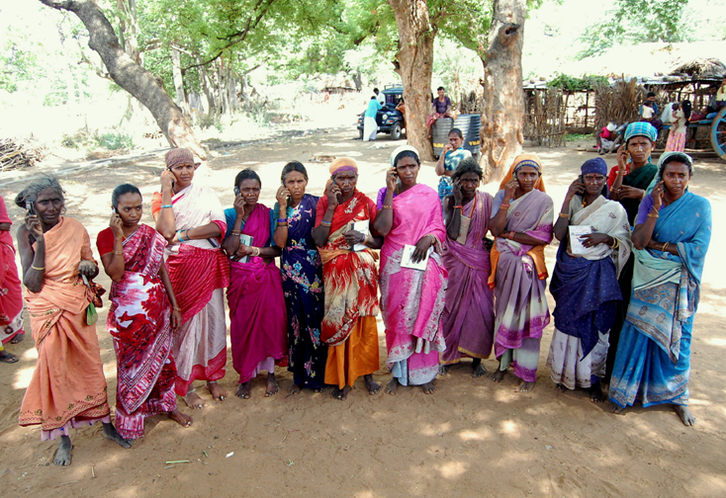
Every $1 invested resulted in $16 worth of income and assets.
Notes:
These women are part of COL’s L3F under which they have learnt agriculture and enterprise development skills using basic mobile phones. Because of this they have established companies in agriculture and livestock in which they are shareholders. They have generated enough assets within a space of three years.
Economic Times, Aug 18, 2017, The Big Farm to Fork Idea that Cuts wastage , ups farmer income

Slide 43

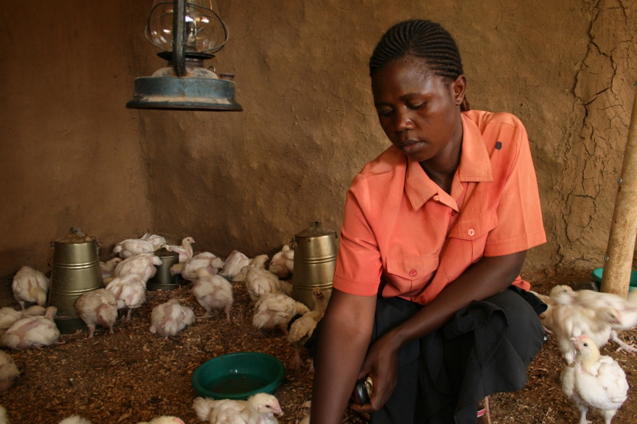
1% increase in empowerment 2.3% increase in profit.
Notes:
KENYA
This L3F project runs in 11 Commonwealth countries. Studies have found that learning leads to empowerment and that for 1% increase in women’s empowerment in Kenya, there was a 2.3% profit in agri-enterprises

Slide 44
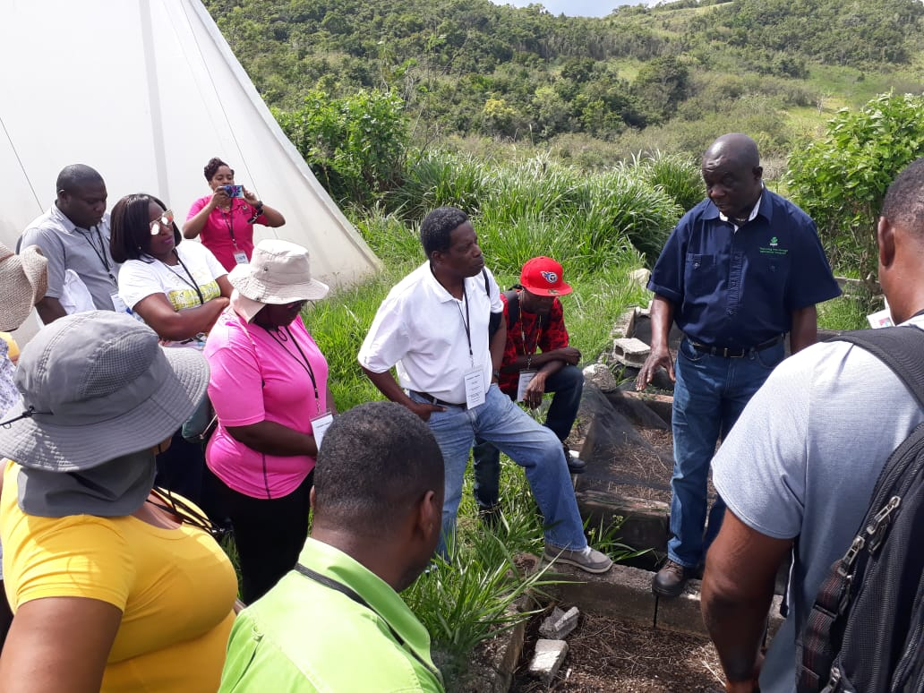
Iton Henry, L3F farmer from Antigua and Barbuda
“[The programme] made a major difference in my income and earnings”
Notes:
Iton, an L3F farmer from Antigua and Barbuda, used to work as a part time farmer and part time gold smith as he struggled to make sufficient income from his farm. Since joining the L3F programme he has learnt how to turn his subsistence farming into a profitable business, through proper record keeping and production planning. He also participated in a cross-training visit to Jamaica to learn from the best practices of farmers like him in a neighboring country. Farming is now his fulltime occupation and has helped him to improve his livelihood.

Slide 45
6
The social capital of the mother is the most important determinant in bringing girls to school
PARADIGM
SHIFT

Slide 46







Notes:
Thanks to grants from the governments of Australia and Canada, COL will train 45000 girls and women in five countries: Bangladesh, India Pakistan, Mozambique and Tanzania. You’ll be pleased to note that in the first eighteen months alone, over 29,000 girls have been trained in various skills and 5, 260 girls have found new sources of income generation.

Slide 47

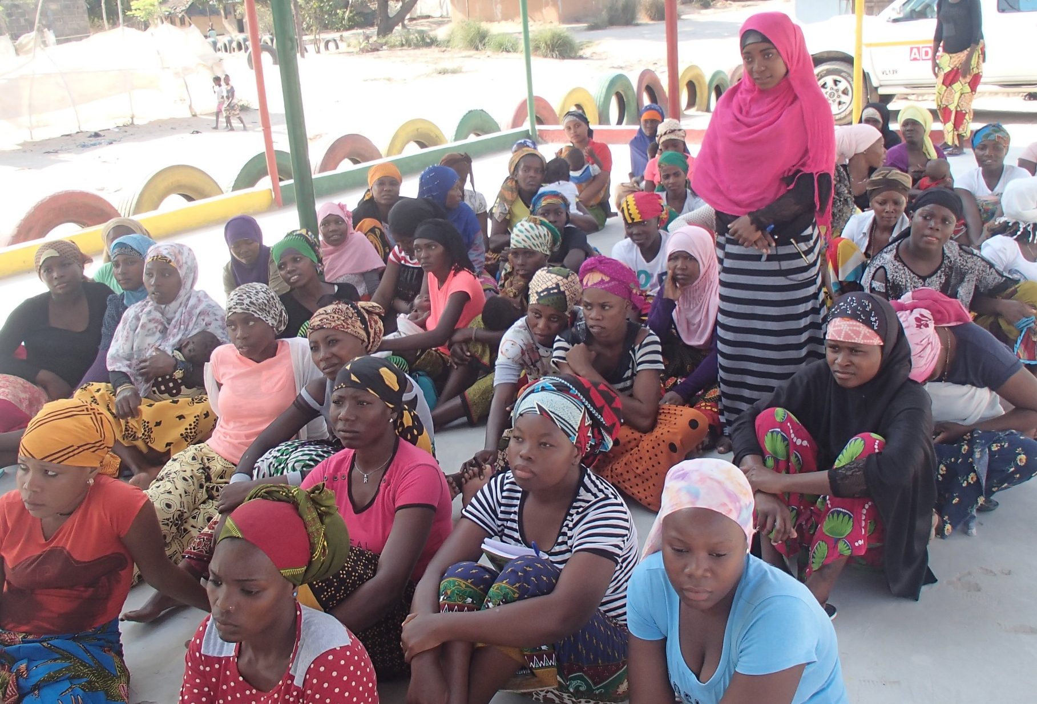
Community involvement prevented Fatima’s early marriage in Mozambique

Slide 48
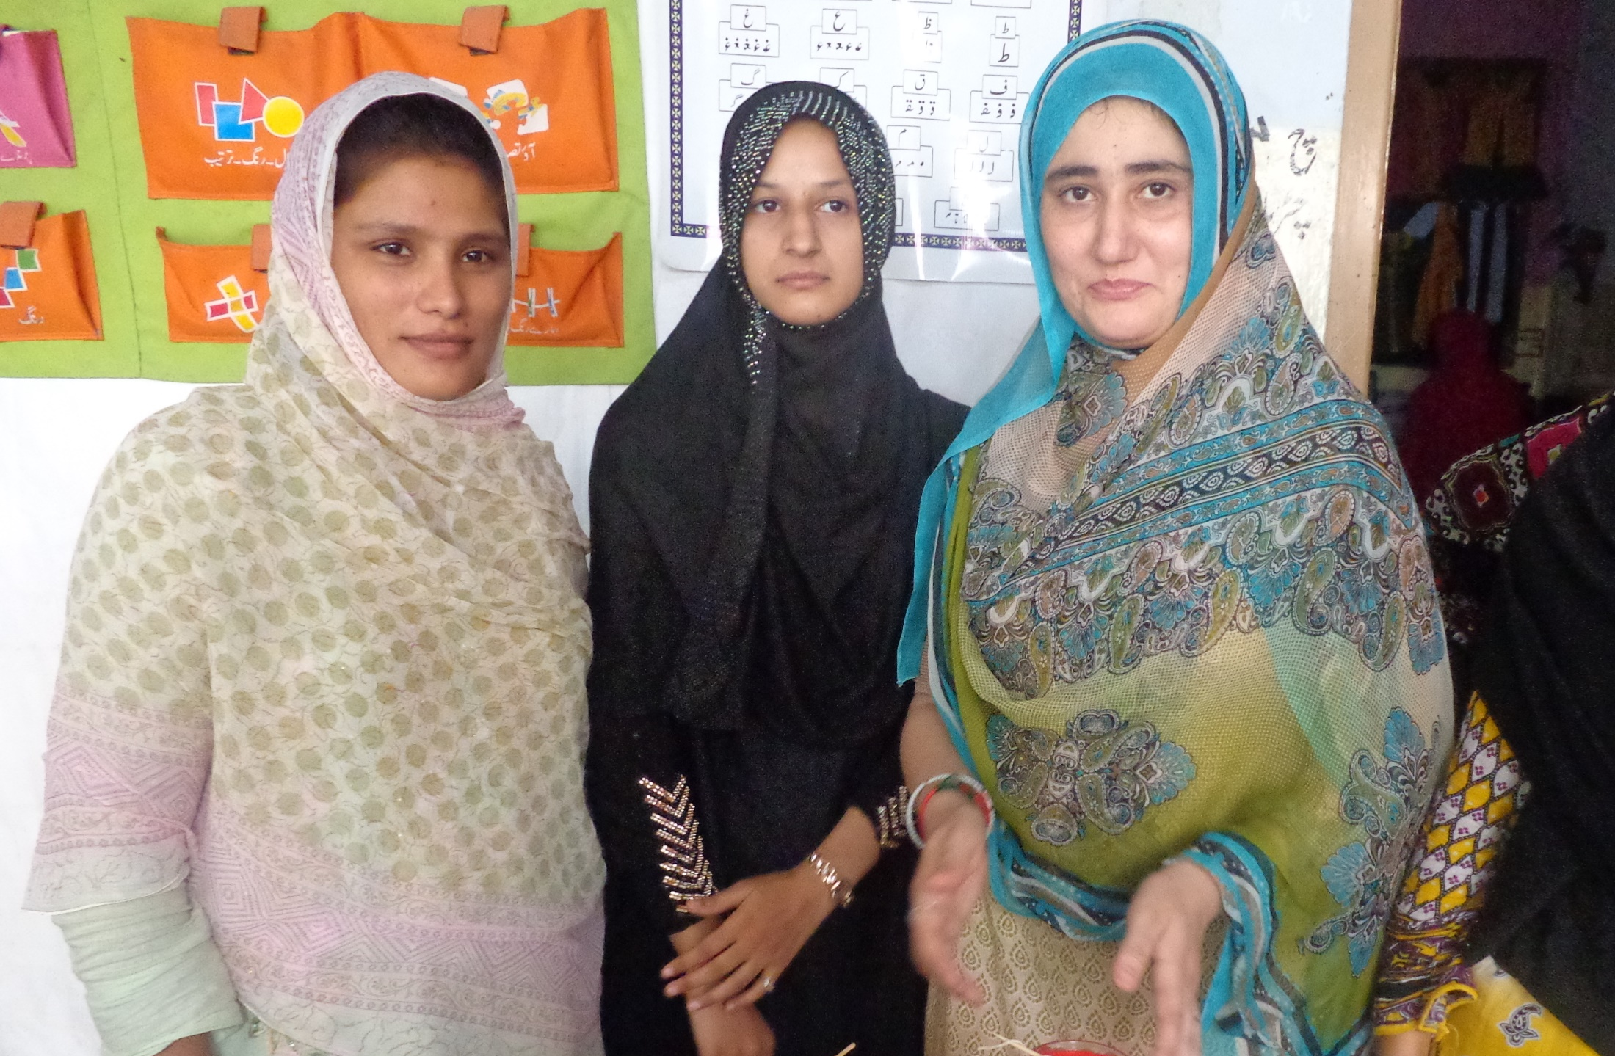
Meet Samina, Mother, Pakistan
When I was young, my parents used to beat me to go and labour with them. So, I could not get education, but now a new hope is developed in me…. And I will send my daughter to the nearest school.

Slide 49

Strategic Plan 2021-2027

Slide 50
Inputs to the planning process
Global trends
Inputs from the Board/partners/ stakeholders
Evaluation
Feedback from Focal Points

Slide 51




Focal Points Meetings
Africa & the Mediterranean
Asia
Pacific
Caribbean

Slide 52

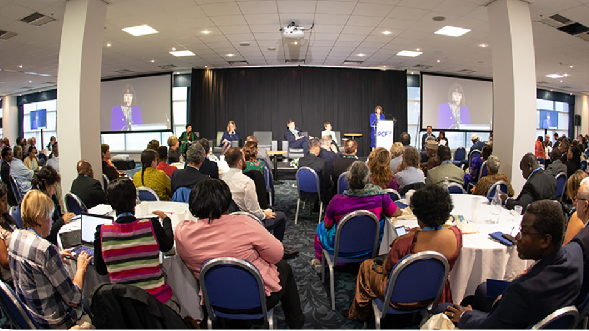
Stakeholder Survey

Slide 53

Highlights of Findings

Slide 54

Highlights …

Slide 55

Highlights …

Slide 56

Highlights …

Slide 57
Mid-term evaluation 2018
(External)
“COL is on the ‘right side of educational history’ and making an important contribution-directly influencing the quality of learning in the Commonwealth and to being a leader in pedagogical reform”
“placed the emphasis on impact, demand, and long term outcomes…in contrast to more traditional development models which are mostly supply oriented and tend towards…outputs.”
Need for more attention to COL’s influence strategies.
(Sauder 2018)

Slide 58

Final Meta-Evaluation
What difference has COL made?

Slide 59
Questions
What are the new development trends that COL must address?
What has changed in your region that COL must address?
How can COL further your national agenda?
How do we achieve scale, impact, visibility?

Slide 60








COL Offers…
World Class Expertise
Innovative Models
Capacity Building
Resources
Notes:
We invite you to engage us; tap into our thought leadership, expertise, networks and resources

Slide 61


What COL asks of you
Dialogue about your priorities
Identification of common regional issues
Your involvement

Slide 62




Thank You
for your contributions
col.org

