Slide 1

Can ODL reach the unreached? Lessons from the Commonwealth
July 27,2016. Abuja, Nigeria
Prof Asha Kanwar, President & CEO,
Dr Sanjaya Mishra, Education Specialist, eLearning
Commonwealth of Learning, CANADA

Slide 2
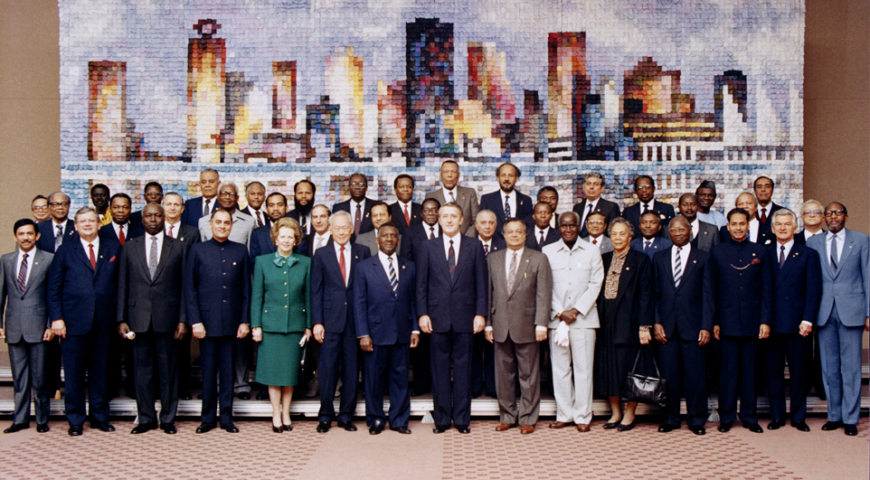
Copyright Commonwealth Secretariat
Commonwealth Heads of Government Meeting
Vancouver, 1987

Slide 3




Where is it?
Metro Vancouver
(Headquarters)
New Delhi
(CEMCA)

Slide 4
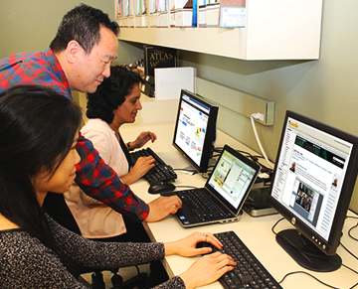
What is it for?
To help Commonwealth governments and institutions use various technologies to improve access to learning in support of development.

Slide 5
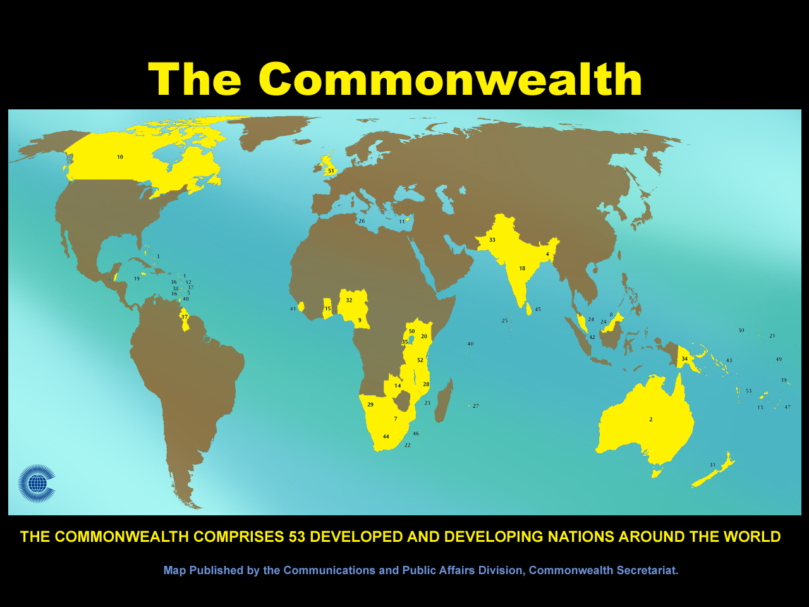

Slide 6

THANK YOU, NIGERIA

Slide 7
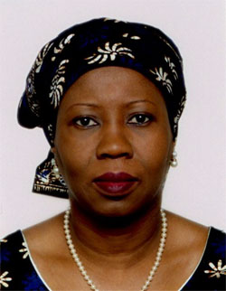
HE Mariam Katagum: Nigeria

Slide 8
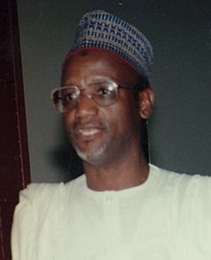

Alhaji Hafiz S. Wali
Dr. A. Umar

Slide 9

ODL in Teacher Training: NTI
Photo source: http://www.nti-nigeria.org/

Slide 10
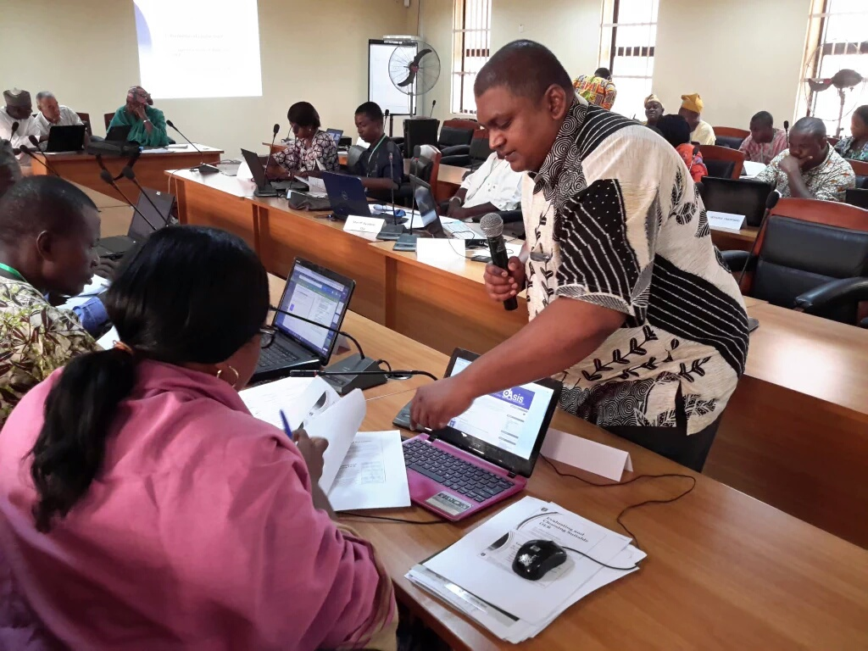
Yaba College of Technology (YCT), Lagos, Nigeria, 2016

Slide 11
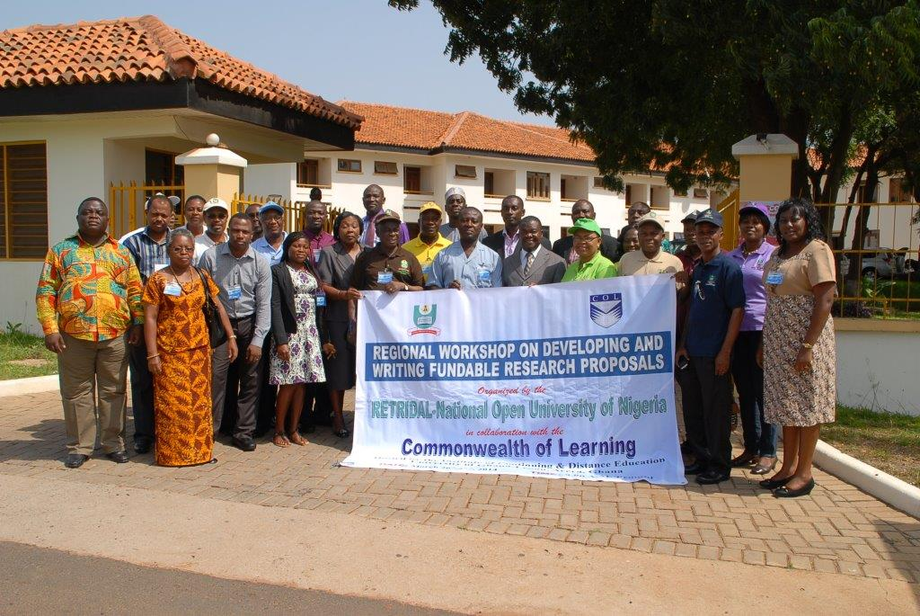
RETRIDOL
Regional Centre

Slide 12
Regional Female Leadership Training Cape Coast, Ghana,
November, 2015

Slide 13
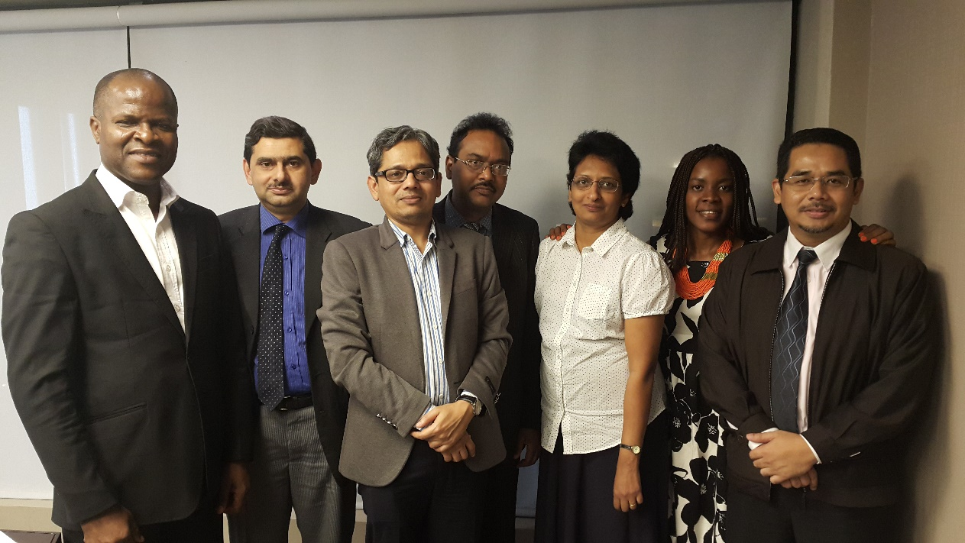
Advanced ICT Skills Course
Certificate in Web Application Development
COURSES
Programming using JAVA
Image Design and Animation Development
Diploma in Mobile App Development

Slide 14

Commonwealth Executive MBA/MPA
11 partner institutions across the Commonwealth with a total enrolment of over 27,000 since inception in 2002.
Notes:
10 countries/flags?

Slide 15
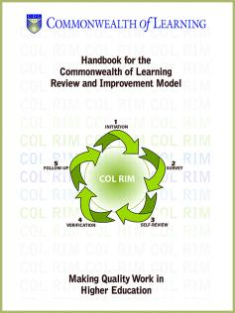

COL Review and Improvement Model (COLRIM)

Slide 16






UNESCO-COL Chairs in ODL and OER

Slide 17
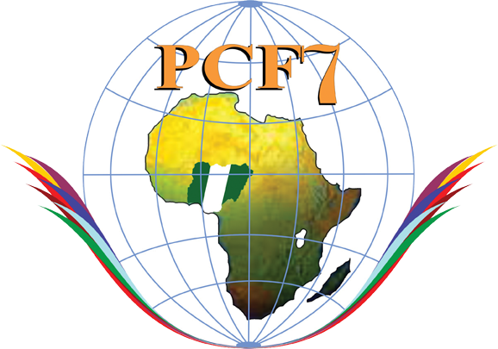
PCF7
2013
Open Learning for Development: Towards Empowerment and Transformation
Abuja, Nigeria

Slide 18
Plan
Context
What is ODL?
Fifth Decade of ODL
Reaching the Unreached
Way Forward

Slide 19

The Context

Slide 20

A Young Nigeria
Nigeria has 64.1million young people between the ages of 15 and 35: 51.6 % female
Source: National Bureau of Statistics, 2012 National Baseline Youth Survey
Notes:
Nigeria has a large youthful population. The National Youth Policy defines a ‘Youth’ as a Nigerian citizen between the ages 18 - 35 years. However, in this survey, age bracket 15 – 35 was considered. The population of youths (15 - 35) in the country was estimated to be 64.1 million with females constituting 51.6 per cent while that of youths (18 - 35) was 52.2 million with female constituting 52.8 per cent.

Slide 21
Nigeria: Youth Unemployment Rate (ages15-24) 2004-2014
Source: World Bank Open Data, last accessed on June 24, 2016
Notes:
https://africacheck.org/factsheets/factsheet-how-nigerias-unemployment-rate-is-calculated/

Slide 22
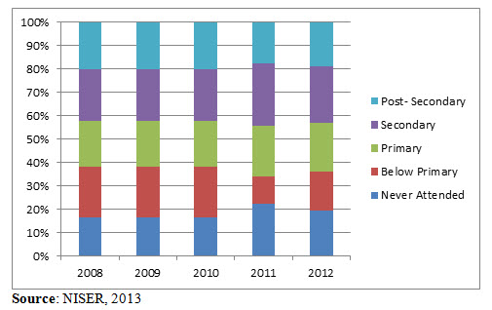
Nigeria: National Youth Unemployment Figures by Education, 2008-2012
Source: Brookings Institution, Youth Unemployment in Nigeria: A Situation Analysis (2014)
Notes:
Over 40% of the unemployed youth have at least secondary education.

Slide 23
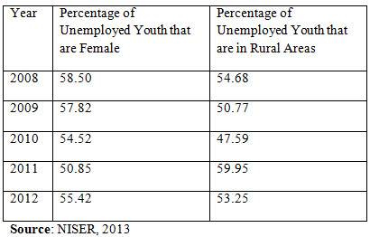
Nigeria: National Youth Unemployment Figures by Gender & Geography, 2008-2012
Source: Brookings Institution, Youth Unemployment in Nigeria: A Situation Analysis (2014)
Notes:
Percentage of unemployed women in the age group of 15-35 are more than young men, and rural youth are more unemployed than their urban counterpart.

Slide 24
ICT in Sub-Saharan Africa 2004 - 2014
Source: The World Bank DataBank, Retrieved on September 3rd , 2015.
Notes:
Source: The World Bank DataBank, Retrieved on September 3rd , 2015.

Slide 25
Nigeria: ICT Statistics 2000-2014
Source: ITU Statistics, last accessed on June 24, 2016

Slide 26
Tertiary Gross Enrolment Ratio in Nigeria 2001 – 2010
Source: UNESCO Institute for Statistics, last accessed on July 14, 2016

Slide 27
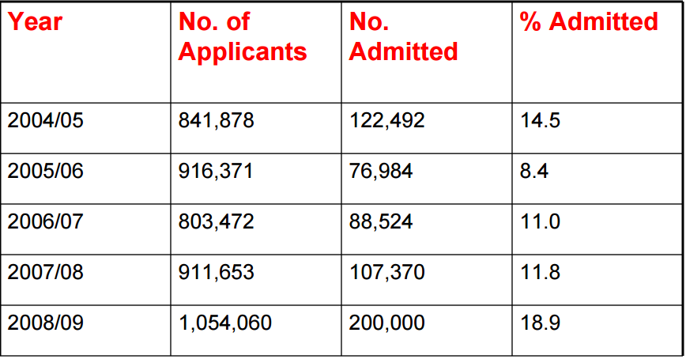
Application and Admission Profiles into Nigerian Universities
Source: UNESCO, Higher Education Statistics – Nigeria Experience in Data Collection(2010)
Notes:
http://www.uis.unesco.org/StatisticalCapacityBuilding/Workshop%20Documents/Education%20workshop%20dox/2010%20Windhoek%20-Regional%20Workshop%20on%20Education%20Statistics%20for%20South%20and%20Eastern%20Africa/NIGERIA-Higher%20educataion%20statistics-%20National%20experience.pdf
The high number of learners not getting entry into the higher education system is a matter of concern, and calls for increased access to open and distance learning system.

Slide 28
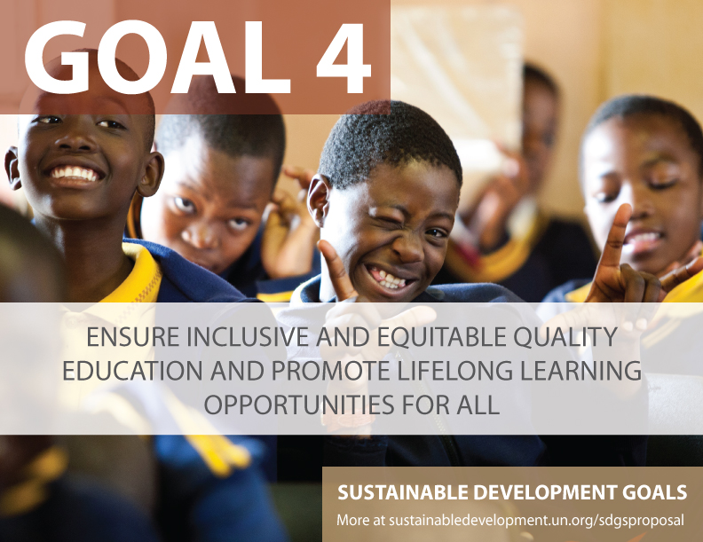

Slide 29
Education 2030: Framework for Action
Develop policies and programmes for the provision of quality distance learning in tertiary
education, with appropriate financing and use of technology, including the Internet, massive
open online courses and other modalities that meet accepted quality standards to improve
access.

Slide 30
What is Open & Distance Learning ?

Slide 31
Open Learning
=
Learning without barriers

Slide 32

Philosophy of ‘Open-ness’
Open as to people,
Open as to places,
Open as to methods, and, finally,
Open as to ideas
  Lord Crowther

Slide 33



‘Open-ness’ in Practice
No entry qualifications
Credit banking
Cafeteria approach to courses
Anytime, anywhere

Slide 34
DISTANCE EDUCATION
=
Separation of teacher and learner

Slide 35
OPEN LEARNING
is NOT the same as
DISTANCE EDUCATION
BUT, they are complementary.
Therefore: ODL

Slide 36
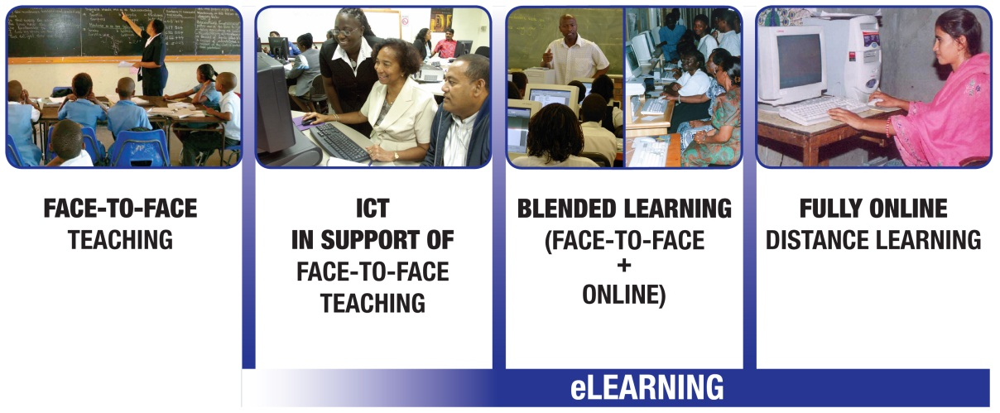
ODL and eLearning
  Access | Quality | New Pedagogies
Notes:
With the advent of technology in teaching-learning practices, ODL has undergone massive transformation, and today, most ODL uses some form of online learning. Thus, ODL moving towards virtualisation and creating spaces that are more open, while retaining the characteristics of organised learning environments online.

Slide 37
Online enrolments in Africa
The growth rate in Africa is 16.3%
Uganda: 45%,
Ghana: 44%,
Rwanda: 42%
  Ambient Insight Regional Report, 2015
Notes:
Source: http://www.ambientinsight.com/Resources/Documents/AmbientInsight-2011-2016-Africa-SelfPaced-eLearning-Market-Abstract.pdf
The growth rate for Self-paced eLearning in Africa is 15.2%. Revenues reached $250.9 million in 2011 and will more than double to $512.7 million by 2016. Eleven of the sixteen countries analyzed in this region have
growth rates above the 15.2% aggregate rate.
Senegal has the highest growth rate in Africa at 30.4%, followed by Zambia, Zimbabwe, and Kenya at 27.9%, 25.1% and 24.9%, respectively. Revenues are growing very fast in many African countries. By 2016,
revenues will double in seven countries and will more than triple in four countries.
Nigeria will be the second largest buying country of eLearning technologies and services in Africa, only next to South Africa.

Slide 38
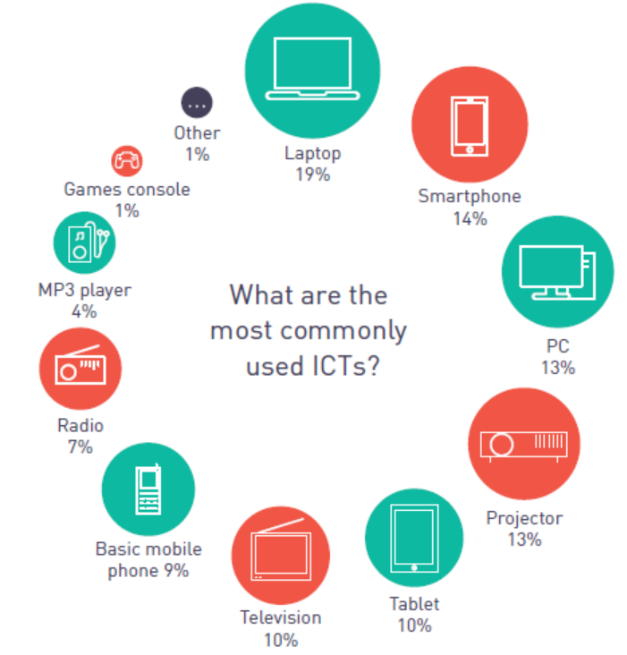
eLearning Africa 2015

Slide 39
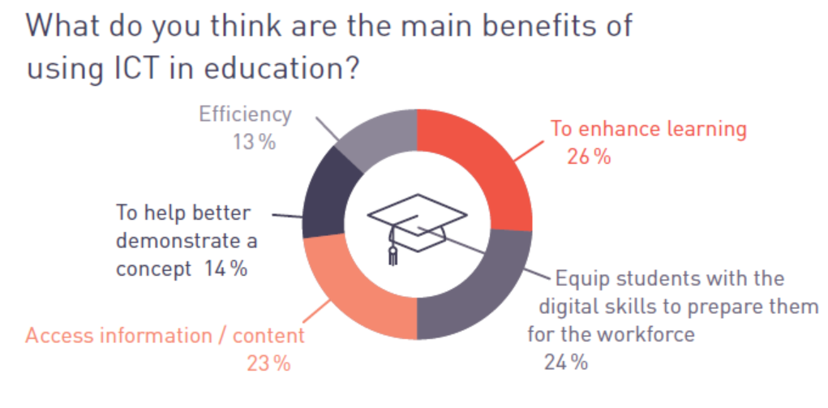
eLearning Africa 2015

Slide 40
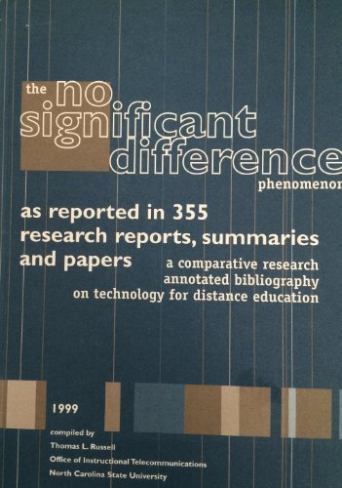
Notes:
Overall research comparing distance education, online learning and face-to-face education have resulted in no significant difference in learning outcomes.
Bernard et al. (2004) after a meta-analytic review of 232 studies concluded that in many cases, the DE group outperformed the traditional education group by over 50%, while there were also instances to the contrary, and therefore, it would could not be concluded that DE is netter than, worse than or even equal to traditional education, reaffirming the no-significant difference. Another meta-analysis study by Shachar and Neuman (2010) indicated that in 70% of the cases, students taking courses by distance education outperformed their counterparts in the traditionally instructed courses, which means distance education is becoming the “new normal”.

Slide 41
The Fifth Decade of ODL

Slide 42





I. The Rise of Open Universities

Slide 43
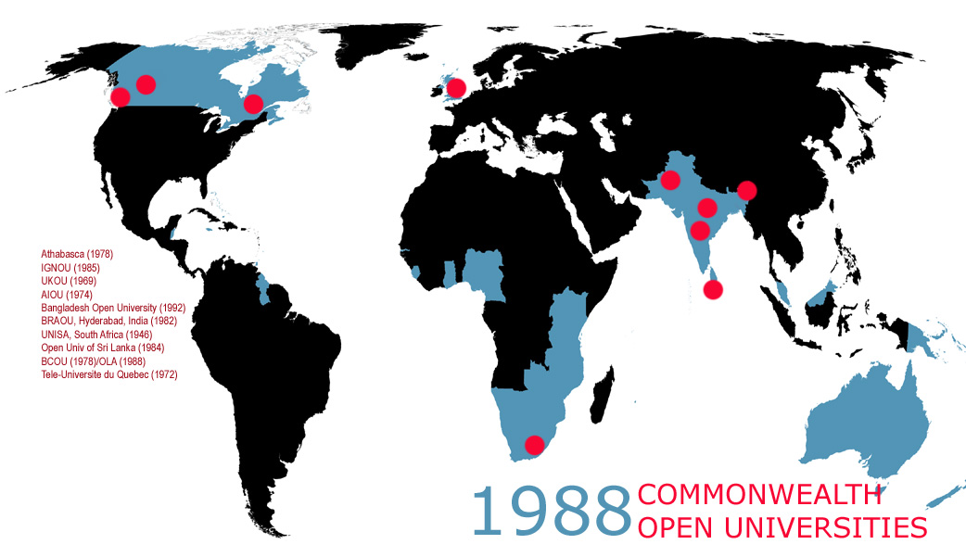

Slide 44
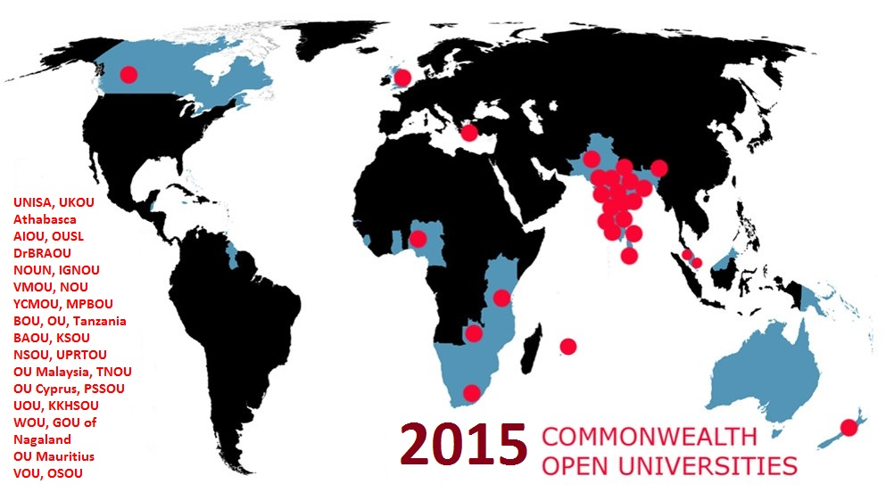

Slide 45
ODL in Nigeria
The Correspondence and Open Studies Unit (COSU) of University of Lagos started in 1974
National Teachers’ Institute (NTI) started as a distance education institute in 1976
The Distance Learning Institute of University of Ibadan started in 1979
NOUN was established in 1983 by an Act of the National Assembly--suspended a few weeks later--revived in April 2001
Source: Ajadi, Timothy Olugbenga, Ibrahim Olatunde Salawu, and Femi Adetunji Adeoye. "E-learning and distance education in Nigeria." TOJET 7.4 (2008).
Notes:
http://www.tojet.net/articles/v7i4/747.pdf
Distance education in Nigeria dates back to 1887, when several students enrolled for the University of London matriculation examination. The University of Lagos established the Correspondence and Open Studies Unit in 1973, which is now the Distance Learning Institute. This was subsequently followed by other universities largely for teacher education, and the National Teacher’s Institute was established in 1978 as the dedicated distance education institution for teacher training. NOUN was established in 1983 by a federal act and then revised again 2001.

Slide 46
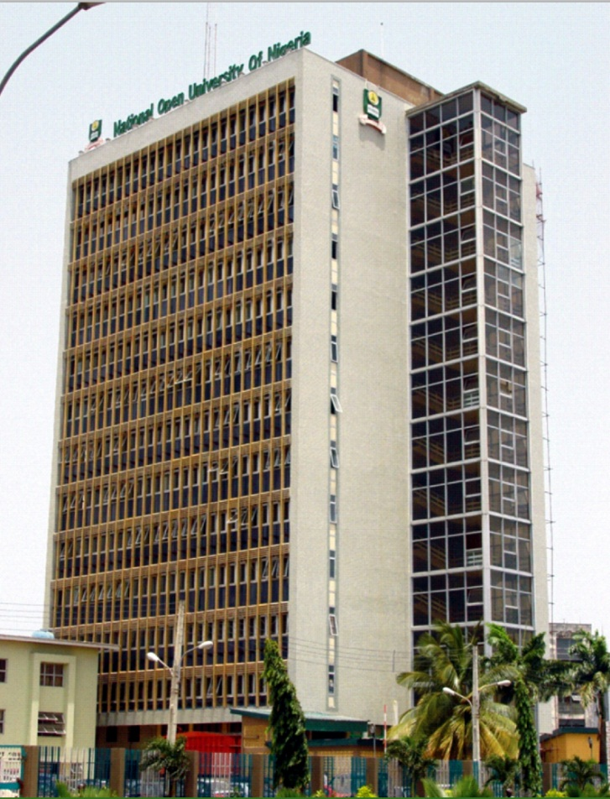
Access: NOUN (120,000 students)

Slide 47
Costs: ODL in mega universities
Country | Institution | Enrolment | % of Campus Cost*
Pakistan | AIOU | 456.126 | 22
China | CCRTVU | 2,300,000 | 40
India | IGNOU | 1,187,100 | 35
UK | OU | 203,744 | 50
*Unit cost per student as a percentage of the average for other universities in the country, NKC, 2004.

Slide 48

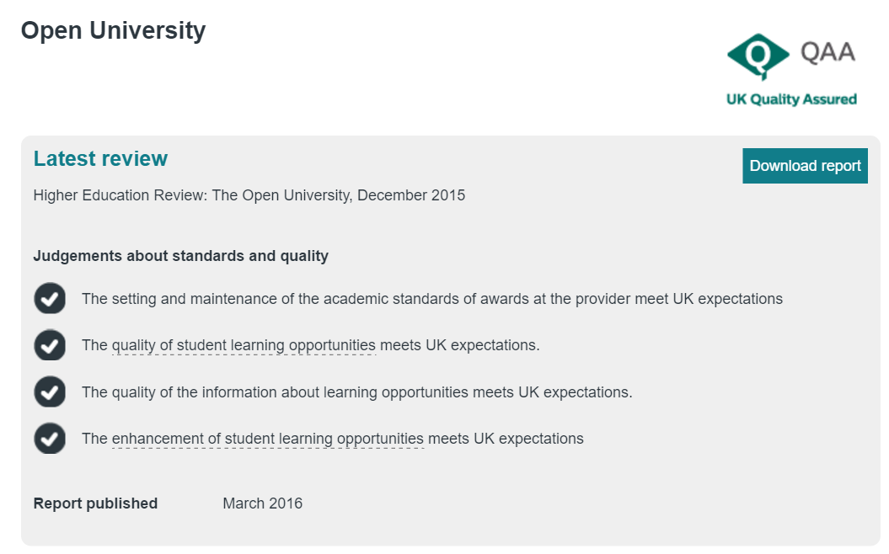
Quality: Open University,UK
In the top three rank for student satisfaction for the seventh consecutive year
QAA Good practice commendation for independent use of experts for setting academic standards; open access and widening participation; meeting needs of disabled learners; and commitment to student success.
Notes:
Source: http://www.open.ac.uk/business-school/news/archive/open-university-stays-top-three-student-satisfaction-seventh-consecutive-year

Slide 49
II. The rise of dual mode institutions
South Africa: Enrolments in single mode dropped by 21% between 1995-1999 ¹
Deakin: Almost a quarter of 53,000 students study at a distance ²
Campus of Open Learning, University of Delhi: More than 200,000 distance students³
One-in-seven (14%) of all higher education students in USA taking some distance education courses⁴
Sources:
UNESCO: Open and Distance Learning - Trends, Policy and Strategy Considerations (2002).
Deakin University: Our reputation and history. Last accessed on May 2, 2016.
Campus of Open Learning, University of Delhi: About us. Last accessed on May 2, 2016
Online Report Card, February 2016.
Notes:
http://unesdoc.unesco.org/images/0012/001284/128463e.pdf
http://www.irrodl.org/index.php/irrodl/article/view/20/360
http://www.deakin.edu.au/about-deakin/our-reputation-and-history

Slide 50
Advantages
Expand access
Availability of academic talent
Optimal utilisation of existing resources
Resource-generation
Access to wider curriculum

Slide 51
Challenges
Lack of autonomy
Poor learner support
Underfunding
Inadequate staff training
Second-class status

Slide 52
Nigeria: Dual Mode Institutions
1 | University of Ibadan, Ibadan | Distance Learning Centre
2 | Obafemi Awolowo University, Ile-Ife | Centre for Distance Learning
3 | University of Lagos, Akoka | Distance Learning Institute
4 | University of Maiduguri, Maiduguri | Centre for Distance Learning
5 | Modibbo Adama University of Technology, Yola | Centre for Distance Learning
6 | University of Abuja, Abuja | Centre for Distance Learning and Continuing Education
7 | Ladoke Akintola University of Technology, Ogbomoso | LAUTECH Distance Learning Centre
8 | Ahmadu Bello University Zaria | Distance Learning Centre ABU, Zaria

Slide 53
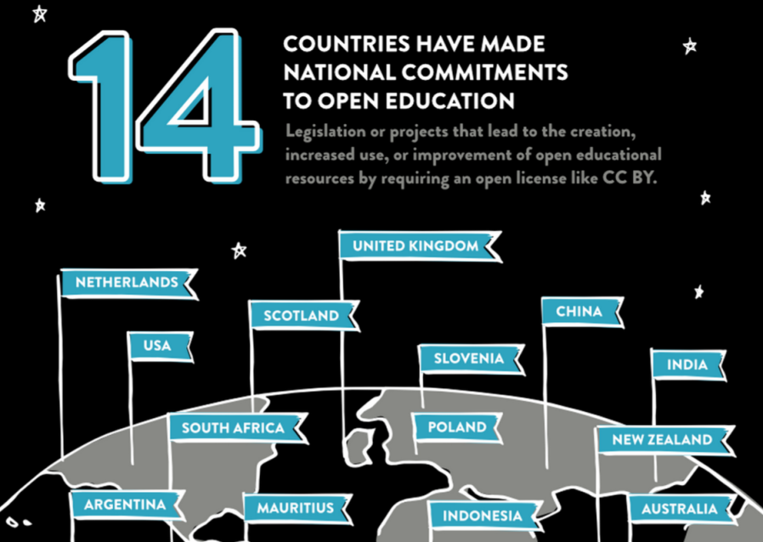
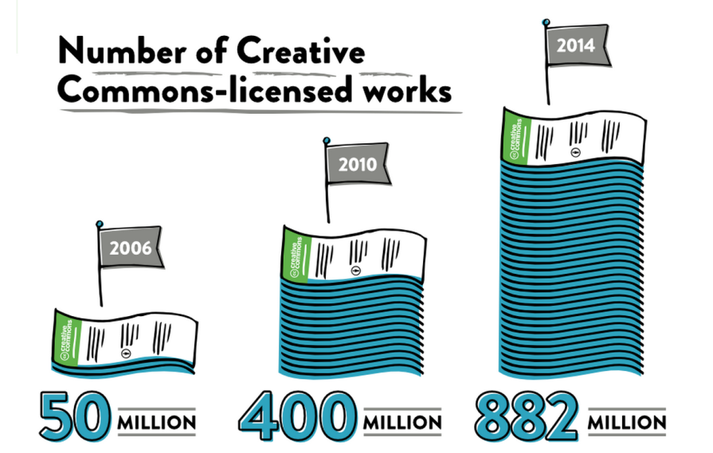
III. Rise of OER
+
FIJI has introduced OER policy in January 2016.
Source: https://stateof.creativecommons.org/report

Slide 54




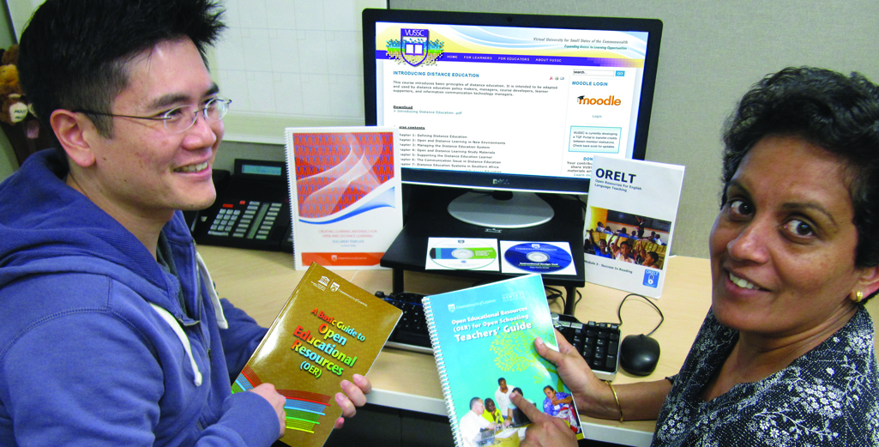
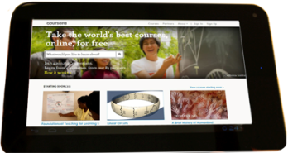

What are Open Education Resources (OERs)?
Materials that are
Free and freely available
Suitable for all levels
Reusable
Digital

Slide 55
Implications of OER for ODL
Free availability of quality content
Faculty time can now focus on learner support
course development

Slide 56
New Realities
Present
Future
Industrial model of operation
Connected model of operation
Institutional Teams
Global Teams of course developers
Student as consumer
Student as producer

Slide 57








ICT in Education and OER in Africa
ICT in Ed Policy (Year)
Ghana | YES | 2008
Kenya | YES | 2006
Namibia | YES | 2005
Nigeria | YES | 2010
Rwanda | YES | 2008
South Africa | YES | 2004
Tanzania | YES | 2007
Zambia | YES | 2007
NO
POLICY
Institutions with OER policies:

Slide 58
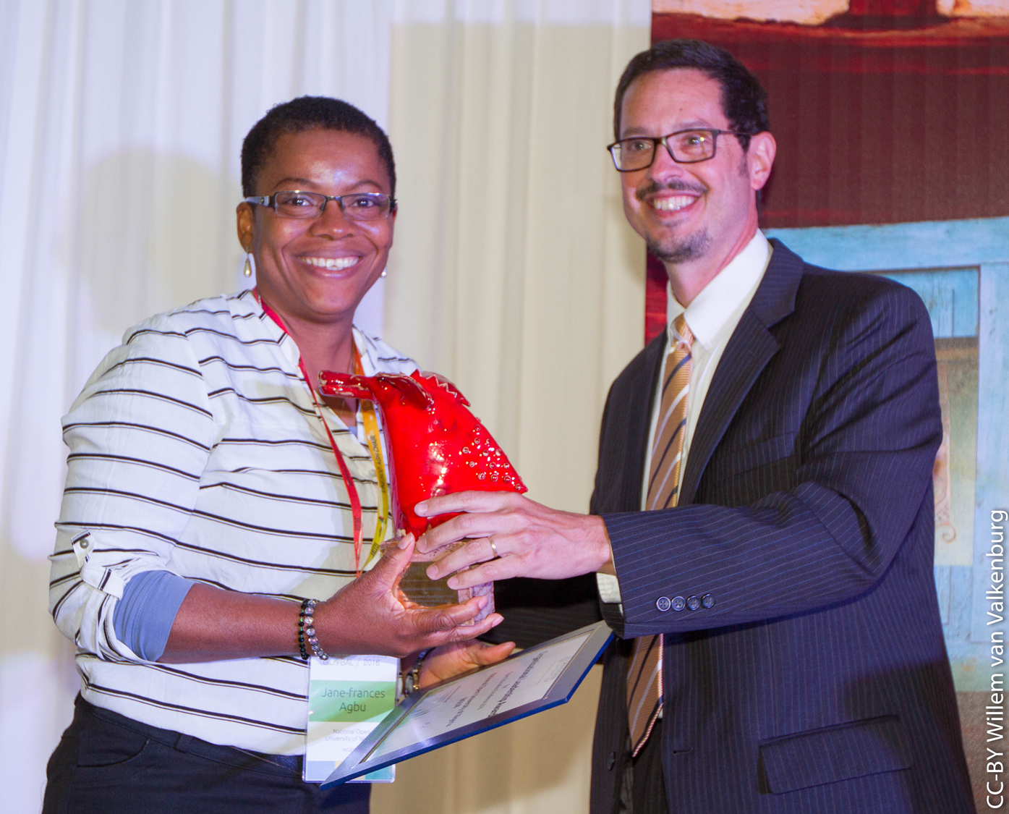
Open Education Award for NOUN, 2016

Slide 59
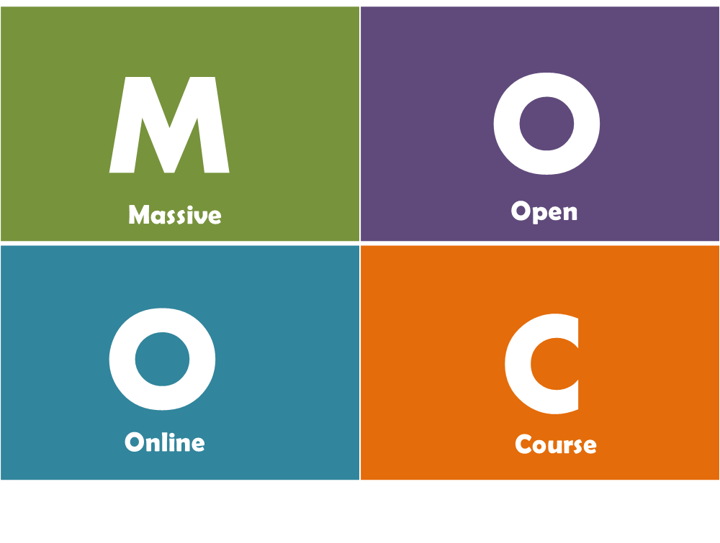
IV. Massive Open Online Course
“MOOCs are online courses designed for large numbers of participants, that can be accessed by anyone, anywhere as long as they have an Internet connection, are open to everyone without entry qualifications and offer a full/complete course experience online for free”
Mulder & Jansen, 2015

Slide 60
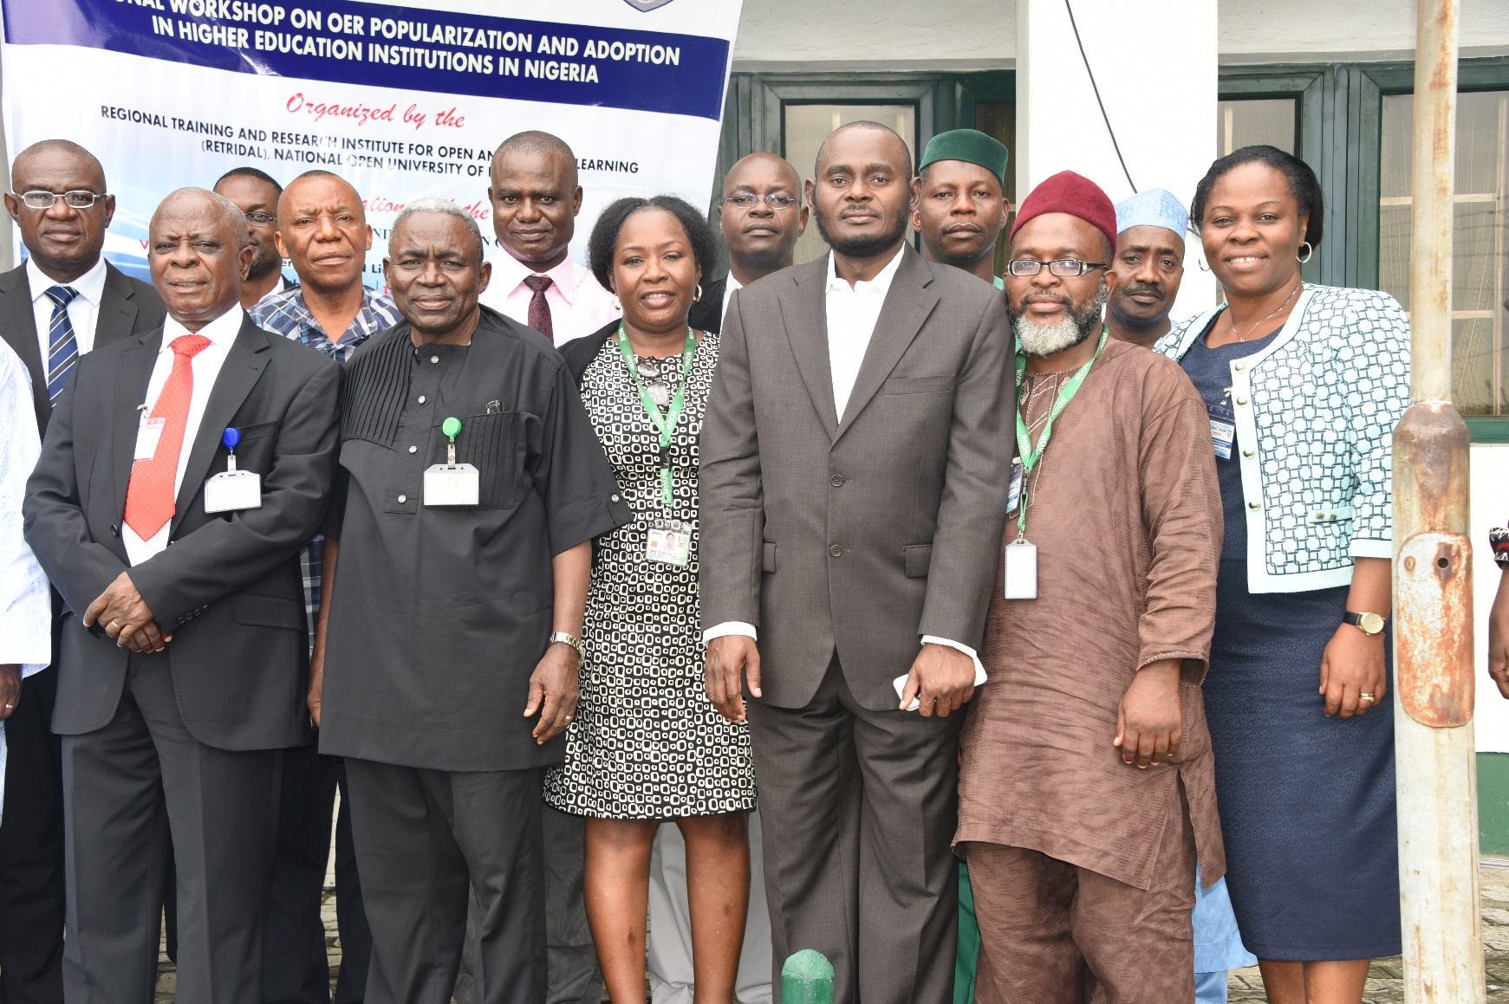
Implications of MOOCs for
Higher Education
Flexibility
Affordability
Fast-track
Notes:
Some experts compare MOOC as iTunes of education, and expect that the MOOC will be a big game changer. It is based on three important aspects of current education system that is rigid, highly costly and take lot of time to graduate. Thus, it provides a successful recipe for a disruption in the educational landscape. Therefore, obviously the top universities have taken the lead in offering MOOCs to a world deprived of quality education at a low cost. Is this disruption going to affect the Open Universities? Or there will be business as usual for them?

Slide 61
New Realities
Present
Future
National or provincial jurisdiction
Global classroom
Limited interaction at study centres
Increased use of Peer2Peer learning and social media
Print+ (audio, video, online)
Online+ (increased use of learning analytics)
Notes:
Openness was the other plank of this movement. This could have been defined in very many ways but the most appropriate expression is attributed to Crowther, the founding chancellor of British OU. His statement touches upon various facets of openness that continue to be important in today’s context cross the generations

Slide 62


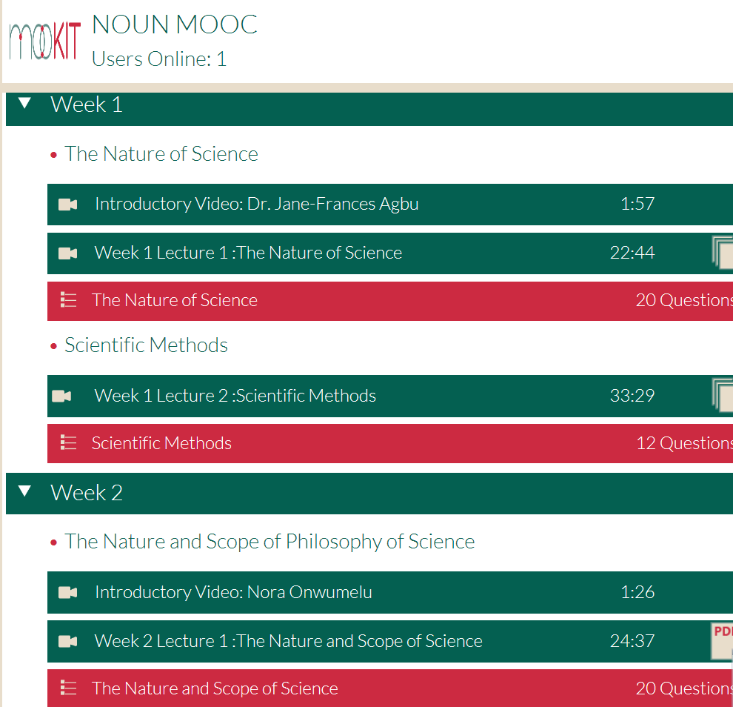
Started 27th June 2016, eight weeks
About 500 learners in this offering
First MOOC by NOUN

Slide 63
Reaching the Unreached

Slide 64
Who are the Unreached?
Economic status
Gender
Remote locations
Language
Disabilities

Slide 65
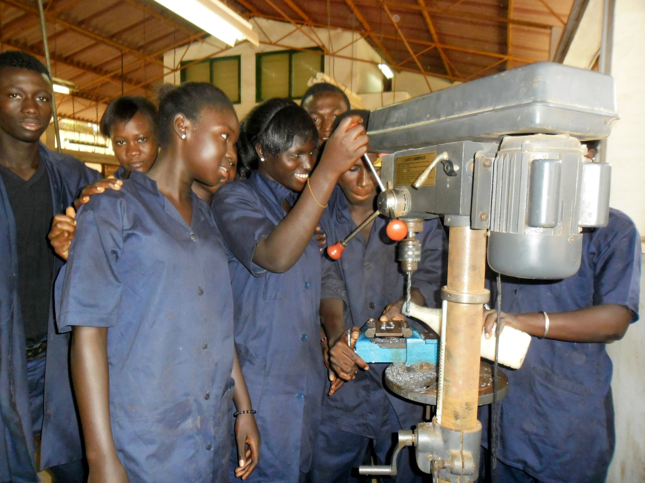
Kenya: economic factors
Impact: 150% increase in income

Slide 66
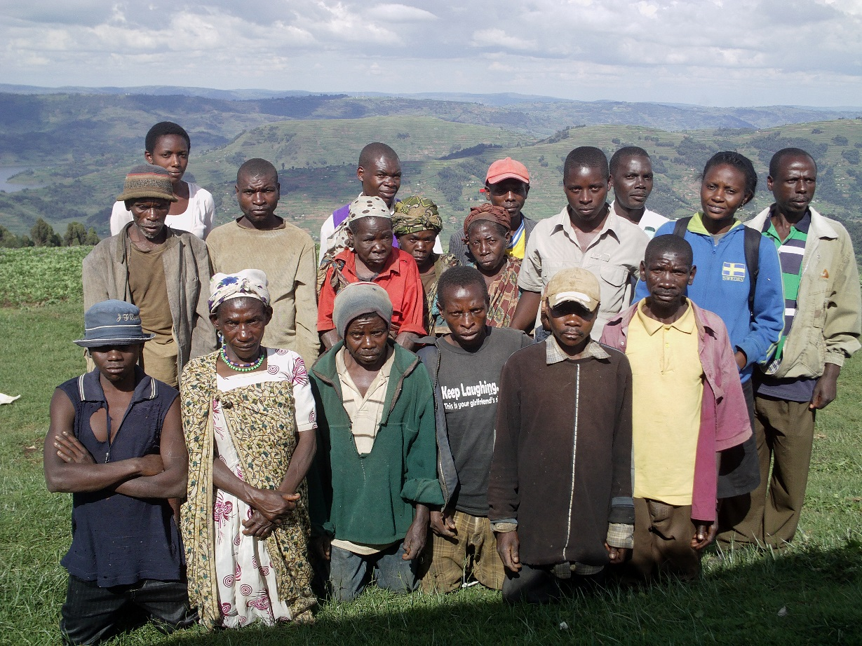
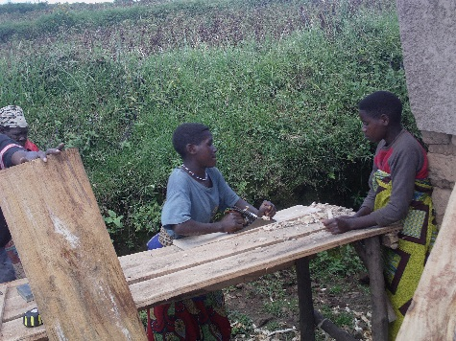
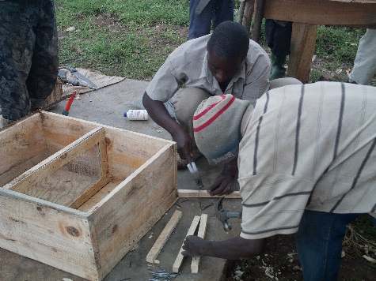
Rejuvenating indigenous communities
Through the mobile learning and self-help group activities of COL’s Lifelong Learning for Farmers (L3F) initiative, Uganda’s Batwa community is strengthening their honey and beekeeping enterprise sustainably.

Slide 67

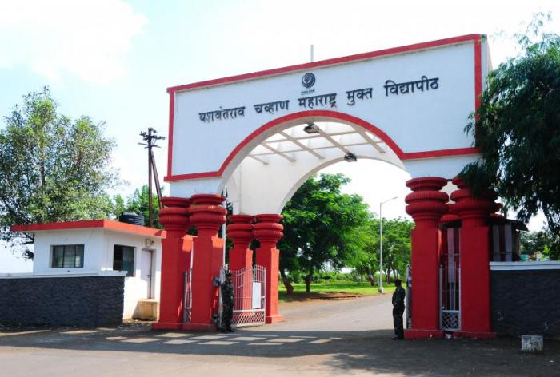
Gender: YCMOU, Nashik, India

Slide 68
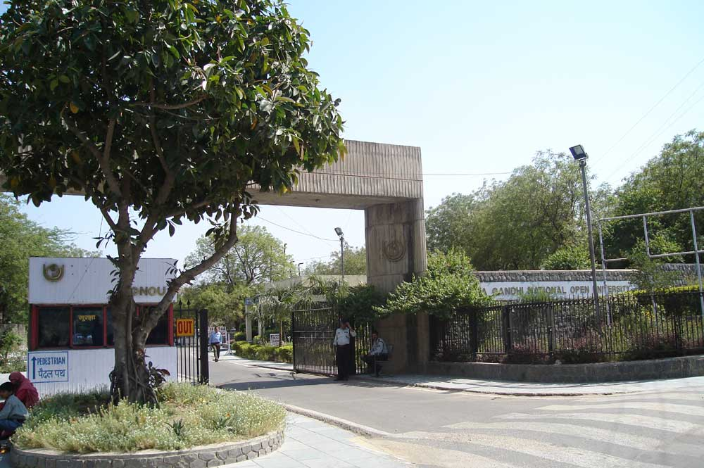

The front gate of the University campus in New Delhi.
http://en.wikipedia.org/wiki/File:IGNOUGATE.jpg

Slide 69

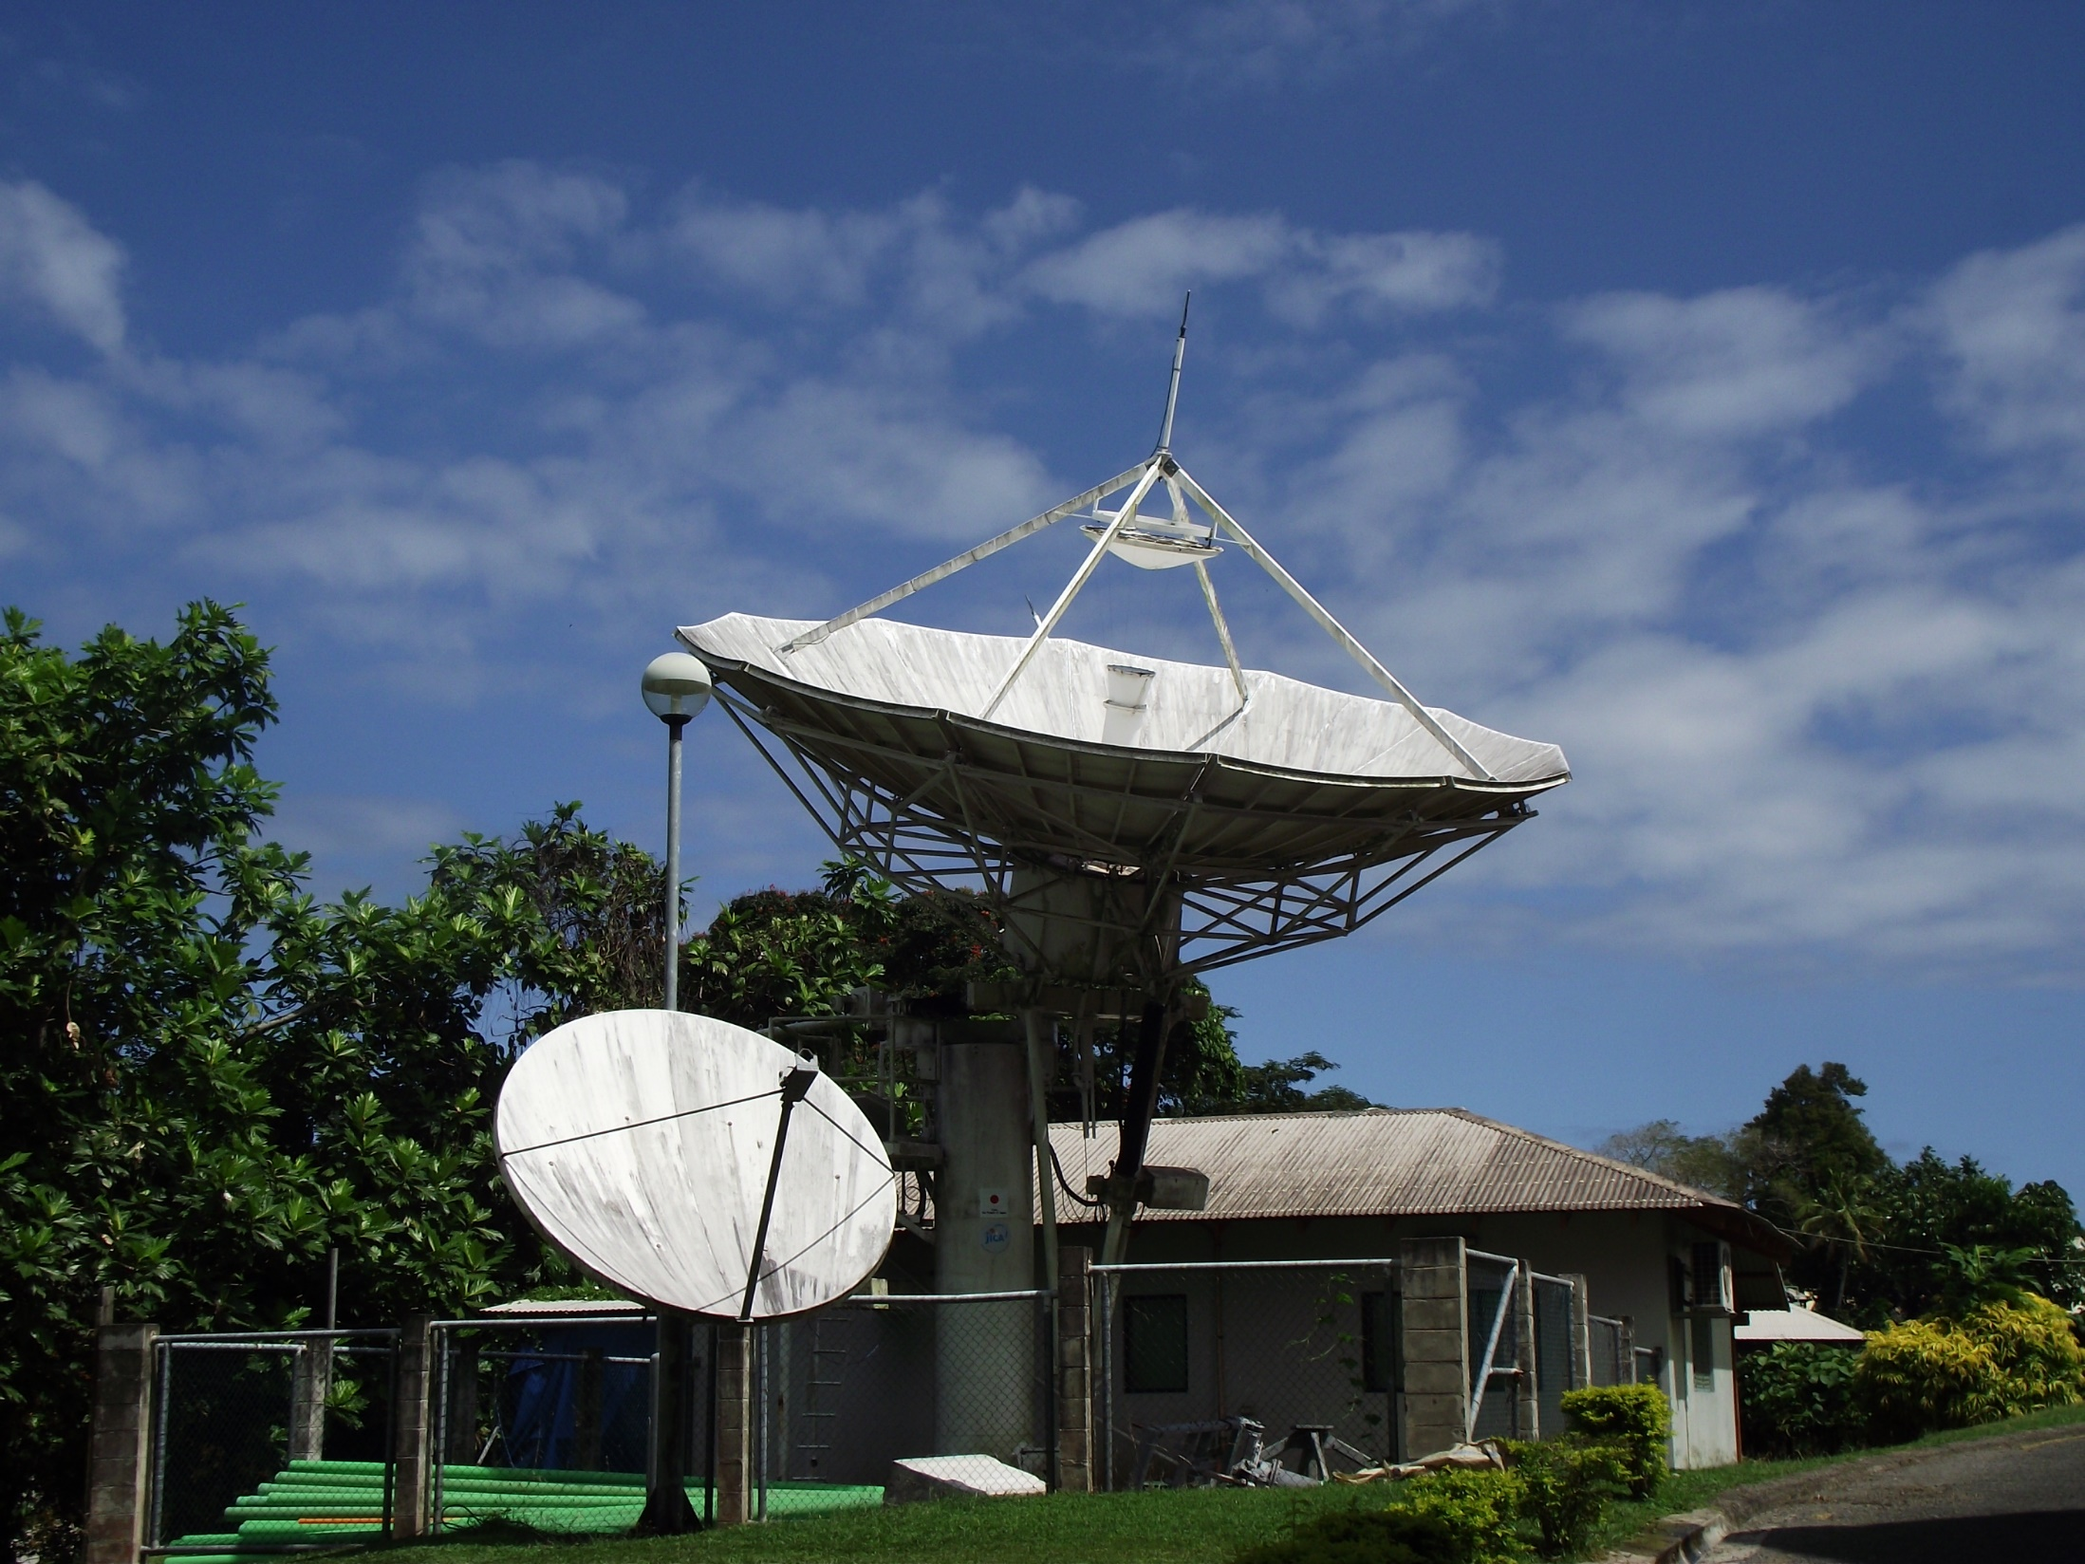
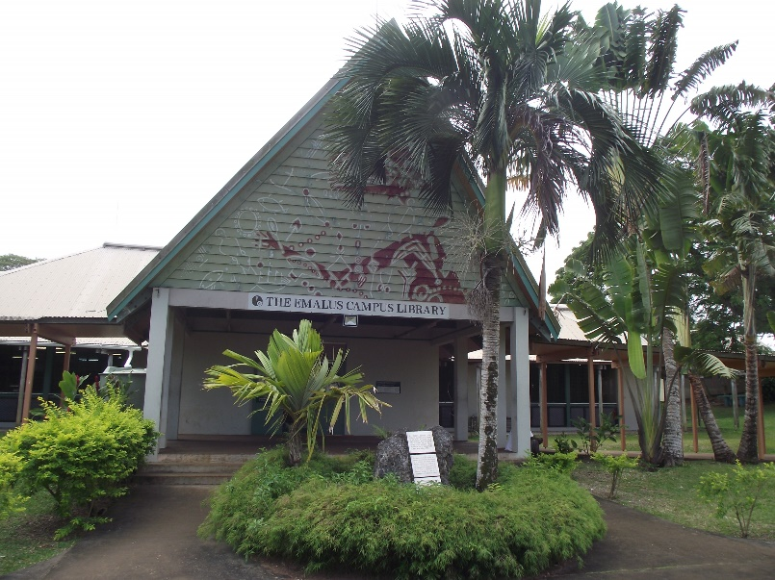
Remote USP, Fiji

Slide 70
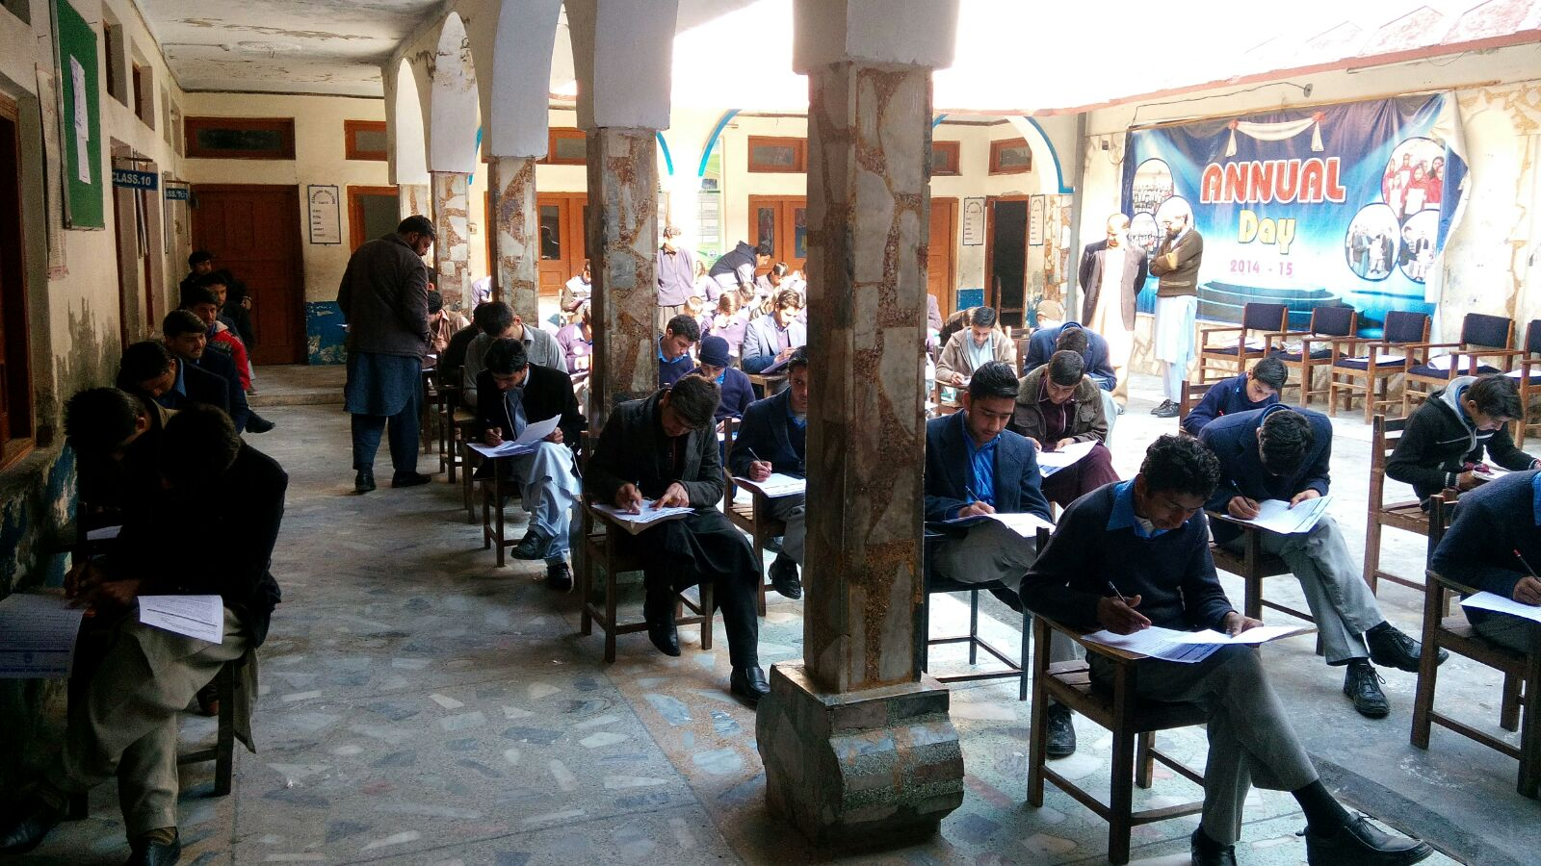
Pakistan mobile learning project
Allama Iqbal Public School and College located at Kanju village, Swat District, Pakistan
Qatar Foundation/ROTA

Slide 71

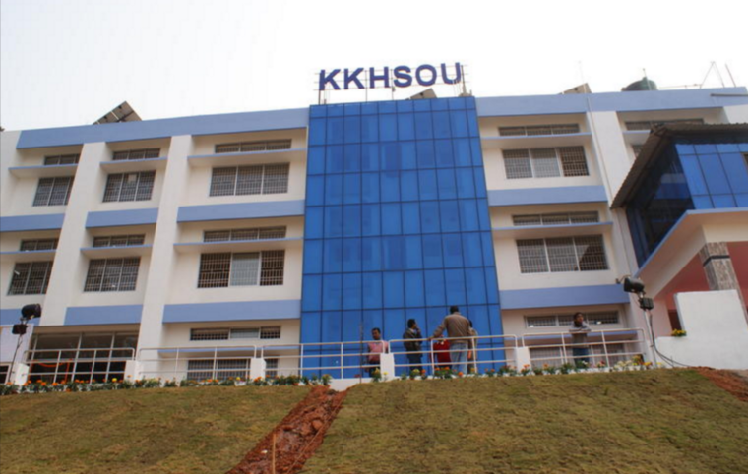
Language: KKSHOU, India

Slide 72

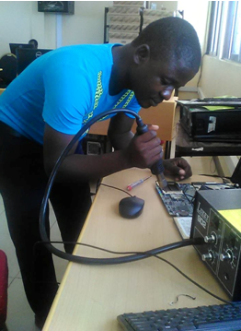
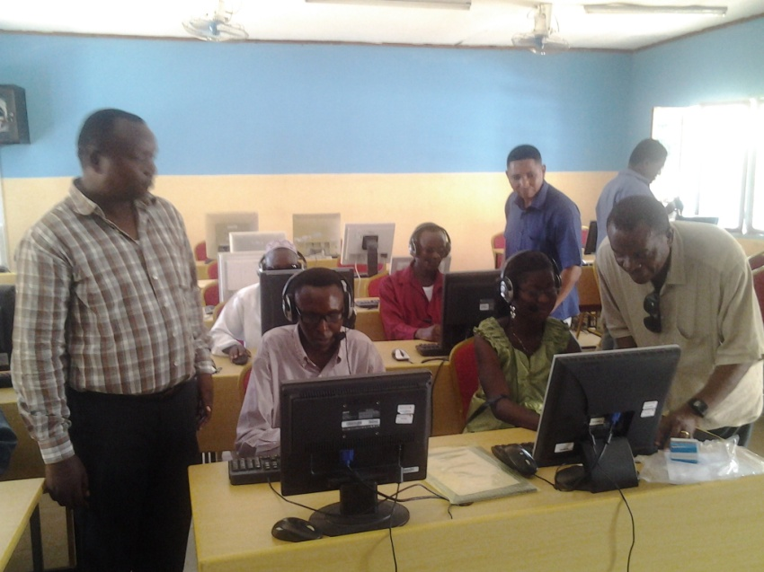
Disabilities: OUT, Tanzania
Photo Courtesy: Elifas Bisanda.

Slide 73
Way Forward

Slide 74

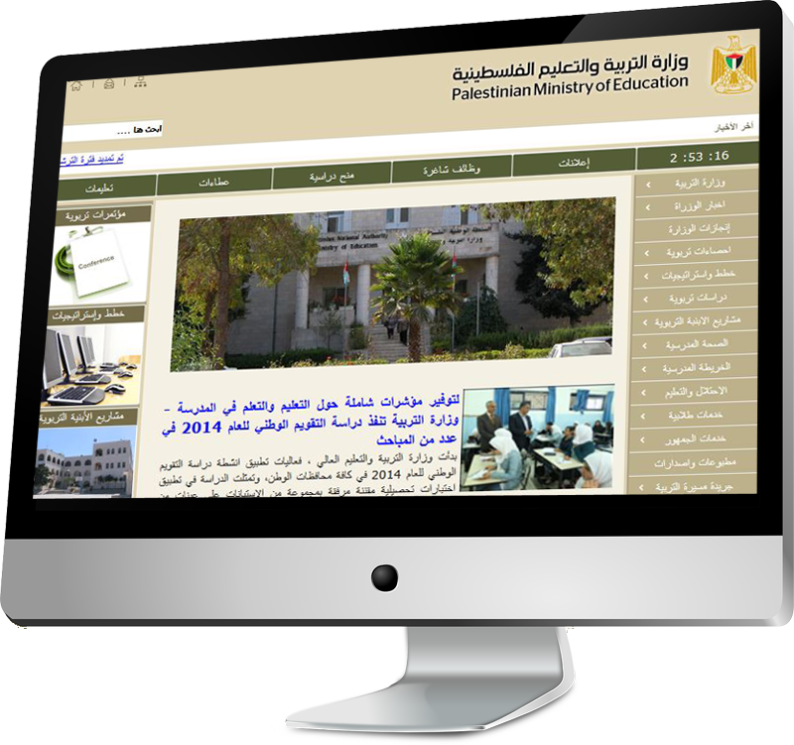
Lesson 1: Targeted Approach
Identify and focus on the unreached groups
Design programmes to suit their needs
Institutional policy for reaching the unreached

Slide 75
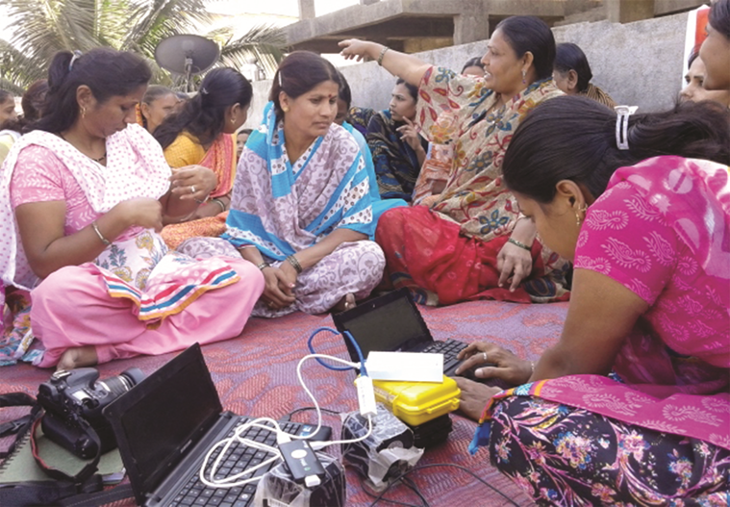

Lesson 2: Appropriate ICTs
Range of technologies (from Radio to Internet)
Two-way interaction
Collaborative learning

Slide 76
Lesson 3:Focus on Livelihoods
Demand based curriculum
Industry/labour market linked courses
Multi-stakeholder partnerships

Slide 77
I. Go Dual-Mode: Institutional Policy
Review the mandate and mission
Identify the objectives for adopting ODL and how these will be achieved
What are the issues relating to faculty?
What are the issues relating to students?
How will academic quality and standards be maintained?
Issues related to management and administration?

Slide 78

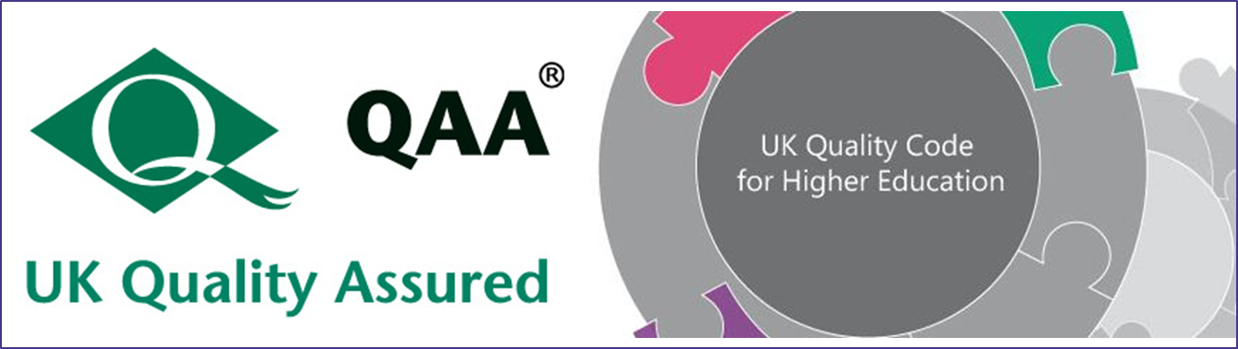
II. Invest in Quality Assurance
National/Regional
QA Guidelines
Create cultures of quality

Slide 79
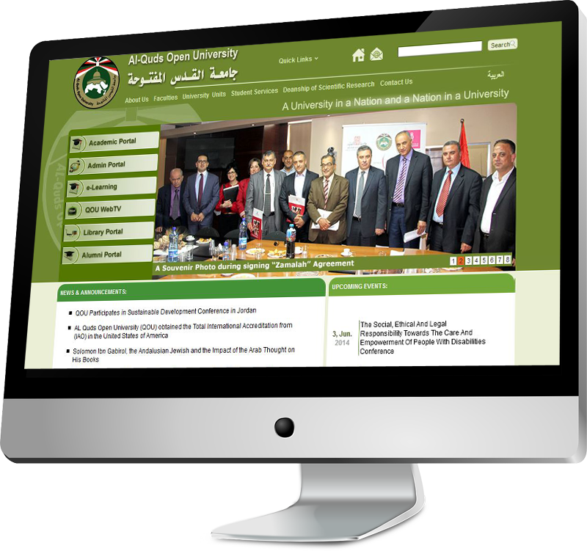


III. Build Capacity in
Curriculum reform
Learner Support
Assessment
OER & MOOCs

Slide 80
Did we achieve our objectives?
National Workshop: Sept, 2000
‘provision of higher education to…one million qualified candidates…in areas of high manpower needs.
Capacity building of 20,000 distance education operators….’
What next?

Slide 81
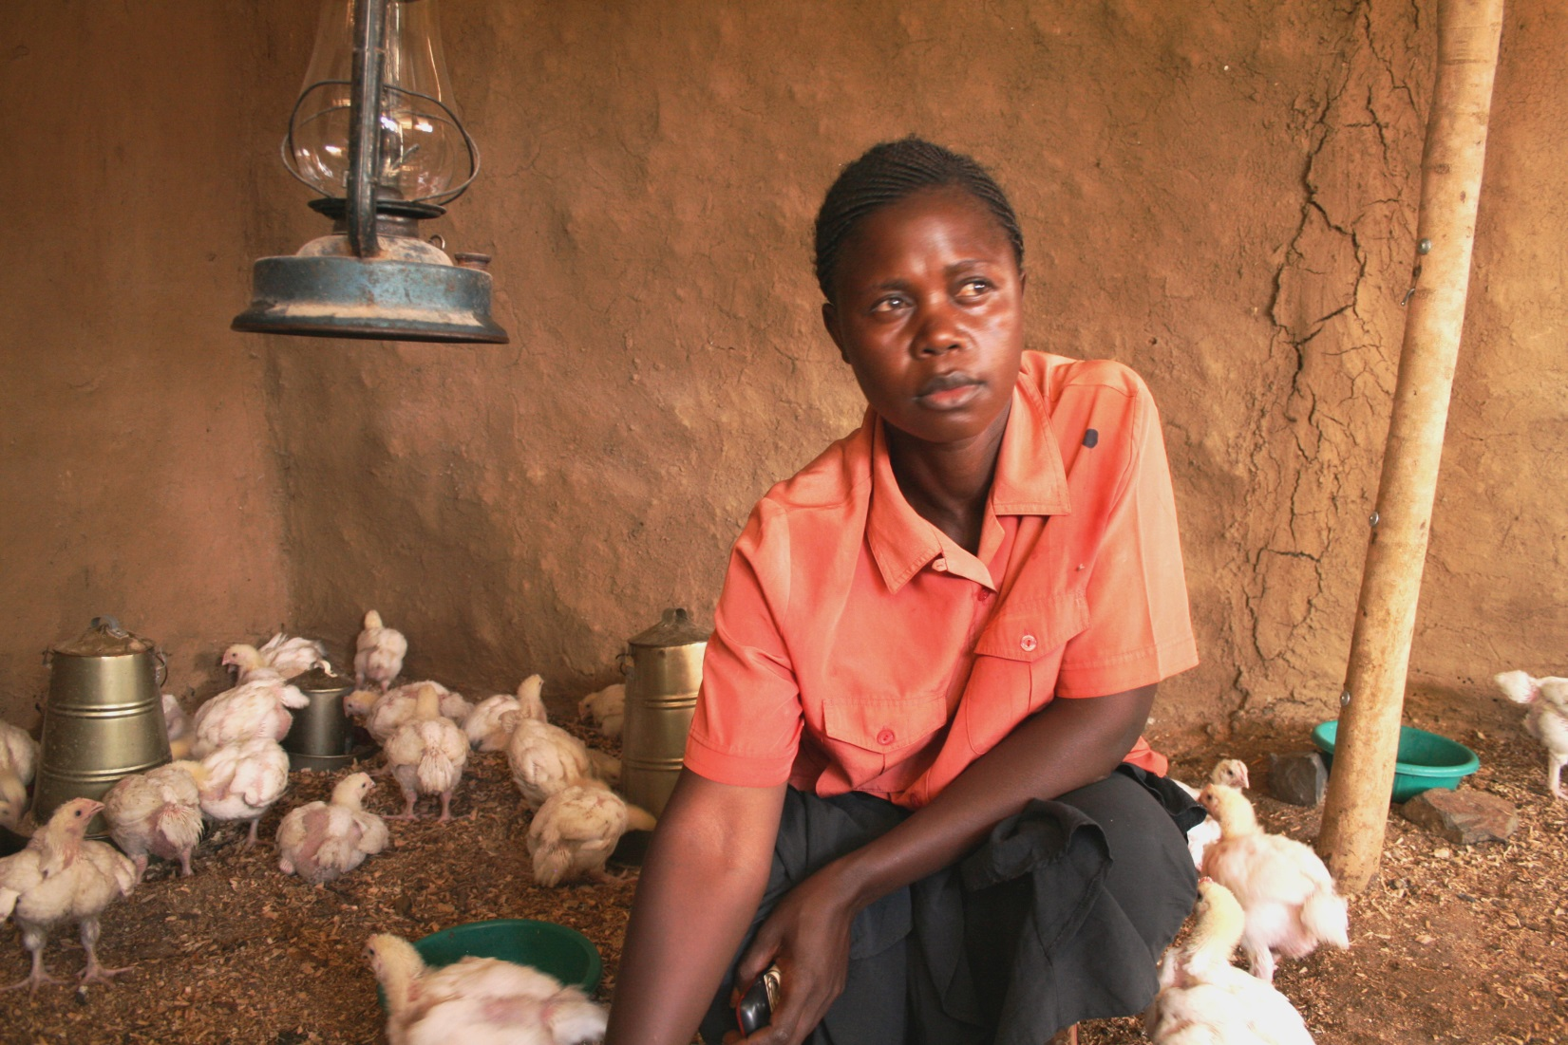
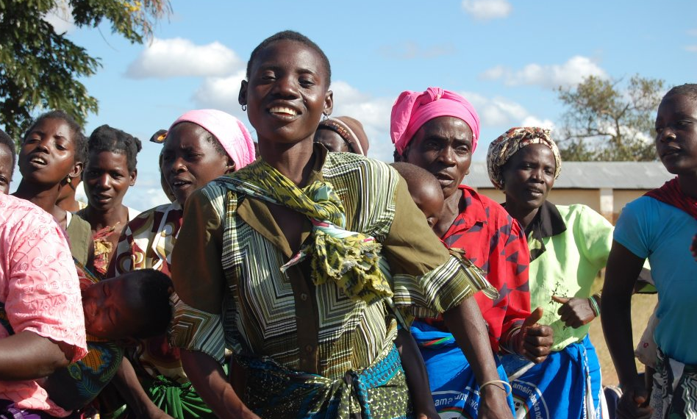
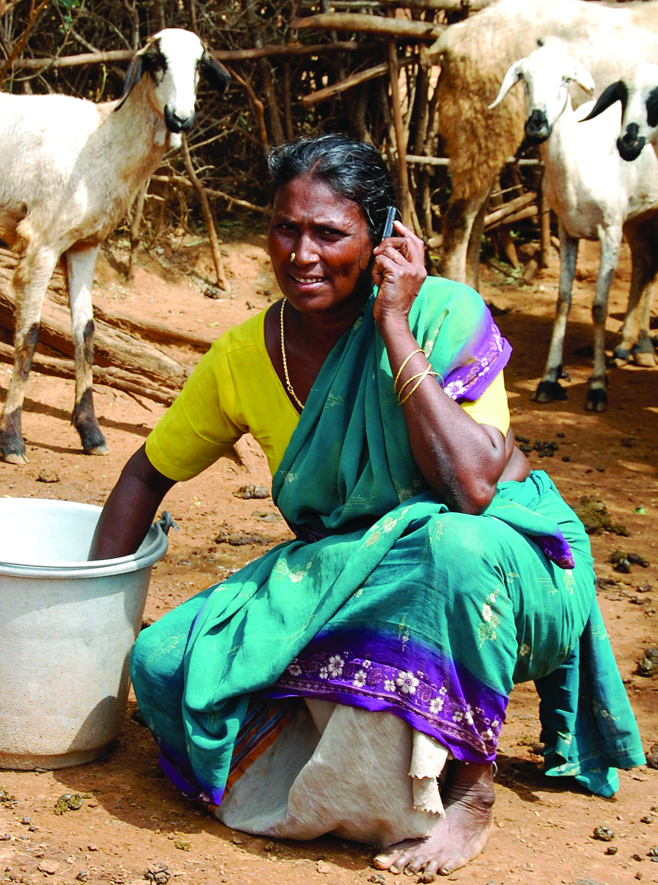
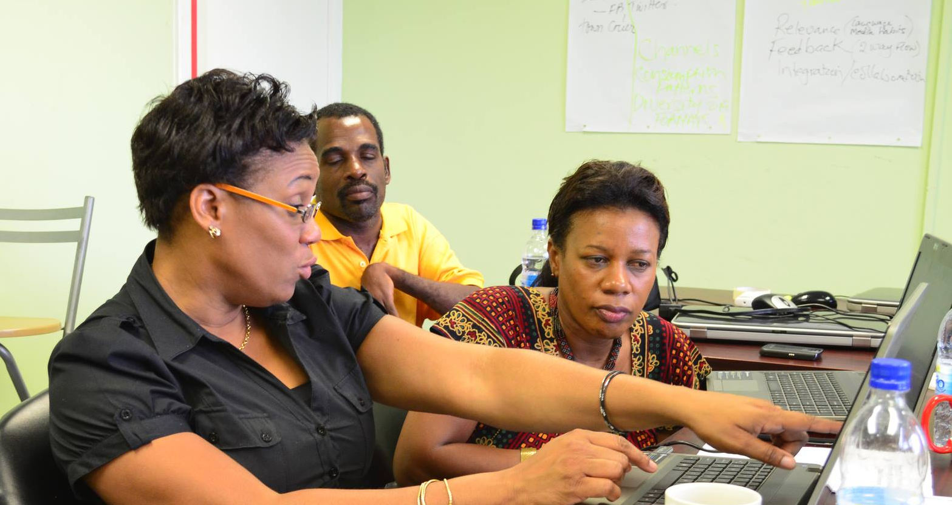
Thank You
www.col.org
Notes:
We invite you to engage us; tap into our thought leadership, expertise, networks and resources

