Slide 1


COVID19:From Response to Resilience
Professor Asha Kanwar
President & CEO, Commonwealth of Learning
Education Ministers Action Group
November 24, 2020 | London

Slide 2

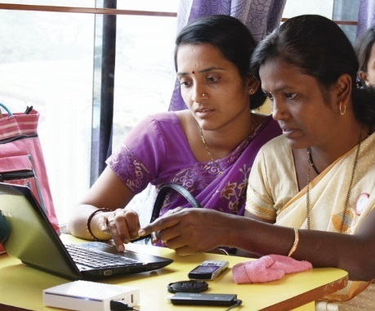
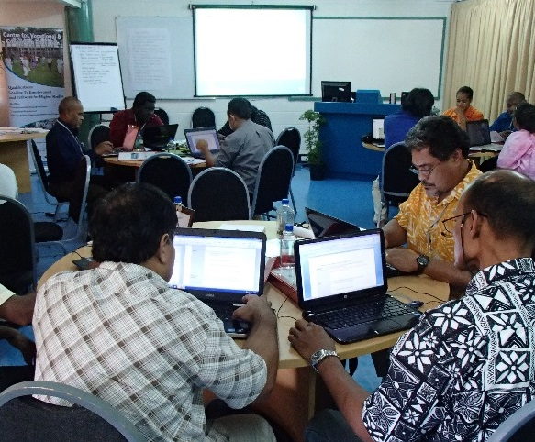
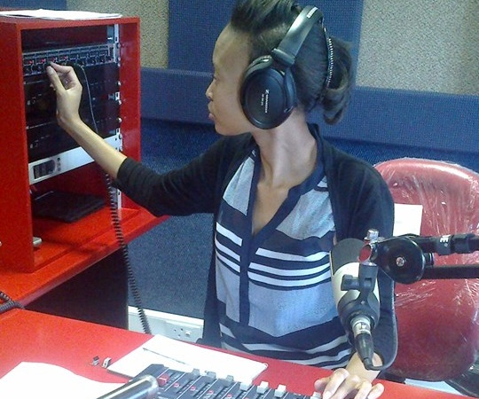
To help Commonwealth governments and institutions use technologies to improve and expand access to education and training

Slide 3
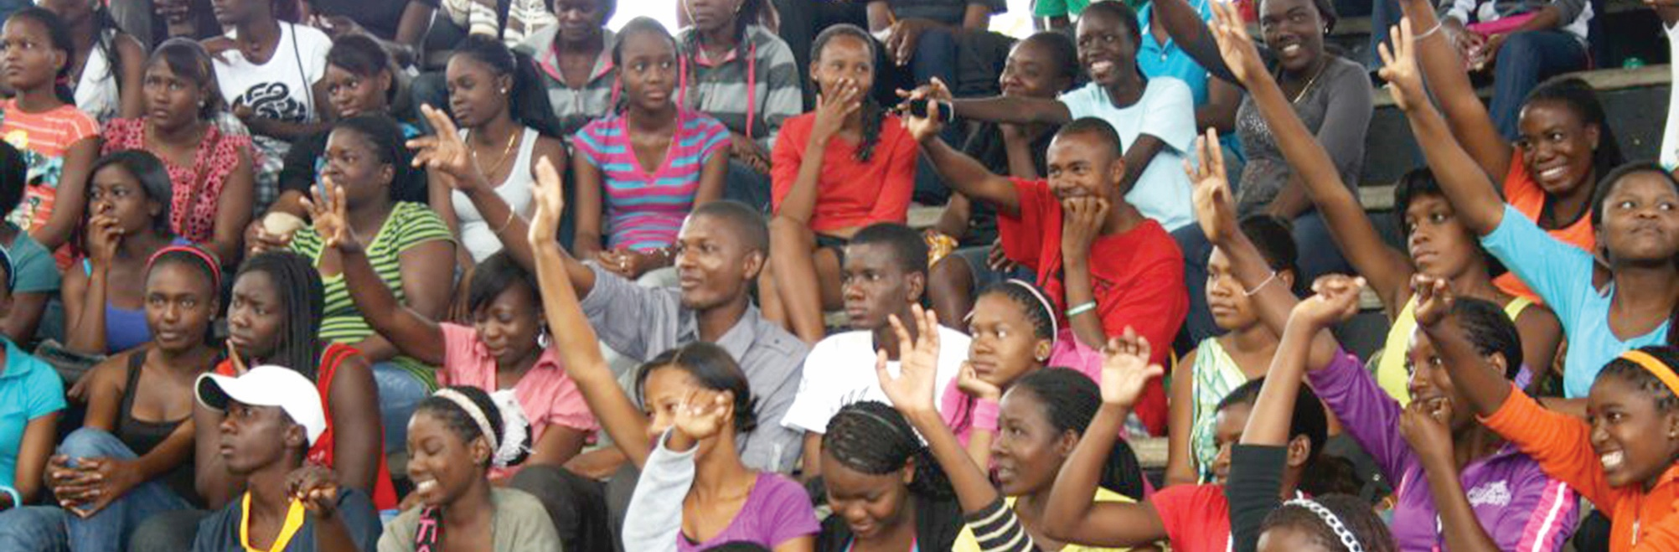

>90% globally
574 million: Commonwealth
(15 May 2020)

Slide 4
Internet Connectivity in the Commonwealth Countries
Source: compiled with data from World Bank Open Data , retrieved on 14 May 2020.

Slide 5
COL’s multi-pronged Approach
Guidance & Advice
Capacity building for Teachers
Responding to country-specific needs
Promoting
collaboration

Slide 6


1
If the child cannot go to school,
the school comes to the child

Slide 7



Open Schools: Access and Equity
India: 2.7 million students
in 5 years; 31 % female
Bangladesh: 165,000 in 3 years: 40% female
Namibia: 80.806 in 3 years:
65% female

Slide 8




Head start during pandemic

Slide 9
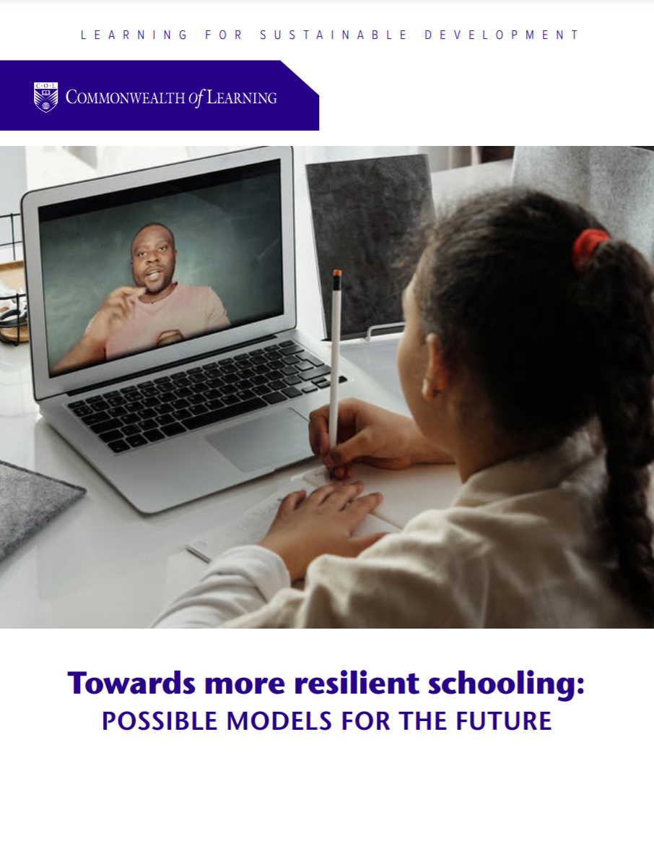

Slide 10
2
Keeping the doors of tertiary education open

Slide 11
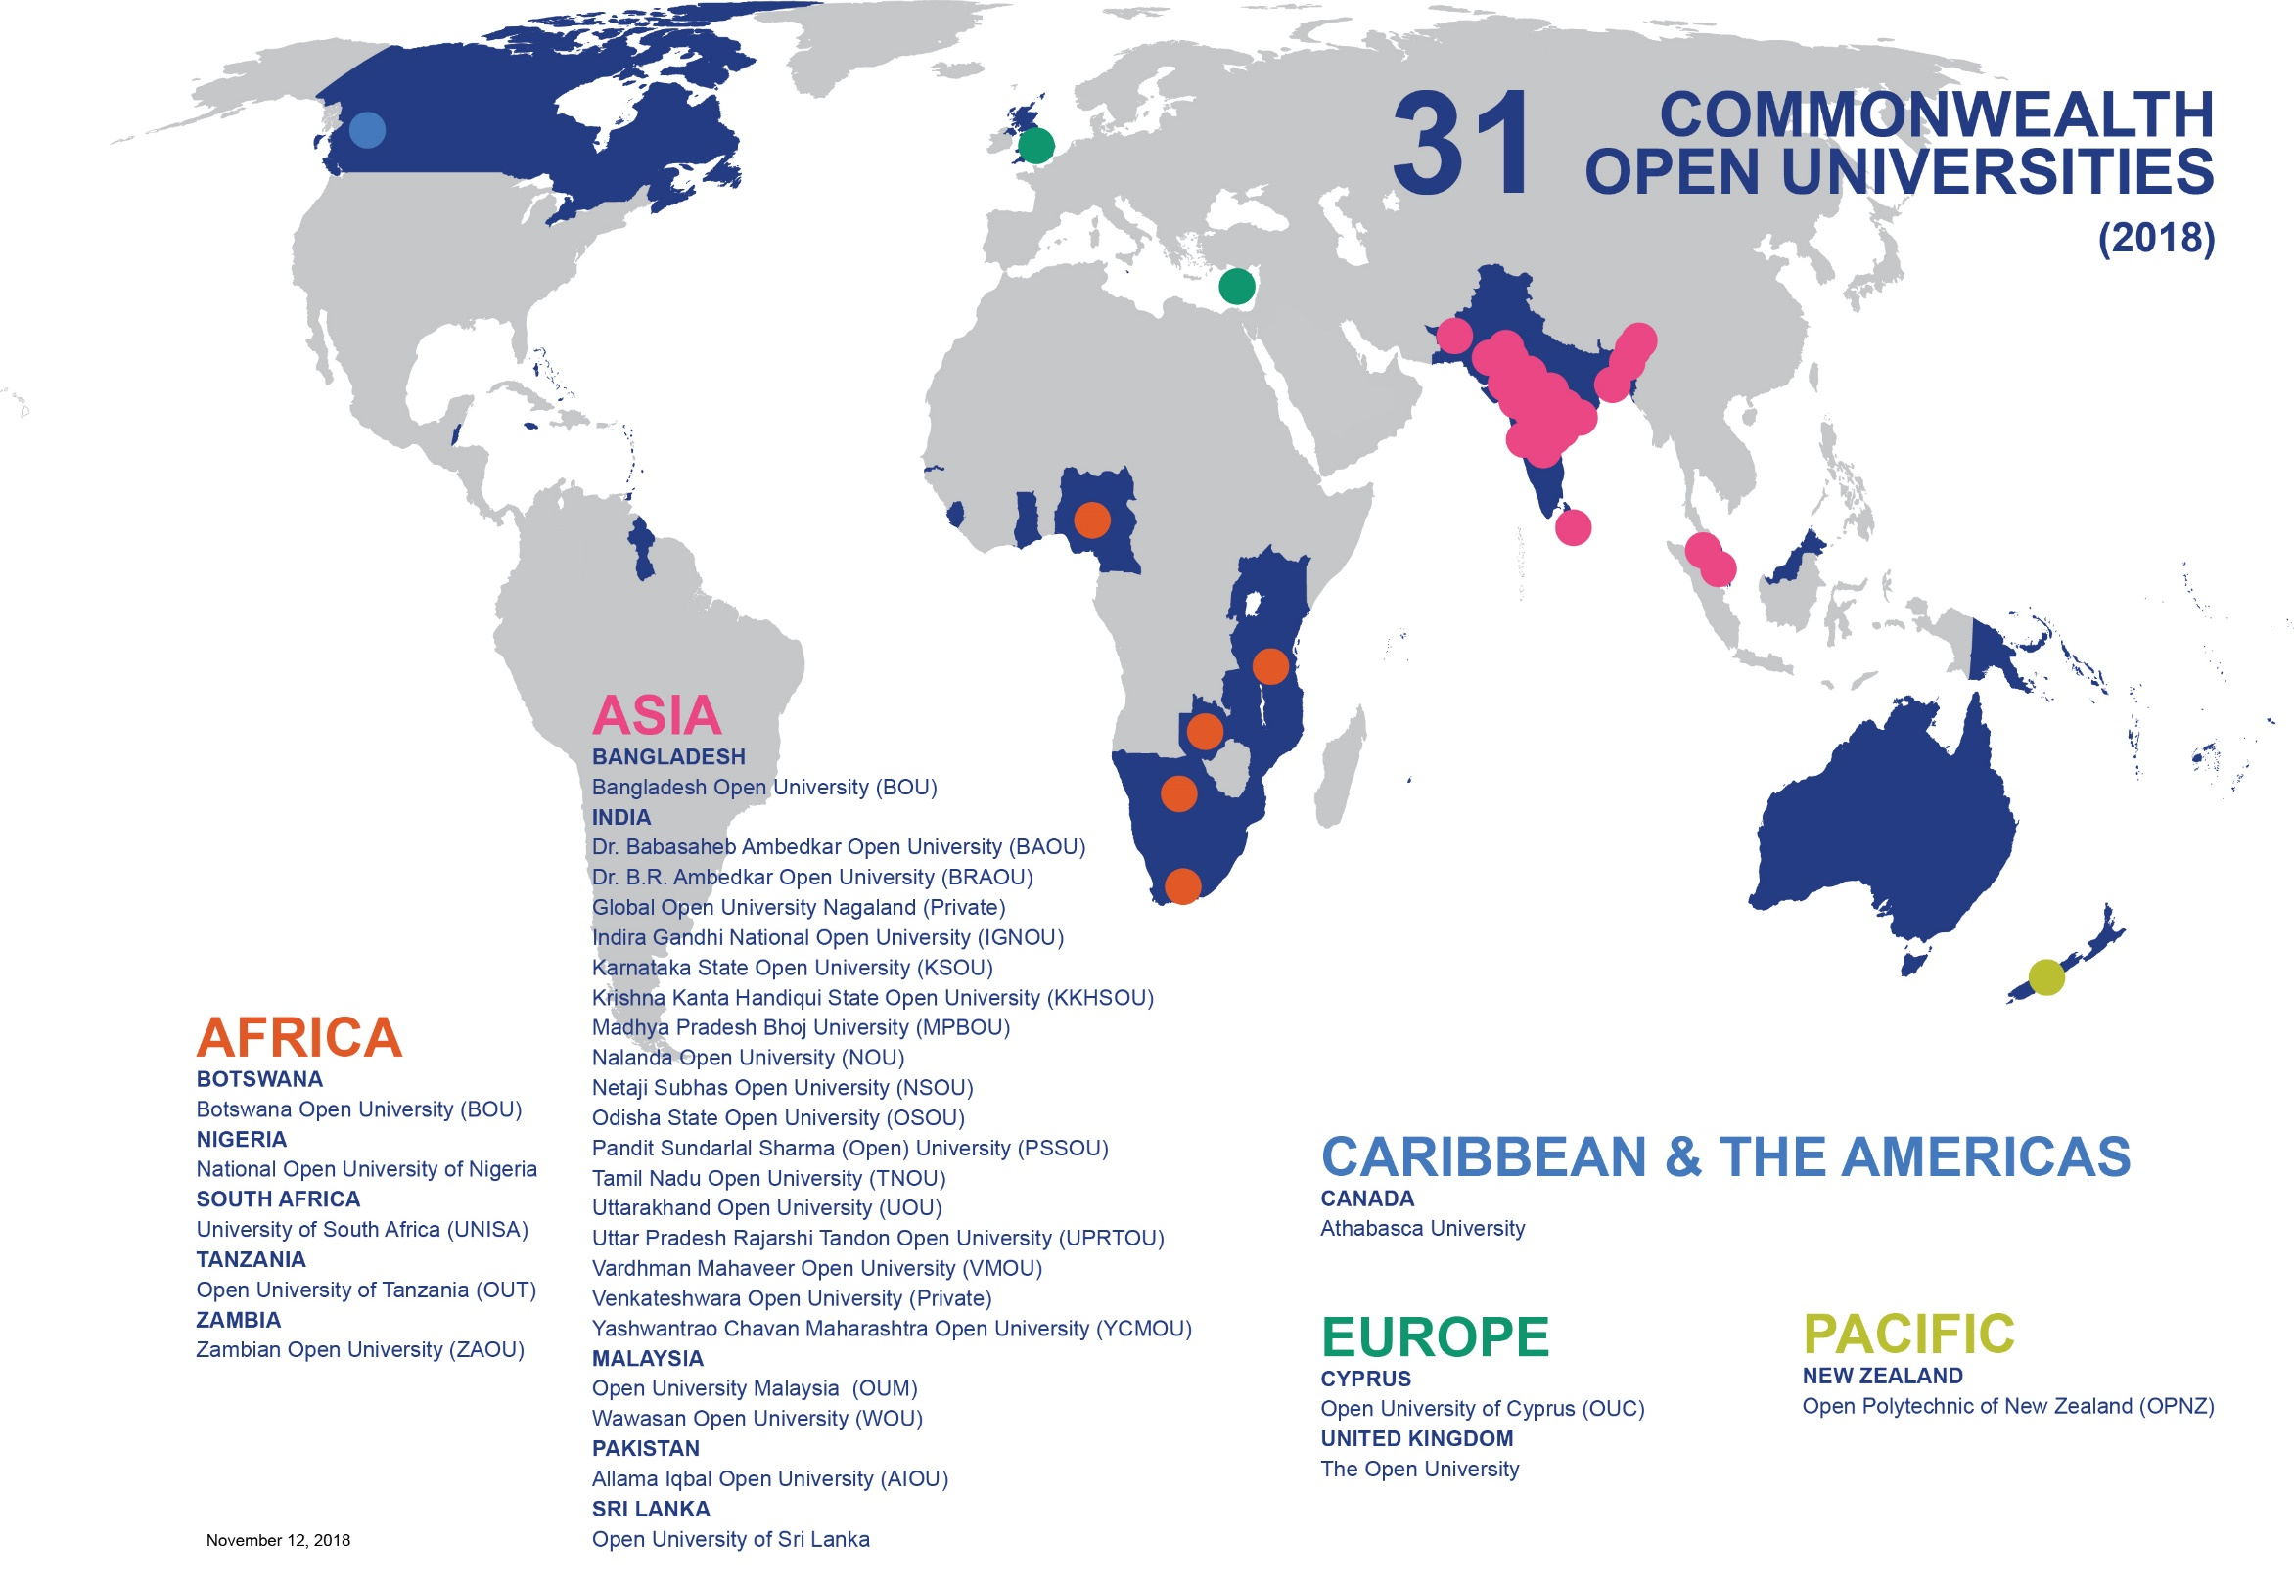

33
(2020)
Notes:
Mauritius: Open University of Mauritius
India: Jagat Guru Nanak Dev Punjab State Open University (2019)
India: Sree Narayanaguru Open University, Kerala (2020)

Slide 12
Support during the Pandemic
Nigeria: dual mode
Zambia: Integrating employability skills
Rwanda: Online safety and privacy policy
Antigua and Barbuda, Kenya and Malaysia: Integrating technology

Slide 13

Content aligned to curriculum
Video-on-demand: Fiji, Nauru, Samoa
STEM courses
VOD

Slide 14


Slide 15
3
Teacher Development

Slide 16



Capacity Building of Teachers
https://www.mooc4dev.org/CyberSecurity4Teachers1
http://www.telmooc.ca/
https://www.blpmooc.org/
https://www.mooc4dev.org/MLM_1

Slide 17
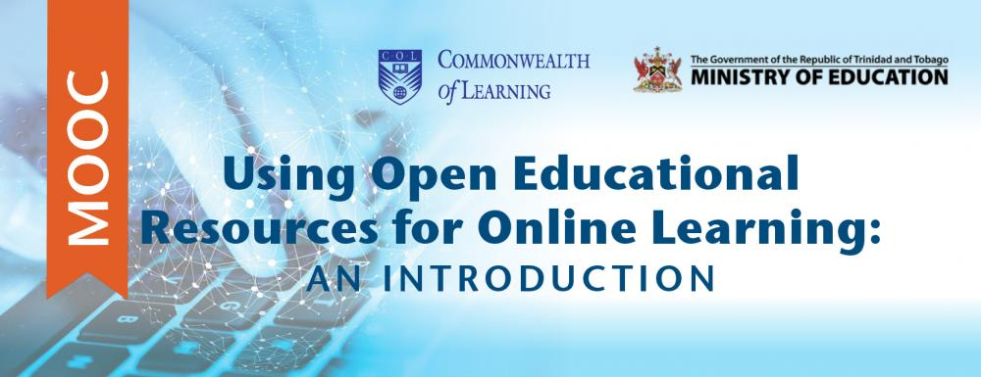
T&T MOOC for Teachers
https://www.mooc4dev.org/Teaching4C2

Slide 18
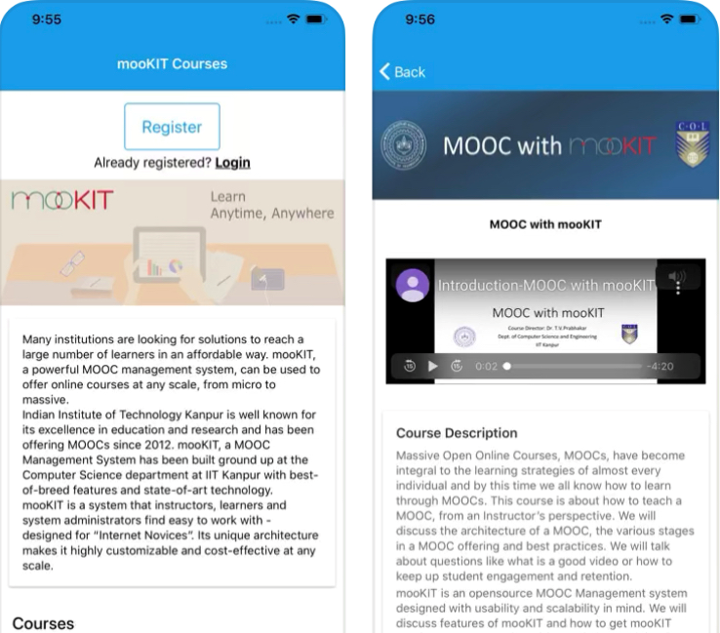
MooKIT
online learning in low bandwidth situations
basic mobile phone interface
MooKIT App via App Store (iOS) or Play Store (Android)
integrates Open Source video conferencing facility
blockchain enabled certificates

Slide 19

Self-learning courses

Slide 20
5
Skilling & reskilling for the ‘new normal’

Slide 21
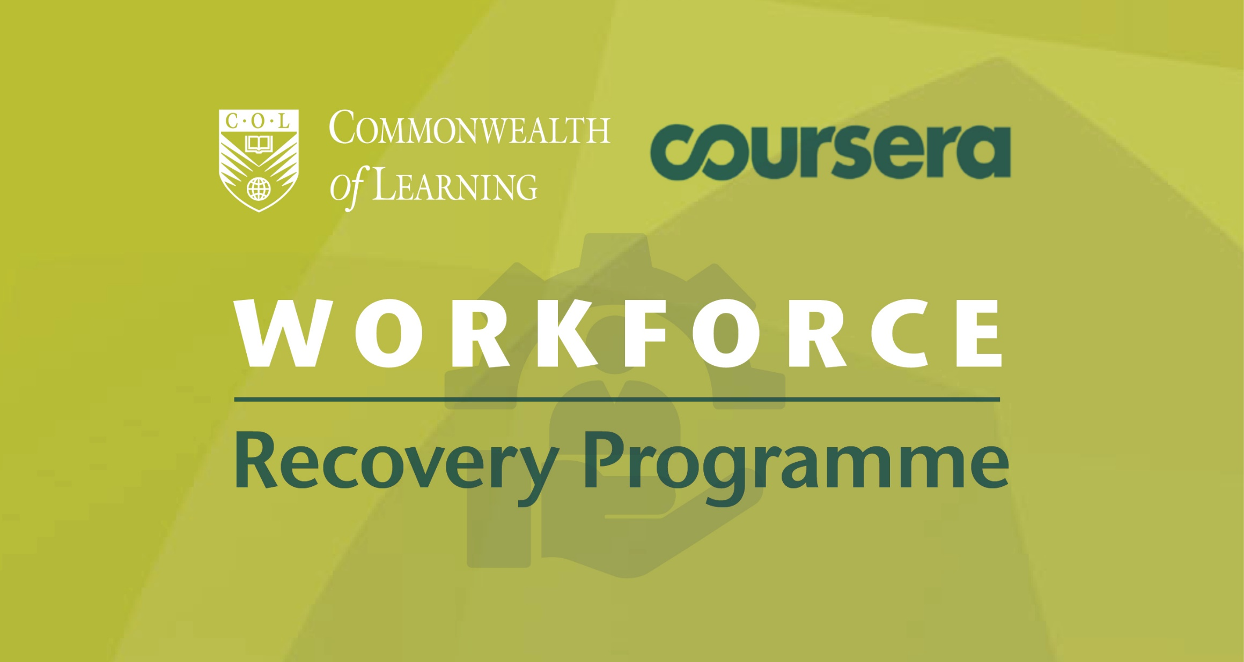
Skilling and re-skilling

Slide 22
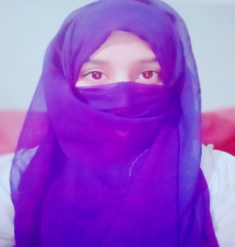
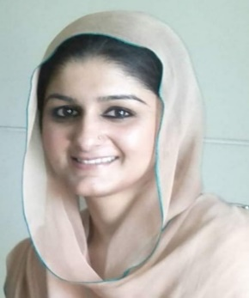
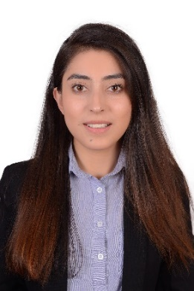
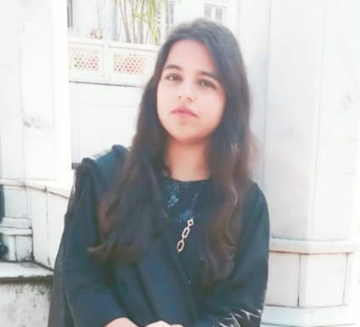
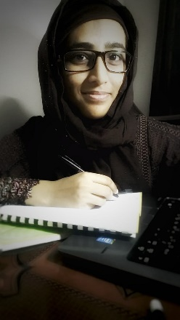
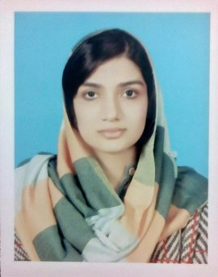

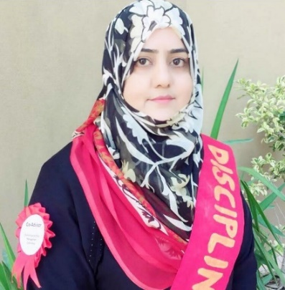
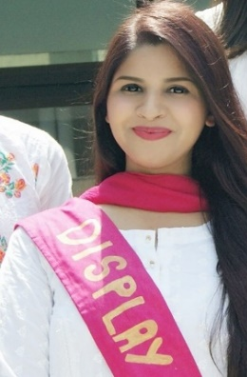

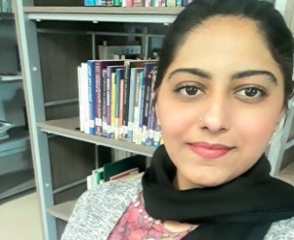
Notes:
.

Slide 23
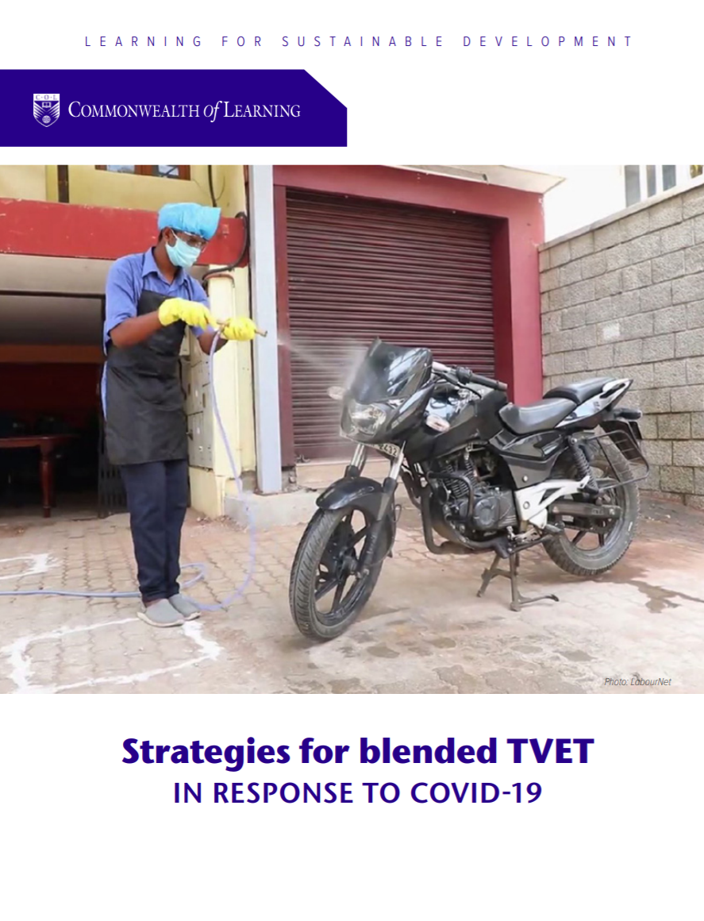

Slide 24
Towards Resilience

Slide 25

60+
https://opendoor.col.org/
Intergovernmental organisations
Universities and educational institutions
Associations and networks
Notes:
bring together institutions/organisations committed to supporting learning at this time of crisis;
share open educational resources (OER) and learning content;
provide tools for implementing affordable learning;
identify concrete collaborative activities;
build capacity in institutions offering distance and online learning; and
develop innovative technology solutions for reaching the unreached

Slide 26
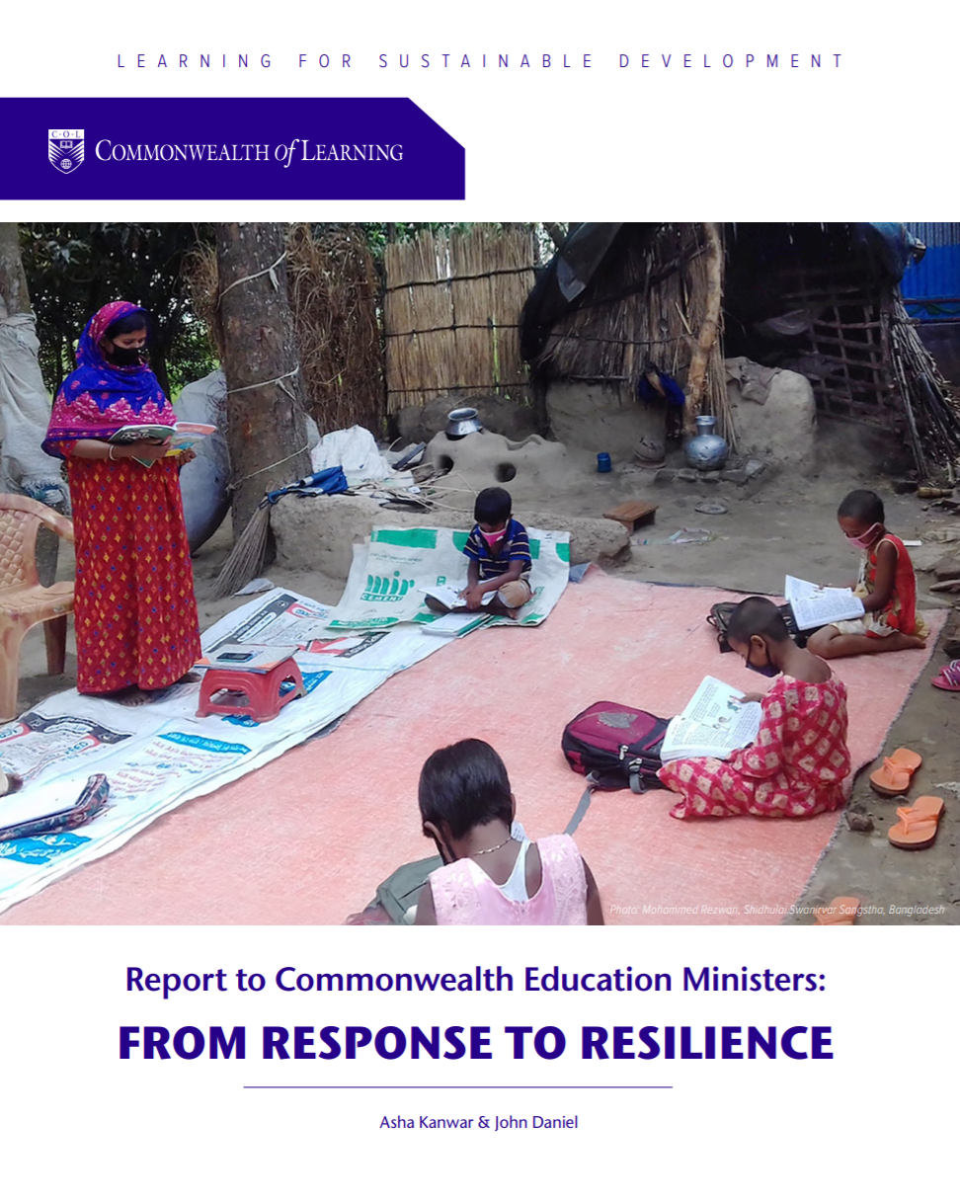
Notes:
ODL can extend equality of access and create reservoirs of resilience.
Teaching and learning require both interactive and independent activities.
Open Educational Resources can make learning materials accessible to all.
Using a range of technologies available requires a coordinated approach for deploying resources and monitoring progress.
Crises are anxious times for students and parents. Reassuring them with targeted communication must be a priority.

Slide 27

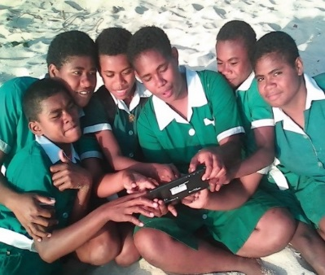
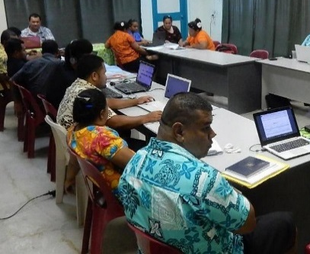
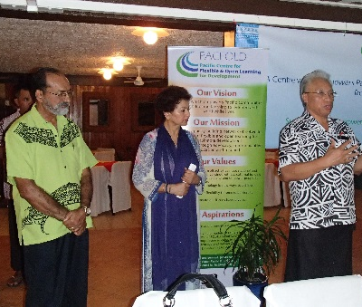
Thank You
for your contributions
col.org

