Slide 1

Supporting Learning for Sustainable Development
through Integrated School-Based Teacher Development
Dr. Betty Ogange
Adviser: Teacher Education
eFacilitation Workshop | March 13, 2018 | NTI, Kaduna, NIGERIA

Slide 2

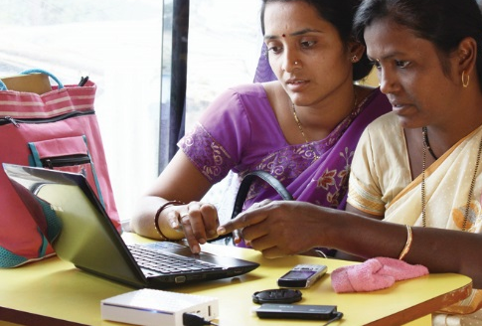

To help Commonwealth governments and institutions use technologies to improve and expand learning for sustainable development

Slide 3


Slide 4

Target 4c:
By 2030, substantially increase the supply of qualified teachers, including through international cooperation for teacher training in developing countries, especially least developed countries and small island developing states
Source: http://en.unesco.org/gem-report/sdg-goal-4
Notes:
Even though teachers are specifically mentioned in 4.C, they are fundamental to achieving all the 7 targets outlined in SDG4

Slide 5
Learning for Sustainable Development
ECONOMIC
GROWTH
SOCIAL
INCLUSION
ENVIRONMENTAL CONSERVATION

Slide 6
Teacher Education Initiative

Slide 7
1
Commonwealth Certificate for Teacher ICT Integration. Designed to improve the ability of teachers to use ICT in the classroom (CCTI)
2
Capacity Building for Teacher Educators in the Developing Commonwealth: Using ICTs & Pedagogical Development (Singapore)
3
Diagnostic tools for Special Needs Education in the Caribbean (SNE)
4
  Collaborative Development of the Postgraduate Diploma/Certificate in ICT Integration in Education (PGDIE) using the CCTI course materials. (DigiTeacher)
5
Transforming Teacher Education Using ICTs by building capacity in Online Support and Online Assessment (Online Support)

Slide 8
6
Child Friendly Schools: Designed to improve the quality of education in schools through the promotion of child-centered teaching-learning methodologies that emphasize learner participation and inclusion (CFS)
7
Open Educational Resources for English Language Teaching supports teachers of English Language to enable them provide quality teaching and learning (ORELT)
8
Green Teacher Nigeria aims at improving the capacity of the National Teachers’ Institute (NTI), Kaduna to be able to develop and deliver an environmental education programme for pre-service and in-service teachers (Green Teacher)
9
In the School-based Teacher Development Programme, COL partners with Teacher Education Institutions (TEIs) to improve teacher quality and learning outcomes through an integrated teacher development model (Teacher Futures)

Slide 9
1
2
3
4
5
CCTI
Singapore
SNE
  DigiTeacher
Online Support
Kenya
Uganda
Rwanda
Tanzania
Ghana
Nigeria
Sierra Leone
Botswana
Cameroon
Lesotho
Mozambique
Namibia
Mauritius
Seychelles
South Africa
Swaziland
Zambia
Antigua & Barbuda
Bahamas
Grenada
Lesotho
Trinidad & Tobago
St. Vincent & The Grenadines
Uganda
Jamaica
Belize
Trinidad & Tobago
Barbados
Dominica
Guyana
Uganda
Kenya
Tanzania
Kenya
Uganda

Slide 10
6
7
8
9
CFS
ORELT
Green Teacher
  Teacher Futures
Nigeria
Kenya
Uganda
Tanzania
Nigeria
Kiribati
Sierra Leone
South Africa
Sri Lanka
The Gambia
Seychelles
Nigeria
Kenya

Slide 11


Slide 12

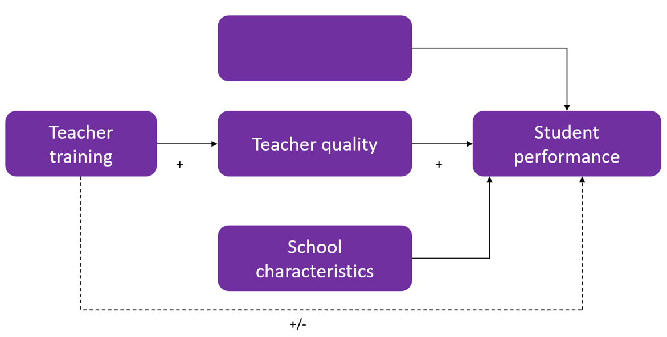
Teacher Quality and
Learner Achievement
Student
characteristics
Access
Mobile
Evers, A., Vermeulen, M., & van der Klink, M. (2007). The need to invest in teachers and teacher education.

Slide 13
Integrated School-Based Teacher Development
01
“Teacher Futures”
Quality
Teaching
02
Learner: Improved learning outcomes
Teacher: School-based teacher development
Pedagogy: Collaborative PBL
Community of Practice: Scalable cross-national approaches
Technology: Integrated delivery using eLearning, Microlearning, Messaging, Print
Community
TEACHER
FUTURES
03
http://teacherfutures.colvee.org
Learning for
Sustainable Development

Slide 14
Phase 1 Activities: July - December, 2017
Project Kick-Off, Baseline Survey, Community Linkage, Learning Design Spaces and Standards, CoP and M&E
Monitoring and Evaluation
Sensitization meetings
with Ministry, TEI and schools
Design of web spaces,
Standards for
integrated delivery
Ministry approval
✓
Cross-national
Community of Practice
e.g. eFacilitation Workshop
Community linkage
Baseline Survey
( & Needs Analysis)
✓
✓ - GT Nigeria

Slide 15
Phase 2 Activities: January - June, 2018
Finalisation of Toolkit, Guidelines & Standards, Learning Design Workshop, Content Uploading, CoP Management, Roll-Out, M&E
Monitoring and Evaluation
Learning Design Workshop
Teacher Generated Content
✓
Training on CoP
Management
✓
Pre-roll out briefing
1. Roll out of initial 10 – 20 hours of
learning content
2. Official launch of GT Nigeria
Toolkit,
Guidelines, Standards
Content Uploading to Web spaces / Print
✓
✓
✓
✓ - GT Nigeria

Slide 16
Researching teacher development for sustainable learning outcomes

Slide 17
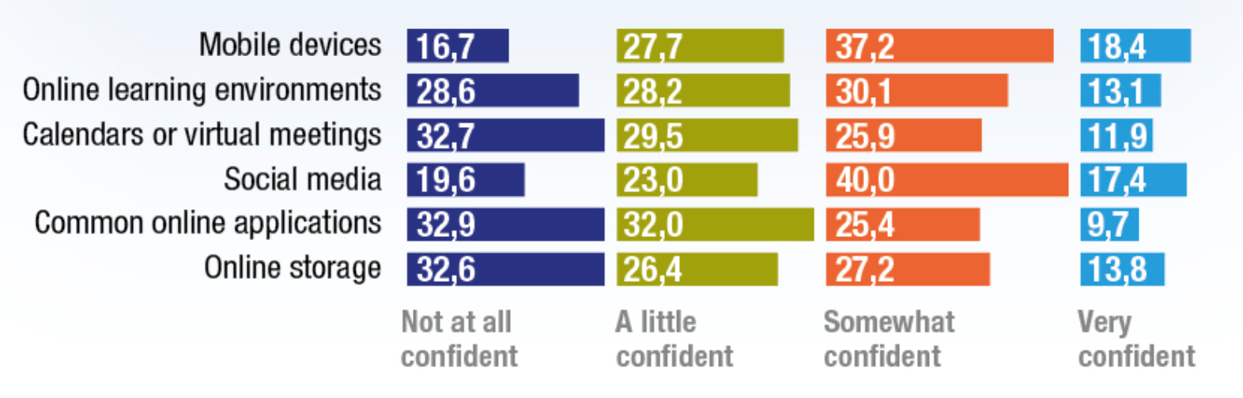
Study 1: Teacher Confidence with Online Collaborative Tools
A study in 4 countries in Europe
Confidence levels established before being introduced to online collaboration methods and tools
On average, total of about 40% were not at all confident or only a little confident
There is a gap in skills and confidence relating to the use of online collaborative tools
How confident are you?

Slide 18
Study 2: Child Friendly Schools
Aim of study
A tracer study of selected NCE graduates who were exposed to the NCE Course on CFS and are currently teaching in primary and junior secondary schools in Katsina and Zamfara states in Nigeria.
Objectives
  To establish the extent to which the teachers use CFS concepts, principles, and approaches in their lessons;
  To determine the differences (if any) between the performance of pupils who were taught by teachers trained on CFS and pupils who were taught by teachers who were not trained on CFS
Methodology
  Quasi-experimental research design
  ‘Archived’ Proxy Pretest design
  Sampling: 4 rural and 4 urban schools
Findings
Teachers from the Treatment schools (T) in Katsina and Zamfara states demonstrated more of the desired teaching behaviours associated with child-centred pedagogy than their counterparts from the Control schools (C). There was no difference in the learning outcomes.

Slide 19
Study 3: ORELT
Aim of study
  An in depth study on teacher integration of ORELT materials in Junior Secondary School English Language classes and the impact on learner participation in the English lessons and language skills
Research questions
  How are ORELT modules used in the schools to meet the curriculum demands?
  What are the changes in learner involvement in the lessons and learner language skills after the use of ORELT materials?
  What are the challenges to effective integration of ORELT into the teaching of English Language?
  How can ORELT modules be more effectively used to meet the curriculum demands?
Methodology
  Quantitative and qualitative designs ( pre and post-tests, pre and post evaluation instruments)
  Sampling: Junior Secondary Schools levels (Form 1 and 2 in Kenya; Senior 1, 2, and 3 in Uganda and Senior 1, 2 and 3 in Tanzania)
Findings
The use of ORELT increased learner interest and participation in the English language lessons, improved retention and learning outcomes. Students were more involved in the learning process as they got more interested in what they were learning.

Slide 20
COL: The learning organisation
1
COL is a ‘learning organisation’ hence the progression from outputs to integrated outcomes-based approach in programme development and implementation
Fewer countries, bigger impact
Scalable models, including expanded teacher communities and sharable teacher-generated content
Research and teacher self-monitoring for sustainable impact
2
3
4

Slide 21
Thank you!

