Slide 1



Smart Education for the Future
Professor Asha Kanwar
COL President & CEO
18 August 2021

Slide 2
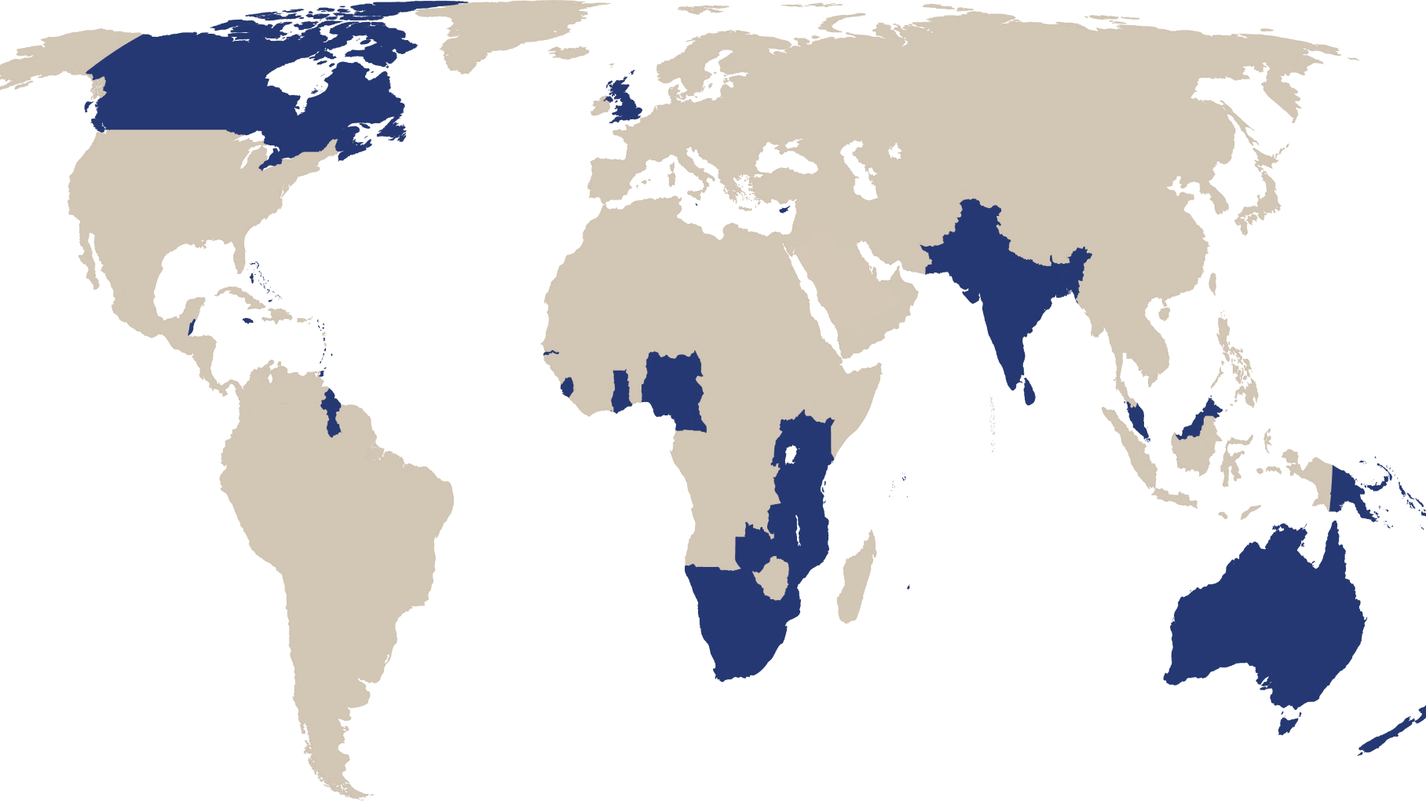

The Commonwealth
54 developed and developing nations around the world

Slide 3


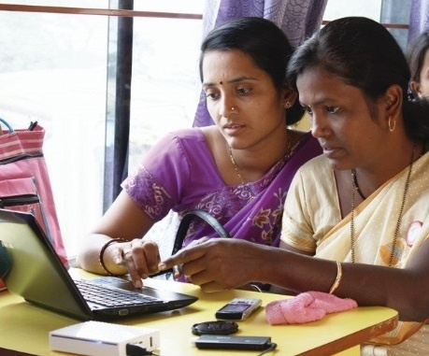
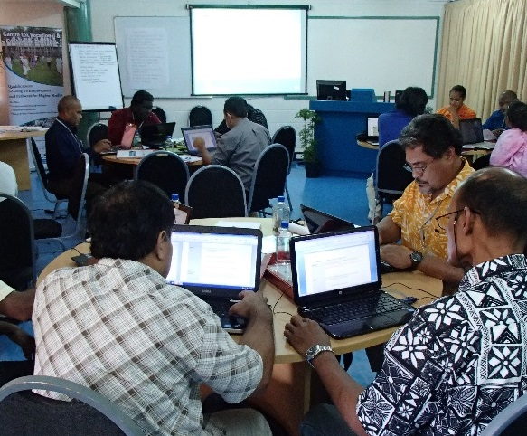
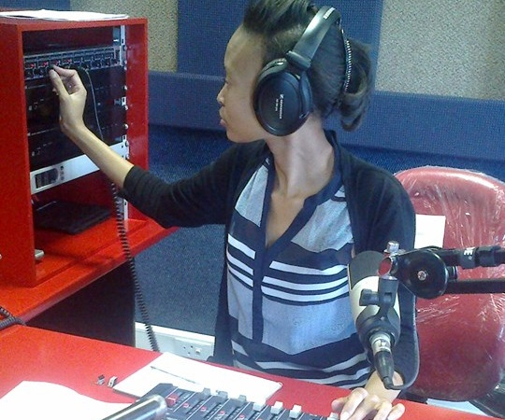
To help Commonwealth governments and institutions use technologies to improve and expand access to education and training

Slide 4
Plan
1
Issues during COVID-19
2
Futures of Learning
3
Smart Education for the Future

Slide 5

>1.5 billion
over 95% of student population

Slide 6
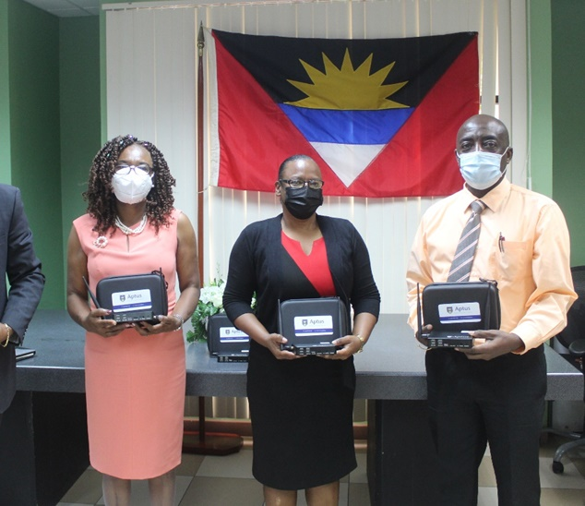
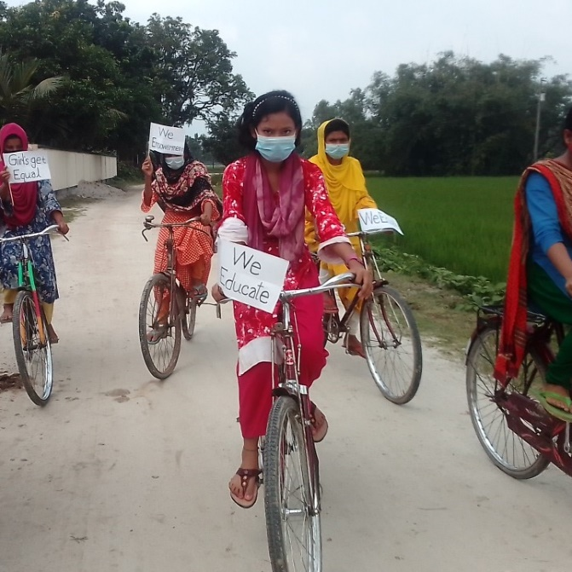
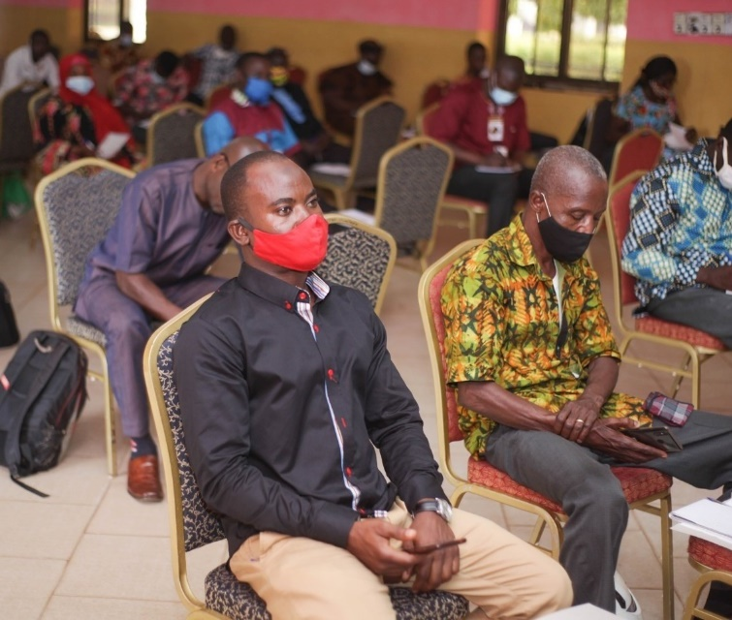
COVID-19
Technology
Teacher Capacities
Inequalities

Slide 7
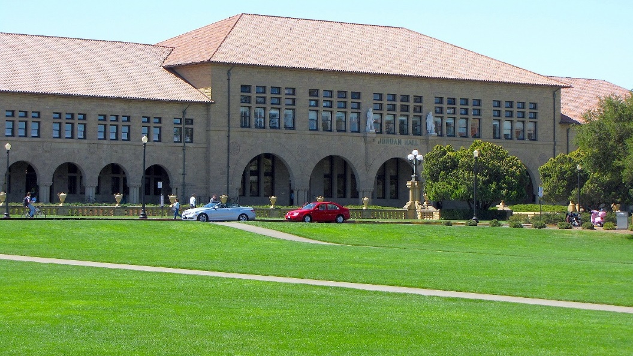
1 - Technology issues
Stanford University
16% undergraduates did not have access to internet for half the time
60% of low-income students did not have a private place to study
Source: https://www.tonybates.ca/2020/08/30/lessons-from-stanford-universitys-move-to-remote-learning/

Slide 8
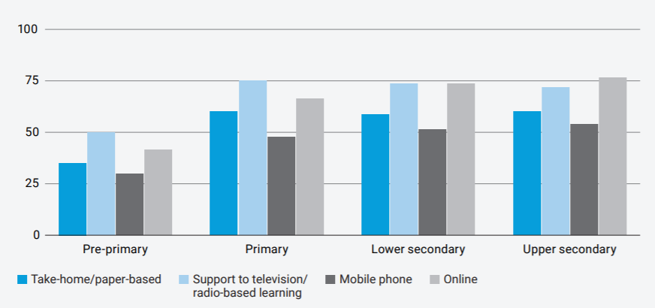
2 – Teacher Capacities
Teachers engaged in alternative teaching
Source: UNESCO-UNICEF-World Bank Joint Survey, May-June 2020, available at http://tcg.uis.unesco.org/survey-education-covid-school-closures

Slide 9

3 - Inequalities
Source: https://en.unesco.org/covid19/educationresponse/girlseducation

Slide 10
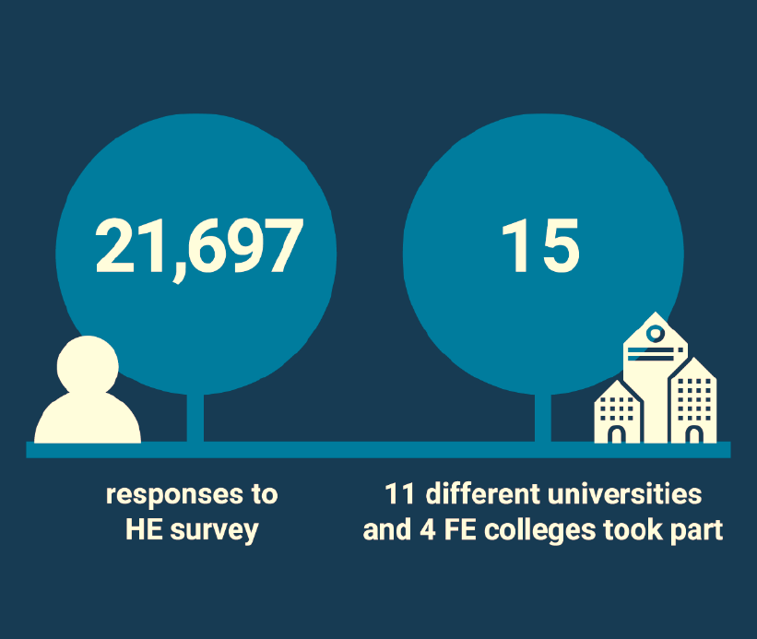
Silver lining?
Positive quality rating
81% of students were learning online
68% of students rated the quality of online digital learning as ‘best imaginable’, ‘excellent’ or ‘good’
62% also rated the support they received for online learning equally highly.

Slide 11
Futures of Learning

Slide 12


Preferrable Future
Universal primary completion will be achieved in 2042
Universal lower secondary completion in 2059
Universal upper secondary completion in 2084

Slide 13

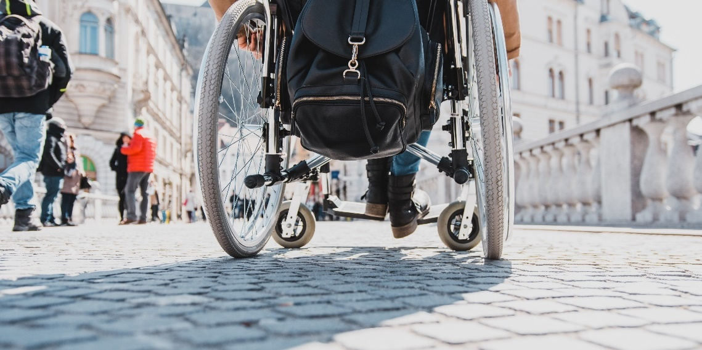
Inclusion
Canada: 10.7%
India: .56%
South Africa: 1% . For example, in South Africa 80% of disabled people aged 20-24 are not in tertiary education.

Slide 14

Learning Crisis
and Learning Loss’
In South Africa, majority of Grade 4 students displayed the capacity of Grade 1 (World Bank, 2018)
Kenya allowing pupils to re-take a year
Source: https://www.education.go.ke/images/Kenya_basic_Education_COVID-19_Emergency_Response_Plan-compressed.pdf#page=11

Slide 15



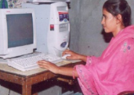
Probable Future
Face-to-Face Courses
Blended Courses
Distance/Online Courses
Blended Learning

Slide 16


More personalized teaching: AI
Can provide an intelligent, personal tutor for every learner
Encourage intelligent support for collaborative learning
Adaptive group formation
Expert facilitation
Source: https://www.ibm.com/watson/advantage-reports/ai-social-good-education.html

Slide 17
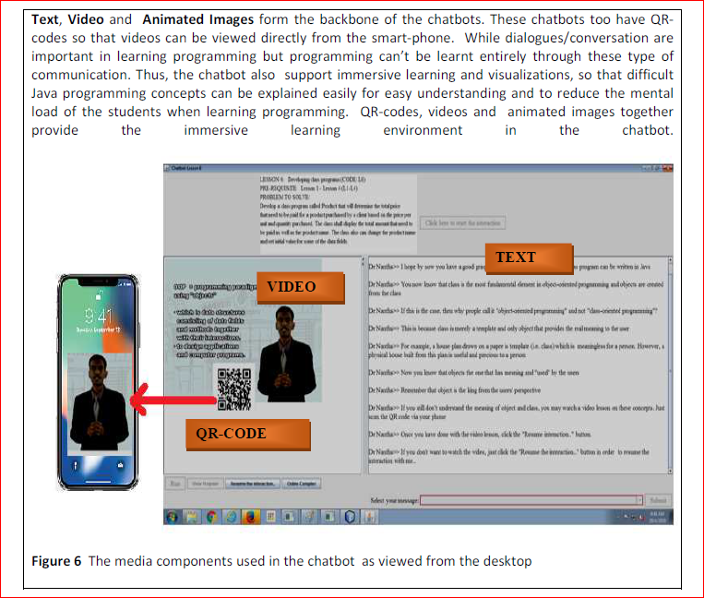
Use of
Chatbots

Slide 18
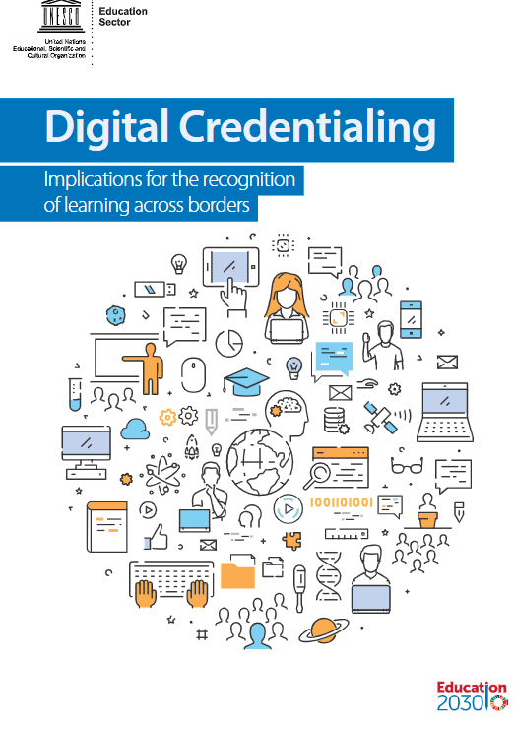
Assessment
Badges and micro-credentials
Recognition of prior learning
Transnational qualifications frameworks for mobility
On-demand examination
Authentic, project-based assessment
https://unesdoc.unesco.org/ark:/48223/pf0000264428?posInSet=4&queryId=N-e4559bf5-0bec-40c7-91a9-5cdea42e1ca4

Slide 19


Possible Future
At the current rate there will be larger and more frequent climate related disasters
Globally, the number of climate disasters has tripled since 1980, while, hot weather in 2016 broke the historic record set in 2015
This Photo by Unknown Author is licensed under CC BY-SA
Source: The Commonwealth Secretariat. 'Climate Change'. https://thecommonwealth.org/climate-change

Slide 20
Education and emissions
Direct
Emissions from construction of schools/infrastructure
Emissions from energy use in schools
Learner emissions
Indirect
Emissions from ‘development’ and economic growth associated with higher levels of education in a country

Slide 21







Research on Emissions and ODL
3x less carbon emissions
Travel – greatest contributor
Mode of delivery - determinant
Source: Carr et.al. Delivery Mode and Learner Emissions: Comparative Study from Botswana. W. Leal Filho and S. L. Hemstock (eds.), Climate Change and the Role of Education, Springer Nature. In Production.

Slide 22
Smart Education
for the Future

Slide 23
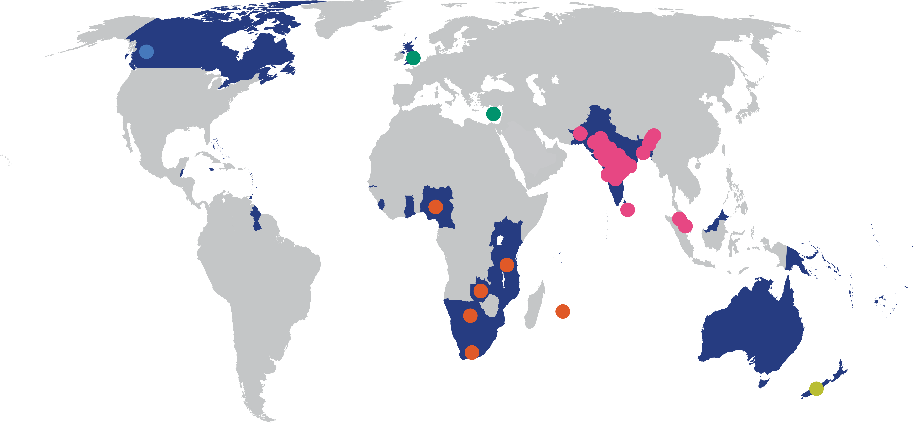
1. Increasing access

Slide 24
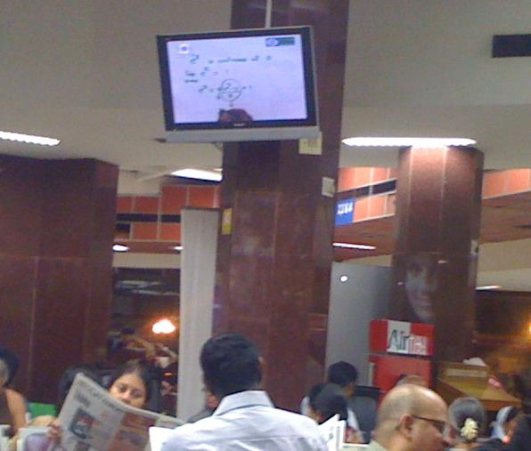
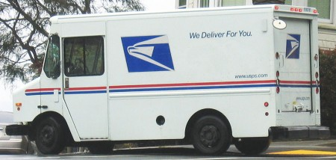
2. Improving quality
Personal support to each student
High quality multi-media materials
Efficient logistics and administration
Teaching rooted in research
(John Daniel, 1998)

Slide 25
3. Reducing costs
Training modes | Cost per completing participant | Total effectiveness points per completing participant (total 300 points) | Cost per unit Effectiveness
Face-to Face | US$1,614 | 244 | US$6.7
Online | US$ 901 | 242 | US$3.7
Source: Jung, I. (2005). Cost‐effectiveness of online teacher training. Open Learning: The Journal of Open, Distance and e-Learning, 20(2), 131-146..

Slide 26
4. Promoting inclusion
CONVENIENT
Study at your own pace, place, time
FLEXIBLE
Option to listen, watch or read lecture in different formats
AFFORDABLE
ANONYMOUS
Don’t require to travel to campus or accommodation
Costs less than F2F
Engage with professors and classmates without feeling discriminated

Slide 27
5. Addressing Climate Change
Reduction of carbon emissions
Raising awareness on disaster preparedness
Reskilling people for a greener future
Resilience for the education sector

Slide 28
Smart Education must…
Increase access
Improve quality
Reduce costs
Support inclusion
Lower carbon foot-print
Inclusion
Environmental Sustainability
Access
Quality
Cost

Slide 29
Elements of Smart Learning: 5 E’s
Enjoyable
Engaging
Efficient
Effective
Ethical

Slide 30


Thank You
www.col.org
The contents of this presentation, except logos/ graphics which are property of the respective owners, is made available under Attribution-ShareAlike 4.0 International (CC BY-SA 4.0).

