Slide 1

2nd EdInnovate 2025: Innovations in Education and e-Learning
Hybrid Conference, Tokyo, Japan
Theme: Driving Educational Excellence through Digital Transformation
Session 3: Digital Content Creation and Curation
Tony Mays
Director: Education, Commonwealth of Learning, Vancouver, Canada

Slide 2

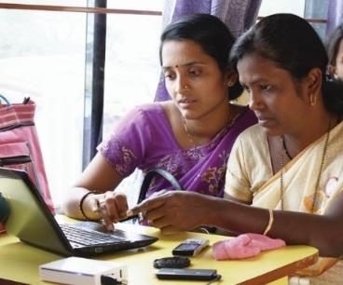
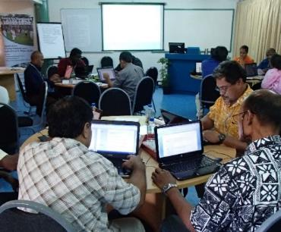
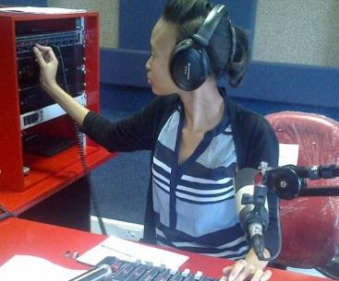
To help Commonwealth governments and institutions use technologies to improve and expand access to education and training

Slide 3

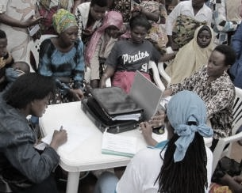
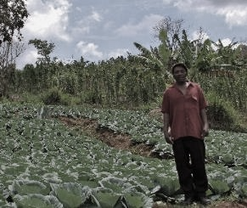


ECONOMIC EMPOWERMENT
SOCIAL
INCLUSION
ENVIRONMENTAL CONSERVATION
$

Slide 4
Overview
SDG Goals
01
Strategies for developing interactive digital content
02
Open educational resources (OER) and digital libraries
03
User-generated content and collaborative platforms
04
Multimedia integration in educational materials
05

Slide 5
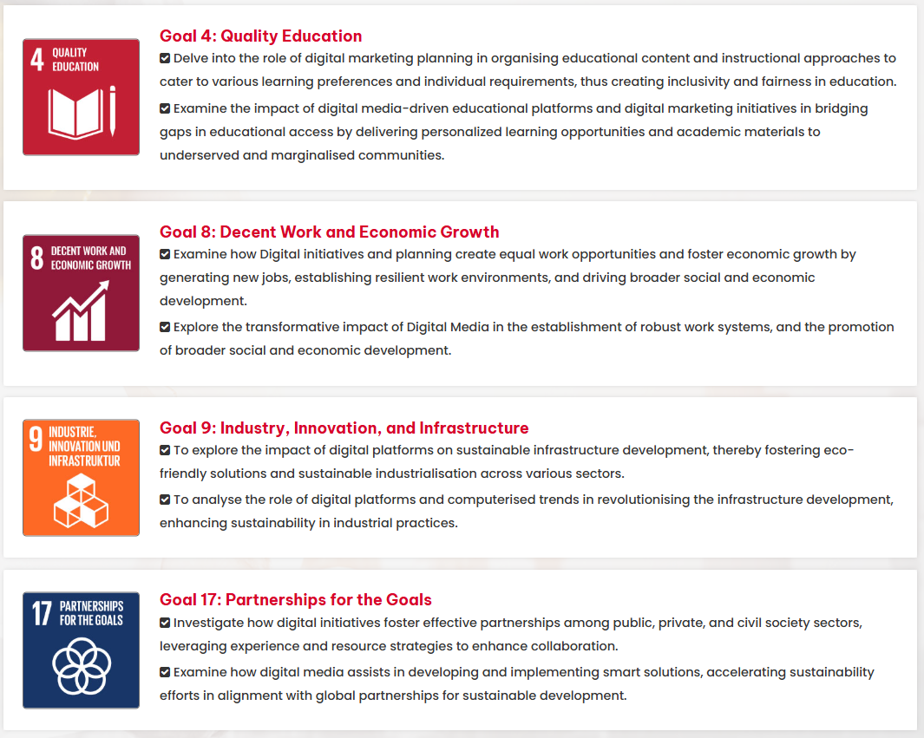
SDG Goals

Slide 6
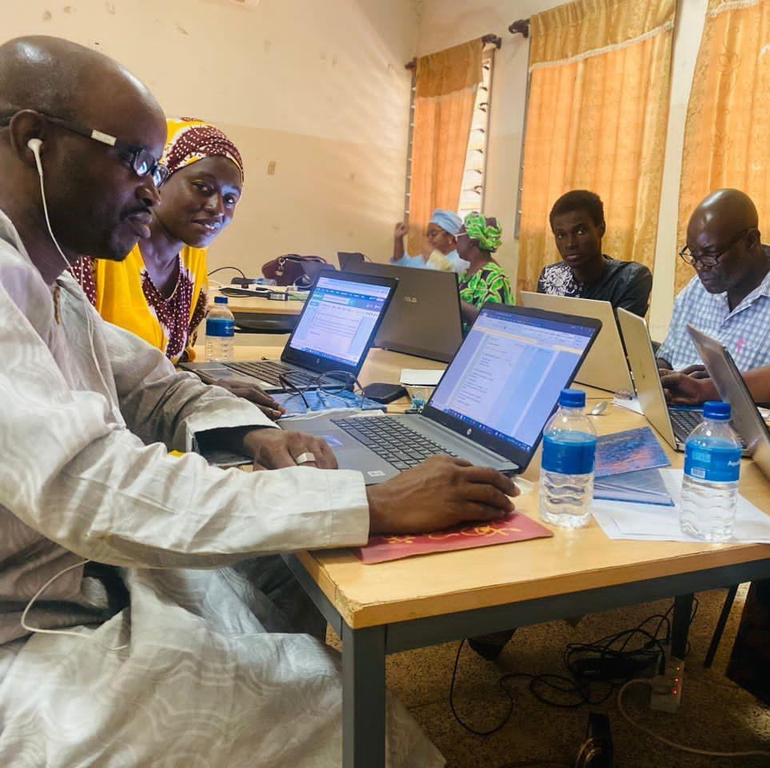
Strategies for developing interactive digital content
Classroom teachers
  Curriculum mapping
  ODL design
  OER
  Inclusion (incl gender)
  Assessment
  Learner Support
COLcommons1
https://colcommons.org/

Slide 7
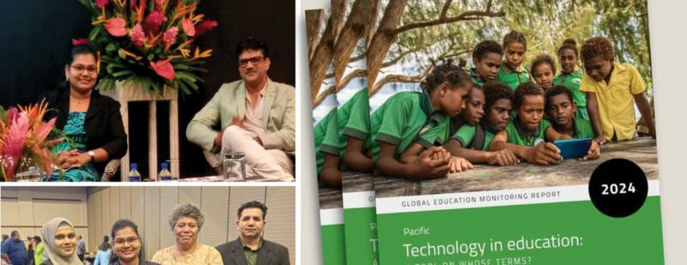
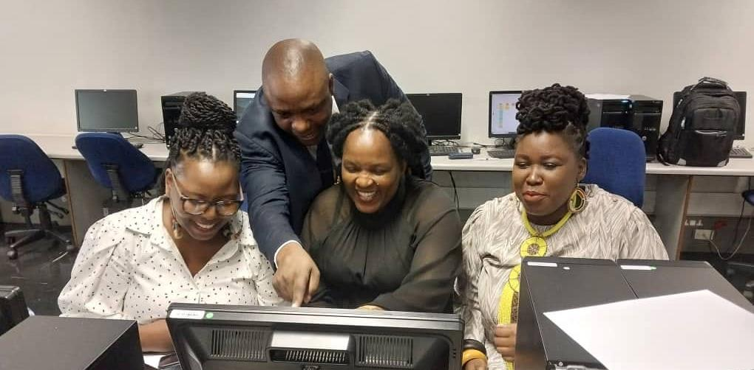
Multimedia integration in educational materials
Digital divide
  Text & Graphics
  Add audio & video: Open Textbooks
  Add H5P etc.
  Add AR/VR in digital labs

Slide 8

A contextual example
[Photo by Jeremy Zero on Unsplash ]

Slide 9
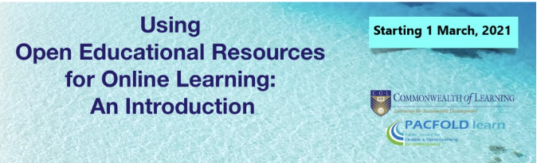
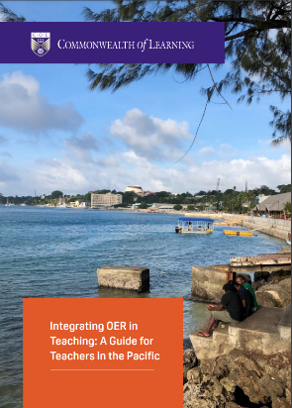
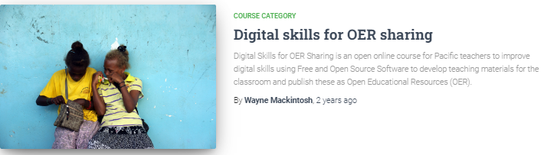
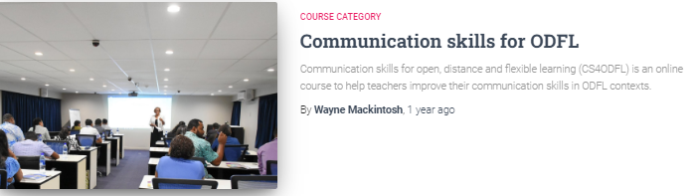
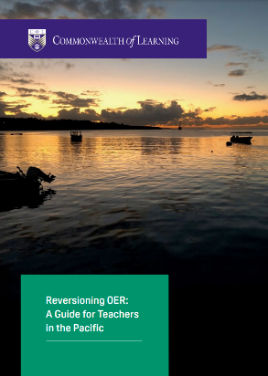
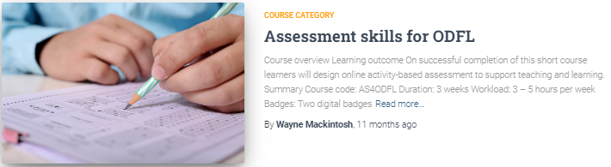
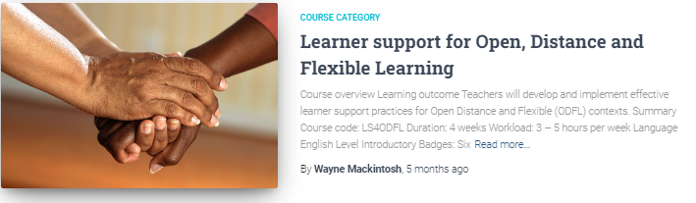
Teacher capacity-building

Slide 10
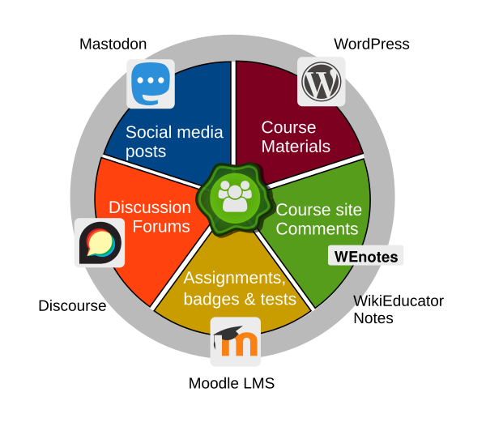
Open Course Platform
Pie Chart by Mackiwg is licensed CC-BY-SA 3.0

Slide 11
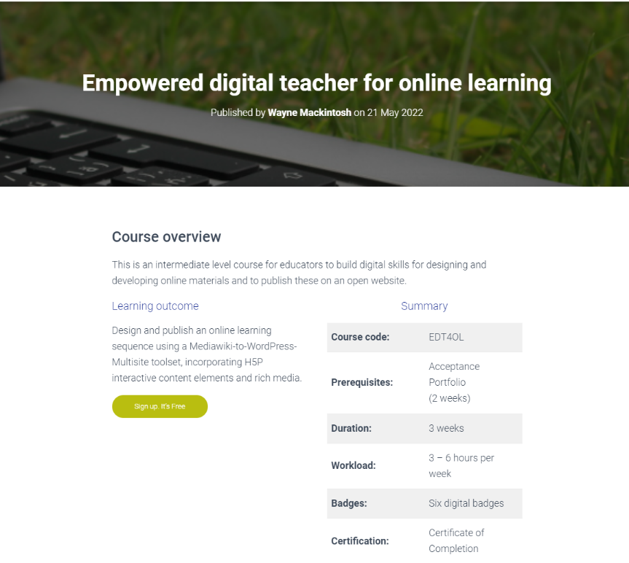
Facilitating ownership

Slide 12

Open educational resources (OER) and digital libraries
COLcommons2 OER course:
  https://colcommons.org/welcome/coursedetails/1
  35,160 registrations and counting
COL Oasis and JL4D
  https://oasis.col.org/home
  https://jl4d.org/index.php/ejl4d
  Over a million downloads per year
Pacific OER Regional collection
  https://staging.oer4pacific.org/
  National collections
International collection
  notesmaster.com/library/guest

Slide 13
User-generated content and collaborative platforms
OER Repositories
01
Moodle Bot: Samoa
02
Semester Zero: Moodle and Course Bot: USP
03
Teacher-in the-Loop
04

Slide 14
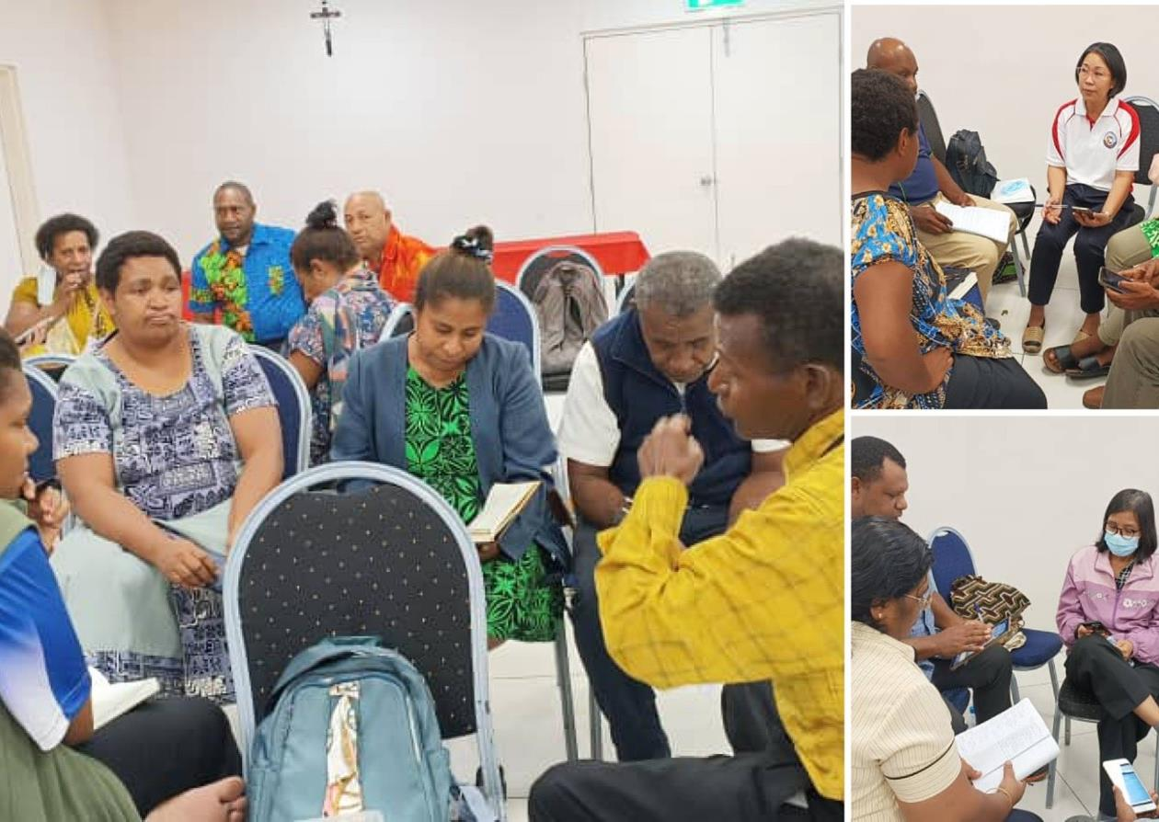
Evolving pedagogy
Pedagogy
Andragogy
  Geragogy
Heutagogy
Ubuntugogy
Peeragogy
Cybergogy

Slide 15
Exploiting synergies
Human
GenAI

Slide 16
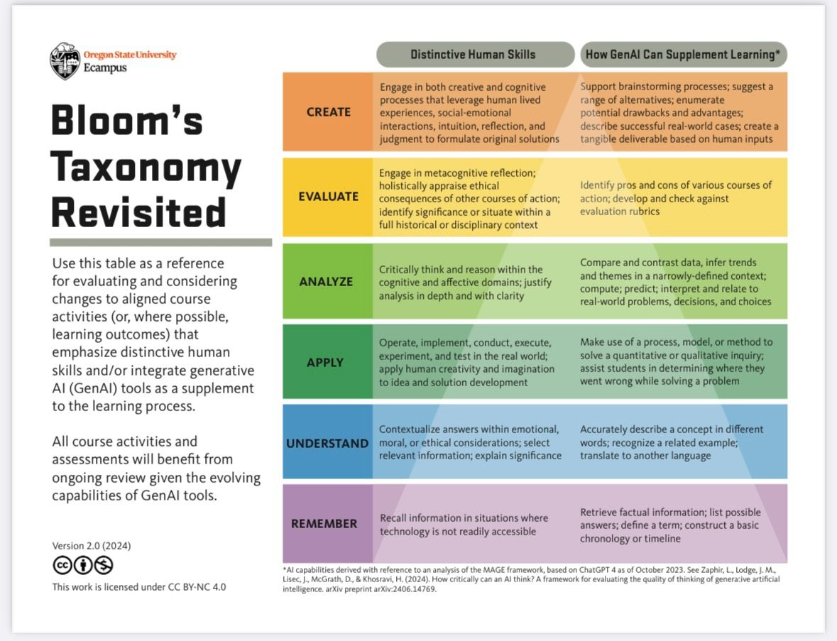

Slide 17


Thank you
www.col.org
The contents of this presentation, with the exception of logos and graphics which are the property of the respective owners, is made available under Attribution-ShareAlike 4.0 International (CC BY-SA 4.0).

