Slide 1

Implementing the UNESCO OER Recommendation: COL Experiences
AAOU 2020
June 3, 2021
Sanjaya Mishra
Education Specialist, eLearning
Commonwealth of Learning, Canada

Slide 2
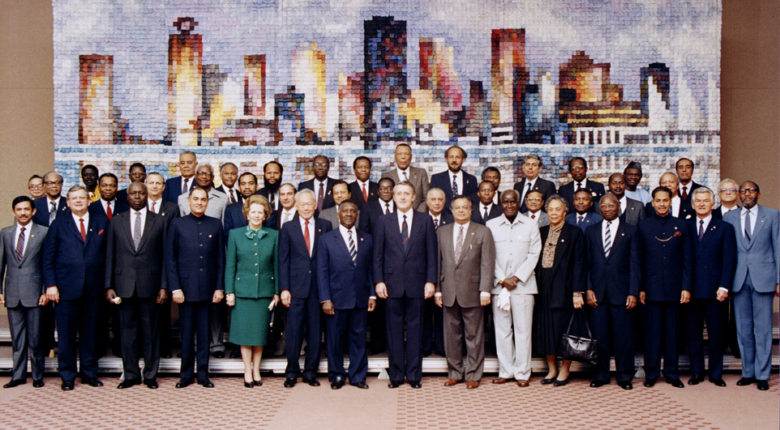
Copyright Commonwealth Secretariat
Commonwealth Heads of Government Meeting
Vancouver, 1987

Slide 3
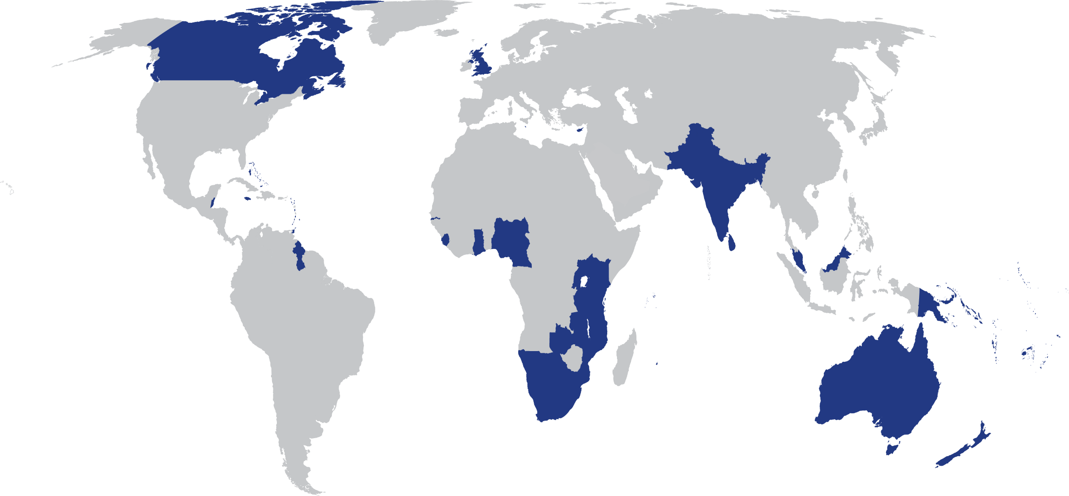
The Commonwealth
54 developed and developing nations around the world

Slide 4

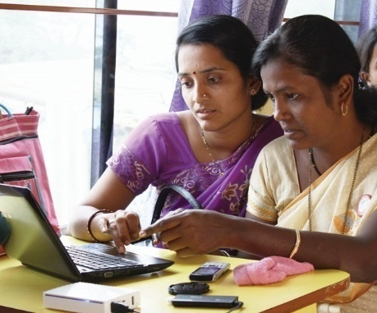
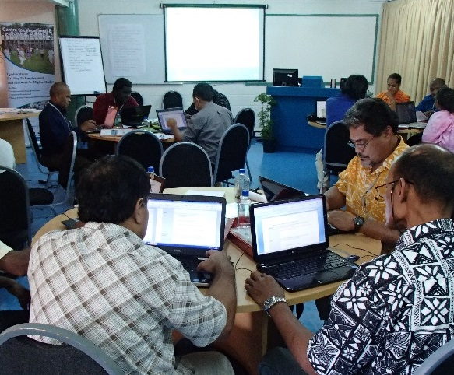
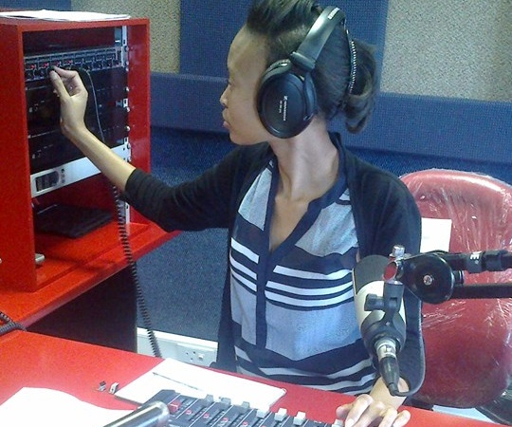
To help Commonwealth governments and institutions use technologies to improve and expand learning for sustainable development
Notes:
What do we do? Our mission is to help Commonwealth member states and institutions to use technologies for expanding access to quality education and training.

Slide 5

Sharing is in the DNA of COL
Facilitating access to learning materials is a key role of COL imagined by the Commonwealth Heads of Government since its establishment.
STAMP 2000+ was one of the earliest collaborative content development project of COL, even before the emergence of the term OER.
COL co-organised the World OER Congress 2012 with UNESCO, and organised six regional consultations leading to the 2nd World OER Congress.
It is the first intergovernmental organisation to have an OER policy in 2011.
DNA by irene hoffman, available under CC BY license
at https://thenounproject.com/term/dna/57371/

Slide 6
OER Recommendations 2019
building capacity of stakeholders to create, access, re-use, adapt and redistribute OER;
developing supportive policy;
encouraging inclusive and equitable quality OER;
nurturing the creation of sustainability models for OER, and
facilitating international cooperation.

Slide 7
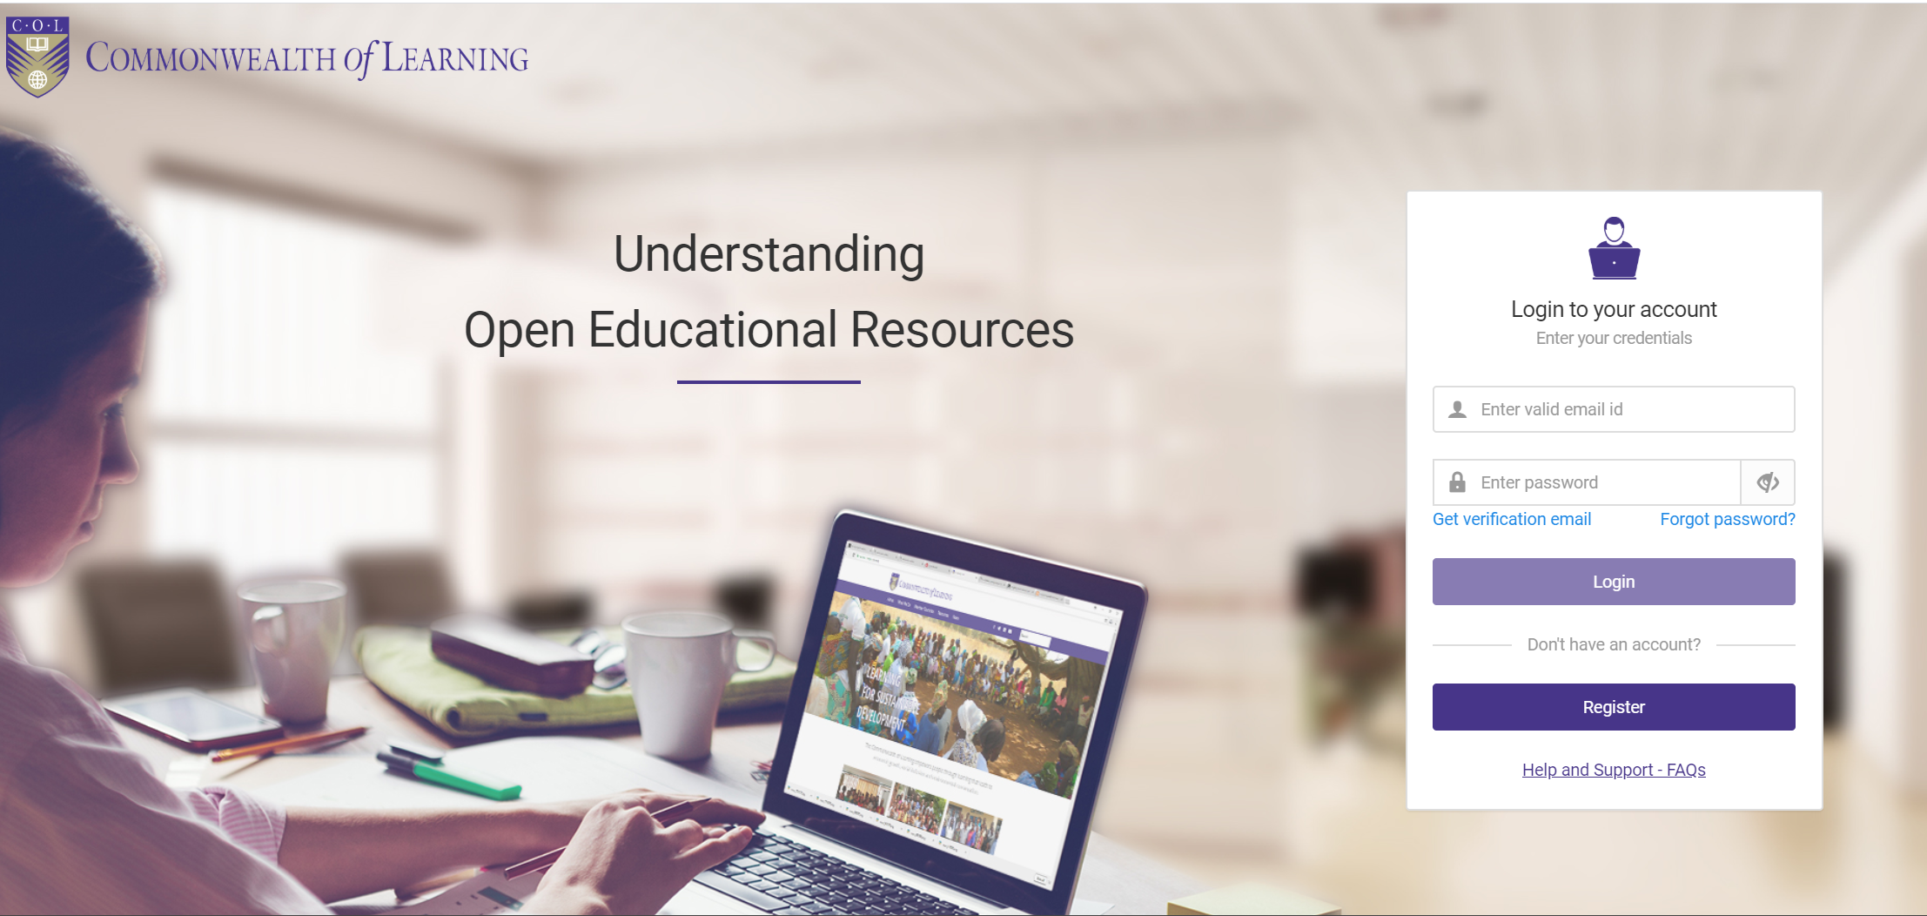
Capacity Building
Participants from 100 countries (including 48 Commonwealth countries)
Over 13,000 registered
62.5% successfully completed
52% of those completed are female
https://learnoer.col.org/
Notes:
In addition, COL provides institutional support for capacity building on OER.

Slide 8
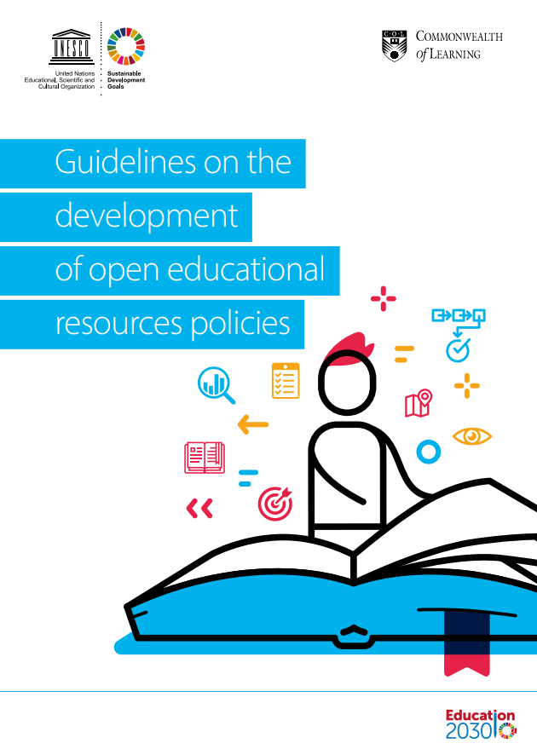
Policy Development
Institutional policy template for OER policy
UNESCO-COL policy guidelines
Policy support: Bangladesh, Belize, Botswana, Cameroon, India, Malaysia, Malta, Mauritius, Nigeria, Saint Lucia, Sri Lanka, Zambia.
Institutional policy support: Over 30 institutions
Notes:
OER policy development at institutional level takes either in the form of stand alone policy or integrated into TEL policy.

Slide 9
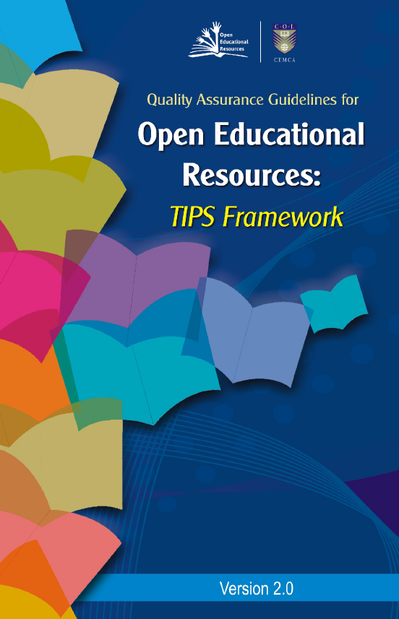
Inclusive and equitable Quality OER
Encouraging the use of local development of quality using TIPS framework
Develop OER adopting Universal Design for Learning
Use of Aptus and print for delivery beyond online.
http://oasis.col.org/handle/11599/562
Notes:
Accessibility
Localisation
Technological barriers
Discoverability
Interoperability

Slide 10
Has completion of this course improved the quality of your OER work?

Slide 11
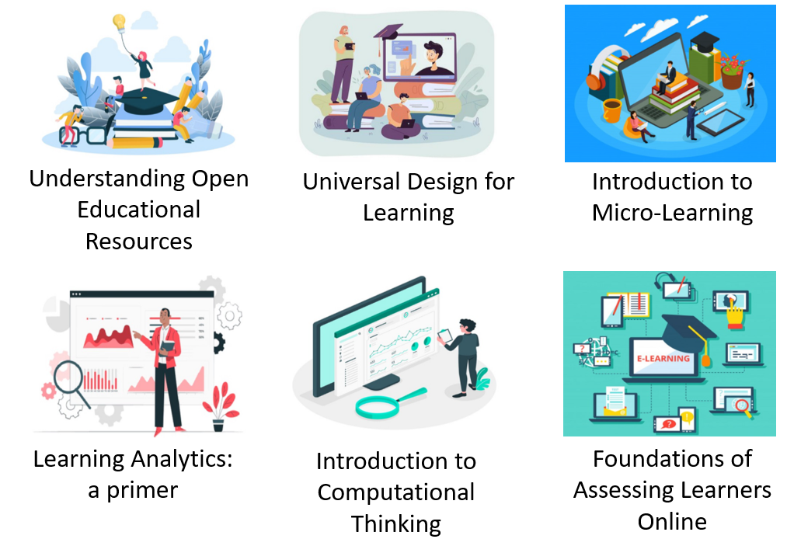
Sustainable Models
Collaborative content development: Diploma in Mobile App Development and Certificate in Web Application Development developed by six open universities (AIOU, IGNOU, NOUN, OUM, OUT, OUSL)
Over 100 courses at
https://www.colvee.org/
Notes:
Other universities partnership to develop courses: Odisha State Open University, Centurion University of Technology and Management, University of Mauritius.

Slide 12
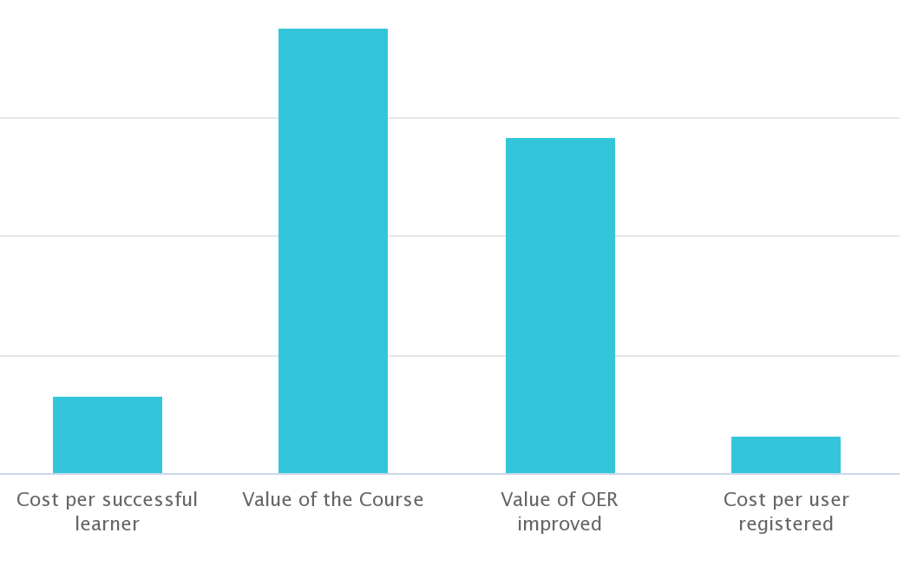
Impact of the OER Course
CAD75
57%
CAD13
CAD6.5

Slide 13
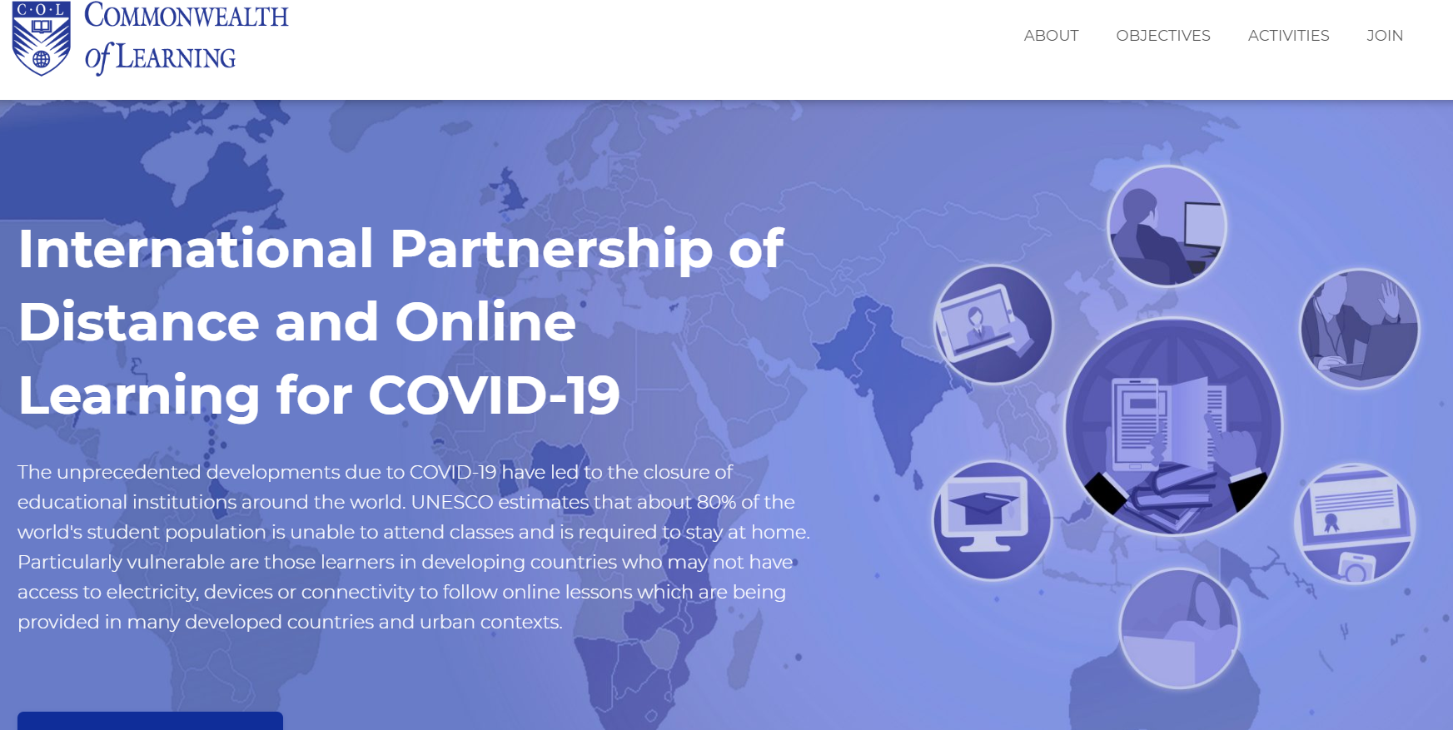
60+
https://opendoor.col.org/
Intergovernmental organisations
Universities and educational institutions
Associations and networks
Notes:
Over 250 courses shared by partners.

Slide 14





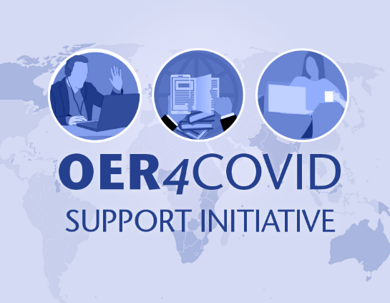

International Cooperation
Regional Consultation for Asia, Pacific and Caribbean (Webinar)
Regional Consultation for Africa and Europe (Webinar)
1,179 members from 79 Countries
Community discussion and curation

Slide 15
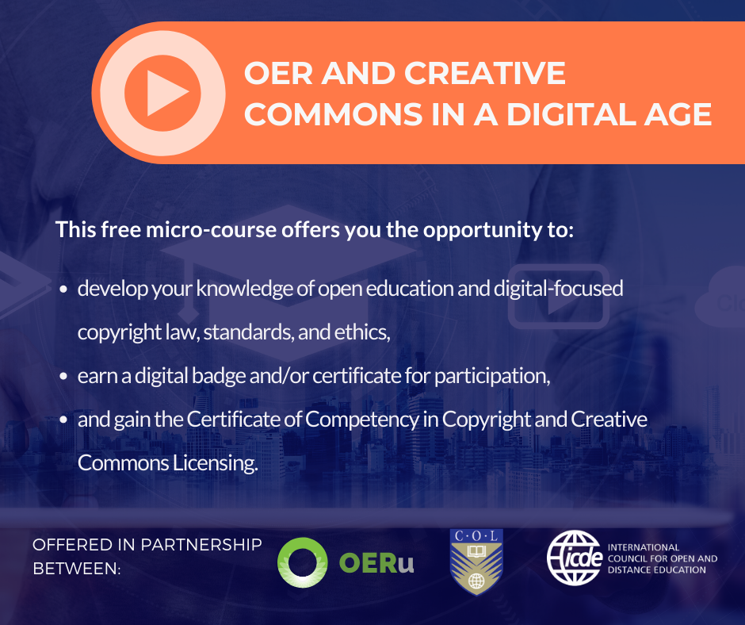
Copyright and Creative Commons Licensing

Slide 16

Q&A
Thank You
The contents of this presentation, except logos/ graphics which are property of the respective owners, is made available under Attribution-ShareAlike 4.0 International (CC BY-SA 4.0).

