Slide 1
SDG’s and
The Potential of Generative AI and
Large Language Models: enhancing the effectiveness of teaching and research support in
Agricultural and Veterinary Universities
Balaji V
Commonwealth of Learning (COL), Canada

Slide 2
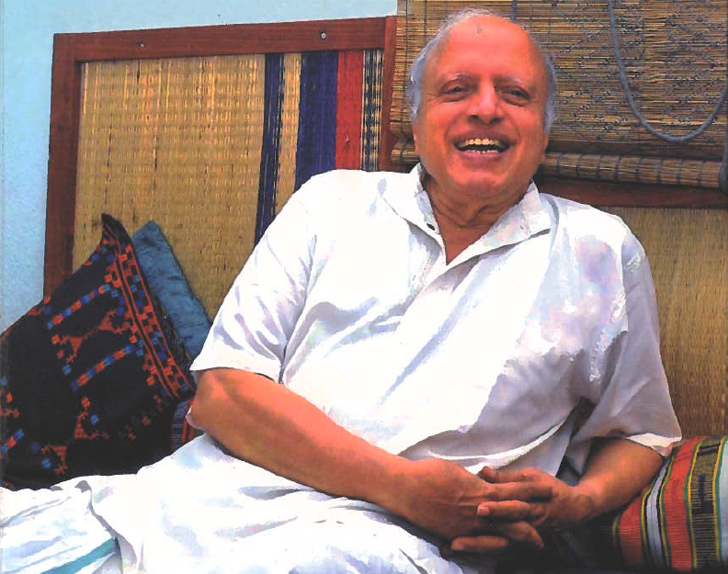
Professor M S Swaminathan (1925-2023)

Slide 3
SDG 2: global review in 2022
World is on the verge of a food crisis
150 million more people facing hunger compared to 2019
Pandemic-induced disruptions impacted supply chains
Climate change
Financial crisis
Regional war with global ramifications

Slide 4
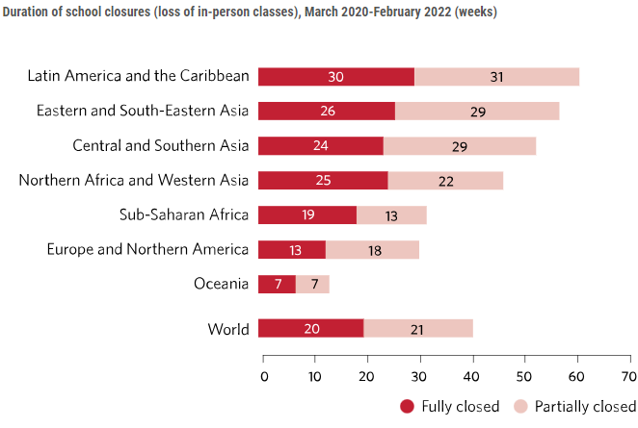
SDG 4: Opportunities for learning impacted

Slide 5
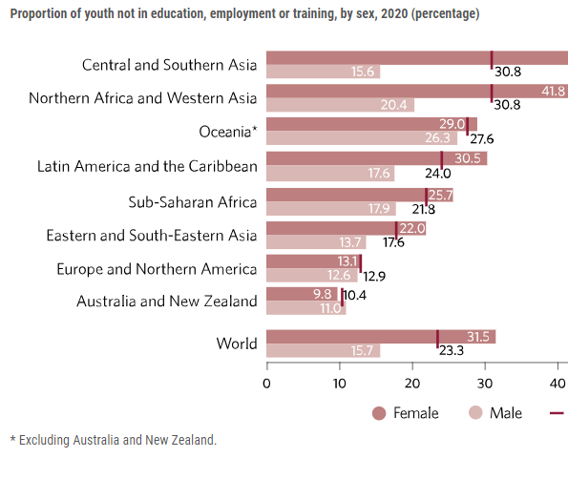
SDG 8: opportunities for decent work minimal

Slide 6
Building resilience in education is a key
Blended learning is here to stay
Institutions need policies for ingraining the digital paradigm at various levels
Data ethics and respect for data sovereignty will be fundamental

Slide 7
Generative AI can offer some opportunities for greater effectiveness in teaching

Slide 8
What is Generative AI?
Generative AI is a subset of artificial intelligence that uses machine learning models to produce content. It can generate text, images, music, and more, mimicking human-like creativity. It’s transforming industries by automating tasks and generating innovative solutions.
(response generated by Bing Chat using GPT-4)

Slide 9
What is a Large Language Model?
A large language model in AI is a neural network trained on massive text data sets, enabling it to generate coherent and fluent language. These models can understand and generate natural language, summarize large volumes of text, translate between languages, and perform other language-related tasks. Prominent examples include GPT-3, BERT, and T5.
(Response generated by Claude 2 of Anthropic)

Slide 10
What are the more widely used services?
ChatGPT (OpenAI- Microsoft)
Claude (Anthropic)
Perplexity AI
Bard (Google)

Slide 11

There are open-source LLMs
LLaMa family with different sizes of parameters (Meta/Facebook)
Falcon family from the UAE

Slide 12
Two useful sites
https://theresanaiforthat.com/ (over 7000 entries on AI for tasks)
http://lmsys.org especially, https://chat.lmsys.org/?arena (for comparing two LLMs for performance)

Slide 13
Services that use LLM’s today
Customer Support Chatbots:
  Automated customer service agents that can handle a variety of queries, providing 24/7 support.
Content Generation and Curation:
  Tools for generating articles, blog posts, and other types of written content.
Voice Assistants:
  More advanced conversational abilities for voice-activated systems like Siri, Alexa, and Google Assistant

Slide 14
Services that use LLM’s today
Translation Services:
  While not entirely replacing traditional methods, LLMs are increasingly used to improve the quality of machine translations.
Transcription Services:
  Example: in a Zoom event, the spoken words can be transcribed for editing
Sentiment Analysis:
  Used in market research and social media monitoring to understand public opinion or customer sentiment
Entertainment:
  Story or dialogue generation in video games, interactive stories, or virtual worlds.

Slide 15
Services that use LLM’s today
Healthcare Assistance:
  Preliminary diagnostic chatbots and advisory services, although these are generally used in conjunction with medical professionals.
Legal and Compliance:
  Automated tools to review contracts, legal documents, or ensure compliance with regulations.
Code Generation and Assistance:
  Tools like GitHub Copilot that assist in writing code by suggesting lines or blocks of code.

Slide 16
Services that use LLM’s today
Data Analytics and Reporting:
  Generating insights or textual descriptions from large datasets, making it easier for decision-makers to understand key takeaways
Search Engines:
  Enhancing search algorithms to understand context and semantic meaning in queries.

Slide 17

Gen AI Services in Education
Virtual Tutoring:
  Generative AI can be used to create virtual tutoring environments, where students can interact with a virtual tutor and receive real-time feedback and support.
Chatbots for Tutoring:
  Chatbots can be used for tutoring; education is the third biggest industry benefiting from chatbots.
Personalized Learning Content:
  Generative AI can produce personalized learning materials that are suited to the needs of each learner. Adaptive quizzes, study materials, and study guides can be produced based on student preferences.

Slide 18
Gen AI Services in Education
Automated Grading:
  Generative AI can automate administrative tasks like grading, allowing educators to allocate more time and energy to teaching and mentoring
Automated Administrative Tasks:
  Generative AI can automate administrative tasks like scheduling, registration, and record-keeping, helping educational institutions cut administrative costs and boost operational effectiveness

Slide 19
Use of LLM’s in research support in Ag and Vet universities
process raw genomic data to enable researchers to
  uncover patterns, identify biomarkers, and
  gain an understanding of genetic factors underlying various diseases
can interpret vast amounts of unstructured data from social media, claims, and other real-world data
  Helpful in disease management and development of therapies
can generate novel molecular structures based on existing compounds.
  These generated molecules can be screened for their potential therapeutic properties

Slide 20
Research Literature Review by LLM- an example- ChatGPT-4
Review of Research Literature on the Effect of Enhanced Levels of Carbon Dioxide on the Yield of Typical Rice Varieties
(demonstration subject to time available)

Slide 21
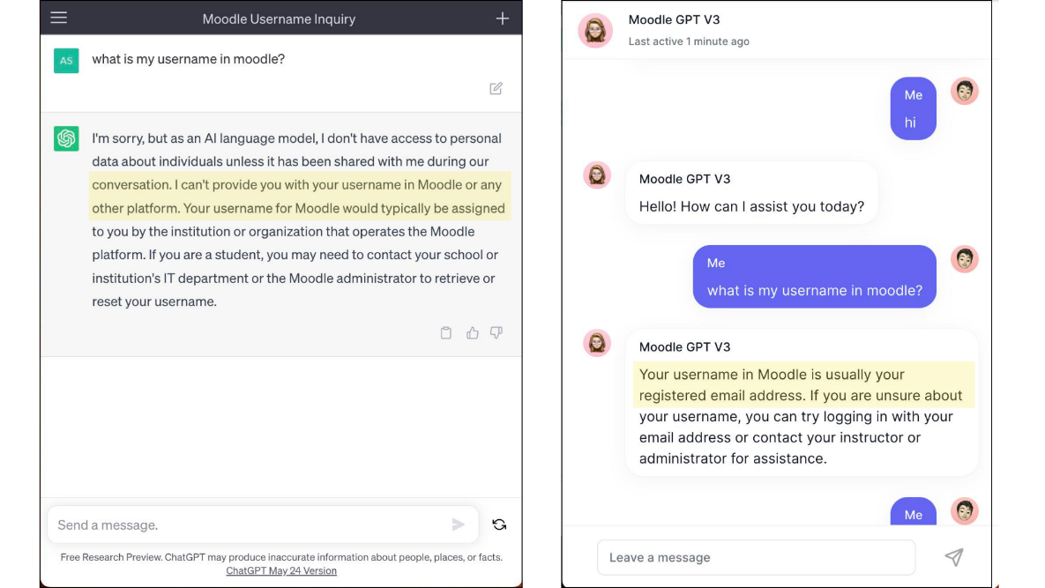
AI/GPT-powered Learner support on Moodle- a COL pilot in Samoa

Slide 22
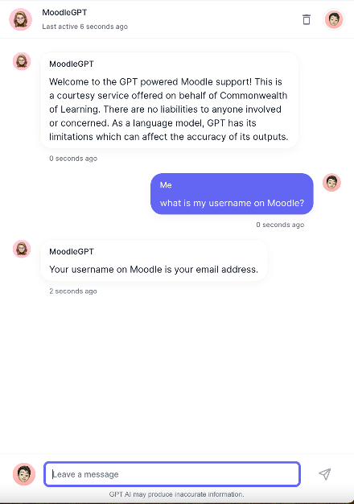
GPT-powered Chatbot for Learner Support- COL pilot in Samoa
About one quarter of learner queries in an online course are about the platform (not course content)

Slide 23
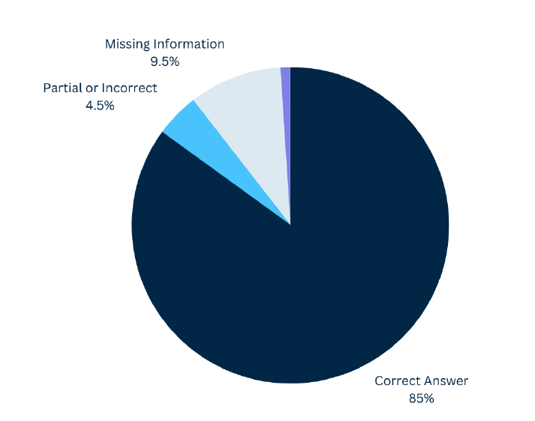
Quality of responses
Users rated GPT4Moodle highly for giving correct answers 85% of the time.
With one more iteration, the response quality can reach 95%

Slide 24
Locally installed LLM in a University- an example
University of Michigan to offer AI tools to U-M community
The university will be offering three GenAI services: U-M GPT, U-M Maizey, and U-M GPT Toolkit.
https://www.cbsnews.com/detroit/news/university-of-michigan-to-offer-ai-tools-to-u-m-community/

Slide 25
Limitations of Gen AI
Language fluency is not a substitute for domain competence
Hallucination by LLM’s is a real challenge
Fake citations - a serious threat
Biases are known
Testing an LLM should be different from testing a human for the same capability

Slide 26
Data Sovereignty and Future Use of LLM
Developers do not offer information on how an LLM was “trained”
The principal sources are not revealed- could include proprietary materials or materials used without attribution
Policymakers are concerned
  USA and UK are considering specially crafted policies to regulate
  EU Digital Services Act goes further to create a regulatory system
Unless well-founded, policy proposals can stop open-source AI developments!

Slide 27
Rising new trends of consequence
AI-infused search services can lead to drop in traffic to websites
In general, highly reliable AI- services have a cost that users may have to meet at least partially.
Gen AI is resource-intensive (electricity for powering the computers and water for cooling the data centers)

Slide 28
SDG’s and Generative AI
Reaching SDG’s: “You must run twice as fast to stay in the same place” (J Nehru on Ag in India in the 1950’s)
Gen AI/LLM services appear to offer support
Much concern about sovereignty and ethics of data must be addressed by experts and policymakers jointly
The NARES can play a key role in piloting Gen AI services to understand the constraints as well as advantages

Slide 29
Hosting an LLM in an Ag or Vet University
With a focus on opening courses to more learners online, a pilot partnership can be developed.
Use an open-source LLM such as LLaM2 or Falcon 40B
Set up a local installation in the university with adequate safeguards
Avail help of students and faculty to “customise” it

Slide 30


Thank you
www.col.org
The contents of this presentation, with the exception of logos and graphics which are the property of the respective owners, is made available under Attribution-ShareAlike 4.0 International (CC BY-SA 4.0).

