Slide 1


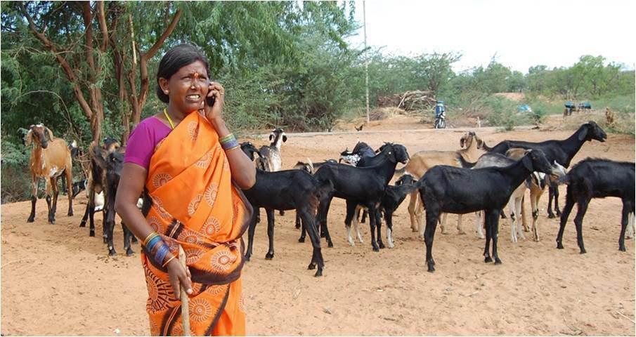
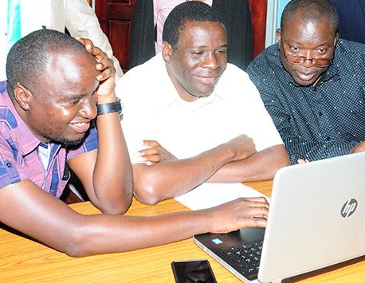

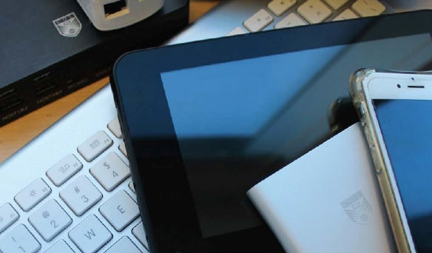

Achieving SDG 4:
Are ICTs the Answer?
Professor Asha Kanwar
President & CEO, Commonwealth of Learning
Education Ministers Action Group (EMAG)
London | 24 January 2019

Slide 2

Commonwealth Heads of Government Meeting
Vancouver, 1987
Notes:
We invite you to engage us; tap into our thought leadership, expertise, networks and resources

Slide 3

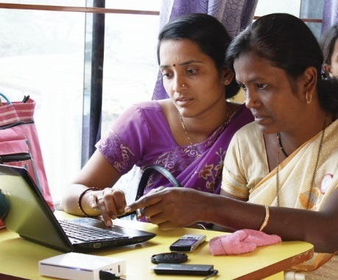
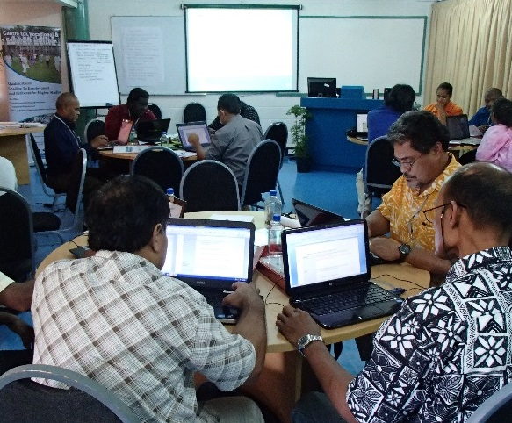

To help Commonwealth governments and institutions use technologies to improve and expand access to education and training

Slide 4

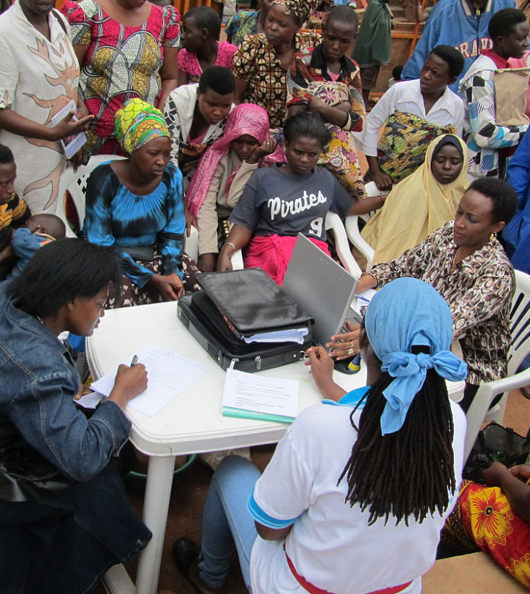
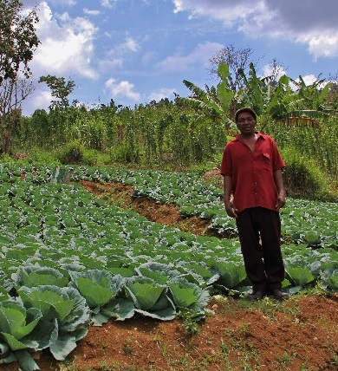



Learning for Sustainable Development
ECONOMIC
GROWTH
SOCIAL
INCLUSION
ENVIRONMENTAL CONSERVATION

Slide 5


Slide 6
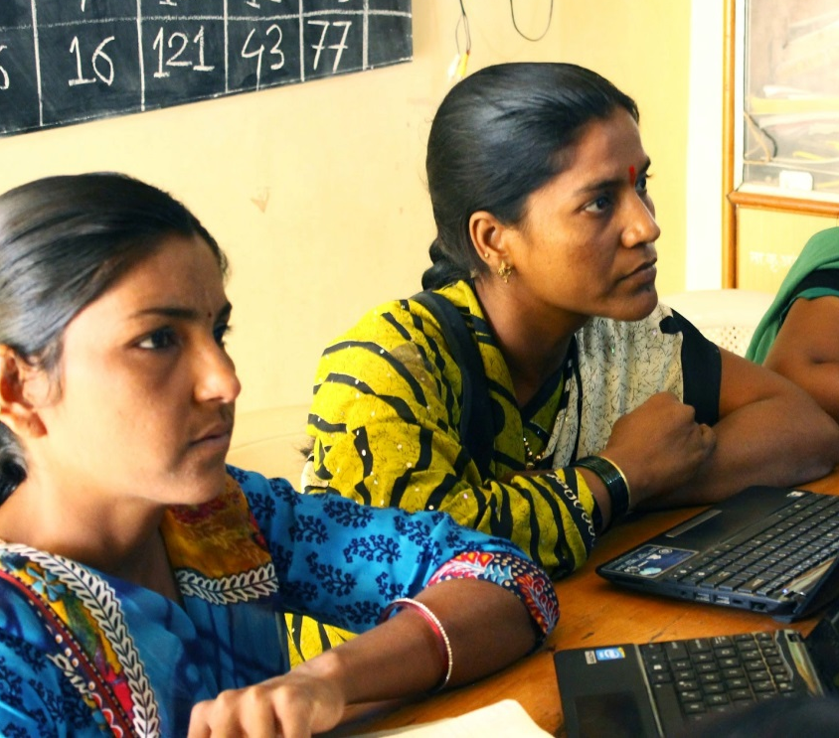


Leveraging
New & Existing Technologies

Slide 7

What Needs to Change?
Business as usual approach
“Brick and Mortar” mindset
Readiness for paradigm shifts

Slide 8
COL’s Six Paradigm Shifts

Slide 9

1
If the child cannot go to school,
the school comes to the child
PARADIGM
SHIFT

Slide 10
Open Schooling
The physical separation of learner from the teacher
The use of innovative teaching methodologies, and information and communications technologies (ICTs)
Flexible approach

Slide 11



Increased Access and Equity
India: 2.7 million students
in 5 years; 31 % female
Bangladesh: 165,000 in 3 years: 40% female
Namibia: 80.806 in 3 years:
65% female

Slide 12
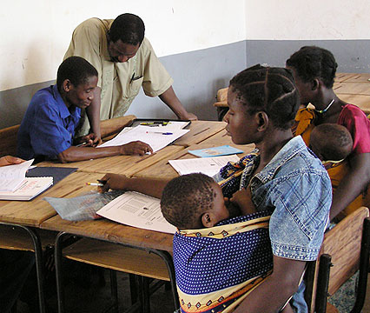


Unit Cost per Student
 | Formal Secondary School | Open School
India | INR 15,288 | INR 1,230
Namibia | ZAR 5,346 | ZAR 1,262
Source: Rumble, G., & Koul, B.N. (2007).
Notes:
Cost of open schooling in India as compared to Kendriya Vidyalaya (Central School) is 1:12, and in Namibia, it is approximately 1:4 for formal secondary school and NAMCOL.

Slide 13
2
Technology-enabled learning can break open the ivory towers of tertiary education
PARADIGM
SHIFT

Slide 14
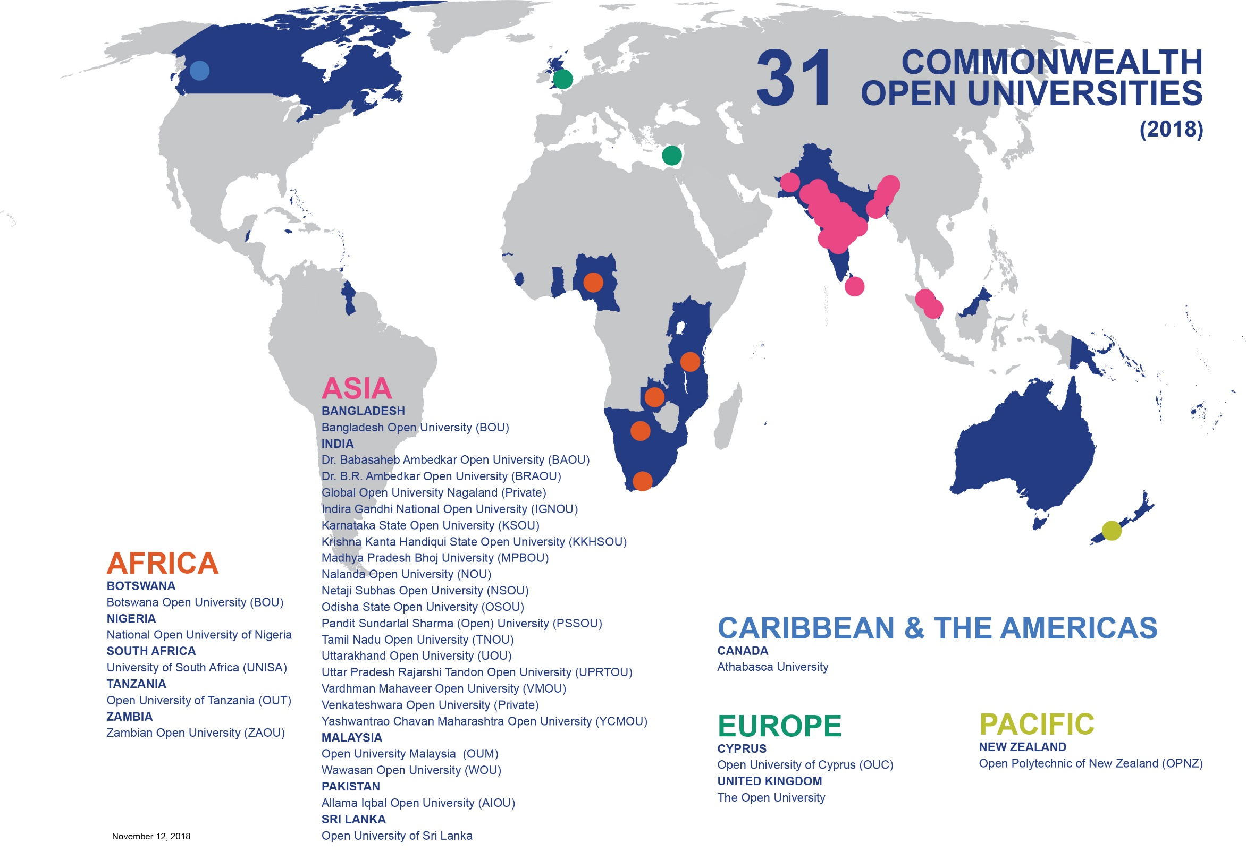


Slide 15
Costs: ODL in Mega Universities
Country | Institution | Enrolment | % of Campus Cost*
Pakistan | AIOU | 456.126 | 22
China | CCRTVU | 2,300,000 | 40
India | IGNOU | 1,187,100 | 35
UK | OU | 203,744 | 50
*Unit cost per student as a percentage of the average for other universities in the country, NKC, 2004.

Slide 16
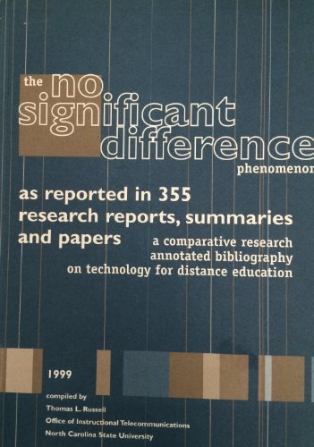

Slide 17
3
Open Educational Resources (OER) are the answer to closed and costly textbooks
PARADIGM
SHIFT

Slide 18
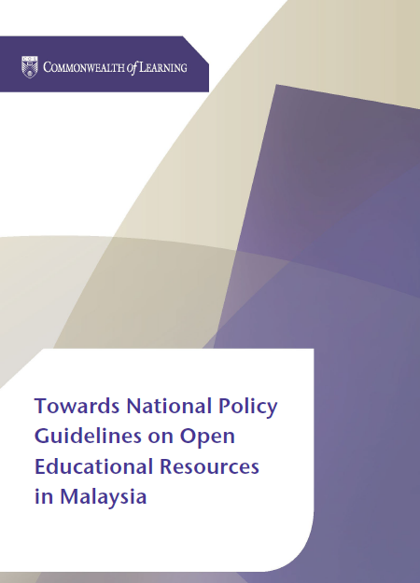


Textbooks: Problem of Cost
In Malaysia, 76.4% students did not buy a textbook because it was expensive
73% students in Bangladesh depended on photocopied materials, as the cost of textbooks is prohibitive
Notes:
Malaysian students spend about 190 MYR per year, which is over MYR 234,871,160 annually.
Student spend on average BDT 1,850 per year, which is over 258 million BDT per year in Bangladesh

Slide 19
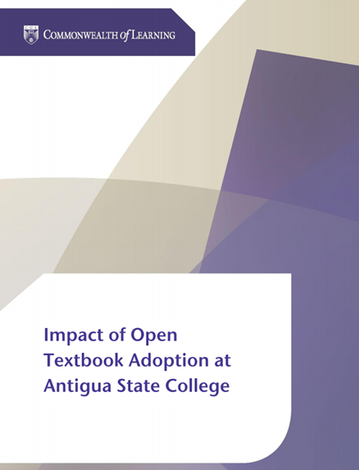

Antigua and Barbuda
Students saved between 75 to 88 ECD per course per semester by using open textbooks
Supplementing textbooks with OER improved student performance by 5.5%

Slide 20



Impact of OER Policy
165 universities participate in the OER curation, development and sharing

Slide 21
4
The digital divide can be transformed into a digital dividend
PARADIGM
SHIFT

Slide 22
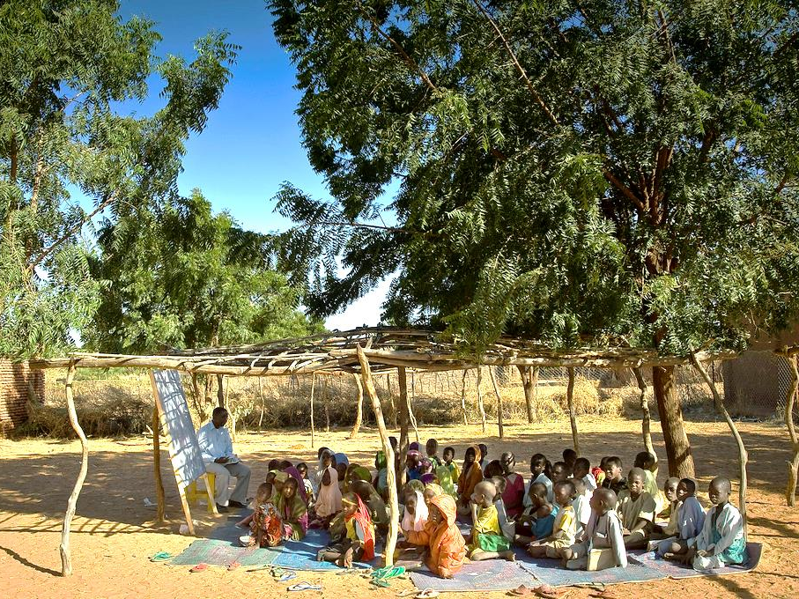
Photo credit: EU Humanitarian Aid and Civil Protection (CC BY-SA 2.0)

Slide 23


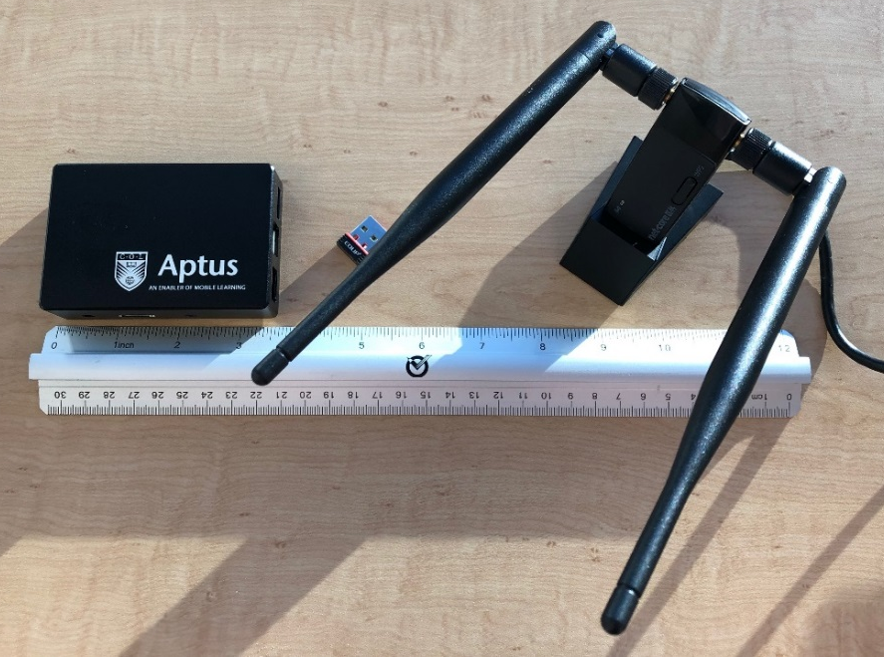
‘The capabilities that Aptus had to offer Fiji just blew me away. It was dynamic [and] at the same time user friendly.’
Matai Tagicaki
Education Specialist
Fiji Higher Education Commission

Slide 24
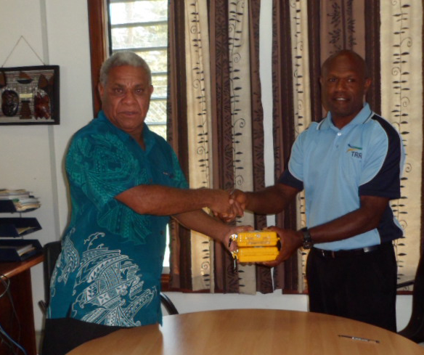
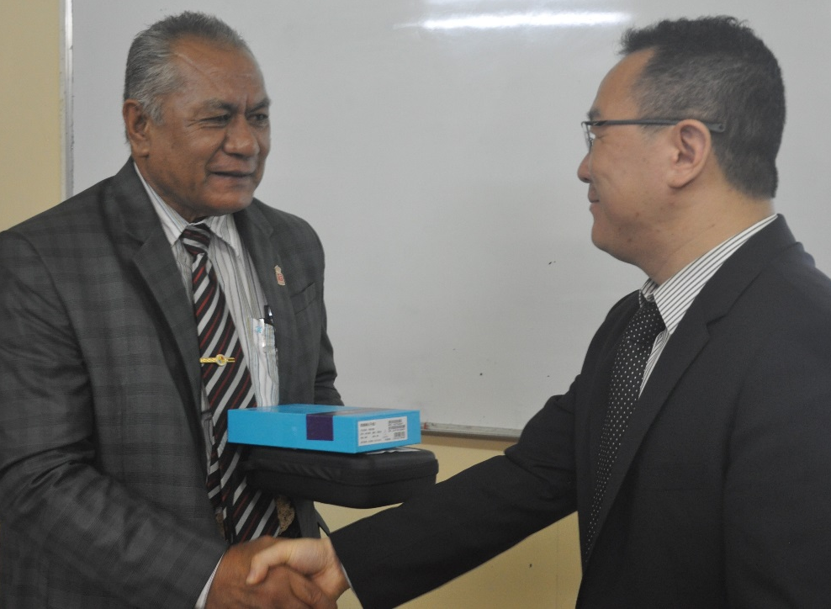



Notes:
Ministry of Education, Vanuatu
“…it is timely to have your new device to bring the government ICT project to the next level of elearning materials for students throughout the archipelago”.
TONGA
Aptus devices sent to assist the Ministry of Education, Tonga in restoring classroom teaching in Tongan schools and colleges, following Cyclone Gita.

Slide 25
5
Literacy is not always a precondition for Learning
PARADIGM
SHIFT

Slide 26

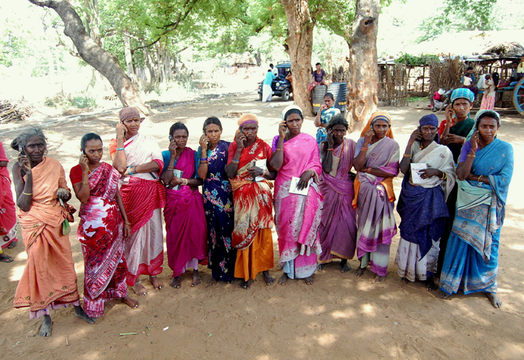

Every $1 invested resulted in $16 worth of income and assets.
Notes:
These women are part of COL’s L3F under which they have learnt agriculture and enterprise development skills using basic mobile phones. Because of this they have established companies in agriculture and livestock in which they are shareholders. They have generated enough assets within a space of three years.
Economic Times, Aug 18, 2017, The Big Farm to Fork Idea that Cuts wastage , ups farmer income

Slide 27


1% increase in empowerment 2.3% increase in profit.
Notes:
KENYA
This L3F project runs in 11 Commonwealth countries. Studies have found that learning leads to empowerment and that for 1% increase in women’s empowerment in Kenya, there was a 2.3% profit in agri-enterprises

Slide 28
6
The social capital of the mother is the most important determinant in bringing girls to school
PARADIGM
SHIFT

Slide 29




Slide 30







Notes:
Thanks to grants from the governments of Australia and Canada, COL will train 45000 girls and women in five countries: Bangladesh, India Pakistan, Mozambique and Tanzania. You’ll be pleased to note that in the first eighteen months alone, over 29,000 girls have been trained in various skills and 5, 260 girls have found new sources of income generation.

Slide 31

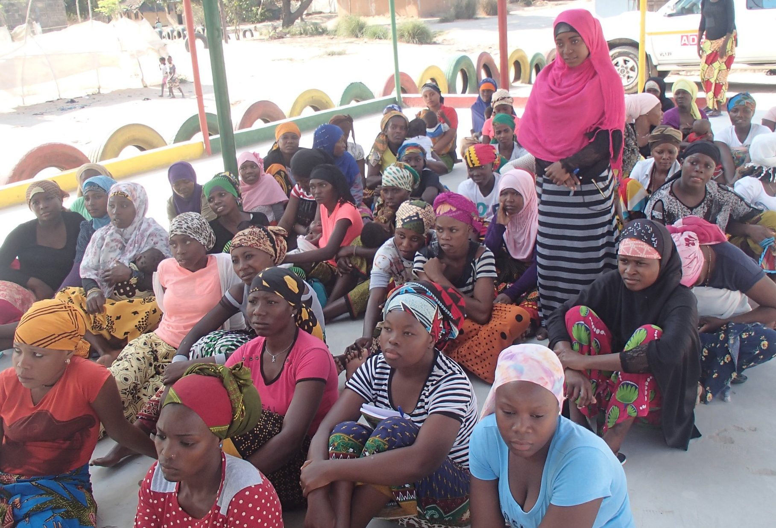
Community involvement prevented Fatima’s
early marriage in Mozambique

Slide 32

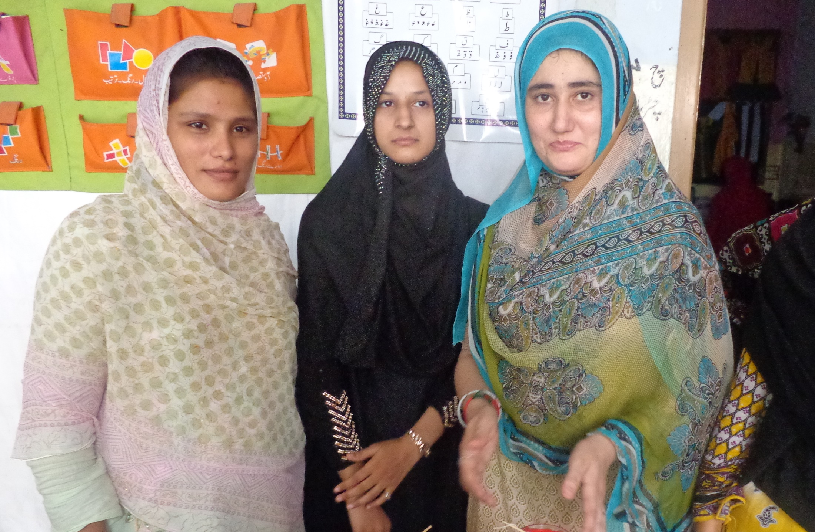
Meet Samina, Mother, Pakistan
When I was young, my parents used to beat me to go and labour with them. So, I could not get education, but now a new hope is developed in me…. And I will send my daughter to the nearest school.

Slide 33
Towards SDG 4

Slide 34
ICT by itself will not help us achieve SDG 4

Slide 35
We need to
Harness the potential of appropriate and affordable technologies
Move beyond conventional pedagogy
Foster innovations
Adopt a targeted approach to involve the community

Slide 36


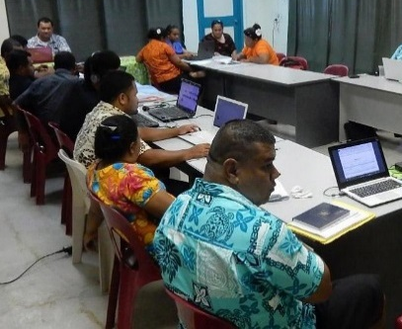
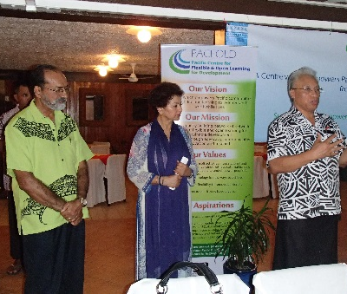
Thank You
for your contributions
col.org

