Slide 1

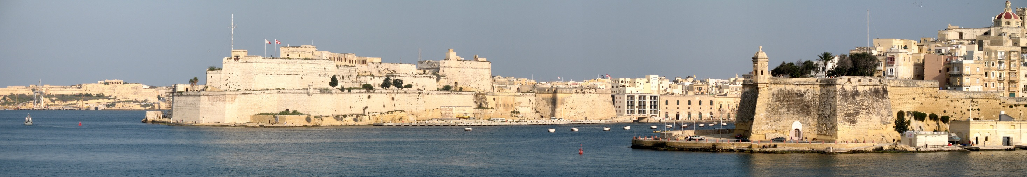


Europe Open Educational Resources Regional Consultation
23-24 February, 2017 | Valletta, Malta
OER for Inclusive and Equitable Quality Education: From Commitment to Action
Professor Asha Kanwar,
Sanjaya Mishra and Venkataraman Balaji
Commonwealth of Learning, Canada
Notes:
Source: https://commons.wikimedia.org/wiki/File:Malta_Valletta_Panorama_10.jpg

Slide 2
Plan
Background
Government & Stakeholder Surveys
Regional Consultation: Asia
OER in the Commonwealth
Towards the 2nd World OER Congress & Beyond

Slide 3


Slide 4
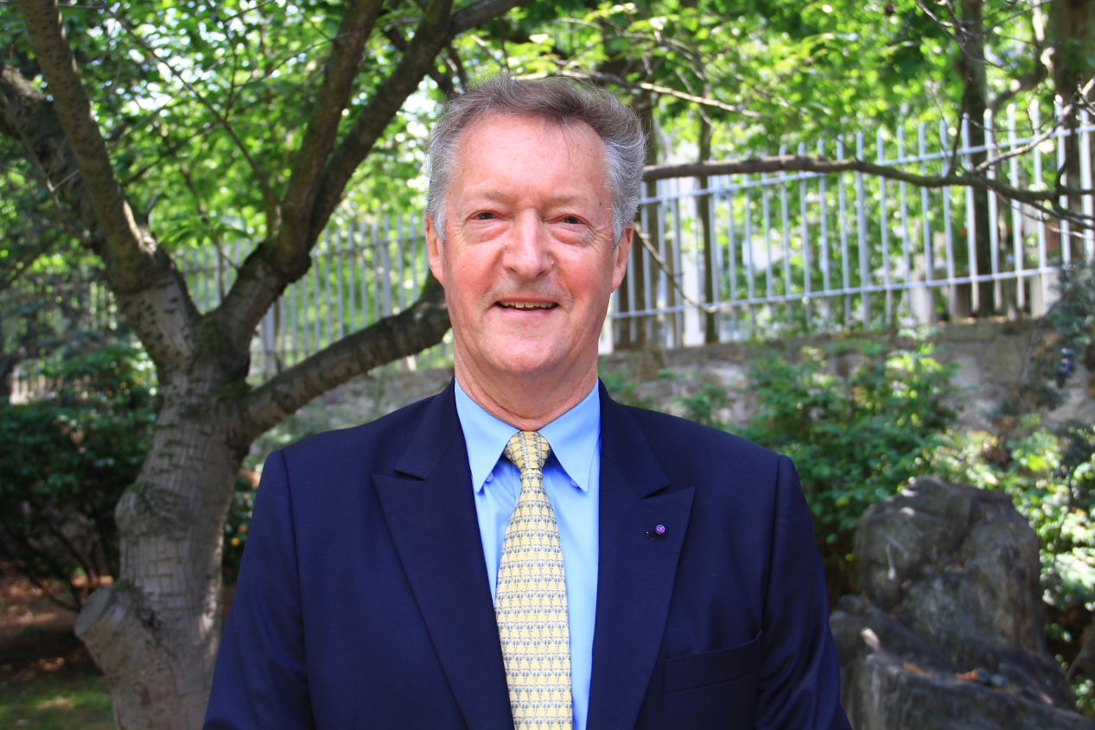
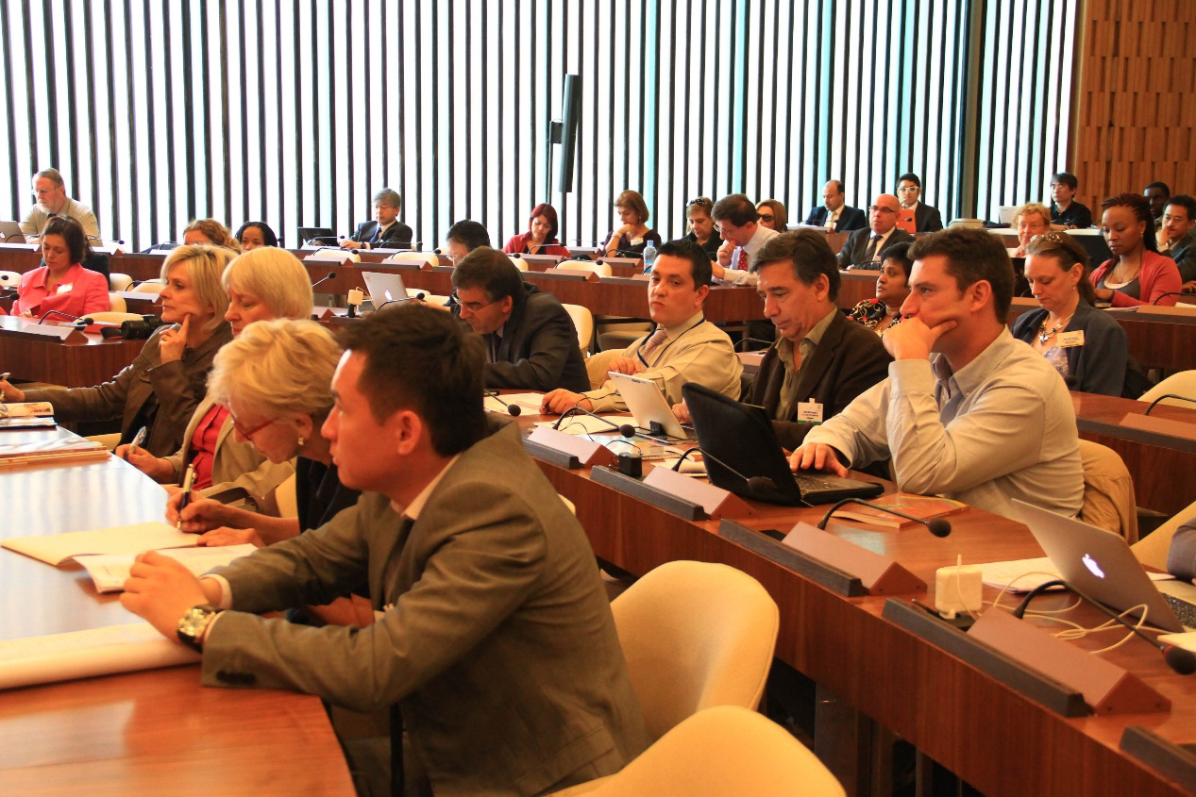
World OER Congress – Paris 2012
Sir John Daniel, Former President of COL
The Congress at UNESCO HQ Paris
Image source (CC-BY): http://www.unesco.org/new/en/communication-and-information/resources/multimedia/photo-galleries/open-educational-resources/world-open-educational-resources-congress-in-photos/

Slide 5

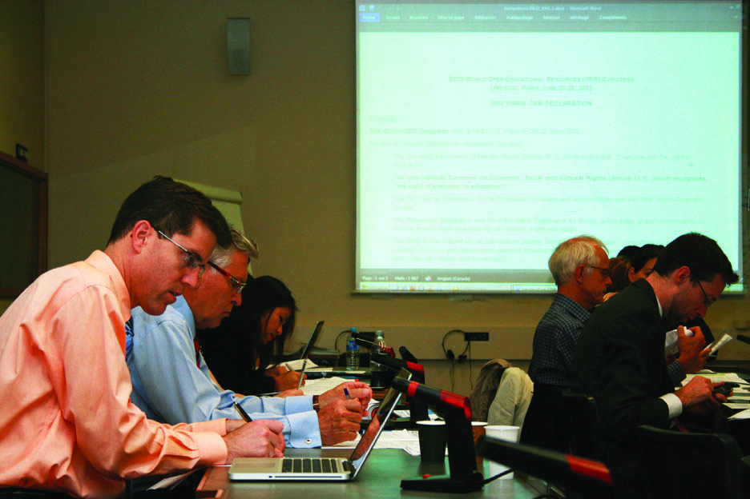
Paris OER Declaration 2012
Foster awareness and use of OER
Encourage the development and adaptation of OER in a variety of languages and cultural contexts
Encourage the open licensing of educational materials produced with public funds
The 2012 Paris OER Declaration drafting group at UNESCO Headquarters, Paris, France
^{Photo: CC-BY Davide Storti}

Slide 6
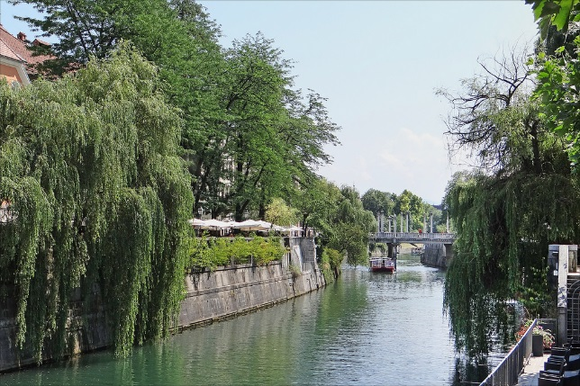
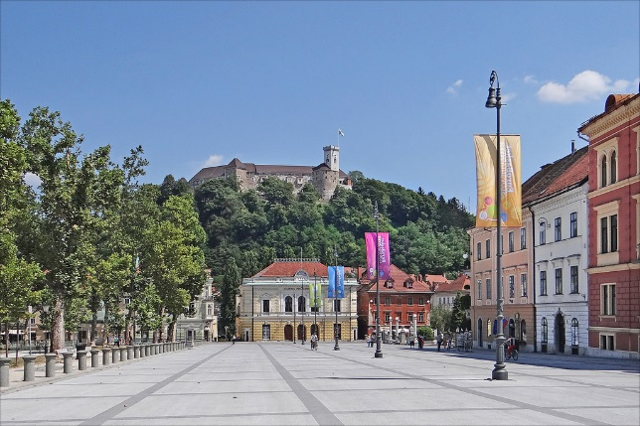
2nd World OER Congress
Image Source (CC BY):https://www.flickr.com
Ljubljana, Slovenia – 18-20 September 2017

Slide 7






The Road to Ljubljana
ASIA
Asia e University: ​​1-2 December, 2016
EUROPE
Malta Ministry for Education and Employment:
​​23-24 February, 2017
MIDDLE EAST & NORTH AFRICA
Qatar Foundation: ​​27-28 February, 2017
AFRICA
Ministry of Education, Mauritius:
​​2-3 March, 2017
AMERICAS
UNICAMP: ​​3-4 April, 2017
​
PACIFIC
Open Polytechnic of New Zealand:
​​29-30 May, 2017
​

Slide 8


Slide 9
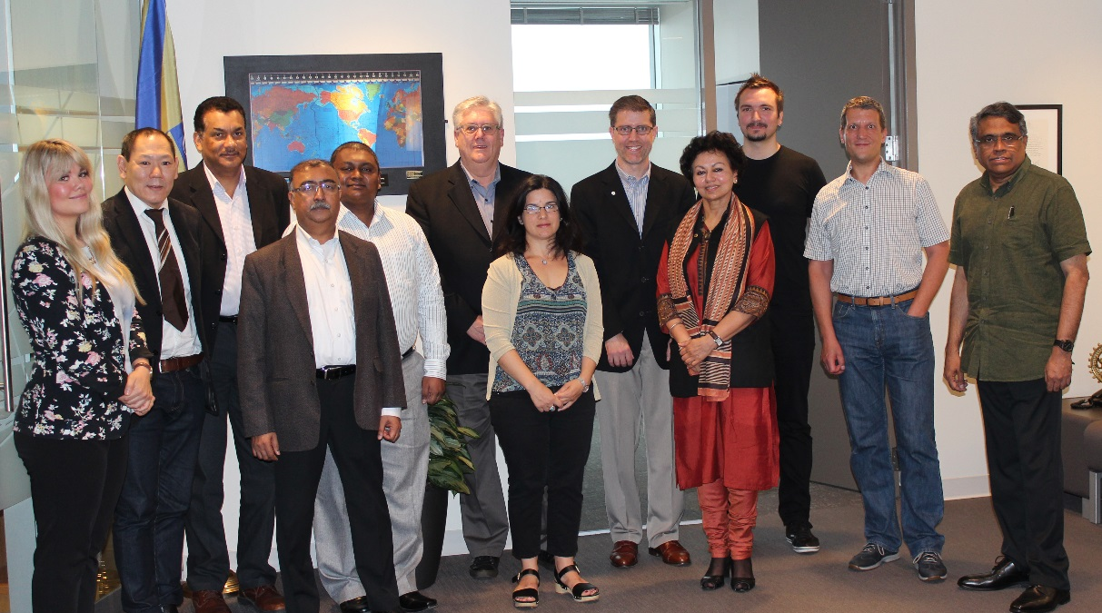
Task Team
Notes:
Dr. Venkataraman Balaji, Director: Technology and Knowledge Management, Commonwealth of Learning (Chair of Task Team)
Mr. John Lesperance, Education Specialist: Virtual University for Small States of the Commonwealth, Commonwealth of Learning
Dr. Ishan Abeywardena, Adviser: Open Educational Resources, Commonwealth of Learning
Mr. Joe Hironaka, Programme Specialist, Communication and Information Sector, UNESCO
Ms. Zeynep Varoglu, Programme Specialist, Communication and Information Sector, UNESCO
Dr. Cable Green, Director of Open Education, Creative Commons Global
Dr. David Porter, Associate Vice President, Education Support and Innovation, BCIT and incoming CEO of eCampusOntario
Dr. TJ Bliss, Program Officer, Education Program, Hewlett Foundation

Slide 10
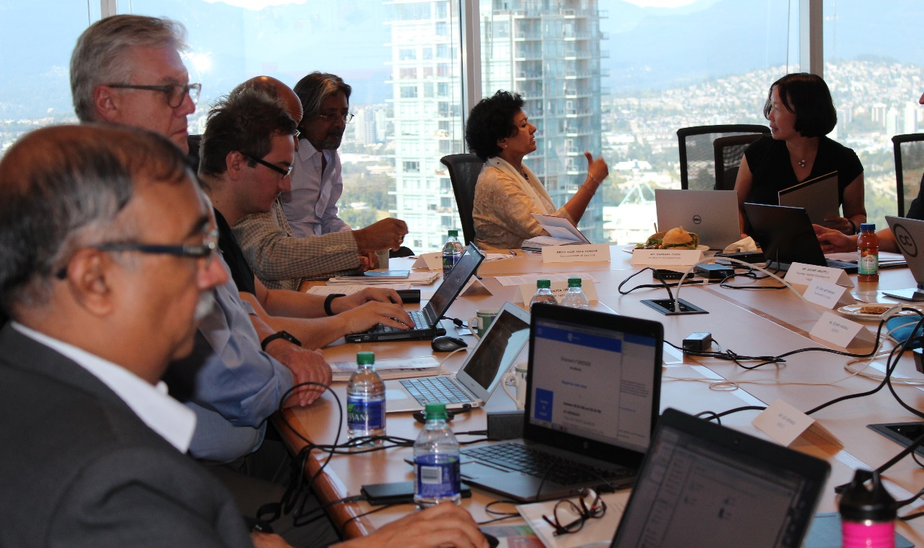
Steering Committee
Notes:
Professor Asha Kanwar, President and CEO, Commonwealth of Learning (Chair)
Dr. K Balasubramanian, Vice President, Commonwealth of Learning
Dr. Indrajit Banerjee, Director: Knowledge Societies Division, Communication and Information Sector, UNESCO
Dr. David Atchoarena, Director: Division for Policies and Lifelong Learning Systems, UNESCO
Mr. Gasper Hrastelj, Deputy Secretary-General, Slovenian National Commission for UNESCO
Mr. Davor Orlic, UNESCO Chair Team on Open Technologies for OER and Open Learning

Slide 11




Partners

Slide 12

OER: Then and Now
2017
2012
Focus was on Governments
Policies
Commitment
Additional focus on stakeholders
Strategies
Concrete action

Slide 13
Objectives of RCOER
Raise regional awareness about the importance of OER and its relationship to SDG4
Identify strategies and solutions to overcome the challenges or barriers to mainstreaming OER
Agree on actions for consideration at the 2nd World OER Congress
Notes:
Where

Slide 14
The Surveys

Slide 15
Two Surveys
  A government survey sent by COL to Member States
  UNESCO sent the survey in English & French to Member States
  A stakeholder survey, which COL posted online at http://fluidsurveys.com/s/rcoer-stakeholdersurvey/ and publicized via social media.
Notes:
made available to COL Focal Points and to National Delegations in UNESCO.

Slide 16
Government Responses: 55 countries
Region | Government
Africa | 22
Middle East and North Africa | 5
Asia and Pacific | 12
Europe and North America | 13
Latin America and Caribbean | 3

Slide 17
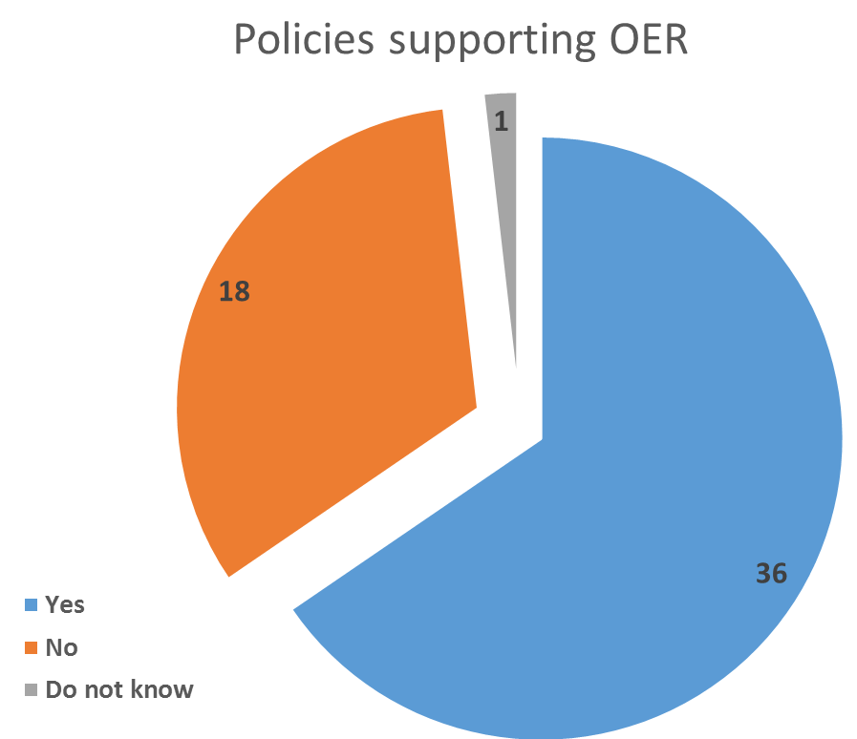
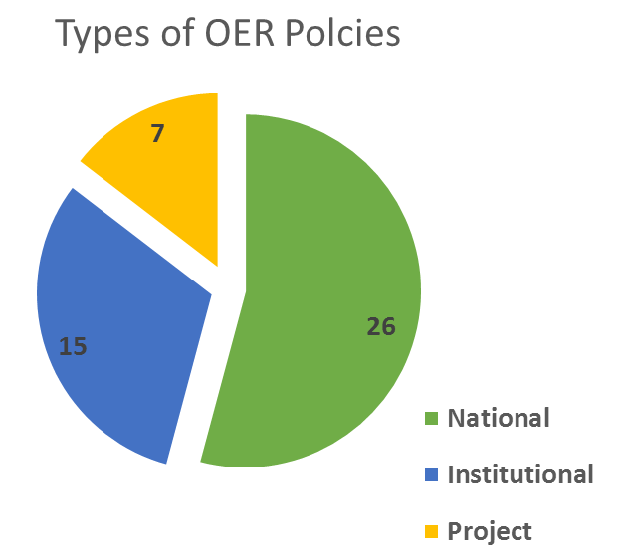
Key Findings from Government Survey

Slide 18
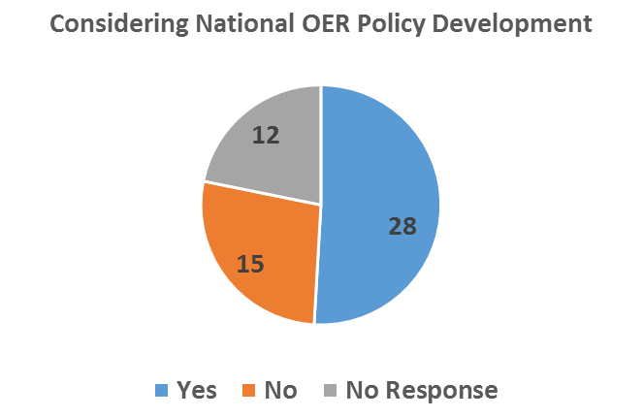
Key Findings from Government Survey

Slide 19
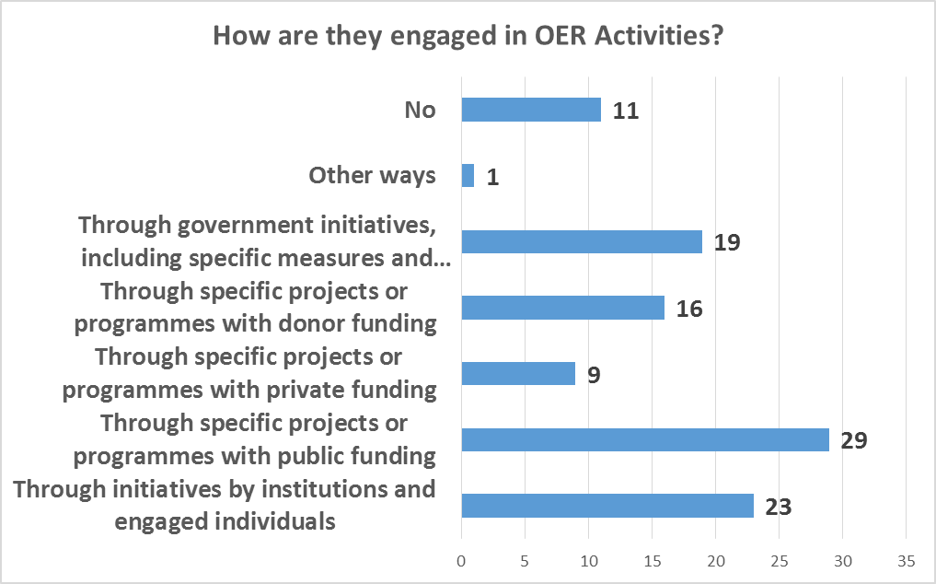
Key Findings from Government Survey

Slide 20
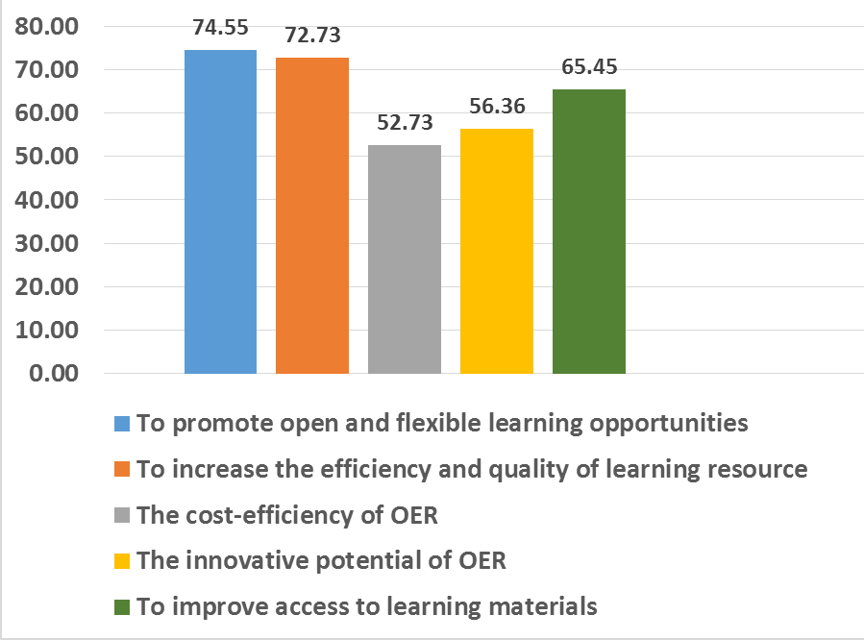
Key Findings from Government Survey
Benefits
Promote flexible learning
Improve quality of learning outcomes
Increase cost-efficiency
Notes:
Reasons for OER Activities

Slide 21
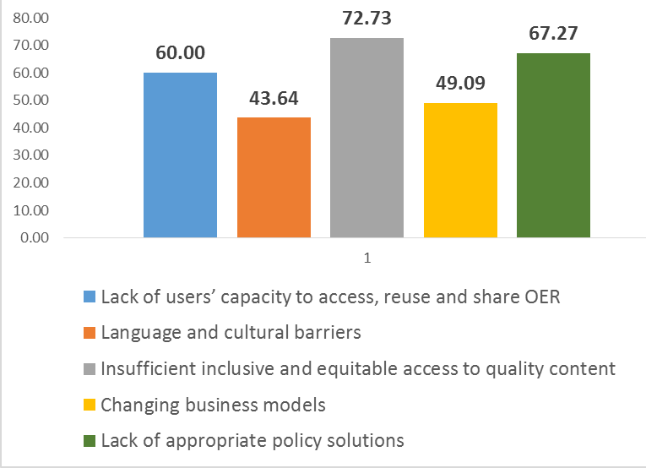
Key Findings from Government Survey
Barriers
Insufficient access to quality content (72.73%)
Lack of appropriate policies (67.27%)
Lack of users’ capacity (60%)
Unavailability of credible business models (49.09%)
Language and cultural barriers (43.64%)
Notes:
Government Survey Barriers

Slide 22
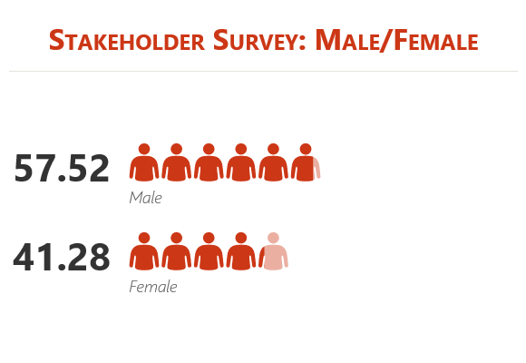
Stakeholder Responses: 499
Region | Stakeholder
Africa | 99
Middle East and North Africa | 6
Asia and Pacific | 247
Europe and North America | 115
Latin America and Caribbean | 32

Slide 23
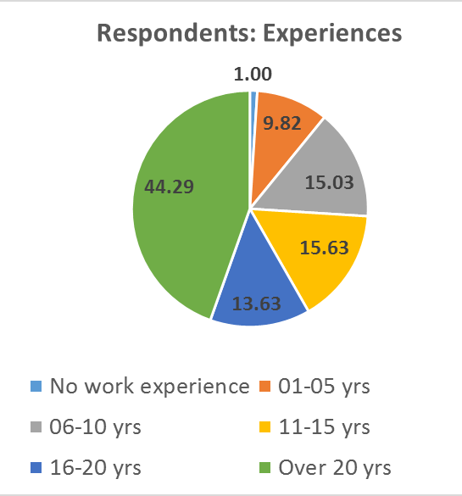
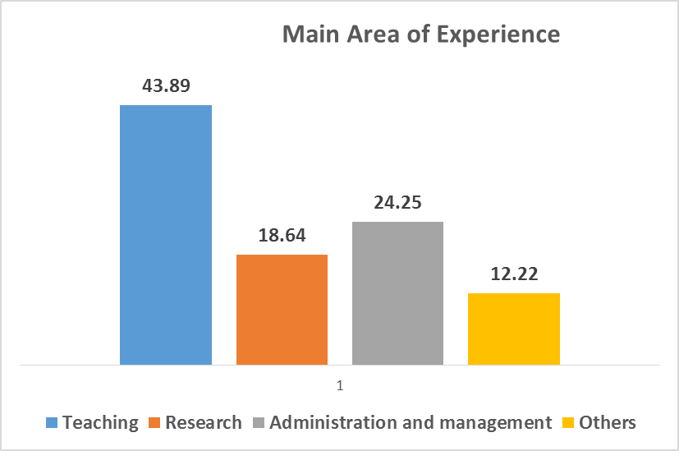
Stakeholder Responses

Slide 24
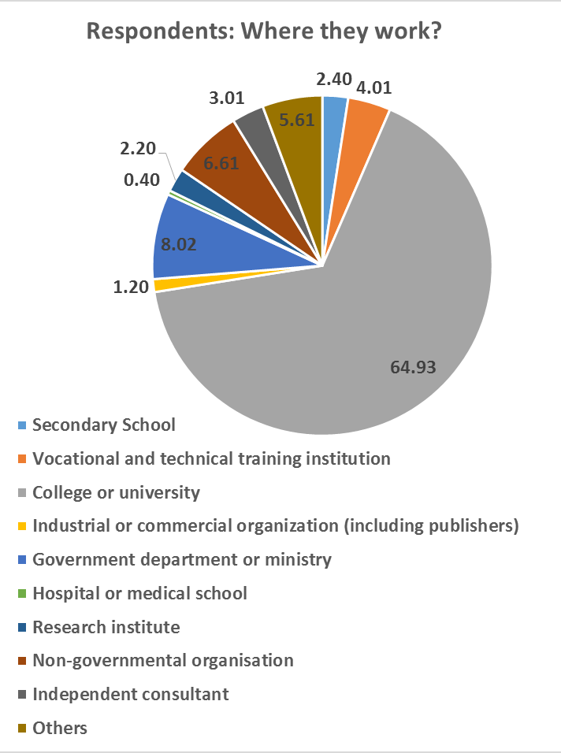
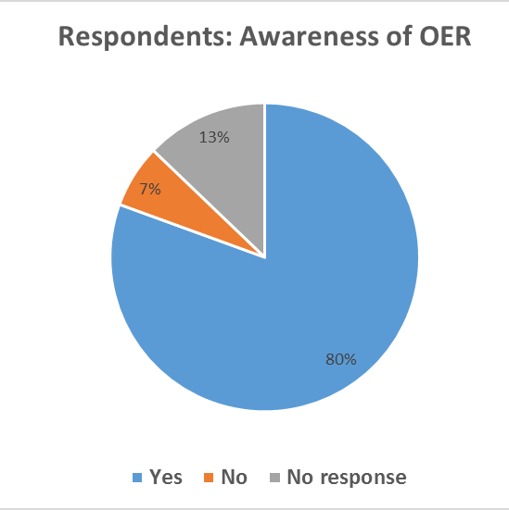
Stakeholder Responses

Slide 25
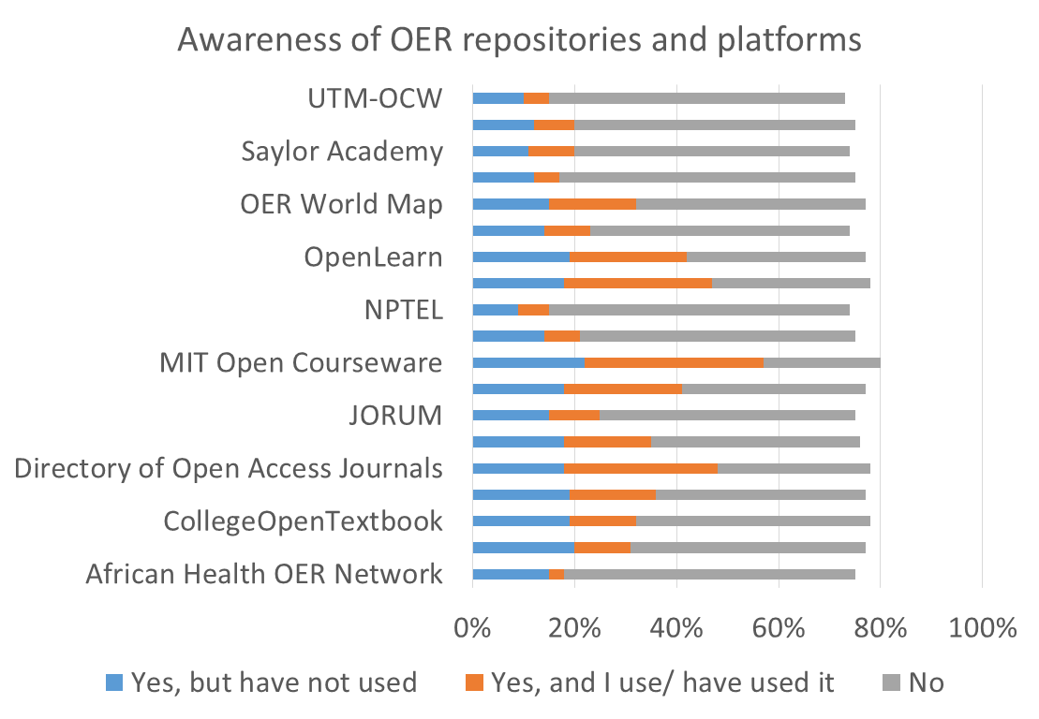
Stakeholder Responses

Slide 26
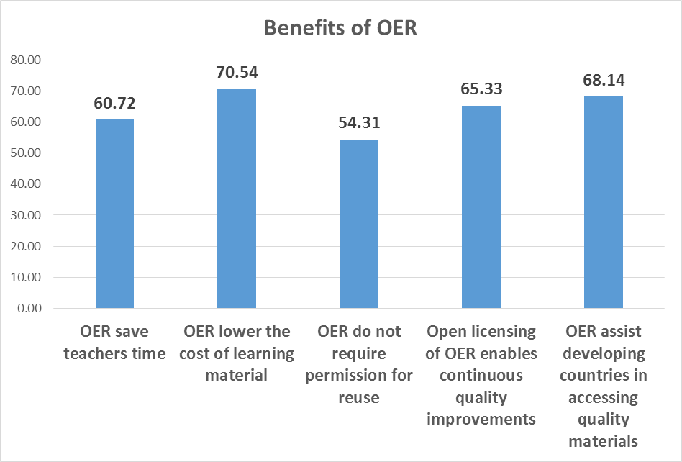
Stakeholder Responses
Benefits
Reduced costs of learning materials
Provides access to quality materials
Enables continuous quality enhancement
Save teachers time

Slide 27
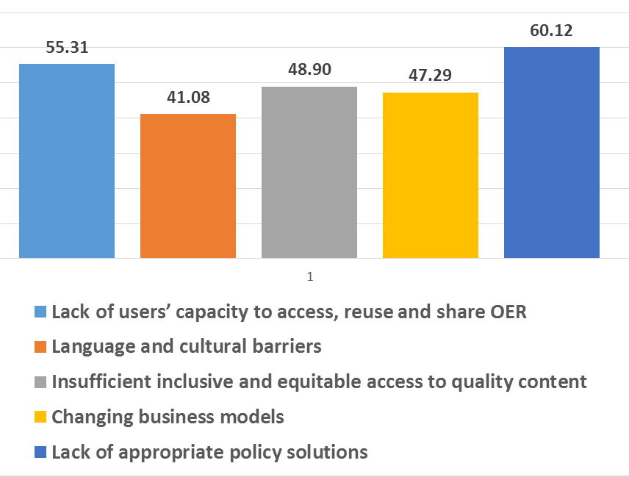
Stakeholder Responses
Barriers
Lack of policy (60.12%)
Lack of Capacity (55.31%)
Insufficient quality resources (48.9%)

Slide 28
Governments and Stakeholders:
Commonalities
Has the potential to lower cost of learning materials
Provides access to quality materials
Lack of policy solutions is a concern
Insufficient quality OER
Poor awareness and capacity of users

Slide 29
Different Focus?
Governments
Governments:
Credible Business Models
Language & Cultural Issues
Stakeholders:
Saves time for teachers
Enables continuous quality improvement

Slide 30
Regional Consultations

Slide 31
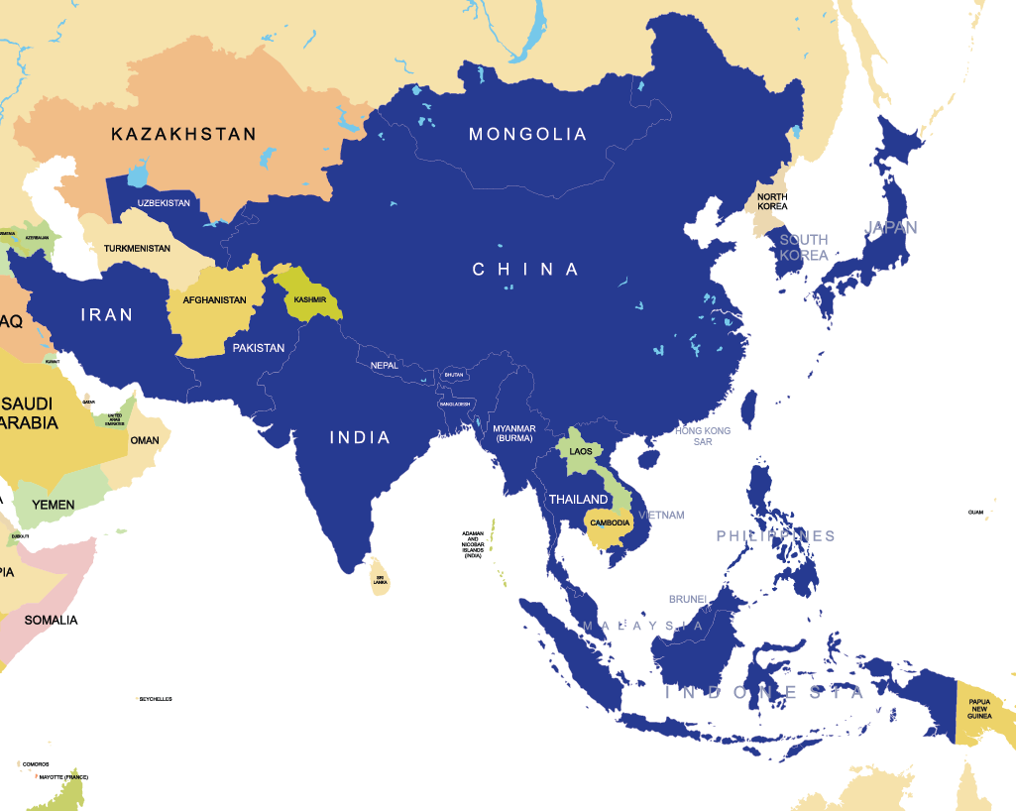
ASIA
Regional Consultation
1-2 December, 2016
20
Notes:
48 participants from 24 countries participated, including 20 countries from Asia.

Slide 32
Key Practices - Asia
Free supply of textbooks at school Level (Bangladesh)
NME-ICT follows CC BY-SA licence (India)
Commitment to OpenCourseWare in eLearning policy (Malaysia)
OER repositories in India, Indonesia, Malaysia, Pakistan, Philippines, Vietnam.

Slide 33
Barriers to OER - Asia
Low bandwidth and Internet access
Low attention to content for people with disabilities
Lack of awareness and capacity to use and contribute to OER
Lack of availability of OER in local languages
No national policy to guide OER

Slide 34
Actions: Stakeholders Identified
Governments
Educational Institutions
Content Developers
Quality Assurance Agencies
Publishers
Civil Society
Individuals and Teachers
Learner and Learner Associations
Parent Teacher Associations
International Cooperation

Slide 35
OER in the Commonwealth

Slide 36
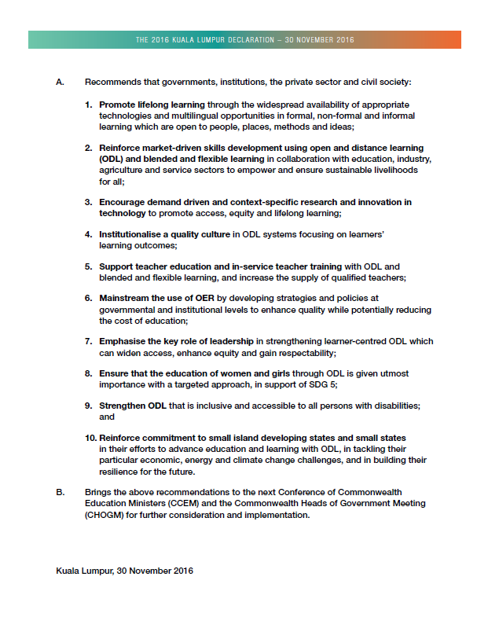

2016 KL Declaration
Mainstream the use of OER by developing strategies and policies at governmental and institutional levels to enhance quality while potentially reducing the cost of education

Slide 37

Key Findings - Benefits
OER saves cost for the students
OER empowers teachers with new tools and techniques
OER improves quality of teaching and learning

Slide 38
Key Findings - Barriers
Uneven awareness of OER
Lack of training
OER improves quality of teaching and learning
Scarcity of OER in audio and video

Slide 39
Towards 2nd World OER Congress & Beyond

Slide 40
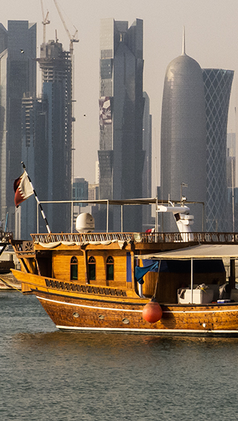
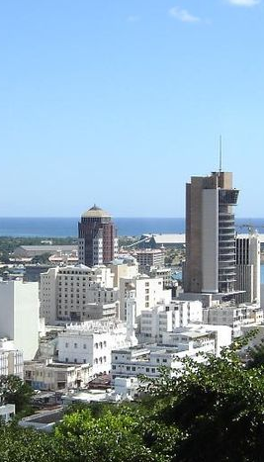
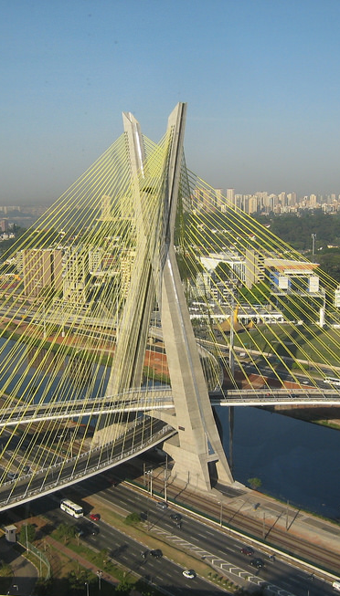
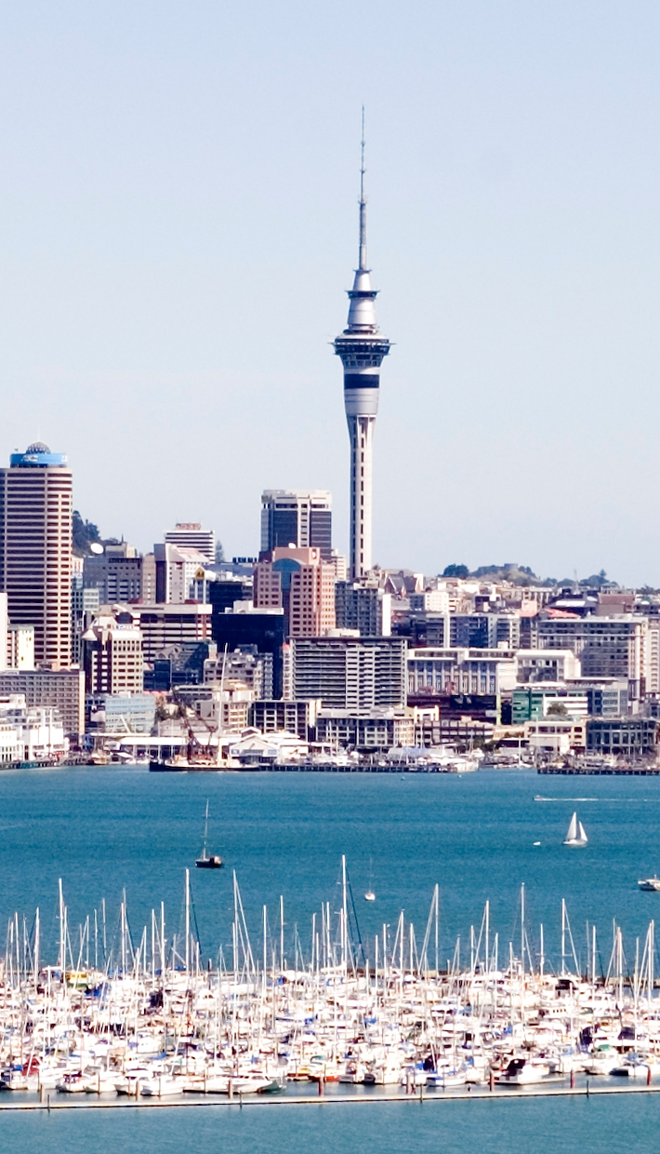
Next 4 Regional Meetings
Port Louis, Mauritius
Auckland, NZ
Doha, Qatar
Sao Paulo, Brazil
Notes:
https://upload.wikimedia.org/wikipedia/commons/8/8c/Corniche_Doha_Qatar.jpg
https://upload.wikimedia.org/wikipedia/commons/thumb/d/d9/Port_Louis_Skyline.JPG/800px-Port_Louis_Skyline.JPG
https://c1.staticflickr.com/4/3004/2863546891_ce2053ceab_b.jpg
https://upload.wikimedia.org/wikipedia/commons/6/60/Bayswater_Marina_Auckland_New_Zealand.jpg

Slide 41

Outcomes of the Regional Consultations
Global OER Survey Report
Synthesis of Actions
for consideration/ adoption

Slide 42
Progress after 2012?
More policies—institutional level
More awareness about the benefits of OER
More champions and advocates
More content available—repositories; but low awareness of repositories
Better ICT infrastructure and connectivity

Slide 43
What next?
Evidence-based advocacy
More capacity building
Targeted interventions
Continue to build and strengthen collaborations

Slide 44
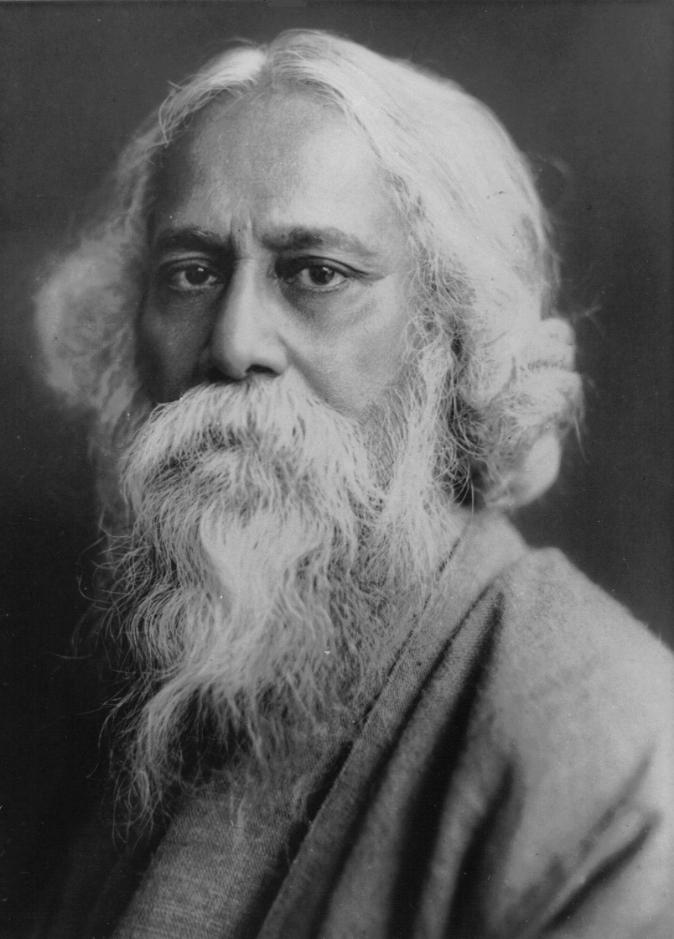
Where the mind is without fear and the head is held high
Where knowledge is free
Tagore, 1910
OER for Inclusive and Equitable Quality Education:
From Commitment to Action
Photo credit: https://commons.wikimedia.org/wiki/File:Rabindranath_Tagore.jpg

Slide 45
Thank you

