Slide 1



Open Educational Resources:
Innovation in
Higher Education?
Professor Asha Kanwar
President & CEO
January 26, 2017 | University of Ibadan, Nigeria

Slide 2
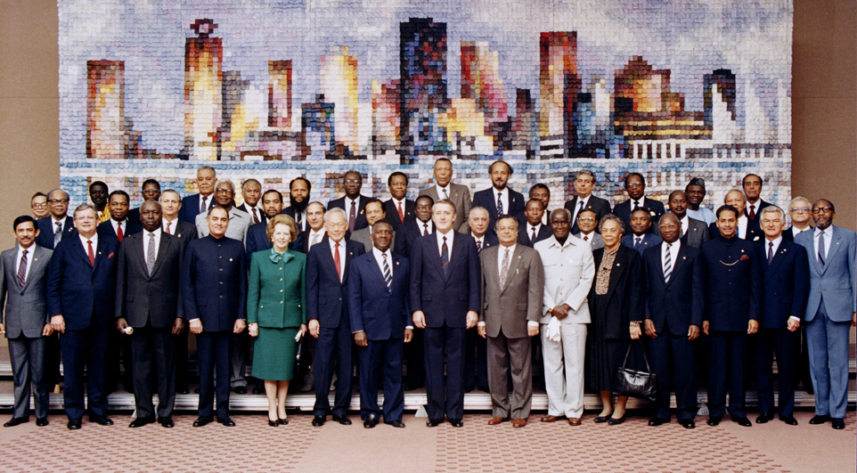
Copyright Commonwealth Secretariat
Commonwealth Heads of Government Meeting
Vancouver, 1987

Slide 3


Where is it?
Metro Vancouver
(HQ)
New Delhi
(CEMCA)

Slide 4
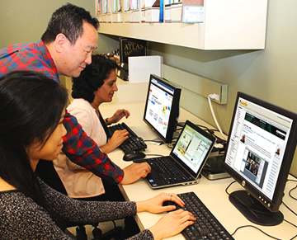
What is it for?
To help Commonwealth governments and institutions use various technologies to improve access to learning for development.

Slide 5
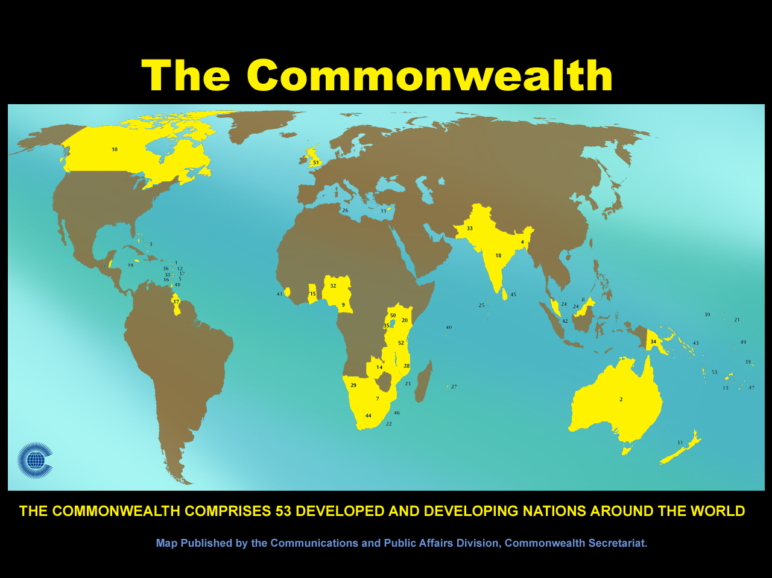

Slide 6

Thank you, Nigeria

Slide 7
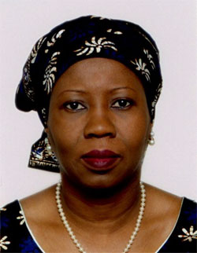
HE Mariam Katagum

Slide 8
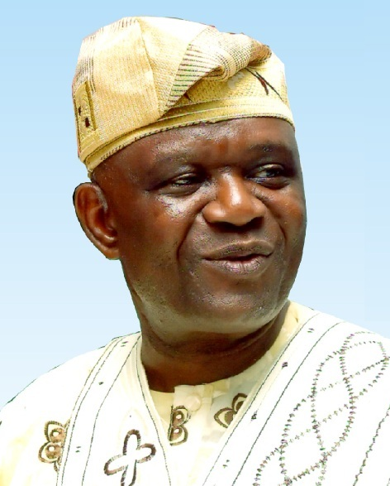
COL Fellow: Prof O Jegede

Slide 9
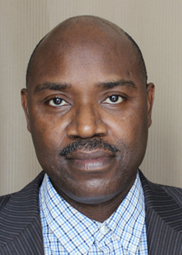
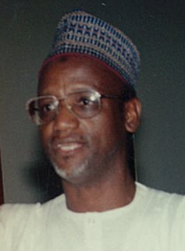
Alhaji Hafiz S. Wali
Dr. A. Umar

Slide 10

Photo source: http://www.nti-nigeria.org/
ODL in Teacher Training: NTI

Slide 11
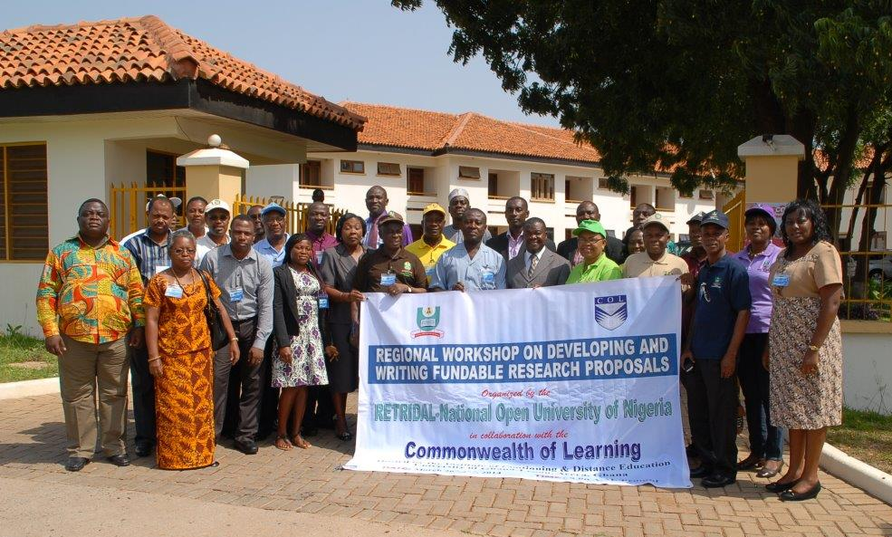
RETRIDOL
Regional Centre

Slide 12






UNESCO-COL Chairs in ODL and OER

Slide 13
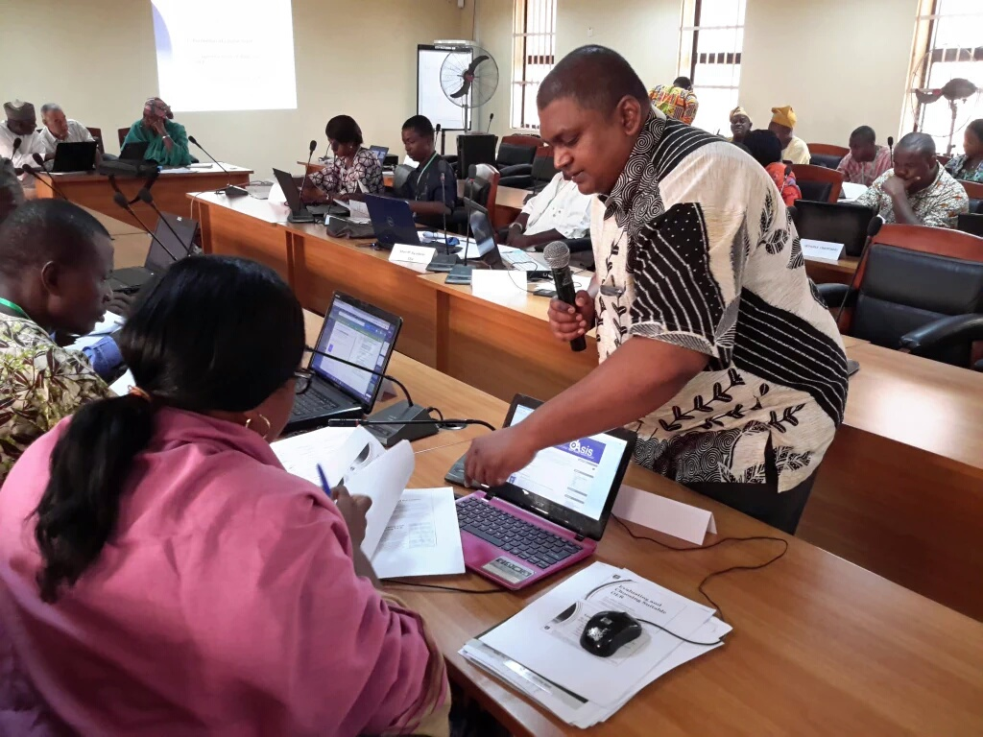
Yaba College of Technology (YCT), Lagos, Nigeria, 2016

Slide 14




2013
Abuja, Nigeria
Open Learning for Development:
Towards Empowerment and Transformation

Slide 15
Plan
Context
3 Generations of Open Education
OER as an Innovation
Global Trends
Way Forward

Slide 16

Context

Slide 17

A Young Nigeria
Nigeria has 64.1million young people between the ages of 15-35: 51.6 % female
Source: National Bureau of Statistics, 2012 National Baseline Youth Survey
Notes:
Nigeria has a large youthful population. The National Youth Policy defines a ‘Youth’ as a Nigerian citizen between the ages 18 - 35 years. However, in this survey, age bracket 15 – 35 was considered. The population of youths (15 - 35) in the country was estimated to be 64.1 million with females constituting 51.6 per cent while that of youths (18 - 35) was 52.2 million with female constituting 52.8 per cent.

Slide 18
Tertiary Gross Enrolment Ratio in Nigeria 1999 - 2011
Source: UNESCO Institute of Statistics, last accessed on January 23, 2017

Slide 19
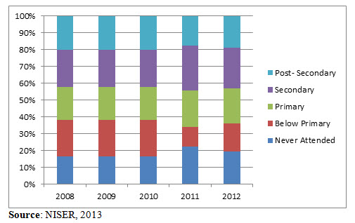
Nigeria: National Youth Unemployment Figures by Education, 2008-2012
Source: Brookings Institution, Youth Unemployment in Nigeria: A Situation Analysis (2014)
Notes:
Over 40% of the unemployed youth have at least secondary education.

Slide 20
Nigeria: ICT Statistics 2000-2015
Source: ITU Statistics, last accessed on January 19, 2017

Slide 21
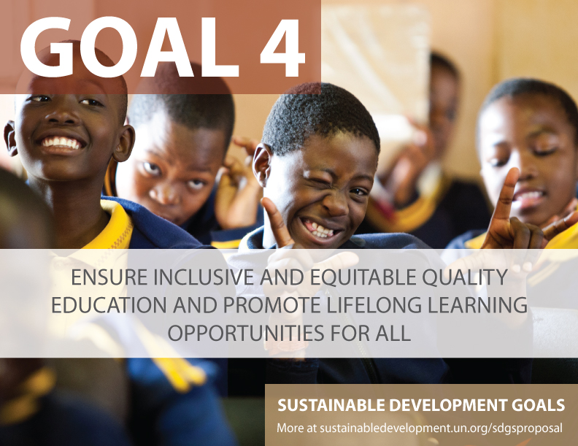

Slide 22
Education 2030:
Framework for Action
Develop policies and programmes for the provision of quality distance learning in tertiary
education, with appropriate financing and use of technology, including the Internet, massive
open online courses and other modalities that meet accepted quality standards to improve access.

Slide 23
3 Generations of Open Education

Slide 24

The Philosophy of ‘Open-ness’
Open as to people,
Open as to places,
Open as to methods, and, finally,
Open as to ideas
  Lord Crowther

Slide 25





The Rise of Open Universities

Slide 26
Opening up HE in Nigeria
The Correspondence and Open Studies Unit (COSU) of University of Lagos started in 1974
National Teachers’ Institute (NTI) started as a distance education institute in 1976
The Distance Learning Institute of University of Ibadan started in 1979
NOUN was established in 1983 by an Act of the National Assembly--suspended a few weeks later--revived in April 2001
Source: Ajadi, Timothy Olugbenga, Ibrahim Olatunde Salawu, and Femi Adetunji Adeoye. "E-learning and distance education in Nigeria." TOJET 7.4 (2008).
Notes:
http://www.tojet.net/articles/v7i4/747.pdf
Distance education in Nigeria dates back to 1887, when several students enrolled for the University of London matriculation examination. The University of Lagos established the Correspondence and Open Studies Unit in 1973, which is now the Distance Learning Institute. This was subsequently followed by other universities largely for teacher education, and the National Teacher’s Institute was established in 1978 as the dedicated distance education institution for teacher training. NOUN was established in 1983 by a federal act and then revised again 2001.

Slide 27
Nigeria: Dual Mode Institutions
1 | University of Ibadan, Ibadan | Distance Learning Centre
2 | Obafemi Awolowo University, Ile-Ife | Centre for Distance Learning
3 | University of Lagos, Akoka | Distance Learning Institute
4 | University of Maiduguri, Maiduguri | Centre for Distance Learning
5 | Modibbo Adama University of Technology, Yola | Centre for Distance Learning
6 | University of Abuja, Abuja | Centre for Distance Learning and Continuing Education
7 | Ladoke Akintola University of Technology, Ogbomoso | LAUTECH Distance Learning Centre
8 | Ahmadu Bello University Zaria | Distance Learning Centre ABU, Zaria

Slide 28
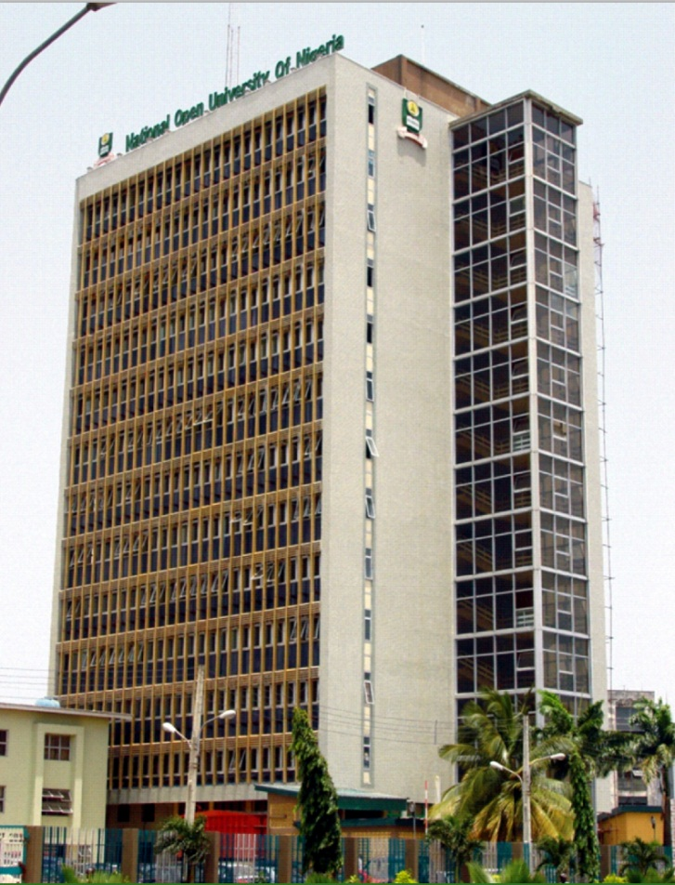

NOUN
(180,000 students)

Slide 29

Key Developments in the
2nd Generation
1984: first electronic
courses
1989: Internet
1991: WWW
1994: first online MBA (Athabasca)
1996: first web-based
course delivery
1999: learning objects; LMS’s

Slide 30

Open Education:
Second Generation
Wider Use of Web and Online Technologies
Interactivity: Key Aspect
Much higher level of personalization through technology mediation
Learning Objects

Slide 31
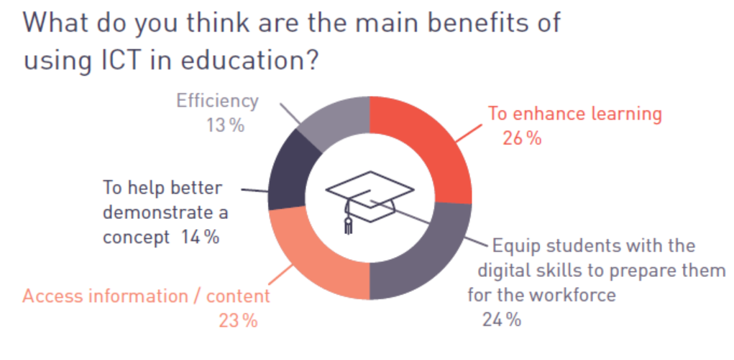
eLearning Africa 2015

Slide 32

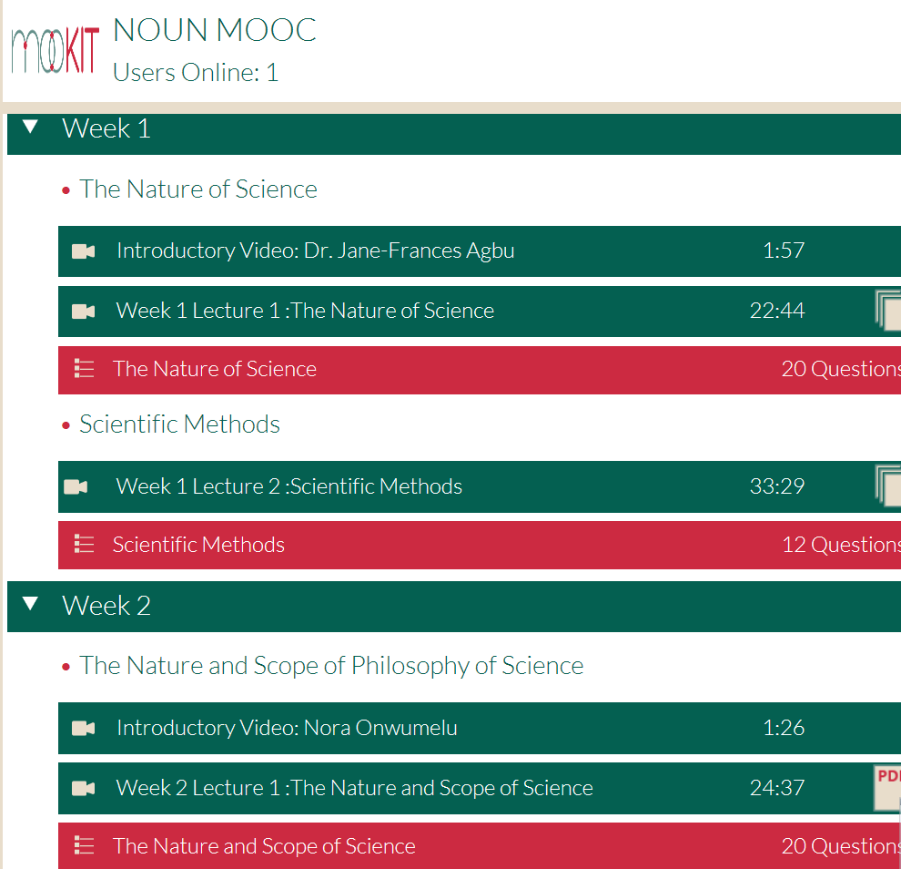
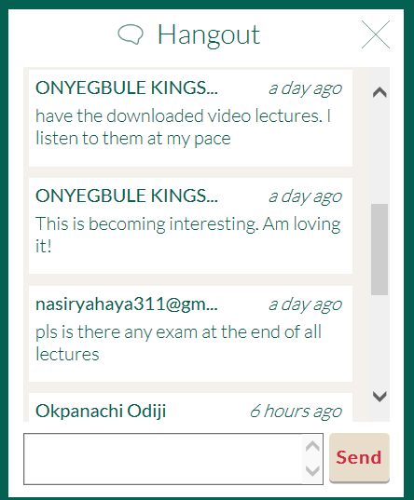
First MOOC by NOUN
Started 27th June 2016,
eight weeks
About 500 learners
in this offering

Slide 33
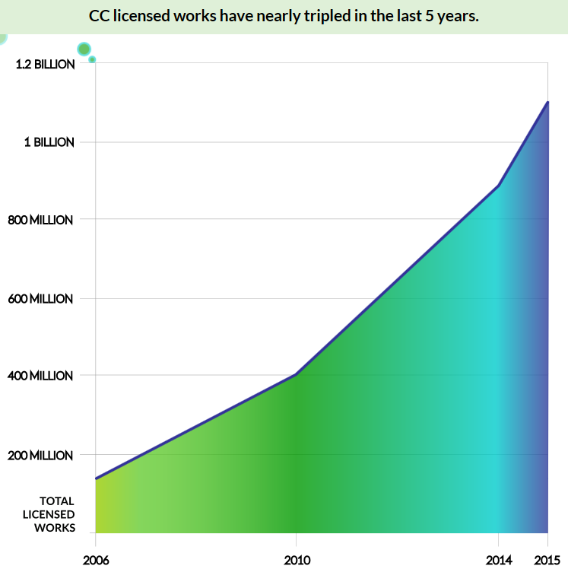
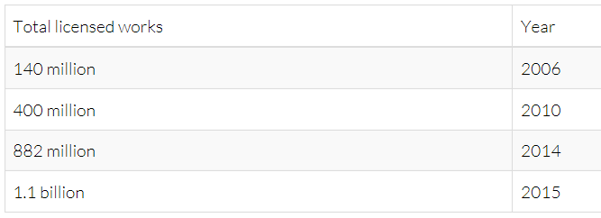
3rd Generation: Rise of OER
Source: https://stateof.creativecommons.org/report

Slide 34
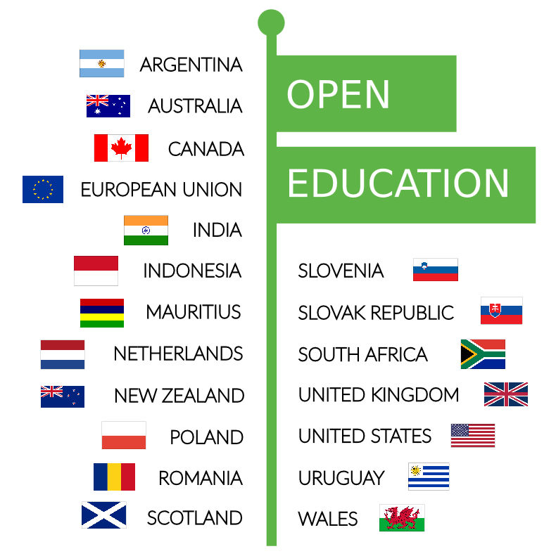
19+ Countries with OE Policies
FIJI introduced OER policy in January 2016
Source: https://stateof.creativecommons.org/report

Slide 35







ICT in Education and OER in Africa
ICT in Ed Policy (Year)
Ghana | YES | 2008
Kenya | YES | 2006
Namibia | YES | 2005
Nigeria | YES | 2010
Rwanda | YES | 2008
South Africa | YES | 2004
Tanzania | YES | 2007
Zambia | YES | 2007
Institutions with OER policies:

Slide 36

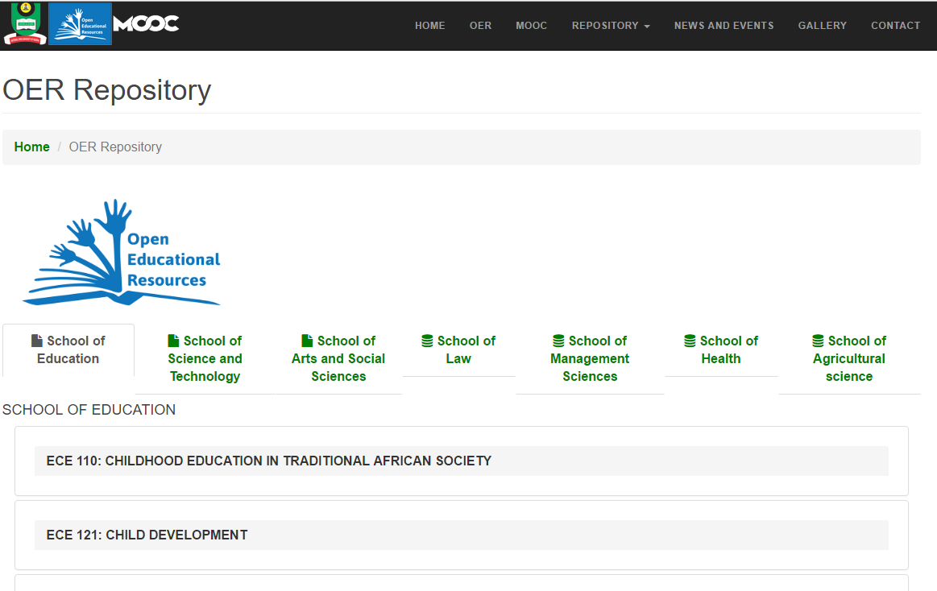
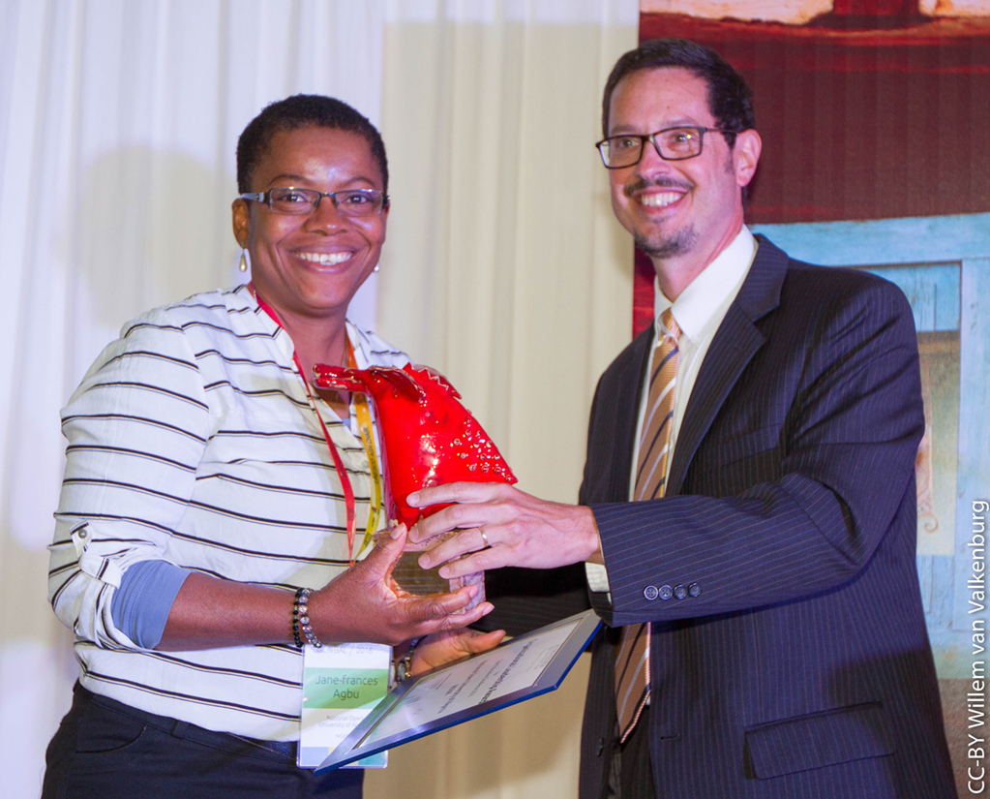
National Open University of Nigeria (NOUN)
OER policy
OER Repository
50% of Curriculum to be shared as OER
Plans to release 40 courses by December 2017

Slide 37
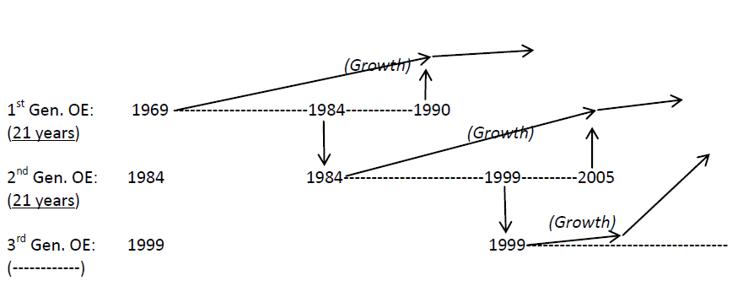
B.N. Koul

Slide 38
OER as Innovation

Slide 39
Open Educational Resources (OER)
OER are teaching, learning and research materials in any medium that reside in the public domain or have been released under an open license that permits their free use and in some instances, re-purposing by others
Atkins, Brown & Hammond, 2007

Slide 40
The 5 Rs of Open Content
RETAIN
make, own, and control copies of the content
REUSE
use the content in a wide range of ways
REVISE
adapt, adjust, modify, or alter the content itself
REMIX
REDISTR-IBUTE
combine the original or revised content with other open content to create something new
share copies of the original content, your revisions, or your remixes with others
David Wiley
Notes:
(e.g., download, duplicate, store, and manage)
(e.g., in a class, in a study group, on a website, in a video)
(e.g., translate the content into another language)
(e.g., incorporate the content into a mashup)
(e.g., give a copy of the content to a friend)

Slide 41
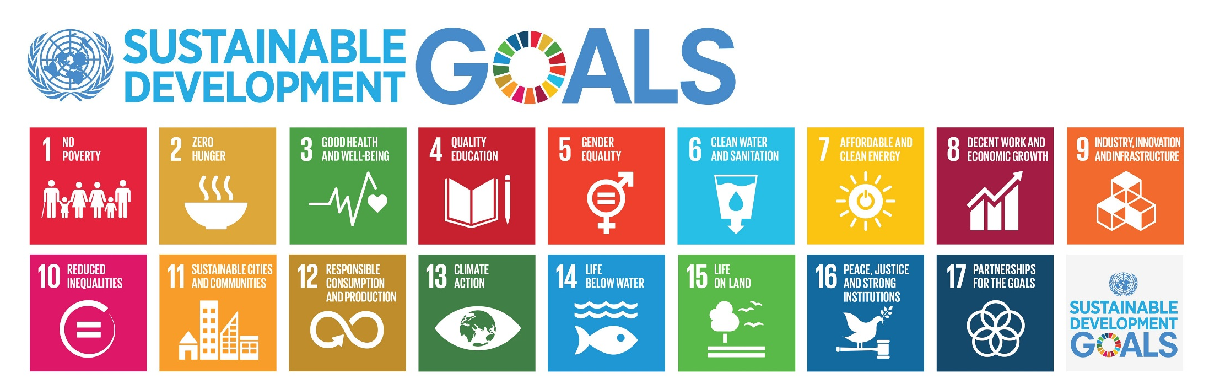
Why OER?
Reduces costs
Enhance access
Improve quality

Slide 42

Costs: OER Textbooks: US
31% students in the US don’t register for a course due to textbook costs.
Thanos & Wiley, 2014
Utah Open Textbooks project:
$5 per printed and zero for online content

Slide 43


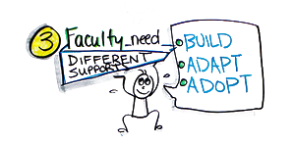
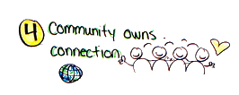
Four Lessons from Textbook Zero
Systemic change required
Senior level champion vital
Faculty require support
Community must take
ownership
‘Four Lessons Learned from implementing Textbook Zero Programs’ June 3, 2014 http://bccampus.ca/2014/06/03/textbook-zero/
Image source: CC-BY, bccampus

Slide 44

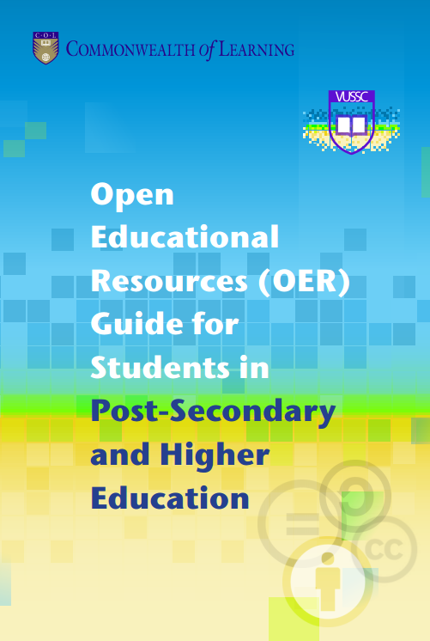
University of Swaziland
OER Policy
Students’ Guide to OER
OER-based Programmes
  Bachelor of Nursing
  Master of Educational Leadership

Slide 45
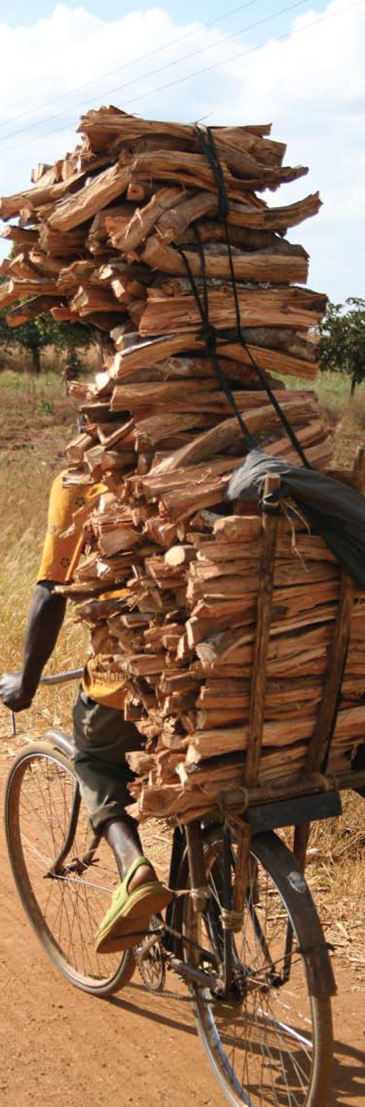
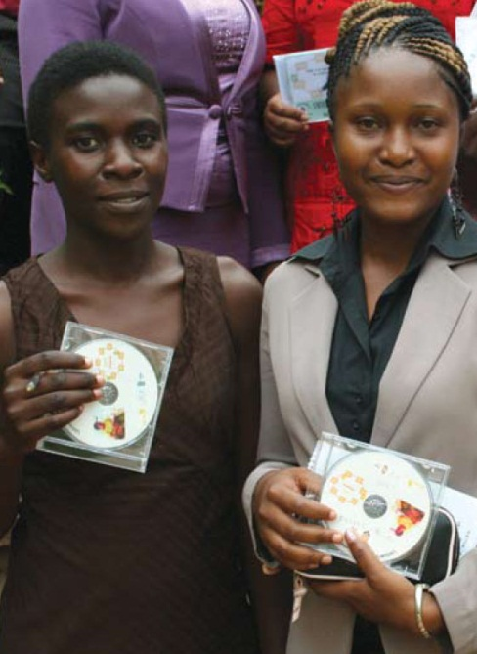
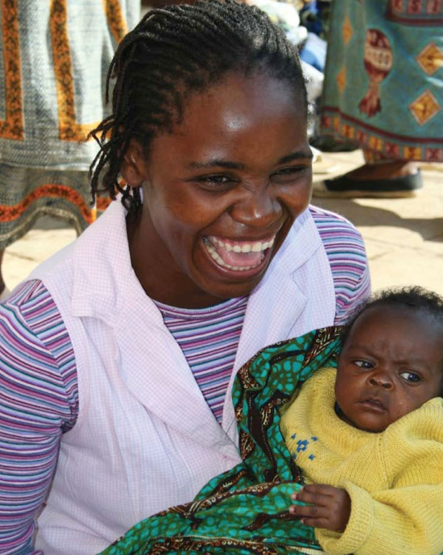

Access: Malawi
Bunda College of Agriculture
  102 page Communications Skills textbook
  75% OER
  Adapted by adding contextually relevant materials, activities, assignments

Slide 46

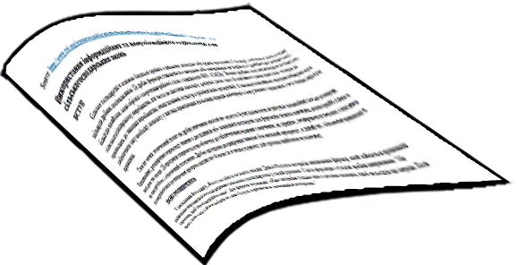


Access: Translation
COL ID template
translated and adapted by Open University of China
COL materials in Ukrainian
CORE

Slide 47
National Open University of Tanzania
Adopted OER Policy in 2016
Developing courses for Advanced ICT training

Slide 48



Can OER contribute to Quality?
770 institutions in India
  KSS Women’s Engineering College, Andhra Pradesh
  Maya Devi Educational Foundation, Uttarakhand
  Bhilai Institute of Technology, Chattisgarh

Slide 49
Implications of OER for ODL
Free availability of quality content
Faculty time can now focus on learner support
course development

Slide 50
New Realities
Present
Future
Industrial model of operation
Connected model of operation
Institutional Teams
Global Teams of course developers
Student as consumer
Student as producer
Notes:
Openness was the other plank of this movement. This could have been defined in very many ways but the most appropriate expression is attributed to Crowther, the founding chancellor of British OU. His statement touches upon various facets of openness that continue to be important in today’s context cross the generations

Slide 51
Implications for Pedagogy
(Meta-analysis by Bernard et al.)
Student <> Content # 1
Student <> Student # 2
Student <> Teacher # 3

Slide 52
Implications for Pedagogy
Behaviorist: Teacher - Student
Constructivist: Student - Student
Connectivist: Student - Content -Terry Anderson 2010
A mix of all three approaches?
How will we assess new ways of learning?

Slide 53

Implications for the Learner
New learner of the 21st century
Digital native
Ubiquitous learner
-consumer as producer
-self-directed learning
-lifelong learning

Slide 54
Impact of OER on formal learners

Slide 55

Research shows that
Students enrolled in face-to-face open courses were almost 7% more likely to succeed than those who took courses with commercial textbooks
Students more likely to receive a C or higher in hybrid/online open courses than their peers who took online courses with commercial textbooks
Student success in open courses was nearly 6% higher
Source: Hilton, J., Fischer, L, Wiley, D., and Williams, L. (2016).
Maintaining Momentum Toward Graduation: OER and the Course Throughput Rate, International Review of Research in Open and Distributed Learning, Retrieved from http://www.irrodl.org/index.php/irrodl/article/view/2686/3967

Slide 56
Global Trends

Slide 57

15 years ago the term open educational resources was coined
10 years ago cape town declaration was written
5 years ago OER Paris Declaration was adopted

Slide 58
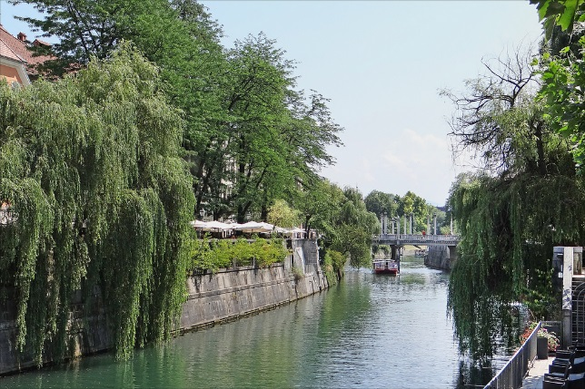
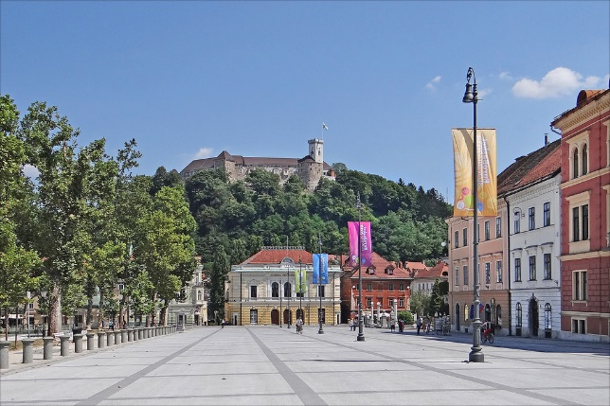

2nd World OER Congress
Image Source (CC BY):https://www.flickr.com
Ljubljana, Slovenia – 18-20 September 2017

Slide 59









OER for Inclusive and Equitable Quality Education:
From Commitment to Action
Asia
Malaysia
Europe
Malta
Middle East / North Africa
Qatar
Africa
Mauritius
Americas
Brazil
Pacific
New Zealand
Notes:
All flag images sourced from: https://commons.wikimedia.org/wiki/Gallery_of_flags_by_design

Slide 60
OER: Then and Now
2012 | Now
Focus was on Governments | Additional focus on stakeholders
Policies | Strategies
Commitment | Concrete action

Slide 61
Two Surveys
  A government survey sent by COL and UNESCO in English & French
  A stakeholder survey, which COL posted online at http://rcoer.col.org/surveys.html
Notes:
made available to COL Focal Points and to National Delegations in UNESCO.

Slide 62
Trends
OER activities mostly at post-secondary and tertiary levels
Main reasons for countries becoming active in OER were:
  Gaining access to the best possible resources
  Bringing down costs for students
  Reaching disadvantaged communities
  Creating more flexible materials
OER improves teacher professional development

Slide 63
Trends
Main barriers to mainstreaming OER are:
  Lack of users’ capacity to access, reuse and share OER,
  Lack of funding and/or incentives; and
  Lack of appropriate policy solutions.
Key skills gaps identified were:
  How to find OER;
  Evaluating quality of OER;
  Understanding licences and how they work;
  ICT Skills.

Slide 64
Way Forward

Slide 65

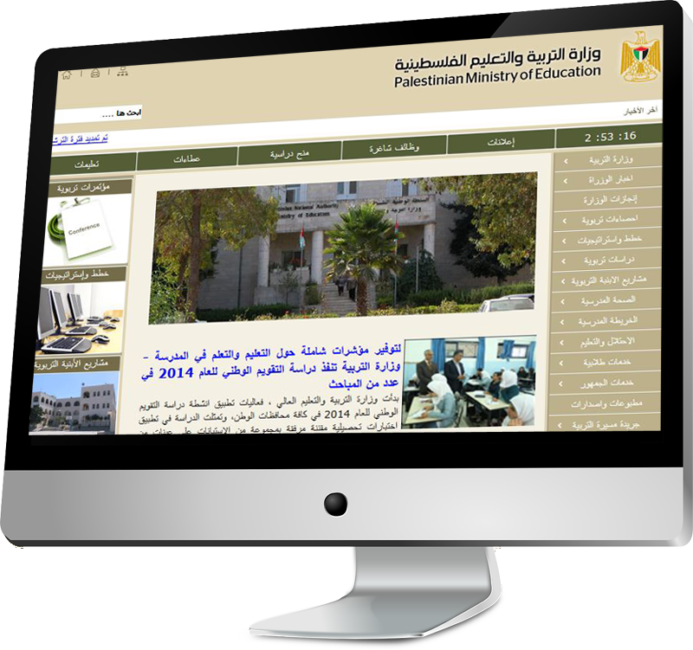
National Governments can
Develop an ICT in Education/OER policy
Propose a vision and strategy for OER at all levels of education
Provide ICT infrastructure

Slide 66

Institutions can
develop an ICT policy
elaborate a policy on copyright
provide incentives for faculty members such as increments and recognition of OER-development towards promotions
make the development of OER a job requirement at the time of recruitment

Slide 67


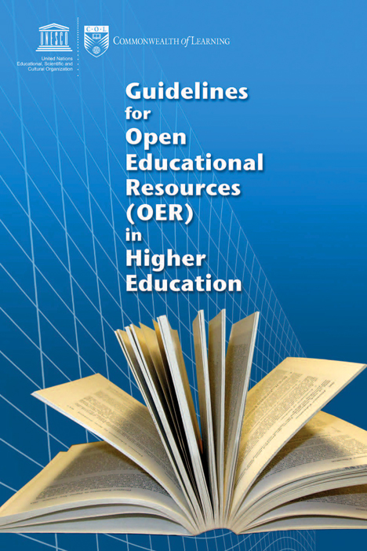
COL Resources

Slide 68
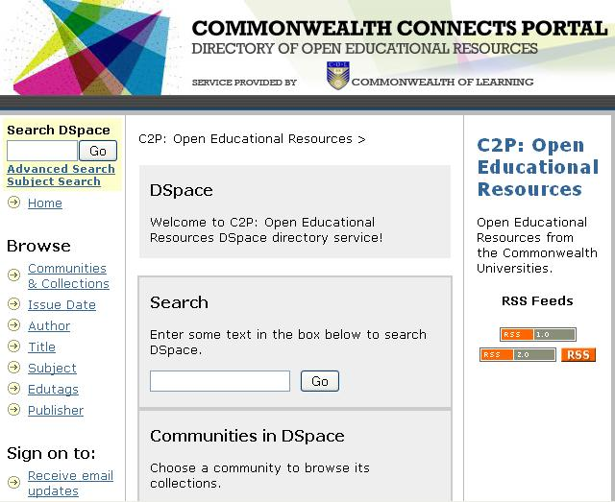
  Directory of Open Educational Resource (DOER)
Open Educational Resources directory service
Only full courses catalogued
A service provided by COL

Slide 69
Towards Innovation
OER can increase access and equity by reducing costs
Become part of global knowledge flows and improve quality
Appropriate technologies to enable stakeholders to be active participants

Slide 70

Innovation: from ‘divide’ to ‘dividend’
emphasis on people, rather than on technologies
learning as a dynamic process of knowledge creation

Slide 71

Let us agree to
Be proactive champions of OER
Collaborate: avoid duplication of effort
Encourage learners to be producers rather than consumers of content

Slide 72
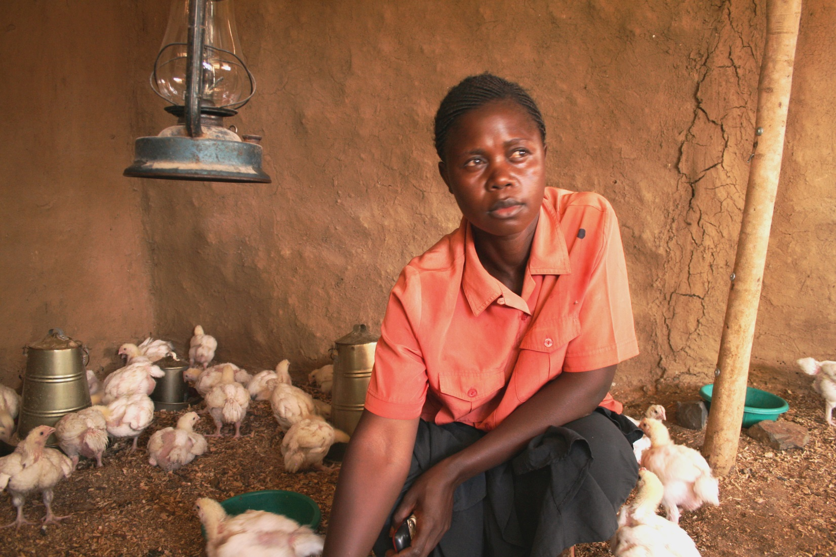
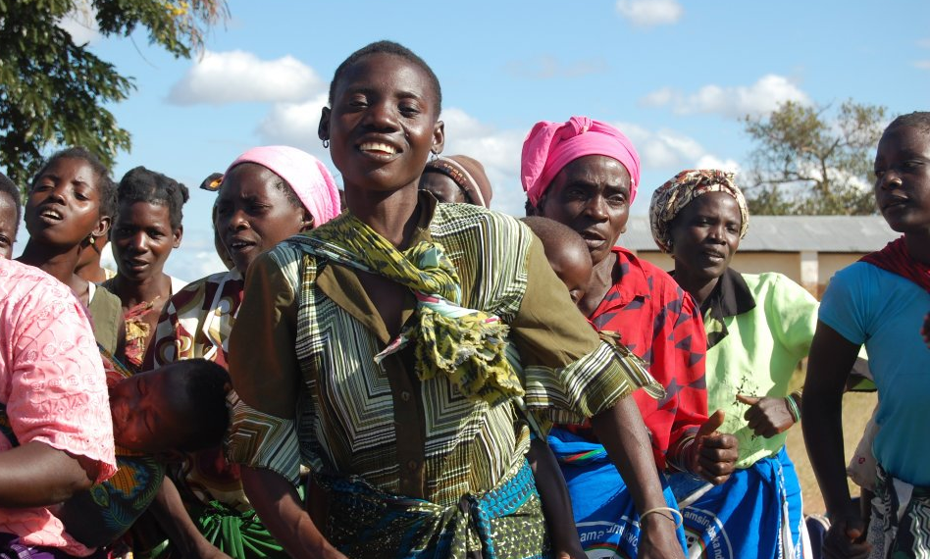
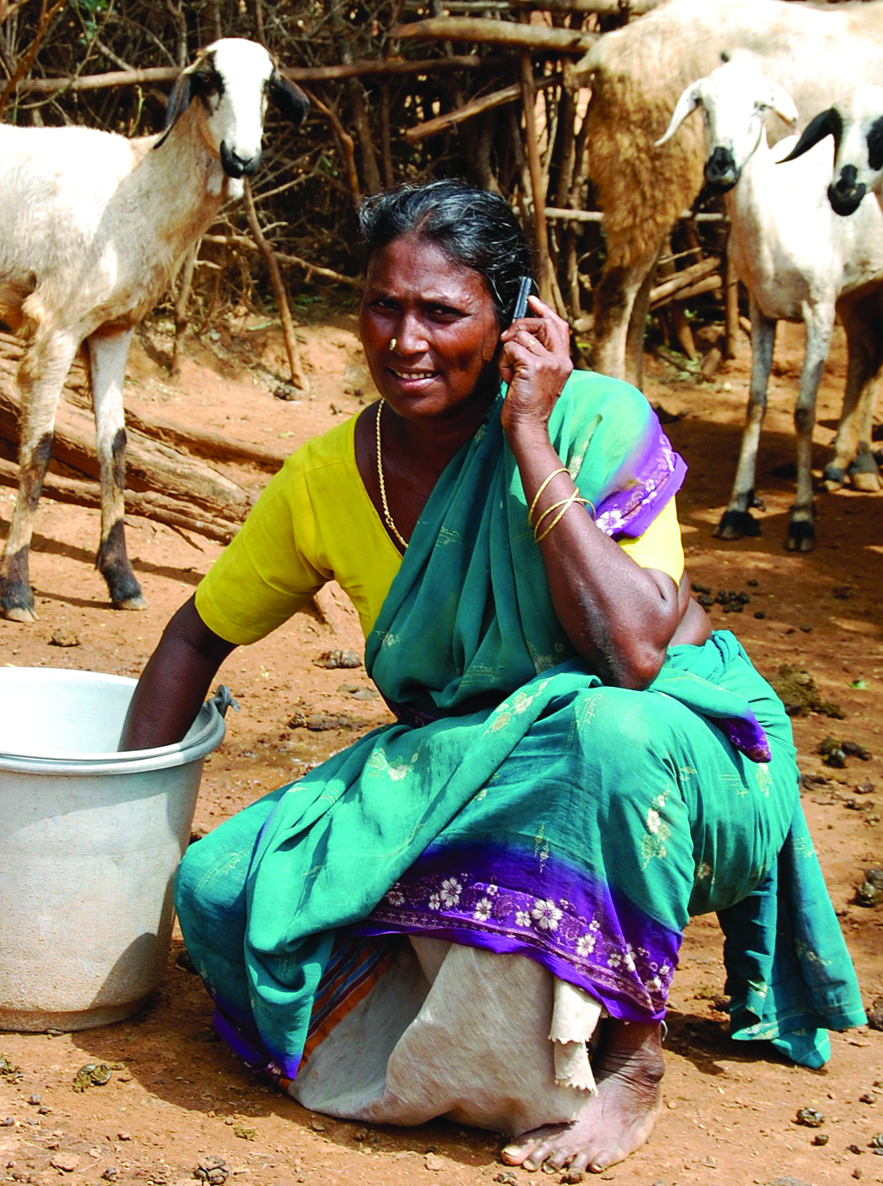
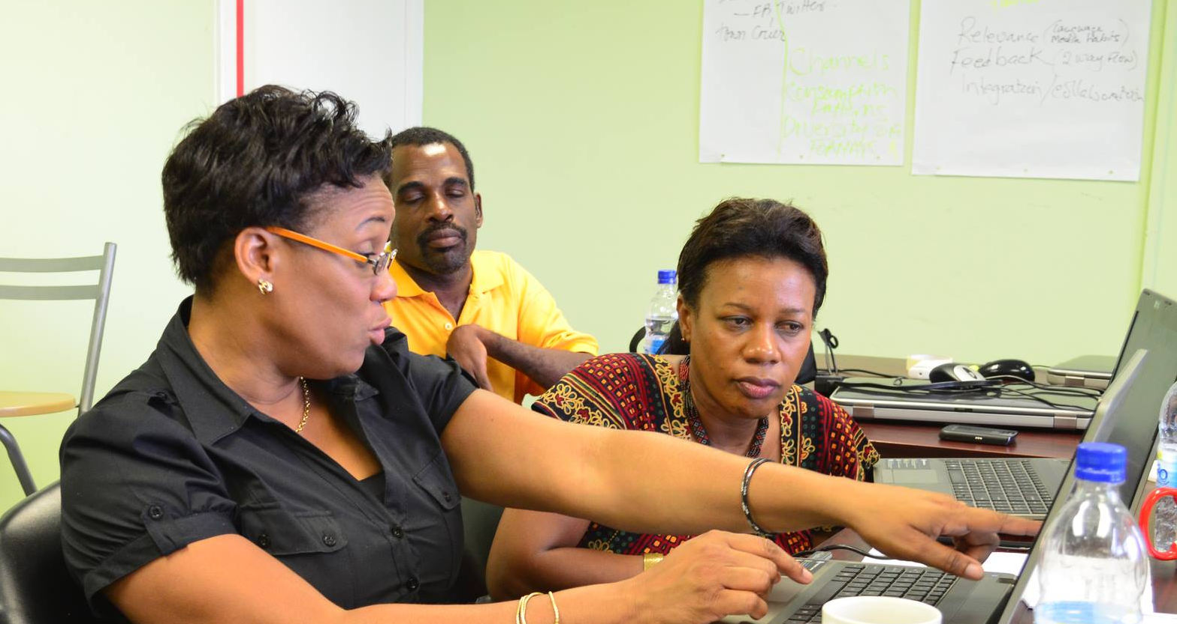
Thank You
www.col.org
Notes:
We invite you to engage us; tap into our thought leadership, expertise, networks and resources

