Slide 1

Developing a national ODL Policy: an international perspective
13-14 May 2016,Islamabad, Pakistan
Prof Asha Kanwar President & CEO, Commonwealth of Learning

Slide 2
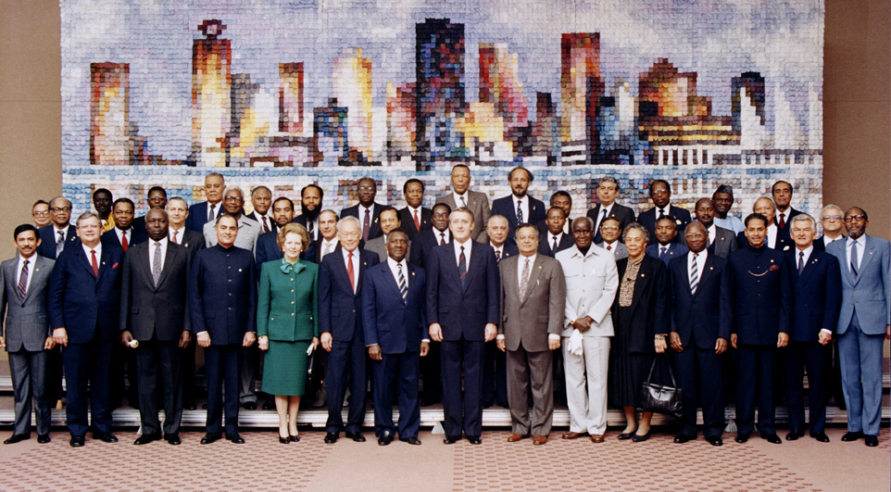
Copyright Commonwealth Secretariat
Commonwealth Heads of Government Meeting Vancouver, 1987

Slide 3
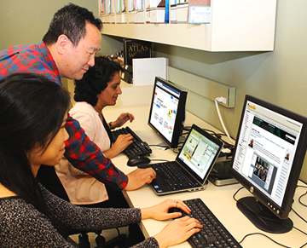
What is it for?
To help Commonwealth governments and institutions use various technologies to improve access to learning in support of development.

Slide 4
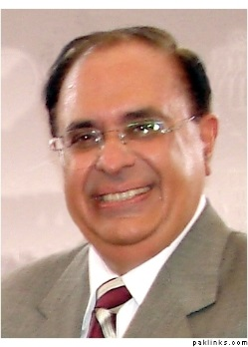
Prof Atta ur Rahman: Asia

Slide 5
Founding Partners: Commonwealth Executive MBA/MPA
Allama Iqbal Open University, (Pakistan)
Bangladesh Open University (BOU)
Indira Gandhi National Open University, (India)
Open University of Sri Lanka

Slide 6


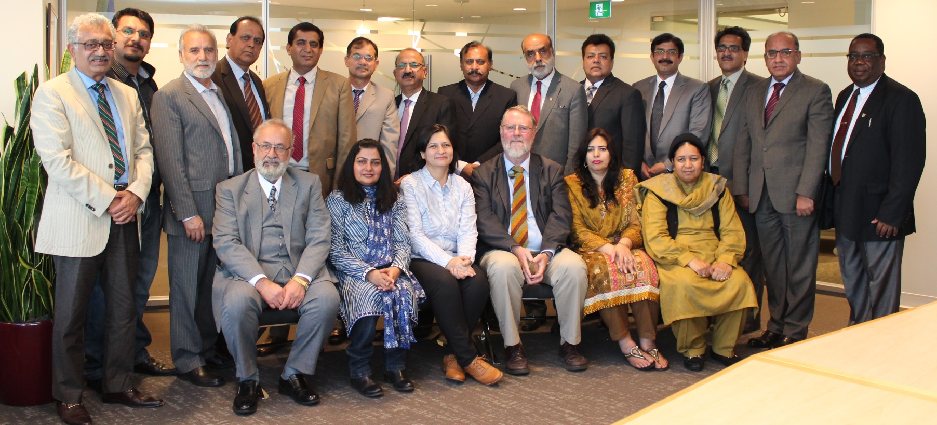


https://www.britishcouncil.pk/
“One of the most important outcomes of this training is the developed understanding between Vice Chancellors of different universities from different parts of Pakistan, which will definitely have long-term positive impact in the country.”

Slide 7

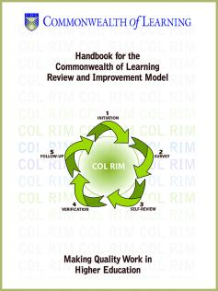

COL Review and Improvement Model (COLRIM)
Allama Iqbal Open University

Slide 8



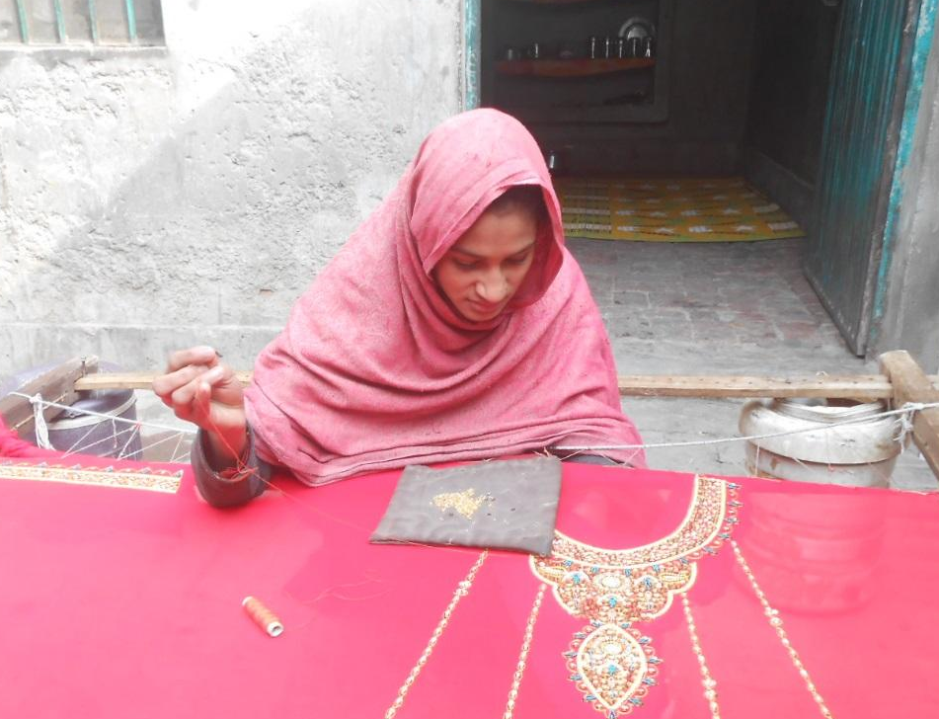
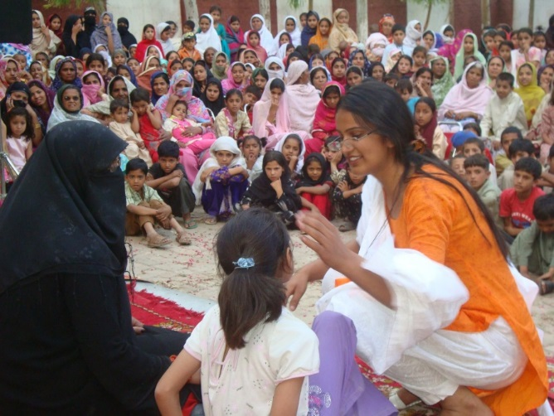
Society for the Protection of the Rights of the Child
Community awareness raising campaign
Bedari
“I’ve never imagined to be that much help to my family as I’m contributing to my family’s well being now..”
Ghulam Fatima, 14 years old
Centre for Street Children, Multan
Society for the Protection of the Rights of the Child

Slide 9
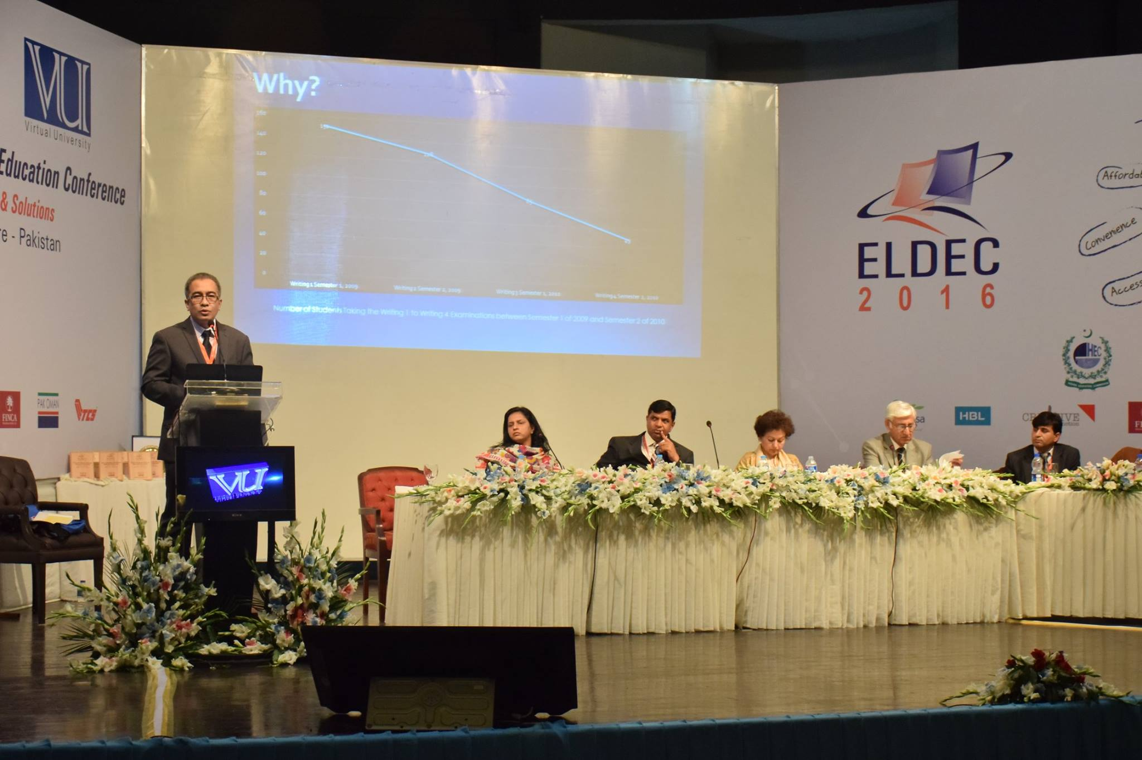



Slide 10
Plan
Context
What is ODL?
Fifth Decade of ODL
Crisis of Credibility
Towards a National Policy

Slide 11
The Context

Slide 12

A Young Pakistan
Pakistan has 37.6 million young people between the ages of 15 and 24 : 20% of its population, 2015.
Source: UN Department of Economic and Social Affairs, Population Division, World Population Prospects, the 2015 Revision

Slide 13
Youth unemployment (% of 15-24) in Pakistan 2004 – 2014
Source: The World Bank Open Data, Retrieved on March 8, 2016.
Notes:
Source: The World Bank Open Data, Retrieved on March 8, 2016.

Slide 14
Tertiary Gross Enrolment Ratio in Pakistan 2004 – 2014
Source: UNESCO Institute for Statistics, Retrieved on March 8, 2016.
Notes:
Source: UNESCO Institute for Statistics, , Retrieved on March 8, 2016.

Slide 15
National Education Policy 2009: Higher Education policy actions
Steps shall be taken to raise enrolment in higher education sector from existing 4.7% to 10% by 2015 & 15% by 2020.
ICT must be effectively leveraged to deliver high quality teaching and research support in higher education both on-campus and using distance education.
Universities shall develop quality assurance programmes, which include peer evaluation including foreign expertise.
Source: National Education Policy 2009, Ministry of Federal Education and Professional Training, Pakistan, last accessed on May 3rd, 2016
Notes:
June 2013

Slide 16
ICT in Pakistan 2004 - 2014
Source: The World Bank DataBank, Retrieved on March 8, 2016
Notes:
Source: The World Bank DataBank, Retrieved on March 8, 2016.

Slide 17
What is Open & Distance Learning ?

Slide 18
OPEN LEARNING
=
Learning without barriers

Slide 19

Philosophy of ‘Open-ness’
Open as to people,
Open as to places,
Open as to methods, and, finally,
Open as to ideas
Lord Crowther

Slide 20



‘Open-ness’ in Practice
No entry qualifications
Credit banking
Cafeteria approach to courses

Slide 21
DISTANCE EDUCATION
=
Separation of teacher and learner

Slide 22
OPEN LEARNING
is NOT the same as
DISTANCE EDUCATION
BUT, they are complementary.
Therefore: ODL

Slide 23
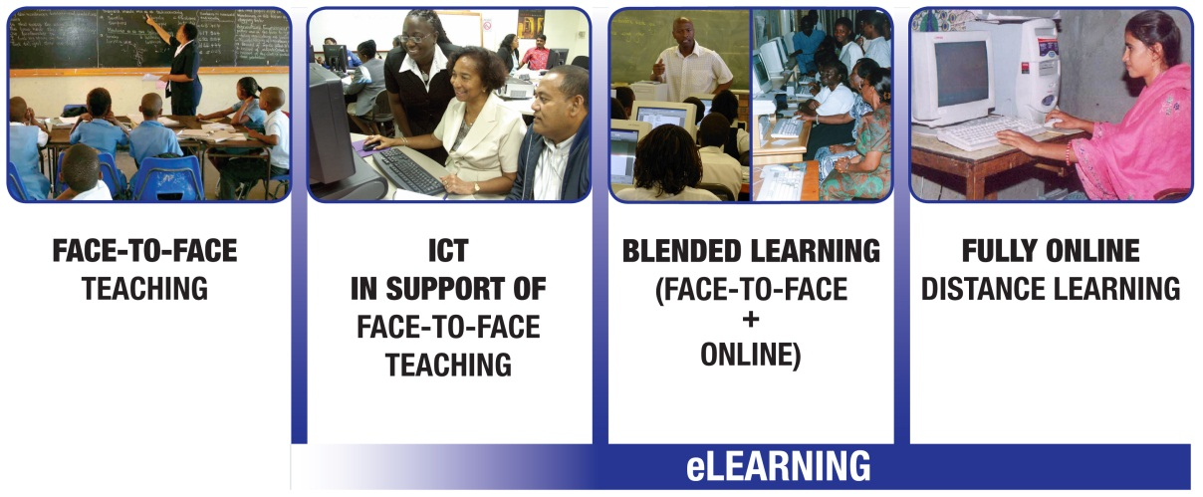
ODL and eLearning
Access | Quality | New Pedagogies

Slide 24
Developing countries
The adoption rate of eLearning in Asian region's higher education segments is astonishing.
OUM: 90,000+ students,
Mumbai University: over 78,000 online students.

Slide 25
The Fifth Decade of ODL

Slide 26




The Rise of Open Universities
I
I

Slide 27
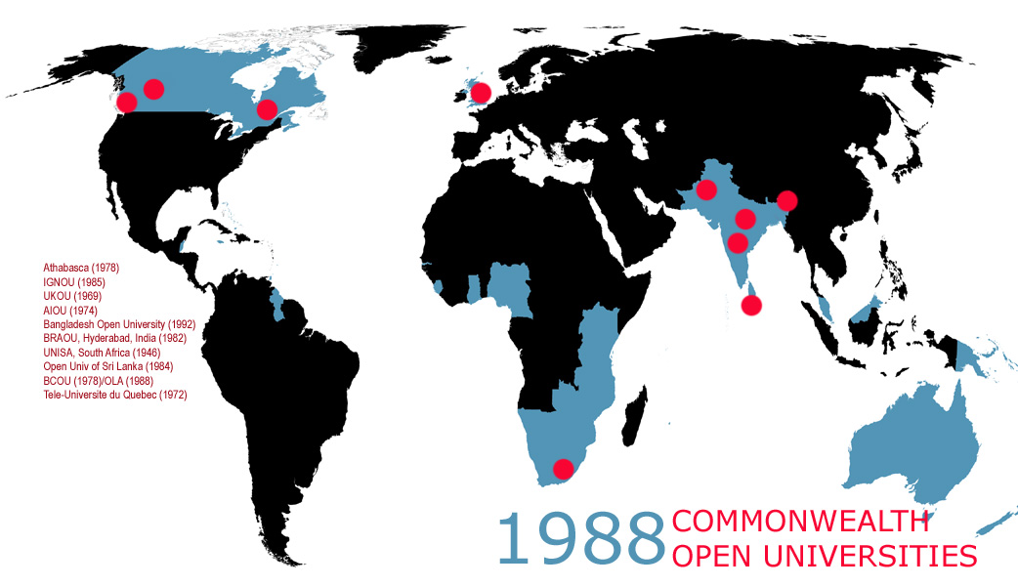

Slide 28
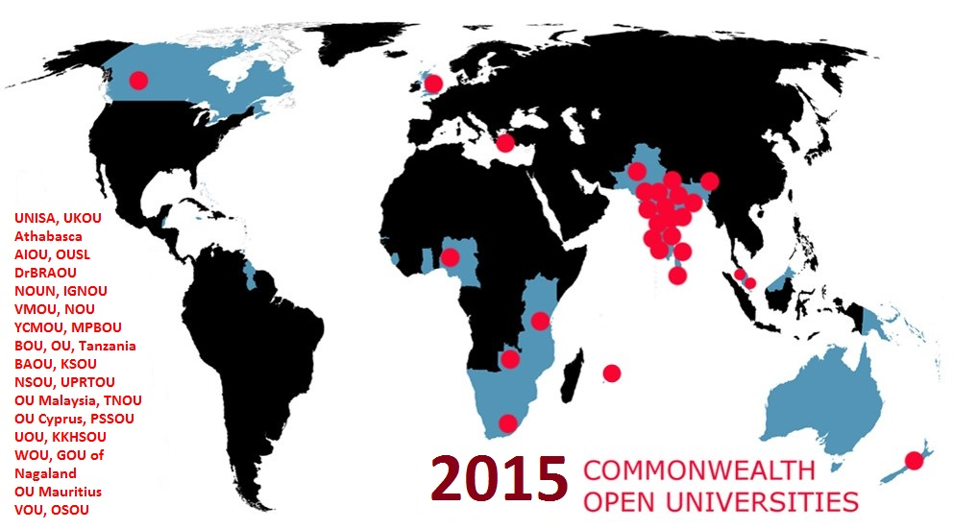


Slide 29
Industrial Model
Division of labour
Mass production
Planning and organisation
Otto Peters, 1967

Slide 30
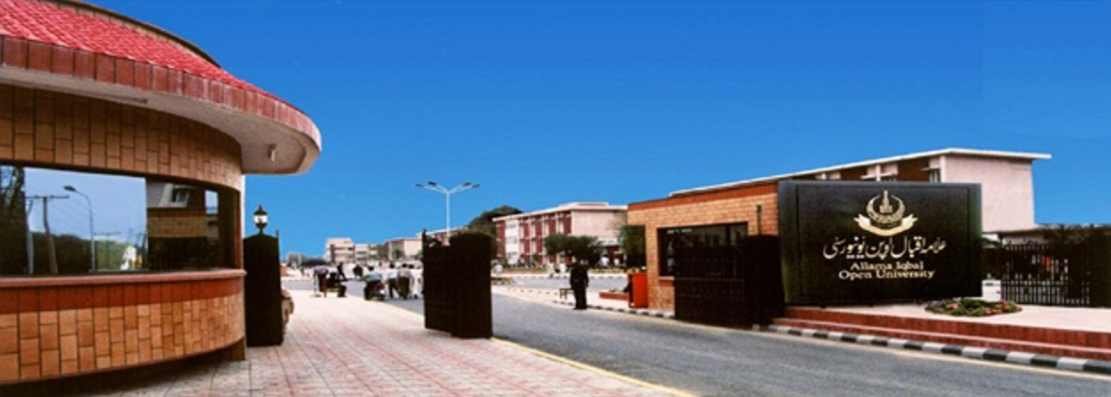
Access: Allama Iqbal Open University (1.3 million: 2015)

Slide 31
Pakistan Vision 2025: Higher Education
To achieve the objective of developing a knowledge economy…significant expansion in higher education enrolment currently from 1.5 million to 5 million.
Apart from establishing new universities…we will improve the quality of existing engineering and technology universities and create models with a focus on quality research.
Source: Pakistan Vision 2025, Ministry of Planning, Development & Report, Pakistan last accessed on May 3rd, 2016
Notes:
June 2013

Slide 32
Costs: ODL in mega universities
Country | Institution | Enrolment | % of Campus Cost*
Pakistan | AIOU | 456.126 | 22
China | CCRTVU | 2,300,000 | 40
India | IGNOU | 1,187,100 | 35
UK | OU | 203,744 | 50
*Unit cost per student as a percentage of the average for other universities in the country, NKC, 2004.

Slide 33

Quality:Open University,UK
highest rated for overall student satisfaction in the 2012 National Student Survey
rated fifth of 100 UK universities (2003)
Source: http://www.open.ac.uk/about/main/the-ou-explained/facts-and-figures
Notes:
Source: http://www.open.ac.uk/about/main/the-ou-explained/facts-and-figures

Slide 34
II. The rise of dual mode institutions
South Africa: Enrolments in single mode dropped by 21% between 1995-1999 ¹
Deakin: Almost a quarter of 53,000 students study at a distance ²
Campus of Open Learning, University of Delhi: More than 200,000 distance students³
Sources:
UNESCO: Open and Distance Learning - Trends, Policy and Strategy Considerations (2002).
Deakin University: Our reputation and history. Last accessed on May 2, 2016.
Campus of Open Learning, University of Delhi: About us. Last accessed on May 2, 2016
Notes:
http://unesdoc.unesco.org/images/0012/001284/128463e.pdf
http://www.irrodl.org/index.php/irrodl/article/view/20/360
http://www.deakin.edu.au/about-deakin/our-reputation-and-history

Slide 35
Advantages
Expand access
Availability of academic talent
Optimal utilisation of existing resources
Resource-generation
Access to wider curriculum

Slide 36
Challenges
Lack of autonomy
Poor learner support
Underfunding
Inadequate staff training
Second-class status

Slide 37

India: policy and practice
Policy: India
15 public Open Universities
242 dual-mode institutions
DE in HE: 3.7 M or 23.4%
DEB UGC
Notes:
http://www.ugc.ac.in/deb/pdf/growthDEB.pdf

Slide 38
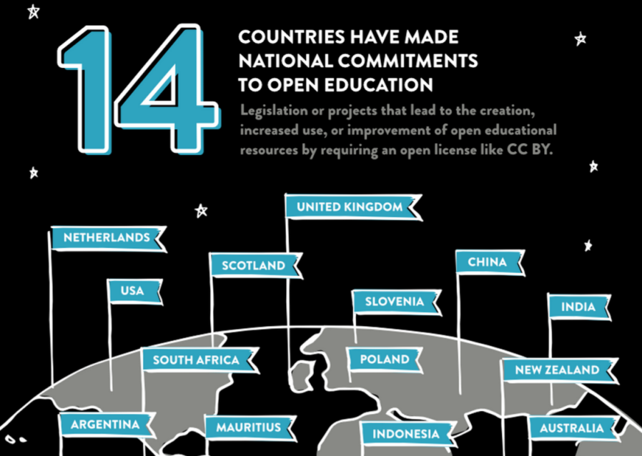
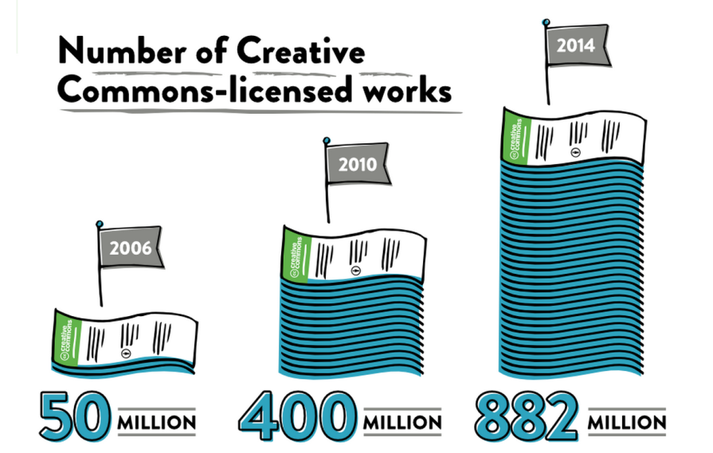
III. Rise of OER
+
FIJI has introduced OER policy in January 2016.
Source: https://stateof.creativecommons.org/report

Slide 39




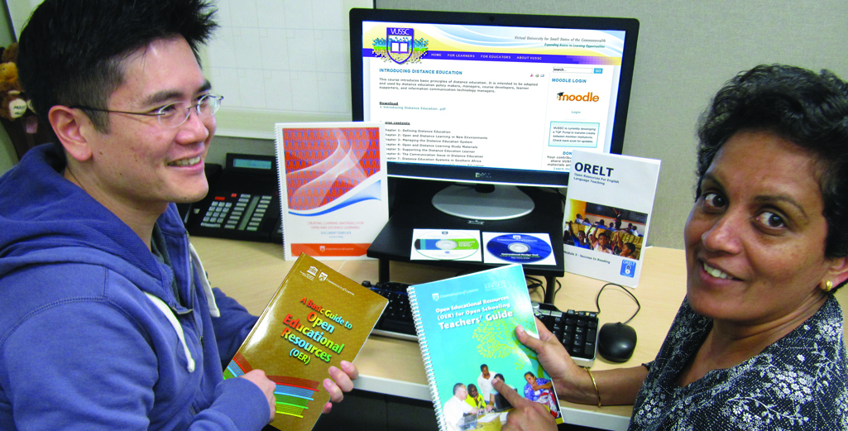
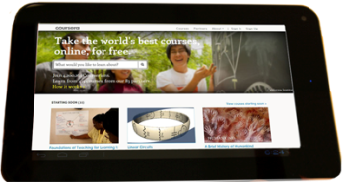

What are Open Education Resources (OERs)?
Materials that are
Free and freely available
Suitable for all levels
Reusable
Digital

Slide 40
Implication of OER on ODL practices
Free availability of quality content
Faculty time can now focus on learner support
course development

Slide 41
New Realities
Present
Future
Industrial model of operation
Connected model of operation
Institutional Teams
Global Teams of course developers
Student as consumer
Student as producer

Slide 42
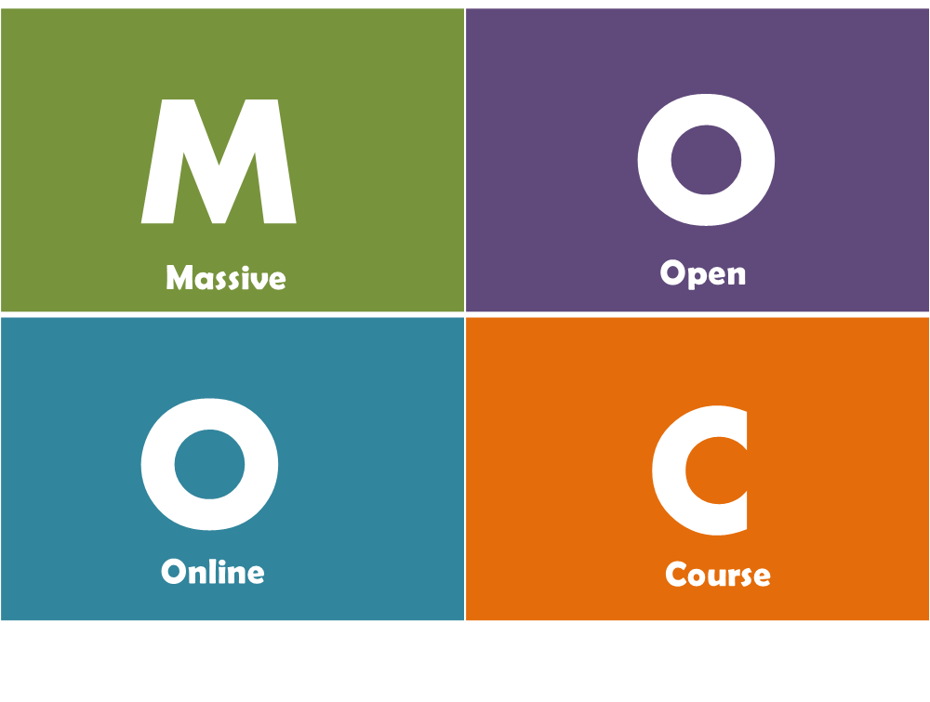

IV. Massive Open Online Course
“… a MOOC is a type of online course aimed at large scale participation ….MOOCs are a recent development in the area of distance education…”
Wikipedia, Dec 10,2014

Slide 43
Prominent MOOC initiatives: Asia
Chinese MOOCs (www.chinesemooc.org) 华文慕课
Provider: Peking University, Alibaba
User: University students, high school students and Public.
JMOOC
(www.jmooc.jp/en/)
Provider: NTT Docomo, NTT Knowledge Square, NetLearning, and the Open University of Japan
User: student, homemaker, senior citizens
Malaysia MOOC
(www.openlearning.com/malaysiamoocs)
Provider: Universities supported by Ministry of Higher Education
User: University students, high school students and Public.
Notes:
http://www.xuetangx.com/about#about_us_en
http://news.tsinghua.edu.cn/publish/news/4205/2015/20150924091710383818309/20150924091710383818309_.html
http://technode.com/2015/02/28/alibaba-peking-university-establish-chinese-mooc-platform/
http://www.paristechreview.com/2014/08/26/moocs-education-china/
http://www.ft.com/cms/s/2/b6eb810e-965b-11e4-a40b-00144feabdc0.html#axzz3nA74AnZ2

Slide 44

Implications of MOOCs in Higher Education
Flexibility
Affordability
Fast-track
Notes:
Some experts compare MOOC as iTunes of education, and expect that the MOOC will be a big game changer. It is based on three important aspects of current education system that is rigid, highly costly and take lot of time to graduate. Thus, it provides a successful recipe for a disruption in the educational landscape. Therefore, obviously the top universities have taken the lead in offering MOOCs to a world deprived of quality education at a low cost. Is this disruption going to affect the Open Universities? Or there will be business as usual for them?

Slide 45
New Realities
Present
Future
National or provincial jurisdiction
Global classroom
Limited interaction at study centres
Increased use of Peer2Peer learning and social media
Print+ (audio, video, online)
Online+ (increased use of learning analytics)
Notes:
Openness was the other plank of this movement. This could have been defined in very many ways but the most appropriate expression is attributed to Crowther, the founding chancellor of British OU. His statement touches upon various facets of openness that continue to be important in today’s context cross the generations

Slide 46
Crisis of Credibility

Slide 47


Slide 48

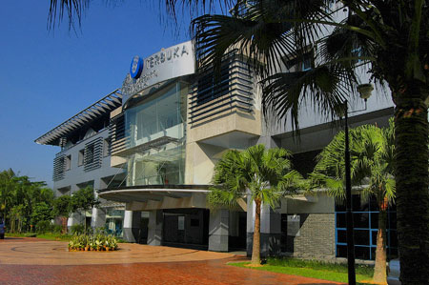
International
Open University of Malaysia: ISO Certification accreditation

Slide 49
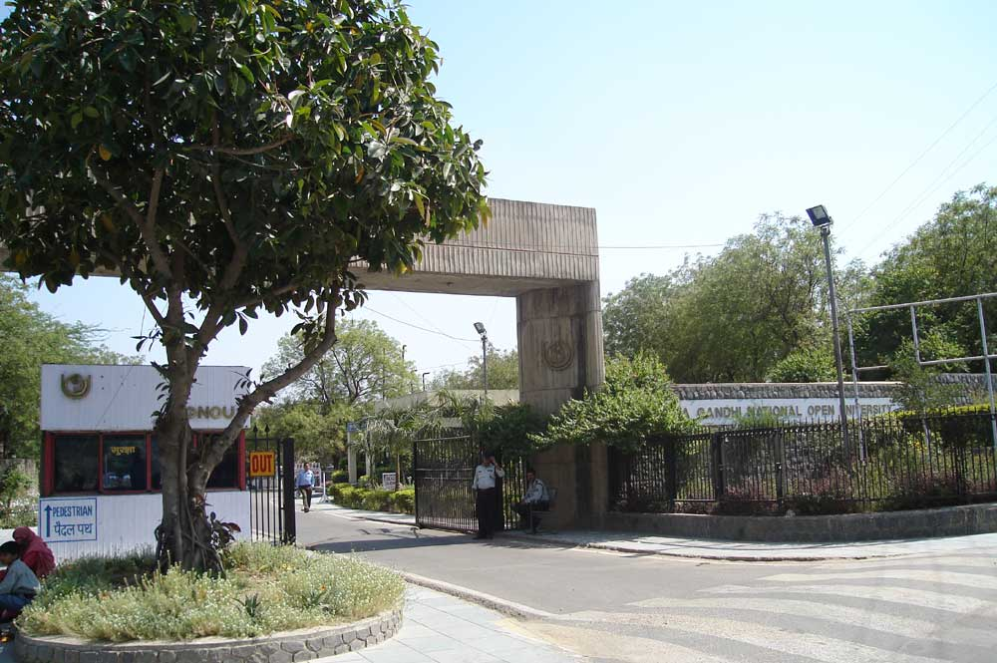

The front gate of the University campus in New Delhi.
http://en.wikipedia.org/wiki/File:IGNOUGATE.jpg

Slide 50

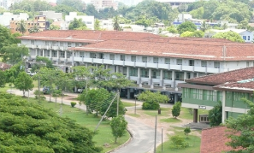
Open University of Sri Lanka
Open University of Sri Lanka

Slide 51
Convergence of external & internal QA measures
OUUK: QAA & Internal validation unit

Slide 52
3-pillars of quality in Distance Education institutions
Personal support to each student from a living and breathing human being who knows the student’s name and aspirations
High quality multi-media materials
Efficient logistics and administration
John Daniel, 1998

Slide 53
QAA(2005) and National Qualifications Framework, Pakistan (2016)
Quality Assurance Agency (QAA) is a policy making and monitoring body for maintenance and enhancement of QUALITY in higher education.
The Pakistan Qualification Framework is considered as mechanism for classification of the qualifications on the basis of the learning outcomes
The Pakistan Qualification Framework provides all the information regarding the accredited higher qualifications and institutions recognized by HEC
Source: National Qualifications Framework of Pakistan; Source: Quality Assurance Agency, Higher Education Commission, Pakistan, last accessed on May 3rd, 2016
Notes:
June 2013

Slide 54
Towards a National Policy

Slide 55



Slide 56
Education 2030: Framework for Action
Develop policies and programmes for the provision of quality distance learning in tertiary
education, with appropriate financing and use of technology, including the Internet, massive
open online courses and other modalities that meet accepted quality standards to improve
access.

Slide 57
Towards a national policy
How useful is ODL to expand access to quality HE/lifelong learning in Pakistan?
What is the ICT infrastructure available and is it affordable?
How do we plan to reach the unreached?
Adopt same or different QA regulations?
Use the NQF for credit mobility?

Slide 58
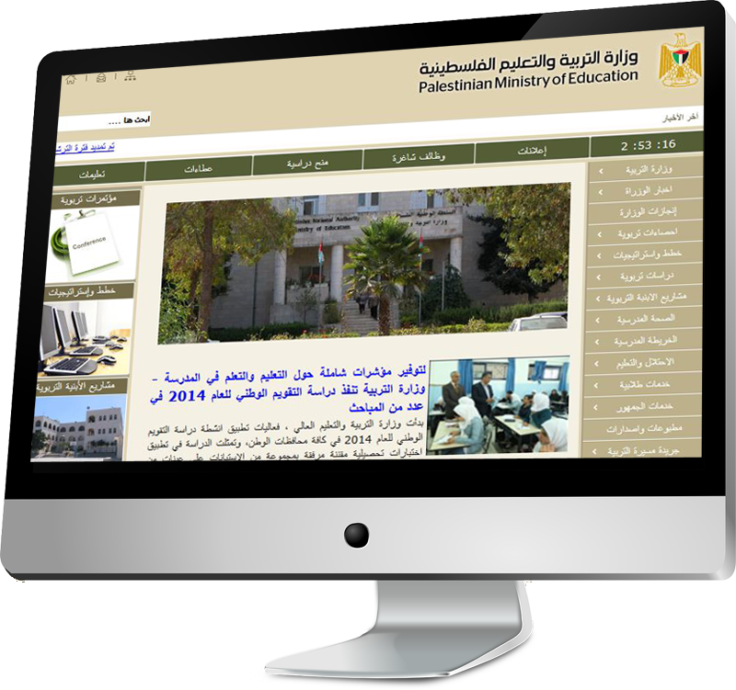
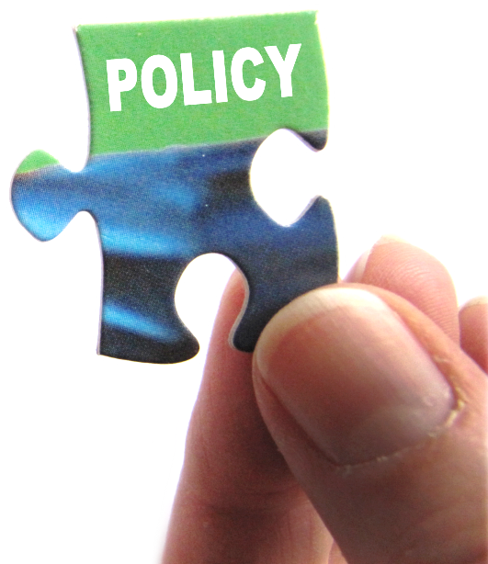

1. Have a National Policy
Integrate ODL into existing policy
Develop a separate ODL policy
Flexible to include new developments eg, OER & MOOCs
Commit resources
www.mohe.gov.ps/default.aspx

Slide 59
Going Dual-Mode: Institutional Policy
Review the mandate and mission
Identify the objectives for adopting ODL and how these will be achieved
What are the issues relating to faculty?
What are the issues relating to students?
How will academic quality and standards be maintained?
Issues related to management and administration?

Slide 60
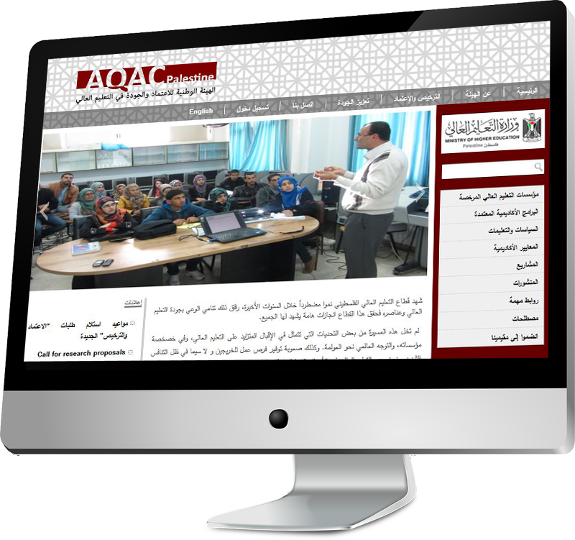
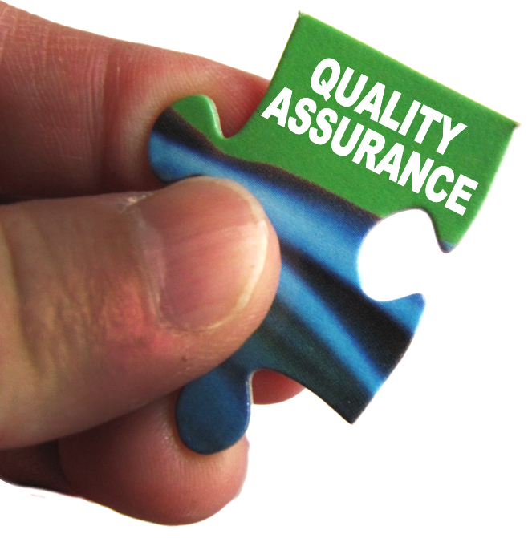

2. Invest in Quality Assurance
National/Regional
QA Guidelines
Create cultures of quality
www.aqac.mohe.gov.ps/

Slide 61
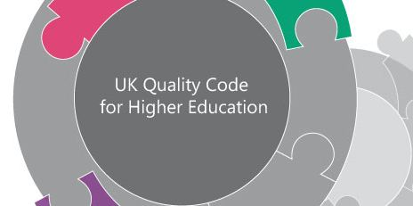

Same Regulations for ODL & F2F
Quality Assurance Agency, UK: assesses both campus and distance universities
From: www.qaa.ac.uk/Pages/default.aspx

Slide 62

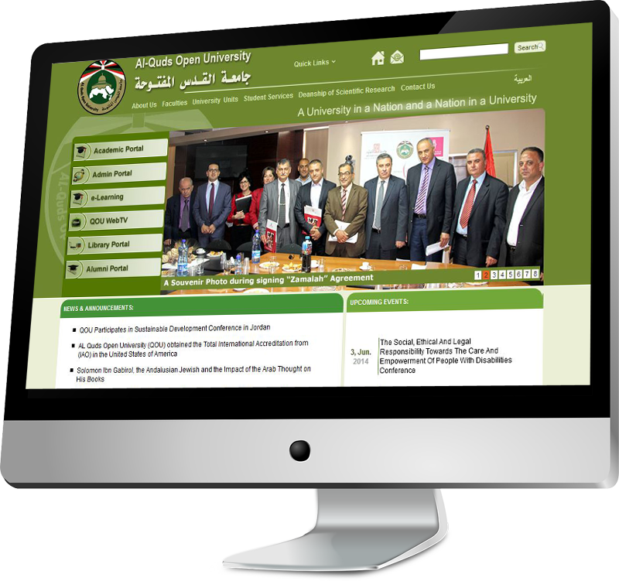


3. Build Capacity in
Curriculum reform
Learner Support
Assessment
OER
www.qou.edu/englishIndexPage.do

Slide 63
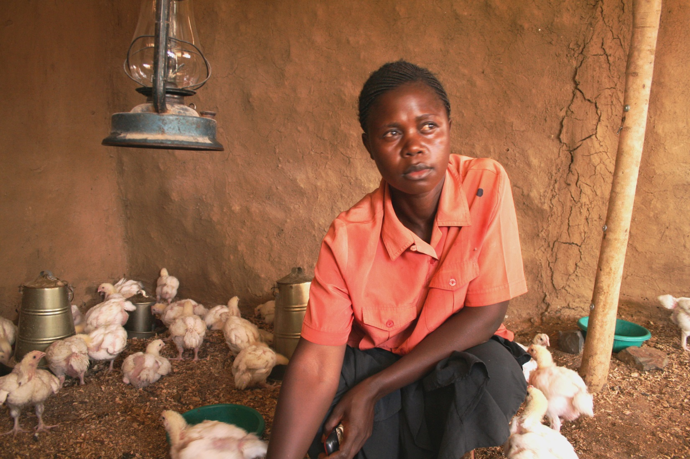
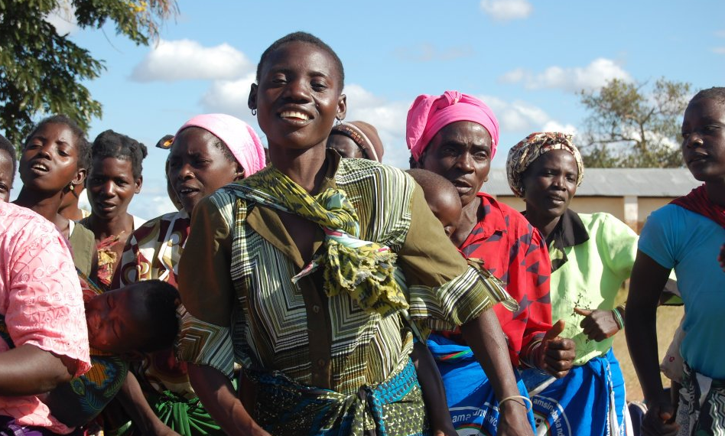
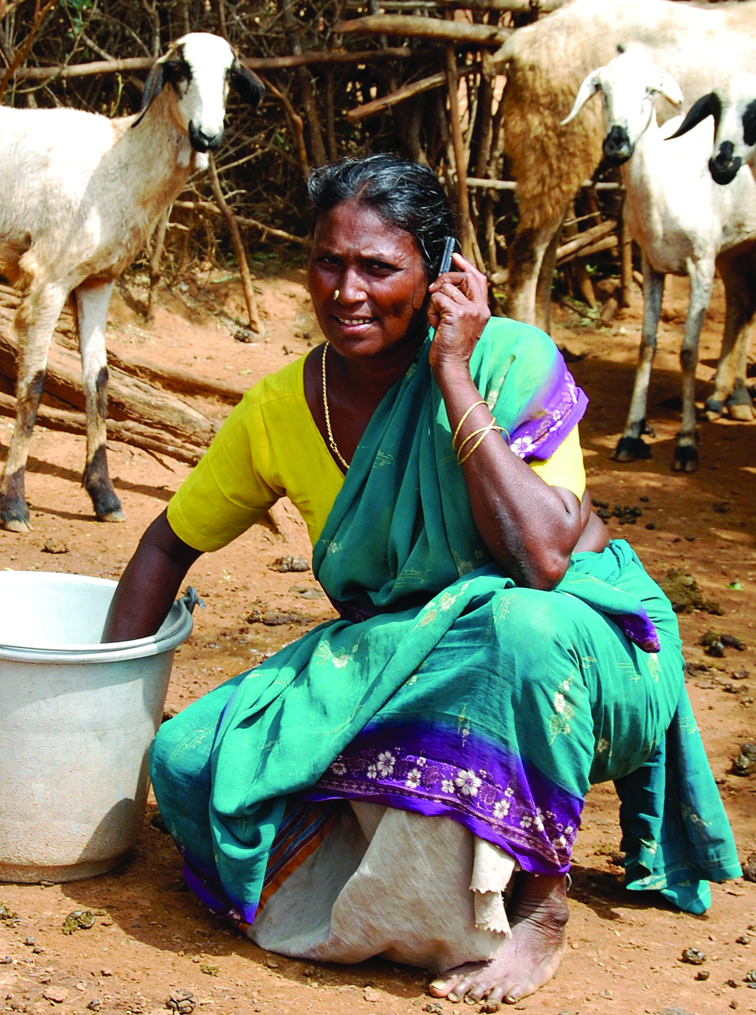
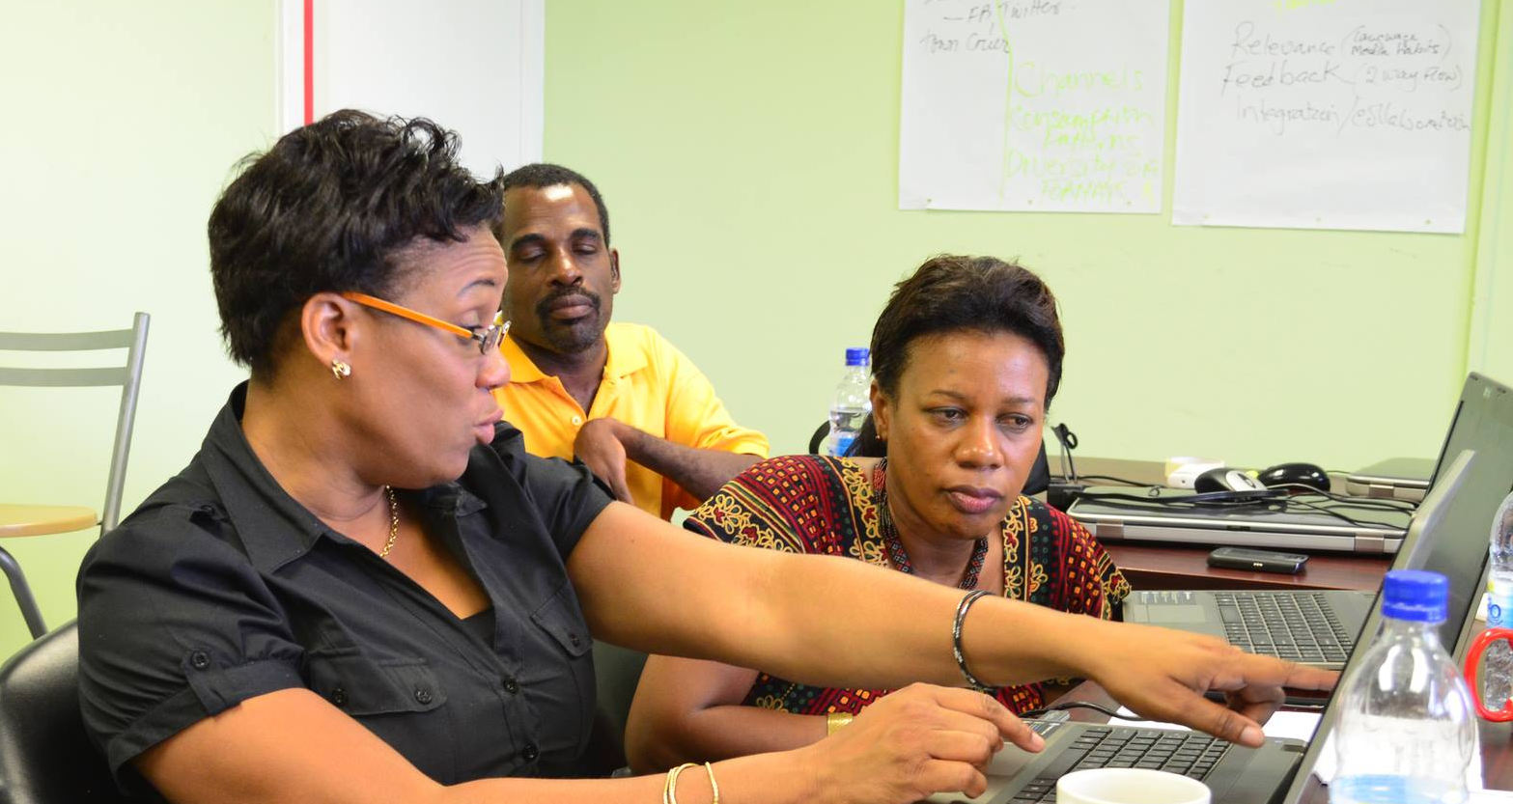
Thank You
www.col.org
Notes:
We invite you to engage us; tap into our thought leadership, expertise, networks and resources

