Slide 1



































Virtual University for Small States of the Commonwealth: Mechanisms and Lessons
Dr Sanjaya Mishra
Director: Education
Dr Mairette Newman
Education Specialist: VUSSC
Notes:
.

Slide 2
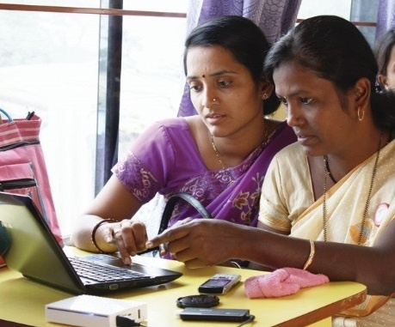
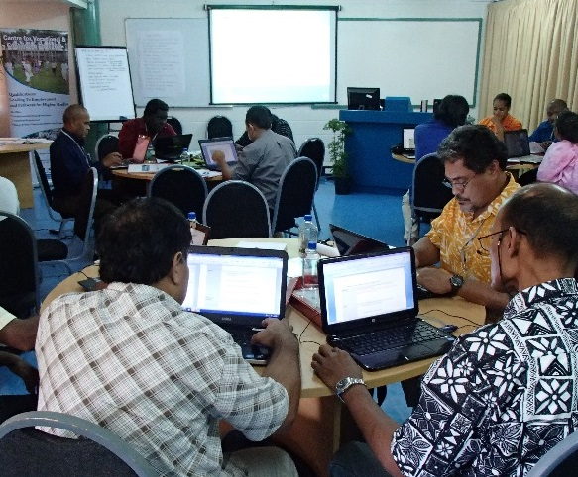
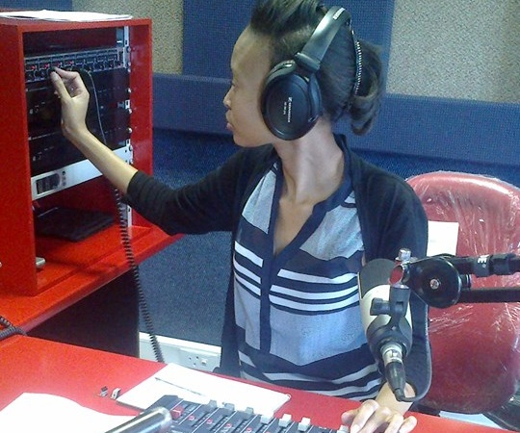
To help Commonwealth governments and institutions use technologies to improve and expand access to education and training

Slide 3
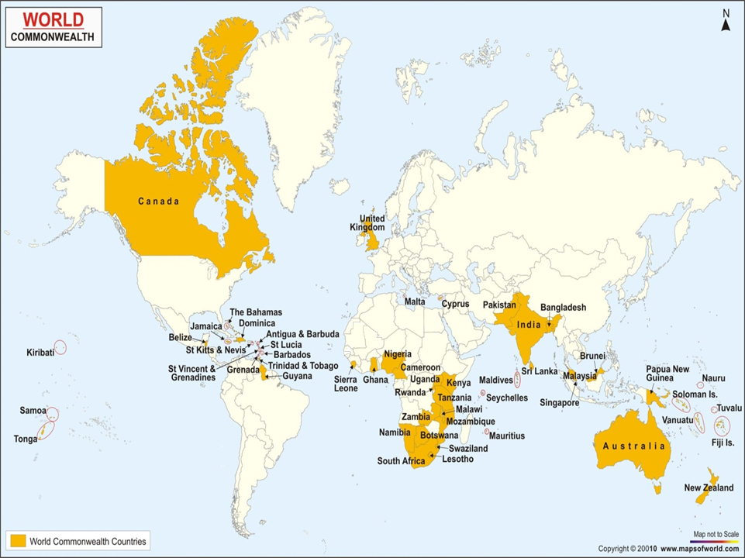
VUSSC: A Network
Notes:
32 countries:
1. Antigua & Barbuda
2. Bahamas, The
3. Barbados
4. Belize
5. Botswana
6. Brunei Darussalam
7. Cyprus
8. Dominica
9. Eswatini
10. Fiji
11. Gambia, The
12. Grenada
13. Guyana
14. Jamaica
15. Kiribati
Lesotho
17.Maldives
18. Malta
19. Mauritius
20. Namibia
21. Nauru
Papua New Guinea
Samoa
24. Seychelles
25. Solomon Islands
St. Kitts & Nevis
28. St. Lucia
29. St. Vincent and the Grenadines
30. Tonga
31. Trinidad & Tobago
32. Tuvalu
33. Vanuatu

Slide 4

VUSSC : the concept
Is a network rather than an institution
Strengthens the capacity of national educational institutions
Promotes delivery in different formats: print & ICT
Adopts a flexible model
Helps countries collaborate
Creates and shares content
Enables small states to be contributors as well as consumers

Slide 5
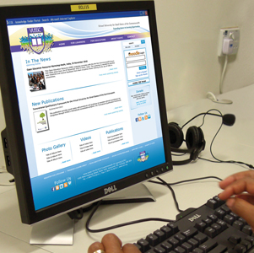
What has the VUSSC Achieved?
Professionals trained in ICT skills
Courses offered
Open Educational Resources (OER) developed
VUSSC Website and online Learning Management System

Slide 6

VUSSC Statistics
32 countries
30 institutions
29,302 learners (2015-2021)
Notes:
Since 2015, it has supported over 30 institutions in the 32 countries reaching about 30,000 learners.

Slide 7
Mechanisms and Lessons

Slide 8
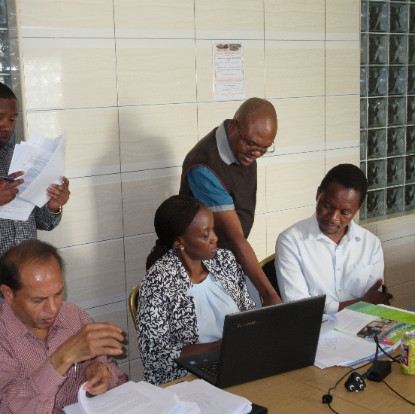
Addressing the needs of the Member States
1
Management Committee
Interlocutors
COL as secretariat

Slide 9
VUSSC Focus Areas
Open Educational Resources
Capacity building for online learning
Platform and technology support

Slide 10
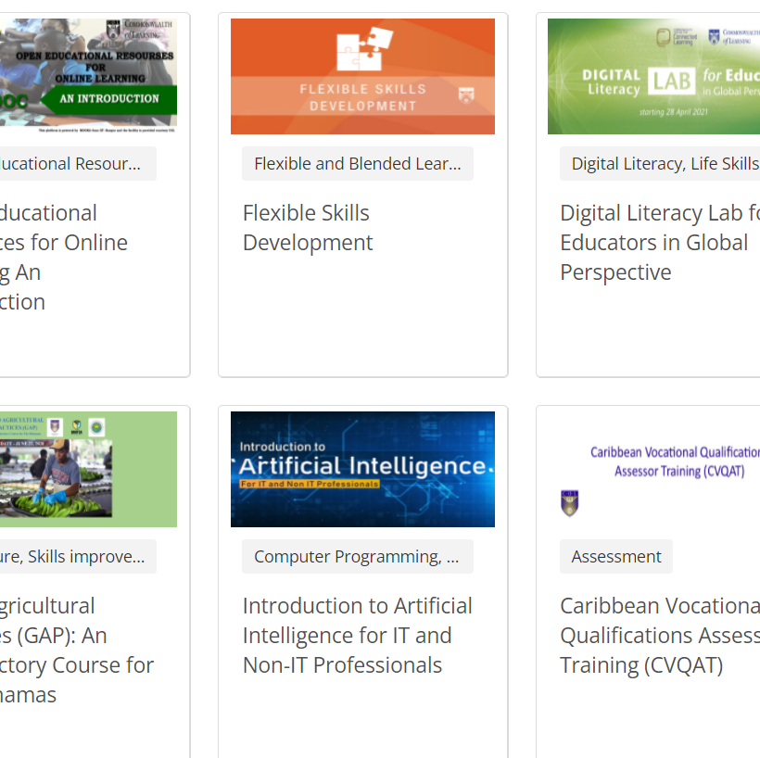
Community of Practice
2
Collaborative course development (from bootcamps to online)
Members decide activities with COL support
Institutional priorities are supported

Slide 11
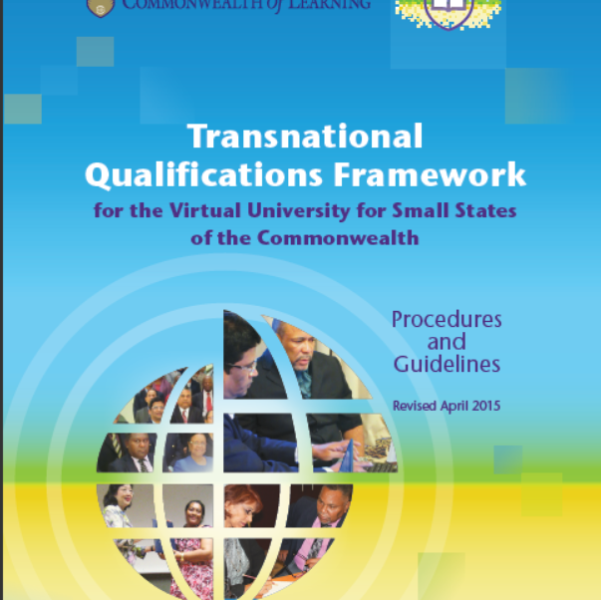
Quality Assurance
3
Capacity building support
Transnational Qualifications Framework
Monitoring and evaluation

Slide 12

Reduced Costs
9%
69% less direct cost to the VUSSC students in tuition fees
77%
77% of VUSSC students work
while studying compared to
only 9% of campus-based students
As a result, VUSSC students were able to earn on average
595 USD more per month
than the face-to-face-students while studying
$

Slide 13
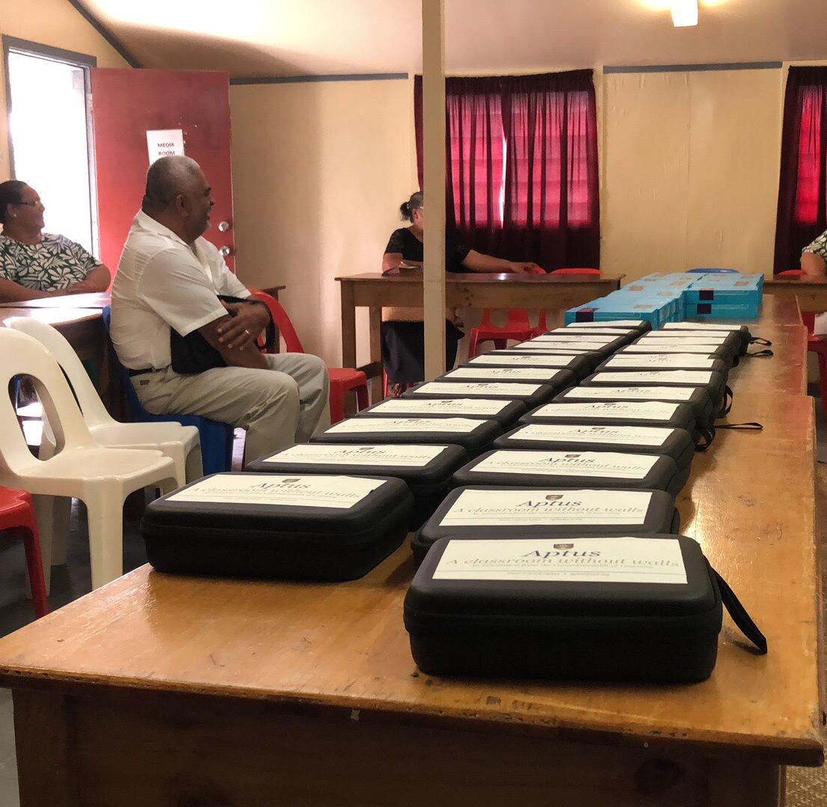
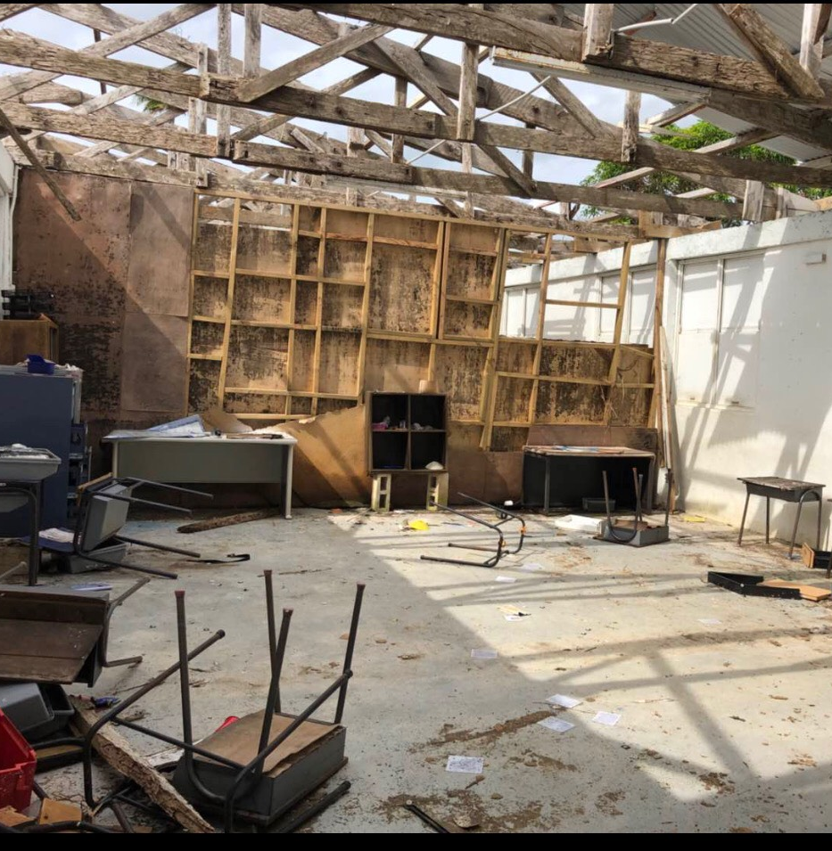
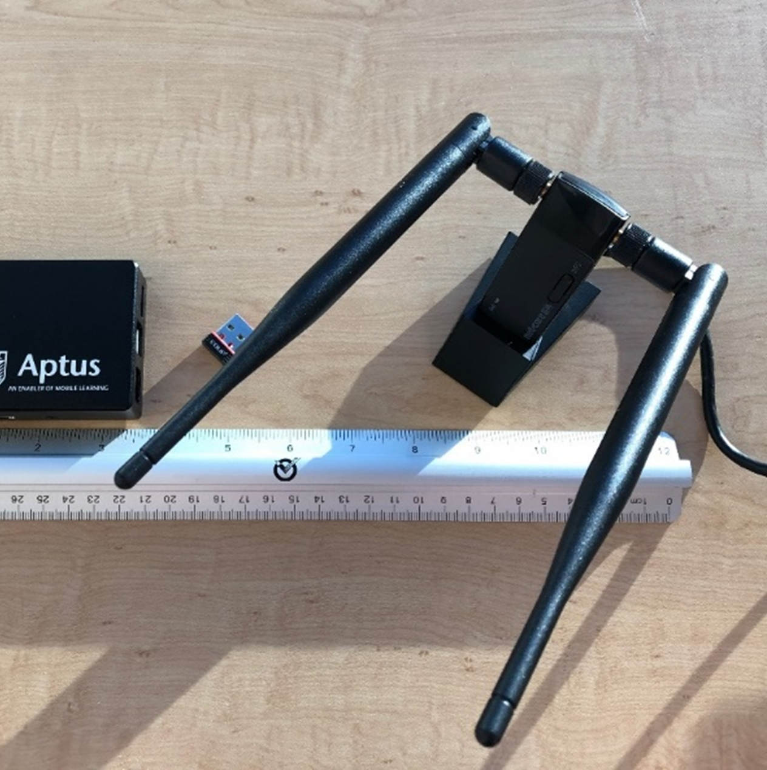

Technology Support
4
LMS support
ICT infrastructure
Aptus

Slide 14
VUSSC and Future of Learning
Promote access to quality tertiary education
Build institutional capacity for sustainable development
Contribute to Commonwealth cooperation

Slide 15


Thank you
www.col.org
The contents of this presentation, with the exception of logos and graphics which are the property of the respective owners, is made available under Attribution-ShareAlike 4.0 International (CC BY-SA 4.0).

