Slide 1
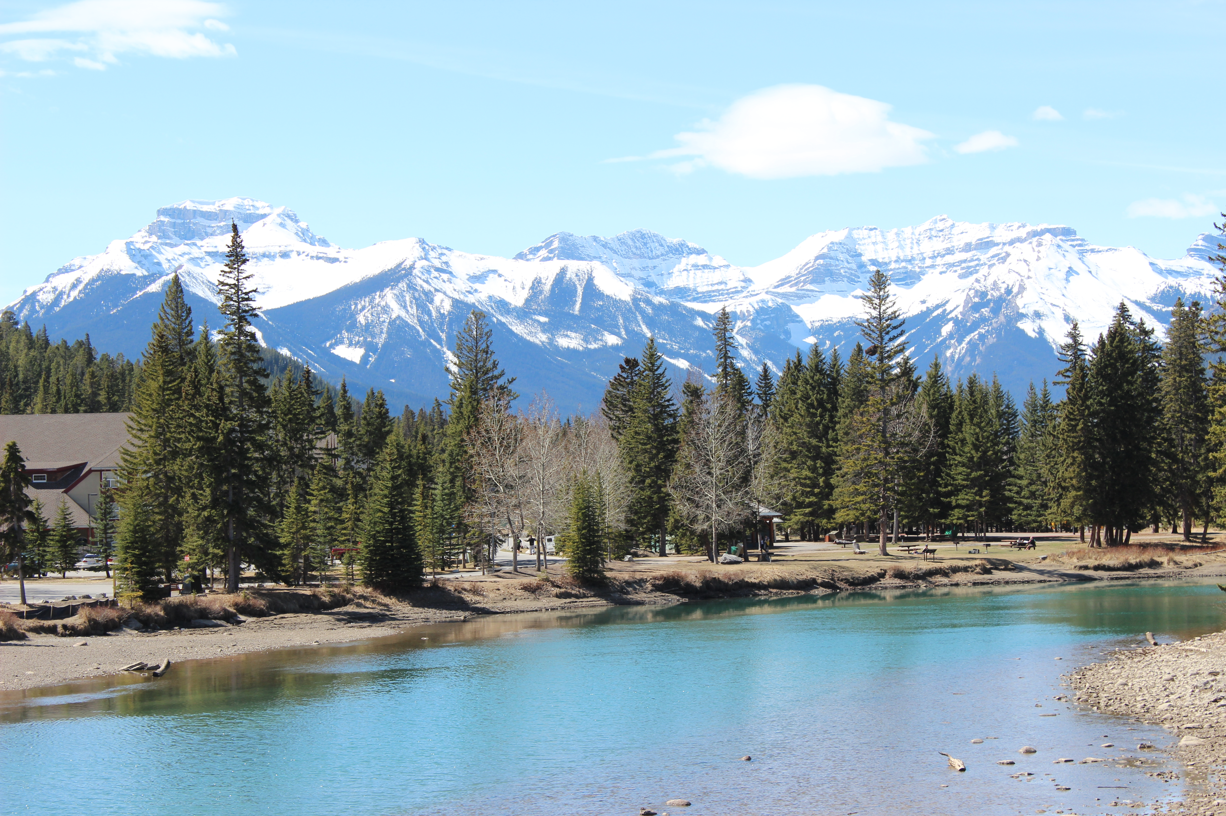




Collaborating across borders: OER use and open educational practices within the Virtual University for Small States of the Commonwealth
Leigh-Anne Perryman, The Open University, UK
leigh.a.perryman@open.ac.uk @laperryman
John Lesperance, VUSSC/Commonwealth of Learning
jlesperance@col.org @COL4D
Presented at OE Global 2015 Conference
Banff, Canada, 21-25 April 2015
Notes:
Leigh-Anne: 1 minute
Thank you…
OER Research Hub Fellow; presenting with John Lesperance from COL, Education Specialist in charge of VUSSC
Today, sharing the results of a survey of educators, formal students and informal learners connected with VUSSC - looking at OER use and OEP

Slide 2
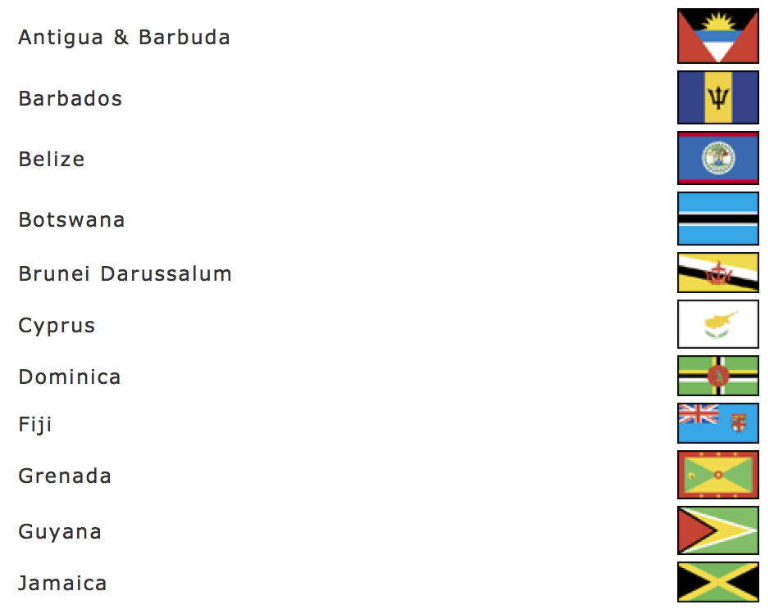
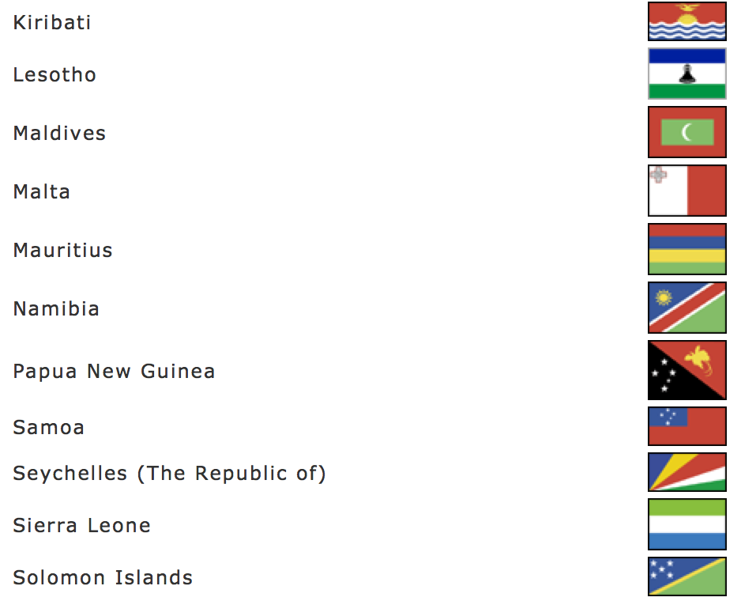
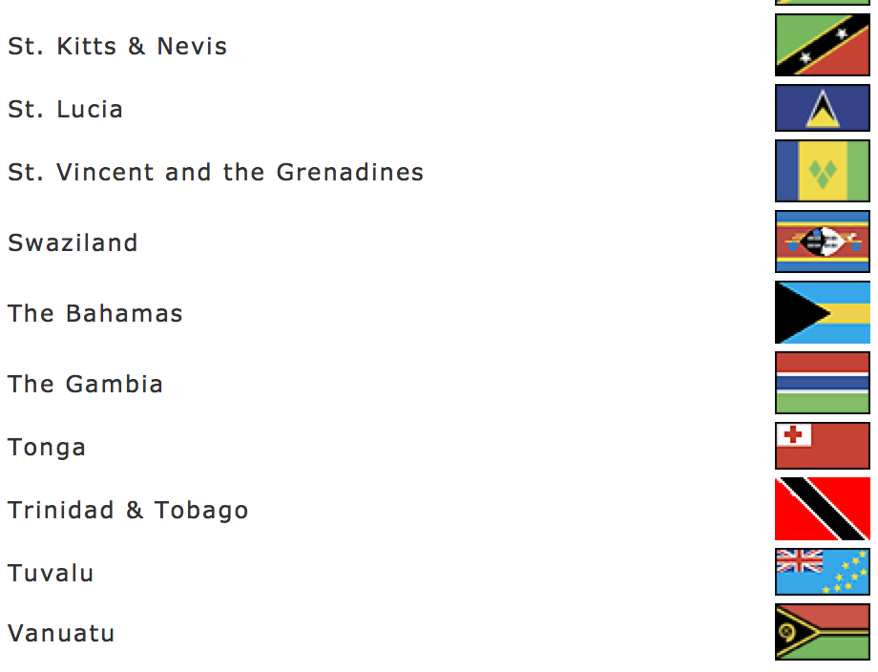
Intro to VUSSC
Network of 32 small developing states committed to collaboratively developing OER
Co-ordinated by Commonwealth of Learning
Notes:
Now I’ll hand you over to John, who will give a summary of how VUSSC works.

Slide 3
Introduction to VUSSC
John Lesperance

Slide 4
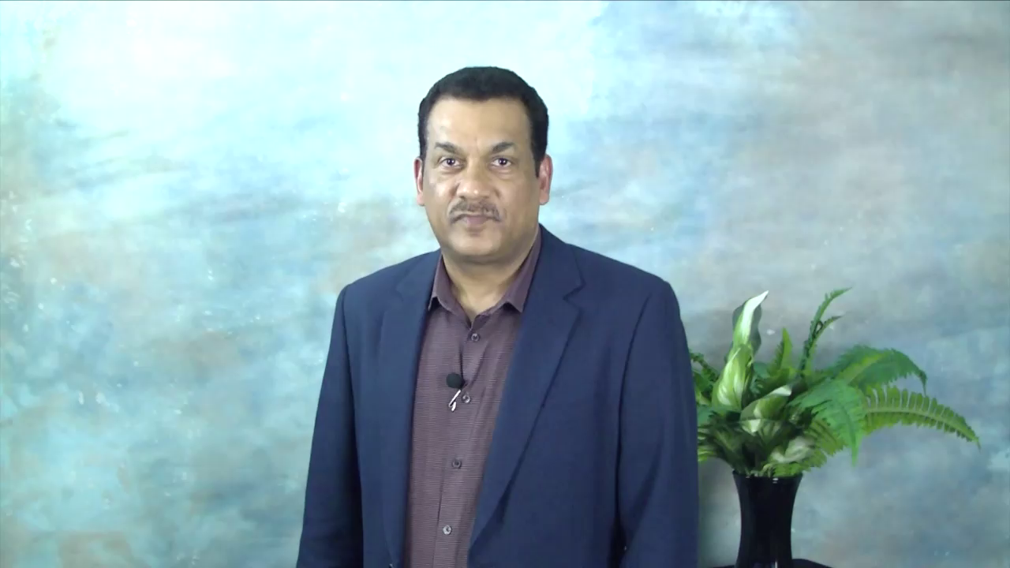
Notes:
Intro to VUSSC: John - video…. 2 minutes

Slide 5
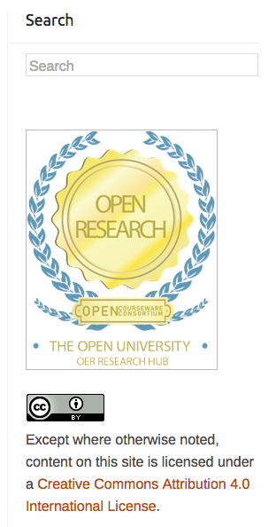
Methods
Use of OERRH questions
Comparison with OERRH global dataset
20 follow-up Skype interviews
Notes:
Leigh-Anne: 1 minute
OER Research Hub - Fellow. Survey drew heavily on OERRH questions, which I was heavily involved in developing. This allows for comparison with evidence from the OERRH global dataset.
Used SurveyMonkey. Then conducted follow-up Skype interviews.

Slide 6
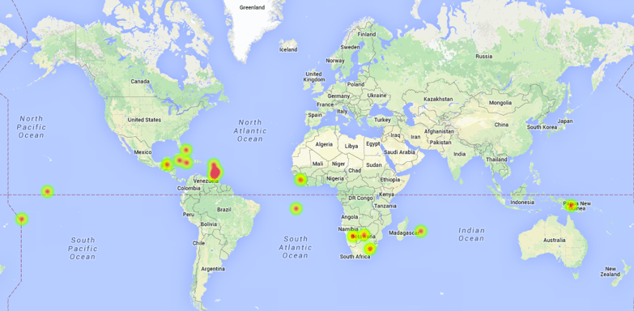
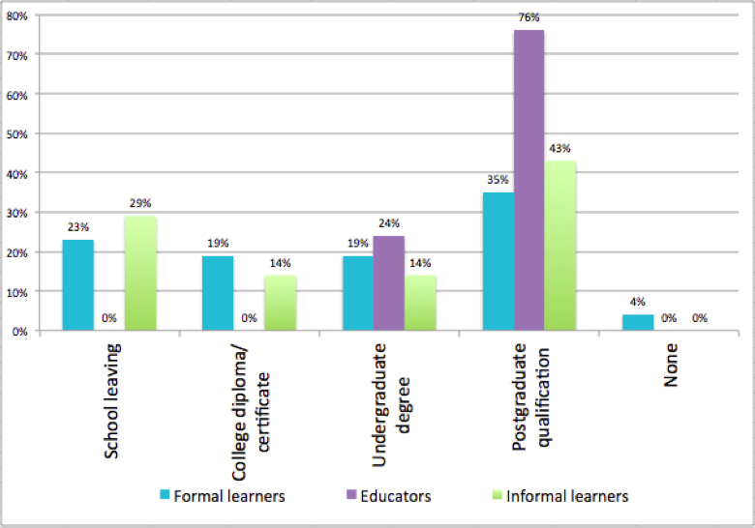
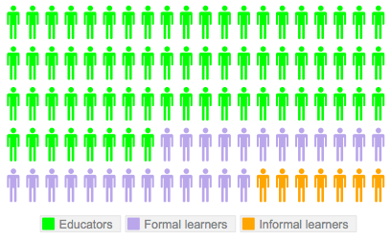
The
sample
18 countries
72% of respondents identified English as their first spoken language
68%
25%
7%
Notes:
Leigh-Anne: 1 minute
18 countries, but 72% identify English as first spoke language
Largely very well qualified…
68% educators, 25% formal students, 7% informal learners.

Slide 7
Educators’ use of OER (1)
Notes:
Leigh-Anne: 2 minutes
Looking first at how the VUSSC educators are using OER. Highly engaged.
Comparison with Indian educators, OpenLearn and Saylor.

Slide 8
Educators’ use of OER (2)
Notes:
Leigh-Anne: 3 minutes
Outcomes of educators’ use of OER. Still shows educators as highly engaged.

Slide 9
Impact of OER on formal learners
Notes:
Leigh-Anne: 3 minutes
Moving to formal learners. Slide compares…..
Shows OER having a big impact on VUSSC formal learners. Especially impressive when compared with other OERRH survey respondent categories.
Hand you over to John again, who will tell you about a case study – Botswana College of Distance and Open Learning – where the impact of VUSSC is very clear.

Slide 10
The BOCODOL Case Study
John Lesperance

Slide 11
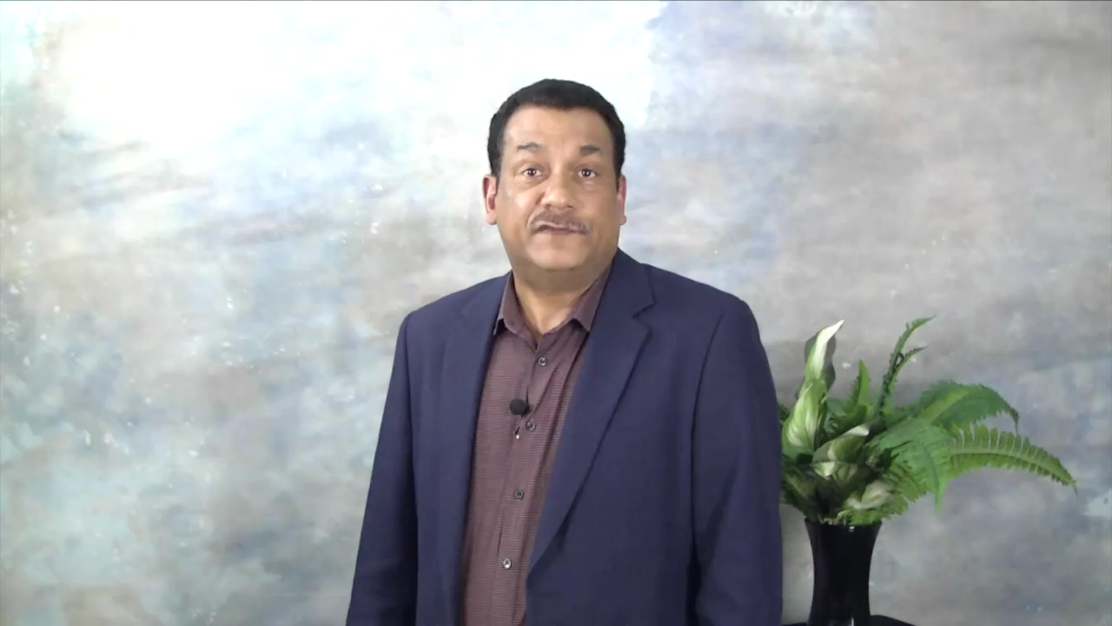
Notes:
Quotes on some slides while John is talking. Probably 2 minutes.

Slide 12
Challenges to OER use
 | Educators | Formal learners
Finding OER relevant to my context | 87% | 80%
Knowing where to find OER | 77% | 82%
Finding OER in my subject area | 76% | 82%
Technical problems | 71% | 80%
Insufficient time to find OER | 73% | 67%
Finding quality OER | 70% | 82%
No connections with OER-using peers | 62% | 57%
Finding up-to-date OER | 56% | 73%
Notes:
Leigh-Anne: 1 minute

Slide 13
What Next?
Future Development of VUSSC
John Lesperance
Future research: case studies; more analysis against
new model (Perryman & Seal, 2015)

Slide 14
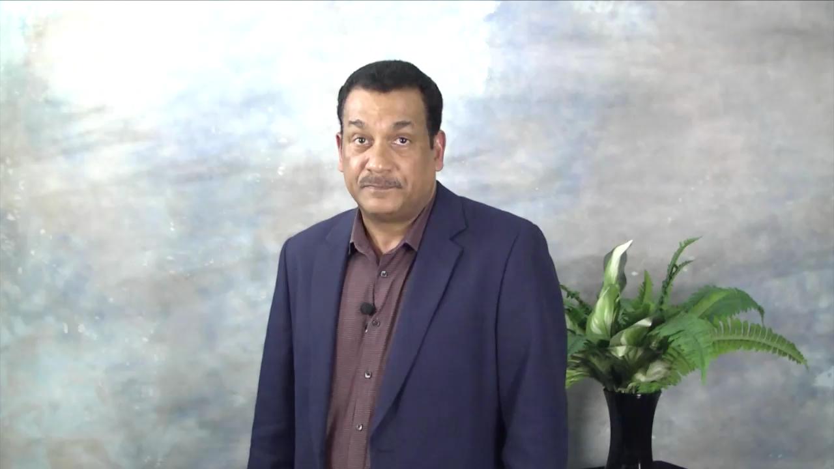
Notes:
John - future development of VUSSC (1 minute video); Leigh-Anne - future research (1 minute)

Slide 15
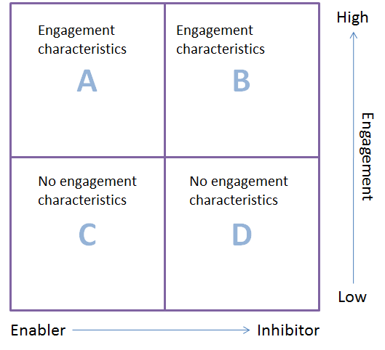
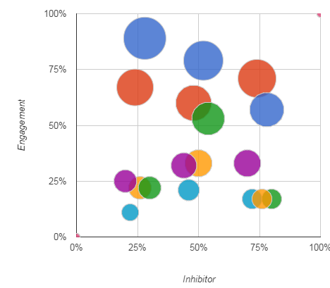
A new model of OER engagement in development contexts

Slide 16
Thank you for listening
Leigh-Anne Perryman, The Open University, UK
leigh.a.perryman@open.ac.uk @laperryman
John Lesperance, VUSSC/Commonwealth of Learning
jlesperance@col.org @COL4D

