Slide 1

Dr Venkataraman Balaji
Director, Technology and Knowledge Management
Faculty Workshop on a MOOC on Life Skills for Engineers Kanpur, India | 27 November 2017

Slide 2
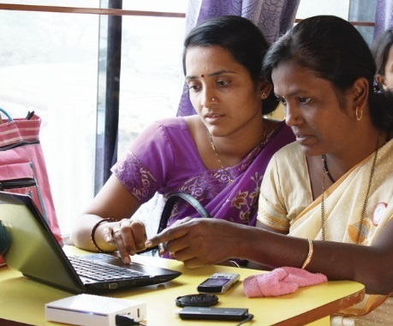
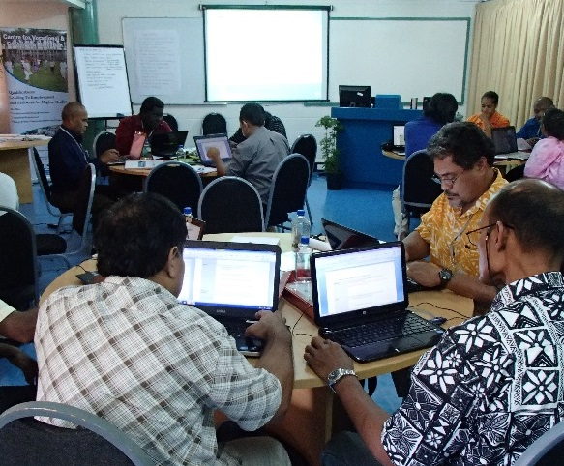
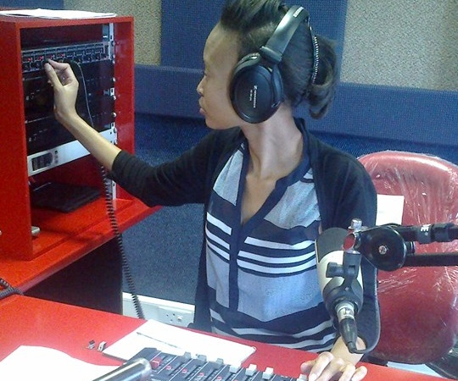
Why MOOC While Teaching Life Skills?
MOOC can contribute to development in general
To skills development, in particular

Slide 3
MOOCs Can be an ally in Open Learning
Provide access to quality learning at low costs.
Build capacity at scale
Improve learning outcomes, through the use of alternative pedagogical approaches
Be integrated within national quality assurance frameworks.

Slide 4
MOOC as a Tech Suite….
scalability
media technology
assessment techniques online
online event/ conferencing management

Slide 5
Diversification in MOOCs
No longer limited to credit orientation
Not limited to Higher Education sector
Notes:
No longer limited to Higher Education
Not confined to credit oriented courses

Slide 6
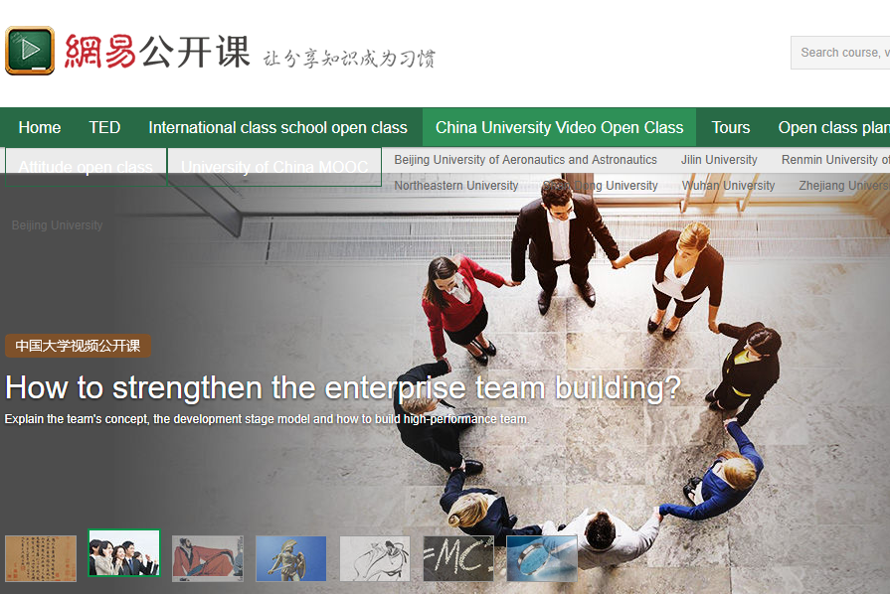

Re-engineering the Tech Suite in MOOC
MOOC portal of Ministry of HRD, India (built by Microsoft)
For-profits in China, such as 163.com

Slide 7
Why is re-engineering necessary for MOOC4D in Open Education
Reaching Out to Faculty with no exposure to TEL
Learners not comfortable with peer-grading and online socialising paradigms in industry-grade MOOCs
Strongly felt need for mentoring in the course space
Video demands bandwidth
  implies reasonable or high costs to learners

Slide 8
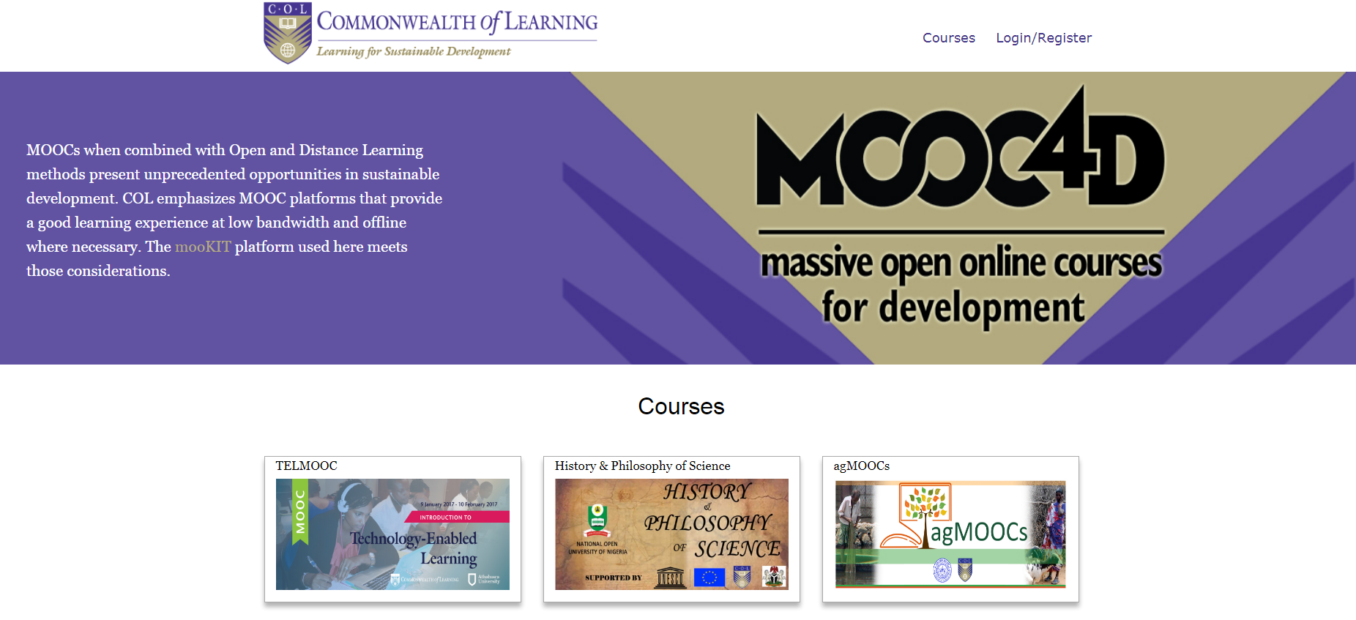
COL’s MOOC4Dev
Adaptation
Re-engineering
and innovation

Slide 9


COL and Indian Institute of Technology Kanpur partnership
MooKIT platform
  Scalable to tens of thousands at low cost
  Uses publicly accessible video streaming services (such as YouTube)
    Content is open (OER)
Audio track of video accessible on a phone
Scripts of talks and slides available (as PDF)
Integrates Social Media into the course discussion space

Slide 10
COL’s MOOC for Development: Overview
18 MOOCs on topics related to Human and Sustainable Development
3 MOOCs using just basic cell phones as access devices
Total of 20,000 learners from 112 countries
Platform used for capture of analytic data covers more offerings by partners
About 112,000 learners in all in 30 months

Slide 11

MOOCs for Agriculture
Online learning
  Food and Ag sector underserved
A consortium conceptualised by COL, anchored at IIT-Kanpur

Slide 12
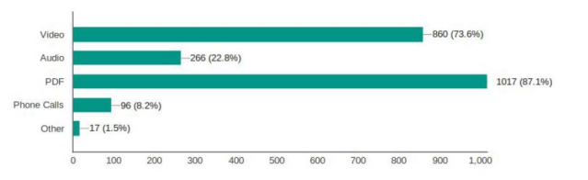
Important to allow content access in multiple formats

Slide 13
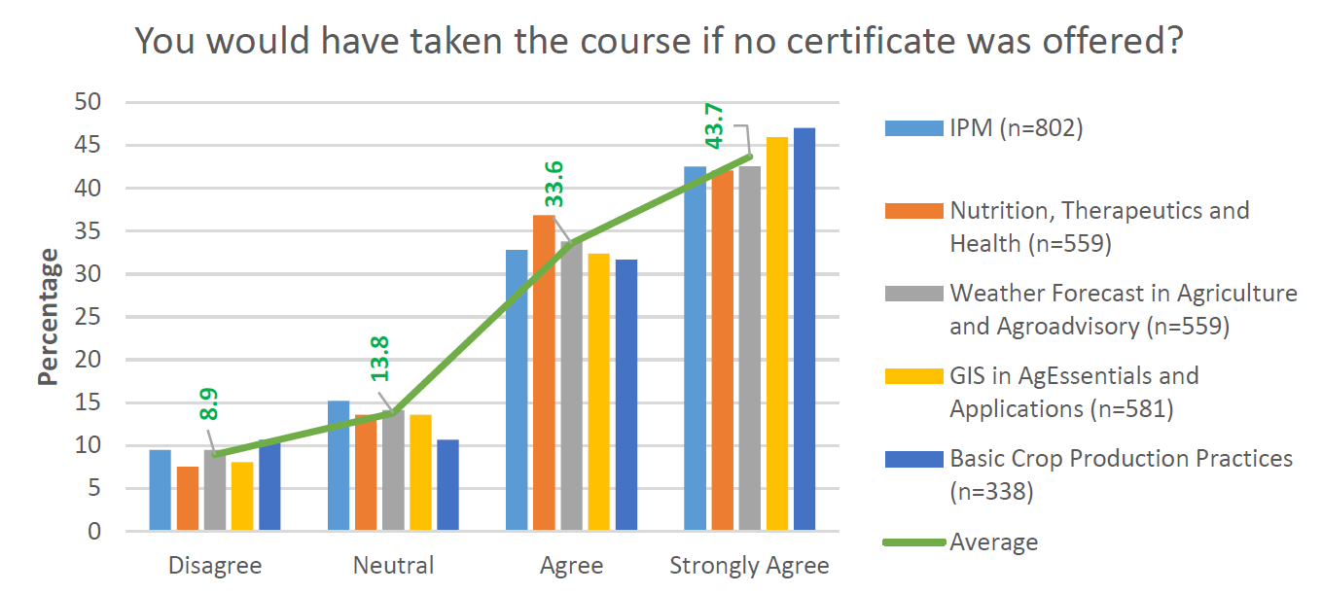
Certificate is not the main source of motivation
Notes:
Responses gathered from several hundred participants in each MOOC

Slide 14
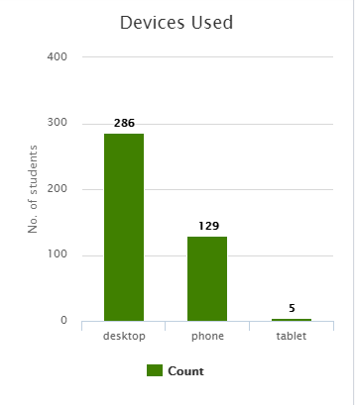
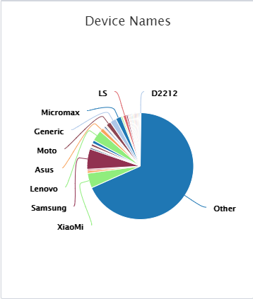
Methods of Access (Sample from a MOOC, Sep 2017)

Slide 15
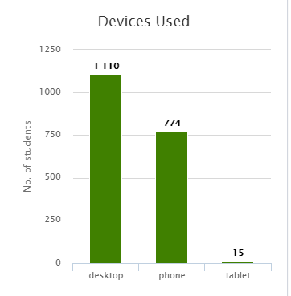
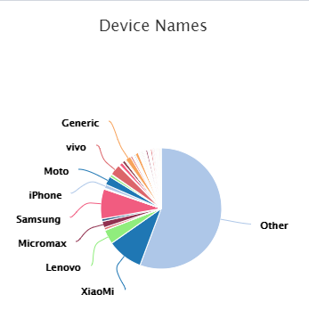
Methods of Access (Data from a MOOC, 10 October 2017)

Slide 16
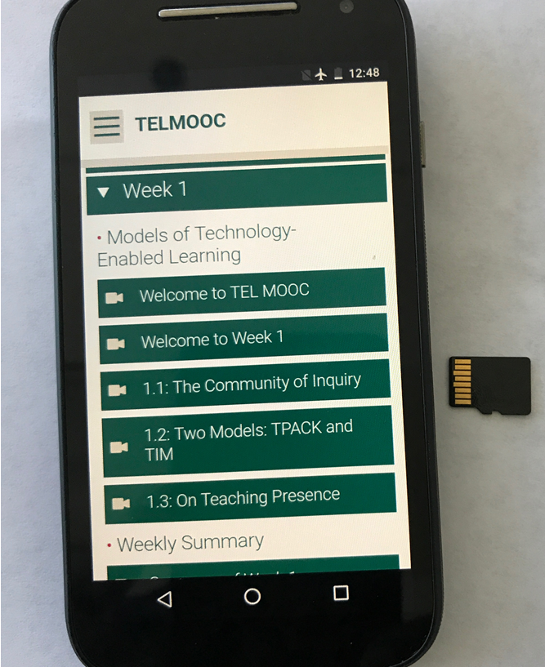

An “Off-lined” MOOC?

Slide 17
Reaching the Bottom Billion
Content should be designed for delivery in low bandwidth
Be able to deliver on a basic phone
Social media integration is a must
Online peer-to-peer interactions must be supplemented with blended approaches
Content should be open ie. OER

Slide 18
Quality

Slide 19
Guidelines for Quality
COL Guidelines for MOOCs
Purpose decides quality indicators
Context critical
Accreditation agencies looking for credit equivalence

Slide 20


Issues for Quality
One size does not fit all
Student verification and academic integrity
Peer assessment needs to be accepted
Delinking of the institutions which teach and the institutions which offer credential

Slide 21

National Policy
View MOOC as a new, interactive broadcast medium
Develop credible QA and Credentialing framework
Focus on Higher Education as well as advanced skills development/in-service training
Develop and nurture a capable and robust infrastructure
Manage costs: adopt OER policies

Slide 22
Finally, for developing countries
New model of MOOCs required, one that reaches the unreached
MOOCs will supplement rather than replace traditional institutions
Excellent platform for skilling at scale and speed

Slide 23
Two major developments
Can influence MOOC for Development in a big way
Rise of Messaging Paradigm
  Messaging today is bigger than social media!
  WhatsApp, WeChat and Messenger have more users daily than all social media combined
  Easier to access even at low bandwidth (e,g India has 200 M users of WhatsApp)
Blockchains
  Enable unique records of learners to be maintained across institutions and offerings
  Applied research still needs to be done
  Major opportunity for developing countries to claim leadership

Slide 24

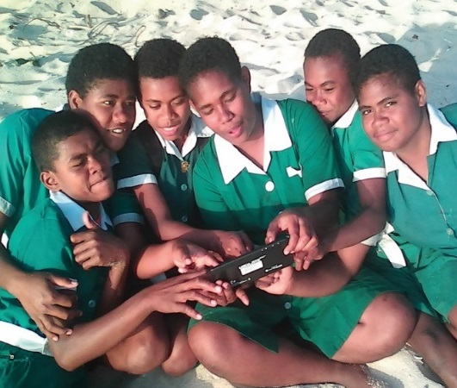
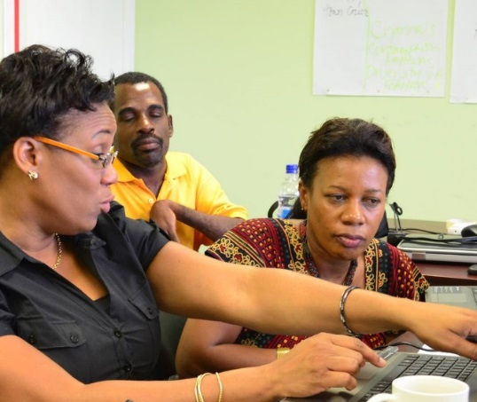
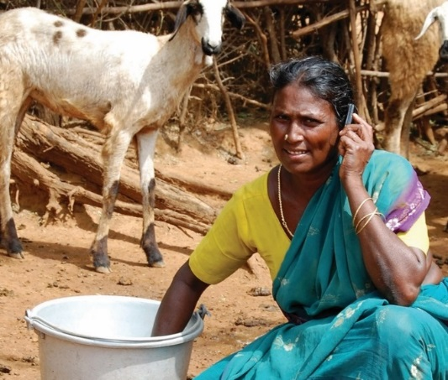
Thank You
col.org

