Slide 1
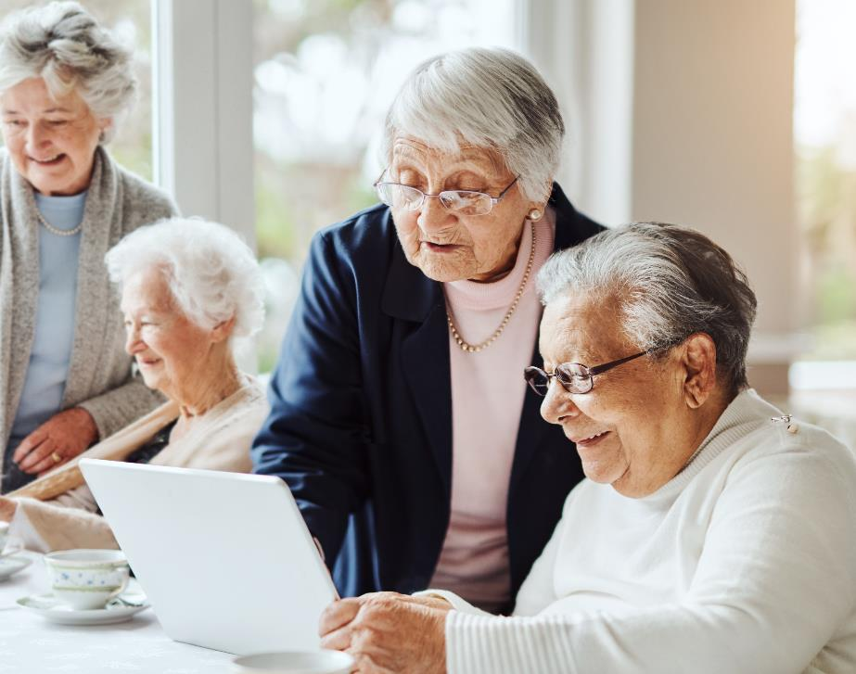



Elderly Learning in the Digital Age: Towards Empowerment
Professor Asha Kanwar
President & CEO, Commonwealth of Learning
Co-written Dr K Balasubramanian, former VP, COL
Mr Ricky Cheng, Knowledge Services Manager, COL
Zheijiang Open University | 16 November 2023

Slide 2
The Commonwealth
56 developed and developing nations around the world
Africa: Botswana, Cameroon, Eswatini, Gabon, The Gambia, Ghana, Kenya, Lesotho, Malawi, Mauritius, Mozambique, Namibia, Nigeria, Rwanda, Seychelles, Sierra Leone, South Africa, Tanzania, Togo, Uganda, Zambia
Asia: Bangladesh, Brunei Darussalam, India, Malaysia, Maldives, Pakistan, Singapore, Sri Lanka
Caribbean & Americas: Antigua and Barbuda, The Bahamas, Barbados, Belize, Canada, Dominica, Grenada, Guyana, Jamaica, St Kitts and Nevis, St Lucia, St Vincent and The Grenadines, Trinidad and Tobago
Europe: Cyprus, Malta, United Kingdom
Pacific: Australia, Fiji, Kiribati, Nauru, New Zealand, Papua New Guinea, Samoa, Solomon Islands, Tonga, Tuvalu, Vanuatu
Updated: December 2022

Slide 3
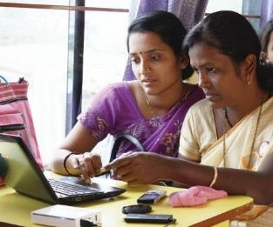
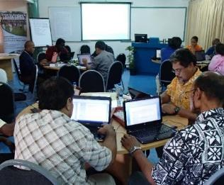
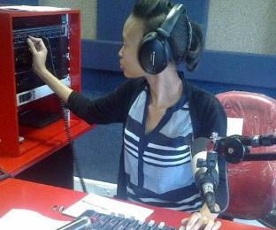
To help Commonwealth governments and institutions use technologies to improve and expand access to education and training

Slide 4


OUTLINE
Understanding Elderly Learning
University of the Third Age: Models
Role of ICT
Towards Empowerment

Slide 5

Understanding
Elderly Learning

Slide 6


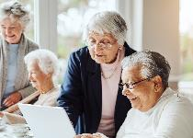
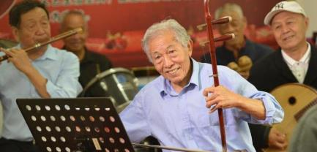
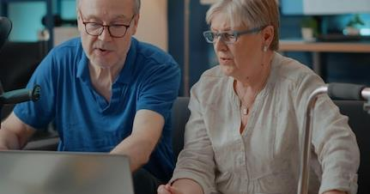
Context Today
Phenomenal developments in technology
Life expectancy: half the people born after 1997 could live up to 100
By 2025, 85 million jobs may be displaced but 97 million more jobs may emerge
Skills for the green and blue economies
Source: The Future of Jobs Report 2020, WEF, Oct 2020
McKinsey Quarterly, Beth Davies, Connor Diemand-Yauman, Nick van Dam, ‘Competitive advantage with a human dimension: from lifelong learning to lifelong employability’

Slide 7
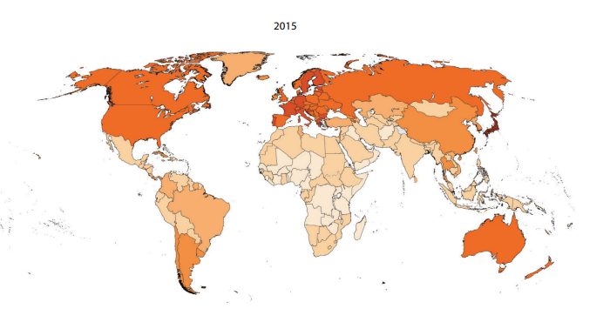
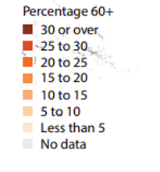
Percentage of the population aged 60 years or over, 2015
Source: United Nations, Department of Economic and Social Affairs, Population Division (2015). World Population Ageing 2015 - Highlights (ST/ESA/SER.A/368)

Slide 8
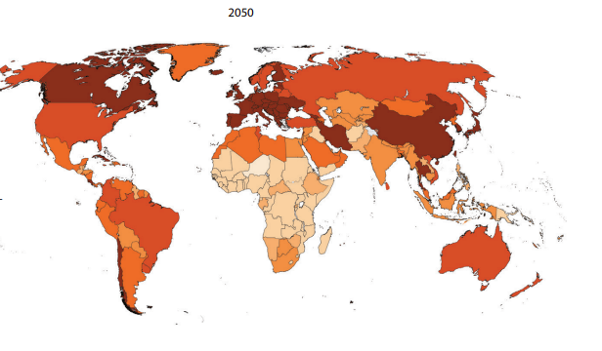

Percentage of the population aged 60 years or over, 2050
Source: United Nations, Department of Economic and Social Affairs, Population Division (2015). World Population Ageing 2015 - Highlights (ST/ESA/SER.A/368)

Slide 9
Pension Age Increases
United Kingdom: current age of eligibility for public pension
benefit will increase to 67 years of age between 2026 and 2028.
Australia: age of eligibility will increase to 67 in 2023.
Denmark began a process of gradually increasing the age of eligibility to 68 years by 2030.
Vietnam, the retirement age will gradually increase to 62 for males by 2028 and 60 for females by 2035.
Source: Pensions at a Glance 2021 - OECD and G20 Indicators
Source: Mercer, Vietnam begins to phase in increased retirement age (2021)

Slide 10
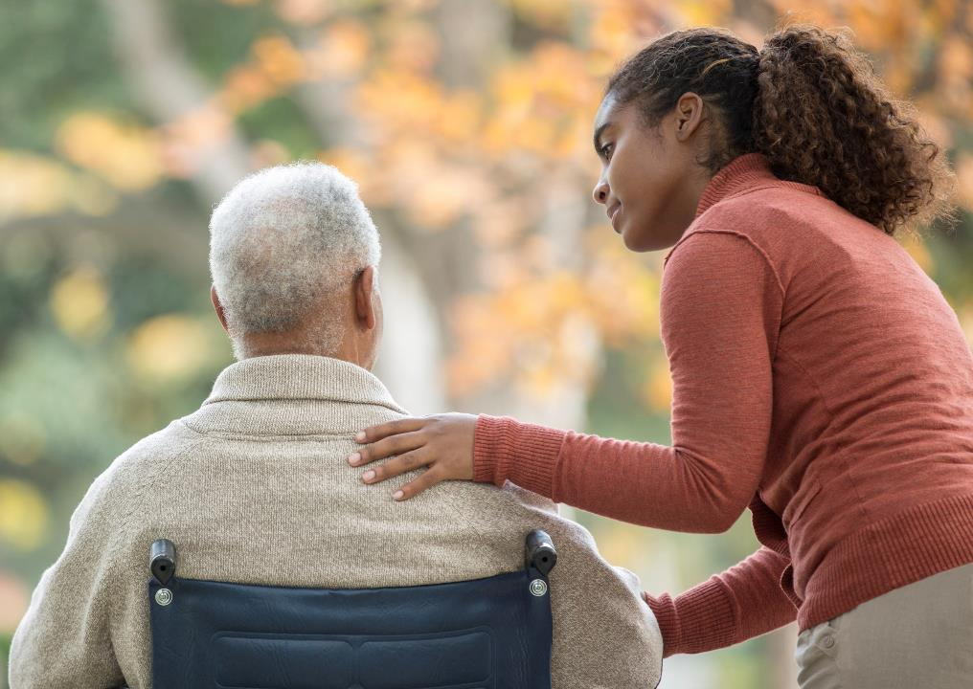
Who are the elderly?
60+ ‘Third Age’
80+ ‘Fourth Age’
Diverse group with differences in gender, culture, class, context
Different needs, behaviours, attitudes

Slide 11
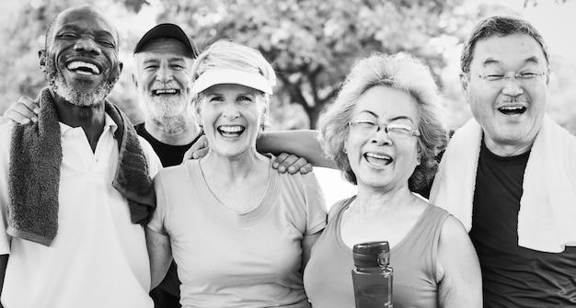
Why do they want to learn?
To give back to society
Keep the mind active and constantly learn
Self-fulfilment and understand the meaning of life
Health
New friendships
Image source: https://www.freepik.com
Gillian M Boulton-Lewis (2010) ‘Education and Learning for the Elderly: Why, How, What, Educational Gerontology, 36:3, 218-219
Notes:
Cybersecurity a major issue

Slide 12
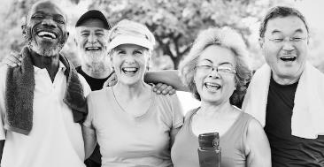
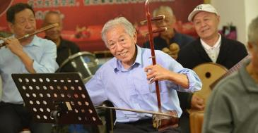

What do they want to learn?
Health management
Finance
ICTs
Leisure and art
Maureen Tam & Ernest Chui (2015): Ageing and Learning: What do they mean to elders themselves?, Studies in Continuing Education, 1-18

Slide 13
Contributions of Elderly Learning
Contributes to physical, functional, psychological, social health satisfaction with life, physical/emotional well-being.
Mental training in later life boosts intellectual power and helps reverse memory decline.
Cognitive activity may allow new neural pathways to develop and replace the ones destroyed.
Gillian M Boulton-Lewis (2010) ‘Education and Learning for the Elderly: Why, How, What, Educational Gerontology, 36:3, 213-228

Slide 14
Benefits
Cognitive gains through new knowledge
Social linkages through new friends and support groups
Spiritual needs relating to meaning of life
Self-health for prevention of disease, medical knowledge for care
E-learning opportunities
(Formosa, p. 116)

Slide 15
Universities of the Third Age: Models

Slide 16

France:
University model (1973)
OBJECTIVES:
Raising the quality of life
Offering an educational programme in relation with younger peers
Advancing research and education in gerontology
Marvin Formosa(2012): ‘Education and Older Adults at the UTA’, Educational Gerontology, 38:2, p.115

Slide 17
France:
University model (1973)
FEATURES:
University decides the courses
Faculty teaches the courses
Classes take place on campus which may not be convenient
Mostly funded by universities, donations, fees

Slide 18

Britain:
Self-help model (1981)
OBJECTIVES:
Rejected the notion of intellectual decline with age
Provide retirees with resources for developing intellectual and cultural lives
Intellectual interests as an end in themselves
Elders both teachers and learners
(Laslett, 1984, cited in Formosa, p.115)

Slide 19
Britain:
Self-help model (1981)
FEATURES:
Flexible arrangements for venue—homes, libraries
Democratically run by committees
No prior qualifications required
Minimal membership fees
(Laslett, 1984, cited in Formosa, p.115)

Slide 20
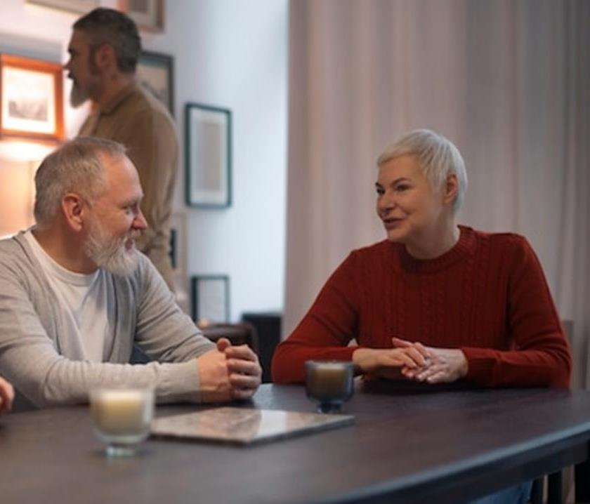
USA, Canada:
Institutes for Learning in Retirement (ILRs): Hybrid model
Focus on personal development (not vocational development)
Sponsored by a university but owned by the group
Volunteers and faculty participate
Promote college level intellectually stimulating courses
Foster social connections through meetings, trips
Community engagement
U3A historical paper, www.worldu3a.org/resources/u3a-worldwide.htm
Image source: www.freepik.com

Slide 21

China:
Supported by local and national government, social associations
By 2017, 490,000 elder schools with 7 million registered students
65% women participate.
UTA’s no longer exclusively for older cadres but for all
By 2020s, 20% older people to participate in educational activities and 50% of townships should include some late-life learning activities
Xinyi Zhao and Ernest Chui, The Development and Characteristics of U3A’s in Mainland China’ , in Marvin Formosa (2019) The University of the Third Age and Active Ageing, Springer.
Image source: www.freepik.com

Slide 22
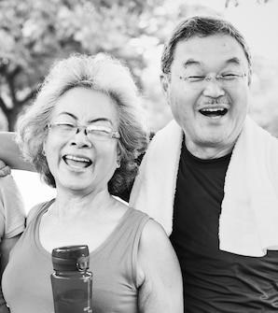
Literature indicates
A bias in favour of the healthy, well-educated and financially secure seniors
Middle-class values and perspectives of ‘active ageing’ projected as the norm
Urban-based
More emphasis on recreational rather than vocational/professional training
Inadequate research on what the elderly want

Slide 23
Role of Technology

Slide 24
ICT Statistics: Internet Users 2009 - 2021
Source: World Bank databank, world development indicators, retrieved on 23 October 2023

Slide 25
ICT Statistics: Mobile Subscriptions
2009 - 2022
Source: World Bank databank, world development indicators, retrieved on 23 October 2023

Slide 26
Barriers to technology use for the elderly
Cognitive—memory and processing speed
Visual, auditory and motor control abilities
Mental—attitudinal
Privacy concerns—security and safety
Rana Mostaghel (2016), Innovation and technology for the elderly: systematic literature review. Journal of Business Research. Elsevier

Slide 27
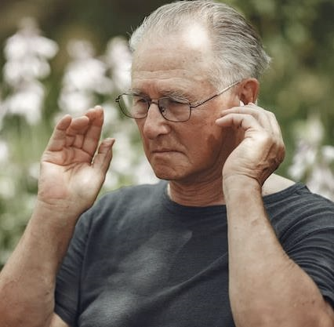
Grey Digital Divide
Seniors often struggle with reduced reactivity, making it harder to keep up with fast-paced technology. Examples:
Platforms that use notifications: 9% of seniors at the age of 75 or over have severe visual impairments, and 18% have severe hearing limitations (EU)
Many seniors struggle with touch screens due to ‘leathery fingers’.
Image source: https://www.freepik.com
Source: No Isolation, Why do many seniors have trouble using technology? Accessed on 25 October 2023.

Slide 28

Senior technology use in Hangzhou
Seniors using cell phones (96%); computers (65%)
Used for talking, texting (58%), taking pictures (20%), social networking (9%)—less than 5% for banking, paying bills, email.
Attitudes towards ICTs are positive
Image source: https://www.freepik.com
Alexander N Chen, James P Downey, Ronald E McGaughey & Kan Jin, (2016) Seniors and Information Technology in China, International Journal of Human-Computer Interaction, 32:2, 132-142
Notes:
Pre-pandemic

Slide 29
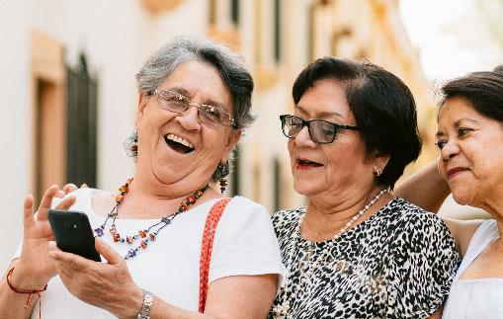
Elderly Attitudes to ICTs:
Spain
Tele-services for the Elderly
65-74 years—recently retired
—more eager to engage in learning
activities
Majority—middle class
Men more involved in activities but
women more self-confident
Positive correlation between participation and positive attitude toward ICT with confidence in the ability to learn and self-confidence
Image source: https://www.freepik.com
Antonio Gonzalez et al (2012), Attitudes of the Elderly Towards ICTs. Educational Gerontology, 38: 585-594, Routledge

Slide 30
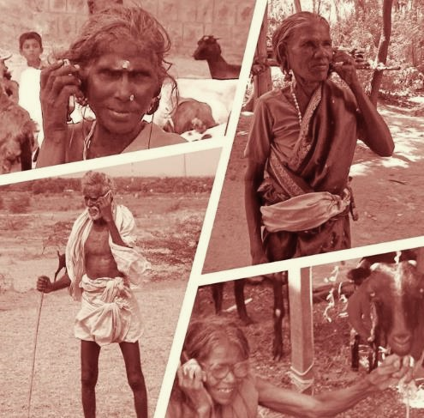
Senior Technology Acceptance and Adoption Model
Ease of use
Perceived usefulness
Attitude towards technology
Self-efficacy
Social influence
Facilitating conditions
Renaud and von Biljon (2008) cited in Mostaghel, p 2

Slide 31
Role of Technology for improving quality of life
Robotics to care for the elderly
Mobile phones to connect with families and friends
Receive virtual visits from healthcare providers
Independence and confidence
Using technology and blended approaches for learning

Slide 32

Building on the Phenomenal Growth of Self-Directed Learning

Slide 33
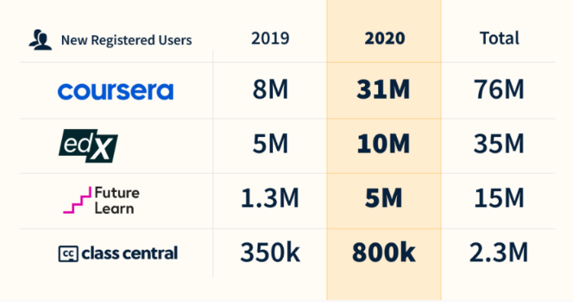
A range of new online courses
Universities started many online courses
Increased adoption of online distance education
Increased acceptability of online training for professional development
Source: https://www.classcentral.com/report/the-second-year-of-the-mooc/

Slide 34
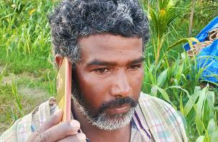
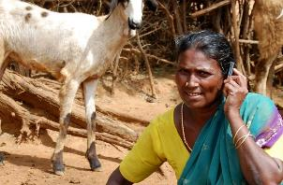
REACHING THE BOTTOM BILLION
Use technologies that are
appropriate and affordable
Content designed for delivery in low bandwidth situations
Open Content in local languages ie. OER
Social media integration
Online peer-to-peer interactions supplemented with blended approaches
Notes:
Online peer-to-peer interactions supplemented with blended approaches

Slide 35
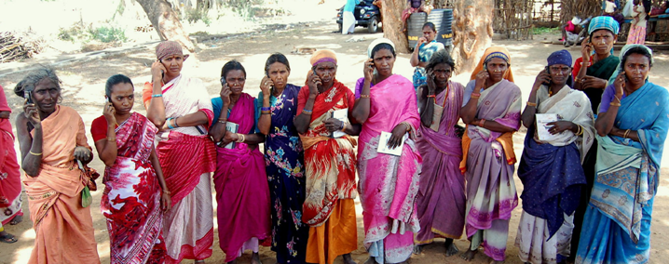
Basic mobile phones for reaching farmers

Slide 36
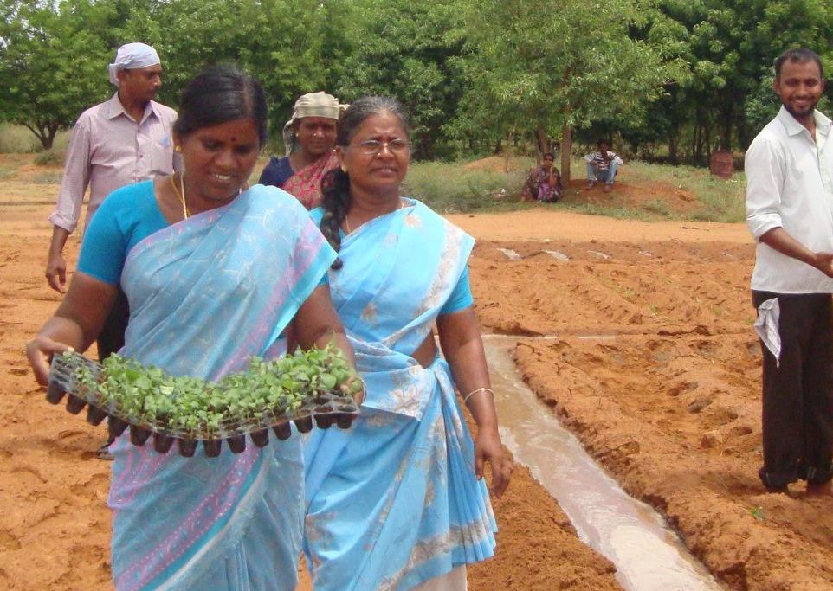
Arogya Mary school dropout, grandmother, who never knew about the internet before the training
Content and Web Manager for a Farmer’s Organization
Facebook content: 600 different content uploaded
YouTube: 500 videos of farmers field experiences
WhatsApp: 150 organic agriculture based content
Trained: over 1000 farmers

Slide 37
Technology
AI-Enabled Applications for Predictive, Personal Learning
Generative AI
HyFlex i.e., seniors can learn on-site, synchronously online, or asynchronously offline
Supports Sense of Connectedness
Source: https://library.educause.edu/resources/2023/5/2023-educause-horizon-report-teaching-and-learning-edition

Slide 38
Empowering the Elderly

Slide 39
Learning for Successful ageing
“Healthy ageing is defined as developing and maintaining the functional ability that enables well-being in older age. Functional ability is determined by the intrinsic capacity of an individual (i.e., an individual’s physical and mental capacities), the environment in which he or she lives (understood in the broadest sense and including physical, social and policy environments) and the interactions among them. (WHO, 2017)
“..successful aging and lifelong learning are socially constructed and culturally determined” (Maureen Tam , 2014)
Maureen Tam (2014): Understanding and Theorizing the Role of Culture in the Conceptualizations of Successful Aging and Lifelong Learning, Educational Gerontology, DOI: 10.1080/ 03601277.2014.907072
https://www.who.int/health-topics/ageing#tab=tab_3
Notes:
Learning for strengthening the intrinsic capacity for successful and healthy ageing

Slide 40
Selection, Optimization, and Compensation:
SOC Model
Normative Approach
Selection: the process through which individuals focus and prioritize goals as they become old
Optimization: maximizing the current resources available with individuals
Compensation: mobilizing additional resources as they age
J. D. Carpentieri, Jane Elliott, Caroline E. Brett, Ian J. Deary, Adapting to Aging: Older People Talk About Their Use of Selection, Optimization, and Compensation to Maximize Well-being in the Context of Physical Decline, The Journals of Gerontology: Series B, Volume 72, Issue 2, 1 March 2017, Pages 351–361, https://doi.org/10.1093/geronb/gbw132
Notes:
Normative or Subjective Approach: Both require lifelong learning and capacity building.
Selection, Optimization, and Compensation “contribute to successful aging by helping older people maximize well-being in the context of physical decline” (J. D. Carpentieri et al 2017)

Slide 41
Multi-Dimensional Model
(Phelan EA et al 2004)
Subjective Approach: individual
How do older adults define successful aging ?
Multidimensional: physical, functional, psychological, and social health.
Phelan EA, Anderson LA, LaCroix AZ, Larson EB. Older adults' views of "successful aging"--how do they compare with researchers' definitions? J Am Geriatr Soc. 2004 Feb;52(2) 211-216. doi:10.1111/j.1532-5415.2004.52056.x. PMID: 14728629.

Slide 42
Paucity of concern
‘there has always been a reluctance among adult educators to examine the principles and practices of teaching and learning as they might apply to the elderly’. (David Battersby ,1987, p. 4)
Battersby, D. (1987) From Andragogy to Gerogogy, Journal of Educational Gerontology, 2(1), pp. 4-10.

Slide 43

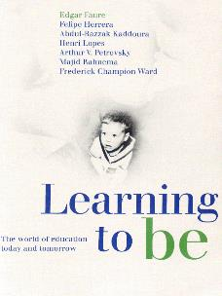
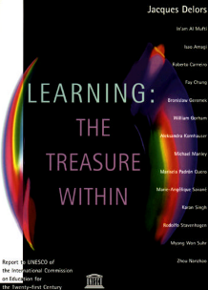
From Lifelong ‘Learning’ to late-life learning
Holistic approach to education not limited to age or socio-economic groups
Edgar Faure Report
Learning throughout life
Learning to know; learning to do, learning to be; learning to live together
Delors Report, UNESCO

Slide 44



Dimensions of Lifelong Learning
When?
Life phases: from cradle to grave; life-wide
How?
Modality of delivery: formal, non-formal, informal
What?
Learning domains: personal, social, cultural, developmental
Source: UIL, 2014, p. 12

Slide 45



“To enhance access to high quality, affordable and relevant education…and ensure lifelong learning opportunities to face challenges in a knowledge society."
" To widen access to quality education and provide lifelong learning opportunities by leveraging on technology… providing a conducive…learning environment at…affordable cost"
Sukhothai Thammathirat Open University aims to be a world-class open university utilizing a distance education system to provide lifelong learning for all
Source: http://www.ou.ac.lk/home/index.php/2013-12-19-09-04-42/introducing-ousl
Source: http://www.oum.edu.my/?q=node/1
Source: http://www.stou.ac.th/Eng/Vision.aspx

Slide 46

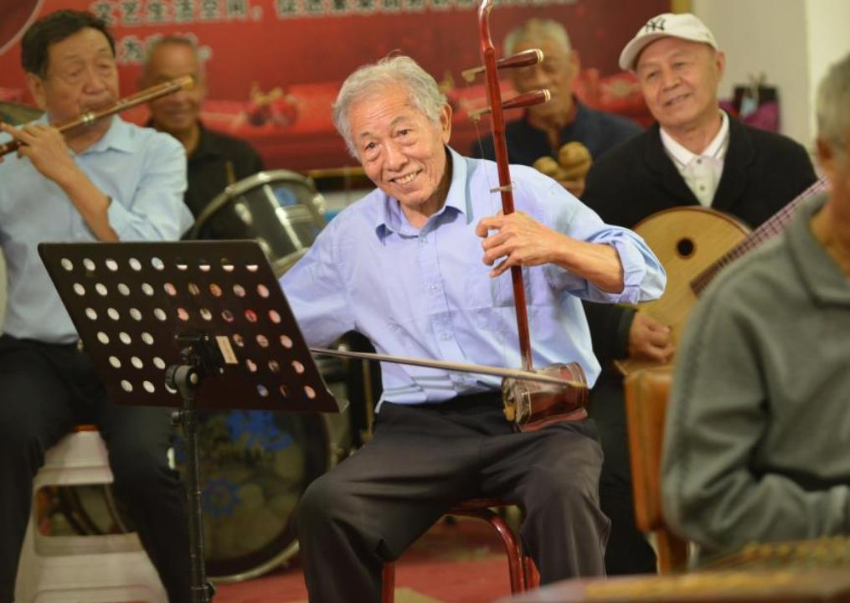
National University for the Aged,
China

Slide 47

The Present Approach towards Lifelong Learning
Focused more on acquiring skills and competencies
Helping to adapt to changing circumstances
Emphasis on formal learning
Yet to become “elderly friendly”

Slide 48
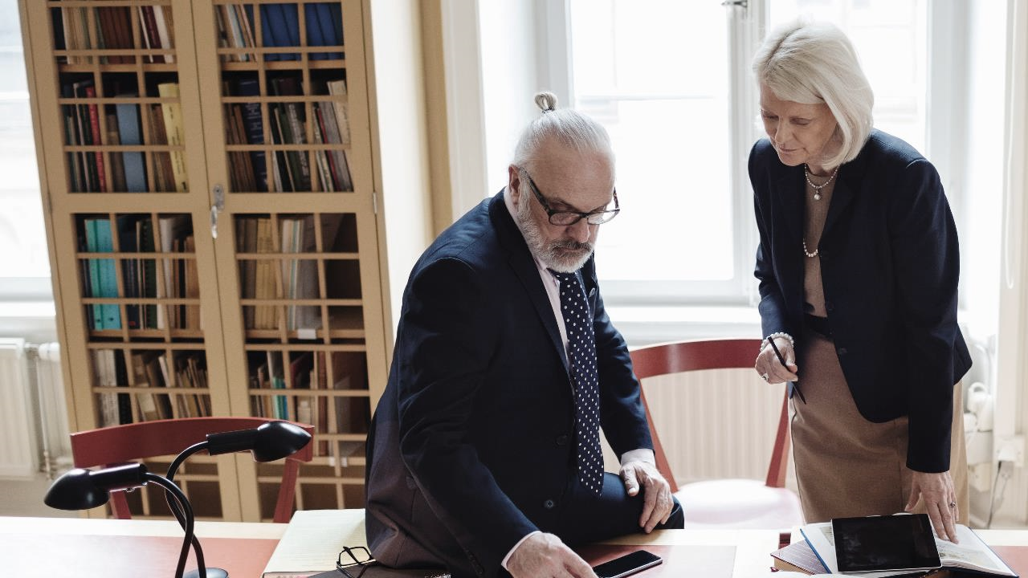
Lifelong Learning for Elders
Move beyond acquiring skills and competencies
Not just adapting to changing circumstances but acquiring ability to change circumstances
Build and strengthen communities of elders
Integrate SOC, Multi-dimensional and WHO models in the framework of lifelong learning

Slide 49


Approaches to lifelong learning
PEDAGOGY (Formal) Teacher Guided Structured Learning
ANDRAGOGY (Non-Formal) Teacher facilitated Self-Directed Learning
Lifelong Learning
HEUTAGOGY (Informal) Learner’s Self-Determined Learning
MORE
LESS
Almost
NONE

Slide 50
For Elders: From Pedagogy to Andragogy to Heutagogy to Gerogogy
Approach | Focus | Target
Pedagogy | Institution-centred , Teacher-Centred Learning | Formal Learning in Schools and Colleges and Training in Institutions
Andragogy | Institution-centred Self-direct Learning | Focus on adults, non-formal education
Heutagogy | Independent Self-Determined Learning | Focus on adults, non-formal and informal learning
Gerogogy | Facilitated self-determined learning | Elderly, community-based peer-learning, Peers plan and facilitate learning

Slide 51

Gerogogy
Addressing the special needs of elders vis-à-vis their physical and psychological health conditions
More on peer-based, horizontal learning rather than on instruction-based learning.
Emphasis on community-based learning and strengthening the ability of the learners to share the learning with other learners
Focus on achieving learning outcomes (such as health, finance, tranquility ) rather than on mere outputs (certificates, credentials)

Slide 52
Gerogogy:
Building on Social Capital
Community based Learning is one of the core principles of Gerogogy. Community of Practice is one form of community-based learning.
Community of practice (CoP) helps in …. exchange of experiences and expertise, and share the issues of mutual concern of elders. It provides a strong learning environment for peer and horizontal learning.
Social capital: Shared values and goals that enable individuals to work together . Social capital helps to build and strengthen community and shapes the Community of Practice.
Notes:
The discourses on these areas in elderly learning and the role of digital media in building social capital and community of practice are at present limited.

Slide 53

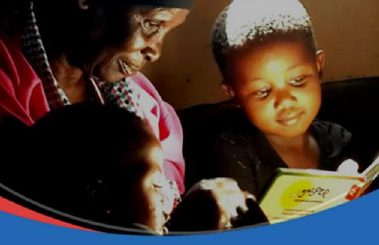
Intergenerational Learning
Grandparents and children in China during the pandemic
Both generations gained more health knowledge, life skills, values
Older generation changed their learning perspective and behaviours
Younger generation understood lifelong learning
Both generations understood each other better
Keyi Lyu, Ying Xu, Hao Cheng, Jiacheng Li (2021), The implementation and Effectiveness of intergenerational learning during the covid 19 pandemic: Evidence from China, International Review of Education, 66:833-855

Slide 54
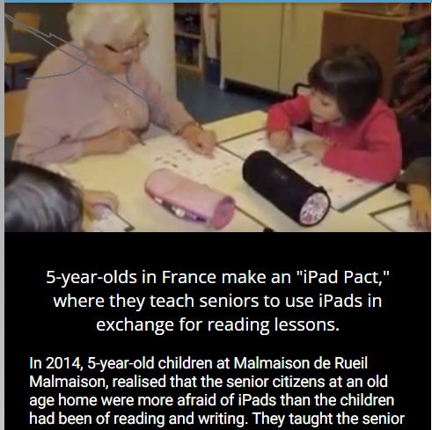
France: The iPad Pact!
very young children developed real empathy with seniors and tried with all their crazy childlike ideas to make their lives nicer and to teach the seniors as much as the seniors taught them. Because the children in their second year at the Ecole Malmaison were learning how to read and write, senior citizens came to the school to help out. Once the children learned to read and write, they in turn wanted to walk all the way to the retirement home and, once there, taught the seniors how to use iPads. The children were used to using technology—computers and iPads—in their everyday activities (for example, during mathematics class).
Source: https://www.youtube.com/watch?v=RxH-RZ2rLII

Slide 55
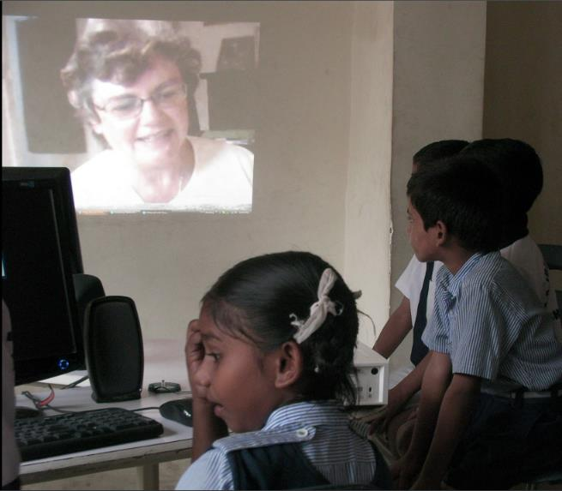
The Granny Cloud
Source: PCF9 keynote speech by Professor Sugata Mitra, The Future of Learning (2019)

Slide 56

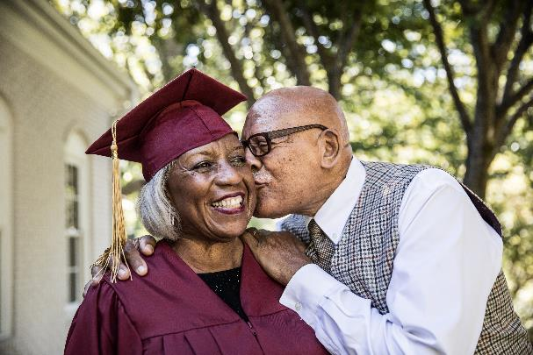
Learnability for late-life
Implementing late-life learning means, encouraging and promoting learnability at various levels
Strategy for developing digital community among elders
This skill of “learnability” is fundamental
Notes:
(such as educational system, training system, production and market system, etc)
Knowledge is continuously acquired
This requires the ability to acquire skills and knowledge efficiently and effectively.

Slide 57

Learnability for elderly is
The desire and the ability to grow and adapt one’s skills, knowledge and values on a continual basis to remain healthy, tranquil, productive in a dynamic changing world. It involves learning, unlearning and relearning continuously.
Modified from https://www.edvantic.com/blog/learnability-the-most-important-skill-of-the-future

Slide 58
Reducing the Learnability divide among elders
Attributes | Promoting
Psychological | Curiosity, Motivation
Social | Cognitive social capital, family and community-based learning; social justice
Institutional | Flexible entry and exit. Developing adaptability, cognitive thinking and experiential learning. Evaluating and accrediting non-formal and informal learning. Integrating pedagogy, andragogy and heutagogy.
Infrastructural | Broadening and enhancing access to and utilization of digital resources.
Notes:
When certain individuals or groups do not have psychological or social, or institutional or infrastructural support .
Promoting Learnability as a skill at all levels of education
Strengthening psychological, social, institutional and infrastructural attributes for promoting learnability
Promoting Learnability as a skill at all levels of education
Strengthening psychological, social, institutional and infrastructural attributes for promoting learnability

Slide 59
Governments
Businesses
Educational Institutions
Governments
Develop and implement late- life learning policies with resources
Involve elders in policy development
Develop regulations that address issues of ‘digital ageism’
Provide incentives for late-life learning

Slide 60
Businesses
Businesses
Educational Institutions
Governments
Invest in technology innovations for seniors
Develop affordable solutions that work for the marginalized and those in remote locations
Partner with institutions and civil society organisations to promote late-life learning

Slide 61
Educational Institutions
Provide seamless pathways between formal, non-formal, informal learning
Integrate pedagogy, andragogy heutagogy and gerogogy
Train teachers and facilitators in gerogogy
Promote more research in late-life learning
Use technologies for connecting seniors to learn and share
Businesses
Educational Institutions
Governments

Slide 62

Keep learning as long as you live
Classical Chinese Proverb
Xinyi Zhao and Ernest Chui, The Development and Characteristics of U3A’s in Mainland China’ , in Marvin Formosa (2019) The University of the Third Age and Active Ageing, Springer. Page 157

Slide 63
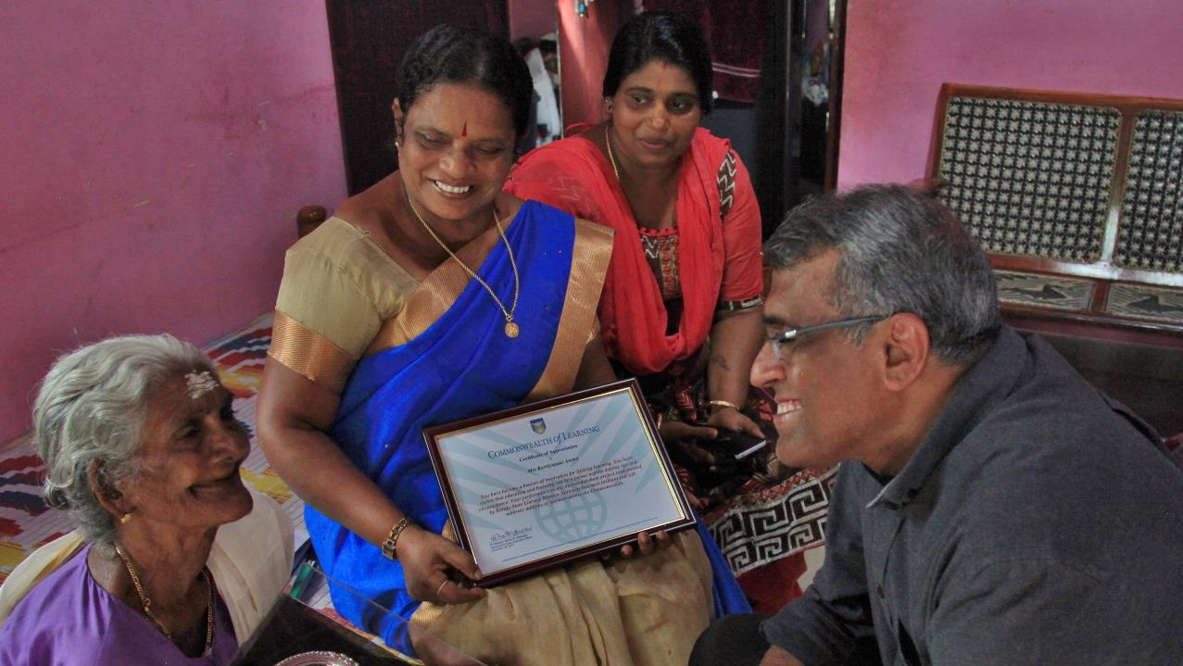

Thank you
col.org

