Slide 1

Smart OER: Bridges for Sustainable Education
Professor Asha Kanwar President & CEO, Commonwealth of Learning
Dr Ishan Abeywardena Adviser: Open Educational Resources
Dr Sanjaya Mishra Education Specialist: eLearning
Innovation Arabia 11 | Dubai, UAE | 11-13 March 2018

Slide 2


OER for Inclusive and Equitable Quality Education From Commitment to Action
2nd World OER Congress| 18-20 September, 2017 | Ljubljana, Slovenia

Slide 3






The Road to Ljubljana
ASIA
Asia eUniversity: ​​December 2016
EUROPE
Malta Ministry for Education and Employment: ​​February 2017
MIDDLE EAST & NORTH AFRICA
Qatar Foundation: ​​February 2017
AFRICA
Ministry of Education, Mauritius: March 2017
LATIN AMERICA & CARIBBEAN
University of Campinas: April 2017 ​
PACIFIC
Open Polytechnic of New Zealand: ​​May 2017

Slide 4

OER: Then and Now
2018
2012
Focus was on Governments
Policies
Commitment
Additional focus on stakeholders
Mainstreaming OER
Concrete Actions

Slide 5

OER Global Report 2017

Slide 6

Global Trends Policies
Increasing support, not accompanied by policies
Despite lack of national OER policies, institutional policies have grown
Regions with extensive OER activities, not always reliant on national policy as the driving force

Slide 7
Global Trends Repositories
OER repositories created in the global north more used than those from the global south
Majority of the repositories are at tertiary level
Repositories are available in diverse fields, including early childhood education

Slide 8
Global Trends Awareness
Many governments and stakeholders not clear about OER
Increased focus on open textbooks has led to neglect of OER for lifelong learning
Governments are supporting MOOCs, which are not necessarily “open”

Slide 9
Priorities for OER
Greater effort needed in creating awareness of the meaning, purpose and advantages of OER
Capacity building for the use and integration of OER for teachers
Promote policy development at both regional/national and institutional levels.

Slide 10

SMART OER: Bridges for Sustainable Education
Bridging the Technological Divide
Reaching People with Disabilities
Crossing Linguistic Barriers

Slide 11
Bridging Technological Divide
9
Average Number of Daily Sessions, Traditional App vs. Chat App
2014 - 2015
2
Notes:
.

Slide 12
Using Appropriate Technologies
WeChat shows the way: communication, video/audio, interactive sessions, payments built-in
Messaging-based learning platforms and Apps will have wider uptake in the developing world
Costs to learners (bandwidth) will be lower
COL currently building a Messaging-based online course management platform with a partner to serve formal and informal learning

Slide 13

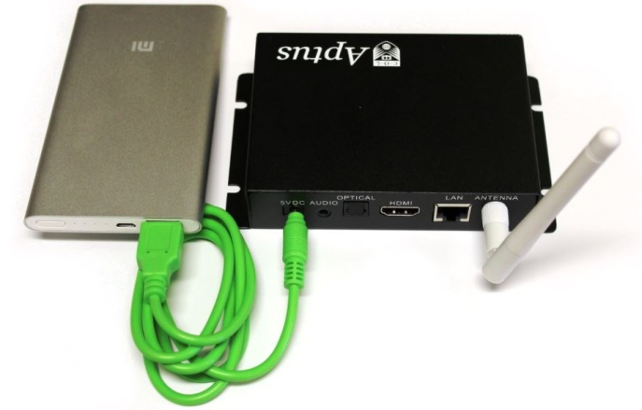

Using Affordable Technologies

Slide 14

Principles of Accessibility
Perceivable
Operable
Understandable
Robust
Source: WCAG 2.0, https://www.w3.org/TR/UNDERSTANDING-WCAG20/intro.html#introduction-fourprincs-head
Notes:
Perceivable - Information and user interface components must be presentable to users in ways they can perceive.
This means that users must be able to perceive the information being presented (it can't be invisible to all of their senses)
Operable - User interface components and navigation must be operable.
This means that users must be able to operate the interface (the interface cannot require interaction that a user cannot perform)
Understandable - Information and the operation of user interface must be understandable.
This means that users must be able to understand the information as well as the operation of the user interface (the content or operation cannot be beyond their understanding)
Robust - Content must be robust enough that it can be interpreted reliably by a wide variety of user agents, including assistive technologies.
This means that users must be able to access the content as technologies advance (as technologies and user agents evolve, the content should remain accessible)
Source: https://www.w3.org/TR/UNDERSTANDING-WCAG20/intro.html#introduction-fourprincs-head

Slide 15
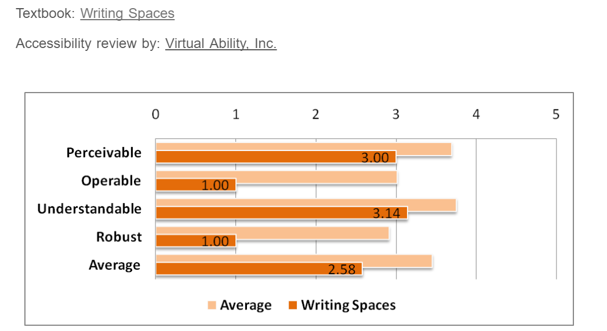
How Accessible are OER?
Source: http://www.collegeopentextbooks.org/textbook-listings/accessibility-reviews
Notes:
The College open textbook site in the USA reviews open textbooks for accessibility, and on an average, the POUR score is about 3.5 in a scale of 5. The major problem is with the robustness criteria, which has score below 3, which means that OER are less amenable to the use of assistive technologies.

Slide 16

LJUBLJANA OER ACTION PLAN 2017
Provide OER in accessible formats that support its effective use by all, including persons with disabilities, by using existing international guidelines for accessibility.

Slide 17
LJUBLJANA OER ACTION PLAN 2017
Ensure that OER accessed through different media, including mobile devices, are available and accessible in formats which allow for its use, adaptation, combination and sharing

Slide 18
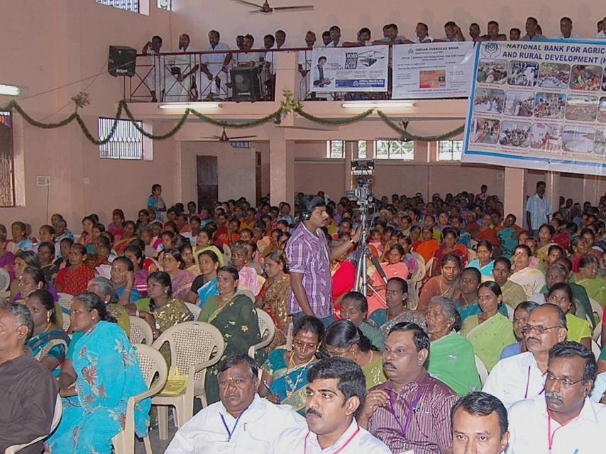

Using local language to share knowledge
Notes:
These women are part of COL’s L3F under which they have learnt agriculture and enterprise development skills using basic mobile phones. Because of this they have established companies in agriculture and livestock in which they are shareholders. They have generated enough assets within a space of three years.
Economic Times, Aug 18, 2017, The Big Farm to Fork Idea that Cuts wastage , ups farmer income

Slide 19
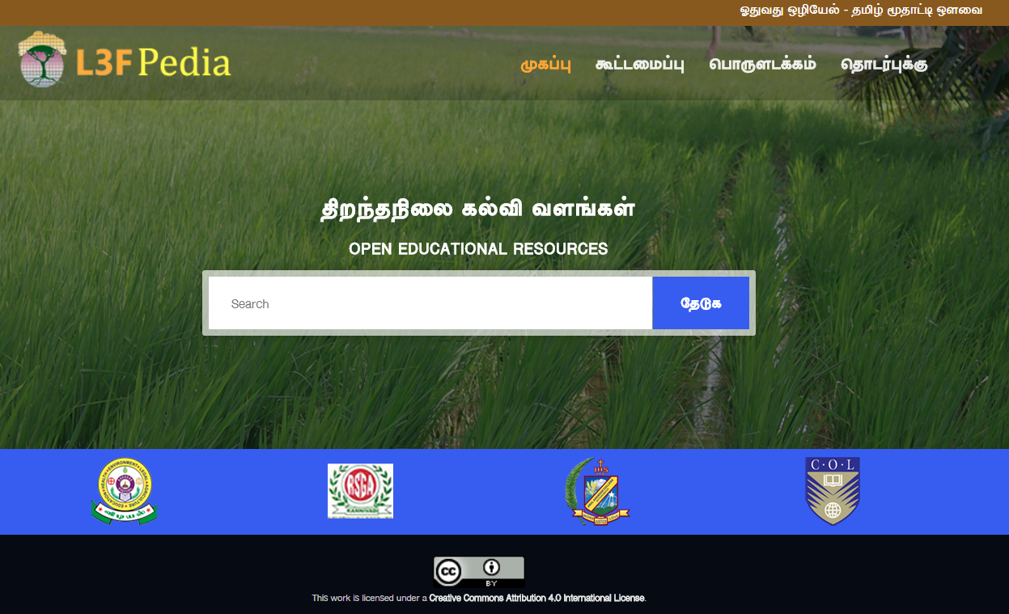
OER Platform in Tamil

Slide 20
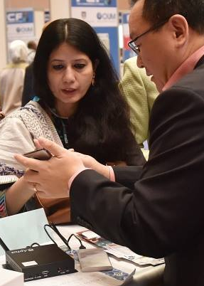
SMART OER are
Specific to the Context
Measurable in terms of impact on learning outcomes
Accessible, adaptable and available
Reusable and relevant
Transformative
Notes:
‘Born Digital’ should be ‘Born Accessible’ is a movement promoted by an technology non-profit – Benetech that hosts the largest accessible library Book Share (https://benetech.org/our-work/born-accessible/)

Slide 21
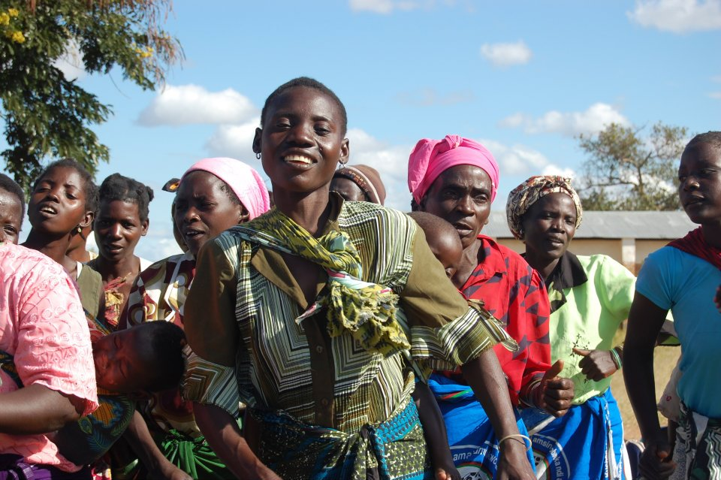
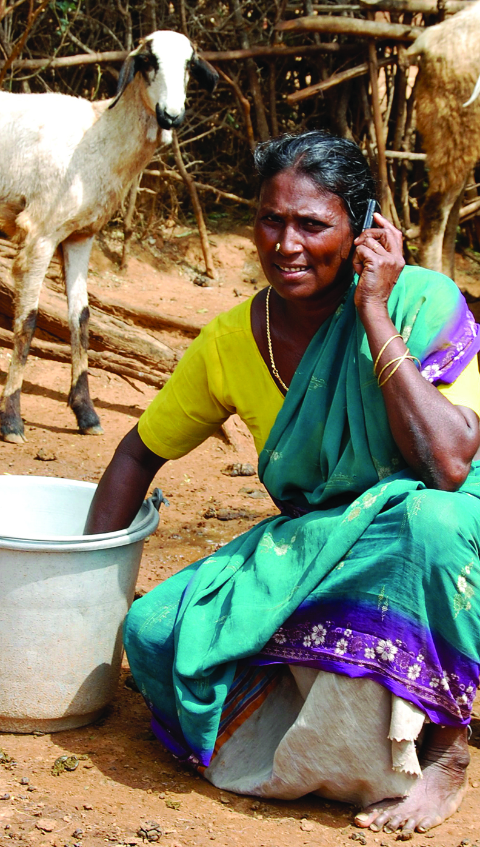
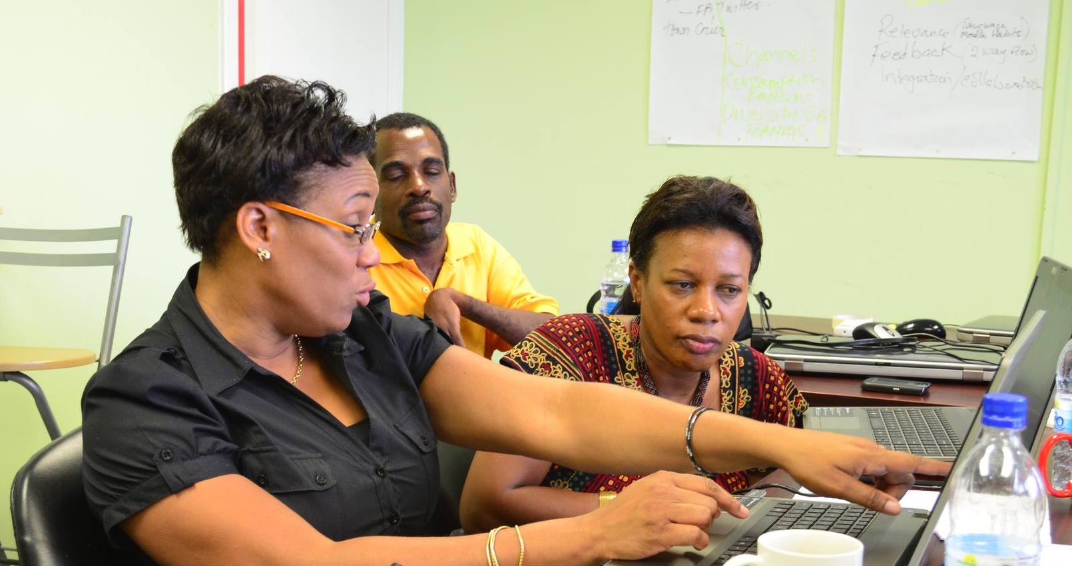

Thank you
Notes:
We invite you to engage us; tap into our thought leadership, expertise, networks and resources

