Slide 1

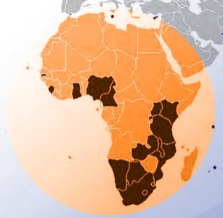
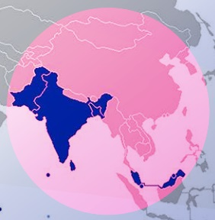
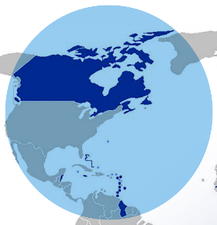
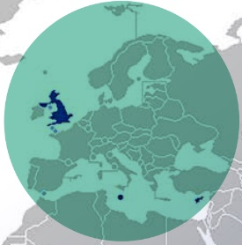
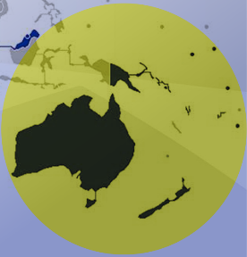

Developing an ODL Policy
A Commonwealth Perspective
Professor Asha Kanwar
President & CEO
Dr Kirk Perris, Adviser: Education
22 June 2018, Banjul, The Gambia

Slide 2
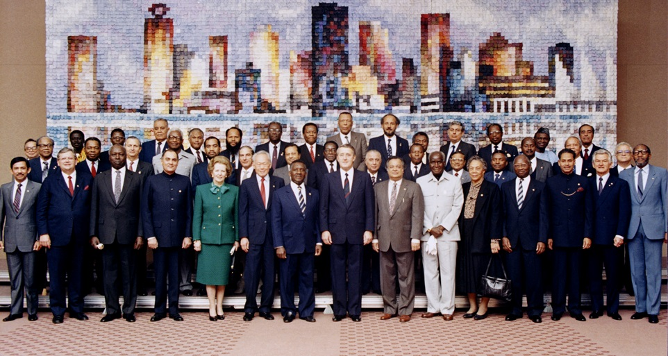
Commonwealth Heads of Government Meeting
Vancouver, 1987
Notes:
We invite you to engage us; tap into our thought leadership, expertise, networks and resources

Slide 3
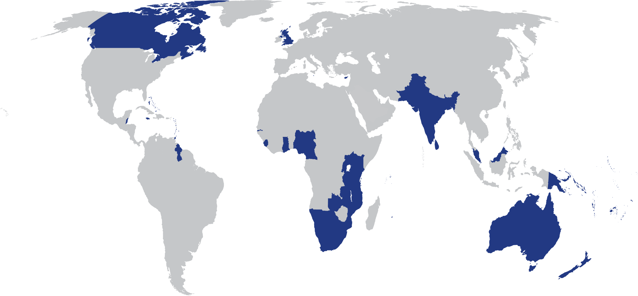
The Commonwealth
53 developed and developing nations around the world
Notes:
Maldives dropped out late 2016.

Slide 4
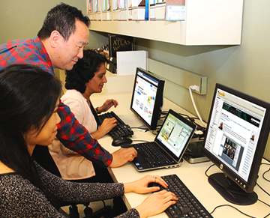
What is it for?
To help Commonwealth governments and institutions use various technologies to improve access to learning in support of development.

Slide 5

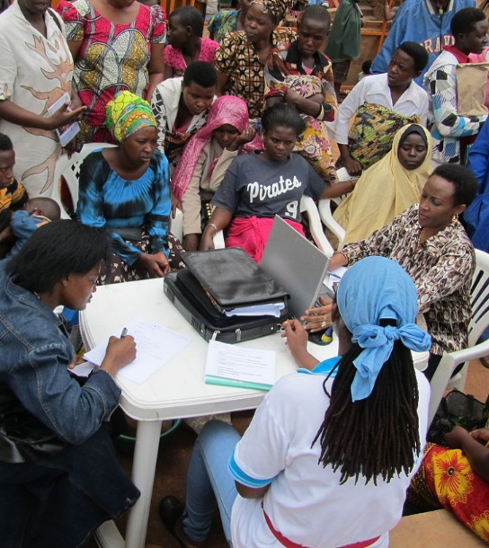
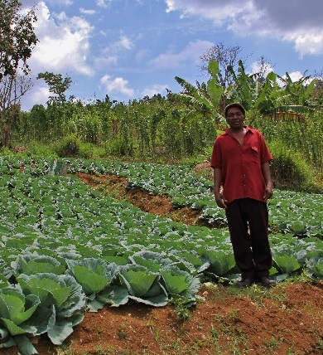



Learning for Sustainable Development
ECONOMIC
GROWTH
SOCIAL
INCLUSION
ENVIRONMENTAL CONSERVATION

Slide 6
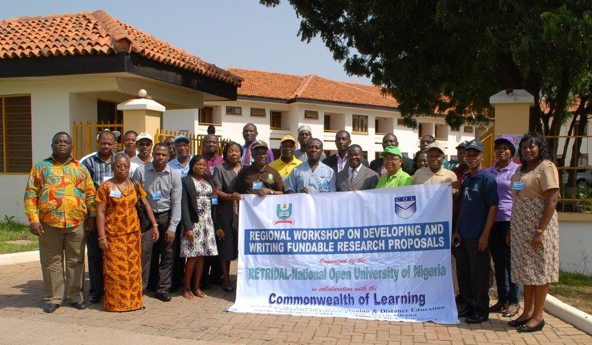
Regional Training and Research Institute for Distance and Open Learning (RETRIDOL)

Slide 7
RETRIDOL
Established in 2003
Located in the National Open University of Nigeria (NOUN)
Promotes capacity building and research activities in open and distance learning (ODL)
Supports the work of member states in West Africa

Slide 8
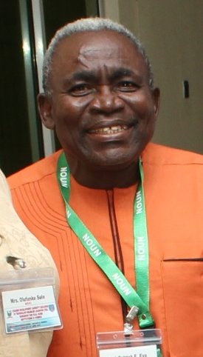
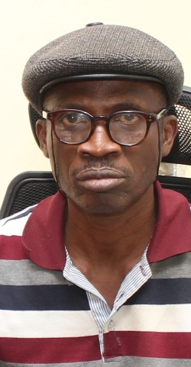
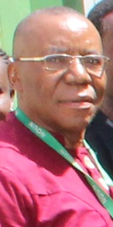
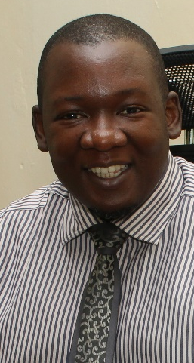
RETRIDOL
Prof. Patrick
Eya
Director
Dr. Olugbenga
Ojo
Associate Professor
Dr. Clifford
Amini
Associate Professor
Mr. Oluwaseun Oluyide
Research Officer

Slide 9
Plan
Context
What is ODL?
Fifth Decade of ODL
Crisis of Credibility
Towards a National Policy

Slide 10
Context

Slide 11

A Young Gambia
The Gambia has 1.2 million young people under 24: 58% of its population.
Source: Central Intelligence Agency World Factbook: https://www.cia.gov/library/publications/resources/the-world-factbook/geos/ga.html, Accessed 05/06/2018

Slide 12
Primary and Secondary Enrolment in the Gambia 2010 – 2012
Source: UNESCO Institute for Statistics, Retrieved on March 8, 2016.
Notes:
Source: UNESCO Institute for Statistics, , Retrieved on March 8, 2016.

Slide 13
Tertiary Gross Enrolment Ratio in the Gambia 2010 – 2012
Source: UNESCO Institute for Statistics, Retrieved on March 8, 2016.
Notes:
Source: UNESCO Institute for Statistics, , Retrieved on March 8, 2016.

Slide 14
What is Open & Distance Learning?

Slide 15


DISTANCE EDUCATION
=
Separation of teacher and learner

Slide 16
OPEN LEARNING
= fewer barriers
and is NOT the same as
DISTANCE EDUCATION
BUT, they are complementary
Therefore: ODL

Slide 17


Philosophy of Open-ness
Open as to people,
Open as to places,
Open as to methods, and, finally,
Open as to ideas
  Lord Crowther

Slide 18

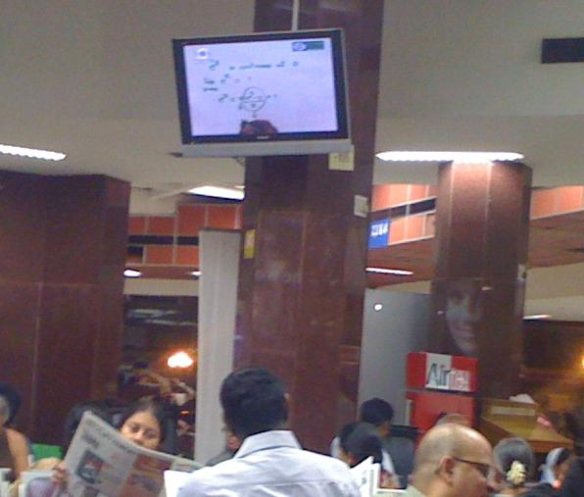
‘Open-ness’ in Practice
No entry qualifications
Credit banking
Cafeteria approach to courses
Anytime, anywhere

Slide 19
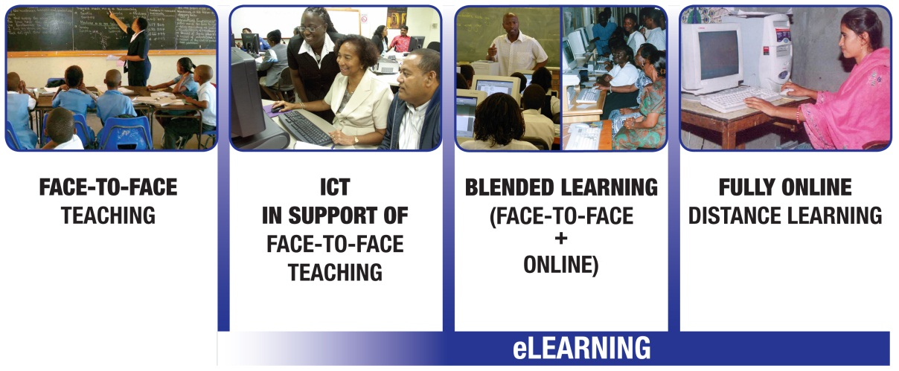
ODL and eLearning

Slide 20
The Fifth Decade of ODL

Slide 21






The Rise of Open Universities

Slide 22
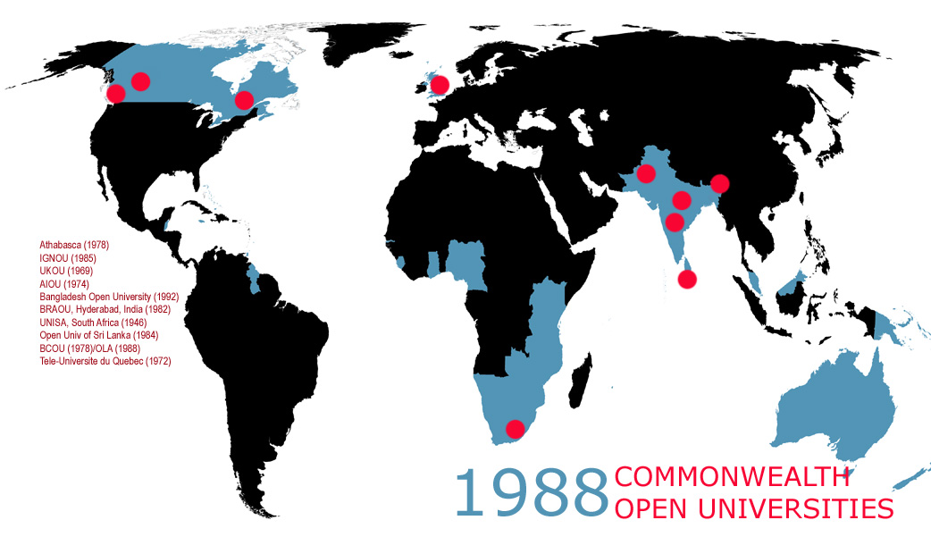
AIOU
ATHABASCA
BCOU
BRAOU
IGNOU
OLA
OUSL
TELUQ
UKOU
UNISA

Slide 23
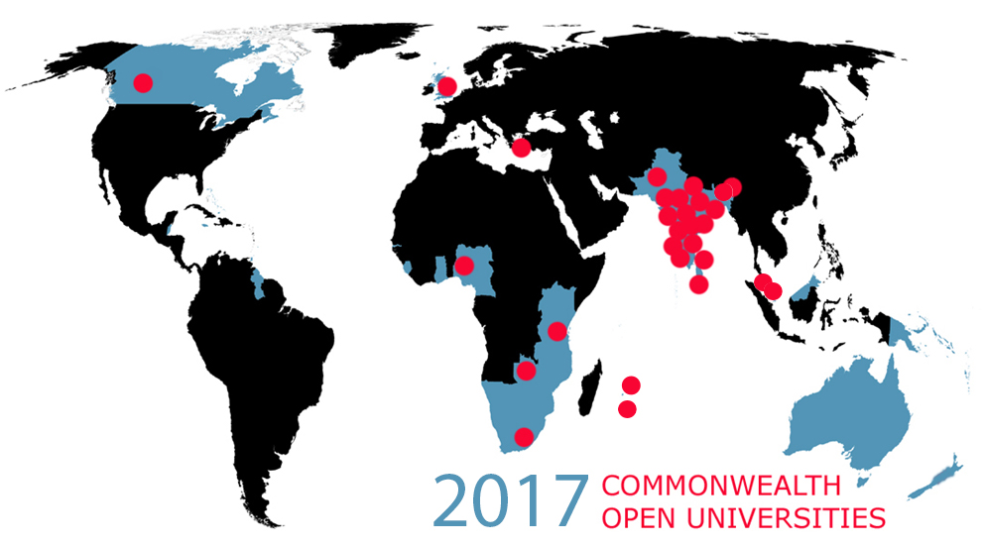
AIOU
ATHABASCA
BAOU
BOU
DrBRAOU
GOU
IGNOU
KKHSOU
KSOU
MPBOU
NOU
NOUN
NSOU
OSOU
OUC
OUM
OU Mauritius
OUSL
OUT
PSSOU
TNOU
UOU
UNISA
UKOU
UPRTOU
VOU
VMOU
SOU
YCMOU
ZAOU
Notes:
Remove one dot from Indian Ocean

Slide 24

Access
NOUN (420,000 students)

Slide 25
Costs: ODL in mega universities
Country | Institution | Enrolment | % of Campus Cost*
Pakistan | AIOU | 456.126 | 22
China | CCRTVU | 2,300,000 | 40
India | IGNOU | 1,187,100 | 35
UK | OU | 203,744 | 50
*Unit cost per student as a percentage of the average
for other universities in the country, NKC, 2004.

Slide 26
Quality
highest rated for overall student satisfaction in the 2012 National Student Survey
rated fifth of 100 UK universities (2003)
Source: http://www.open.ac.uk/about/main/the-ou-explained/facts-and-figures
Notes:
Source: http://www.open.ac.uk/about/main/the-ou-explained/facts-and-figures

Slide 27


The Rise of Dual Mode Institutions
South Africa: Enrolments in single mode dropped by 21% between 1995-1999 ¹
Deakin: Almost a quarter of 53,000 students study at a distance ²
Campus of Open Learning, University of Delhi: More than 200,000 distance students ³
Sources:
UNESCO: Open and Distance Learning - Trends, Policy and Strategy Considerations (2002).
Deakin University: Our reputation and history. Last accessed on May 2, 2016.
Campus of Open Learning, University of Delhi: About us. Last accessed on May 2, 2016
Notes:
http://unesdoc.unesco.org/images/0012/001284/128463e.pdf
http://www.irrodl.org/index.php/irrodl/article/view/20/360
http://www.deakin.edu.au/about-deakin/our-reputation-and-history

Slide 28
Advantages
Expand access
Availability of academic talent
Optimal utilisation of existing resources
Resource-generation
Access to wider curriculum

Slide 29
Challenges
Lack of autonomy
Poor learner support
Underfunding
Inadequate staff training
Second-class status

Slide 30
Crisis of Credibility

Slide 31


Slide 32



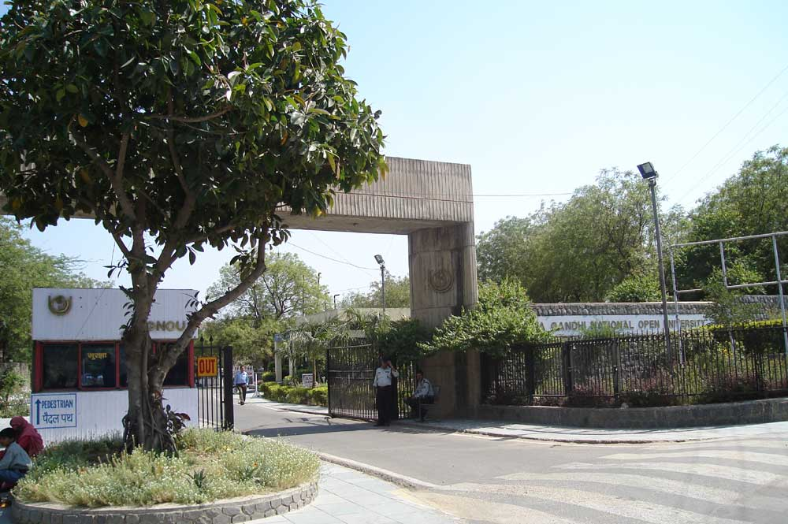
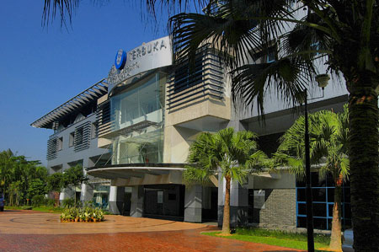
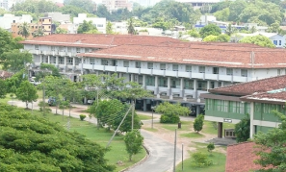
International:
ISO Certification Accreditation
Open University of Sri Lanka
http://en.wikipedia.org/wiki/File:IGNOUGATE.jpg

Slide 33
Convergence of External and Internal
Quality Assurance Measures
QAA & Internal Validation Unit

Slide 34

3-pillars of Quality in Distance Education Institutions
John Daniel, 1998
Personal support to each student
High
quality
multi-media materials
Efficient
logistics
and admini-stration

Slide 35
Towards an ODL Policy

Slide 36
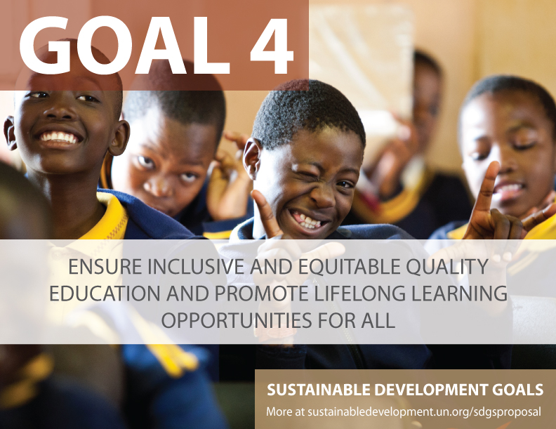


Slide 37


Education 2030: Framework for Action
Develop policies and programmes for the provision of quality distance learning in tertiary Education, with appropriate financing and use of technology, including the Internet, massive open online courses and other modalities that meet accepted quality standards to improve access.

Slide 38
Towards an ODL policy
How useful is ODL to expand access to quality HE/lifelong learning?
What is the ICT infrastructure available and is it affordable?
How do we plan to reach the unreached?
Adopt same or different QA regulations?

Slide 39
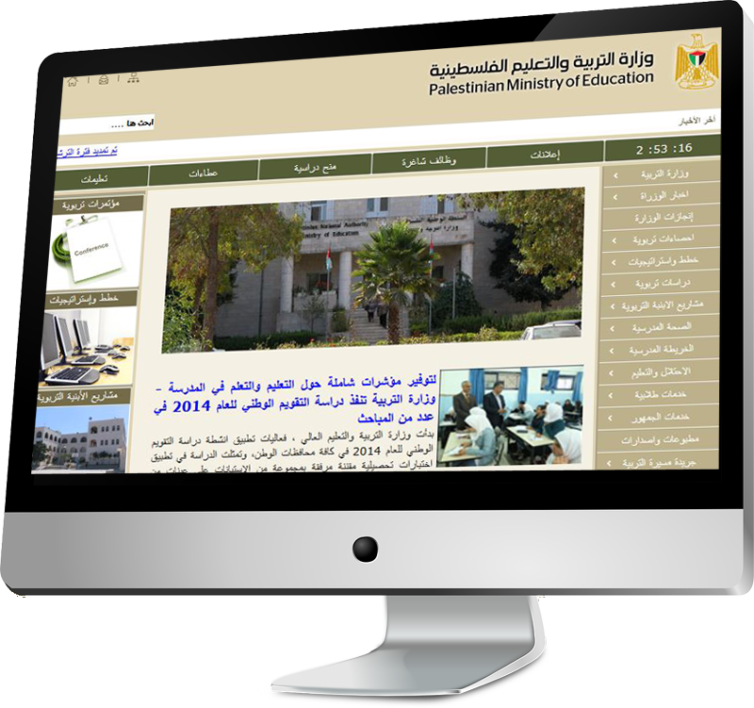


Have a National Policy
1
Integrate ODL into existing policy
Develop a separate ODL policy
Flexible to include new developments
Commit resources
www.mohe.gov.ps/default.aspx

Slide 40
Going Dual-Mode:
Have an Institutional Policy
2
Review the mandate and mission
Identify the objectives for adopting ODL and how these will be achieved
What are the issues relating to faculty?
What are the issues relating to students?
How will academic quality and standards be maintained?
Issues related to management and administration?

Slide 41
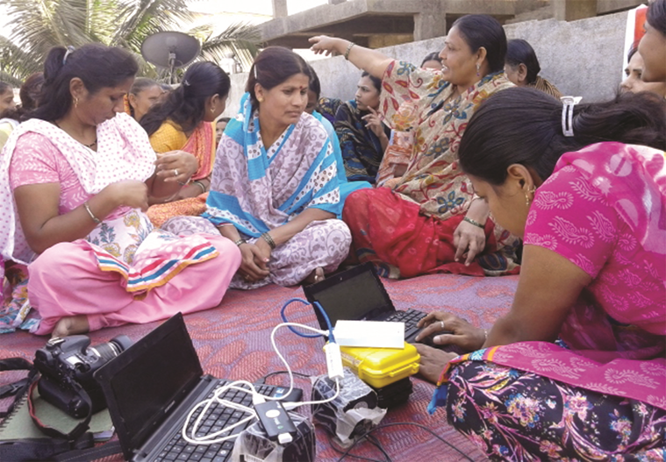

Select Appropriate ICTs
3
Range of technologies
(from Radio to Internet to mobiles)
Two-way interaction
Collaborative learning

Slide 42
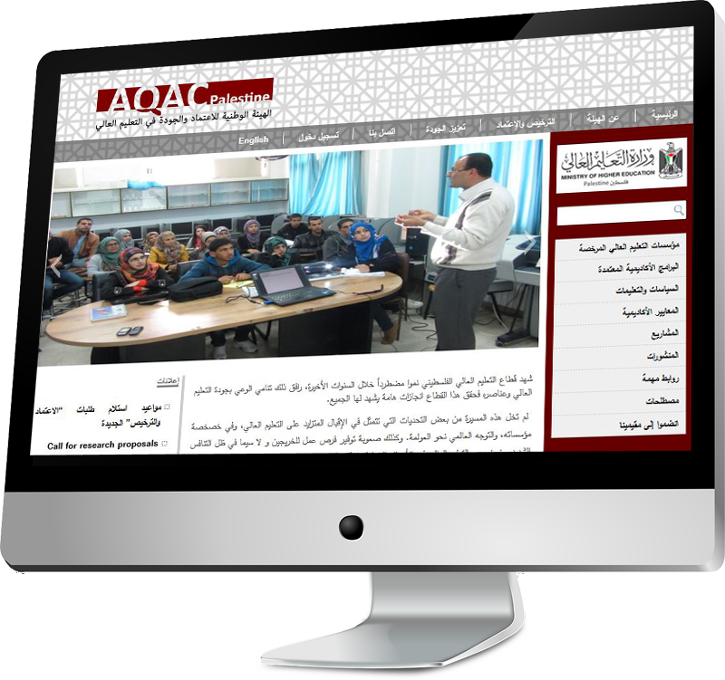
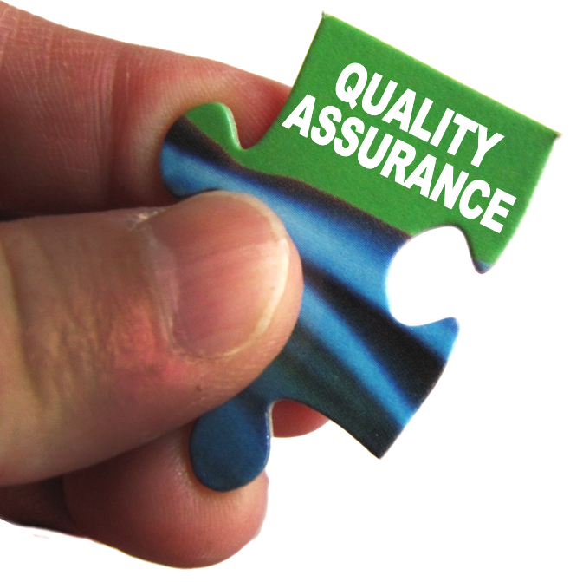

Invest in Quality Assurance
4
National/Regional
QA Guidelines
Create cultures of quality
www.aqac.mohe.gov.ps/

Slide 43


Same Regulations for ODL & F2F
Quality Assurance Agency, UK: assesses both campus and distance universities
Source: www.qaa.ac.uk/Pages/default.aspx

Slide 44

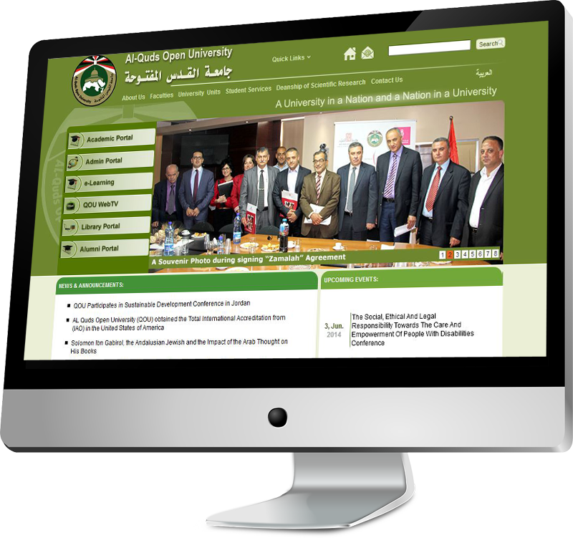


Build Capacity
5
Curriculum reform
Learner Support
Assessment
www.qou.edu/englishIndexPage.do

Slide 45
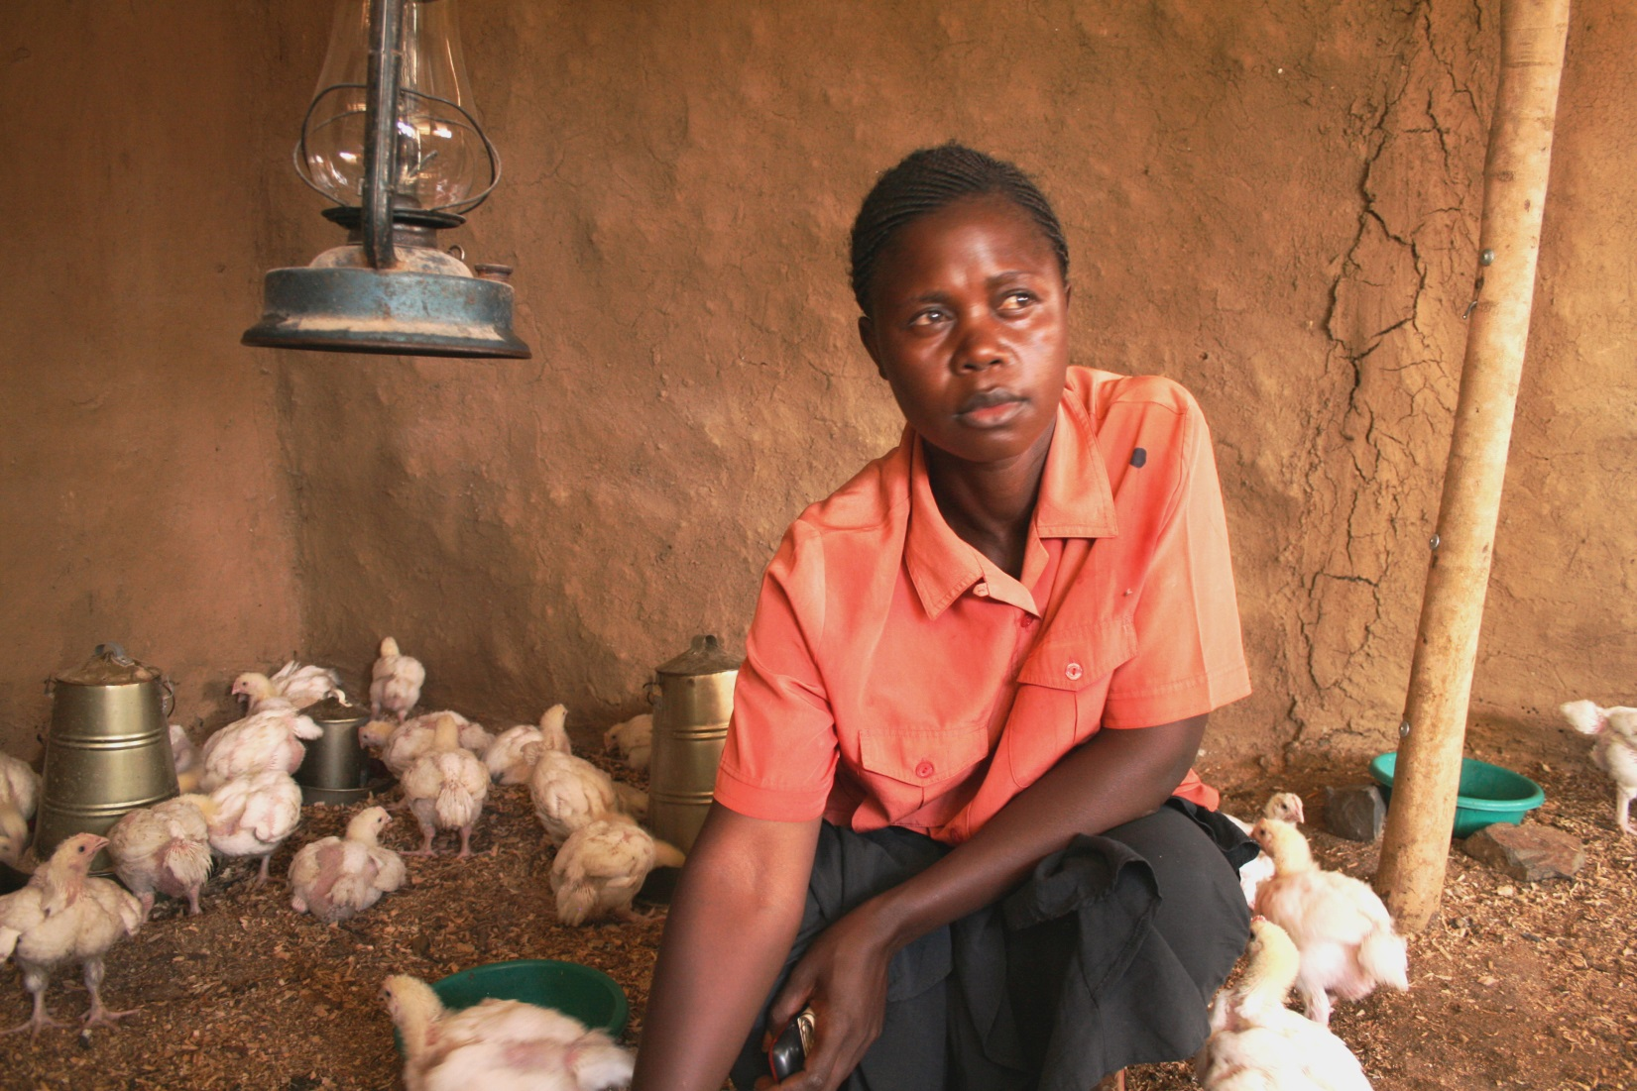
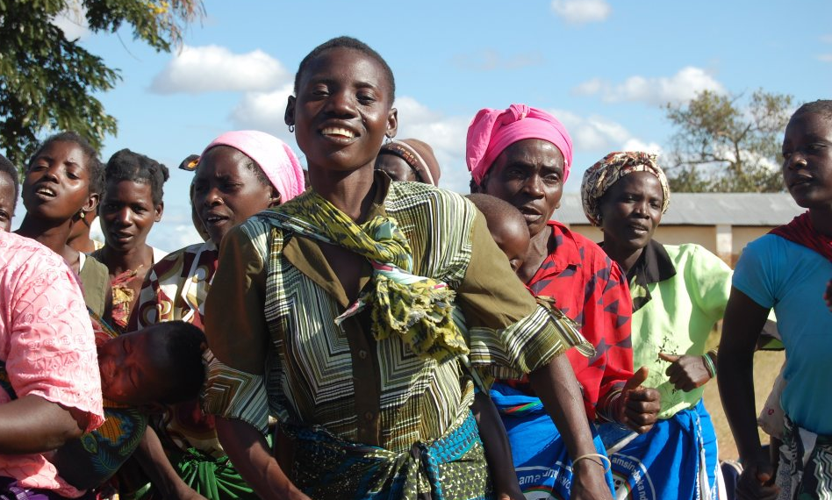
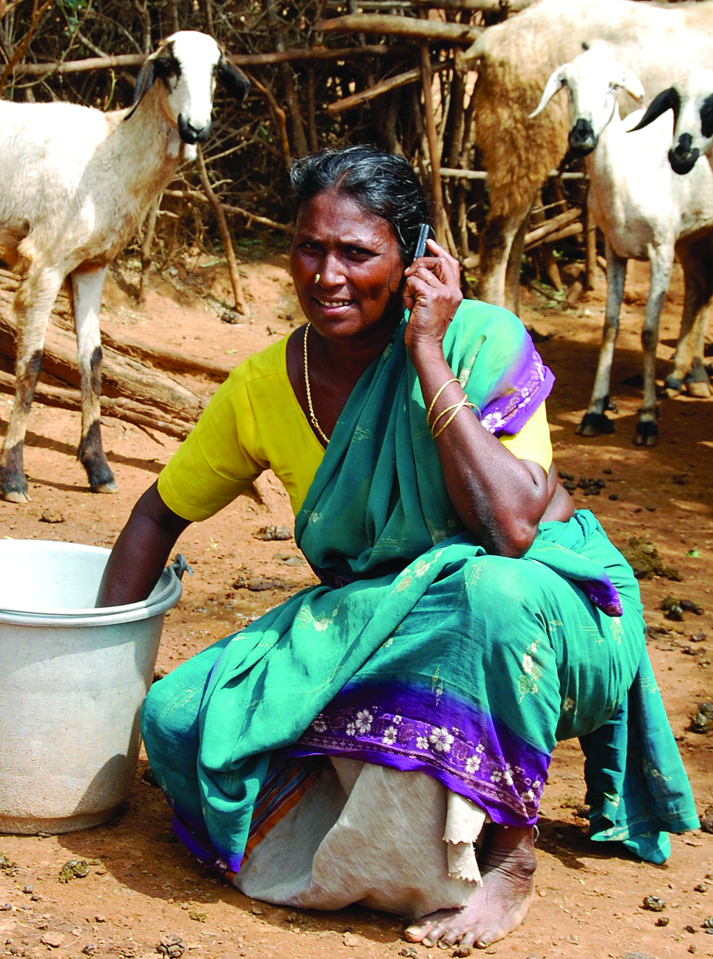
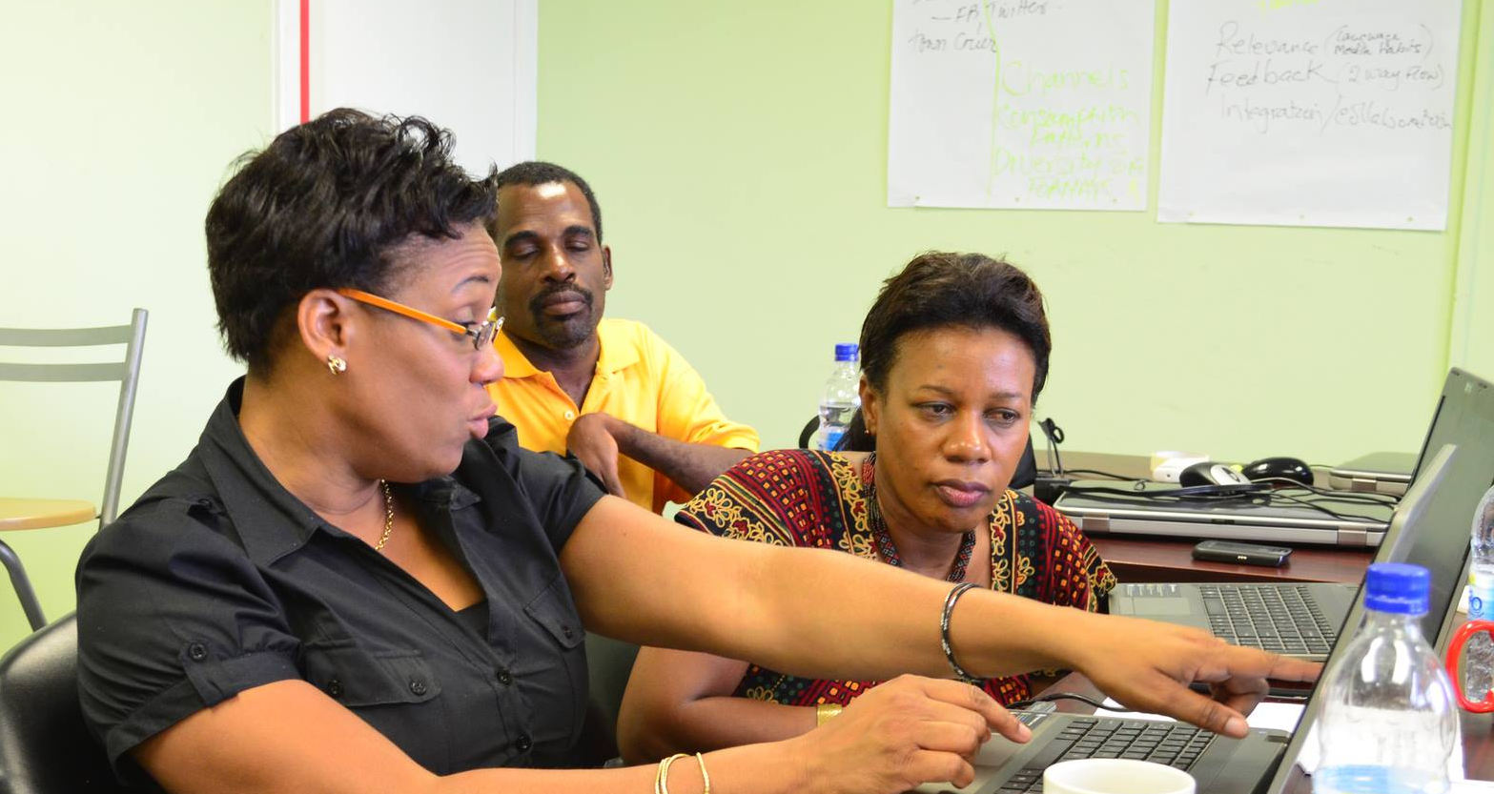
Thank You
www.col.org
Notes:
We invite you to engage us; tap into our thought leadership, expertise, networks and resources

