Slide 1


Open Educational Resources
Status and Trends
Sanjaya Mishra
Commonwealth of Learning, Canada

Slide 2

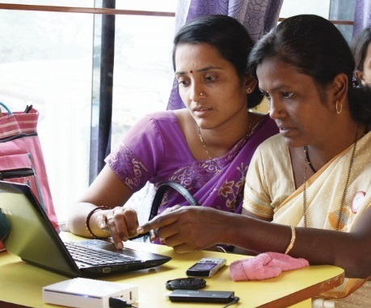
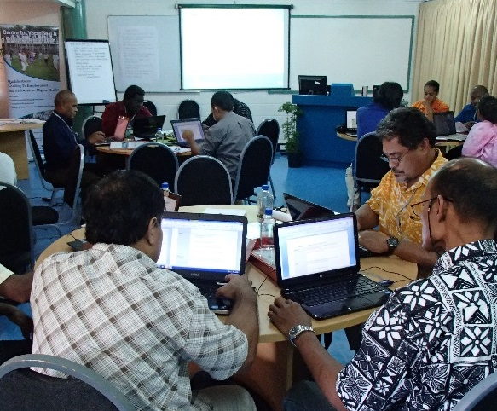
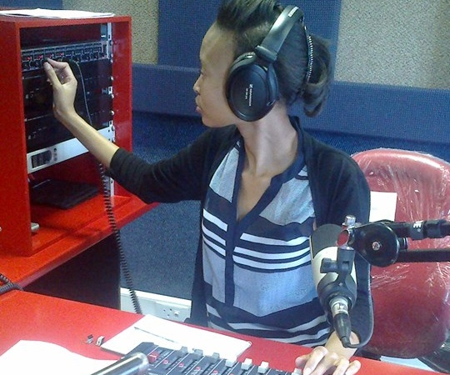
To help Commonwealth governments and institutions use technologies to improve and expand access to education and training

Slide 3
The Access Challenge: A Personal Story
Childhood Riddle:
What is not reduced, when shared?

Slide 4
The Access Challenge
In 2012 there was only 1 reading textbook for 12 students and only 1 mathematics textbook for 14 students in grade 2 in Cameroon. (UNESCO GEMR Policy Paper 23)
In grade 2, there were 3 students for every reading textbook, compared with 8 students for every mathematics textbook in Togo. (UNESCO GEMR Policy Paper 23)
On average higher education students in Bangladesh spend BDT 1850 per year on books and supplies. (COL, 2017)
In Malaysia 76.4% learners decide not to buy textbooks due to high costs (COL, 2017)

Slide 5


Slide 6
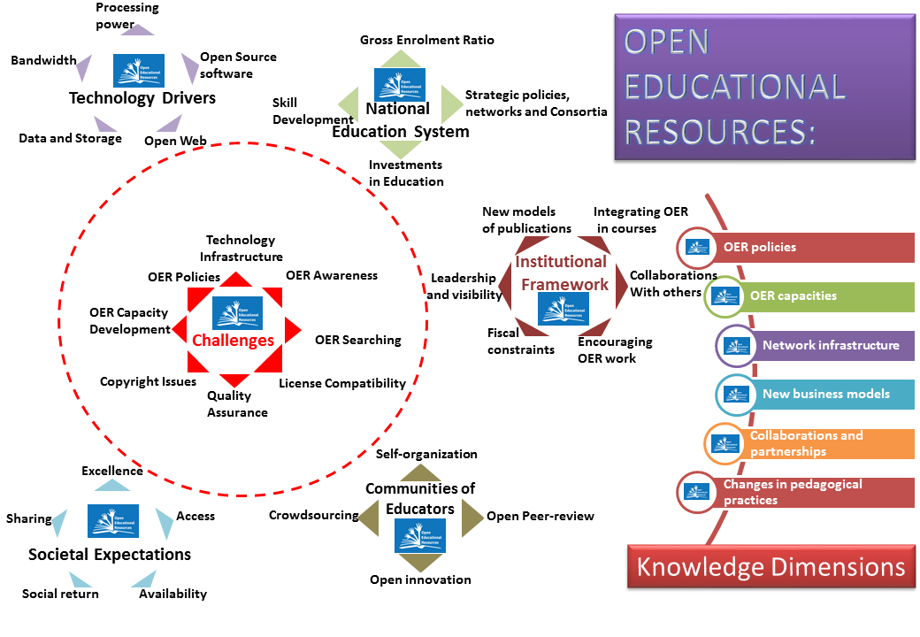
OER: Definition
OER are teaching, learning and research materials in any medium that reside in the public domain or have been released under an open license that permits their free use and in some instances, re-purposing by others

Slide 7
Philosophy of Open
Knowledge is Free and should be shared amongst those who need it
Access to past knowledge is essential to create new knowledge
Everyone has a right to knowledge, and authors exercise their rights to share
Open Access is not contrary to Copyright
No individual should be discriminated due to various disadvantages
Preserve cultural heritage and foster development of knowledge societies

Slide 8

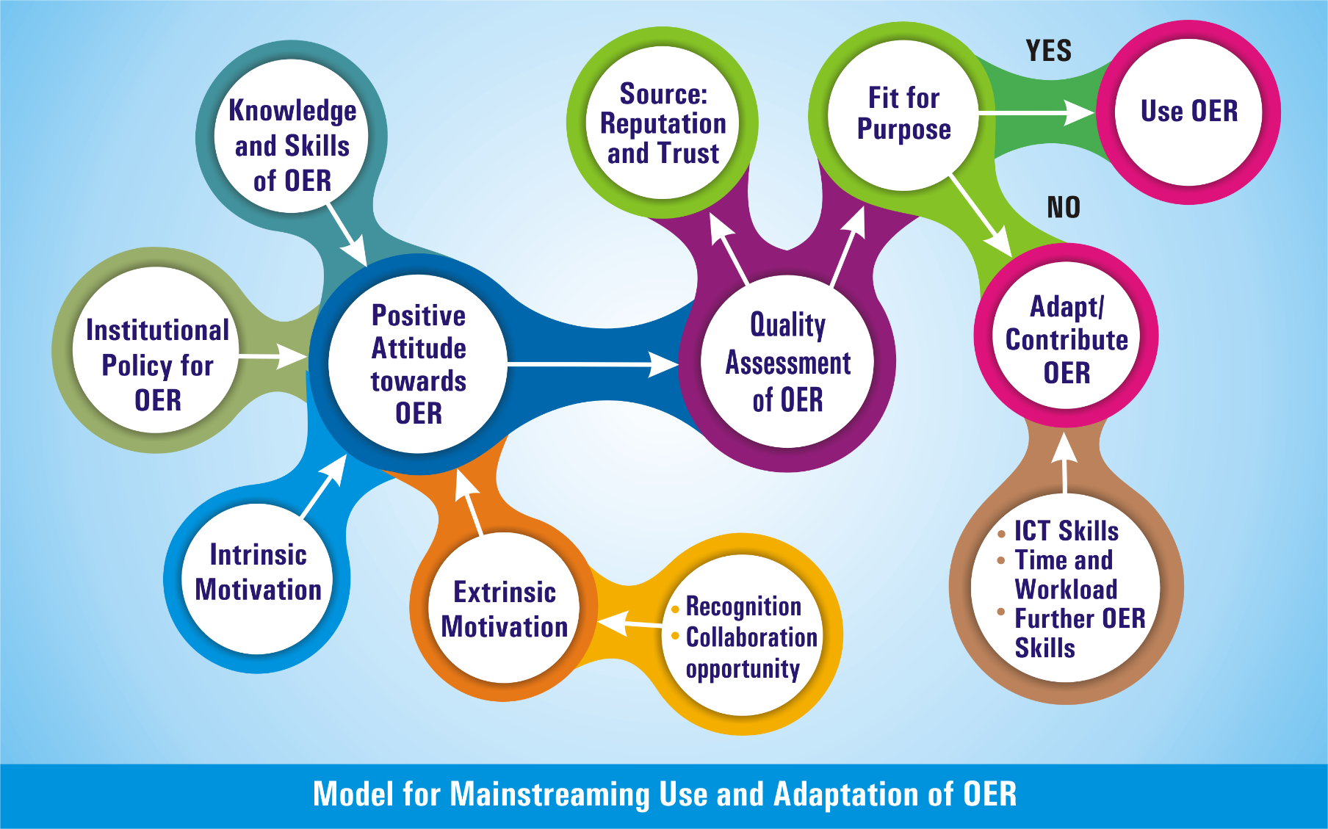
Mainstreaming OER
Source: Mishra, 2017. http://oasis.col.org/handle/11599/2659

Slide 9
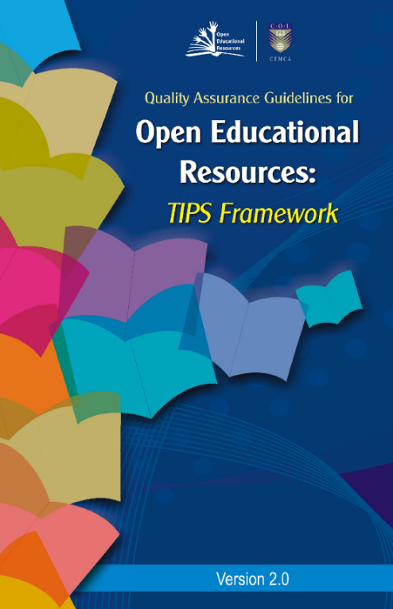
Quality Guidelines for OER
Teaching and learning processes
Information and material contents
Presentation, products and formats
System, technical and technology
Source: http://oasis.col.org/handle/11599/562

Slide 10

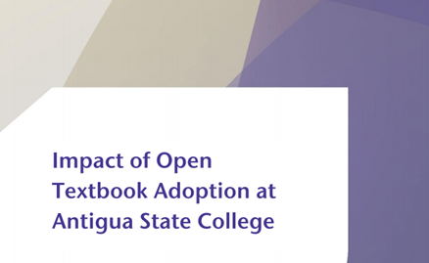
Antigua and Barbuda
Students saved between 75 to 88 ECD per course per semester by using open textbooks
Supplementing textbooks with OER improved student performance by 5.5%
Source: http://oasis.col.org/handle/11599/2750

Slide 11
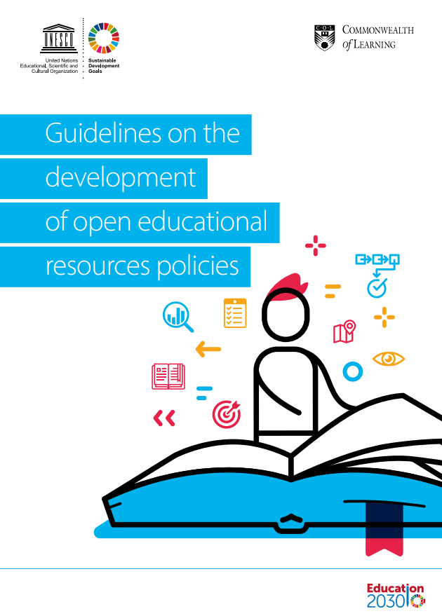
Policy Development
Institutional policy template for OER policy
UNESCO-COL policy guidelines
Policy support: Bangladesh, Belize, Botswana, Cameroon, India, Malaysia, Malta, Mauritius, Nigeria, Saint Lucia, Sri Lanka, Zambia.
Institutional policy support: Over 30 institutions
http://oasis.col.org/handle/11599/3455

Slide 12
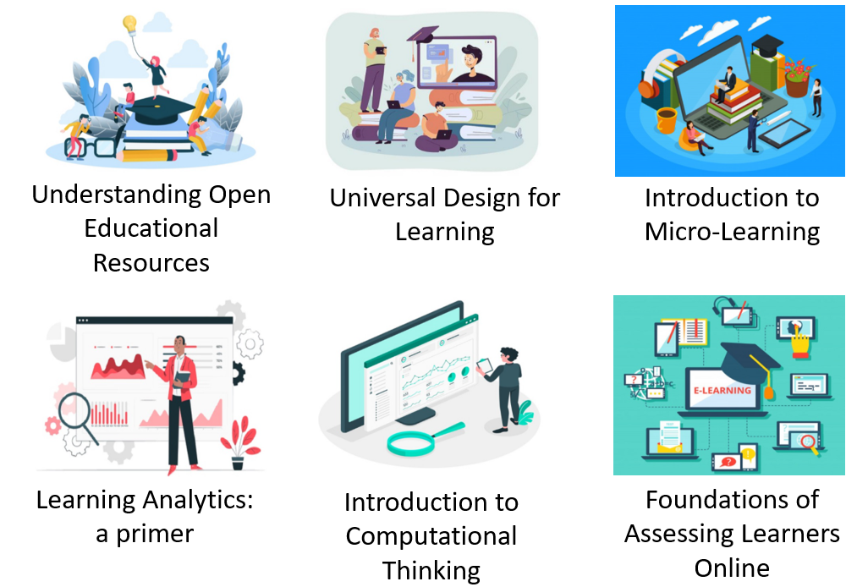
Collaborative Course Development
Collaborative content development: Diploma in Mobile App Development and Certificate in Web Application Development developed by six open universities (AIOU, IGNOU, NOUN, OUM, OUT, OUSL)
Over 100 courses at
https://www.colvee.org/

Slide 13





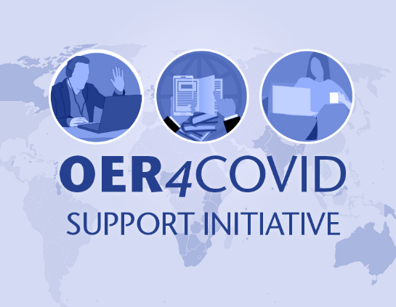

#OER4COVID
Regional Consultation for Asia, Pacific and Caribbean (Webinar)
Regional Consultation for Africa and Europe (Webinar)
1,179 members from 79 Countries
Community discussion and curation

Slide 14


Micro-courses platform
https://colcommons.org/

Slide 15
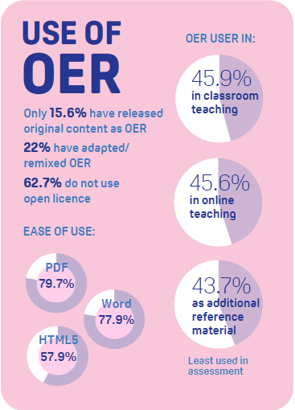
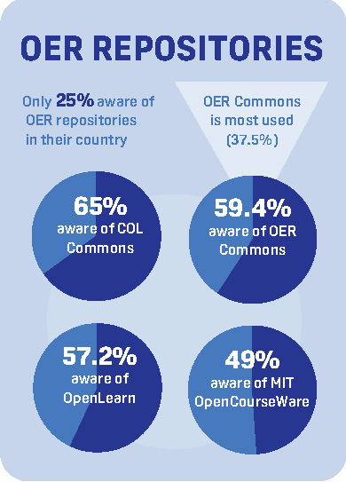
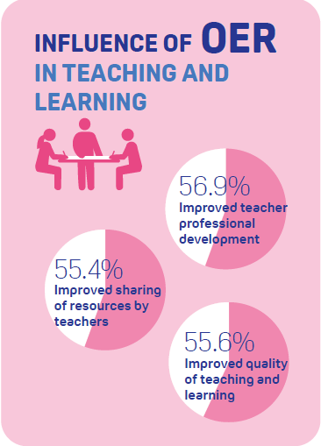
OER in the Commonwealth

Slide 16
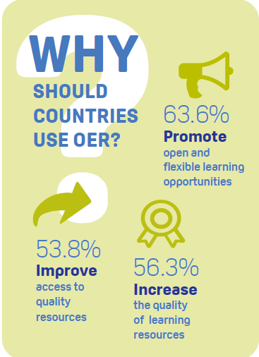
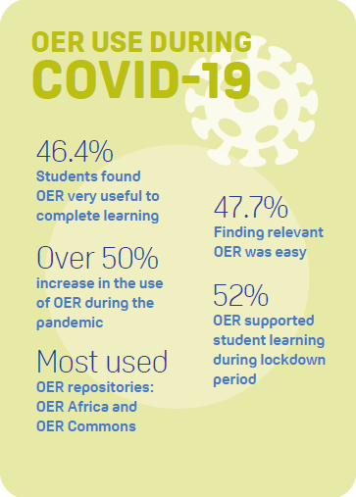
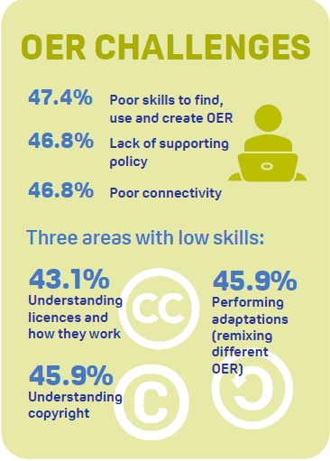
OER in the Commonwealth

Slide 17
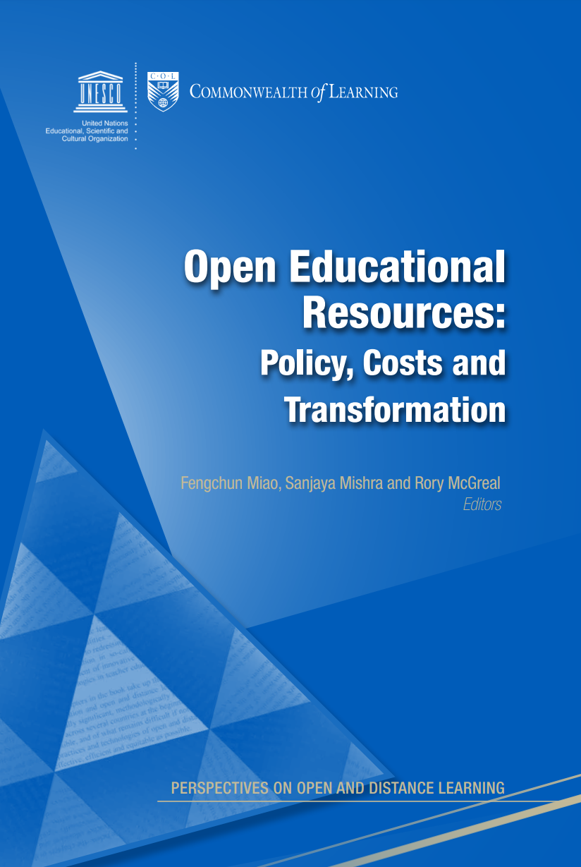
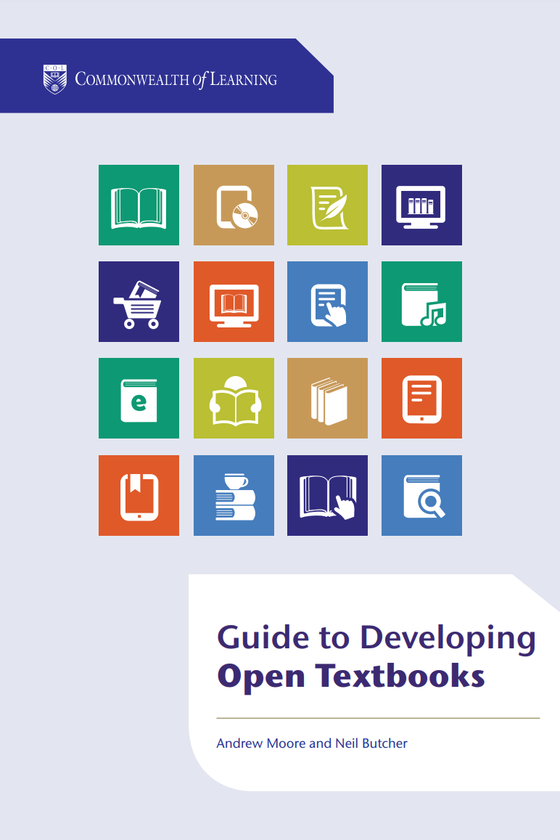


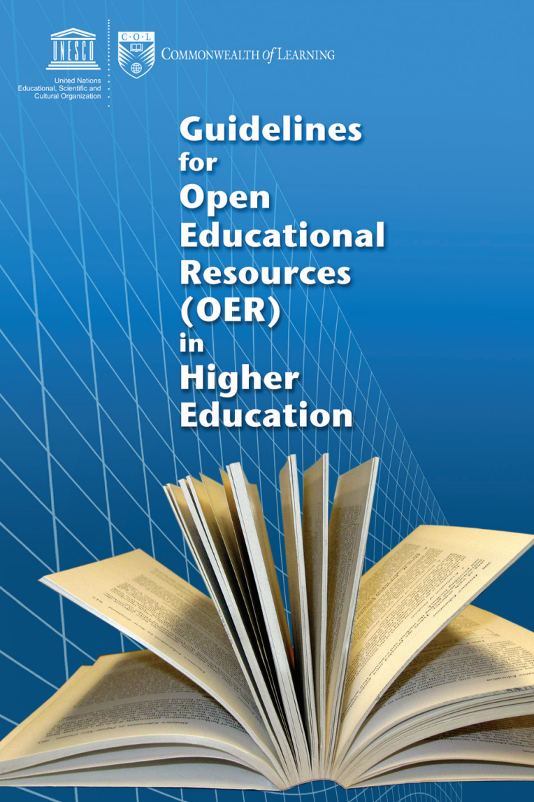
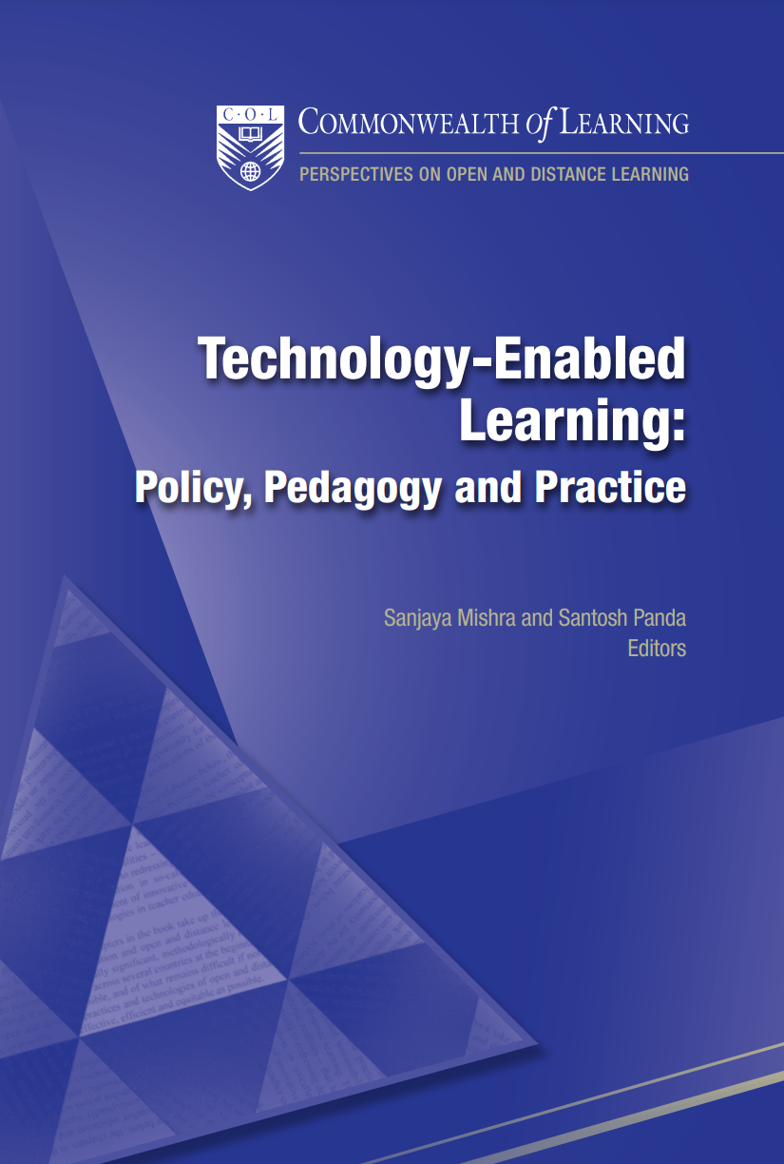
Thank you
www.col.org
The contents of this presentation, with the exception of logos and graphics which are the property of the respective owners, is made available under Attribution-ShareAlike 4.0 International (CC BY-SA 4.0).

