Slide 1
MOOCs for Development: the COL Experience
Professor Asha Kanwar
President and CEO, Commonwealth of Learning (COL)
16 June 2016

Slide 2
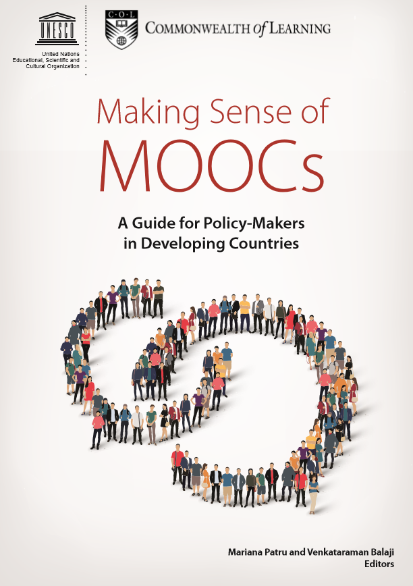
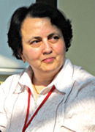
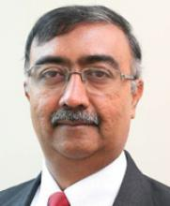
Making Sense of MOOCs
Mariana Patru
UNESCO
V. Bajalji
COL

Slide 3
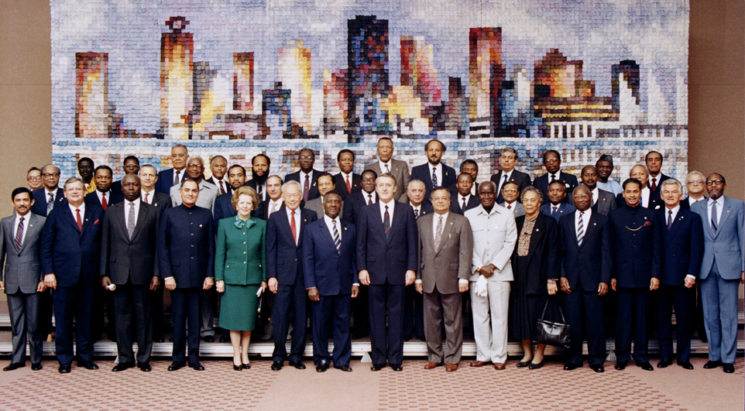
Copyright Commonwealth Secretariat
Commonwealth Heads of Government Meeting
Vancouver, 1987

Slide 4
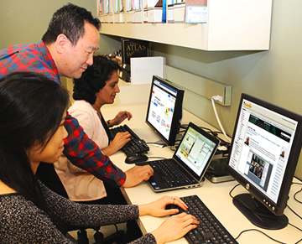
What is it for?
To help Commonwealth governments and institutions use various technologies to improve access to learning in support of development.

Slide 5
Context

Slide 6
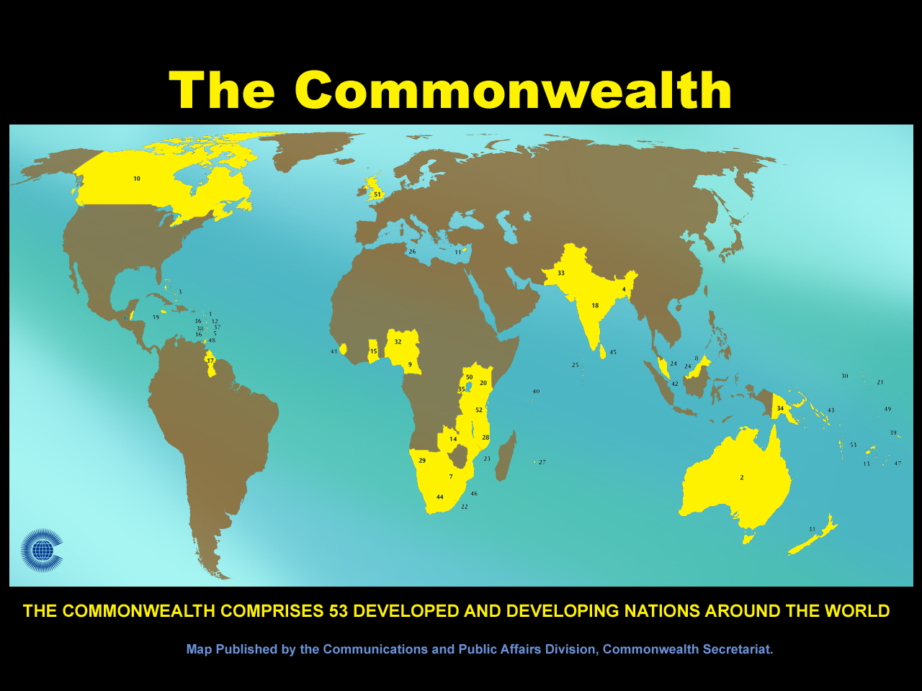

Slide 7

The Youth ‘Bulge’: 1.2 billion 15-24
Of the 2.2 billion population of the Commonwealth,
60% under the age of 29

Slide 8
Commonwealth: Youth Unemployment Rate
(ages 15-24, ILO estimate) 2004-2014
Source: World Bank Open Data, last accessed on May 4, 2016

Slide 9
Percentage of households using
the internet, 2015
Source: ITU, MIS Reports, 2015. http://www.itu.int/en/ITU-D/Statistics/Pages/publications/mis2015.aspx

Slide 10
Commonwealth: ICT Statistics 2000-2014
Source: ITU Statistics, last accessed on May 4, 2016

Slide 11
Gross Enrolment Ratio 2013 by Region and Level of Education
Source: UNESCO Institute for Statistics, Last accessed on May 19, 2016.
Notes:
Source: http://unstats.un.org/unsd/methods/m49/m49regin.htm#developed
Developing regions
Africa
Americas excluding Northern America
Caribbean
Central America
South America
Asia excluding Japan
Oceania excluding Australia and New Zealand
Developed regions
Northern America
Europe
Japan
Australia and New Zealand

Slide 12



Slide 13

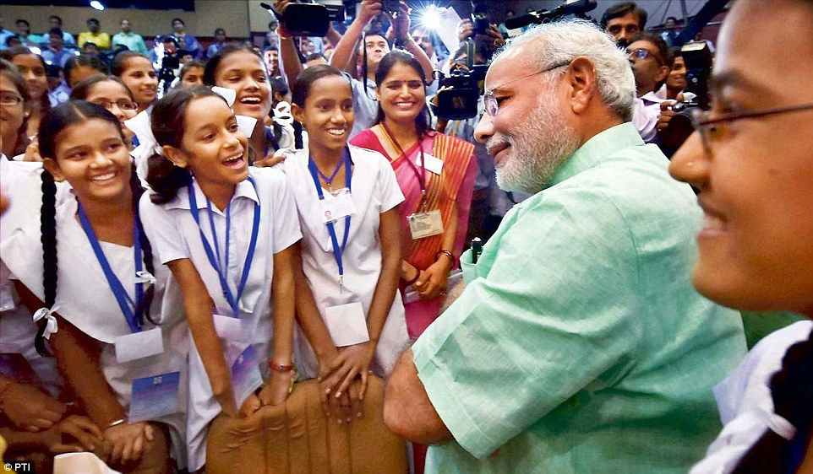
Skills, Speed, Scale
Photo credit: PTI, from Daily Mail Online India

Slide 14

Notes:
The Incheon Declaration and the related Education 2030 Framework for Action (UNESCO, 2015) highlight the need for governments to develop policies and programmes for the provision of quality distance learning in tertiary education, making use of technology — including the Internet and MOOCs as well as other modalities that meet accepted quality standards — to improve access

Slide 15
MOOCs

Slide 16
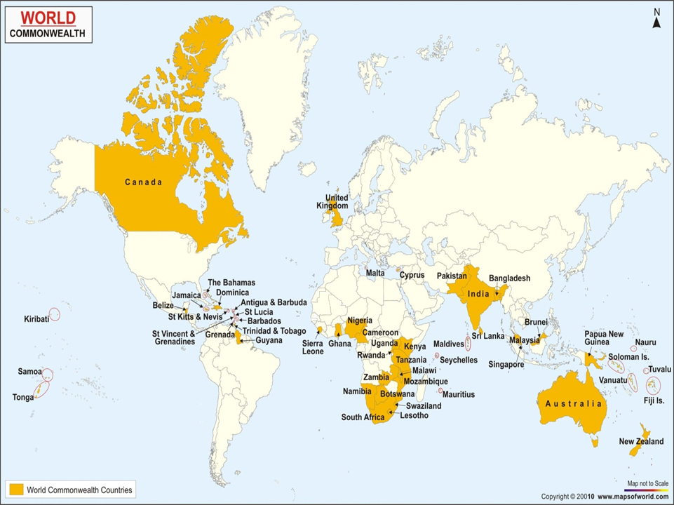
A Connected Classroom

Slide 17
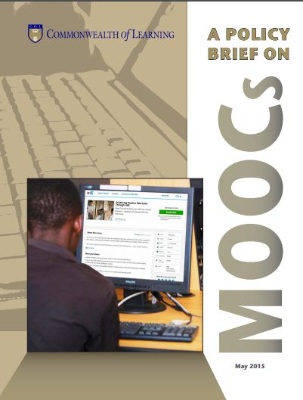

Notes:
Access
MOOCs can provide access to quality learning opportunities at low costs. Governments and institutions must consider investing in MOOCs to democratise education for all.
Capacity Building
Harness MOOCs to provide new ways to offer opportunities at scale for capacity building, education and skills development.
Innovation
Foster innovative uses of available and appropriate technologies, such as mobile devices, to deliver MOOCs.
Pedagogy
The richness of MOOCs derives from their being essentially an Internet-based technology. To improve learning outcomes, governments and institutions should promote the use of the alternative pedagogical approaches enabled by MOOC technology.
Quality
Integrate MOOCs within national quality assurance frameworks to enable the recognition and accreditation of qualifications.

Slide 18
MOOCs Can
  Provide access to quality learning at low costs.
  Build capacity at scale
  Foster innovative uses of technologies, such as mobile devices
  Improve learning outcomes, through the use of alternative pedagogical approaches
  Be integrated within national quality assurance frameworks.

Slide 19

Notes:
What is MOOC for Development?

Slide 20

“…..presenters were amazed at the contributions and cross cultural exchanges that happened on Social Media”.
Ian Thomson, Course Manager
Notes:
We are beginning to appreciate a huge potential for MOOCs as a capacity building tool in the Pacific.
The Climate Change MOOC showed that Pacific Islanders are ready for this.
Many of our presenters were amazed at the contributions and cross cultural exchanges that happened on Social media. Much better than F2F classes and on Moodle

Slide 21
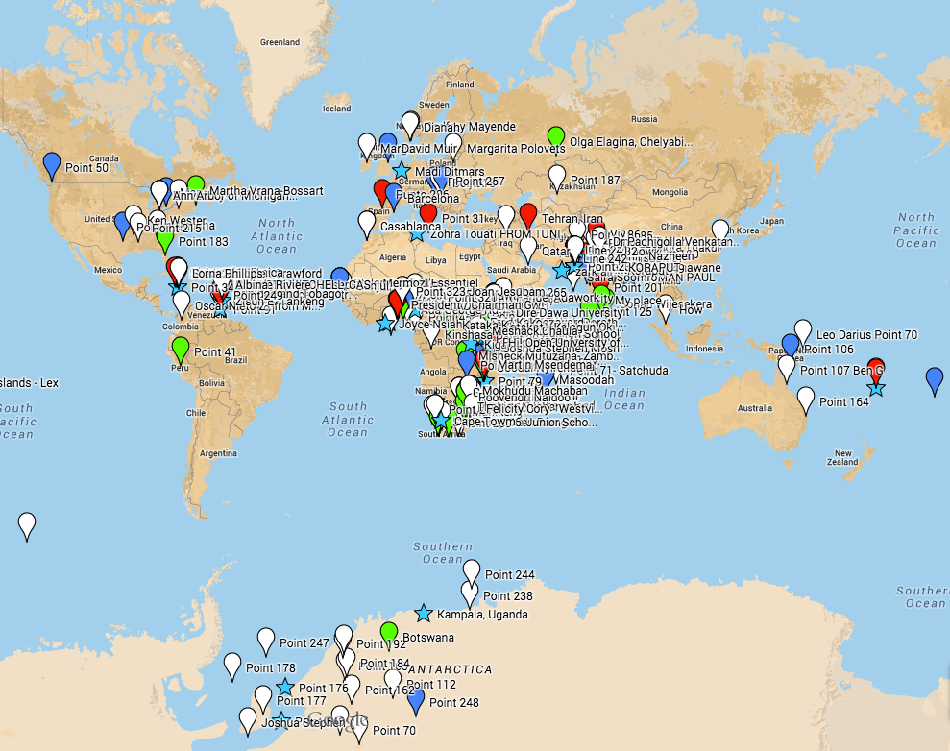
Using ICTs to Enrich Teaching and Learning
- Collaboration with AVU – 2015
- 1,692 registered
- Use of video clips, graphics and games
Kenya, South Africa, India, United States, Nigeria, Uganda, Trinidad & Tobago, Jamaica, Pakistan, Tanzania

Slide 22
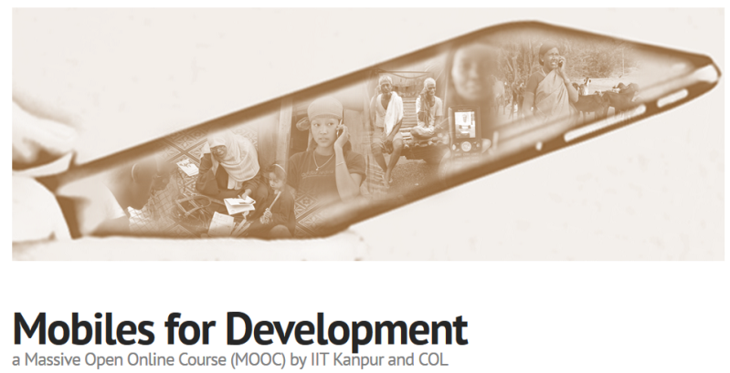
MOOC on Mobiles for Development
Videos and text used
Material in video format was couriered on DVDs and memory cards to Sierra Leone and Zambia
The groups completed online assignments and examination; some eligible for certification

Slide 23

MOOCs for Agriculture
Online learning
  Food and Ag sector underserved
A consortium conceptualised by COL, supported by NPTEL-India

Slide 24
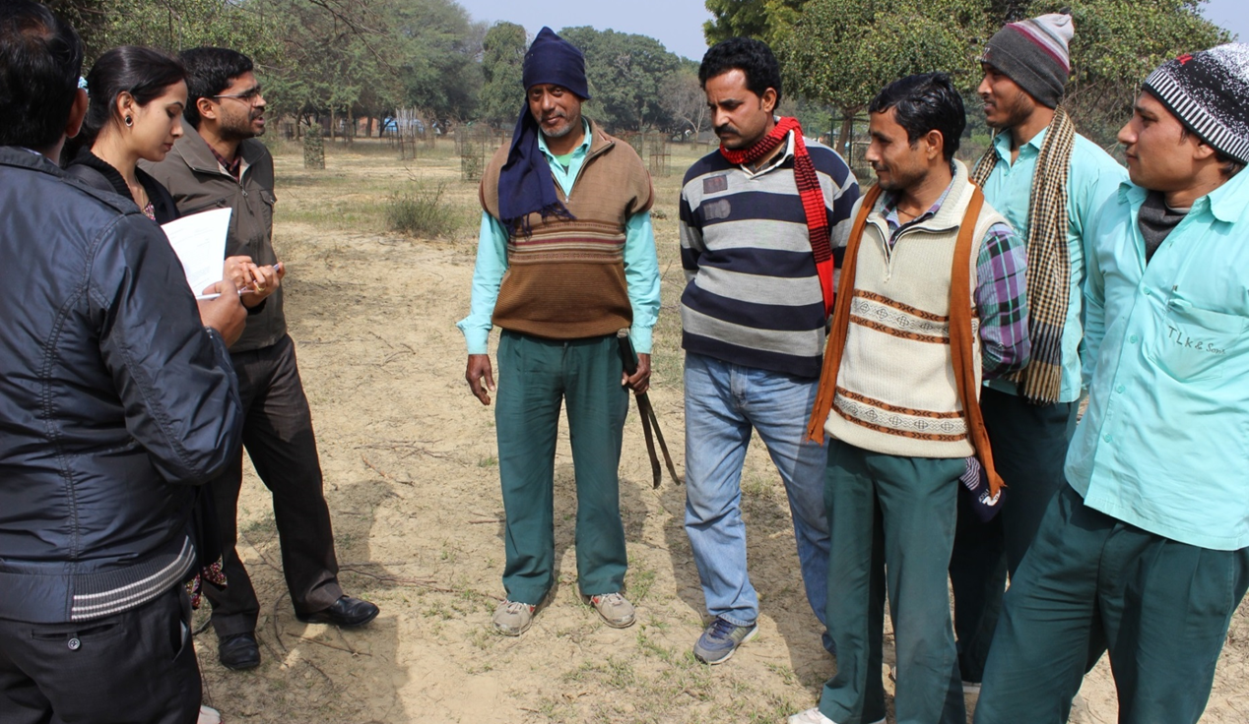
Audio-only MOOC for Gardeners

Slide 25
Reaching the Bottom Billion
  Content should be designed for delivery in low bandwidth
  Be able to deliver on a basic phone
  Social media integration is a must
  Online peer-to-peer interactions must be supplemented with blended approaches
  Content should be open ie. OER

Slide 26
Quality

Slide 27
Guidelines for Quality
COL Guidelines for MOOCs
Purpose decides quality indicators
Context critical
Accreditation agencies looking for credit equivalence

Slide 28
Guidelines for QAA of MOOCs
Presage
Process
Product
Platform and Provider
Credits and Credentials
Institutions, Instructors
Learners
Instructional Design
Resources
Learning Process
Engagement and Participation
Completion
Satisfaction

Slide 29
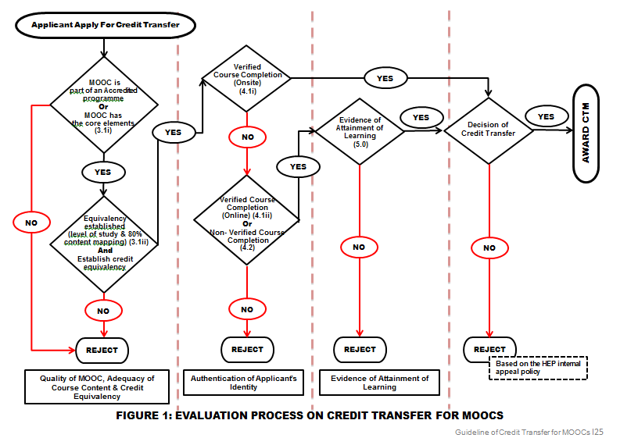
Malaysian MOOC Credit Transfer

Slide 30

Issues for Quality
One size does not fit all
Student verification and academic integrity
Peer assessment needs to be accepted.
Delinking of the institutions which teach and the institutions which offer credential.

Slide 31
Implications for policy

Slide 32
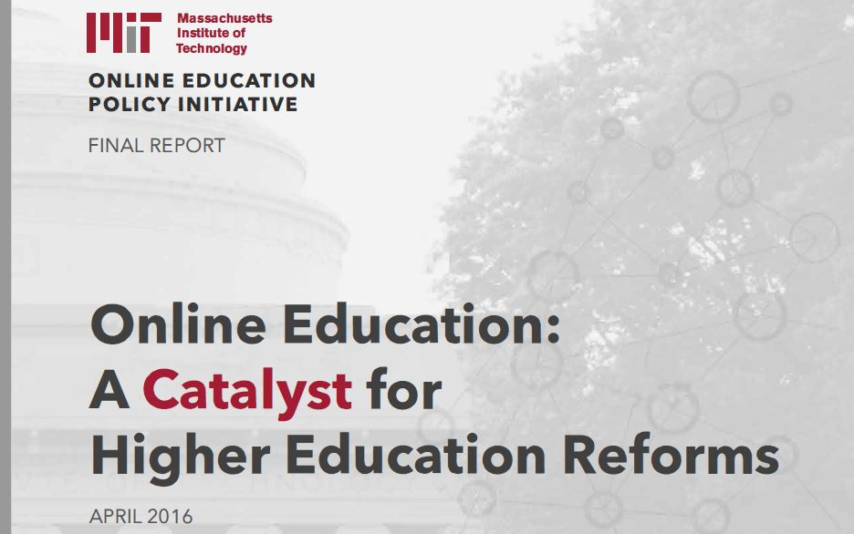
MOOC is a catalyst
Notes:
COL is continuing with trials in learning engineering with MOOCs as the canvas
Much better adaptability to bandwidth variations
Delivery via telephone on demand
Totally audio-based courses for semi-skilled farmers (or, “mali”s) with advanced backend for tracking progress, sending reminders and calling ones at risk of dropping out

Slide 33
National Policy
View MOOC as a new, interactive broadcast medium
Develop credible QA and Credentialing framework
Focus on Higher Education as well as advanced skills development/in-service training
Develop and nurture a capable and robust infrastructure
Manage costs: adopt OER policies

Slide 34
Finally, for developing countries
New model of MOOCs required, one that reaches the unreached
MOOCs will supplement rather than replace traditional institutions
Excellent platform for skilling at scale and speed

Slide 35


MOOCs
A tool for achieving SDG 4

Slide 36
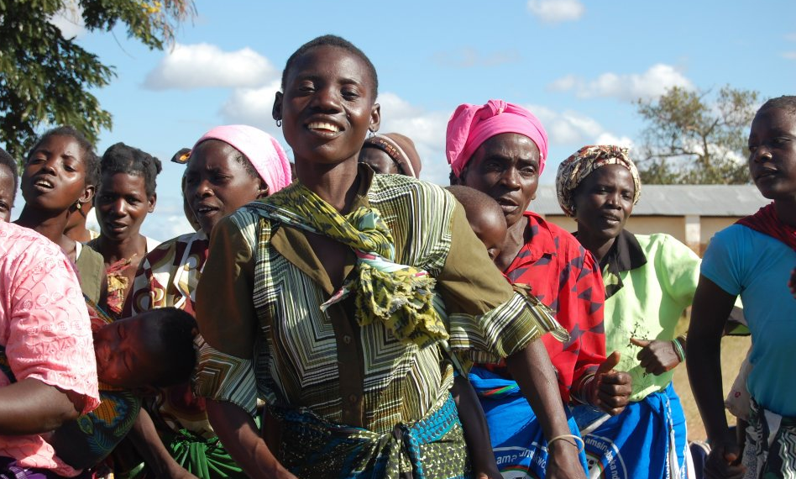
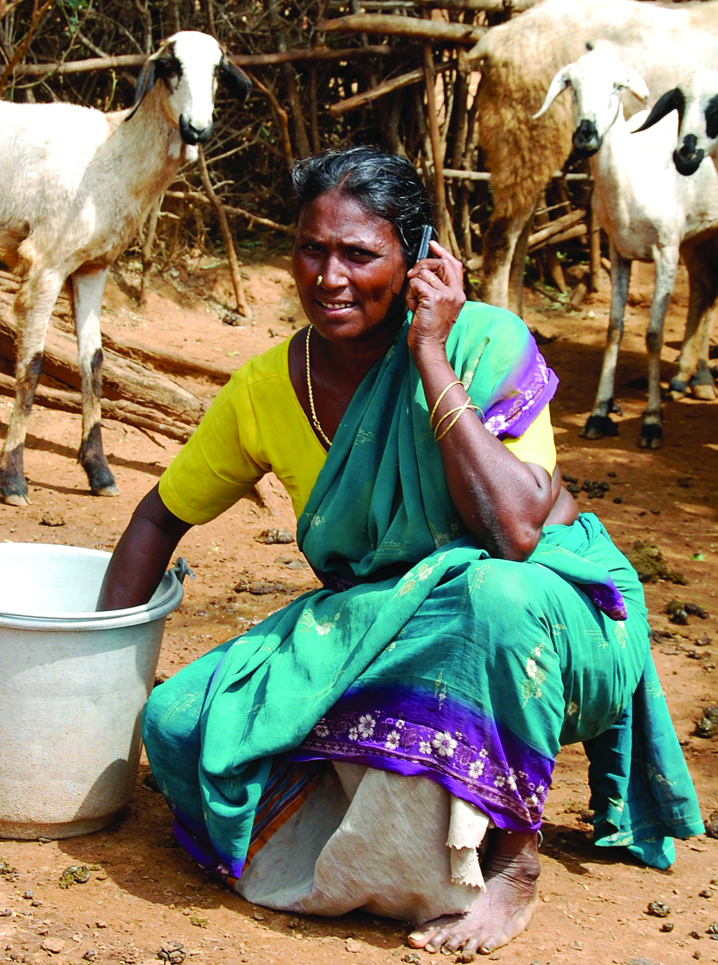
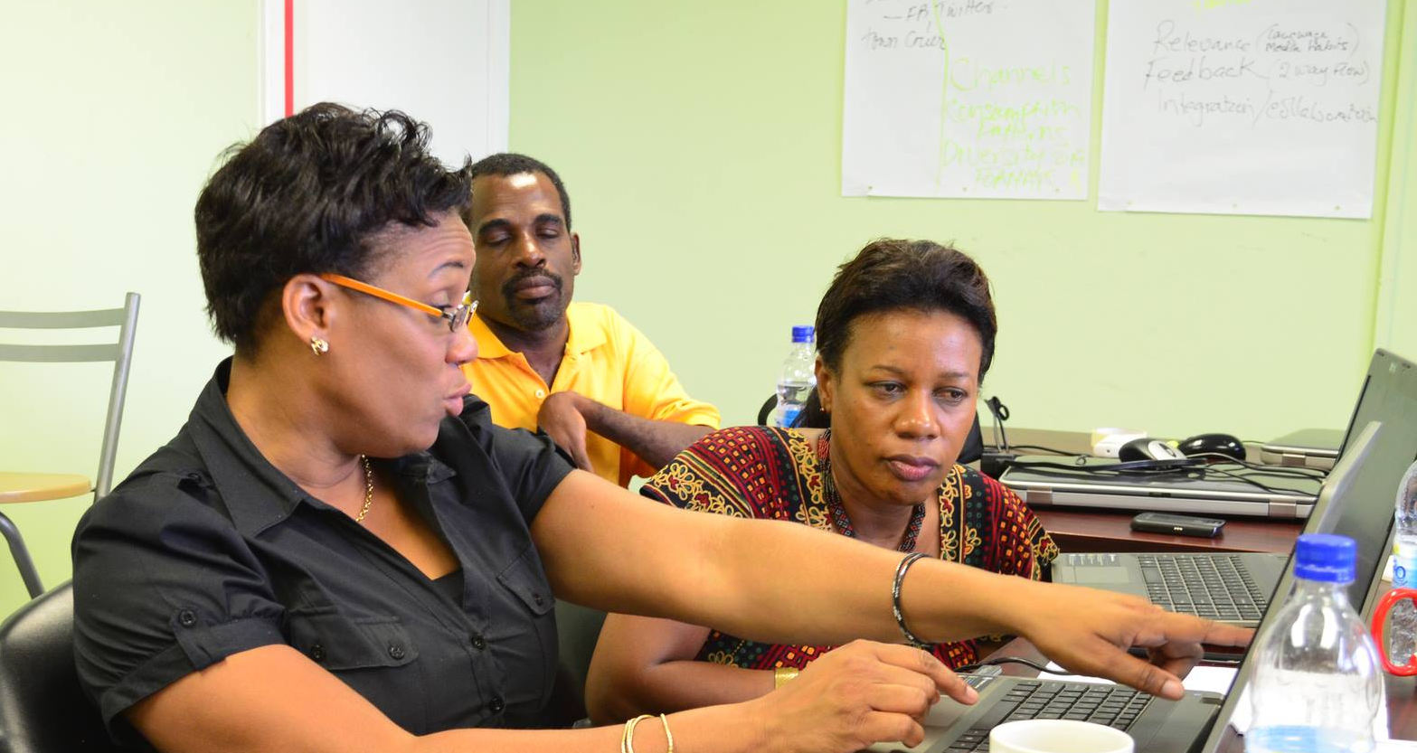
Thank You
www.col.org

